Slide 1
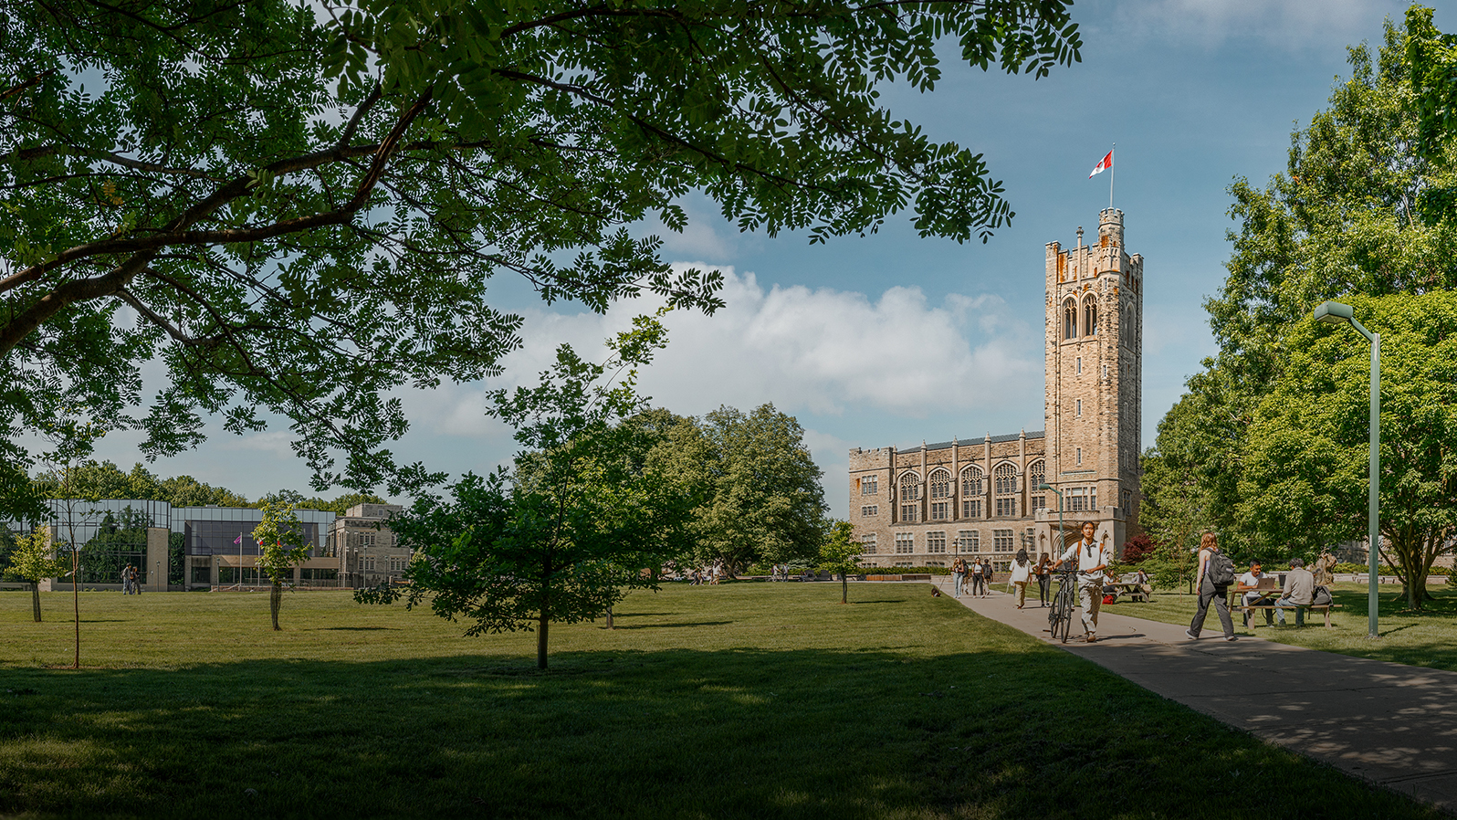


Determining Shear-Wave Velocity Profiles in Langley using MHVSR Inversion
By: Asha Punia
Supervised By: Dr. Sheri Molnar

Slide 2

Key Points
  Metro Vancouver is situated in a high-risk seismic zone and has a subsurface that contains a variety of geologic material requiring detailed hazard assessment
  Constrained MHVSR inversions performed on sites in Langley, BC can produce ground profiles giving the depth and shear wave velocity of the layers in the subsurface
  Shear wave velocity profiles can be used to build accurate hazard maps that enhance emergency preparedness in the region
Why is this research being done?
The main conclusion
Broader implications of the research

Slide 3
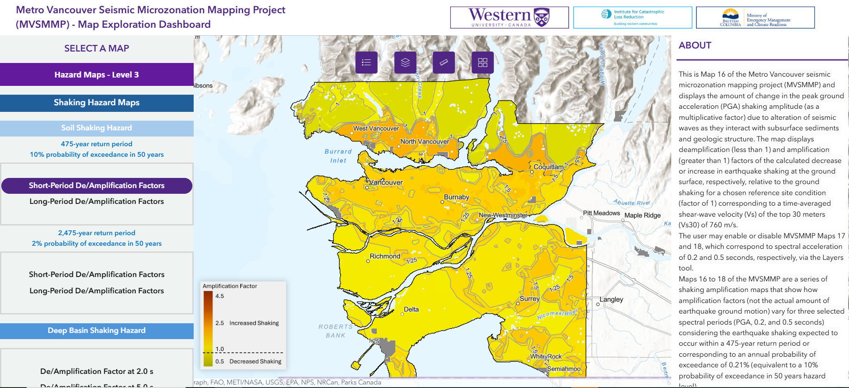
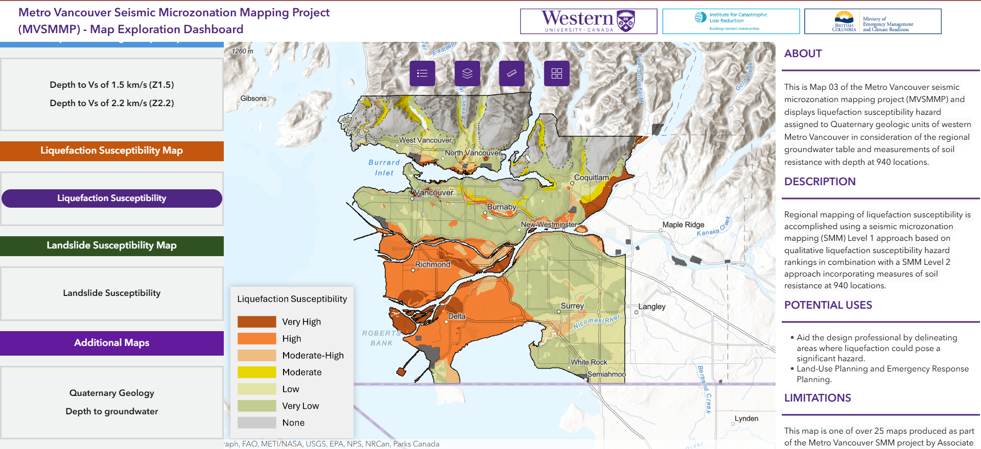
Introduction
1)
Metro Vancouver Seismic Microzonation Project
  Assesses shaking, liquefaction, and landslide hazards
  Open-source data used for emergency response, land use planning, risk analysis and detailed earthquake investigations
2)
Figure 1) Short Period/Deamplification hazard map from the phase 1 MVSMMP open database Figure 2) Liquefaction susceptibility hazard map from the phase 1 MVSMMP open database

Slide 4
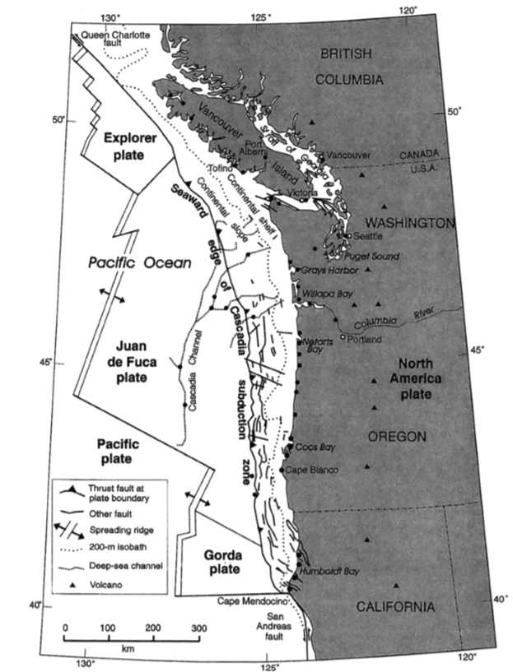

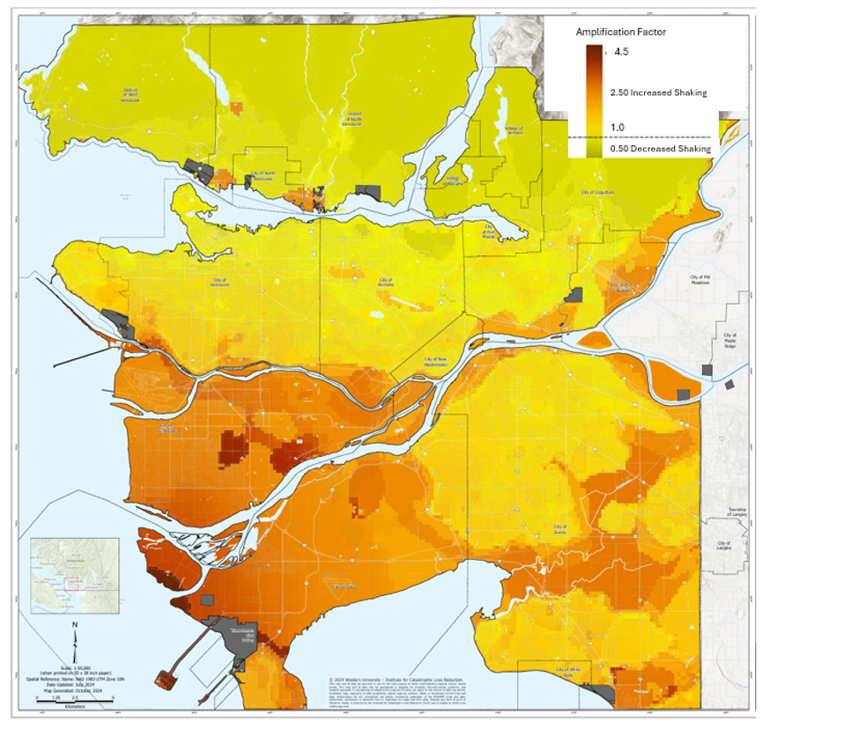
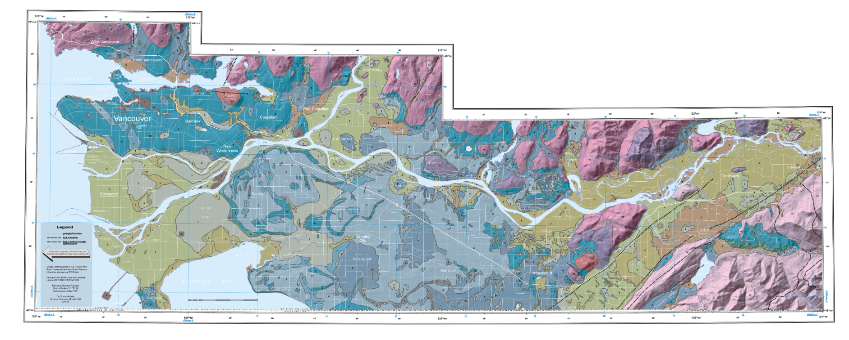
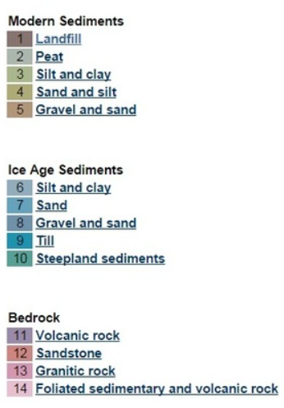
Background
1)
3)
The Cascadia Subduction Zone
  Capable of producing a Magnitude 9.0 earthquake
Site Effects
  How does the ground respond to shaking?
Shear Waves (Vs)
  Oscillating waves
  Velocities correspond to material properties
2)
3)
Figure 1) Cascadia subduction zone (Clague, 1997) Figure 2) Example of a finished hazard map for the Western region Figure 3) Metro Vancouver Geologic map. Retrieved from (Turner et al., 1997)

Slide 5
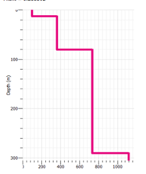

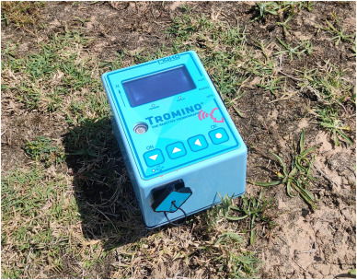
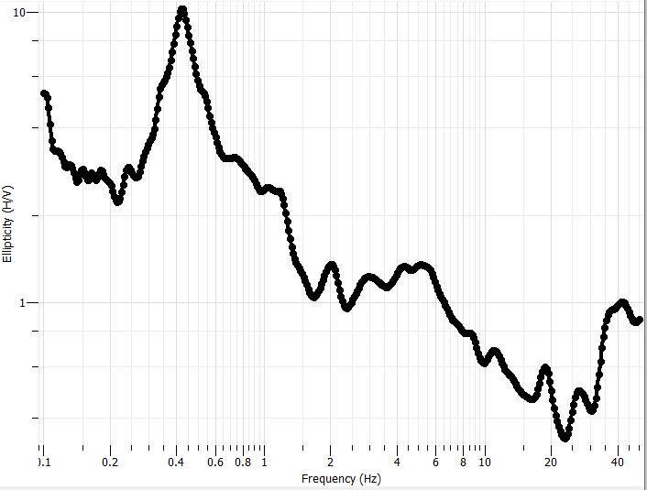

Objective for this Project
  To perform constrained inversions on MHVSR field data collected in Langley to generate one-dimensional shear-wave velocity profiles

Slide 6
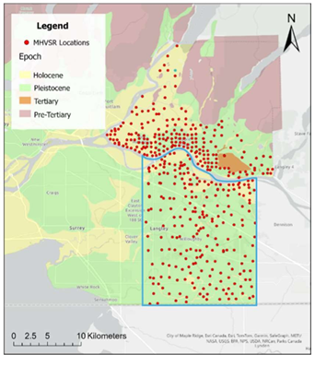
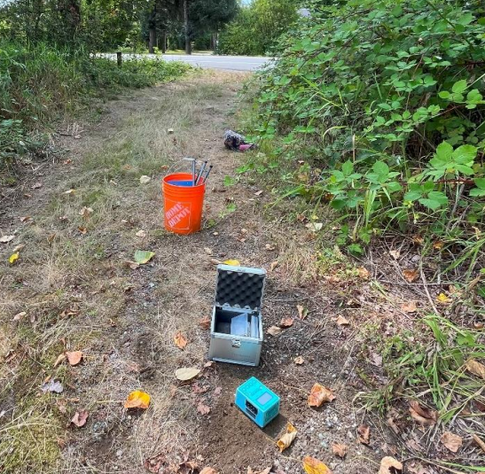
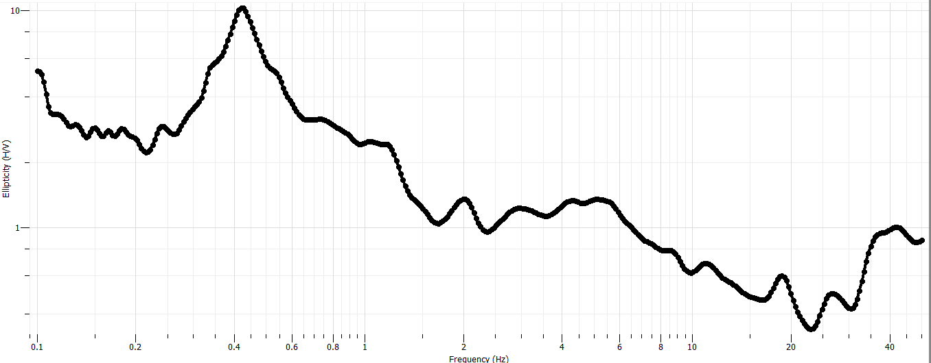
Methods
1)
2)
Microtremor horizontal-to-vertical spectral ratio (MHVSR)
  Used for data collection
  227 measurements taken in the township of Langley
  A non-invasive technique that uses a three component seismometer and measures the ratio of horizontal to vertical shaking
  Fourier transform applied
3)
Figure 1) MHVSR sites in eastern Vancouver. Retrieved from (Motuzas 2025) Figure 2) MHVSR measurement taking (Motuzas 2025). Figure 3) LAN004 MHVSR curve

Slide 7
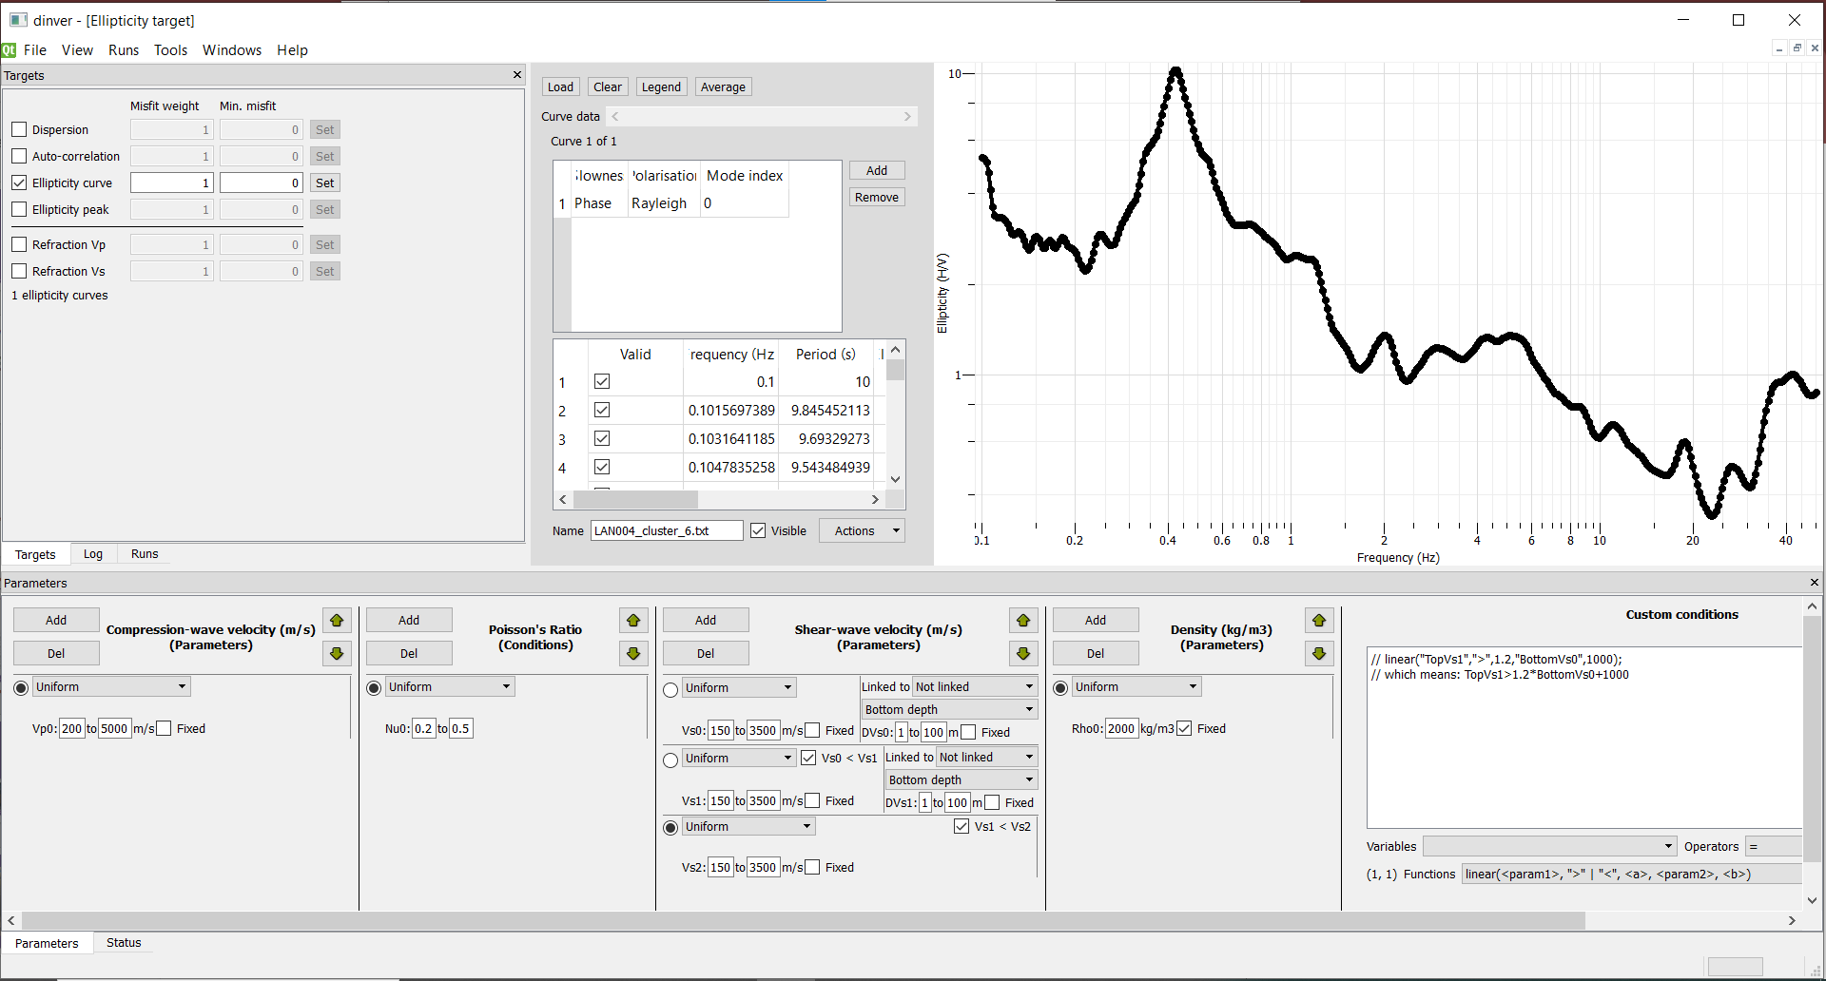
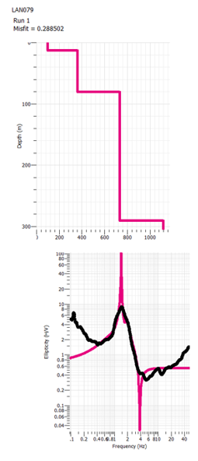

Methods continued
1)
1)
Inverting the MHVSR data
  Geopsy DINVER
  Utilizes a neighborhood algorithm to search for 1D layered earth models
  Our inversions rely on the parameters we set to constrain the results
  Produces depth profiles
Option 1
Layer Number | Depth (m) | Vs (m/s)
1 | 1-100 | 50-250
2 | 30-100 | 200-400
3 | 75-500 | 400-1000
4 | half space | 1000-2500
Option 2
Layer Number | Depth (m) | Vs (m/s)
1 | 1-50 | 50-400
2 | 10-500 | 400-800
3 | half space | 400-1000
Option 3
Layer Number | Depth (m) | Vs (m/s)
1 | 1-50 | 50-250
2 | 30-100 | 350-800
3 | 100-600 | 800-1500
4 | half space | 1500-2500
3)
2)
3)
Figure 1) Geopsy DINVER Figure 2) Example of model parameterization boundaries Figure 3) LAN079 ground profile and frequency curves

Slide 8
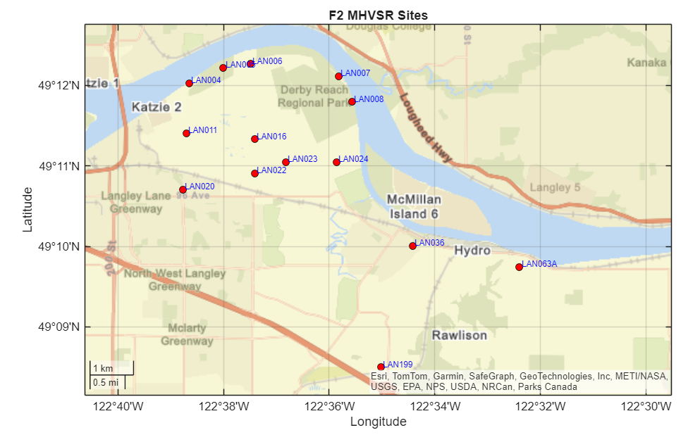
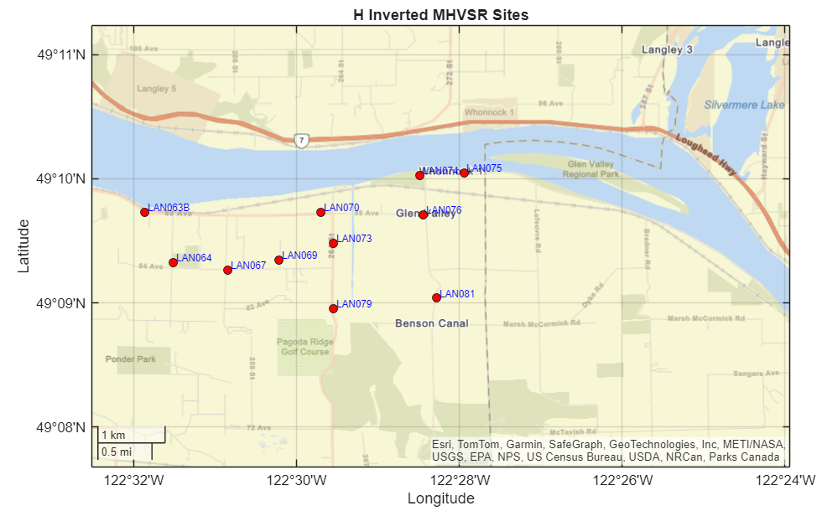
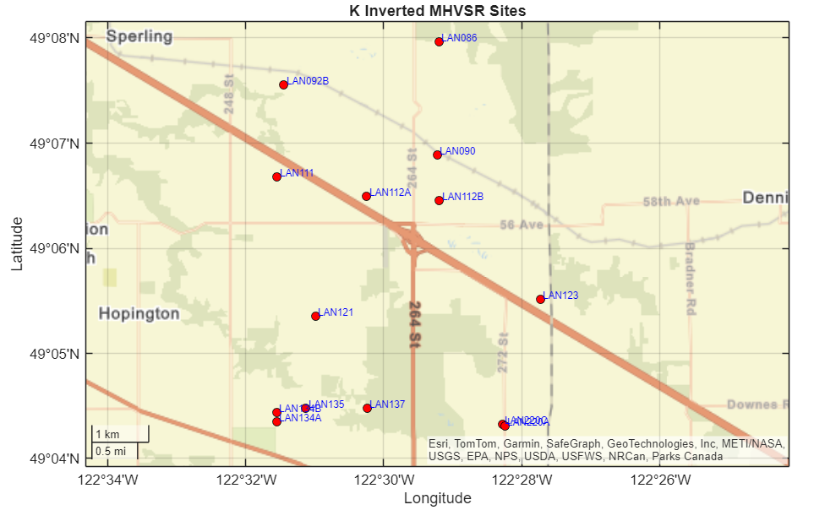
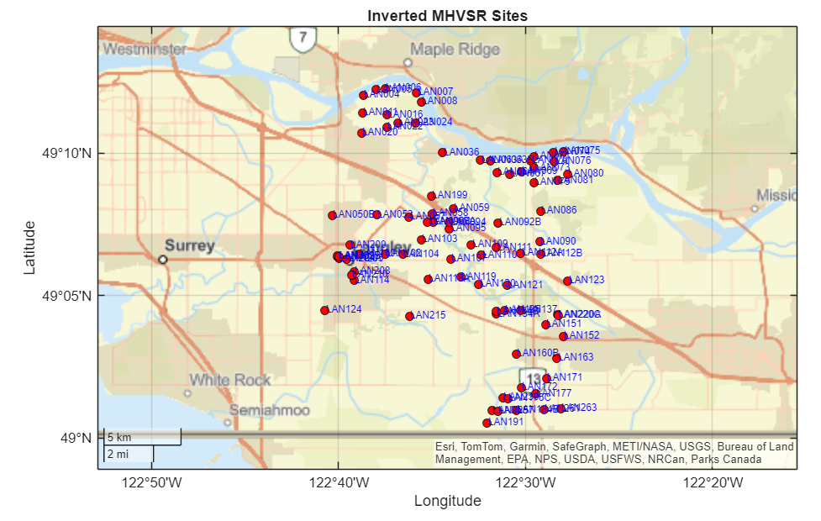
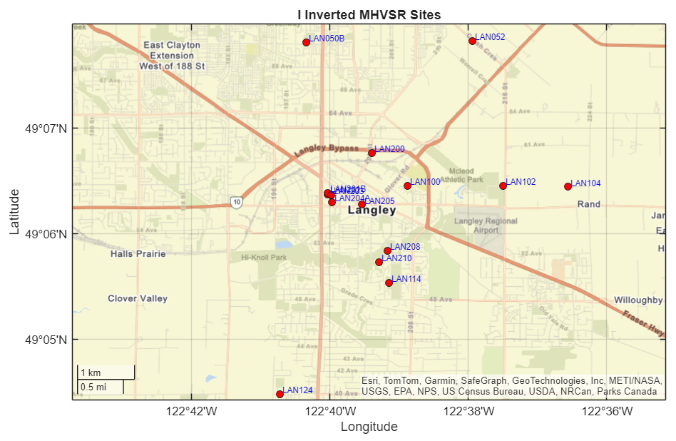
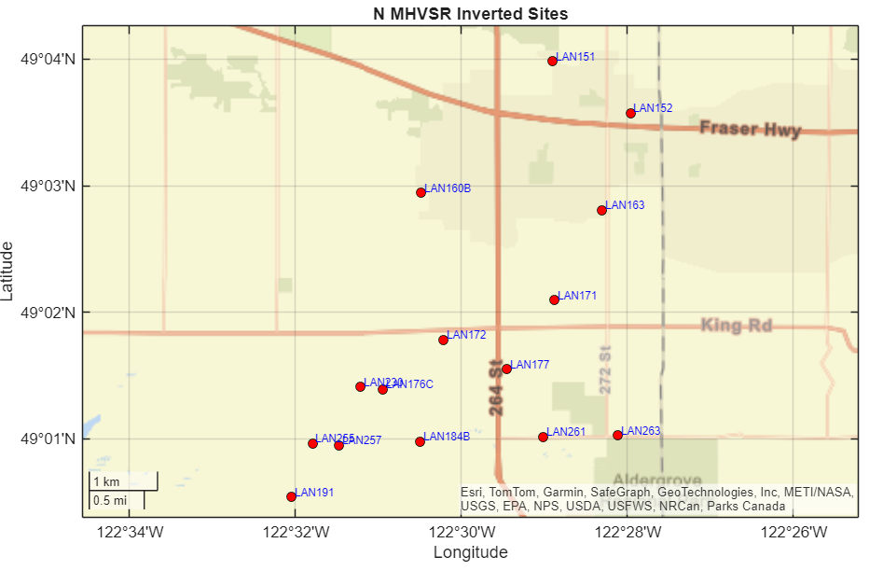
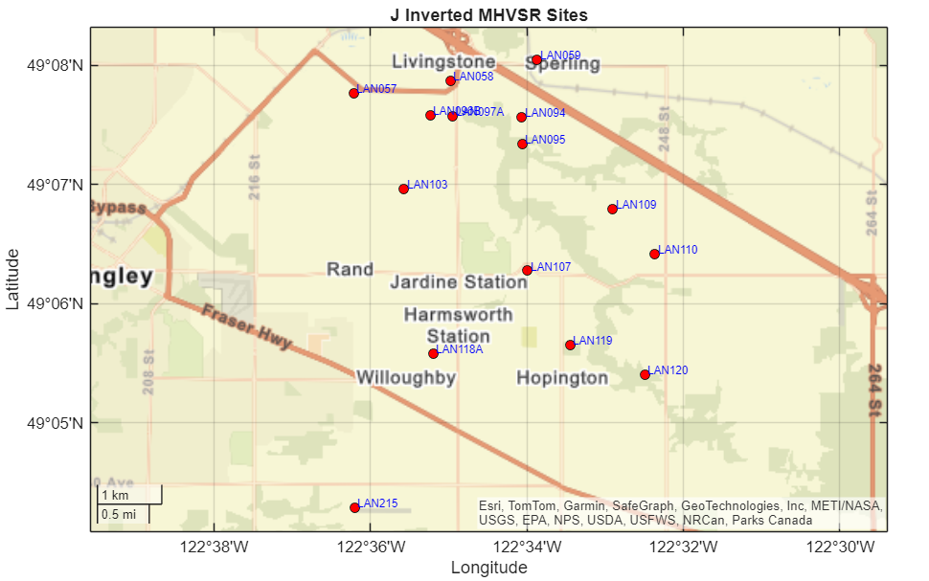
Inverted Sites

Slide 9
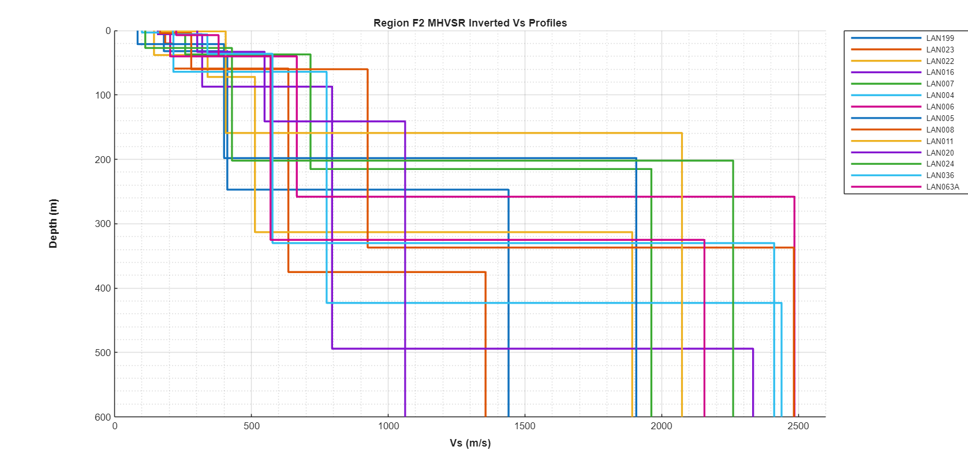
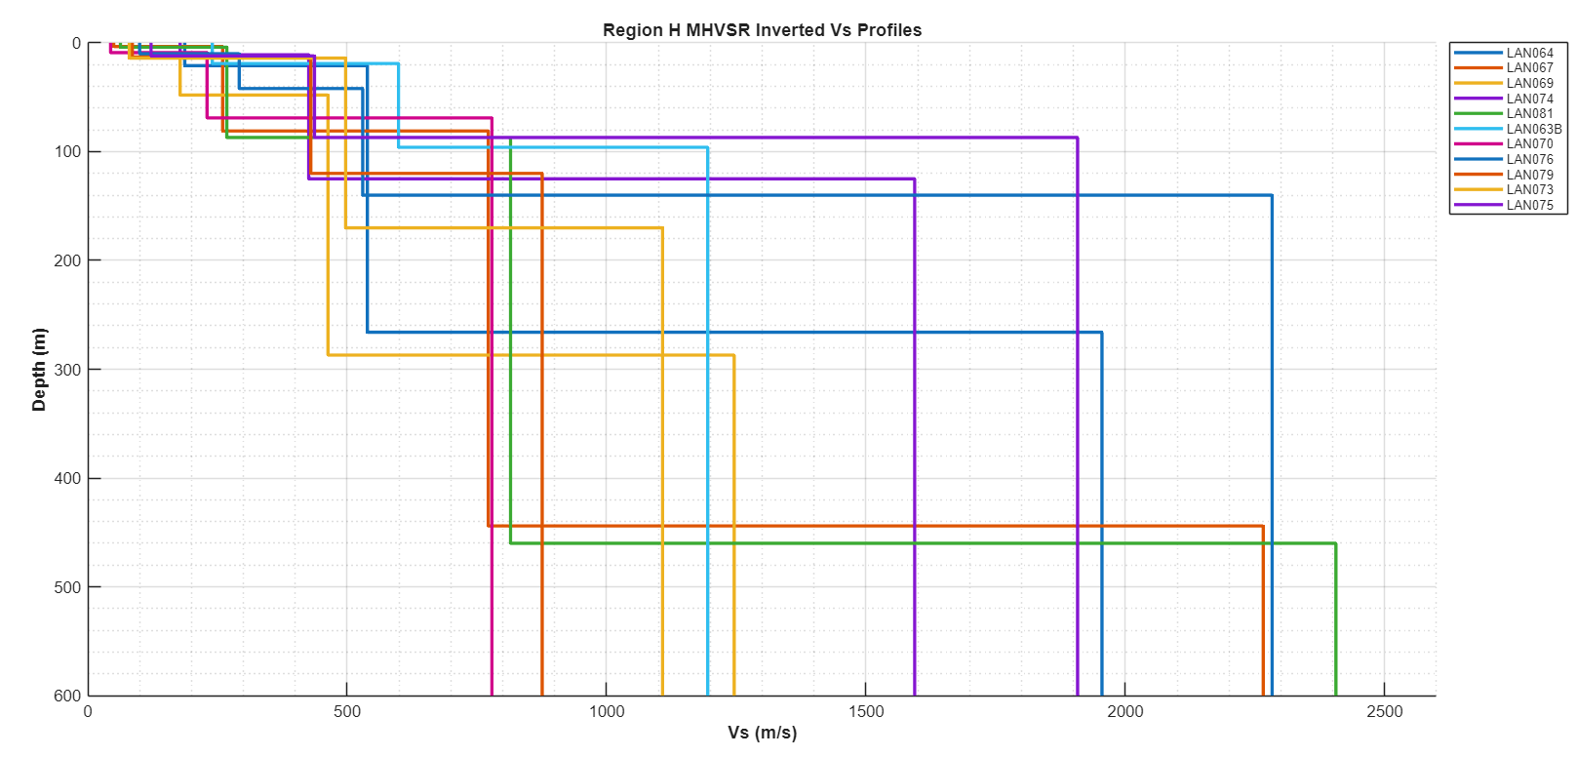
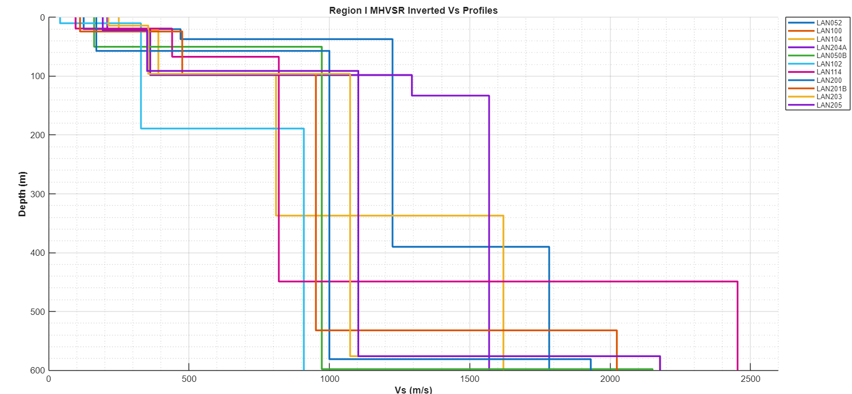
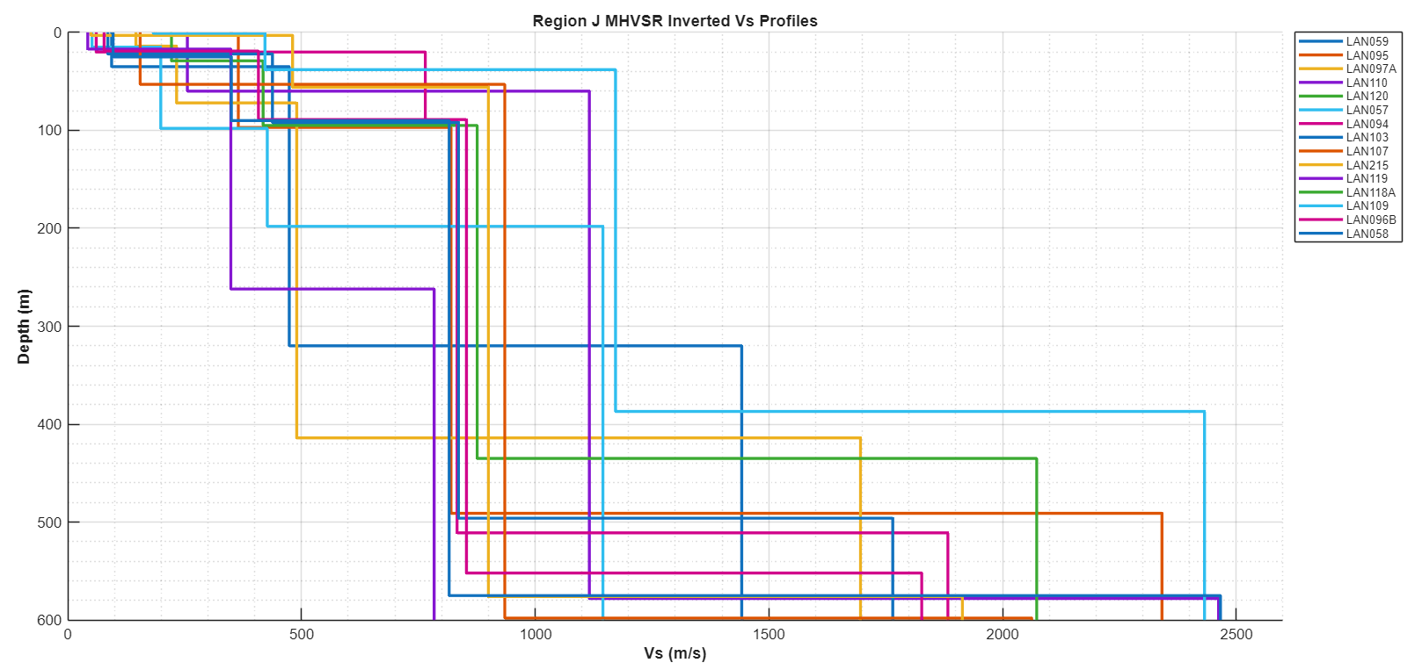
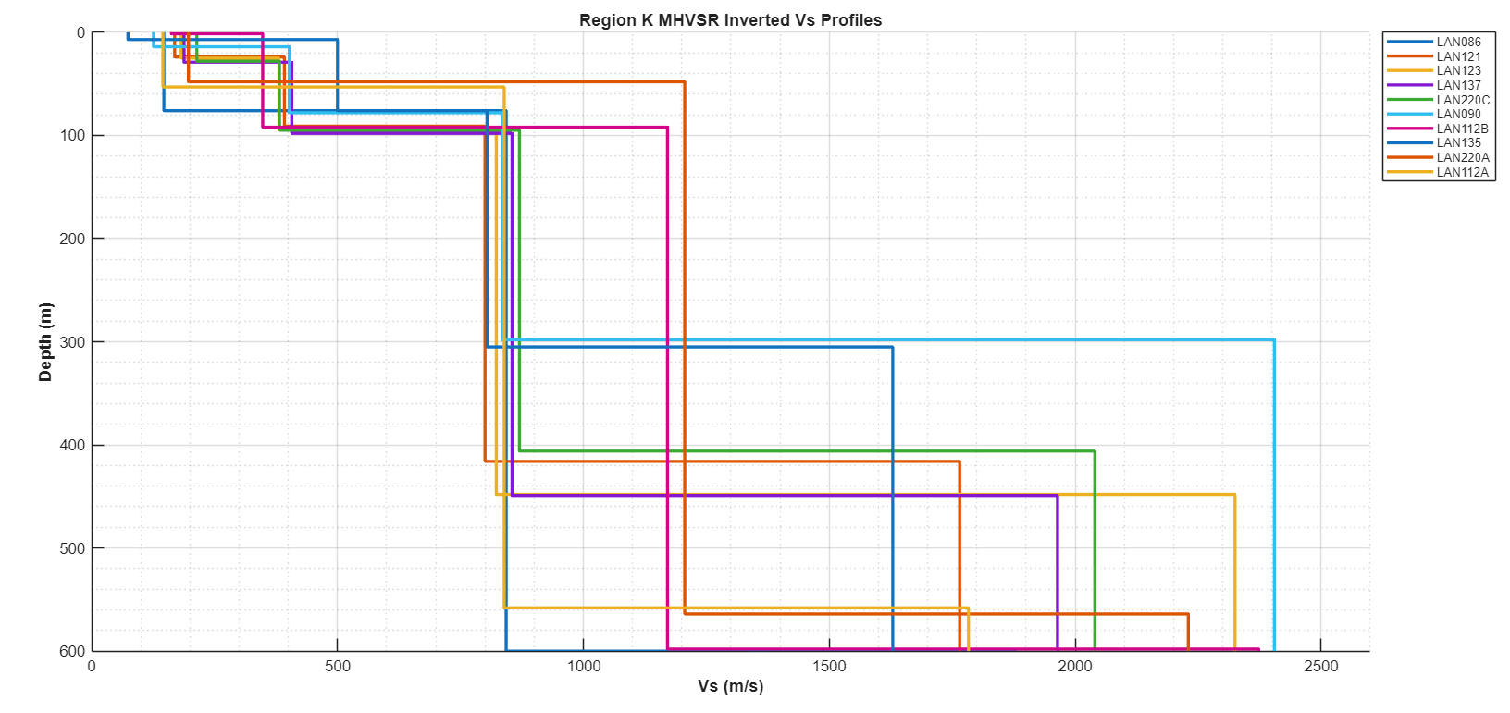
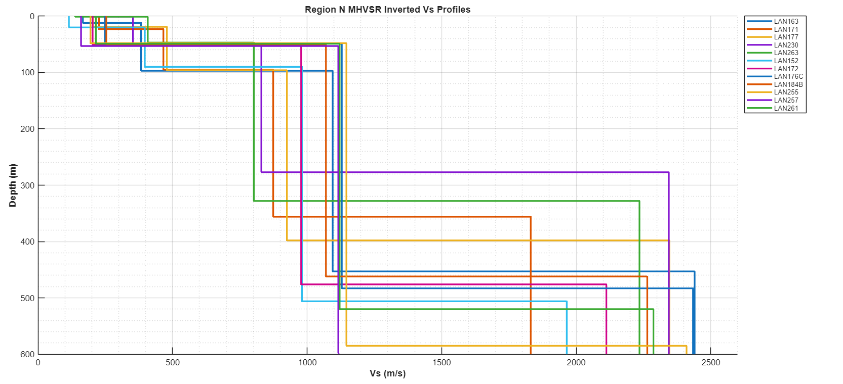
Results: Ground Profiles
88 Inverted sites

Slide 10
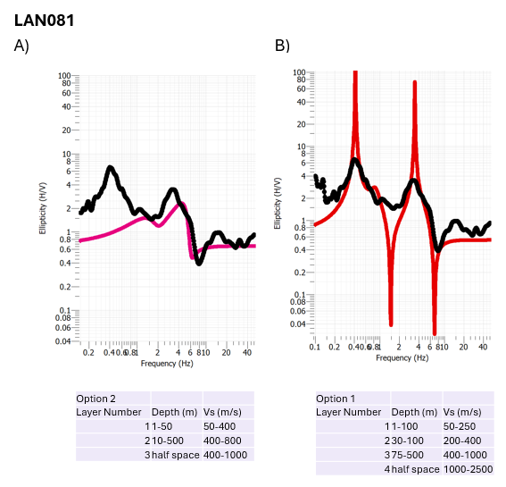
Results
1)
Re-doing the inversions
This site required new parameters
  Switching from a 3 layer model to a 4 layer model
Figure 1) Frequency Ellipticity curves for LAN076 for two inversion attempts

Slide 11
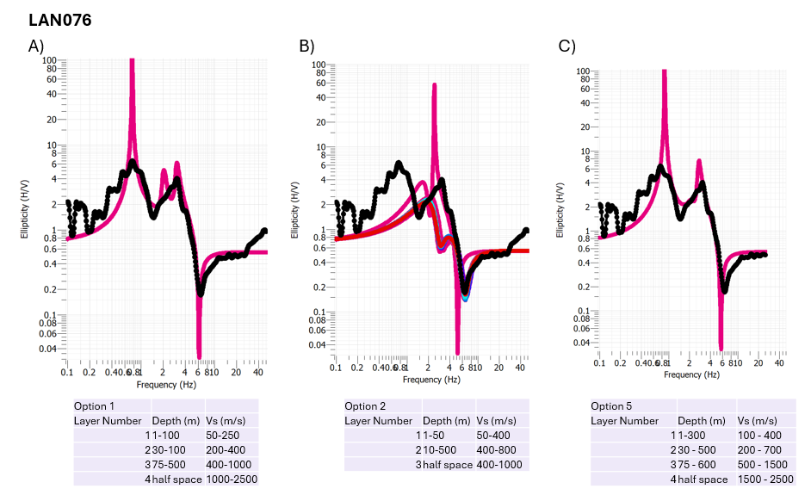
Results
Re-doing the inversions
This site required new parameters
  Switching from a 3 layer model to a 4 layer model ❌
  A deeper and faster model needed
1)
Figure 1) Frequency Ellipticity curves for LAN076 for three inversion attempts

Slide 12
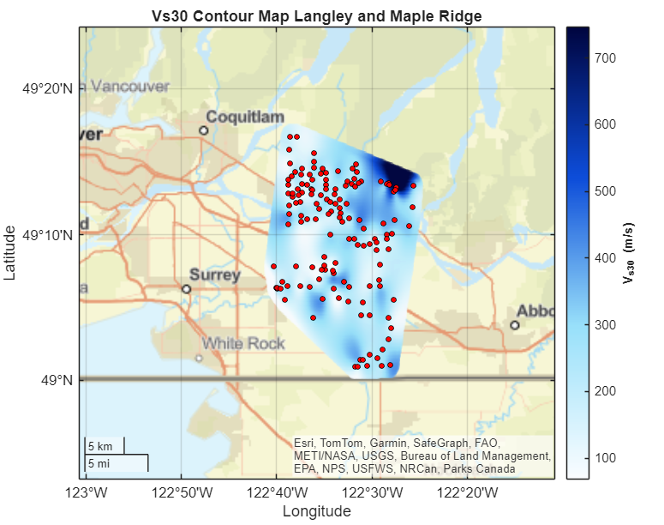
Vs30
1)
The average shear-wave velocity in the top 30 meters
  Langley and Maple Ridge data combined
  Clay channel
  Granitic mountains
Figure 1) Contour map of Vs30 values from Langley and Maple Ridge. Maple ridge inversions performed and provided by Ari Chote

Slide 13
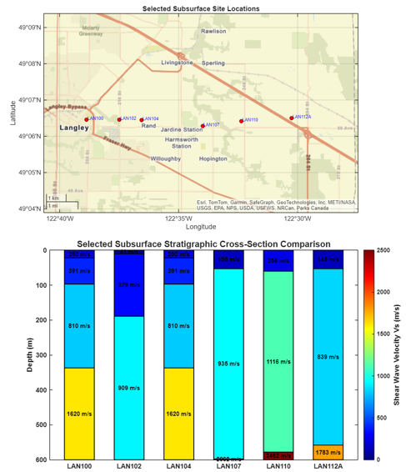
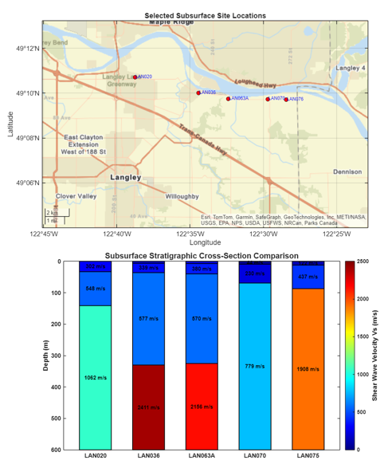
Transects
1) 2)
Figure 1) West to East subsurface transect Figure 2) Another West to East subsurface transect

Slide 14
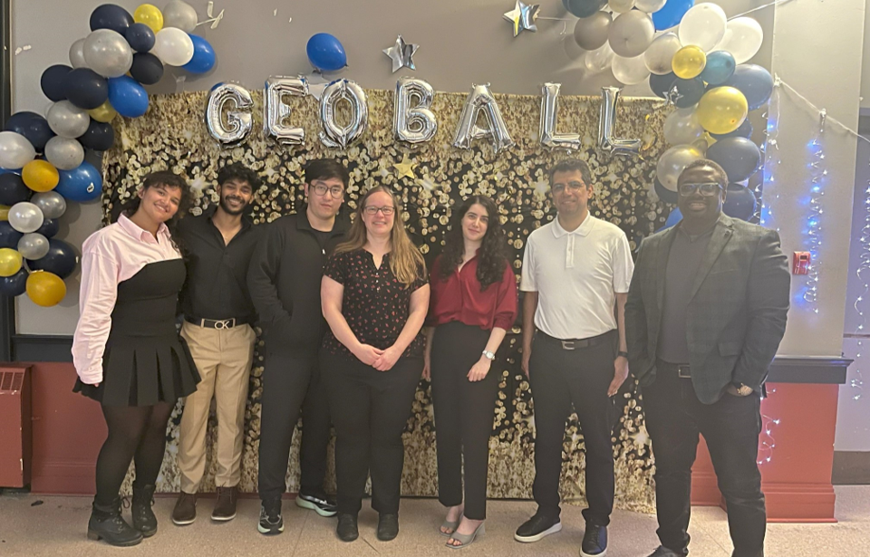
References:
Clague, J.J., 1997, Evidence for large earthquakes at the Cascadia Subduction Zone: Reviews of Geophysics, v. 35, p. 439–460, doi:10.1029/97RG00222.
Earthquakes in southwestern British Columbia, 2011, Natural Resources Canada (NRCan), https://www.seismescanada.rncan.gc.ca/pprs-pprp/pubs/GF-GI/GEOFACT_earthquakes-SW-BC_e.pdf.
Molnar, S., A. Bilson Darko, H. Ghofrani, S. Adhikari, and S. Mohammad, 2023, The Metro Vancouver Seismic Microzonation Mapping Project: Overview and Multi-Method Approach to Regional Geodatabase Development.
Motuzas, C., 2025, Evaluation of Amplification Frequency Spectra in Eastern Metro Vancouver , BSc Geophysics Thesis, University of Western Ontario.
Nakamura, Y., 1989, A Method for Dynamic Characteristics Estimation of Subsurface using Microtremor on the Ground Surface: v. 30.
Şafak, E., 2001, Local site effects and dynamic soil behavior: Soil Dynamics and Earthquake Engineering, v. 21, p. 453–458, doi:10.1016/S0267-7261(01)00021-5.
Turner, R. J. W., J. J. Clague, B. J. Groulx, and J. M. Journeay, 1997, GeoMap Vancouver: <https://www.cgenarchive.org/vancouver-geomap.html> (accessed August 10, 2026).
Acknowledgements
Dr. Sheri Molnar
Natalia Gomez Jaramillo
Ari Chote
Dr. Robert Shcherbakov
Questions?

