Slide 1


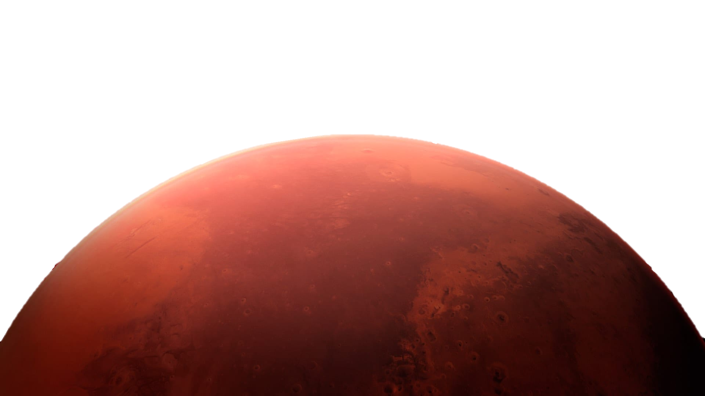
The Interior of Mars
Asha Punia
Geophysics 9572

Slide 2

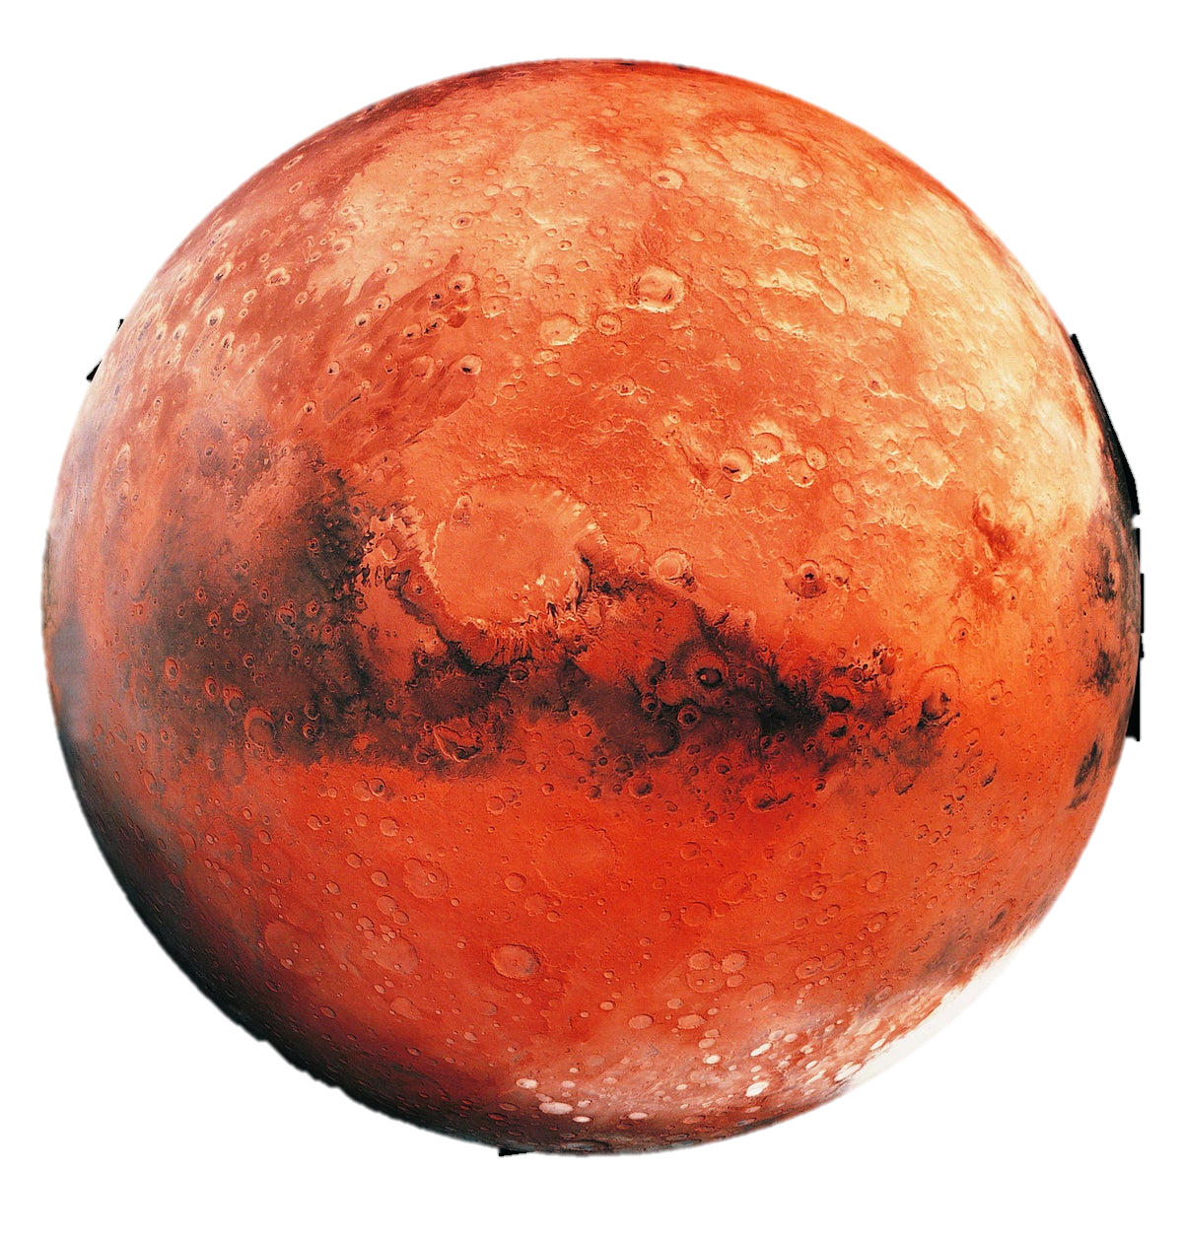

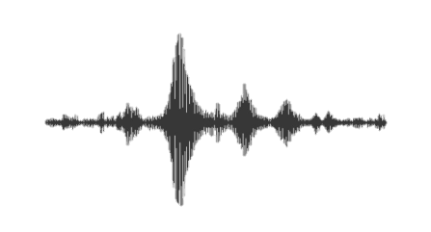

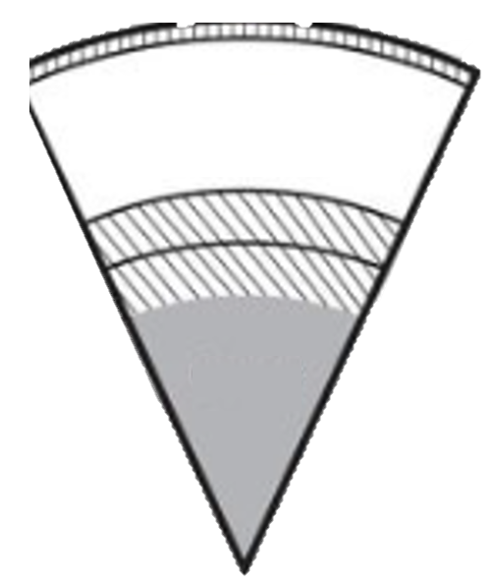




Outline
The InSight Mission
Core
Mantle
Crust
Summary
Marsquakes
Other InSight Discoveries
https://www.scientificamerican.com/podcast/episode/mars-lander-will-peer-inside-the-red-planet/

Slide 3
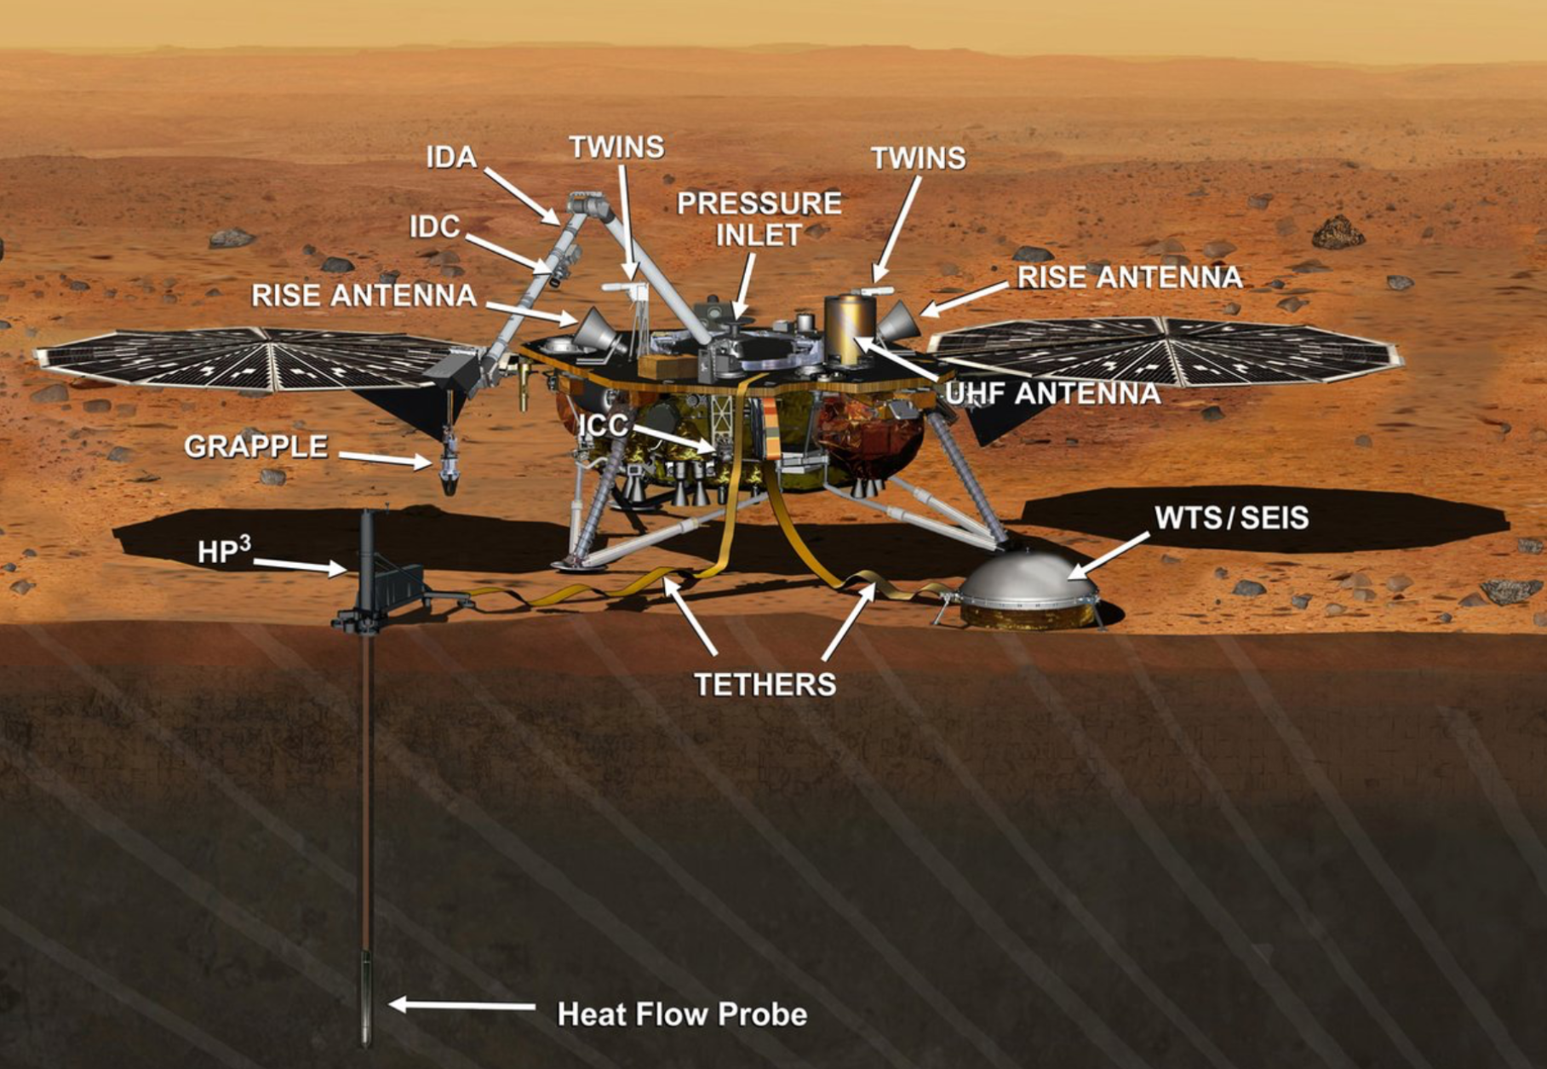
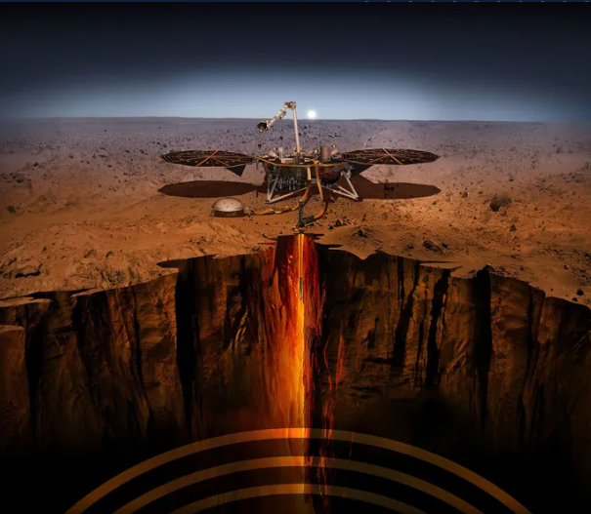
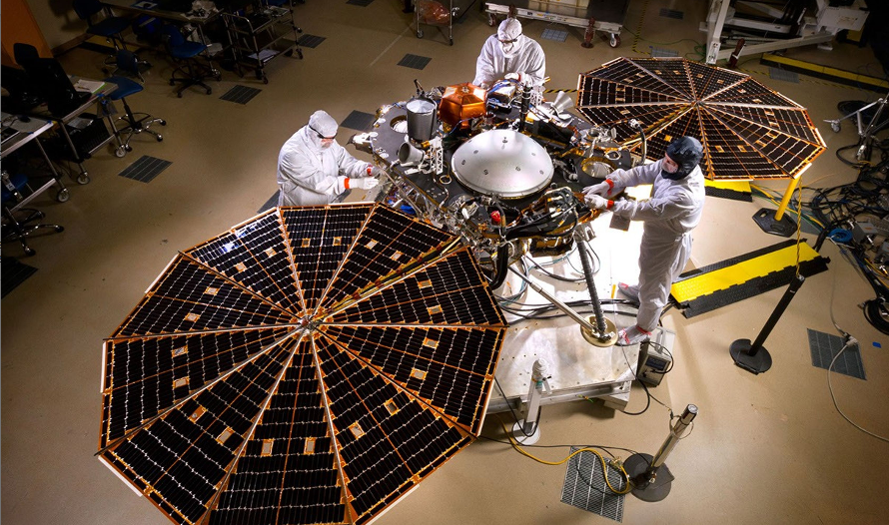
The Insight mission
https://science.nasa.gov/mission/insight/
https://www.technologyreview.com/2020/02/24/906091/nasas-insight-mission-proves-mars-is-rocked-by-hundreds-of-earthquakes/
https://science.nasa.gov/mission/insight/
https://www.jpl.nasa.gov/edu/resources/teachable-moment/how-insight-revealed-the-heart-of-mars/
Interior ExploratioN using Seismic Investigations, Geodesy, and Heat Transport
I N S I G H T
Notes:
Insight Mission
The insight mission launched in May 2018
The first mission to mars to study the interior of Mars
Rovers and other technologies studies the surface
Three parts of it
SEIS
Seismometer, measures seismic waves on Mars
HP3
Heat Flow and Physical Properties Package
Was designed to drill to monitor temperatures beneath the surface
They ran into issues with the soil
Rotation and Interior Structure Experiment
Measures rotation of Mars and also sends signals back to earth

Slide 4

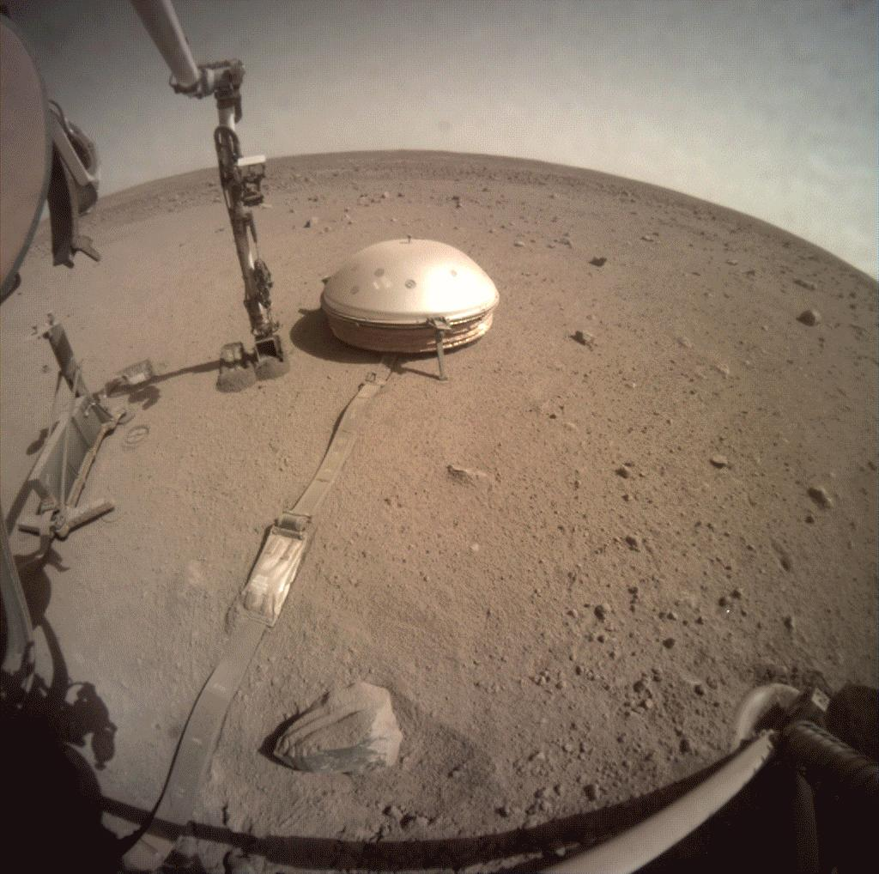
marsquakes
Just like earthquakes, but on Mars… right?
The crust of Mars consists of one solid plate
Faults are created when the crust shrinks after cooling and then breaks. Seismic waves are generated from this breaking
1319 Marsquakes detected by InSight
The seismic waves from Marsquakes were used to study the interior of the planet
WRONG…sort of
https://www.nasa.gov/centers-and-facilities/jpl/nasas-insight-detects-two-sizable-quakes-on-mars/
Notes:
Tectonics on earth vs. mars

Slide 5
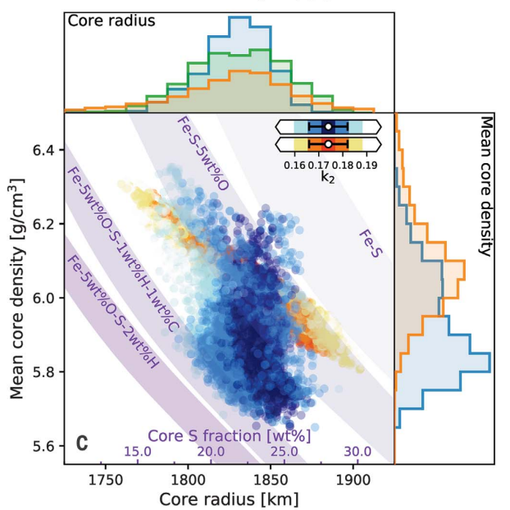
Core
The core was found by observed ScS waves that reflected off the Core Mantle Boundary
A liquid inner core
Radius = ~1830km (Very large)
Density = 5.7-6.3 g/cm³
Composed of Fe – Ni (Also minorly composed Sulfur, Oxygen, Hydrogen and Carbon)
(Stähler et al., 2021)
Notes:
Stahler paper

Slide 6
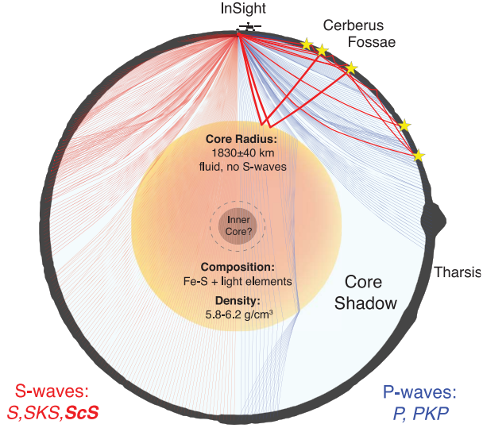
(Stähler et al., 2021)
Notes:
The large inner core creates a large shadow zone (a lot of seismic activity on mars not recorded)

Slide 7
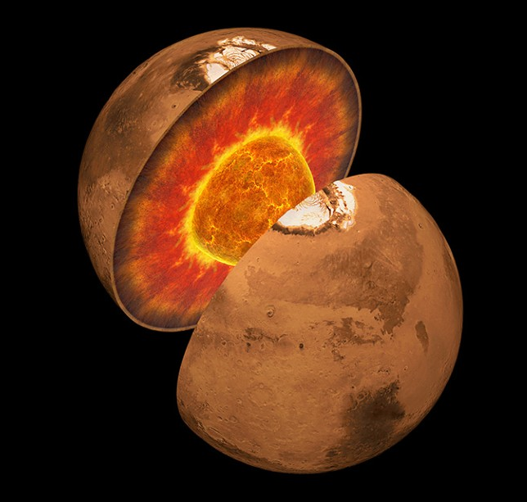
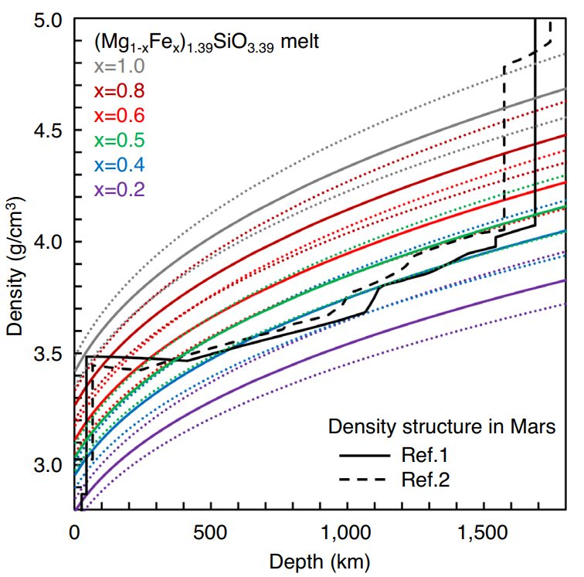
The Core Mantle Boundary
https://science.nasa.gov/mission/insight/
(Witze, 2023)
(Kono et al., 2025)
Notes:
- Kono Paper

Slide 8
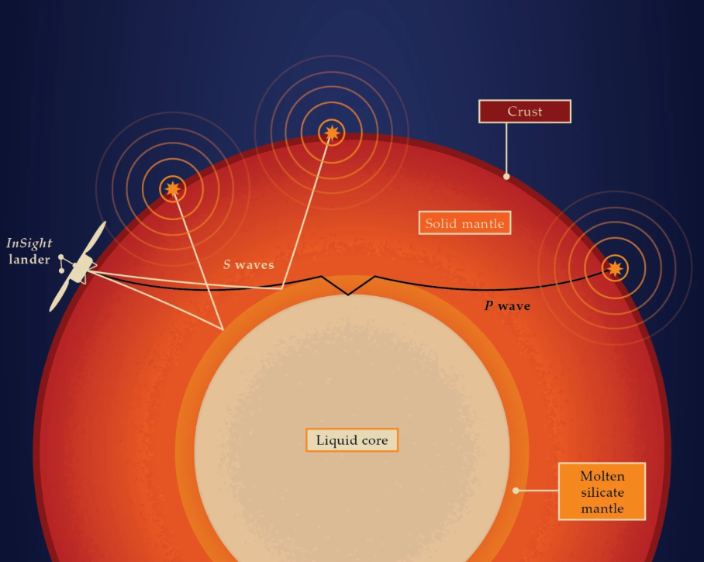
Mantle
A solid upper layer and a lower molten silicate layer
September 5th, 2021
S waves reflected off a solid–liquid boundary revealing the hypothesized molten silicate mantle
Lots of research on the mantle
(“Uncovering the molten mantle of Mars,” 2024)

Slide 9
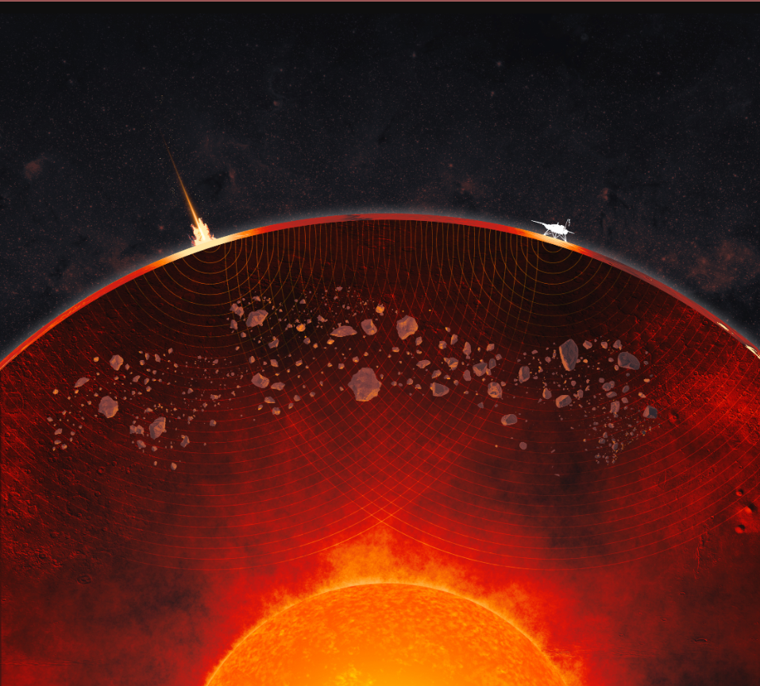
A lumpy mantle
(“NASA Marsquake Data Reveals Lumpy Nature of Red Planet’s Interior - NASA,” 2025)
Notes:
- Lumpy Mantle website

Slide 10
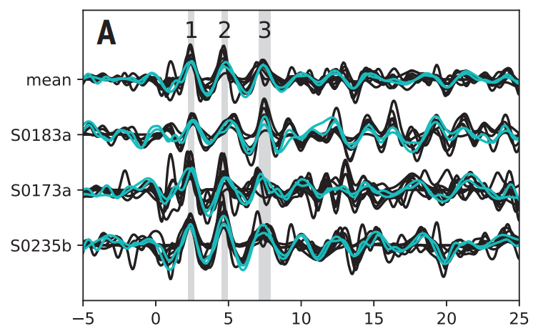
Crust
Properties of the crust discovered by observing P and S waves sent from Marsquakes and by studying surface sediments
Average crustal thickness 32 – 70km
Density 2.9 -3.1 g/cm³ (lower than expected)
Low density theorized to be due to high porosity, fluids, low density cements
A 2 (maybe 3) layer model proposed
(Knapmeyer-Endrun et al., 2021)

Slide 11
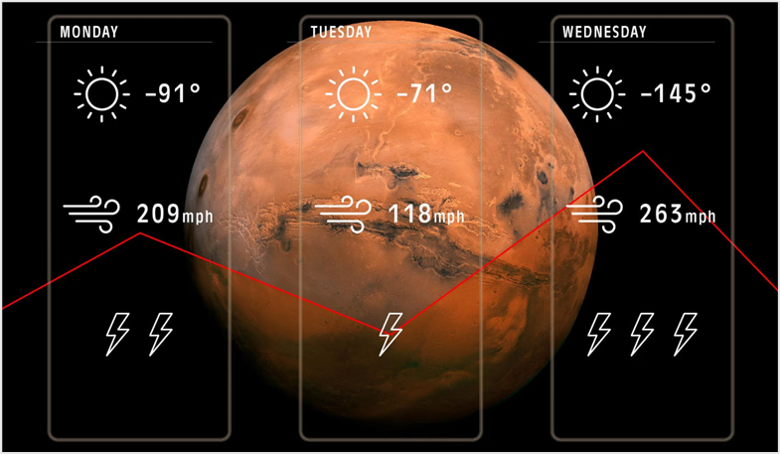
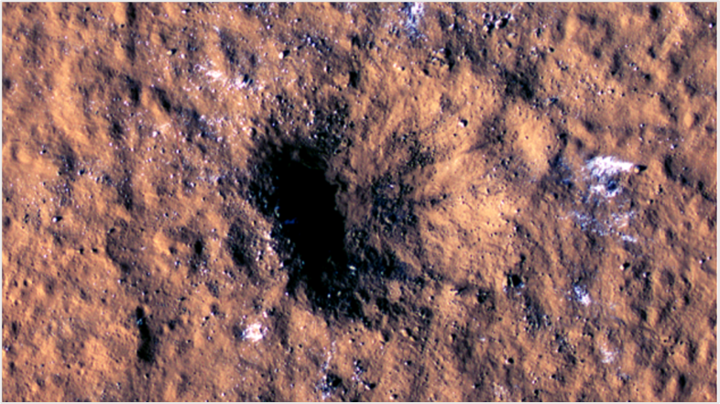
Other Insight discoveries
https://science.nasa.gov/mission/insight/
(Shelton, 2021)
(“Science Highlights - NASA Science,” 2024)
Weather
Impact Sites
Notes:
- Crater – Dundas paper

Slide 12
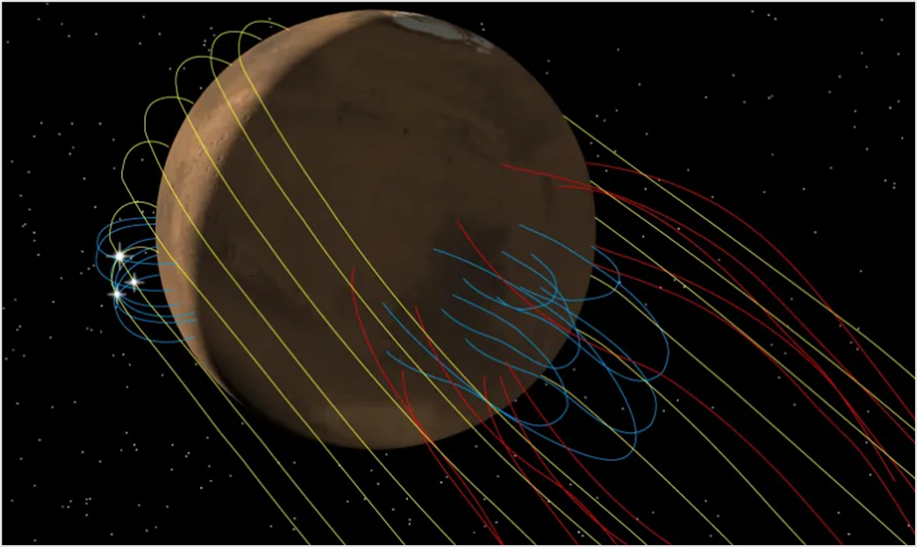
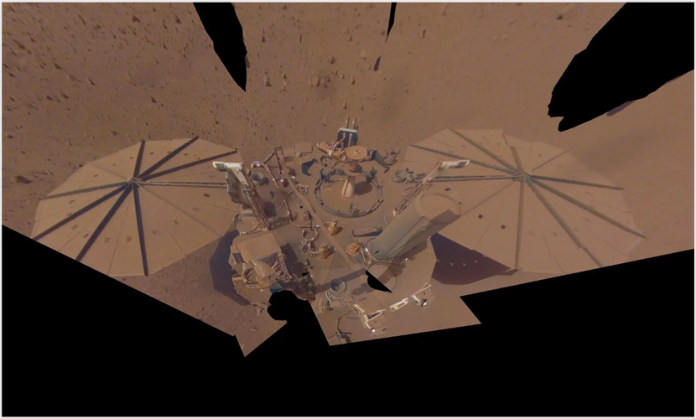

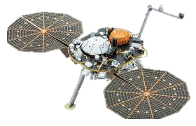

Other Insight discoveries
(“Science Highlights - NASA Science,” 2024)
(“NASA Retires InSight Mars Lander Mission After Years of Science - NASA,” 2022)
Magnetic Field
Lots of Dust

Slide 13
SUMMARY
This was a groundbreaking mission as it was the first successful attempt to use seismology outside the Earth and Moon
InSight showed Mars has a large liquid core. This allowed for a better understanding of potential shadow zones
Seismic data showed a solid mantle consisting of potential evidence for early impactors. It also showed evidence for a molten core mantle boundary.
InSight found the crust is strongly layered and less dense than predicted, with multiple distinct seismic boundaries
InSight also improved knowledge of weather patterns, detected new meteoroid impacts, and measured strong crustal magnetization. This gives us a better picture of what’s happening at the surface today

Slide 14
references
Dundas, C.M. et al., 2023, A Large New Crater Exposes the Limits of Water Ice on Mars: Geophysical Research Letters, v. 50, p. e2022GL100747, doi:10.1029/2022GL100747.
Hoffman, T., 2018, InSight: Mission to Mars, in 2018 IEEE Aerospace Conference, Big Sky, MT, IEEE, p. 1–11, doi:10.1109/AERO.2018.8396723.
Johnson, C.L. et al., 2020, Crustal and time-varying magnetic fields at the InSight landing site on Mars: Nature Geoscience, v. 13, p. 199–204, doi:10.1038/s41561-020-0537-x.
Khan, A. et al., 2021, Upper mantle structure of Mars from InSight seismic data: Science, v. 373, p. 434–438, doi:10.1126/science.abf2966.
Knapmeyer-Endrun, B. et al., 2021, Thickness and structure of the martian crust from InSight seismic data: Science, v. 373, p. 438–443, doi:10.1126/science.abf8966.
Kono, Y., Koyama, C., Kondo, N.M., Ohara, K., Kuwahara, H., Nakada, R., Watanabe, Y., Oda, H., and Ishikawa, T., 2025, Gravitational stability of iron-rich peridotite melt at Mars’ core-mantle boundary: Communications Earth & Environment, v. 6, p. 1–7, doi:10.1038/s43247-025-02117-3.
Mittelholz, A., Johnson, C.L., Fillingim, M., Joy, S.P., Espley, J., Halekas, J., Smrekar, S., and Banerdt, W.B., 2021, Space Weather Observations With InSight: Geophysical Research Letters, v. 48, p. e2021GL095432, doi:10.1029/2021GL095432.
NASA Marsquake Data Reveals Lumpy Nature of Red Planet’s Interior - NASA, 2025, https://www.nasa.gov/missions/insight/nasa-marsquake-data-reveals-lumpy-nature-of-red-planets-interior/ (accessed November 2025).

Slide 15
references
NASA Retires InSight Mars Lander Mission After Years of Science - NASA, 2022, https://www.nasa.gov/missions/insight/nasa-retires-insight-mars-lander-mission-after-years-of-science/ (accessed November 2025).
Science Highlights - NASA Science, 2024, https://science.nasa.gov/mission/insight/science-highlights/ (accessed November 2025).
Stähler, S.C. et al., 2021, Seismic detection of the martian core: Science, v. 373, p. 443–448, doi:10.1126/science.abi7730.
Shelton, J., 2021, The forecast for Mars? Otherworldly weather predictions | Yale News:, https://news.yale.edu/2021/08/30/forecast-mars-otherworldly-weather-predictions (accessed November 2025).
Tavernier, L., 2024, How InSight Revealed the Heart of Mars:, https://www.jpl.nasa.gov/edu/resources/teachable-moment/how-insight-revealed-the-heart-of-mars/.
Uncovering the molten mantle of Mars, 2024, PHYSICS TODAY, https://physicstoday.aip.org/news/uncovering-the-molten-mantle-of-mars (accessed November 2025).
Wieczorek, M.A. et al., 2022, InSight Constraints on the Global Character of the Martian Crust: Journal of Geophysical Research: Planets, v. 127, p. e2022JE007298, doi:10.1029/2022JE007298.
Witze, A., 2023, Mars has a surprise layer of molten rock inside: Nature, v. 623, p. 20–20, doi:10.1038/d41586-023-03271-4.

Slide 16
KEY POINTS
Asha Punia
The Interior of Mars: Discoveries From the InSight Mission
1. InSight used seismic waves to reveal the structure and properties of the core, mantle, and crust for the first time.
2. The core is large and liquid, the mantle may have 2 layers and is thinner than expected, and the crust has 2-3 layers and is not very dense.
3. InSight contributed to a variety of other studies by monitoring weather, impacts, and magnetic signals.
Questions?

