Slide 1
Sacramento Restaurant Delivery Analysis
Alexander, Ashley, Fatima, Maria

Slide 2


Original Hypothesis:
Given the restrictions put in place due to COVID-19, restaurant delivery has become much more lucrative than it was before. We intended to use data from Yelp and Google Places to analyze the reviews of restaurants in the greater Sacramento area who advertise they offer delivery in their profile to determine if their ratings or number of reviews have changed since COVID.

Slide 3


Gathering Data
Why does that change things?
Without finding any exportable information regarding previous months or years data we are unable to make any clear comparison regarding reviews, delivery options, or ratings to current data.
We used Yelp and Google Places APIs in order to acquire data to use for our project regarding restaurants, locations, rating and delivery information.
The Unexpected Unfortunately both Yelp and Google were not able to offer us all the data we needed.
What happened? We were unable to locate past data through any API or available website to compare current to past ratings or delivery options.
What did you find?
With the information we were able to retrieve we did find a few interesting points of information regarding restaurants in our local area.

Slide 4
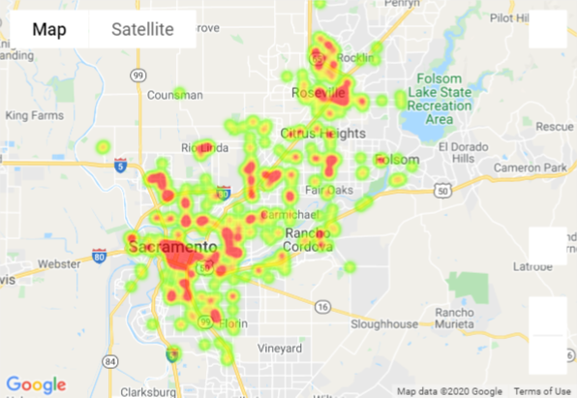

Restaurant Map
We pulled data on restaurants in the greater Sacramento area and as the heatmap shows us restaurants are concentrated in downtown Sacramento and Roseville with another small concentration in Natomas.
Notes:
Heatmap for ALL restaurants

Slide 5


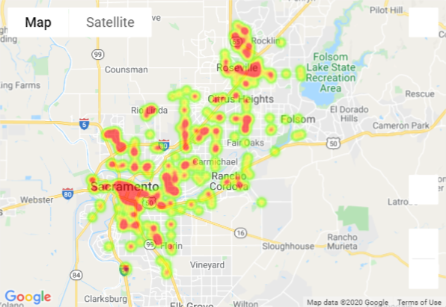


Delivery Map
This map shows us that the concentration of restaurants offering delivery is almost identical to the overall concentration of restaurants in the area.
Notes:
This shows us that in our current economic circumstances delivery is in demand for restaurant services.

Slide 6
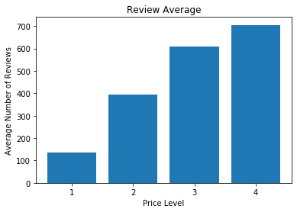
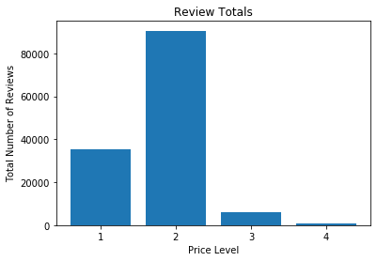
Average Review Count per Price
Total Reviews per Price
Notes:
Restaurants that cost more have a higher average number of people that leave reviews while lower priced restaurants have a lower average review count.
We can see in the overall review count as well that there is only one $$$$ restaurant in our data (Morton’s Steakhouse at Capitol Mall downtown which also DOES deliver).
Also our data shows that the $$ restaurants are most likely to be reviewed in general

Slide 7
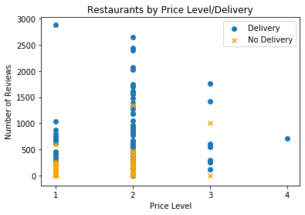
Review Count per Price & Delivery
Notes:
Looking at effect of price vs number of rating split out by delivery.
Again higher ratings for restaurants that deliver
Except for outlier at price 1, price 2 get higher number of reviews

Slide 8
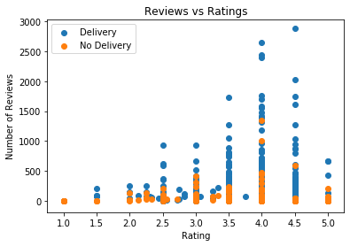
Delivery Impact on Rating and Reviews
We can see that for restaurants with and without delivery, ratings for restaurants with higher reviews tends to be between 3.5 and 4.5.
Notes:
Restaurants with higher review count also tend to have a higher rating
People leaving a really bad rating or really high rating may not care to take the time to write a review
Remember our data is missing a lot of information as the rating/review a person may leave is dependent on several other factors that are not taken into consideration on Yelp
Significant?

Slide 9
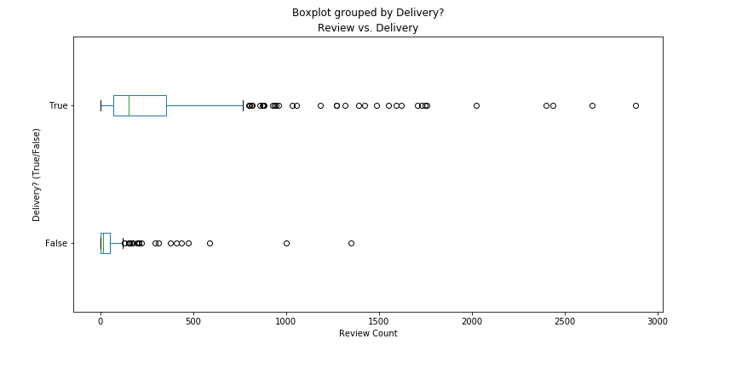
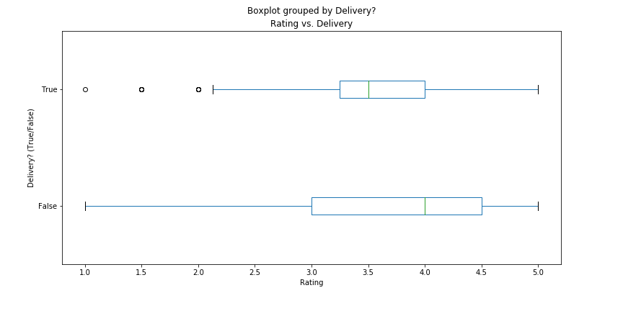
Number of Reviews by Delivery?(T/F)
The graph shows that the mean review count for both delivery and non-delivery is below 250. There are, however, a lot of outliers in the review count data, which indicates the data is skewed.
Restaurant Rating by Delivery(T/F)
The mean rating for restaurants that deliver appears to be lower than for restaurants that do not deliver.
Notes:
There doesn’t seem to be a correlation between whether a restaurant delivers and the review count due to all the outliers.
*Why is this important? The skew is affecting the mean because yelp is so user dependant and there is info that isn’t taken into consideration when people leave feedback.
It is easier to rate than review. Review count is

Slide 10


What were we missing?
Pre/post COVID data
Ability to filter on review date
Ability to pull more than 50 records at a time
Notes:
Pre/post COVID data - Neither Google or Yelp have the ability to pull data from a specified time point. This prevented us from having a range of dates.
Ability to filter on review date - While the Google API
Ability to pull more than 50 records at a time

Slide 11
Conclusions we got from our Data
Delivery:
Average Rating - 3.52
Average Review Count - 305
No Delivery:
Average Rating - 3.34
Average Review Count - 104
Cheaper restaurants don’t receive as many reviews as more expensive restaurants.
Average Review Count
$ -> 157
$$ -> 393
$$$ -> 609
$$$$ -> 705
In our experience during this project we faced a very difficult situation. Imperfect data is unfortunate but sometimes is what you have. In our case, we decided to cut our losses and go as far as we could with what we had.
Notes:
Talk about restaurants with Delivery having more reviews, but the ratings not really differing much
Price $ has an overall average of 157 review count per restaurant while Price $$ has 393 Price $$$ has 609 and Price $$$$ has 705

Slide 12



ProTip: Top Restaurants in Sacramento per Yelp
Based on our findings, here are the top Sacramento restaurants that currently offer delivery. Ramen House Ryujin has the most reviews out of the restaurants in our data, while Guy’s For Lunch has the most reviews out of the other five-star restaurants in our data. Both restaurants are rated as “$” on Yelp.

Slide 13

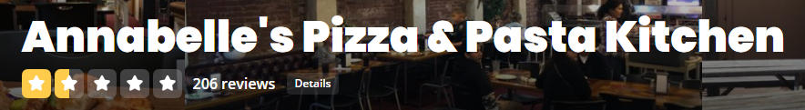
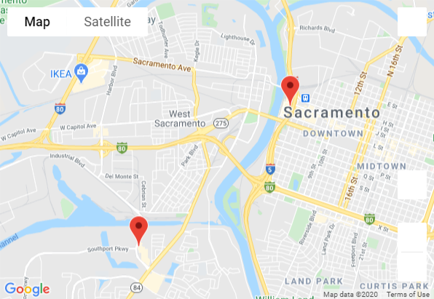


Warning: BOTTOM Two
Based on our data, here are the WORST restaurants that currently offer delivery. Annabelle's Pizza & Pasta Kitchen, and McDonald's have the most reviews of the six restaurants that have 1.5 star reviews. We recommend staying away from these restaurants.
Notes:
Of the restaurants in our data that had more than 50 reviews, the lowest-rated restaurants were mostly fast-food restaurants.

