Slide 1
ACCOMMODATION MANAGEMENT SYSTEM
NAME | REGISTRATION
ASHA MOHAMED MBAROUK | BCS/14/19/009/TZ
HAMISA YAHYA SALIM | BCS/14/19/010/TZ
MABULA LIMBU | BCS/14/19/012/TZ

Slide 2
SHORT DESCRIPTION
This project is established to serve services for different colleges. The name of project is “HOTEL ACCOMMODATION MANAGEMENT SYSTEM”
Aim
To develop student’s Hostel Accommodation management system that can store all student information and enables the management team to retrieve back the information that have been stored and to maintain all activities in managing a hostel.

Slide 3
Objectives of the system
The following are the objectives of the system that main objective and specific objective
Main objective
To design and develop student accommodation management system that can save the records of the students about their rooms and other things.
Specific objective
To enable the staff to allocate student information and manage them.
To provide the convenience to the user and easy to manage the information.

Slide 4
Purpose
➢ Provides the searching facilities based on various factors. Such as Rent, Hostel, Rooms, Payments
It tracks all the information of Allotters of Rooms
Manage the information of Rent.

Slide 5
FUNCTIONAL REQUIREMENTS
The system allow staff to register all the information about student.
The administrator has the responsibilities to enter and update the information of users in the system.
The system has to show all the rooms allocated in the given hostel and cost of each room.
The system show the all the room located and not located.
The system has ability to register new universities.
The system allow to enter the privileges different users as to login.
The system allow to add the new room.

Slide 6
NON FUNCTIONAL REQUIREMENTS
The system should present understandable error messages.
The system should make use of encryption to ensure that data is stored securely.
The system must always be available.

Slide 7
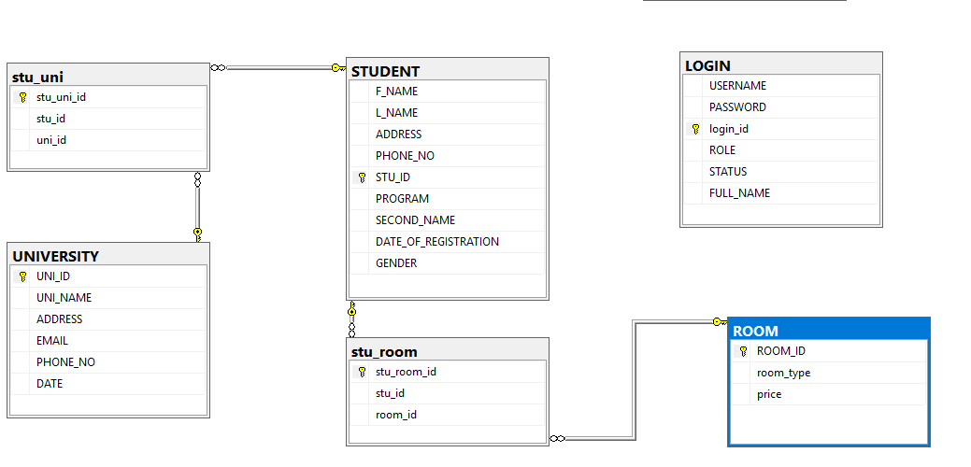
DATABASE DESIGN

Slide 8
THANKS

