Slide 1
The Economics of an
Integrated World Oil Market
William Nordhaus
Sterling Professor of Economics
Yale University
Plenary Address
Energy Information Administration
2009 Energy Conference: A New Climate for Energy
April 7, 2009

Slide 2




This is not a bathtub.

Slide 3
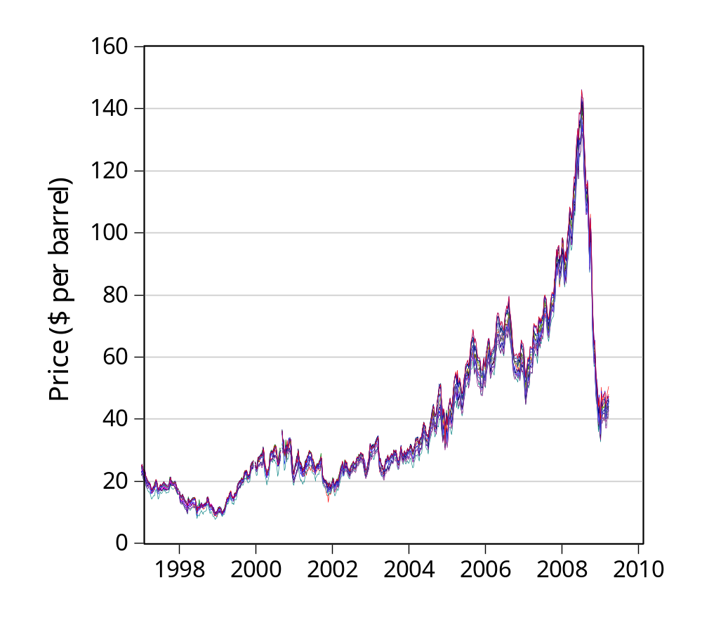
The Integrated World Oil Market
Weekly oil prices for 15 sources around the world. Source: EIA.

Slide 4
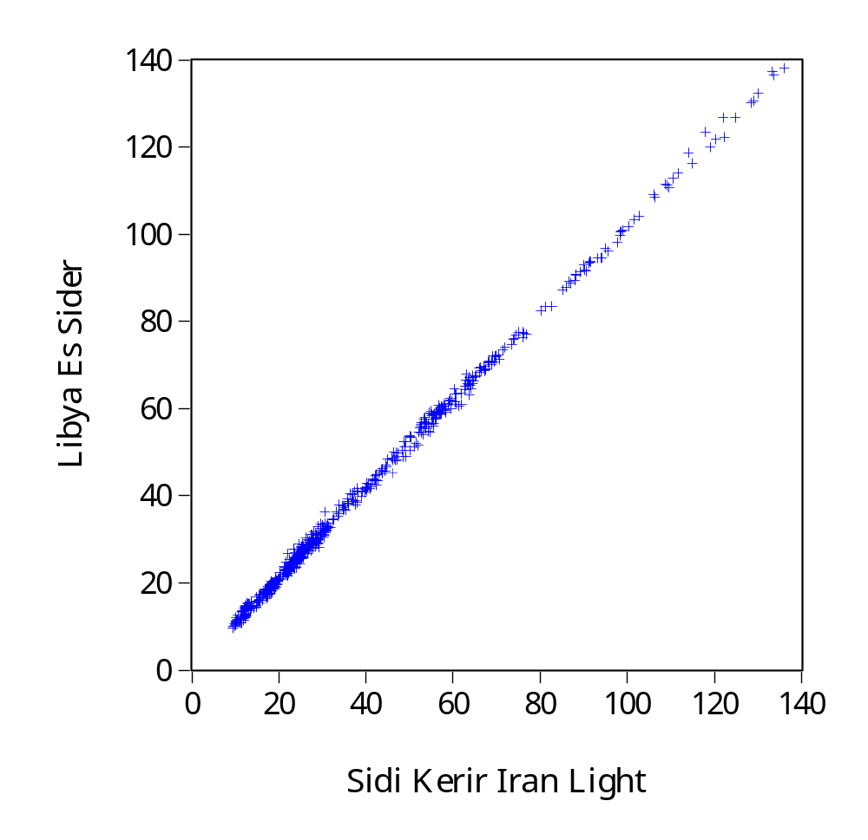
Libyan and Iranian Prices
[$ per barrel, 1979 - 2009

Slide 5
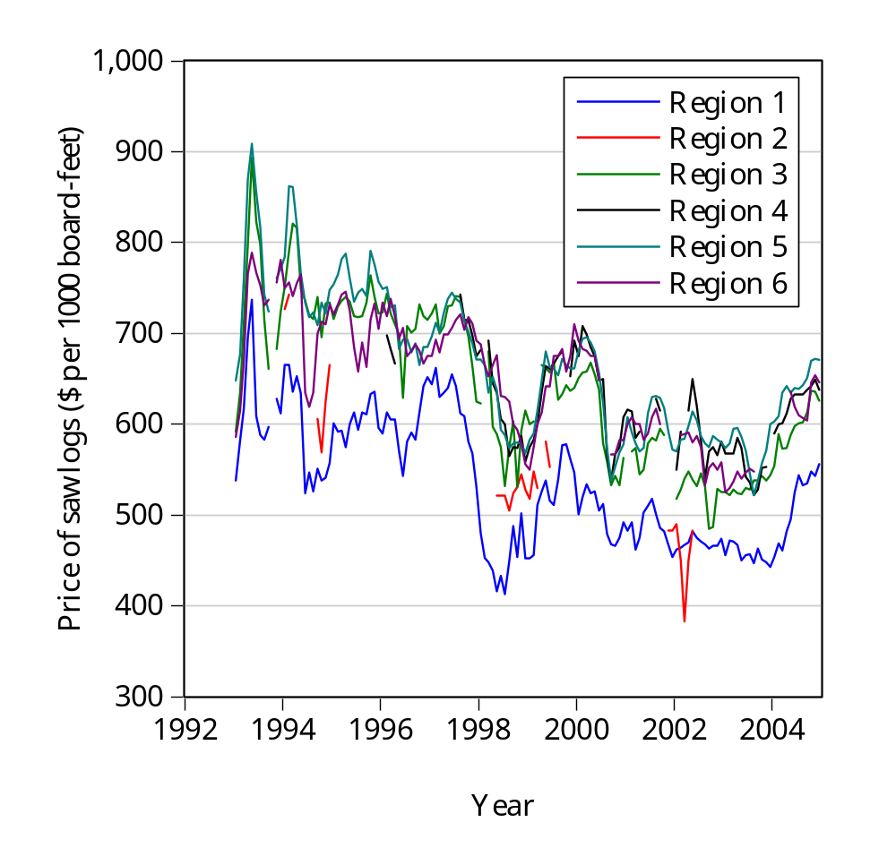
A Not-So-Integrated Market:
Douglas Fir Log #2 in Pacific Northwest

Slide 6
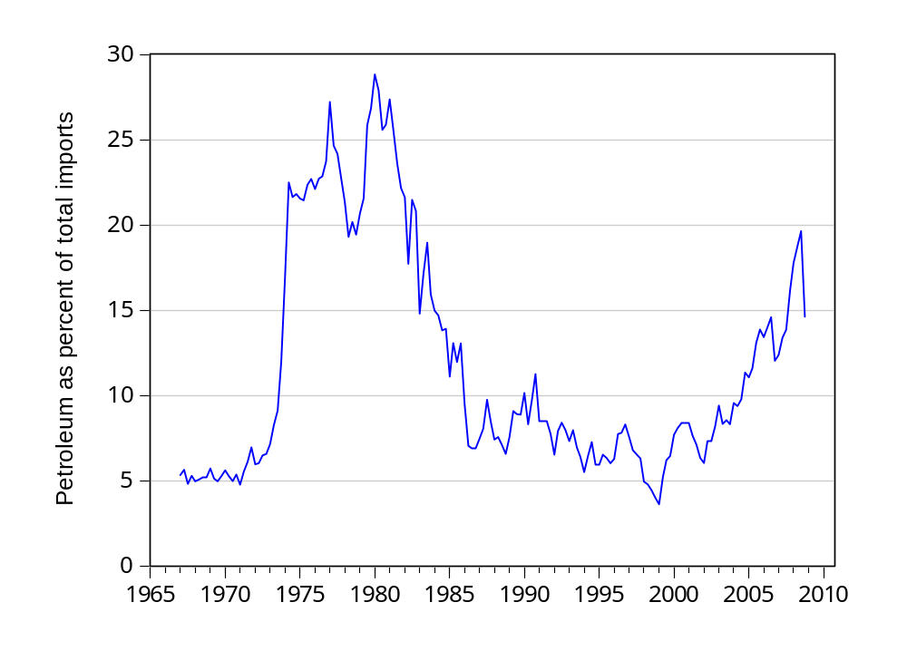
Share of petroleum in total imports

