Slide 1



Slide 2
To Cover…
Transport Energy and CO₂
  Where are we going?
  What are the dangers?
  How do we change direction?
Primarily reporting on:
  IEA WEO 2008
  IEA ETP 2008
  On-going work with IEA’s Mobility Model
One or two detours to talk about modelling

Slide 3
Where are we headed? World Energy Outlook 2008
World primary energy demand in the Reference Scenario:
an unsustainable path
Mtoe
18 000
Other renewables
16 000
Hydro
14 000
12 000
Nuclear
10 000
Biomass
8 000
Gas
6 000
Coal
4 000
Oil
2 000
0
1980
1990
2000
2010
2020
2030
World energy demand expands by 45% between now and 2030 – an average rate of increase of 1.6% per year – with coal accounting for more than a third of the overall rise

Slide 4
WEO 2008 Reference Scenario:
Incremental oil demand, 2006-2030
Mtoe
800
Rest of world
Other Asia
600
India
China
400
OECD
200
0
-200
Transport
Industry
Non-energy
Other
use
Around three-quarters of the projected increase in oil demand comes from transportation

Slide 5
Change in oil demand by region in the Reference Scenario, 2007-2030
OECD Pacific
OECD Europe
OECD North America
Africa
E. Europe/Eurasia
Latin America
Other Asia
India
Middle East
China
-2
0
2
4
6
8
10
mb/d
All of the growth in oil demand comes from non-OECD, with China contributing 43%, the Middle East & India each about 20% & other emerging Asian economies most of the rest

Slide 6
Oil-import dependence in the Reference Scenario
OECD North America
2007
2030
United States
China
Other Asia
OECD Europe
OECD Pacific
European Union
India
20%
30%
40%
50%
60%
70%
80%
90%
100%
OECD Europe & Asia become even more dependent on oil imports, but import dependence drops in North America & OECD Pacific

Slide 7
Energy subsidies in non-OECD countries, 2007
Iran
Oil
Russia
Gas
China
Saudi Arabia
Coal
India
Electricity
Venezuela
Indonesia
Egypt
Ukraine
Argentina
South Africa
Kazakhstan
Pakistan
Malaysia
Thailand
Nigeria
Chinese Taipei
Vietnam
Brazil
0
10
20
30
40
50
60
Billion dollars
Energy subsidies in the 20 largest non-OECD countries hit $310 billion in 2007 – creating, in many cases, an unsustainable economic burden & exacerbating environmental effects

Slide 8
World oil production by OPEC/non-OPEC in the Reference Scenario
120
52%
OPEC - other
mb/d
100
50%
OPEC - Middle East
48%
80
Non-OPEC - non-
46%
conventional
60
Non-OPEC -
44%
conventional
40
OPEC share
42%
20
40%
0
38%
2000
2007
2015
2030
Production rises to 104 mb/d in 2030, with Middle East OPEC taking the lion’s share of oil market growth as conventional non-OPEC production declines
Notes:
.

Slide 9
World oil production by source in the Reference Scenario
120
Natural gas liquids
mb/d
Non-conventional oil
100
Crude oil - yet to be
developed (inc. EOR)
80
or found
Crude oil - currently
60
producing fields
40
20
0
1990
2000
2010
2020
2030
64 mb/d of gross capacity needs to be installed between 2007 & 2030 – six times the current capacity of Saudi Arabia – to meet demand growth & offset decline

Slide 10
Energy-related CO₂ emissions in the Reference Scenario
45
International
Gigatonnes
marine bunkers
40
and aviation
Non-OECD - gas
35
Non-OECD - oil
30
Non-OECD - coal
25
OECD - gas
OECD - oil
20
OECD - coal
15
10
5
0
1980
1990
2000
2010
2020
2030
97% of the projected increase in emissions between now & 2030 comes from non-OECD countries – three-quarters from China, India & the Middle East alone

Slide 11
WEO 2008 scenarios for CO₂ emissions pathways to 2030
45
550
450
Gigatonnes
Policy
Policy
Scenario
Scenario
40
9%
Nuclear
14%
CCS
23%
Renewables & biofuels
35
Energy efficiency
30
54%
25
20
2005
2010
2015
2020
2025
2030
Reference Scenario
550 Policy Scenario
450 Policy Scenario
While technological progress is needed to achieve some emissions reductions, efficiency gains and deployment of existing low-carbon energy accounts for most of the savings

Slide 12


World energy-related CO₂ emissions in 2030 by scenario
40
Gigatonnes
35
30
25
20
World
15
World
10
5
0
Reference Scenario
550 Policy Scenario
450 Policy Scenario
OECD countries alone cannot put the world onto a 450-ppm trajectory,
even if they were to reduce their emissions to zero

Slide 13
IEA’s Long-term View: Energy Technology Perspectives 2008
A Low CO₂ world to 2050: what it looks like and how to get there
  A study primarily about the role of technology
  Achieving IPCC CO₂ emission targets
    Transport does not have to achieve zero emissions, but it would clearly help.
  Identifying short and medium term technology and policy needs
Scenario analysis – three main scenarios:
  Baseline WEO2007 Reference Scenario, extended to 2050
  Global stabilization by 2050 (ACT – up to USD50/tonne)
  Global 50% reduction by 2050 (BLUE – up to USD200/tonne)
Notes:
This publication consists of three parts, 17 chapters and about 550 pages.
The first part discusses the short and medium term policy needs: RD&D, technology deployment and investment needs. A key component of the whole book are 17 technology roadmaps.
The short and medium term policy needs are guided by a long-term outlook for the period to 2050, based on energy scenarios. Three scenarios are discussed in part two. The Baseline scenario is consistent with the IEA World Energy Outlook 2007 Baseline scenario, and extrapolates this scenario to 2050.
Two new policy scenarios have been developed that analyse the role technology can play in meeting the environmental and energy security challenges in the coming decades. It is the first time ever that the IEA publishes a scenario that is consistent with emissions halving in 2050 compared to 2005 levels.
The third part discusses the current status and outlook of energy technologies in the power generation sector, transport, industry, buildings and appliances. This is an update of the discussion in the ETP2006 that we published two years ago. A number of new insights have emerged, for example with regard to the potential role of solar energy and battery technology.

Slide 14
Baseline Scenario
We have a lot of decoupling in the BAU case…
Growth 2005 - 2050
  GDP x 4
  Final & Primary energy use x 2
  Coal demand x 3
  Gas demand x 2.5
  Oil demand x 1.5
  Electricity demand x 2.5
  Energy CO₂ emissions x 2.3
If we don’t get this decoupling, the baseline will be even higher…

Slide 15
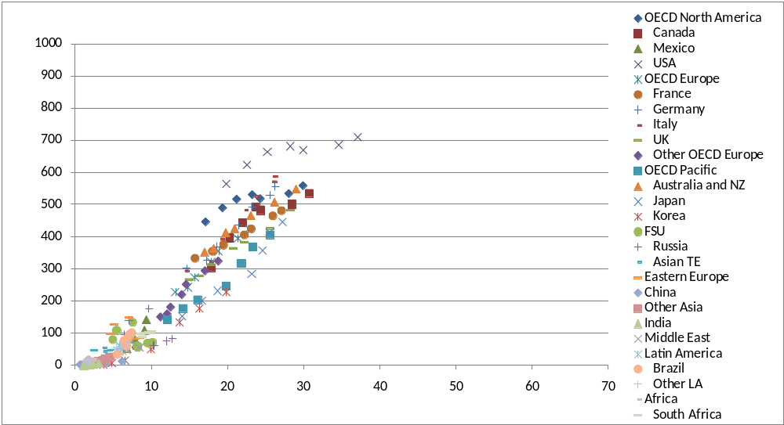
LDV stock and personal income
Historical data
Cars per 1000 people
Personal income, thousand real USD (using PPPs) per capita

Slide 16
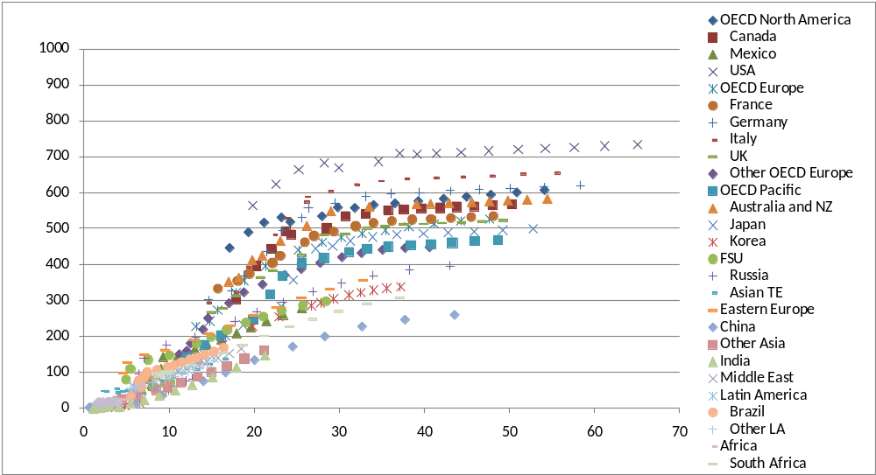
LDV stock and personal income
ETP projections (consistent with WEO)
Cars per 1000 people
Personal income, thousand real USD (using PPPs) per capita
Trends similar to the past, with Asia (India, China, SE Asia) on the low-end because of…
  High degree of urbanization (road space issues?)
  Extremely fast growth rates in income, skewed towards some population subsets

Slide 17
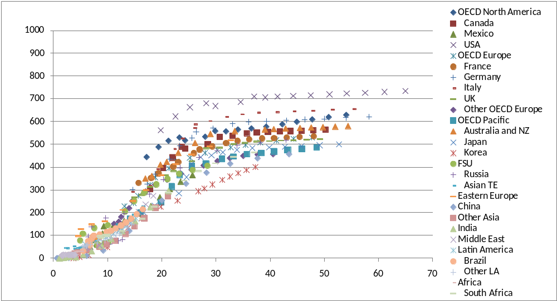
LDV Stock: A possible alternative (higher ownership)
Cars per 1000 people
Personal income, thousand real USD (using PPPs) per capita
Trends per unit income are more similar to IEA countries in the past
However, assumes that ownership growth rates per unit time are far higher, and must be associated with very rapid development of infrastructure

Slide 18
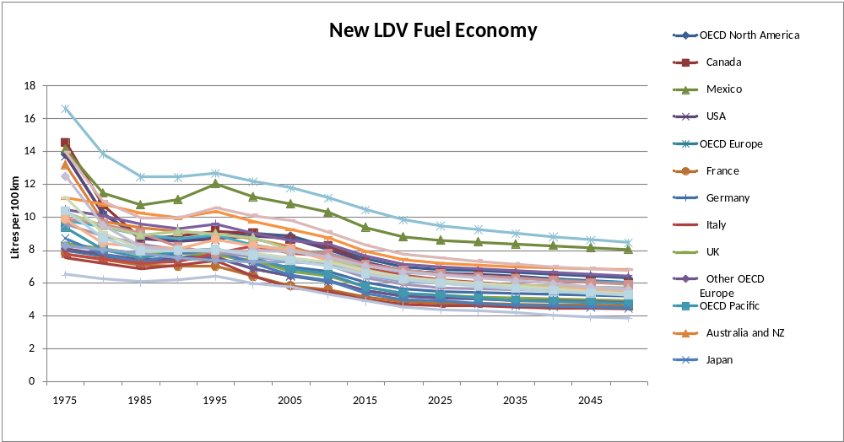
LDV Fuel Economy Baseline
Fuel economy improves by 25% 2005-2050 in the baseline scenario
Assumes all pending fuel economy rules take effect
Available technology for conventional gasoline and diesels is progressively introduced all over the world – 75% for fuel economy, 25% for other things

Slide 19
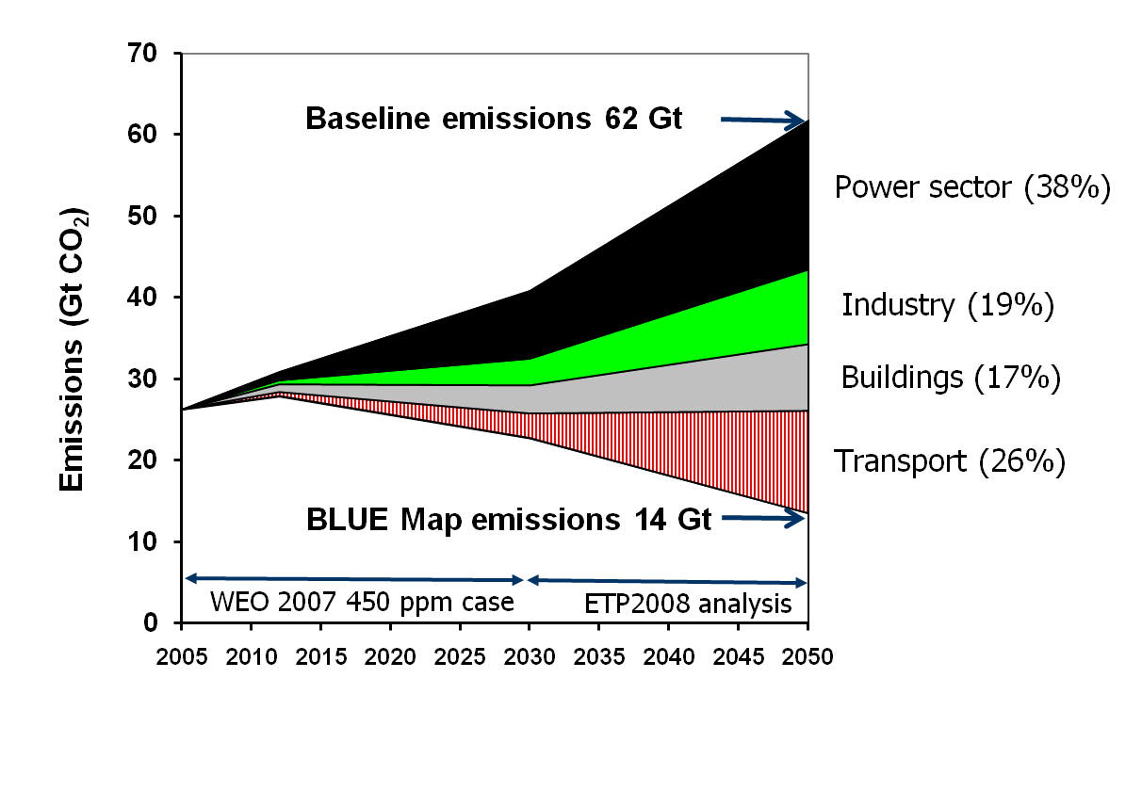
Sector Contributions

Slide 20
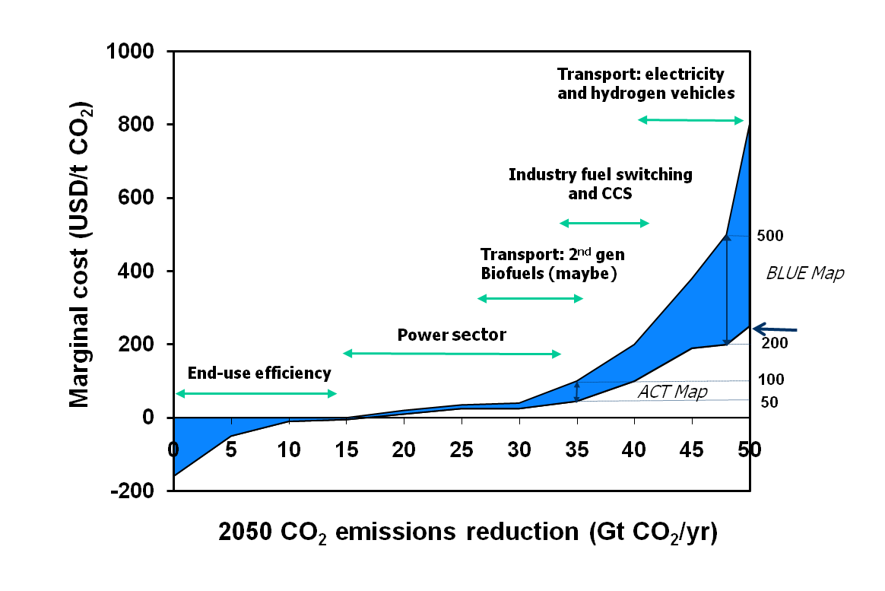
To bring emissions back to current levels by 2050 options with a cost up to USD 50/t are needed. Reducing emissions by 50% would require options with a cost up to USD 200/t, possibly even up to USD 500/t CO₂
A New Energy Revolution ?
Technology
Pessimism
Technology
Optimism
Notes:
A halving of emissions worldwide by 2050 would be an extremely challenging target (the BLUE scenarios). It would not be possible with technologies that are available today. Especially the transport sector will require new solutions. In other sectors it would be possible but the cost would be very high. In all sectors new technologies are also needed to bring the cost down further. Emissions can be reduced by 50% compared to the 2005 level if measures with a cost up to USD 200/t CO2 are considered. The cost may be even rise to USD 500/t CO2, if less progress is made in terms of cost reduction for new technologies, notably for the transport sector.
For transport:
Vehicle efficiency improvements up to 50% can be achieved at very low or negative cost per tonne (left side of graph)
Biofuels, IF truly low GHG WTW characteristics can be attained, should be in the middle of the chart, between $0 and $100 per tonne, after 2015.
Advanced technologies such as electric vehicles and H2 fuel cell vehicles are likely to remain above $100 tonne, estimated to reach betweeen $200 to $500 per tonne by 2050.

Slide 21
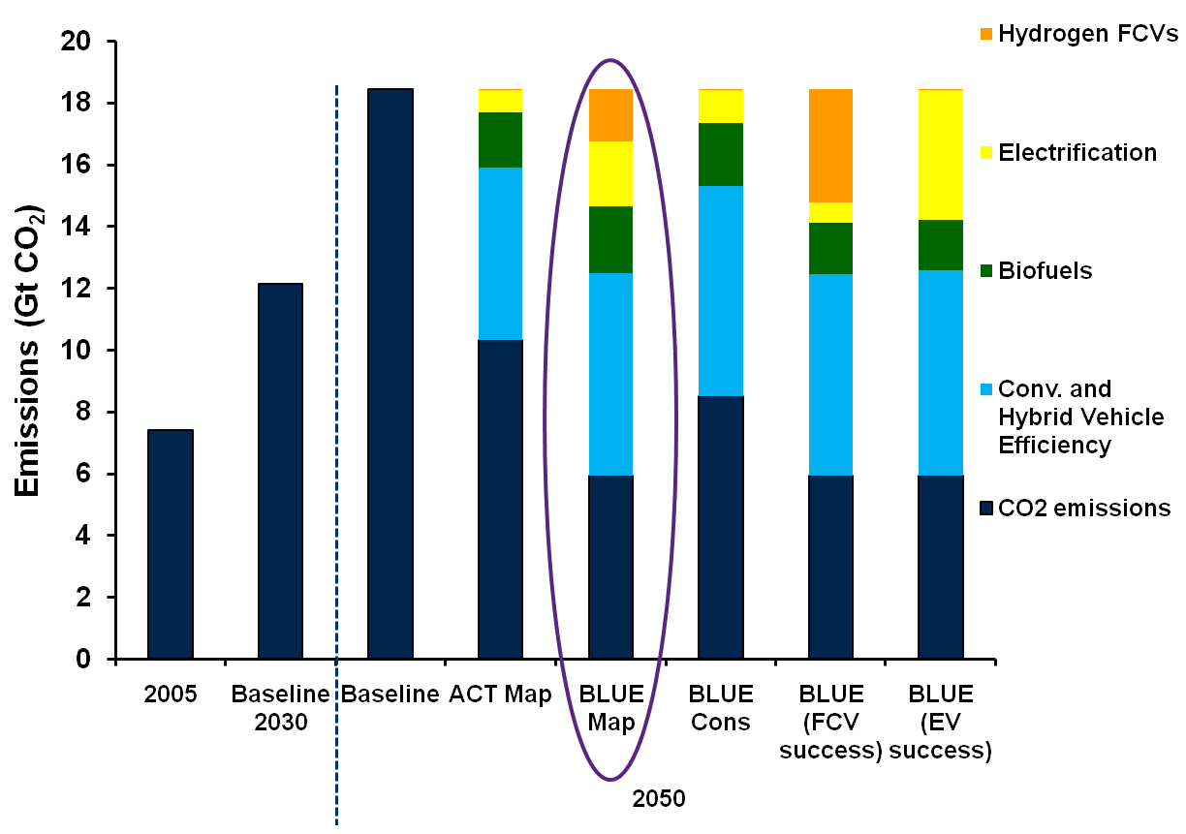
Transport GHG Emissions
(well-to-wheels CO₂-equivalent emissions)
Notes:
The shows the contribution of different components on CO2 reduction. In all ACT and BLUE cases, efficiency provides the greatest amount of CO2 reduction. Biofuels provide anywhere from about 1.5 to 2.5 gigatonnes per year of reduction by 2050.
Again, this is predicated on development of truly very low CO2 biofuels (assumed to be about 85% lower, well-to-wheels, than conventional gasoline vehicles throughout the projection period).

Slide 22
ETP BLUE
Light-duty Vehicles (cars, SUVs)
LDVs 50% more efficient by 2030
  Hybrids dominate by 2030, plug-in hybrids dominate by 2050
  IEA has launched the Global Fuel Economy Initiative
Electric and / or H2 Fuel Cell Vehicles play a major role after 2030
Biofuels reach up to 12% of total liquid fuel share by 2030, mostly 2nd gen, mostly diesel
  Rising to 26% by 2050 (20-fold increase compared to 2007)
  LDVs may not be the best application

Slide 23
ETP BLUE: Other Transport Modes
Half of total demand
Air
  15% efficiency improvement over baseline (30% in baseline) by 2050
  Some logistic improvements
  30% biofuels (BTL fuel) by 2050
Shipping
  30% efficiency improvement by 2050;
  30% biofuels (heavy fuel oil substitutes) by 2050
Trucks, buses
  30-50% efficiency improvement by 2050
  Same biofuels share as for LDVs
Lots of biofuels in these modes – and it probably won’t be ethanol!
Notes:
The key point here is that we don’t really have the electric or H2 vehicle option for heavy duty vehicles, ships or aircraft. So we rely on strong efficiency improvements and biofuels. As a result, most of the biofuels used in BLUE go to these modes…

Slide 24
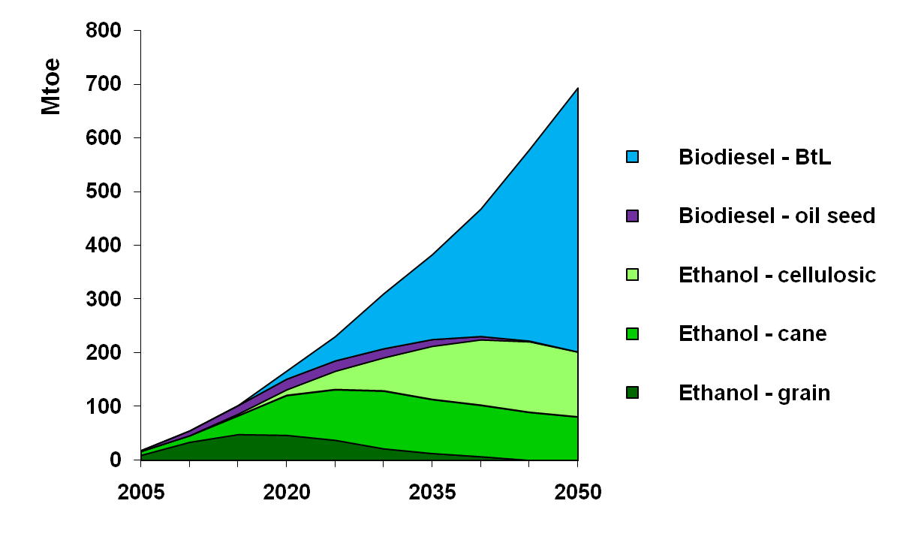
Biofuels Use in BLUE Map
26% of Transport Fuel Use in 2050
Notes:
The dark green and blue areas are conventional (1st generation) biofuels, that we assume are phased out by 2030 or so.
The light green areas are cane and ligno-cellulosic ethanol, both very low CO2 and we assume the production of these fuels rises rapidly between 2010 and 2030. However, after 2030, global gasoline demand in BLUE levels off and even begins to decline, as Evs and/or FCVs begin to gain market share and eventually dominate the market.
However advanced biodiesel fuel expands by far the most after about 2025, due to ongoing increases in demand from trucks, ships and aircraft. This results in a dominance of biodiesel over ethanol after 2035 or so, and is a signficant finding in our study.
We plan to further investigate the implications of this finding, including further exploration of the use of ethanol to replace heavier grades of oil products like distillates in diesel engines.

Slide 25
Um, Policies?
Clearly we will need strong policies both internationally and at national levels (and local!)
  International framework especially critical for air and maritime transport
  Carbon price, yes – but $50/tonne is only $0.12/litre
National measures should include:
  Fuel economy standards on all types of vehicles – 30-50% reductions in energy intensity by 2050 seem possible for most
  2nd Gen Biofuels – yes – but we should not push this too fast!
  EVs/FCVs but relatively high cost and massive infrastructure investments will be needed
    PHEVs as an incremental approach
Local level - land use/ modal shift policies (but national gov’s can encourage)

