Slide 1


Institute of Transportation Studies
University of California, Davis
Energy & Transportation Science Division
Oak Ridge National Laboratory
Transportation’s Energy
Transition
The 2009 Energy Conference
Energy Information Administration
April 7, 2009

Slide 2
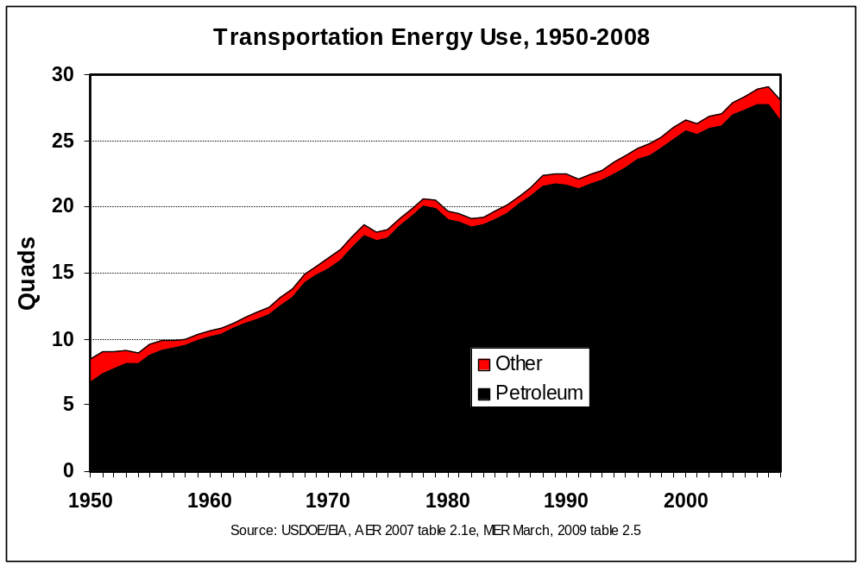
Petroleum, petroleum and petroleum.
Notes:
In my talk this morning I would like to make two points. One old and one, I hope, is new to you. The first old news. Conventional oil production outside of the OPEC cartel is nearing a global peak or plateau. This you have heard before but it is important to this morning’s topic because given the underlying growth you have heard about from Dr. Fulton, global transportation WILL make an energy transition in the coming decades. Arnulf Grubler correctly observes that the only scarcity-driven energy transition he can find in history is the case of whale oil, and that it is highly unlikely that we will experience a scarcity-driven transition from petroleum. Arnulf is probably right. We may make the transition to protect the global climate. We may discover the ultimate battery or fuel cell. My point is that whatever the reason may be, we WILL begin a transition from conventional petroleum soon.

Slide 3
Depletion of conventional oil outside of OPEC combined with OPEC’s market power and long-term economic interests will require a transition from conventional petroleum to…..
All the possible options have risks and uncertainties
  Unconventional petroleum sources
  Biofuels
  Hydrogen
  Electricity
Can we also achieve our energy goals?
  Climate protection – 50-80% GHG reduction by 2050
  Energy security – 11 mbd change in US petroleum Supply/Demand balance by 2030
  Sustainable energy - ?

Slide 4
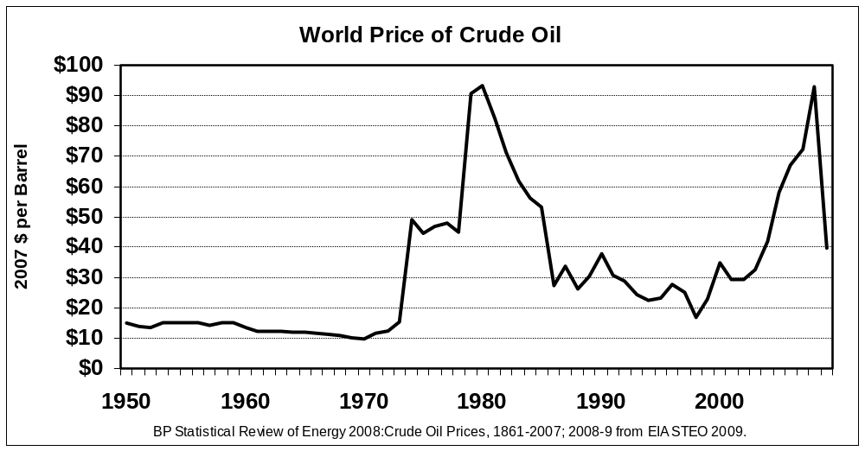
“The real problem we face over oil dates from after 1970: a strong but clumsy monopoly of mostly Middle Eastern exporters operating as OPEC.” Prof. M. Adelman, MIT, 2004.
After OPEC
Before OPEC

Slide 5
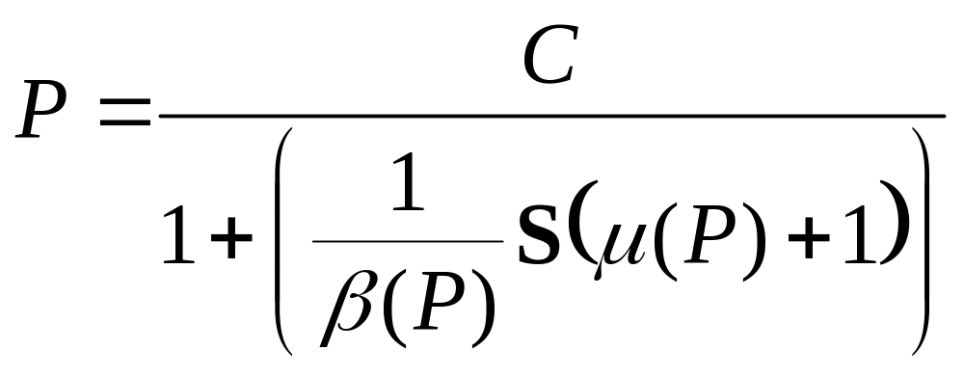
The economic theory of the behavior of partial monopolists, like the OPEC oil cartel, was developed more than half a century ago by Heinrich von Stackelberg.
P = profit maximizing price
C = marginal cost of producing oil
β = price elasticity of world oil demand
S = OPEC share of world oil market ( 0 < S < 1 )
µ= non-OPEC supply response ( -1 < µ < 0 )
Oil prices are uncertain because short-run elasticities
are 1/10th as large as long-run elasticities.
Notes:
OPEC’s market share is shown in bold because that is the one parameter of this equation over which they have substantial control, in the long run by investment in production capacity, in the short run via quotas. There is not one mechanism for OPEC to influence oil market prices. There is a long-run mechanism and a short-run mechanism.

Slide 6
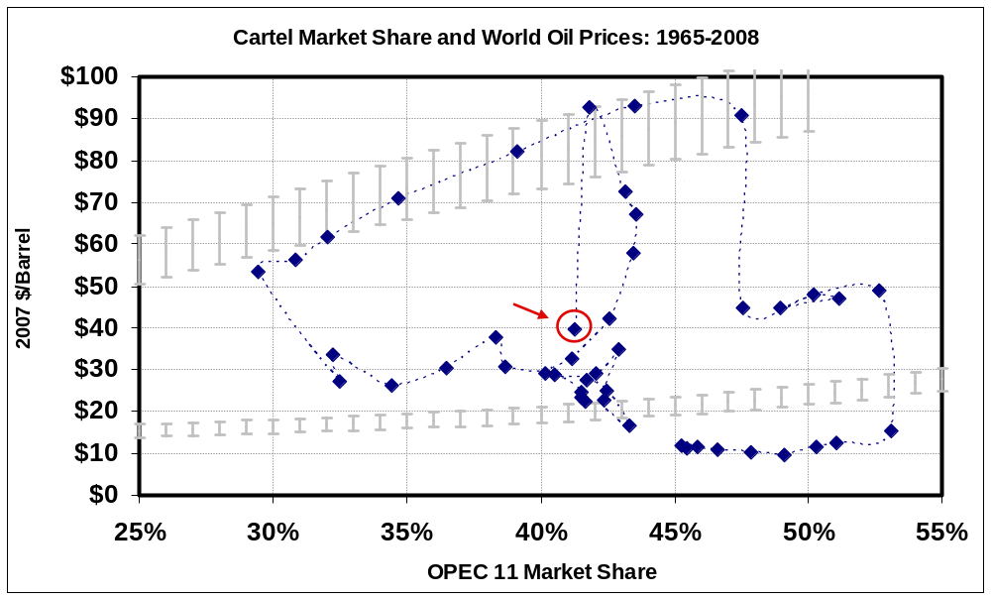
The past 35 years of oil market experience fit the partial monopoly theory remarkably well.
?
Source: Price and OPEC market share, BP
Oil demand elasticities: Long-run = -0.7, short-run = -0.105
Oil supply elasticities: Long-run = 0.60, short-run = 0.06
Assuming linear, annual lagged-adjustment functions, elasticities at $28/bbl.
Sour

Slide 7
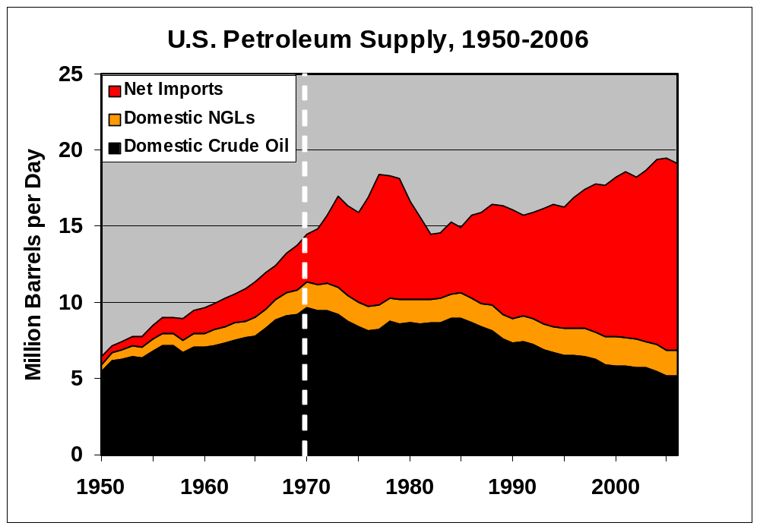
In the early 1970s the cartel’s market power was strengthened by growing world demand, its increasing market share and… the peaking of US crude oil production in 1970.

Slide 8

The RATE of world oil use should be alarming.
The 2007 NPC report expects
1.1 trillion barrels of oil production
over the next 25 years. More than
consumed in in all of human history.
2002
67%
Remaining recoverable conventional crude oil*
Not reserves, ULTIMATE RESOURCES
Cumulative Production to end of 2005
Cumulative Production to the
end of 1995 was 710. Over ¼
of all oil ever consumed was
consumed in those 10 years.
979
33%
Billions of Barrels
* From USGS 2000, USGS 1995, and MMS 1996

Slide 9
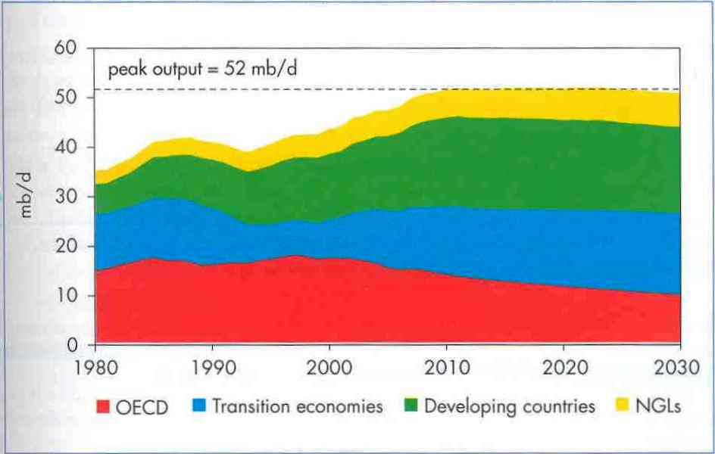
In 2005, the International Energy Agency foresaw a non-OPEC plateau with OPEC supply and unconventional resources filling the gap between non-OPEC supply and growing world demand.

Slide 10
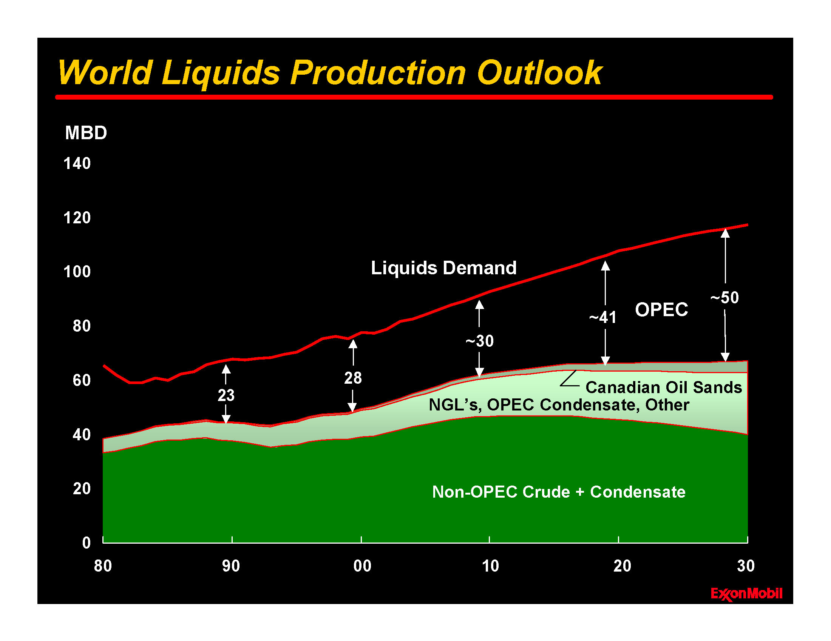
ExxonMobil also saw a non-OPEC peak coming.

Slide 11
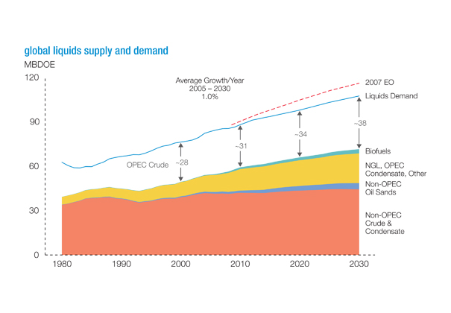
ExxonMobil’s 2008 energy outlook was not much more optimistic.
Price matters, but not that much.
Source: ExxonMobil, The outlook for energy: a view to 2030, January 14, 2009.
http://www.exxonmobil.com/Corporate/energy_outlook.aspx

Slide 12
IEA does model oil depletion and oil peaking.
But the WEO does not reflect OPEC behavior.
World oil production by OPEC/non-OPEC in the Reference Scenario
(Lew Fulton, IEA, today)
120
52%
OPEC - other
mb/d
100
50%
OPEC - Middle East
48%
80
Non-OPEC - non-
46%
conventional
60
Non-OPEC -
44%
conventional
40
OPEC share
42%
20
40%
0
38%
2000
2007
2015
2030
Production rises to 104 mb/d in 2030, with Middle East OPEC taking the lion’s share of oil market growth as conventional non-OPEC production declines
Notes:
.The orange part is euphemistically termed the “call on OPEC”. “Hello OPEC, could we please have some more oil?” “We’ll think about it.” But they don’t have to think very long or very hard.

Slide 13
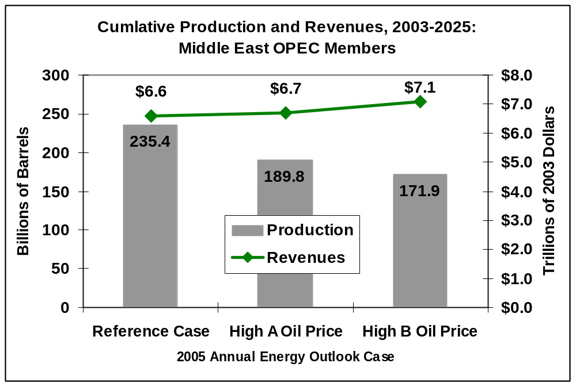
OPEC will not “fill the gap” because they can make more money by leaving the oil in the ground for future generations.
Cumulative Production and Revenues, 2003-2025
Middle East OPEC Members
U.S. DOE/EIA, Annual Energy Outlook 2005.
Notes:
It does not pay to answer the “call on OPEC.” I’m not blaming OPEC for this. Why should we expect them to do anything different?

Slide 14
Where does this leave us?
OPEC will not fill the gap. Something else will.
“Plenty” of unconventional sources of oil, but…
  Higher GHG emissions by 10% to 100% (except EOR), which makes petroleum look like a low carbon alternative.
  Capital intensive, often water intensive and environmentally challenging development.
  Uncertain policy environment.
How large a role for biofuels?
  “Billion ton” study suggested 30%, but…
  What’s the real benefit given indirect land use effects?
  Does our biofuels policy make sense?
Hydrogen? Electricity?
  Technological breakthroughs required
  New fuel infrastructure for hydrogen
Notes:
We have only two technologies that could potentially deliver truly zero carbon vehicles. Why would we give up on either one?
It’s the vehicles, not the infrastructure.

Slide 15
What should we do now, given that the necessary technological advances remain uncertain?
What are our (quantitative) energy goals?
  CLIMATE PROTECTION: 50% to 80% reduction in GHG emissions by 2050 (-60%)
  OIL SECURITY: Reduced demand + Increased supply = 11 mmbd by 2030
  SUSTAINABLE ENERGY: ?
Business-as-usual policies will not get it done.
Current technology will not get it done.

Slide 16
Potential effects of 11 advanced energy technologies on GHG emissions in EIA 2008 Frozen Technology Scenario by 2050.
Carbon Capture & Storage | Coal & gas emission -90%, energy intensity +10%
Nuclear Electricity | Nuclear share from 12% to 32%
Wind Electricity | Replace 18% coal, 50% natural gas
Solar Electricity | Replace 15% primary energy for electricity
Bio-Energy | Displace 3.7 Q for electricity, 6.7 Q additional biofuels for transportation (70% lower GHG)
Electric Drive Vehicles | Displace 13.2 Q petroleum, increase electricity demand by 6.6 Q
Transportation Efficiency | Reduce overall energy intensity by 35%
Buildings Efficiency | Reduce overall energy intensity by 50%
Industrial Efficiency | Reduce overall energy intensity by 30%
Efficient Generation & Grid | Reduce system-wide energy intensity by 30%
Advanced Fossil Liquids | W/o CCS increase carbon intensity by 15%
Notes:
The 2008 Frozen Technology Scenario includes full application of all existing technologies and policies, but no new, advanced technologies. No time to explain rationales for impacts or details of methodology. Use Kaya identity to handle first order impacts, no modeling of economic effects. Success = economical given reasonable GHG policies.

Slide 17
Potential effects of 11 advanced technologies on petroleum supply and demand in 2030.
Carbon Capture & Storage | No direct impact. Reduces carbon intensity of Coal-to-liquids.
Nuclear Electricity | No impact.
Wind Electricity | No impact
Solar Electricity | No impact.
Bio-Energy | Displace 6.7 Q additional petroleum in transportation, 0.7 Q in industry
Electric Drive Vehicles | Displace 2.5 Q petroleum
Transportation Efficiency | Reduce overall energy intensity by 16%
Buildings Efficiency | Eliminate 2 Q petroleum use in buildings
Industrial Efficiency | Reduce overall energy intensity by 10%
Efficient Generation & Grid | Eliminate petroleum use: -0.9 Q
Advanced Fossil Liquids | Additional domestic supply of 10.1 Q (4.7 mmbd): unconventional oil, EOR, envir. responsible oil production in environmentally sensitive areas.

Slide 18
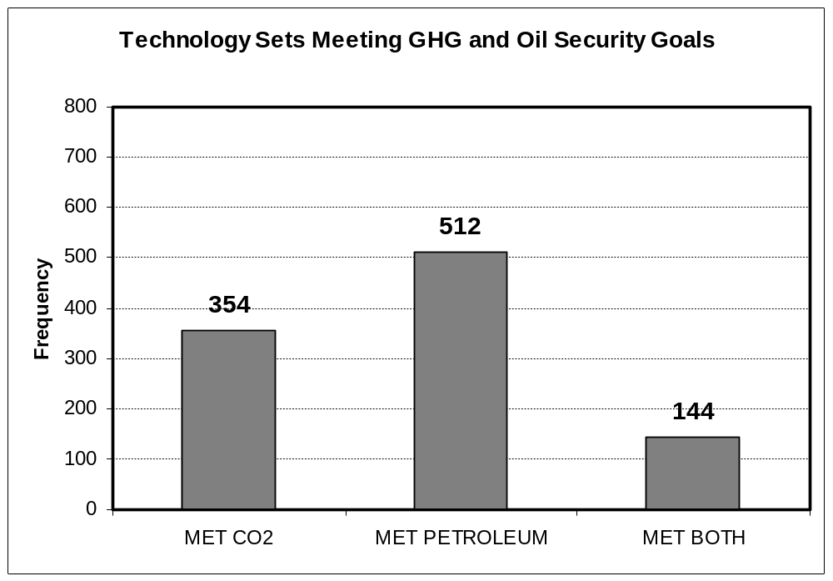
ALL of the eleven technologies are uncertain. If successful, which combinations (out of 2,048) could achieve the energy goals?
7%
Notes:
Since we do not know which technologies will succeed, we enumerate all possible combinations of the 11 and determine which can achieve BOTH goals.

Slide 19
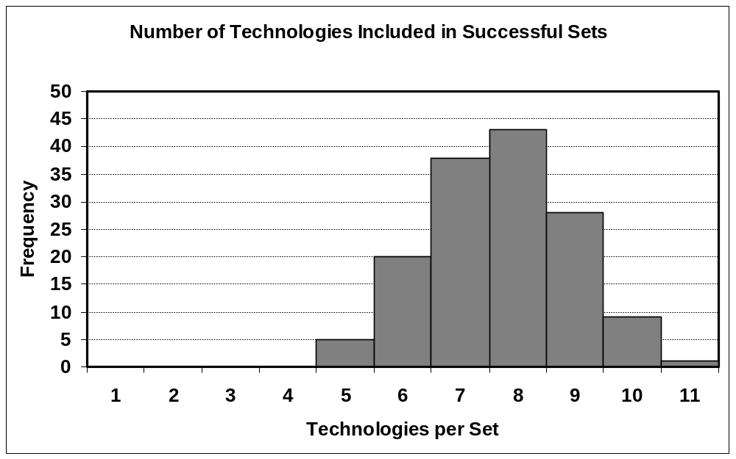
Almost every successful case includes a majority of the technologies.
Notes:
We’ll need most of them to succeed.

Slide 20
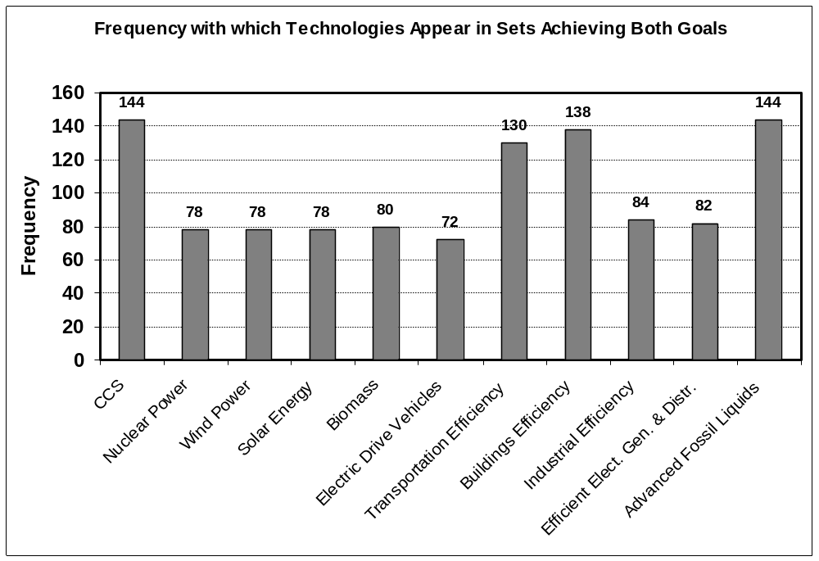
Two technologies, CCS and Advanced Fossil Liquids, appear in every successful set.
Notes:
It does not appear that we can get to a 60% CO2 reduction in the energy sector and an 11 mmbd change in the petroleum balance without both CCS and advanced fossil liquids. Now that should be a surprise.

Slide 21
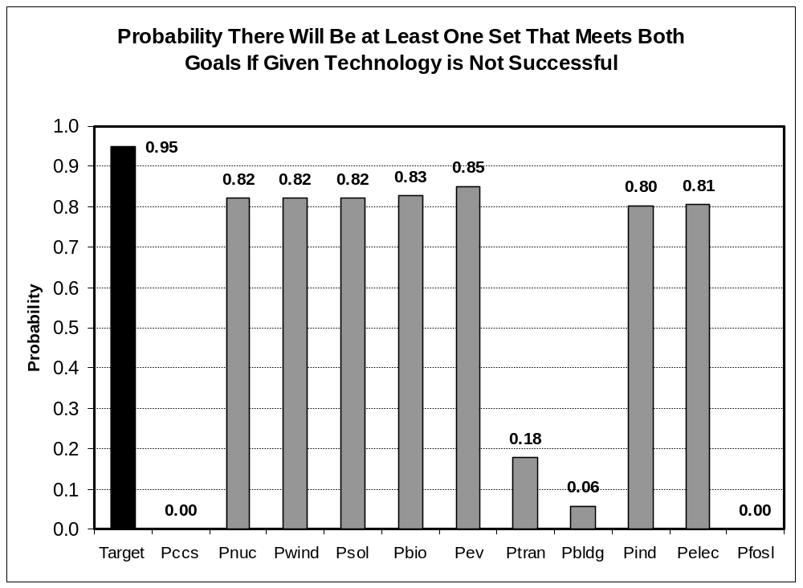
If we want to be 95% sure of meeting both goals we must be 60% certain of successfully developing each technology. How is the 95% certainty affected by the failure of any particular technology?
Notes:
All the technologies are important. CCS and Advanced Fossil Liquids appear to be essential. Transportation and buildings efficiency appear to be very, very important.

Slide 22
What does this imply for a successful energy transition for transportation?
Establish CCS as a proven technology.
Produce more conventional oil environmentally responsibly, especially via Enhanced Oil Recovery, and work hard to prove technologies like in situ shale oil production.
Reduce Energy Intensity of NEW transportation vehicles by 30% to 50% by 2030; across all modes.
Achieve Biofuel goals with the right kinds of truly low carbon biofuels for the right applications.
Research, Develop and Demonstrate advanced Energy Efficient Technologies and Hydrogen FCVs, PHEVs and Battery EVs, and subsidize Market Creation as electric drive technologies mature.

Slide 23
THANK YOU.

