Slide 1

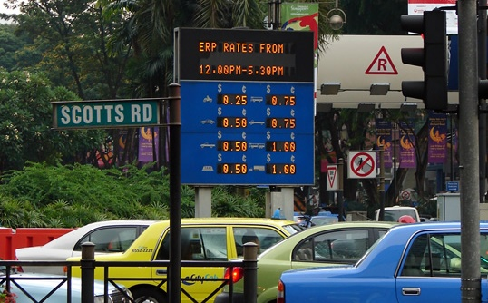

Looking Before You Leap into A Model:
A New Climate for Seeing Transport Energy Futures?
Lee Schipper
Senior Research Engineer
Precourt Energy Efficiency Center, Stanford University
and
Project Scientist, Global Metropolitan Studies, UC Berkeley
EIA 2009 Energy Conference
April 7
Washington DC

Slide 2
Precourt Energy Efficiency Center
Stanford University
A research and analysis institute at Stanford
Established in October 2006
Initial funding: $30 million pledge by Jay Precourt
Mission
  To improve opportunities for and implementation of energy efficient technologies, systems, and practices, with an emphasis on economically attractive deployment
  Focus on the demand side of energy markets
  Energy efficiency: economically efficient reductions in energy use (or energy intensity)

Slide 3
Transport Energy Futures
The Traditional Approach – Less Helpful for Seeing
The ASIF Approach
Data Nightmares
  Our Own US Problems: We can’t count
  What savings from dieselization in Europe
The Blind Side – Transport Futures Trump Oil Futures
  Mexico City CO2 Benefits – Oil and CO2 Savings No One Saw
  Two Wheeler World in Hanoi – Sustainable Transport
  Hyper-motorization in China (and India); Room on the Road?
Conclusions
  Tools and approaches for better views of the future

Slide 4
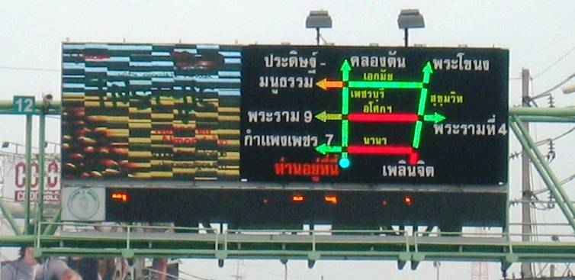
Congestion or Access?
Is Our View of the Future Stuck?

Slide 5
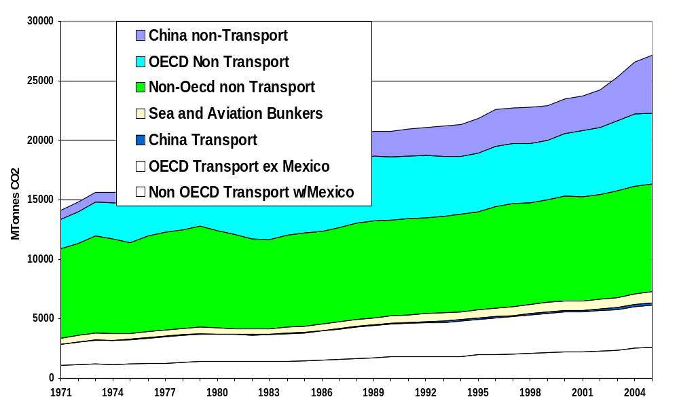
WORLD CARBON EMISSIONS: TRANSPORT
Roughly 35% of Transport Emissions in/around Cities

Slide 6
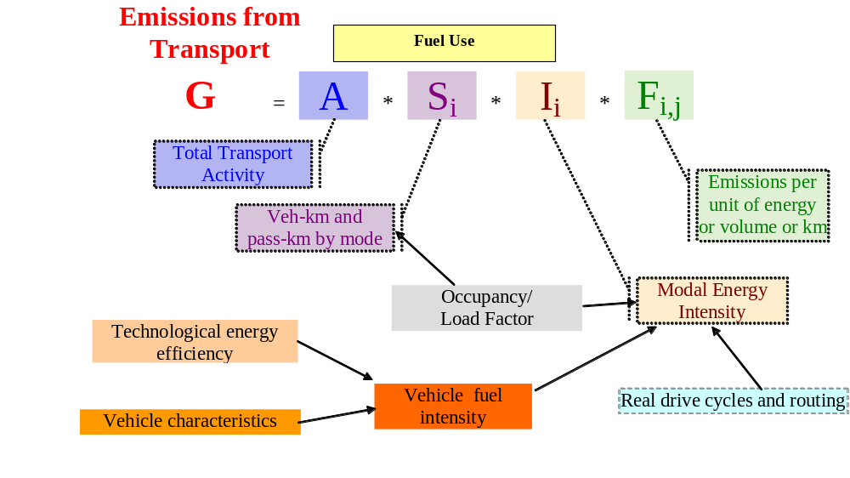
“ASIF” Decomposition: Road Map For Saving
Air pollution, health impacts
Global CO2
Lesson : Attack All Components of Fuel Use and CO2-
How Much Do we Even Know about the DC Metro Area?
Notes:
2

Slide 7
Key Issues in US Road Transport Models
Activity And Fuel Economy Data
Cars and Household Light Trucks – How are Numbers Made Up?
  Nat Household Travel Survey every (X) years – No fuel data
  DOT Table VMT-1 (by state) – how accurate are fuel sales and VMT?
  DOE Household Energy Consumption Survey- VMT but no fuel
Trucking
  Table VM 1 Data on VMT and fuel by truck type – How collected?
  No medium or short haul ton mile data
  VIUS/TIUS Died in 2002 – how will we understand light trucks
Why Is This a Problem?
  No on-road fuel economy data when they are subject of public policy
  Difficulties measuring short and long term changes in VMT
  Rising interest in VMT Tax as part of way to pay for roads
It Could Be Worse: No VMT, Fuel Economy, or
Consistent “Active Vehicle” Fleet Data for LDCs!
Notes:
3

Slide 8
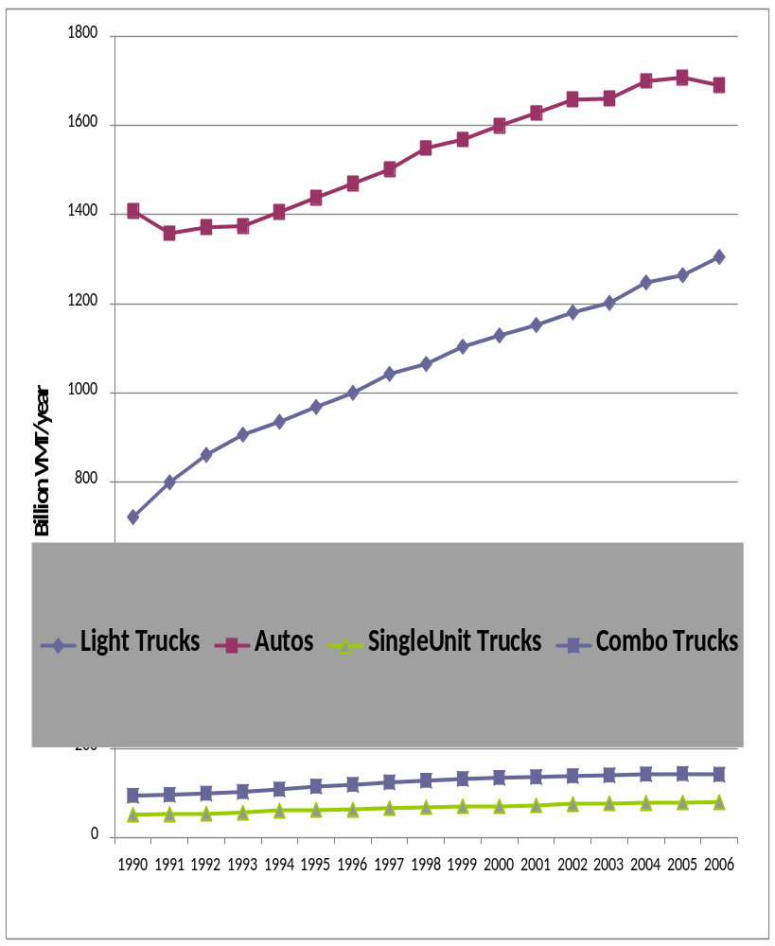
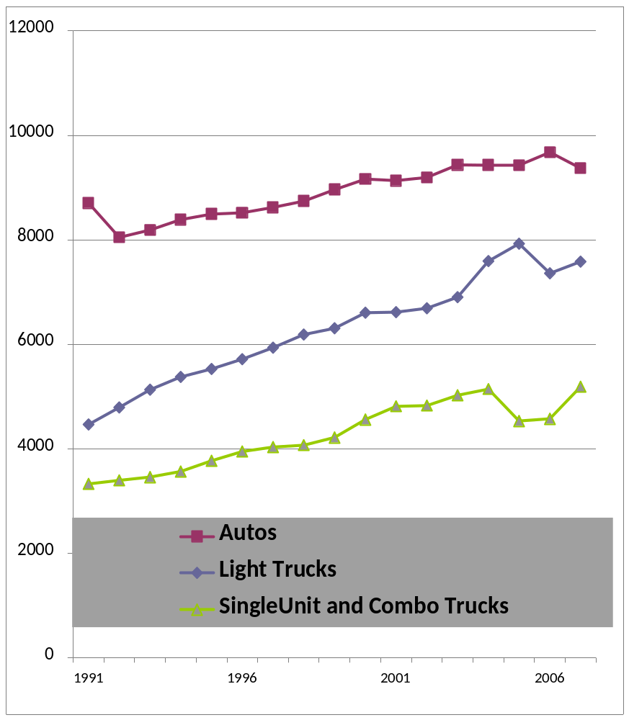
Where Did the Fuel Go?
Our Own VMT and Fuel Accounts Don’t Match

Slide 9
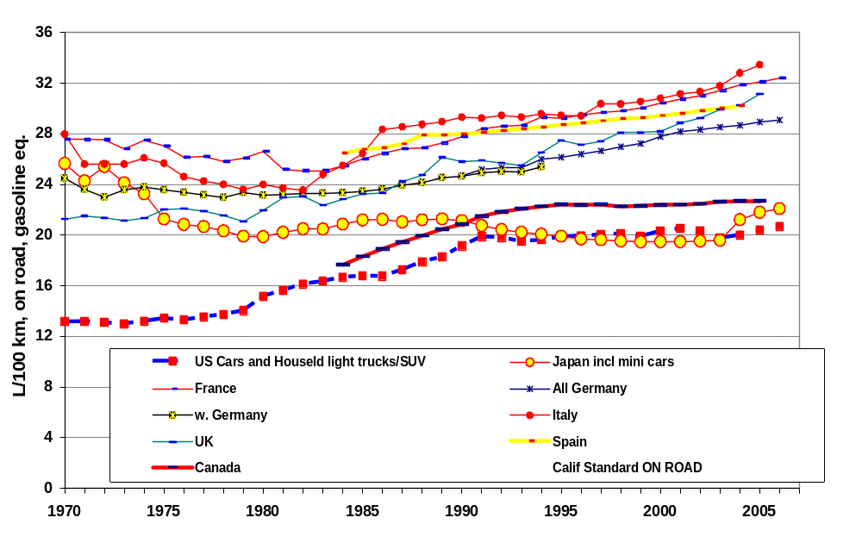
Where Is the US in On-Road Fuel Economy?
Hard To Tell What the Trend Is!

Slide 10

Saving Emissions From Transport –
It Rarely Comes Down to Just Technology
Traditional Technology – 40-60 MPG or 2.5-4 l/100km?
  Less power, lighter materials, lower drag, CVT, cold cylinders
  Gasoline or clean diesel hybrids
  End to the power and weight chase?
Other Approaches - Cost, Time to Deploy
  City cars vs. long distance cars?
  Plug in hybrids – most driving is for local, short trips
  Fuel cells? Many cost, feedstock, materials challenges
Alternative or Bio-Fuels – What are They Worth?
  US Corn ethanol a dead end, other biofuels increasingly uncertain
  True low carbon fuels not here, won’t arrive under present policies
  Non-oil always possible, but always expensive and higher CO2
  Do We Know How these Technologies will Perform?
  Do We Know How To Put These Technologies into Models?

Slide 11
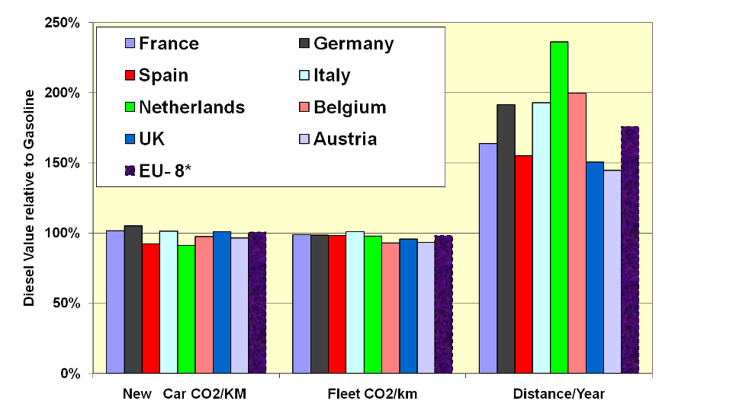
Dieselization in Europe: Where are the Savings?
Relative to Gasoline, Diesel Shows Little Energy or CO2 Savings Moreover, Driving Distances Larger
(Schipper and Fulton TRB 2009)
Source:` official national data
Notes:
2

Slide 12
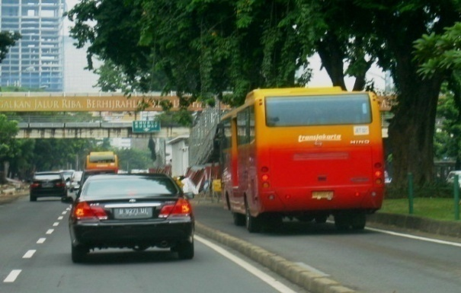
Opportunities in Other Modes
Overlooking the System Effects?
BRT – High Speed, Low Emissions
  Articulated buses running in dedicated BRT lines
  Parallel hybrid drive trains using diesel propulsion
  Fill them up!
Trucking – Important Globally
  Improve freight logistics, reduce empty running
  Promote inter-modalism
  Improving efficiency of trucks
Rail?
  Building or strengthening freight networks - uncertain
  Consider low-cost, medium speed intercity rail (tilt trains)
  Improve intermodal access around rail facilities to boost usage
  Opportunities Are Great, but mostly from
  Transport System Improvements, not Technology

Slide 13
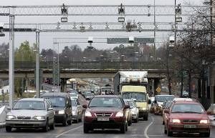
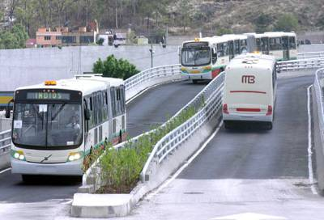
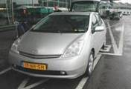
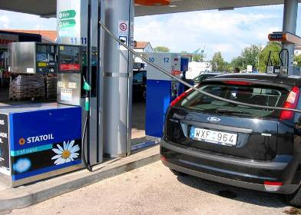
All Modes of Transport Will Evolve:
How Many Of These Components are in Models?
Notes:
Hybrid bus……. TMilenio

Slide 14
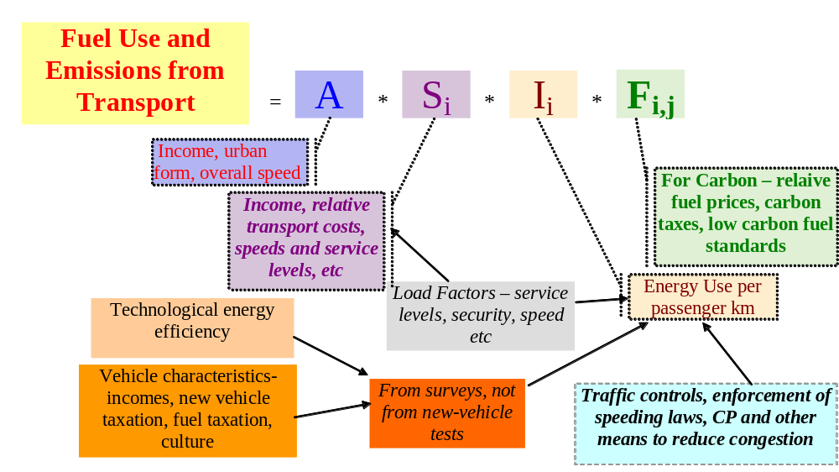
Changes in Transport Fuel and Emissions:
Improving Fuel Economy Not Enough
What Shapes Each Component?
Most Components Related to Transport Policy, NOT Oil or CO2
Notes:
2

Slide 15
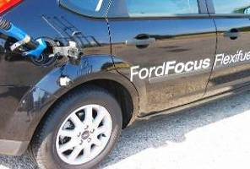
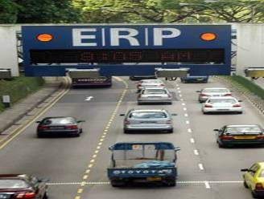
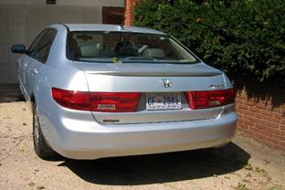
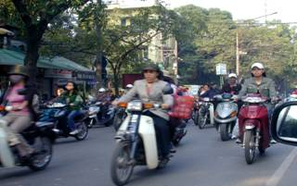
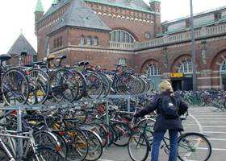
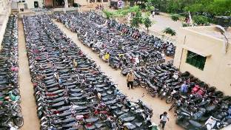
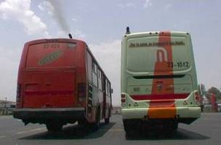
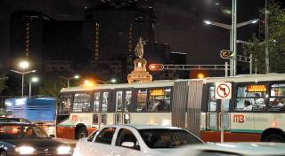
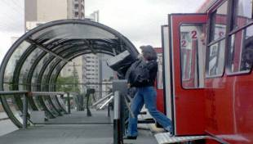
Best Practices for Sustainable Transport:
Little Money, but Pricing and Political Will
Real Biofuels in Sweden
Congestion Pricing Singapore
Honda Accord Hybrid
Two-Wheelers in Hanoi??
Bikes in Copenhagen
Bikes at Bangalore Bus Sta.
Mexico City Clean Bus
Bus Platform Curitiba
Mexico City Metrobus

Slide 16
Urban Mobility Patterns
The Mobility Ladder
Passenger-Km/year
16000
Car
Two Wheeler
12000
Metro, Urban Rail
City Bus
Mini Bus, Taxi
Walking, Bike
8000
China
4000
0
LOW
MIDDLE
HIGHER MIDDLE
IEA EUROPE
USCANANZ

Slide 17
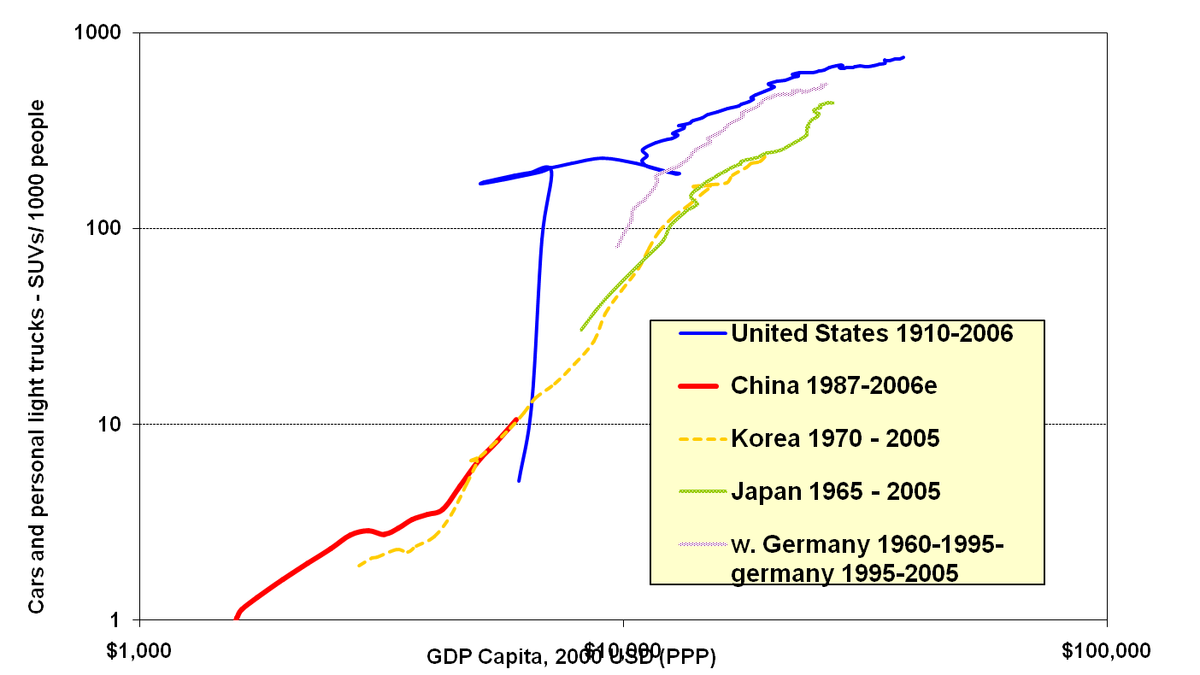
Motorization and Economic Growth:
The China Syndrome?
Source: EMBARQ
Key Question: Is this path of motorization good? Inevitable or avoidable?

Slide 18
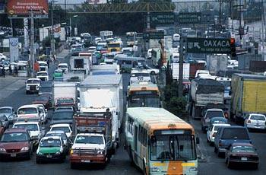
Creating Comfort from Chaos in Mexico City
From South to North?

Slide 19
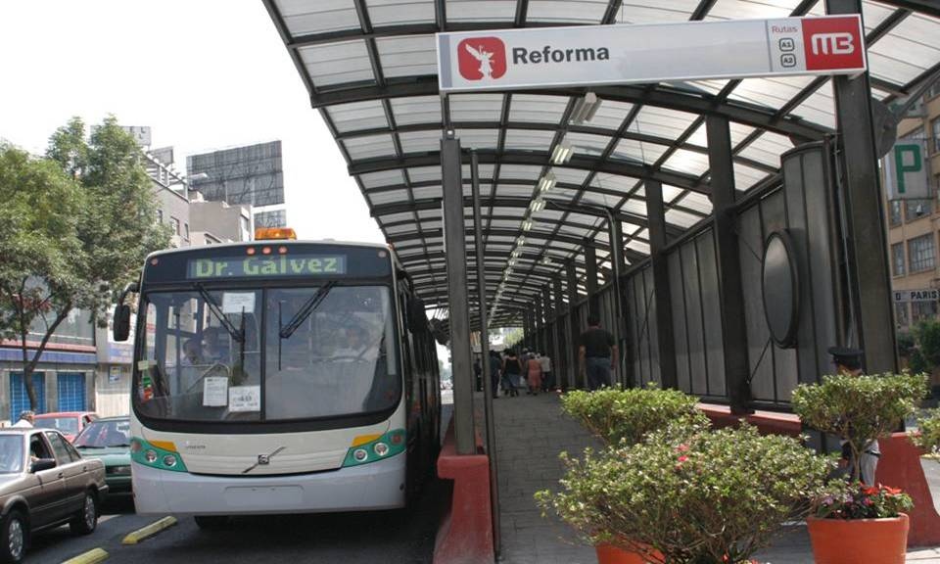
Bus Rapid Transit – Mexico’s 1st Metrobus Line
260,000 people/day over 19km for US $80mn
Lower emissions and CO2, reduced car traffic

Slide 20
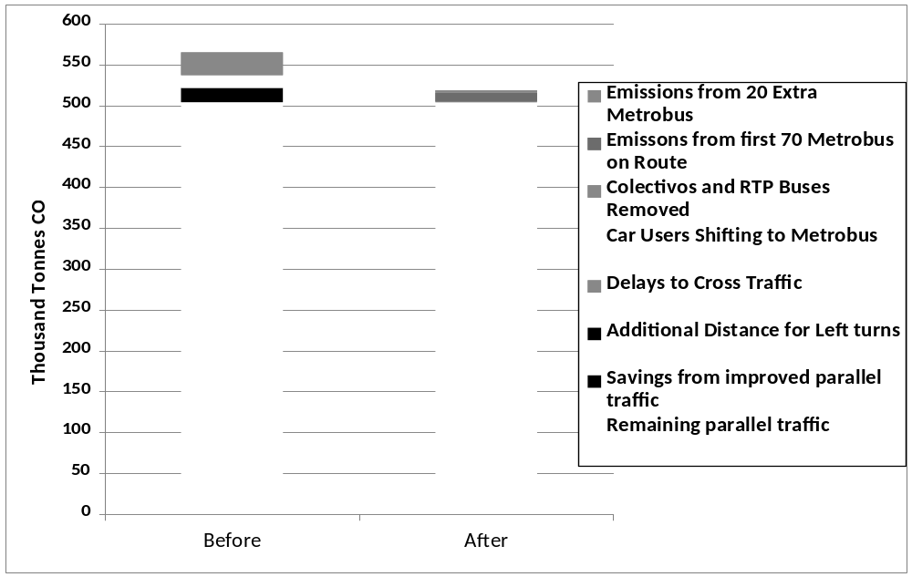
Metrobus CO2 Changes by Component
Source Rogers 2006, 2009

Slide 21
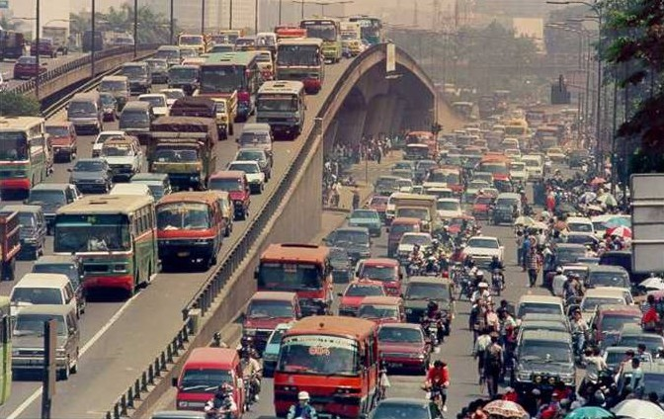
Mal-Asia?
Jakarta and Dozens of other Asian Cities

Slide 22
Scenarios for Hanoi-
JICA and EMBARQ
Year | 1995 | 2005 | 2020
Transport policy (JICA) | History | Present | Let trends continue |  |  | High Mass Transit
Transport system (JICA) | History | Present | Trends |  |  | BRT, Tram, etc.
Public transport share | 1% | 6% | 14.5% |  |  | 30%
Environment Emissions policy (EMBARQ) | History | Present | Do nothing |  | Medium | Do nothing | Medium | Ambitious
Emissions CoefficientCases EMBARQ | 1995 | 2005 | 2020-I 1.35 x today |  | 2020-I1 1.35 x Euro2 | 2020-IV Euro 2 | 2020-V Euro 3 | 2020-VI Euro 4

Slide 23
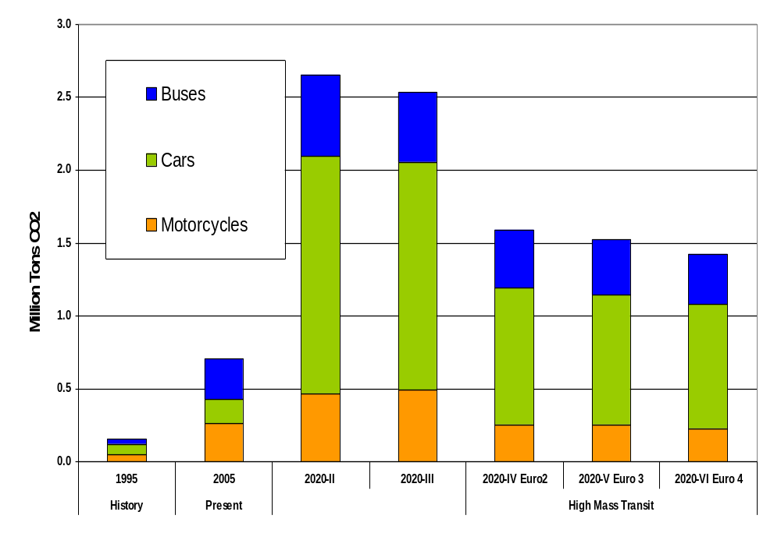
Resulting CO2 Emissions
Fuel Economy CO2 Differences
Transport Policy
Differences
Fuel Economy CO2 Differences

Slide 24
Introduction: Basic Thesis About (Hyper)-Motorization in China
Speed of Motorization leaving officials, walkers behind
  Incomprehensible growth rate in car ownership
  Very poor data on use, fuel consumption, etc
  Even word “car” in Chinese poorly understood
Little Policy Competency to Slow or Control
  Glory of modern motorization trumping other concerns
  Whole city sections rapidly transformed into asphalt
  Over-reliance on “technology” – human beings not in picture
“Unintended” (or unknown?) Consequences
  Burgeoning road fatalities (over half walkers, cyclists)
  Air Pollution from vehicles rapidly replacing that from coal
  Congestion now major threat to productivity, well being

Slide 25
EMBARQ’s Scenarios for China
  Base Case – China has Korean car/GDP
  ratio in 2020
      120-160 million cars, 12,000 km/car
      8-8.5 L/100 km if no new measures
      Closer to 2 mn bbl/day oil in 2020
  Oil Saving Scenario – 40% as much oil, some CNG
      Japanese/Euro level of fuel prices
      110-130 million cars, but less driving/car
      Fuel economy standards, some hybrids and CNG
  Integrated Transport - Livable cities with
  good transport
      Much lower car ownership and use– avoiding the plague
      Very small cars (incl. slow electrics, hybrids)
      to avoid space and congestion problems in cities
      Serious BRT, car-use restraint, land-use planning

Slide 26
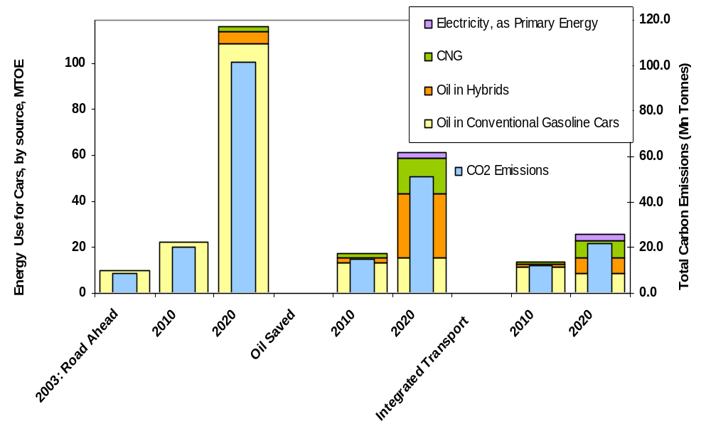
Sustainable Transport for China:
Cars and CO₂ Emissions in 2020
Sustainable Urban Mobility Saves Cities, Fuel, and
Greenhouse Gas Emissions
Notes:
2

Slide 27
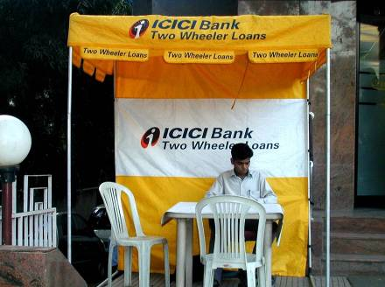
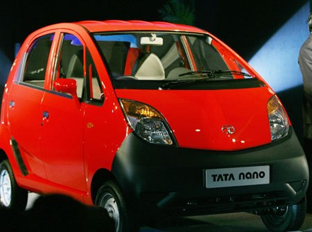
Cheap Two Wheelers,
but No Sidewalks
And Now The Peoples’ Car

Slide 28

Scenarios and Assumptions for India
(Transport Research, forthcoming)
Business as Usual (BAU)
  Unconstrained development of road traffic and vehicle demand
  Infrastructure is assumed to not be a constraint
Energy Efficiency
  Higher fuel efficiency
Clean Two and Three wheelers
  Cleaner fuels and two and three-wheelers
  Increases in two and three wheeler modal shares
  Reduction in all other types of private transport modes
Sustainable Cities/Urban Transport (SUT)
  Demand management and modern mass transit
  Regulation of private car use reflected by
  reduction in modal share
  Widespread implementation of BRT systems
Extra Effort -- All of the above

Slide 29
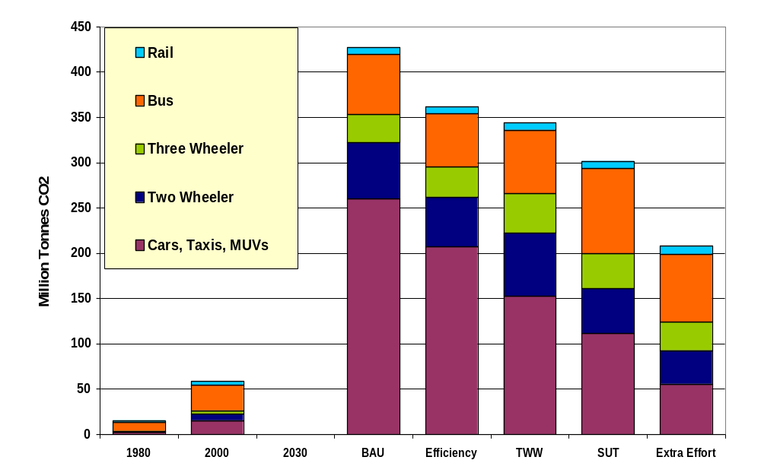
India: CO₂ Emissions by Transport Mode

Slide 30
Lesson: Transport a Powerful Force
Focusing on Fuel Misses Real Changes
Cities, Transport and Land Use Changing
  500 million more people expected in Asian cities by 2030
  American model of sprawl being tried, but not working well
  Real space constraints more important than fuel prices?
Private Motorization- Trends Continued?
  Hanoi model (two wheelers), Nano, Hummer or? Depends on Policy
  Future of freight levels, systems also very uncertain
  Present models too influenced by American experience
Where Energy/Fuel Enters the Picture
  Fuel prices important to fuel efficiency, vehicle use
  Fuel economy standards an unknown but rising influence
  Fuel choices can be important if true, large scale bio-fuel emerges

Slide 31
Conclusions: Reframing the Transport-Energy Future Challenge is About Sustainable Transport
A New Framing of the Issue
  Oil and carbon externalities less than clean air, congestion, safety
  Developing countries now in serious mobility trouble – oil 2nd problem
  CO2 is not a transport problem, but transport causes CO2 problems
How to View CO2 and Energy Saving
  Avoiding carbon intensive transport – a development issue
  Developing good transport w CO2 co-benefits – not today’s mess
  Then and only then estimate of reduced fuel or CO2/veh kilometer
Tools and Data
  Reasonable vehicle stock, use, pass- and tonne-km data (not easy)
  Models of urban/rural, demographic, and income evolution
  New approach to estimating “CO2 and Energy Saving”

Slide 32
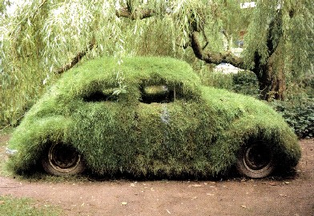
Thank You
Lee Schipper – mrmeter@stanford.edu
Car that absorbs its own carbon and needs no oil?
http://piee.stanford.edu
In Future:
http://peec.stanford.edu

