Slide 1
Meeting the World’s Demand for
Liquid Fuels
A Roundtable Discussion
A New Climate For Energy
EIA 2009 Energy Conference
April 7, 2009
Washington, DC

Slide 2
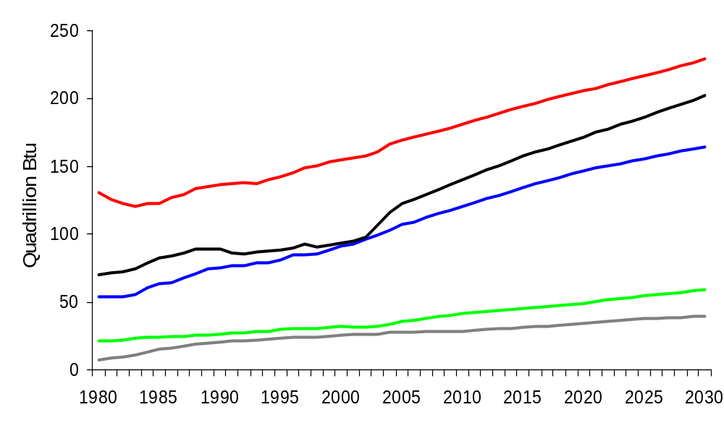
World Marketed Energy Use by Fuel Type
History
Projections
33%
29%
36%
Liquids
24%
27%
Natural Gas
Coal
23%
Renewables
8%
8%
6%
Nuclear
6%
Source: EIA, IEO2008

Slide 3
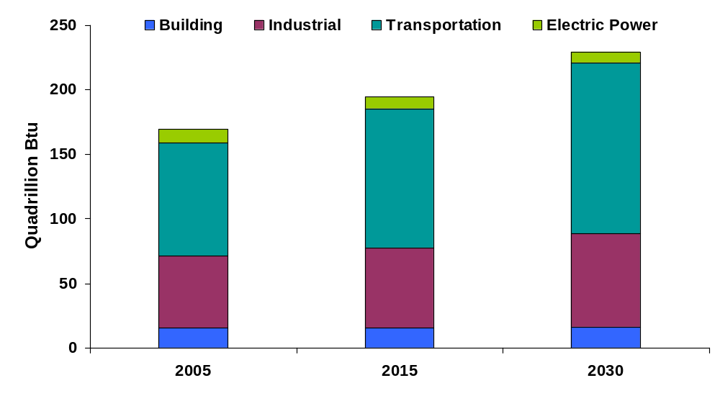
World Liquids Consumption by End-Use Sector, 2005, 2015, and 2030
Source: EIA, IEO2008

Slide 4
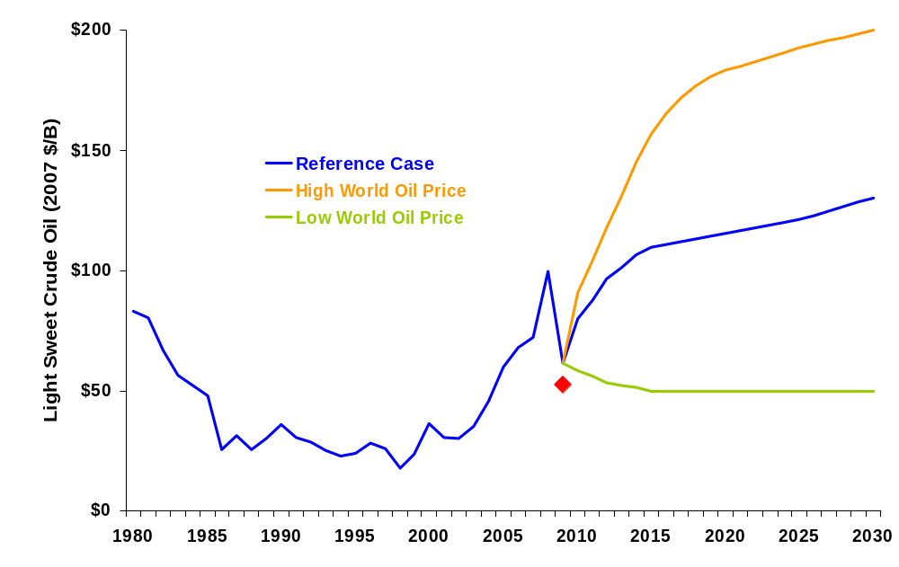
World Oil Prices in Three Price Cases,
AEO2009 – Real Prices
$200
$130
$50
Closing price on April 3, 2009
History
Projections
Source: EIA, AEO2009, NYMEX
Notes:
A key input to our projections is the world oil price trend.
Since 2000, world oil prices have been higher than what was experienced during the 1990s.
The world oil price path in the AEO2009 reference case is much higher than that in AEO2008. Real world crude oil prices are projected to sharply decline from their historic highs in 2008, but this is short-lived and after 2009 prices continue to rise quickly as the world recovers from the current economic downturn and growth returns to potential.
Prices rise from a low of $64 per barrel in 2009 to $189 per barrel ($131 per barrel in real, inflation-adjusted 2007 U.S. dollars).
World crude oil prices are expressed in terms of the average price of light, sweet crude oil at Cushing, Oklahoma (NYMEX contract specs).
The reference case is only one of many cases considered in the AEO2009. Energy market projections are subject to considerable uncertainty. Price projections are particularly uncertain, because small shifts in either supply or demand, which are both relatively insensitive to price changes, can necessitate large price movements to restore balance between supply and demand.

Slide 5
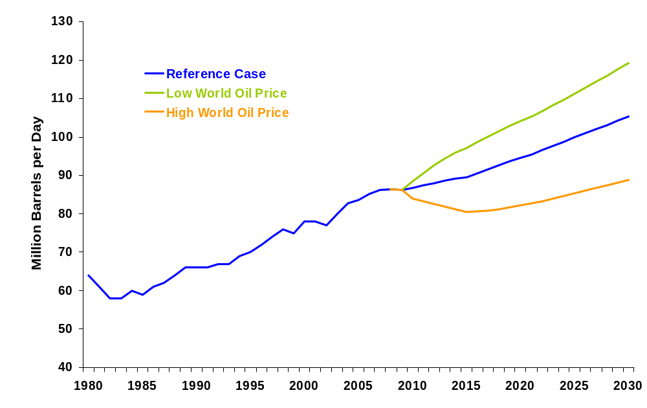
World Liquids Consumption in Three Price Cases,
AEO2009
2008
119
105
89
86
History
Projections
Source: EIA, AEO2009

Slide 6
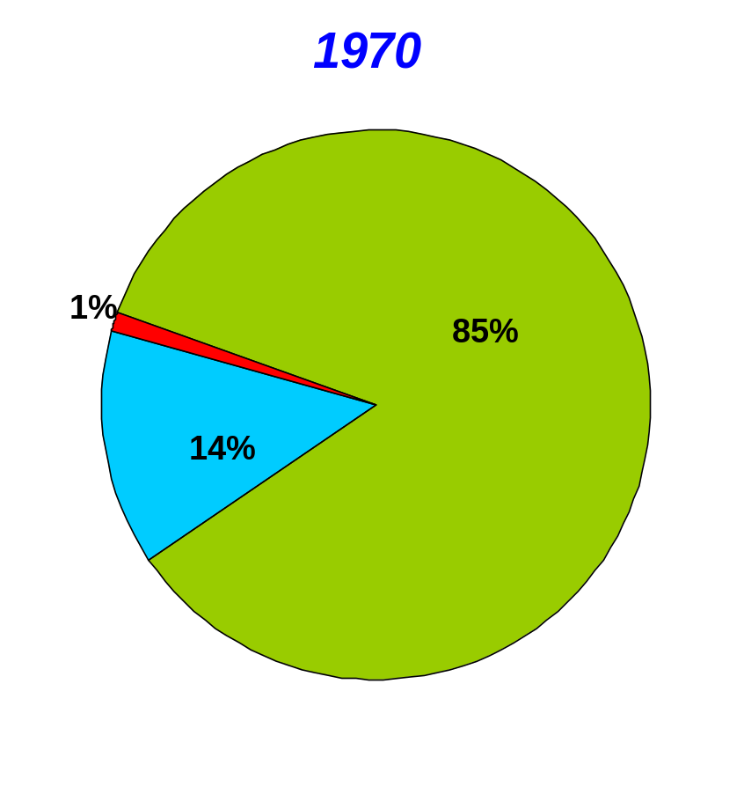
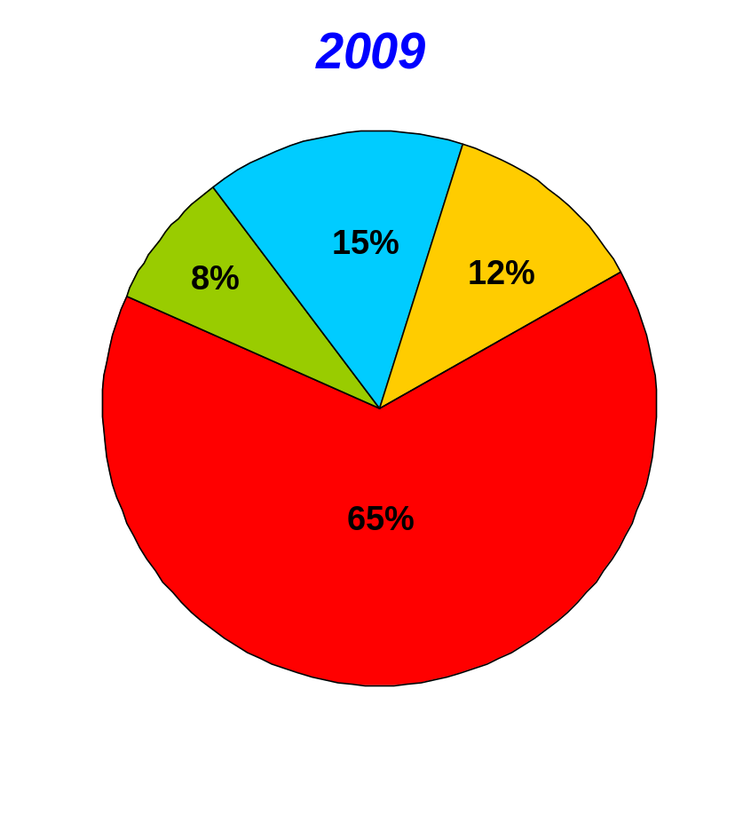
NOCs Increasing Control over the World’s
Oil and Gas Reserves
Reserves Held by Russian Companies
NOC Reserves
NOC Reserves
(Equity Access)
(Limited Equity Access)
Full IOC Access
SOVIET
Reserves
Full IOC Access
NOC Reserves
(Limited Equity Access)
Source: PFC Energy, Oil & Gas Journal, BP Statistical Review
Notes:
What case is “chosen” and whether or not it is satisfied will depend on who is producing, where they are producing from, and what type of liquids they are producing.

Slide 7
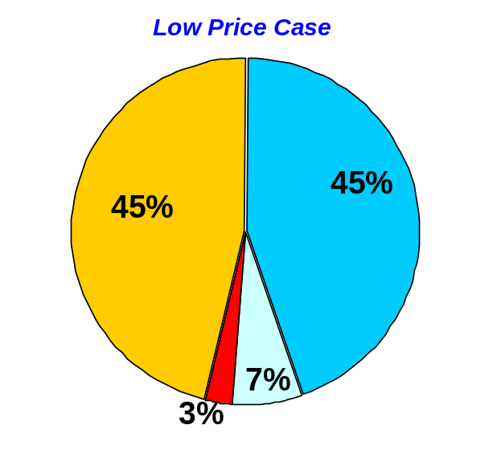
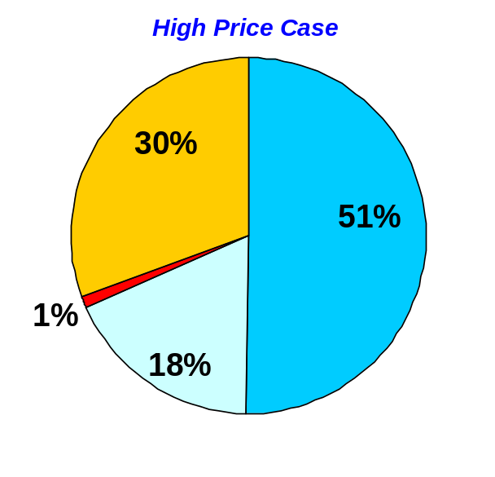
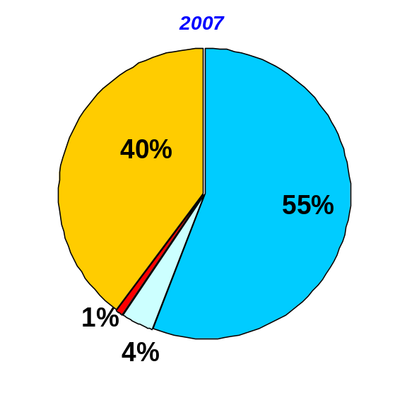
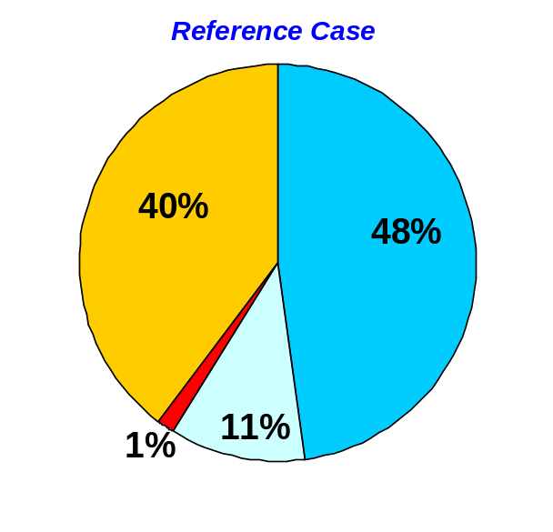
Liquids Supply in 2030
Non-OPEC Conventional
Non-OPEC Unconventional
OPEC Unconventional
OPEC Conventional
Source: EIA, AEO2009
Notes:
What case is “chosen” and whether or not it is satisfied will depend on who is producing, where they are producing from, and what type of liquids they are producing.

Slide 8
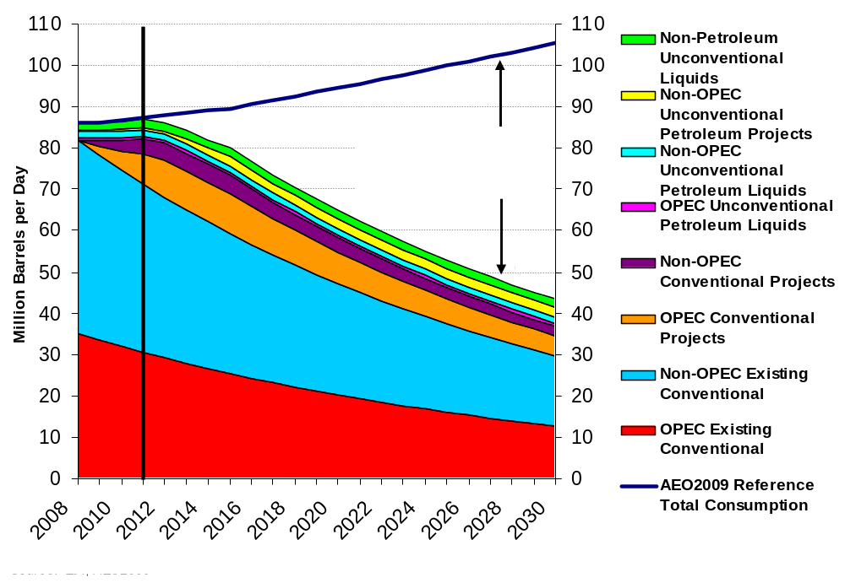
World’s Liquid Fuels Supply
Source: EIA, AEO2009

Slide 9
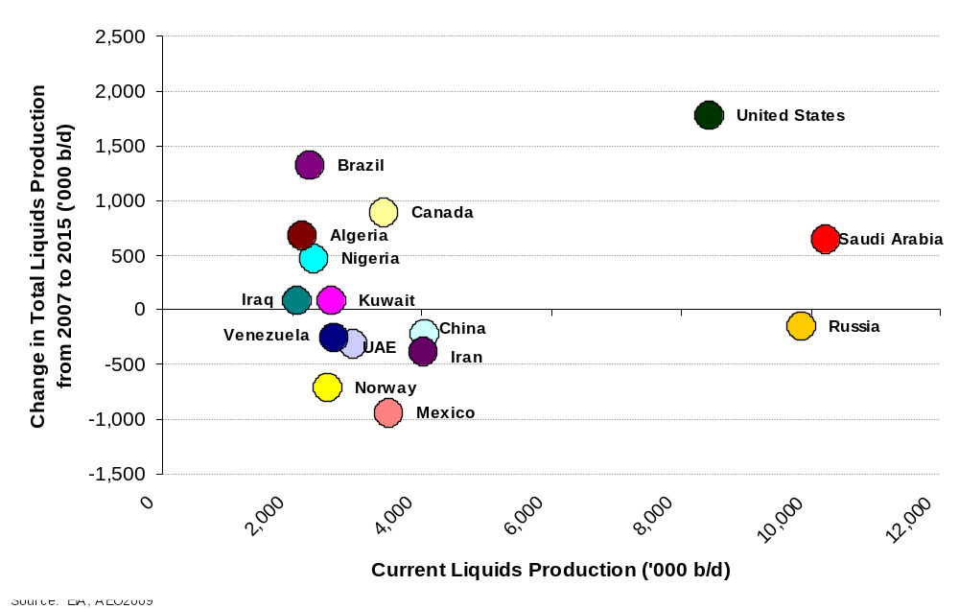
Top 15 Liquids Producers and Their Prospects
Source: EIA, AEO2009

Slide 10
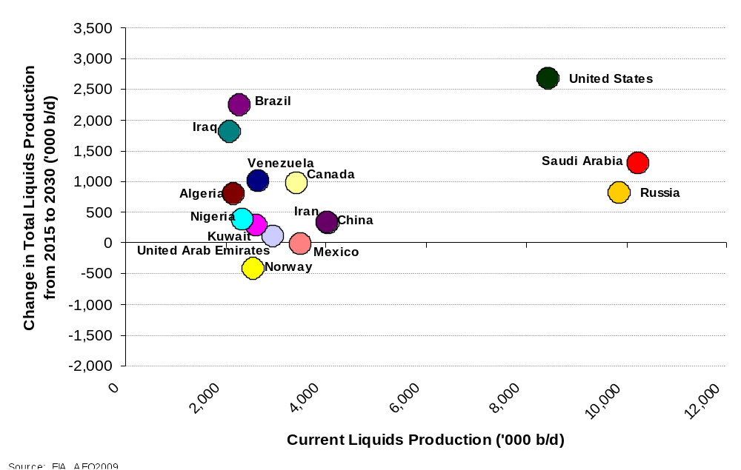
Top 15 Liquids Producers and Their Prospects
Source: EIA, AEO2009

Slide 11
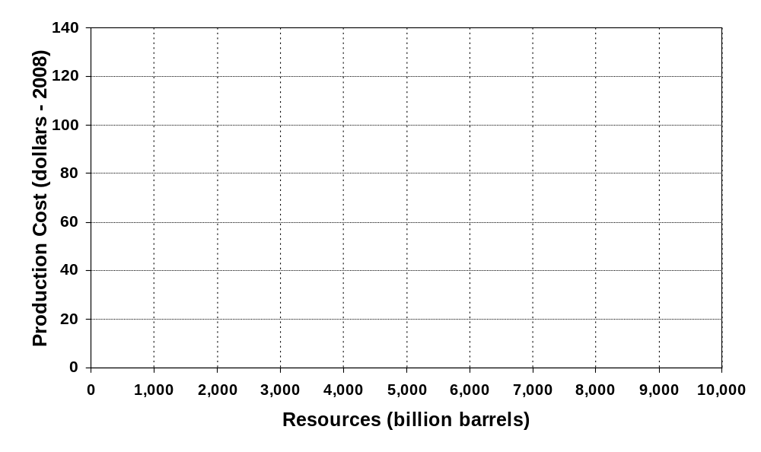
Costs of Production by Resource
Deepwater and ultra deepwater
Coal
to liquids
Oil
shales
Gas
to liquids
Arctic
CO2 - EOR
EOR
Heavy oil and bitumen
Other
Conventional
Oil
Produced
MENA
Source: International Energy Agency, IEA

Slide 12
Additional Slides
Country Sheets

Slide 13
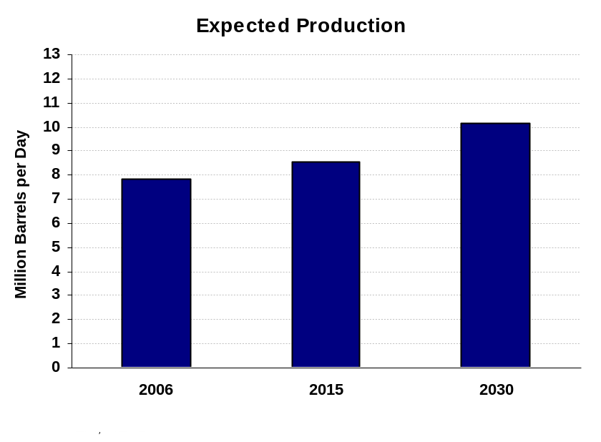
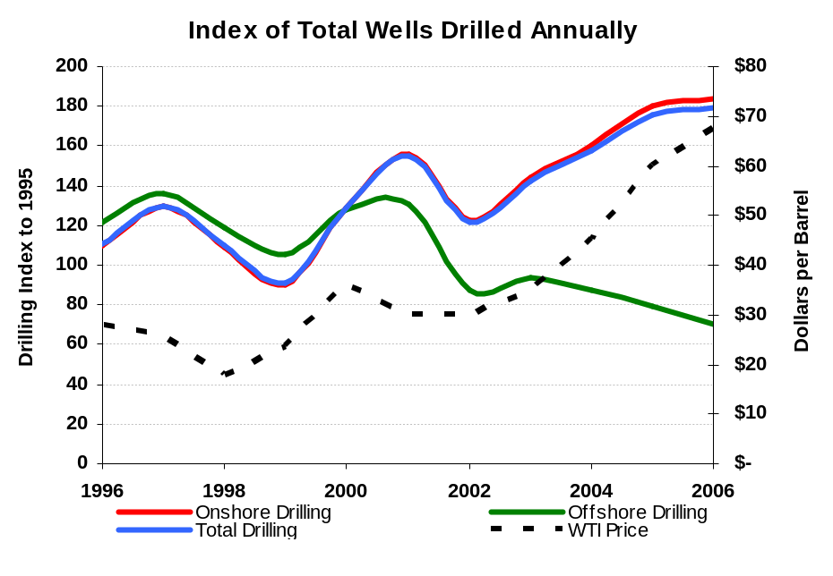
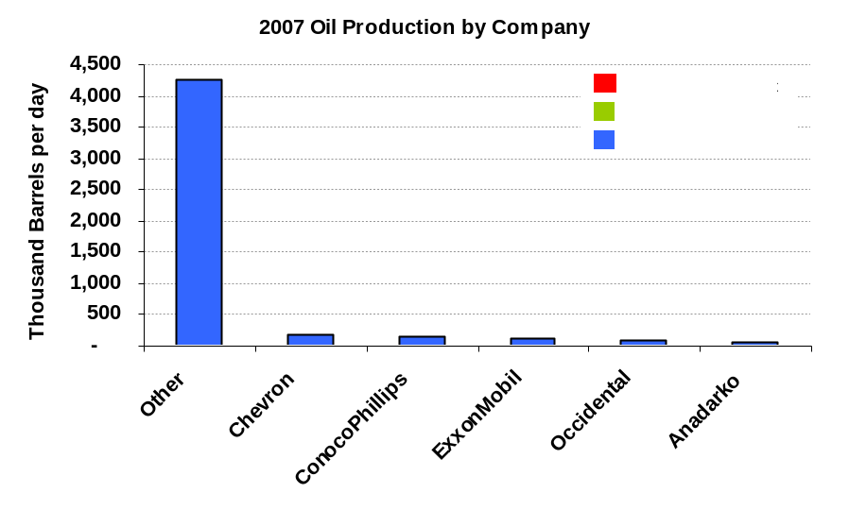
United States
Downside Risks & Upside Potential
Onshore fields might not be as responsive to EOR as currently expected
Independent E&P companies may not have access to capital in the near-term
Legislation could open to development more currently restricted areas
Legislation on climate change could provide additional incentives to use CO₂ for EOR

Slide 14
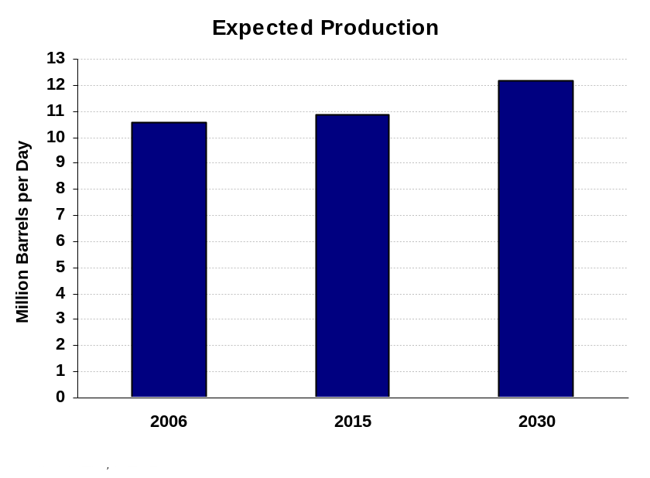
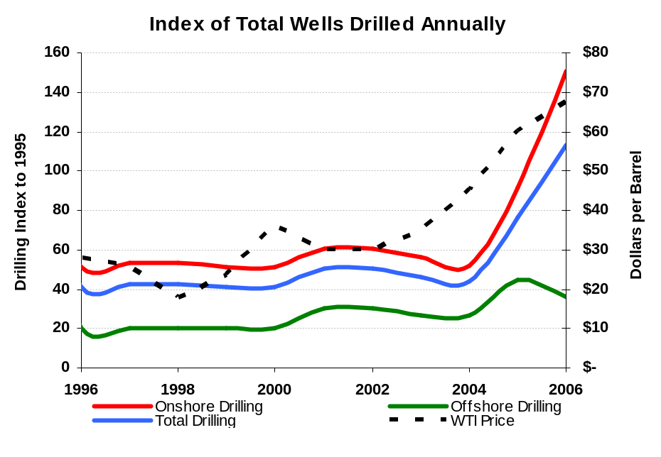
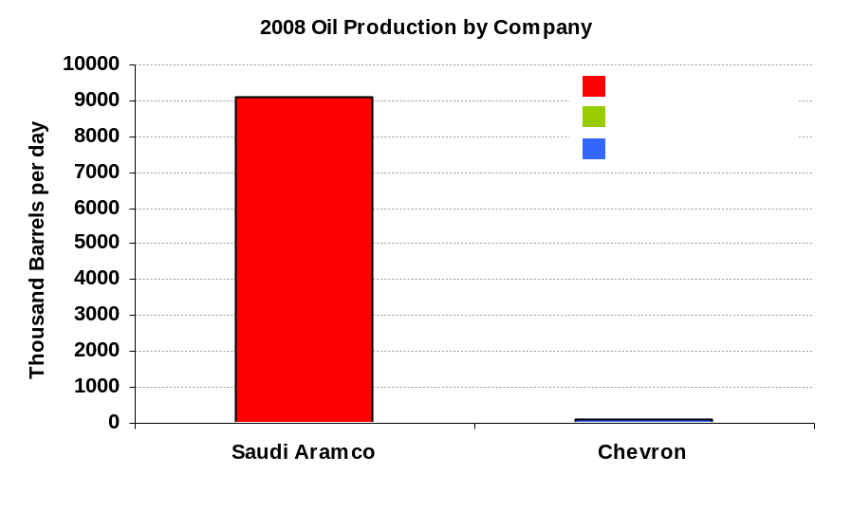
Saudi Arabia
Downside Risks & Upside Potential
Production could be cut to support world oil prices
Kingdom could abandon commitment to spare capacity and high production levels
Field decline rates could accelerate
Production could be expanded to discourage alternatives

Slide 15
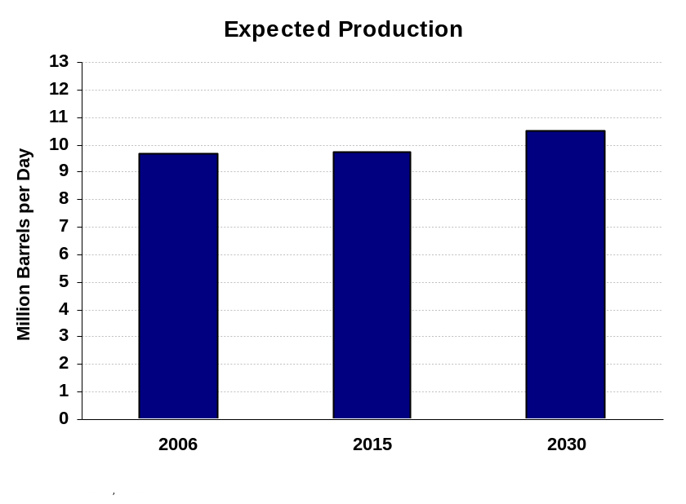
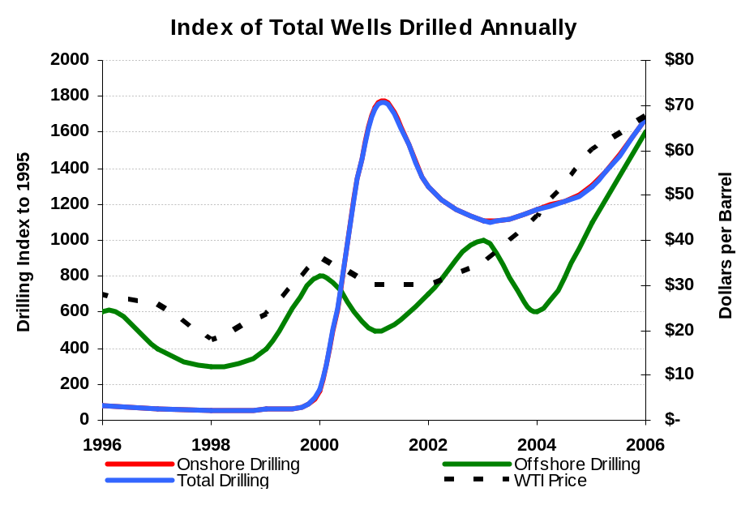
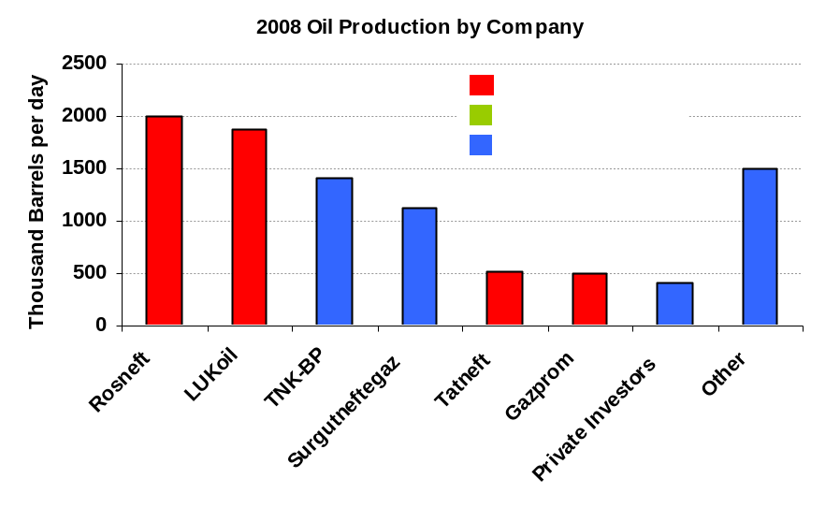
Russia
Downside Risks & Upside Potential
High levels of taxation could remain in place
Exploration in eastern Siberia and offshore could fall due to concerns about nationalization
Levels of investment could remain low.
Future changes in taxation policies could have large impact and encourage investment
Small firms could rebound faster than expected from financial crisis

Slide 16
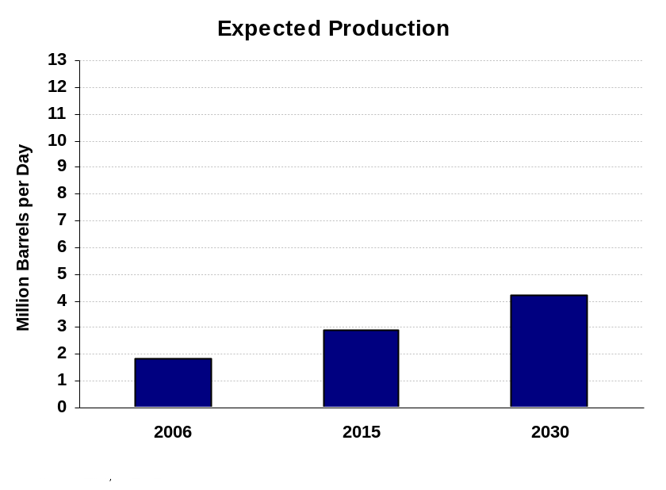
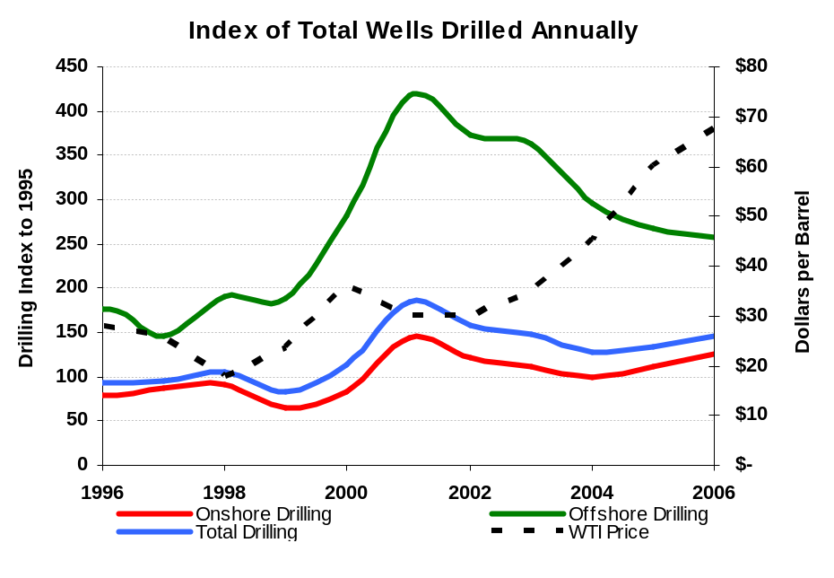
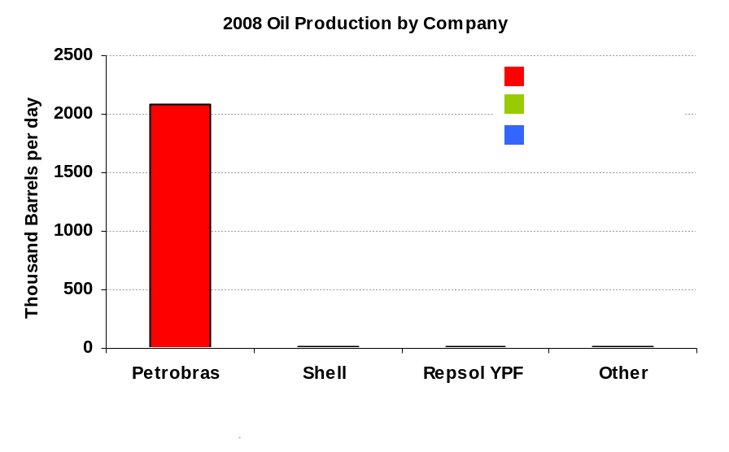
Brazil
Downside Risks & Upside Potential
Changes to licensing and bid round structure could be severe enough to discourage some foreign investors
Subsalt potential could be less than expected
Unexpected technical difficulties could slow production of subsalt resources
Changes to licensing and bid round structure could work to facilitate investment and joint development
Subsalt potential could be much larger than expected

Slide 17
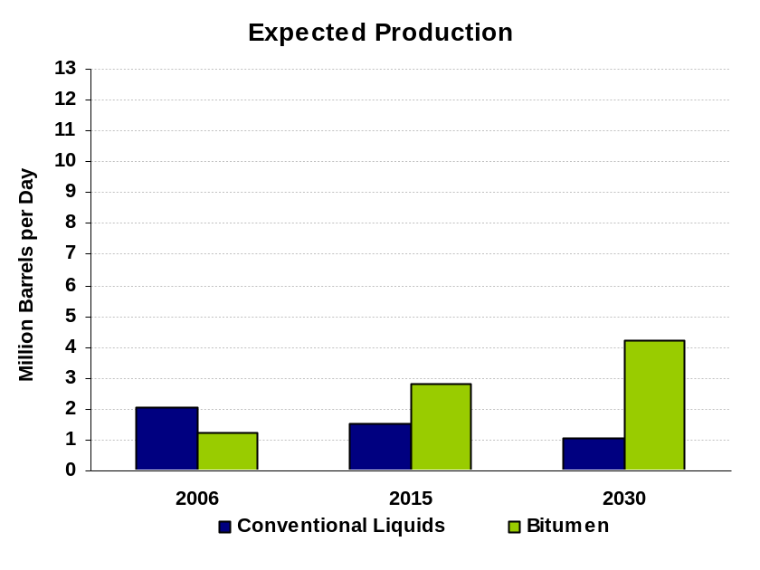
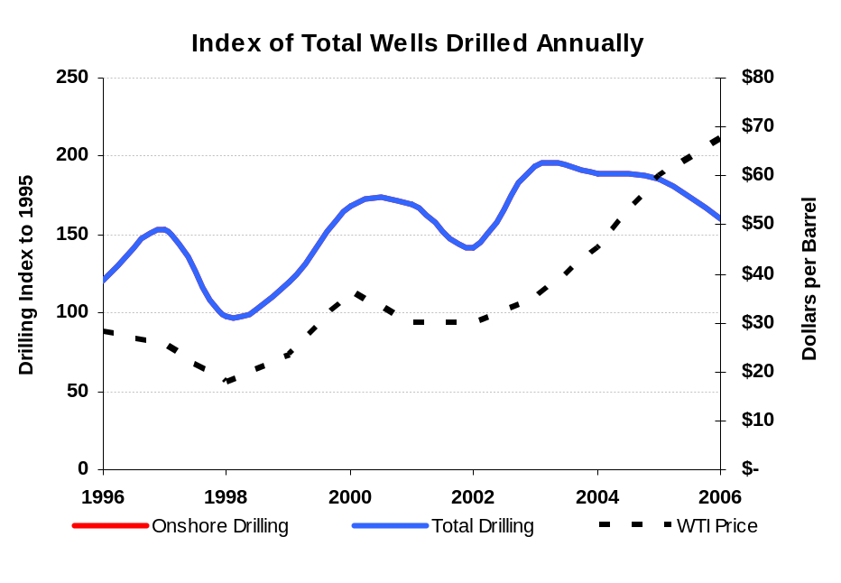
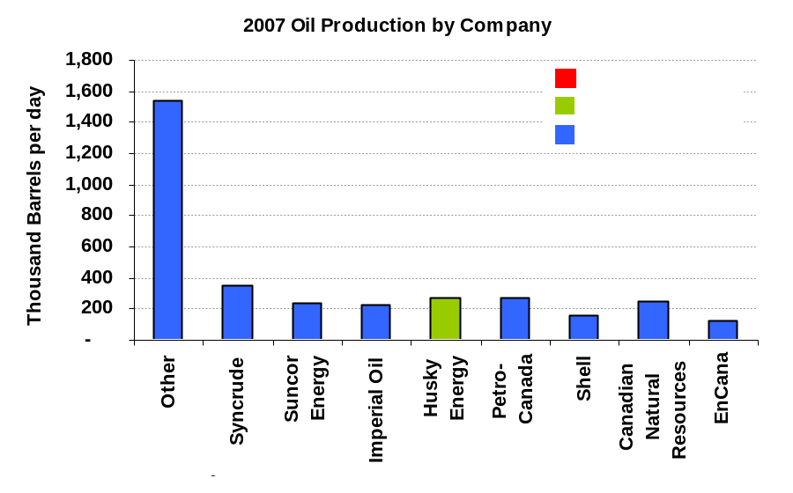
Canada
Downside Risks & Upside Potential
Current conventional decline rates could accelerate
Environmental legislation (in Canada or the U.S.) could limit bitumen production
Decline rates at conventional fields might be slowed
Bitumen extraction technology could continue to improve

Slide 18
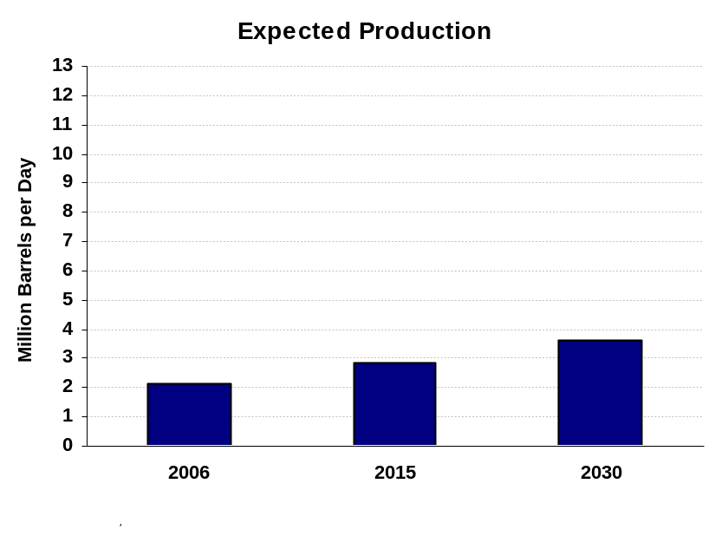
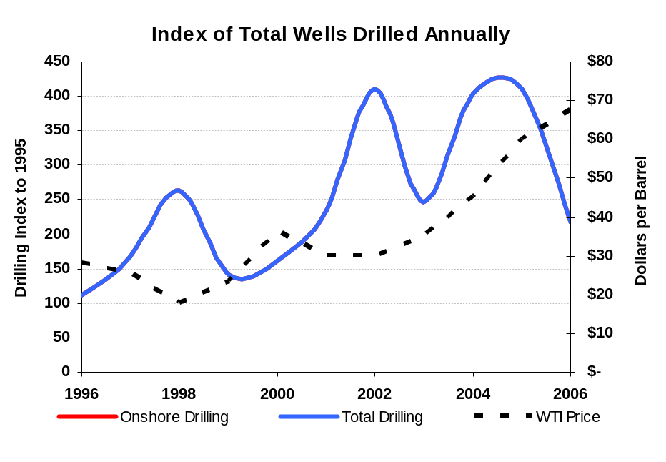
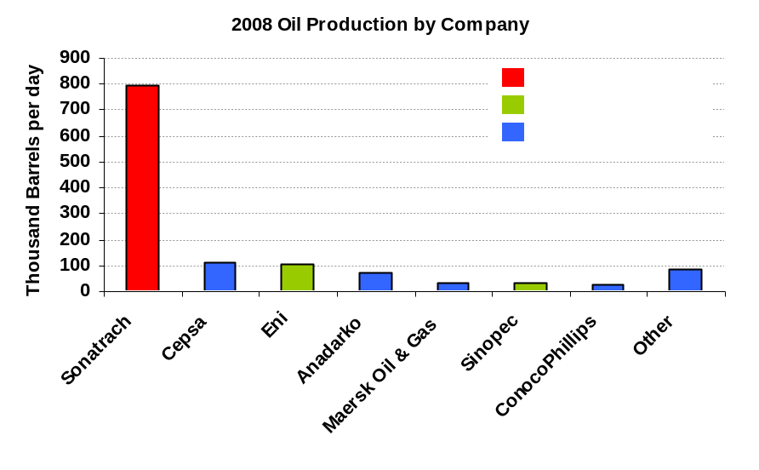
Algeria
Downside Risks & Upside Potential
Government could further discourage foreign investment, as it did with the 2006 Hydrocarbon Law
Sonatrach’s ability to invest in production maintenance and expansion could be hindered due to competing government expenditure needs
Government could reverse nationalization tendencies expressed in the 2006 Hydrocarbon Law

Slide 19
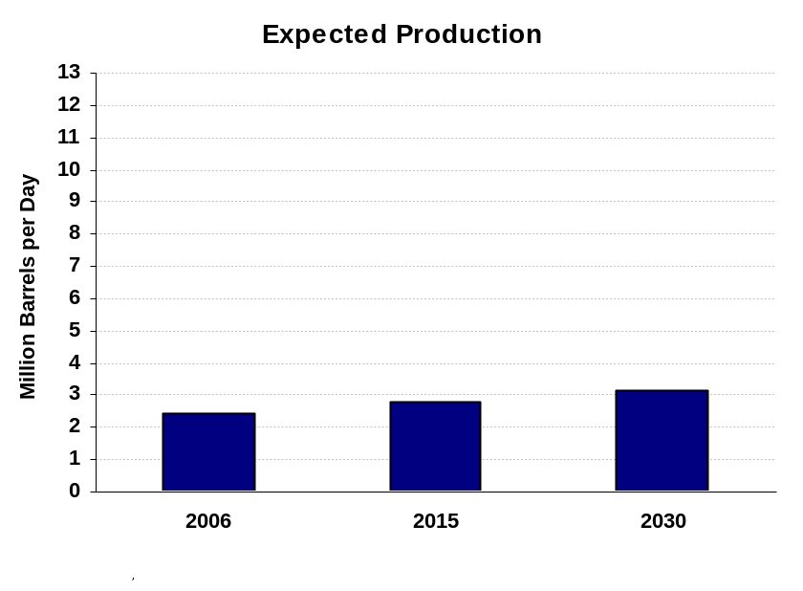
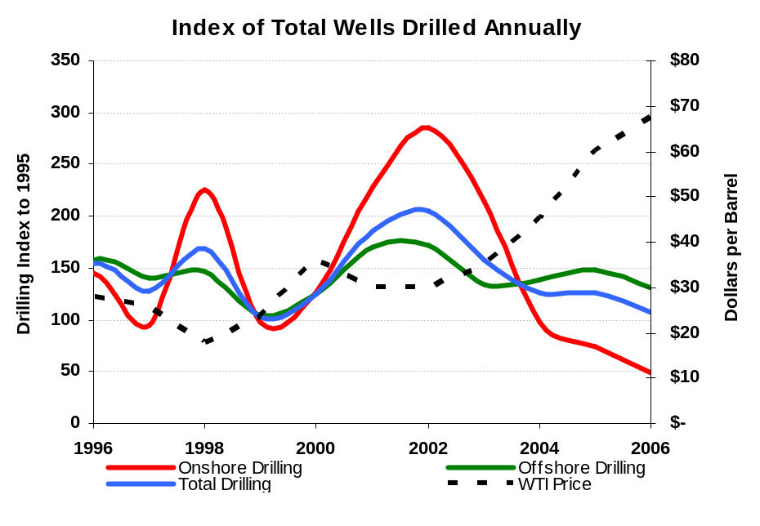
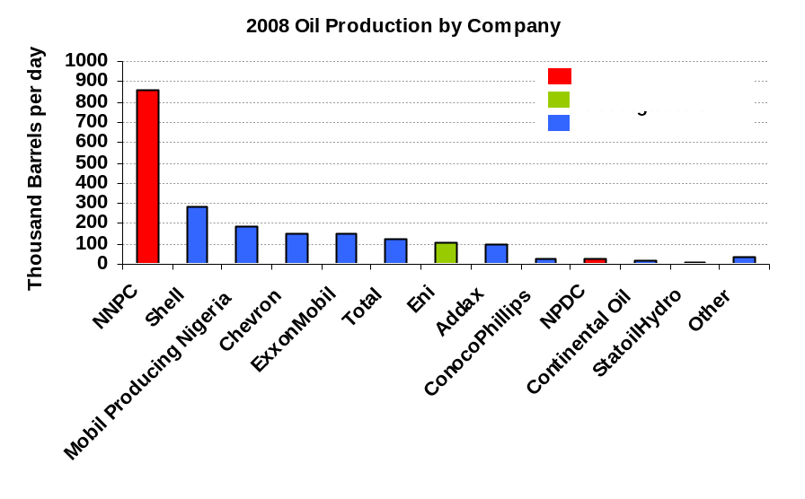
Nigeria
Downside Risks & Upside Potential
Violence in the Delta could continue and expand into deepwater locations
Financial management at NNPC could deteriorate further
Nigerian government might implement policies that reduce violence in the Delta

Slide 20
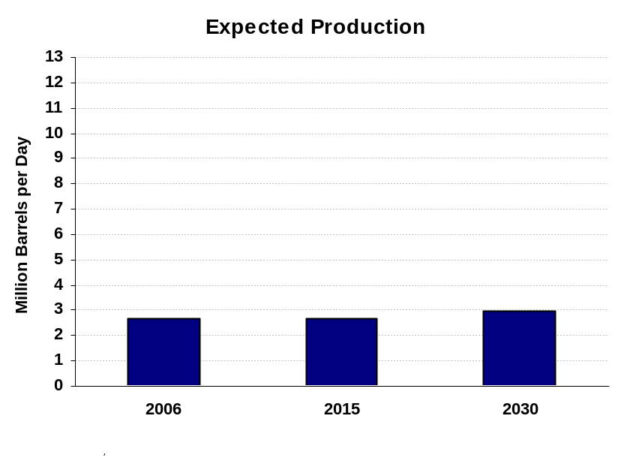
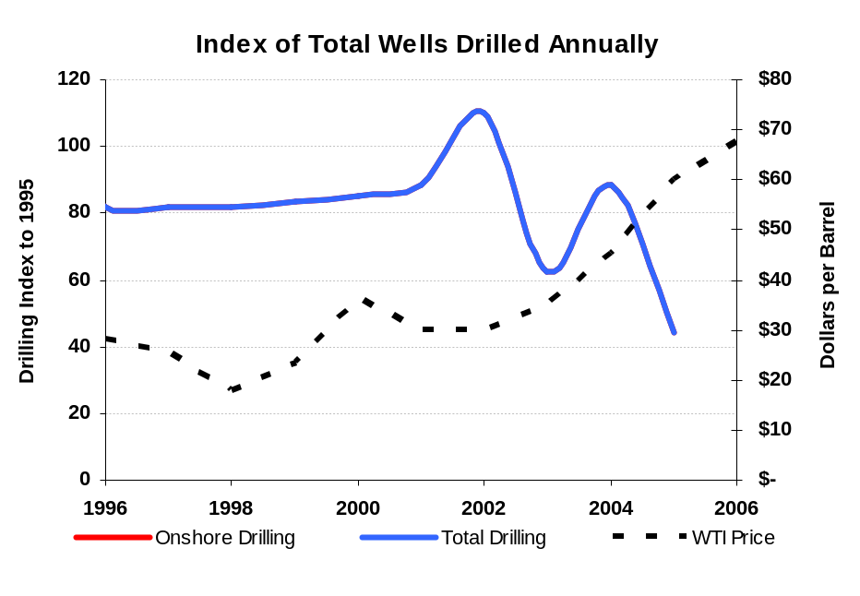
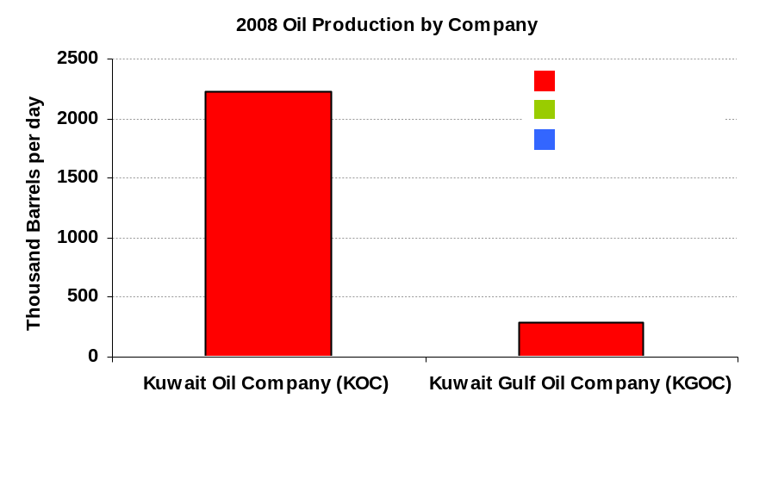
Kuwait
Downside Risks & Upside Potential
KPC’s technical ability to maintain and expand production could be hindered by politically motivated management changes
Political disagreements could prevent Project Kuwait from achieving expected progress
Political disagreements could settle and allow Project Kuwait to move forward
KPC technical capabilities could return to previous levels

Slide 21
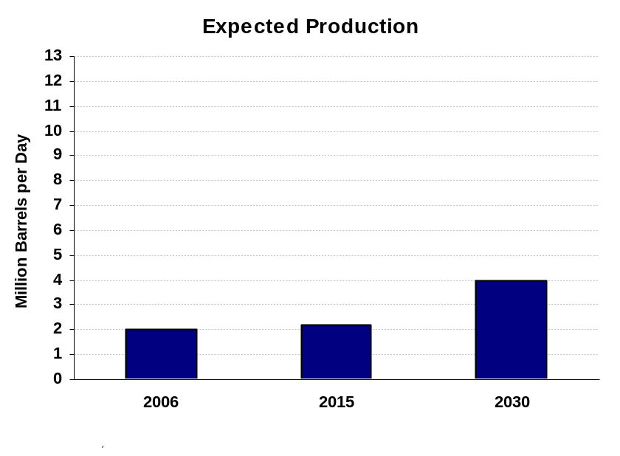
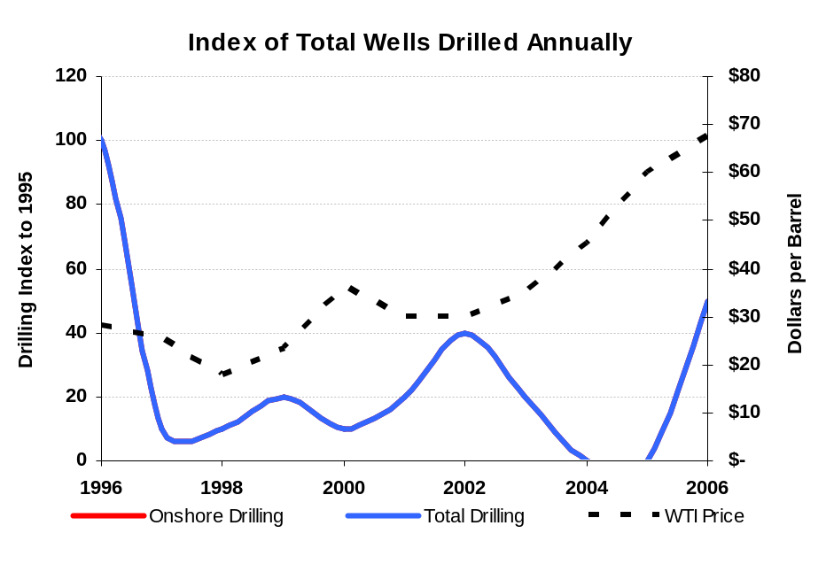
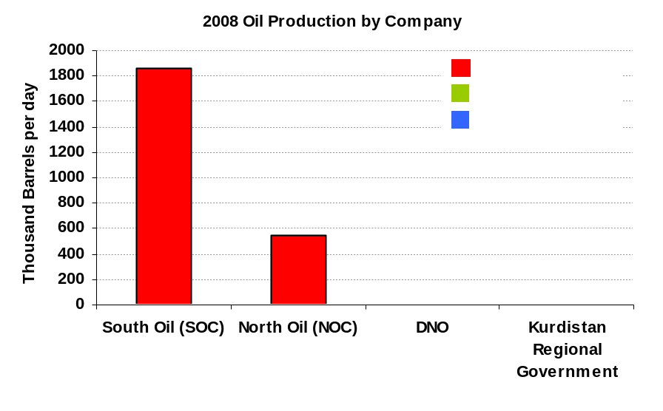
Iraq
Downside Risks & Upside Potential
Violence could escalate as U.S. troops withdraw
Legislation and licensing issues between national government and Kurdistan regional government could inhibit large scale foreign investment
Security could continue to improve
National and Kurdistan regional governments could reach agreement on licensing and jointly encourage foreign investment

Slide 22
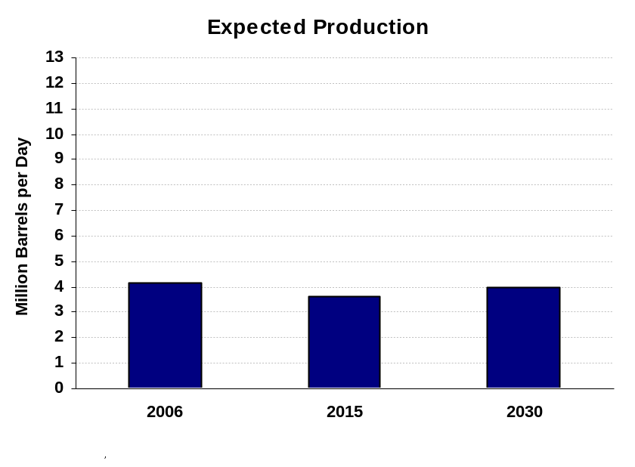
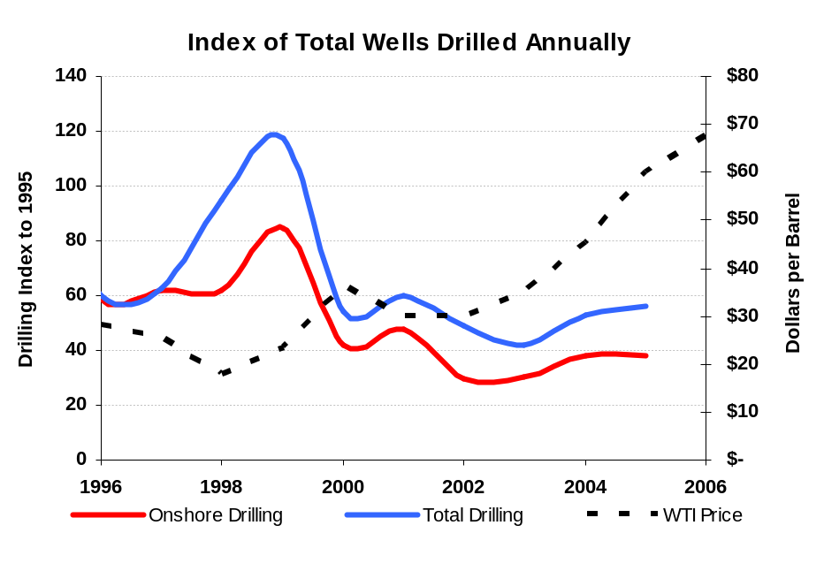
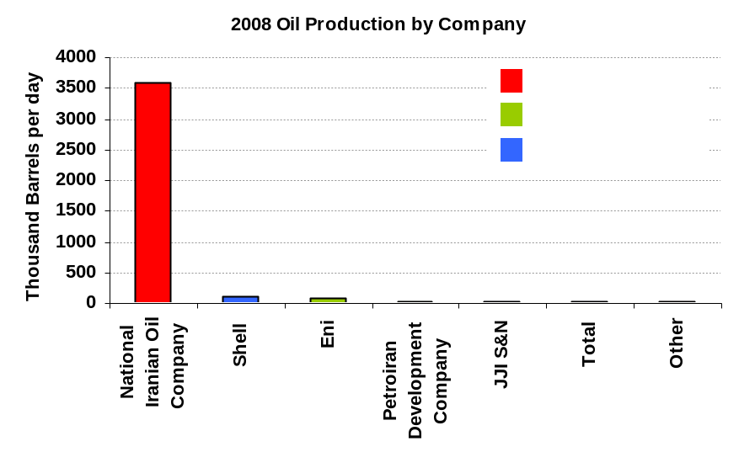
Iran
Downside Risks & Upside Potential
Domestic consumer gas needs reduce gas volumes for EOR
NIOC management and performance issues could escalate and cause production from existing fields to decline faster than expected
Domestic gas production could increase, allowing more EOR
NIOC investment and development capabilities could improve and/or financial terms for international companies could improve

Slide 23
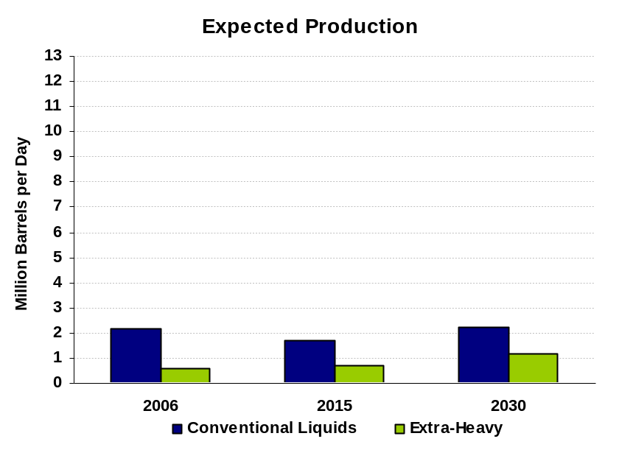
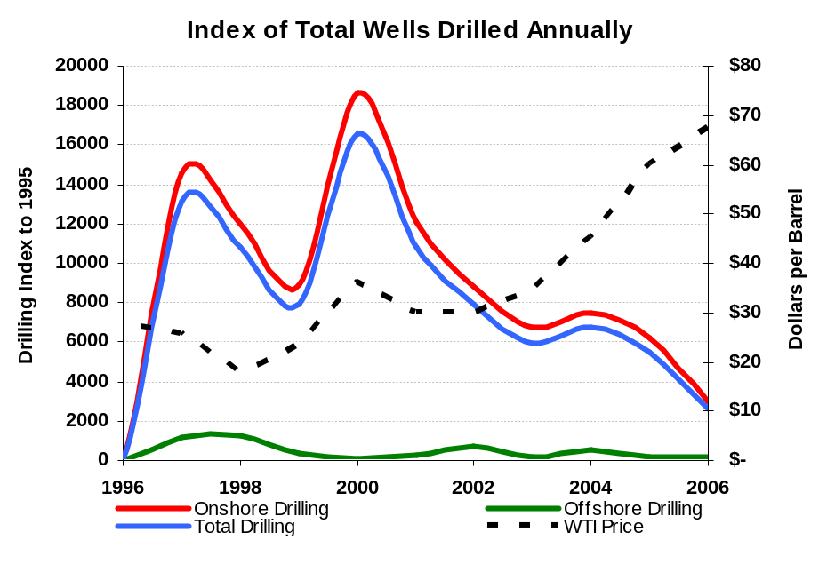
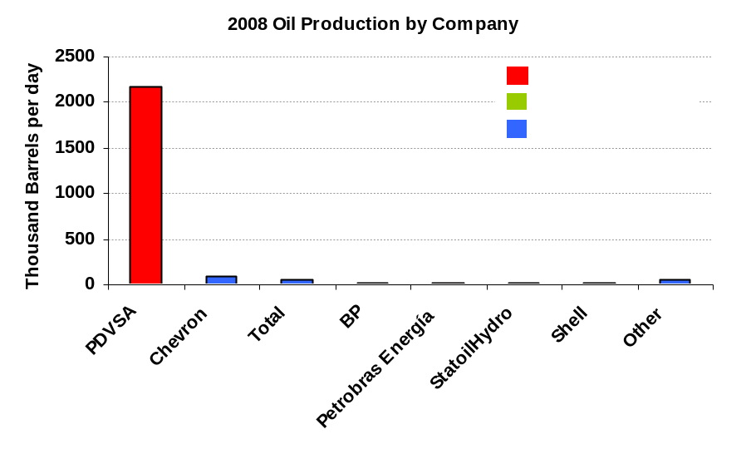
Venezuela
Downside Risks & Upside Potential
Nationalization tendencies could continue
Foreign investment could continue to be discouraged either directly through government actions or indirectly through threats of nationalization and instability
E&P investment could become more limited due to non-sector expenditures
Confidence in contract stability might be repaired, encouraging renewed foreign investment

Slide 24
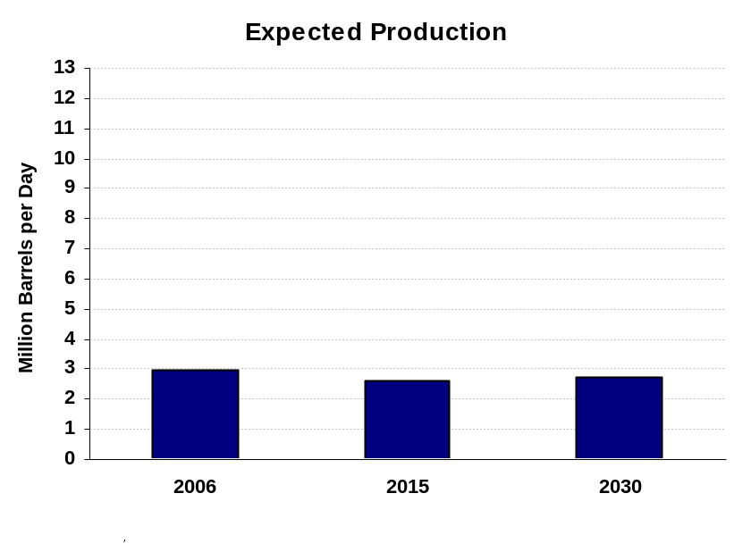
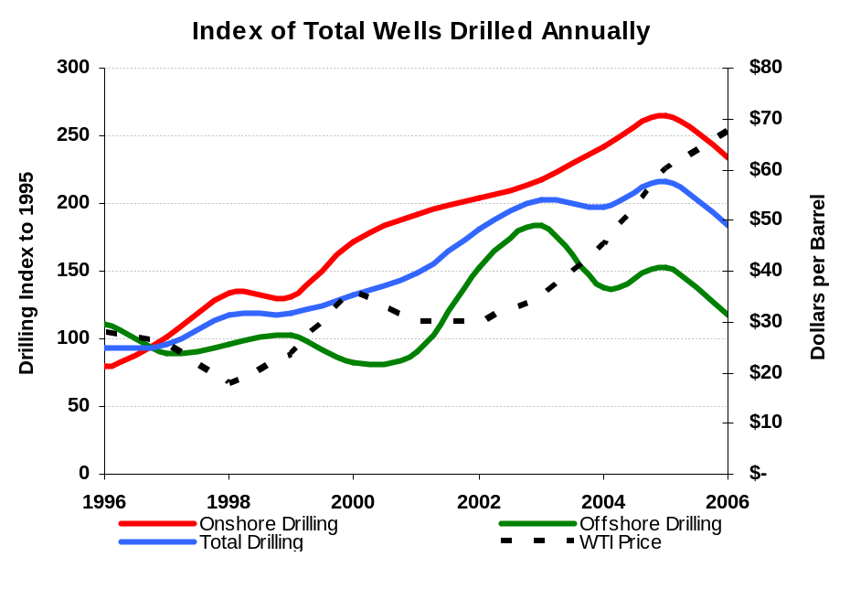
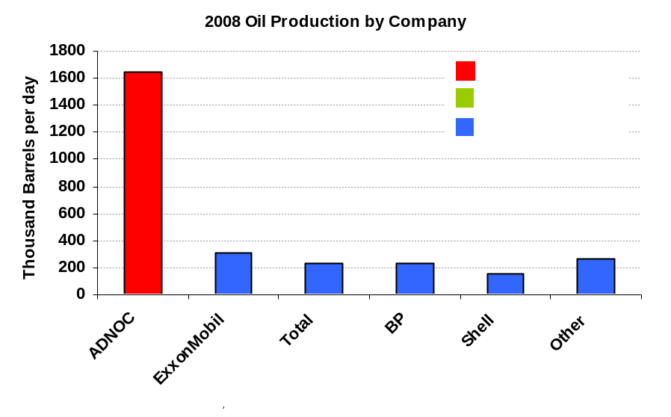
UAE
Downside Risks & Upside Potential
Government could refuse to renew concessions and place additional pressure on ADNOC to achieve production goals without IOC participation
Government could renew concessions upon expiry or enable different structure encouraging IOC participation

Slide 25



Mexico
Downside Risks & Upside Potential
Government may be unable to adopt legislation to allow foreign technology to be implemented
Deepwater GOM resources could be much lower than anticipated
Government could adopt legislation that allows foreign technology to be implemented
GOM resources might higher than expected

Slide 26



China
Downside Risks & Upside Potential
Declines at major mature fields could accelerate
Offshore developments could prove insufficient to compensate for onshore declines
Offshore boundary issues might be resolved
Offshore resources might prove more significant than currently thought

Slide 27



Norway
Downside Risks & Upside Potential
Decline rates at major fields could accelerate
Smaller finds could be unable to compensate for declines at existing large fields
Government’s licensing terms could continue to encourage investment despite competition from other promising offshore developments
A significant number of small finds could be capable of offsetting some of decline in existing fields

