Slide 1

Transmission Incentives
P. Kumar Agarwal
Acting Director, Division of Reliability & Engineering Services
Federal Energy Regulatory Commission
U.S. DOE, Energy Information Administration 2009 Energy Conference
Washington, DC
April 7, 2009

Slide 2
History
Energy Policy Act of 2005, August 5, 2005
  Created FPA Section 219
FERC issued order No. 679 on July 20, 2006 adopting regulations to promote transmission investment through pricing reform

Slide 3
FPA Section 219 and Order No. 679
Goals
  ensure reliability and reduce the cost of delivered power by reducing transmission congestion
  promote capital investment in the enlargement, improvement, maintenance, and operation of transmission facilities
  provide a return on equity that attracts new investment in transmission facilities

Slide 4
Transmission Incentives
Types of Incentives
  Higher Return on Equity
    usually ranges from 50-200 basis points
  Recovery of CWIP (Construction Work-in-Progress)
  Recovery of Abandonment Costs
  Advanced Technology Adder

Slide 5
Rebuttable Presumption
It is assumed that a project qualifies for transmission incentives if it meets one of the following:
  Approved through a Regional Planning Process (e.g. PJM’s RTEP Process)
  National Interest Electric Transmission Corridor (NIETC)
  Approved by state siting authority

Slide 6
Nexus Test
Project must demonstrate a nexus between the incentive sought and the investment made
The total package of incentives is weighed against the risks, challenges and benefits of project as a whole

Slide 7
Orders Granting Incentives
Out of 33 projects seeking transmission incentives to build new transmission:
  27 accepted
  3 rejected
  3 pending
Notes:
EL08-78 (ComEd) did not receive general incentives because the projects failed to meet the nexus test. ComEd didn’t receive an advanced tech adder because the two SVCs they planned to build were not new and had a limited scope.
ER09-14 (Pioneer) did not receive incentives because the projects failed to meet the nexus test requirement.
ER09-590 (TrAILCo) did not receive incentives because the Kammer project failed to meet the nexus test. The project did not show sufficient risk or challenges to warrant incentive treatment.

Slide 8
Summary of FERC Actions on Transmission Incentives
27 Accepted Projects
  Total cost ~ $27 billion
  Total new transmission lines ~ 8,000 miles
  Range of kV: 230 – 765 kV
  Range of basis points: 100-200

Slide 9
Major Transmission Projects that Received Incentives
PacifiCorp (Energy Gateway Project)
2,000 miles of 500 kV, 345 kV, and 230 kV transmission line in a six-state region delivering 3,000 MW of capacity from location-constrained renewable resources in Wyoming to distant load centers
Cost $6 billion; completion by 2014
Received 200 basis points of tx incentives

Slide 10
Major Transmission Projects that Received Incentives (cont’d)
Tallgrass Transmission & Prairie Wind Transmission
400 miles of 765 kV line in Oklahoma and Kansas facilitating the connection of over 10,000 MW of renewable
Cost $1.1 billion; completion by 2013
Received 150 basis points of tx incentives

Slide 11
Major Transmission Projects that Received Incentives (cont’d)
Pioneer Transmission (AEP/Duke)
240 miles of 765 kV line facilitating the interconnection of over 4,000 MW of wind generation
Cost $1 billion; completion by 2015
Received 200 basis points of tx incentive

Slide 12
Major Transmission Projects that Received Incentives (cont’d)
Trans-Allegheny Interstate Line (TrAIL)
300 miles of 500 kV line increasing the west-to-east transfer capability by 3,800 MW over base case levels
Cost $870 million; completion by 2011
Received 100 basis points

Slide 13
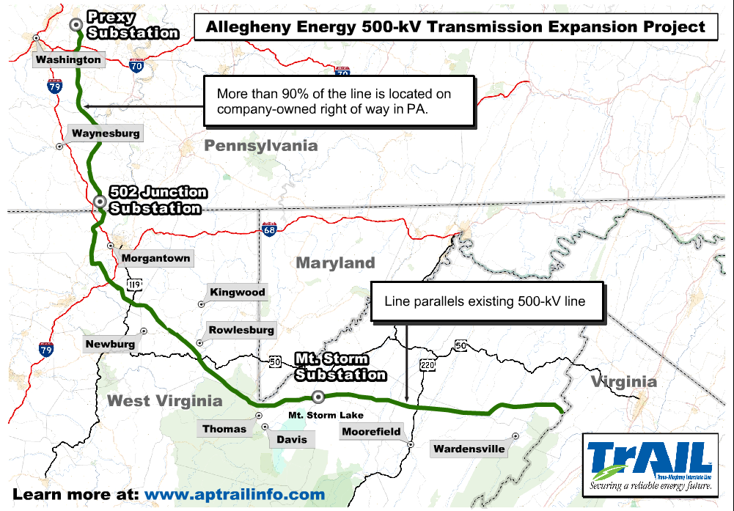
Trail Route in West Virginia and Pennsylvania

Slide 14
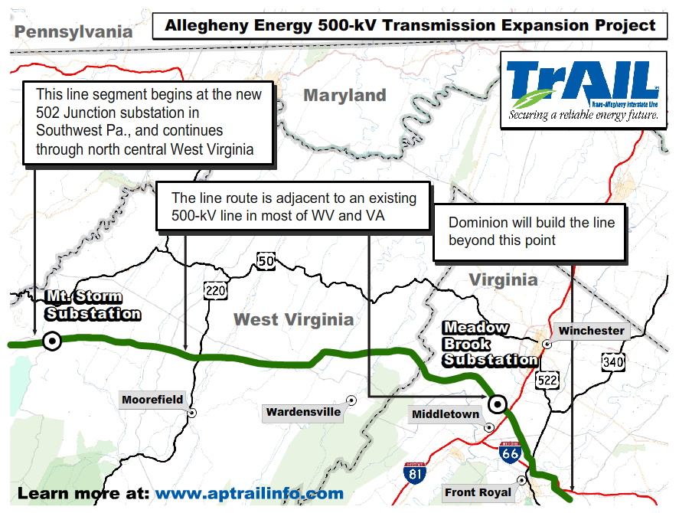
Rest of TrAIL Route

Slide 15
Transmission Line Mileage
 | 1990 (actual) | 2000 (actual) | 2007 (actual) | 2012 (proj.) | 2017 (proj.)
Total Miles AC and DC Transmission lines (>230 kV) | 146,595 | 155,669 | 163,480 | 174,436 | 177,988
Percent Increase |  | 6.19% |  |  | 8.87%
Notes:
This shows a projected 8.87% increase over the next 10 years.

Slide 16
Summary
Transmission Incentives are designed to foster a more robust grid through greater investment
Petitioners can receive General ROE Adder, CWIP, Recovery of Abandonment costs and Advanced Tech Adder
FERC acted on 27 projects representing 8,000 miles of new transmission

