Slide 1
Supporting the Infrastructure:
Has Deregulation Helped or Hurt?
Tim Brennan
Professor, Public Policy and Economics, UMBC
Senior Fellow, Resources for the Future
brennan@umbc.edu
U.S. DOE, Energy Information Administration
2009 Energy Conference
Electric Power Infrastructure:
Status and Challenges for the Future
Washington, DC
Apr. 7, 2008

Slide 2
Has opening markets promoted infrastructure?
Was commitment to opening markets realistic?
  Energy on-peak can be enormously expensive
  Everyone gets to charge high price
  Good economics; contentious politics
Do consumers fit the textbook?
  Revealed preference not to have to choose?
  Will dim consumers lead to dim lights? Energy efficiency …
Restructuring vs. investment?
  Does divestiture help or hurt?
  Necessary for competition
  Short run pricing
  Long run coordination

Slide 3
Reliability, and reregulation
Reliability vs. Competition?
  Non-storability + interconnection => central dispatch, control
  Aug. 14, 2003: Who’s to blame in an interconnected grid?
  Best sign: We’re arguing about prices, not blackouts (so far!)
Finally, some words on what’s going on in Maryland
  State of paradoxes
  Price and use?
  Conserve or produce?

Slide 4
Political intolerance for peak power prices?
Extreme peak costs can exceed average by 50-100
  ONT: 15% of capacity during 125 peak hours, < 1.5% time
Regulation: Peak cost buried in average price
Markets: All capacity gets to sell at peak prices
  Economics sees this as a virtue
  Data showing high prices with open markets may be good!
Massive short-run redistribution
  The unforeseen problem in California
  High retail rates => retail re-regulation => distribution utility bankruptcy => market gone
Will entry fix the problem? Will public wait?

Slide 5
Behavioral issues: Do consumers really want it?
“What if they gave a [market] and nobody came?
Life would ring the bells of Ecstasy and Forever be Itself again?”
  paraphrase of quote attributed to Allen Ginsberg
“Who let those people break up the phone company?”
  Tim’s dad, whenever occasion allows (1984-present)
“The best policy is to declare victory and leave”
  Sen. George D. Aiken (R-VT), 1966, about the Viet Nam War

Slide 6
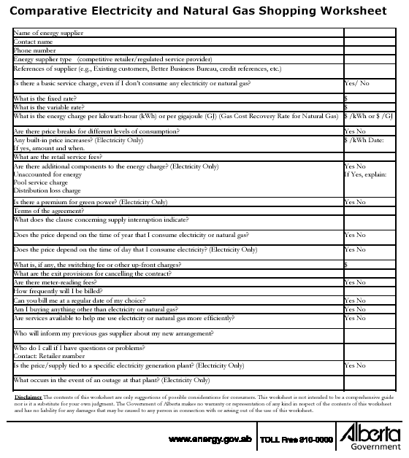
Alberta:

Slide 7
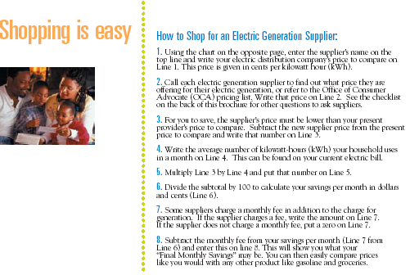
Shopping in Pennsylvania

Slide 8

A few simple questions ….

Slide 9
Smart grids, but what about the users?
Many aspects of energy efficiency well known
  Compact fluorescent lights
  “Negative cost” carbon controls
So too, the smart grid
  Top 15% of capacity used less than 1-2% of the time
  Real-time use management
  Need not just metering but monitoring and adjustment
  Utility management, automation could reduce costs
Why are these $20 bills all over the sidewalk?
  Consumers don’t have “the information”?
  Utilities withholding the information?
Return to this theme at the end

Slide 10
Leave which investments to the market?
Residential consumers less interested in the hassle
  “Why are you making me choose”?
  Very low take up rates despite education, unless large incentives/penalties
Forcing competition where it doesn’t fit?
  Franchise competition to be “default provider”?
Success for industrial, commercial users
  MD – 2% residential, but
  > 69% C&I, 94% “large customers”
Declare victory for 2/3 of the market ready to choose?
  Offer residential users energy at controlled prices
  Efficiency: Even more information, or mandatory investment?

Slide 11
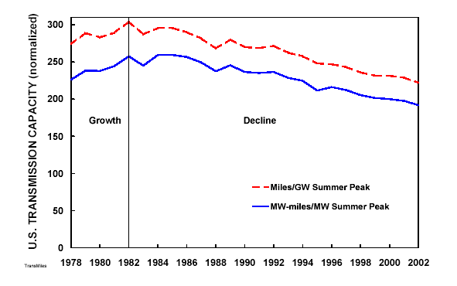
What about transmission? Is capacity adequate?
Transmission growth rates below generation growth
Grid not designed for interstate wholesale markets
August 2003 blackout

Slide 12
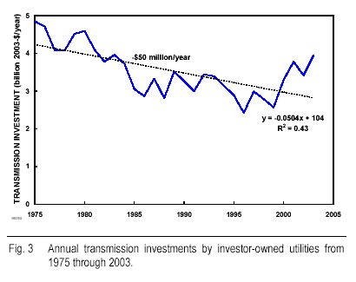
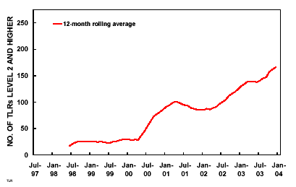
Other evidence: investment trends, TLR growth

Slide 13
Is “restructuring” the problem?
Can’t simply deregulate: Monopolies in “wires”
Incentives to evade wires regulation without separation from generation, marketing
  Justify if not divestiture, the “I” in ISO:
  Can antitrust come to the rescue? Not after Trinko
But does separation, independence work?
  Vary transmission price with generation use? Congestion
  Timing of unit installation, expansions?
Can we get the right investment?
  Need to coordinate major generation, transmission investments? -- Wind, solar even more
  What’s the point of competition if entry requires planning?

Slide 14
Institutions: reliability vs. competition
Crucial, fragile, interconnected:
Electricity’s unique combination
My reliability affects your reliability:
  The August 2003 blackout example
  A policy rationale for a “smart grid”!
Valuing security
  What does a blackout cost?
  Infinite investment in transmission, generation?
How much central control necessary?
  Just an air traffic controller?
  Or complete management of dispatch and investment?

Slide 15
Good news, but stay vigilant
So far, reliability not threatened
  Despite trends regarding transmission
  (Vague?) Accusations regarding post-emergency restoration
Arguing about price instead of blackouts a good sign
  Doesn’t Lehman wish its profits had just fallen 25%?
What happens if there’s another Aug. 2003 blackout?
  Claims of disaster in 2011-12 in MD
Reliability as a collective good could justify at least some smart grid investment
But policy not out of the woods

Slide 16
Which brings us to Maryland …
The two pillars of Maryland electricity policy:
  (1) The price is too high
  (2) People buy too much
  Requires consumer irrationality
More paradoxes: Conserve or produce?
EmPower Maryland
  Reduced electricity use 15% by 2015
  Join RGGI; use permit revenues to fund efficiency
But re-regulate – Why? TO BUILD MORE PLANTS!
  Ban independent entry, erase large user gains?
  Why weren’t plants build? 15% demand reduction, maybe?
Get me the aspirin!!

Slide 17
Read more about it?
Generating the Benefits of Competition: Challenges and Opportunities in Opening Electricity Markets, Toronto: C. D. Howe Institute, Commentary 260 (April, 2008)
“Consumer Preference Not to Choose: Methodological and Policy Implications,” Energy Policy 35 (2007): 1616-27.
“Alleged Transmission Inadequacy: Is Restructuring the Cure or the Cause?” Electricity Journal 19, no. 4 (May 2006): 42-51.
“Making Electricity Markets Competitive: How Fast and By Whom,” in Portney, Paul and Richard Morgenstern (eds.), New Approaches on Energy and the Environment: Policy Advice for the President (Washington: Resources for the Future, 2004): 38-43.
“Market Failures in Real-Time Metering,” Journal of Regulatory Economics 26 (2004): 119-39.
“Electricity Capacity Requirements: Who Pays?” Electricity Journal 16, no. 8 (Oct. 2003): 11-22.
“Mismeasuring Electricity Market Power,” Regulation 25 (Spring, 2003): 60-65.
Alternating Currents: Electricity Markets and Public Policy (with Karen Palmer and Salvador Martinez), Washington, DC: Resources for the Future (2002).
The California Electricity Experience, 2000-2001: Education or Diversion? Washington, DC: Resources for the Future (2001).

