Slide 1

Renewable Energy in the Transportation and
Power Sectors
April 7th, 2009
Energy Information Administration
2009 Energy Conference:
A New Climate for Energy
Energy Information Administration
Notes:
Welcome to this session which addresses the topic of renewable energy in the transportation and power sectors. A topic that is very much on the minds of the public at large, policy makers who are pondering the benefits, costs and preferred outcomes of the varied current and the potential of future laws and regulations, researchers who are busily involved with pushing the state of the art in a number of key technology areas, technology developers who are weighing the risks and benefits of pursuing different business plans in this evolving market, and environmentalists who are concerned with the direct and indirect – both good and bad – impacts of pursuing these technologies versus ‘business-as-usual’ or other options.
Before we continue, however, there are a few ‘housekeeping’ issues I want to go over:
First, please take out all of your cell phones or pdas and either silence them, or ensure that has already been done.
Second, we will be taking questions at the end of the four presentations. If you have a question, write it out on the cards you have been provided and simply hold up your hand – one of our fine staff will be quite happy to pass those cards up to the front.

Slide 2

Renewable energy to contribute a growing share of supply
quadrillion Btu
History
Projections
Coal
Natural Gas
Liquid Fuels
Liquid Biofuels
Renewables (excl liquid biofuels)
Nuclear
Source: EIA Annual Energy Outlook 2009 Reference Case
Notes:
As reflected in EIA’s recently release Annual Energy Outlook, Renewables – which includes hydroelectric power in this chart – comprises a small but growing share of the nation’s energy supply portfolio.
In 2007, combination of biofuels and other renewable power constituted 6.8 percent of total supply and is expected to grow to become 12 percent of supply by 2030 – and at a 3.2 percent per year average annual growth rate, easily growing faster than any other form of supply. Indeed, the growth rates of non-hydro renewables and other components is even faster. This growth rate is what EIA projects will occur under currently enacted laws and regulations and under crude oil prices that reach $130 per barrel in 2030.

Slide 3
Renewable Energy in The Transportation and Power Sectors
Transportation
Power
David Humbird
  National Renewable Energy Laboratory
Bob Dineen
  Renewable Fuels Association
Denise Bode
  American Wind Energy Association
Bryan Hannegan
  Electric Power Research Institute
Notes:
We have with us today a diverse group of speakers who are working at the forefront of developing renewable technologies for the transportation and power markets, and also in creating that environment in which these technologies can flourish.
We will all be interested in understanding from our speakers answers to questions such as:
How much is possible (quantities)?
What are the technologies that will make this happen and what progress needs to be achieved?
When will progress and the commercial-scale quantities come about?
What will it cost?
Will we have enough feedstocks at reasonable prices?
What are the other current impediments to achieving these visions?
What are the effects of ‘success’ in achieving the full realization of that vision?

Slide 4
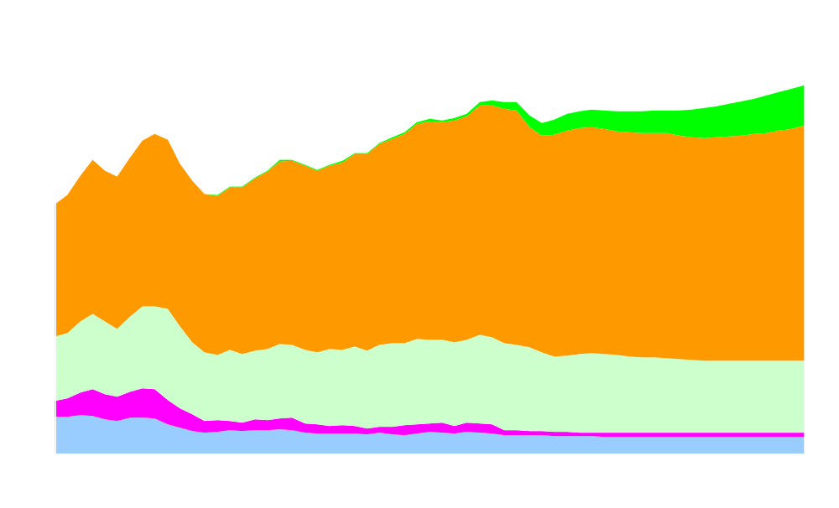
Biofuels use grows as petroleum-based liquid fuels remains flat
million barrels per day
History
Projections
Biofuels
Transportation
Industrial
Electric Power
Residential and Commercial
Source: EIA Annual Energy Outlook 2009 Reference Case
Notes:
Use of biofuels in the U.S. has been growing in both quantity and prominence in recent years. EIA’s projection is that the goal of 36 billion gallons of biofuels by 2022, as set out in the Renewable Fuel Standard as amended in the Energy Independence and Security Act of 2007, will not be met. However, the projection does show that all of the growth in total liquids consumption is to be met by the growth in biofuels.
Between 2007 and 2030 biofuels consumption grows at an average annual rate of over 7 percent per year – which results in the market share of biofuels in transportation to grow from 2.3 percent to almost 15 percent by 2030.
With us today are Dr. David Humbird of the National Renewable Energy Laboratory and Mr. Bob Dineen, president of the Renewable Fuels Association to describe some of the issues associated with the development and use of biofuels.

Slide 5
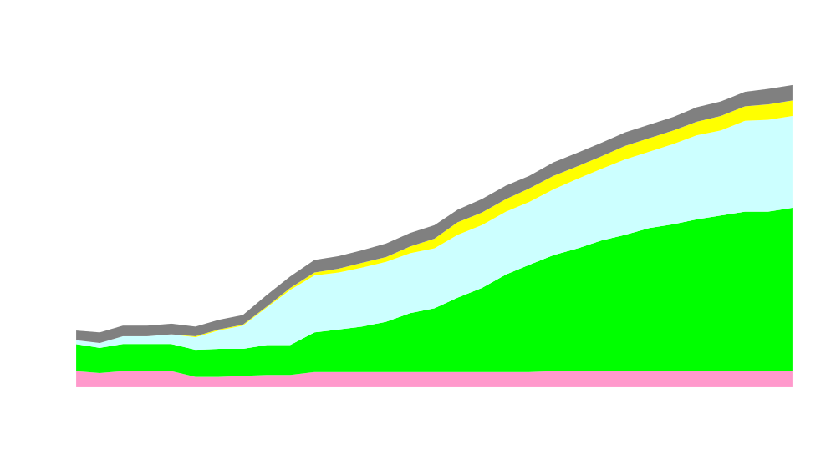
Non-hydroelectric renewables to achieve eight percent of total electricity generation
Under Current Laws and Regulations
billion kilowatt-hours
History
Projections
Geothermal
Solar
Wind
Biomass
MSW/LFG
Source: EIA Annual Energy Outlook 2009 Reference Case
Notes:
2007 2030
% share total generation 3.3% 8.9%

