Slide 1
Pickens' Peak: Fundamentals, Speculation, or Market Structure
Robert McCullough
Energy Information Administration
April 7, 2009

Slide 2
Why did the chicken cross the road?
Curiously, this is often offered as an example of an imponderable question
As everyone knows, chickens cross roads for many reasons:
Random walk: All chickens cross all roads if enough time has lapsed
Nutrition: The grass is always greener on the other side of the road
Competition: There are fewer chickens over there
Reproduction: The chickens across the road are potential domestic partners

Slide 3
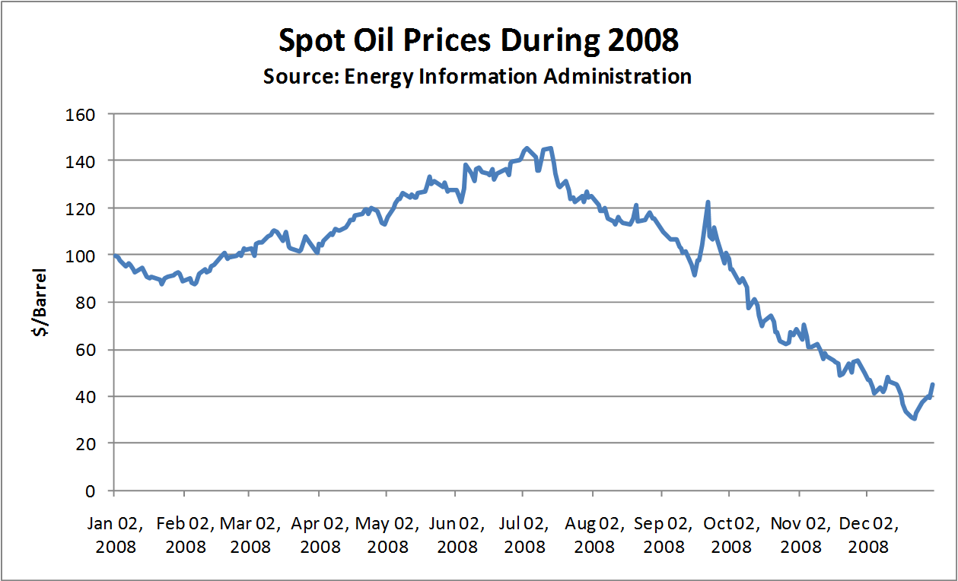
In 2008, WTI crude prices rose 45% and then fell by 80%

Slide 4
Media pundits had many answers:
India and China
Hubbert’s Peak
Exchange rates
Excessive speculation
Market manipulation

Slide 5
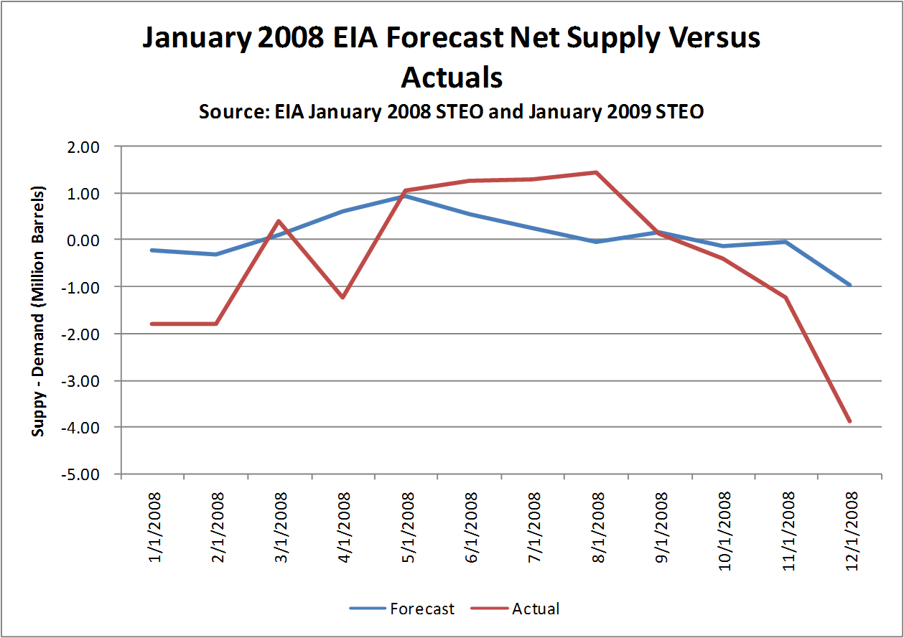
Fundamentals explain very little

Slide 6
Actually, fundamentals go the wrong way

Slide 7
Speculation or Market Structure?
Speculation in the non-pejorative sense – buying land you don’t plan to live on or stock in a company you don’t plan to run
Market structure:
Perfect competition with no control over prices
Oligopoly where price and inventory decisions are subject to substantial discretion

Slide 8
Intro Finance 101
Oil forwards should reflect the risk adjusted cost of capital since it is easily stored (not even pumped)
The risk adjusted cost of capital should reflect the risk premium of risk takers willing to make forward commitments
The spot forward premium (positive or negative) should increase over time

Slide 9
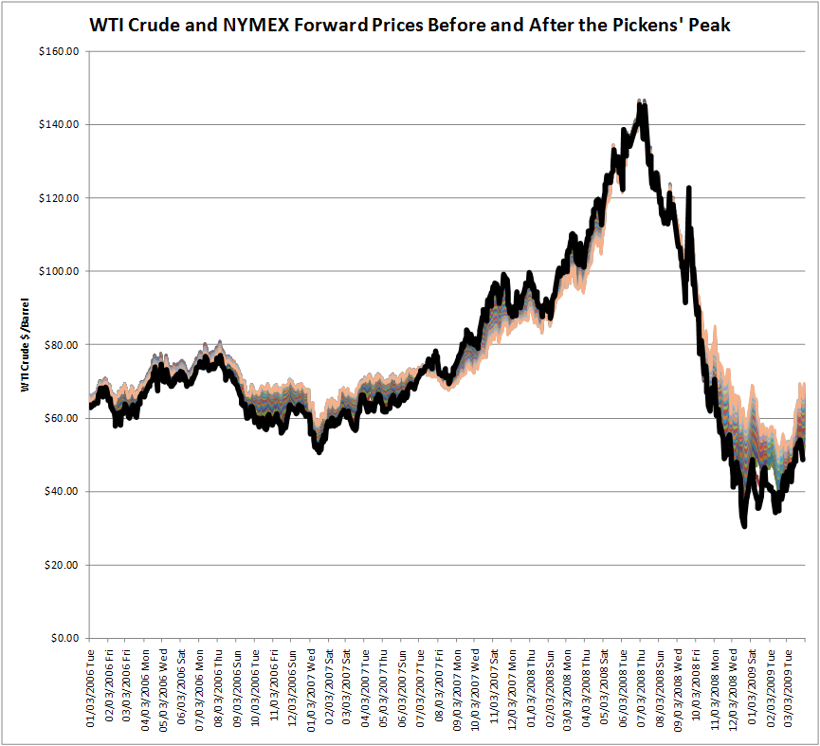
NYMEX Spot and Forwards

Slide 10
Pickens’ Peak showed little term structure
From March through September, forwards and spot were effectively identical
This phenomena, often called “curve shift”, reflects traders marking their forward curves up or down to reflect changes in spot prices
This would seem to be inconsistent with speculators “bidding up” the risk premium for forward oil

Slide 11
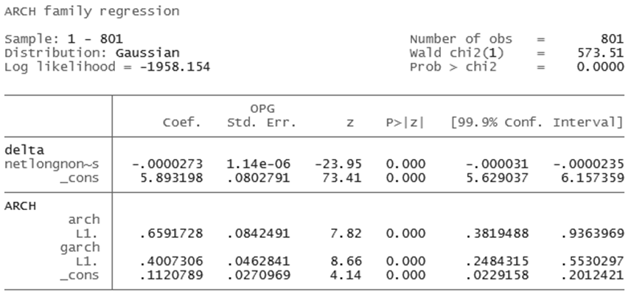
Testing the data

Slide 12
Speculators?
If the causal linkage was forward back to spot, speculators “bid up” the risk premium without any apparent risk premium
Moreover, the statistical impact has the wrong sign

Slide 13
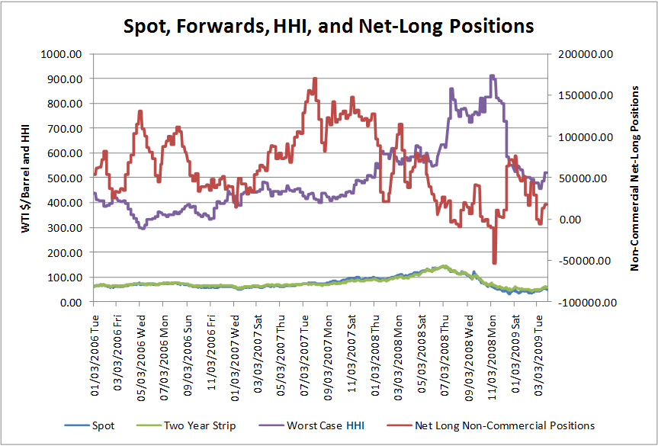
Market Structure

Slide 14
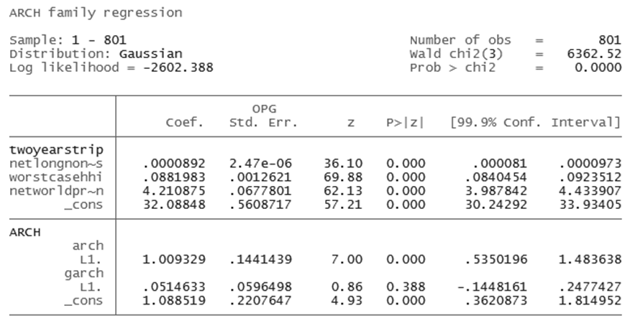
The case for market structure

Slide 15
Why market structure?
Concentration increased during the price increase
“Non-commercial” net-long positions increased during the spring and summer
World inventories increased during the spring and summer
All three fell sharply during the fall

Slide 16
Conclusions and Recommendations
Market structure fits the data very well: a rational oligopolist would leave traces in the data identical to those we saw in 2008
We need to accumulate transaction data on the spot oil market since market power leads to very different policy recommendations than the alternatives

Slide 17
Paper and data
“A Forensic Analysis of Pickens’ Peak: Speculators, Fundamentals, or Market Structure” is available here at the conference and at mresearch.com
We are happy to share our data set with other researchers

Slide 18
McCullough Research
http://www.mresearch.com

