Slide 1
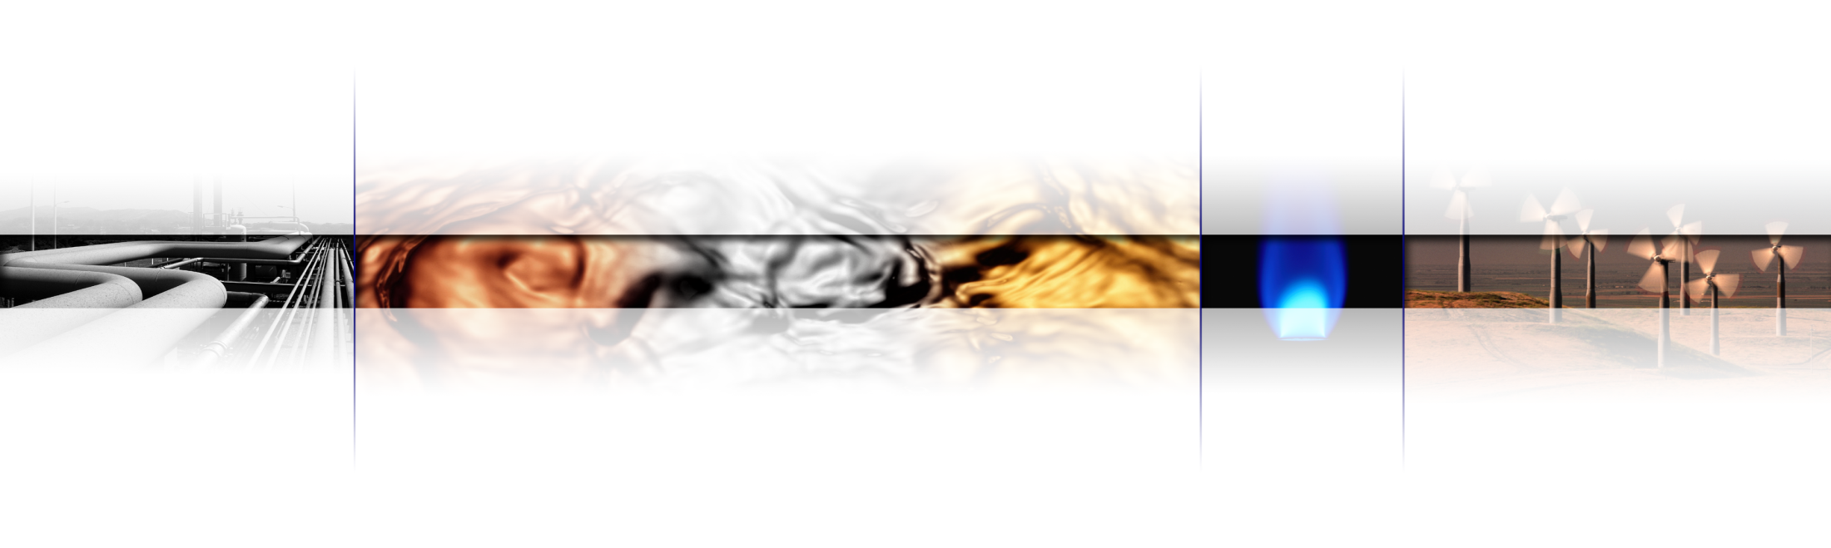
Dark Markets and Oil Prices
Energy Information Administration 2009 Energy Conference
Session 6: Financial Markets and Short-Term Energy Prices
07 April 2009 Washington
Adam E. Sieminski
Chief Energy Economist
Deutsche Bank AG
adam.sieminski@db.com
+ 1 202 662 1624
All prices are those current at the end of the previous trading session unless otherwise indicated. Prices are sourced from local exchanges via Reuters, Bloomberg and other vendors. Data is sourced from Deutsche Bank and subject companies.
DISCLOSURES AND ANALYST CERTIFICATIONS ARE LOCATED IN APPENDIX 1.

Slide 2
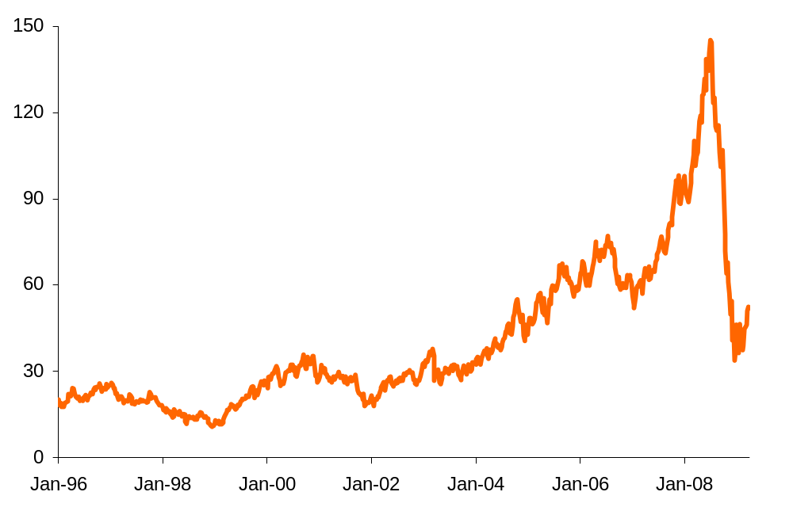
Oil Prices Spiked
WTI oil prices rose sharply from early 2007 and then collapsed
Source: Nymex, Deutsche Bank

Slide 3

Somebody Must Be Blamed
The Dark Markets

Slide 4
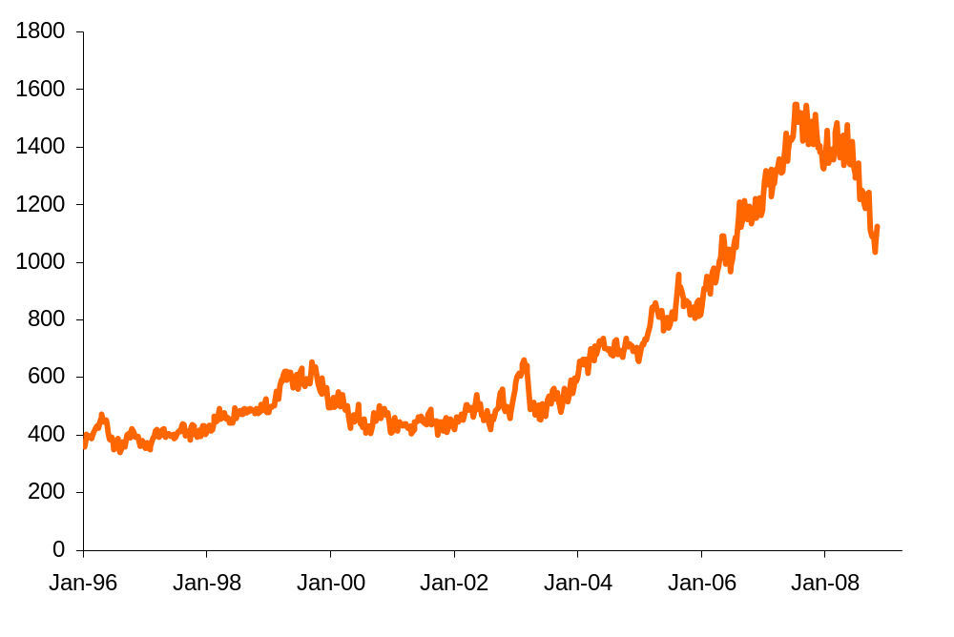
Speculation?
Open interest in the Nymex crude oil contract
This shape looks a lot like the oil price graph.
Source: CFTC, Deutsche Bank

Slide 5
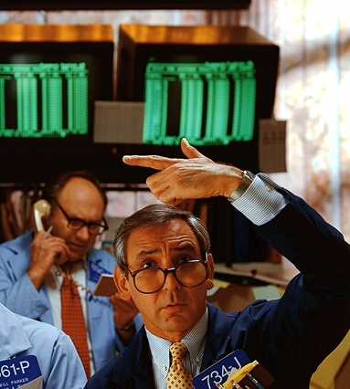
But Was It Really All Speculators?
What other forces were at work in the oil price run-up?

Slide 6
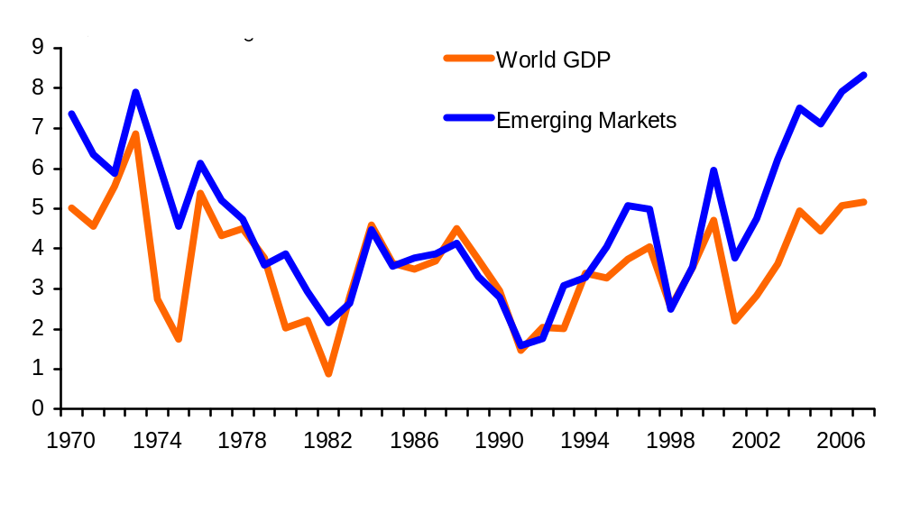
Global GDP Growth Went Ballistic
Strongest economic growth since the 1973 oil spike
The incredibly strong global economic growth from 2004 through 2007 drove the demand for all commodities upward, including oil.
7.7%
4.9%
Source: International Monetary Fund, January-2009
Deutsche Bank

Slide 7
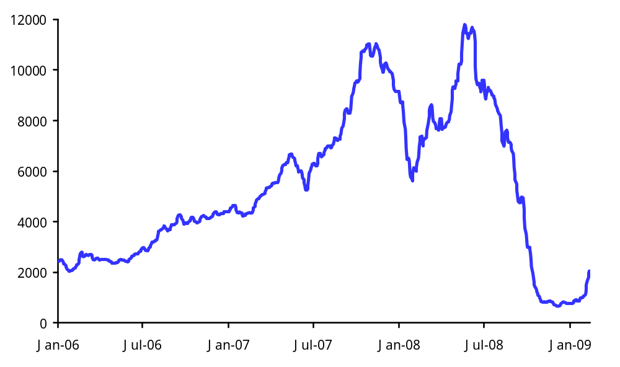
Demand Got Too High and It Wasn’t Just Oil
Baltic Dry Freight Index
The Baltic Freight Index has been a useful barometer for global growth cycles.
What about the role played by consumption subsidies in Asia and the Middle East?
And what about Strategic Reserve purchases?
Source: Reuters, Deutsche Bank

Slide 8
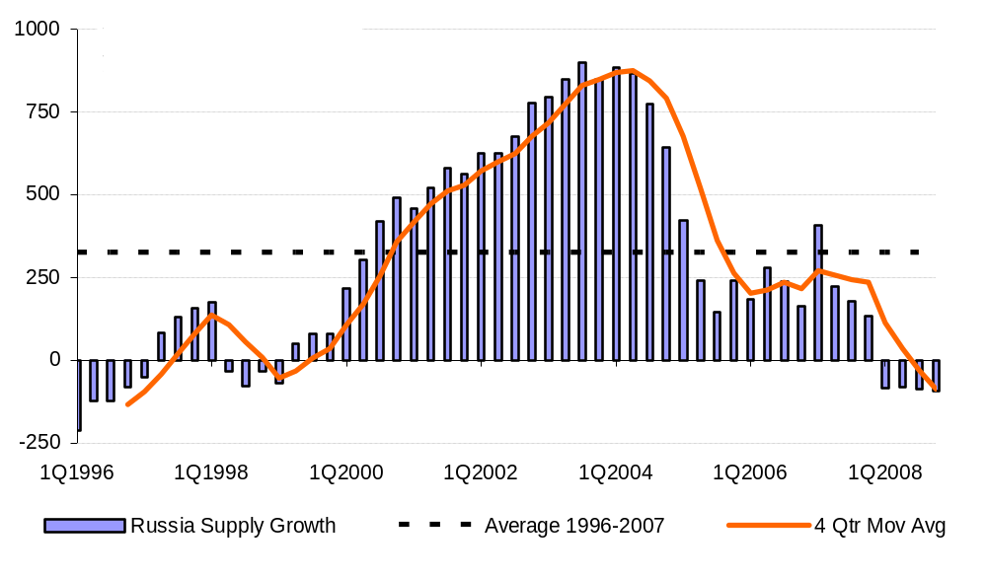
Supply Growth Got Too Low
Russian Oil Production Growth
Pres. Putin’s policies in his first term worked but in his second term were a disaster for oil output.
Venezuela
Nigeria
Iran
Iraq
Mexico
North Sea
Source: IEA, Deutsche Bank

Slide 9
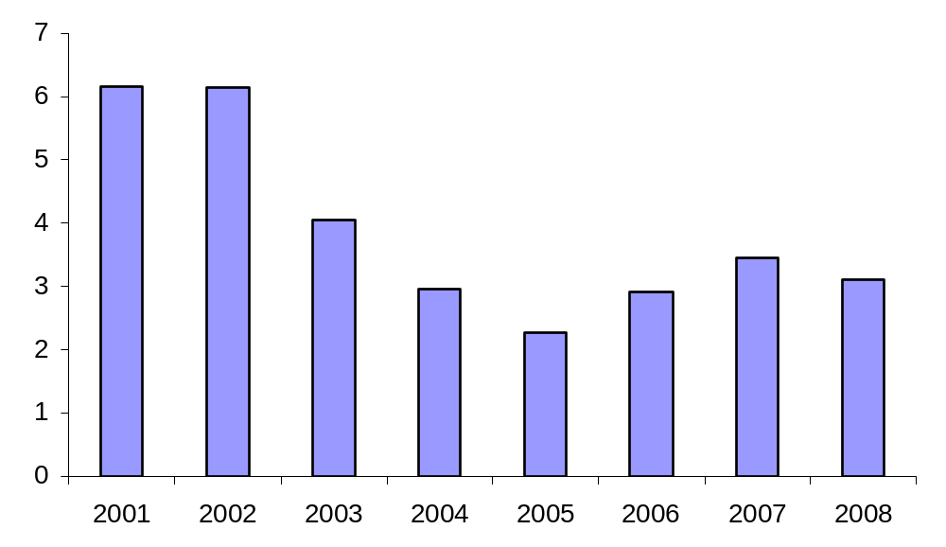
OPEC Spare Production Got Too Low
As OPEC cuts quotas, spare capacity increases
The lack of spare OPEC production capacity played a strong role in the run-up in oil prices in 2003-08; this is reversing in 2009-10.
Source: IEA, Deutsche Bank

Slide 10
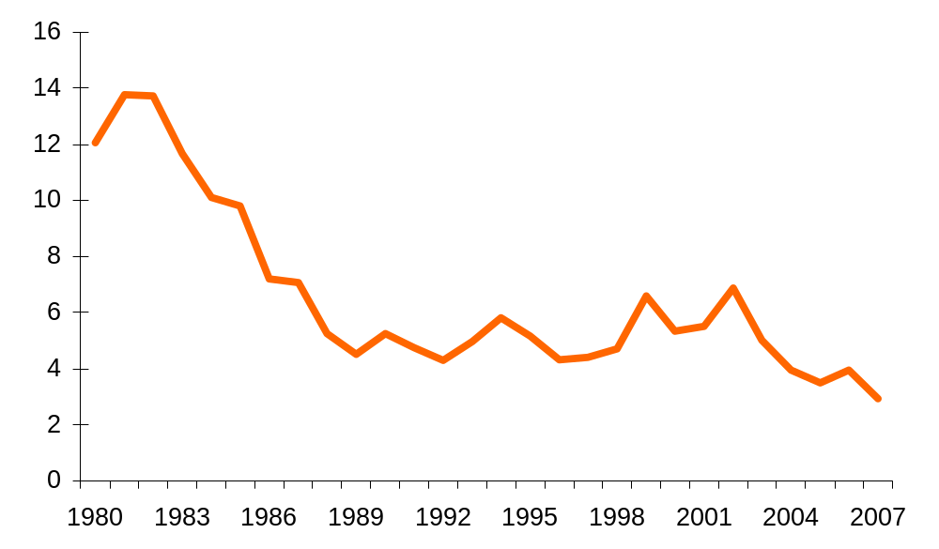
Spare Refinery Capacity Got Too Low
Ability to refine high sulfur crude oil was exhausted
The lack of spare refining capacity played a strong role in the run-up in oil prices in 2007-08; this is reversing in 2009-10.
Source: BP Statistical Review, Deutsche Bank

Slide 11
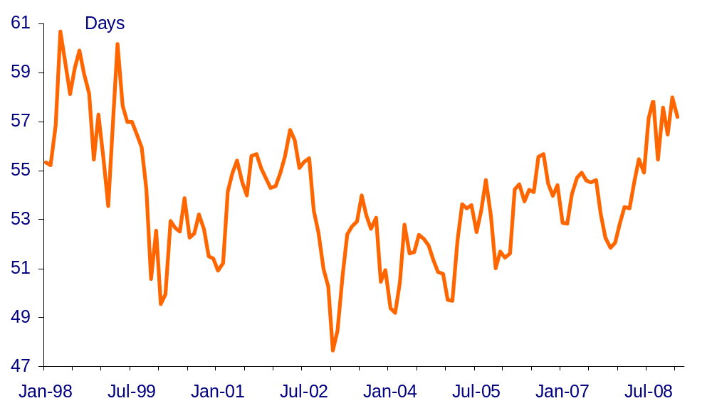
OECD Inventories Got Too Low
Days forward cover of OECD crude and product stocks
A sign of weakness in the oil markets giving way to a more neutral stance.
DEC 2007
Source: IEA, DB Global Markets Research

Slide 12
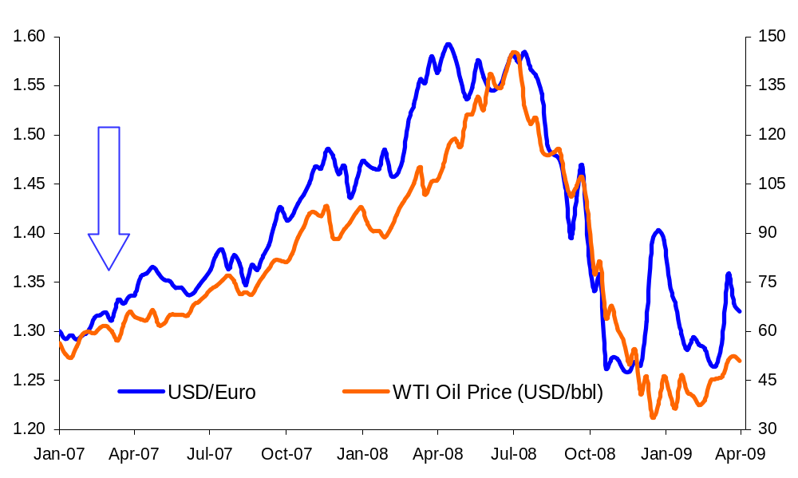
The Dollar Got Too Low
What is the shifting dollar doing to commodities and oil?
The dollar-oil regression is not perfect, but traders like it...
...and a study by the IMF says that gold and oil are sensitive to movements in the dollar.
Source: Nymex, Bloomberg, DB Global Markets Research

Slide 13
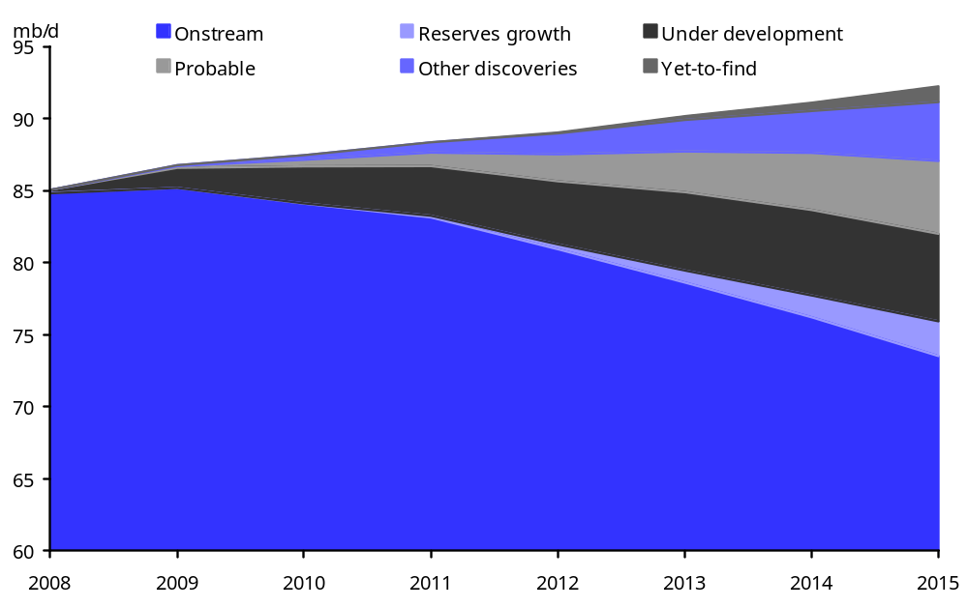
Declines Curves Got Too High
New developments are required for sustenance
Running hard to stay in place.
Estimates for global oil production suggest that, absent investment, today’s global oil production base of 84mb/d will decline to near 75mb/d by 2015.
Source: Wood Mackenzie,
DB Global Markets Research

Slide 14
What Else?
Speculation may have played some role
Geologic Limitations
Low Elasticities
Time Delays
Monopoly Pricing
Scarcity Rent
Source: James D. Hamilton, Understanding Crude Oil Prices, Energy Journal Vol 30, No 2, 2009

Slide 15

Why Do We Blame Speculators?
Because it’s fun to point fingers
…a more satisfying “sound-byte” than the complicated answer that involves a review of a large number of social and economic forces with inherent data limitations

Slide 16
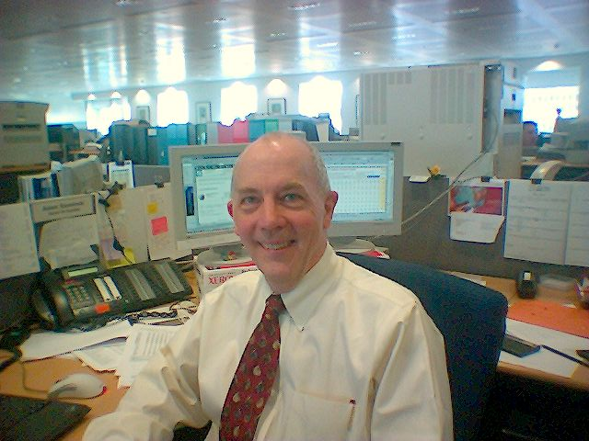
Adam Sieminski
Chief Energy Economist for Deutsche Bank, working with the Bank's global commodities research and trading units.
Drawing on extensive industry, government and academic sources, Mr. Sieminski forecasts energy market trends and writes on a variety of topics involving energy economics, climate change, politics and commodity prices. From 1998 to 2005 he served as the energy strategist for Deutsche Bank's global oil & gas equity team. Mr. Sieminski was the senior energy analyst for NatWest Securities in the US during 1988-1997, covering the major US international integrated oil companies. He received both his undergraduate degree in Civil Engineering and a masters in Public Administration from Cornell University.
He has been president of the US Association for Energy Economics and the National Association of Petroleum Investment Analysts. He is a member of the US National Petroleum Council, an advisory group to the US Secretary of Energy, and helped author the NPC's Global Oil and Gas Study: The Hard Truths. He also acts as a senior advisor for the Center for Strategic and International Studies in Washington and is an advisory board member of the Global Energy and Environment Initiative at Johns Hopkins / SAIS. He is a member of the London, New York and Washington investment professional societies, and holds the Chartered Financial Analyst (CFA) designation.

Slide 17
Analyst Certification
The views expressed in this report accurately reflect the personal views of the undersigned lead analyst. In addition, the undersigned lead analyst has not and will not receive any compensation for providing a specific recommendation or view in this report. Adam Sieminski
Global Disclaimer
Investing in and/or trading commodities involves significant risk and may not be suitable for everyone. Participants in commodities transactions may incur risks from several factors, including changes in supply and demand of the commodity that can lead to large fluctuations in price. The use of leverage magnifies this risk. Readers must make their own investing and trading decisions using their own independent advisors as they believe necessary and based upon their specific objectives and financial situation. Past performance is not necessarily indicative of future results. Deutsche Bank makes no representation as to the accuracy or completeness of the information in this report. Deutsche Bank may buy or sell proprietary positions based on information contained in this report. Deutsche Bank has no obligation to update, modify or amend this report or to otherwise notify a reader thereof. This report is provided for information purposes only. It is not to be construed as an offer to buy or sell any financial instruments or to participate in any particular trading strategy.
Unless governing law provides otherwise, all transactions should be executed through the Deutsche Bank entity in the investor’s home jurisdiction . In the U.S. this report is approved and/or distributed by Deutsche Bank Securities Inc., a member of the NYSE, the NASD, NFA and SIPC. In Germany this report is approved and/or communicated by Deutsche Bank AG Frankfurt authorised by Bundesanstalt für Finanzdienstleistungsaufsicht. In the United Kingdom this report is approved and/or communicated by Deutsche Bank AG London, a member of the London Stock Exchange and regulated by the Financial Services Authority for the conduct of investment business in the UK and authorised by Bundesanstalt für Finanzdienstleistungsaufsicht (BaFin). This report is distributed in Hong Kong by Deutsche Bank AG, Hong Kong Branch, in Korea by Deutsche Securities Korea Co. and in Singapore by Deutsche Bank AG, Singapore Branch. In Japan this report is approved and/or distributed by Deutsche Securities Inc. This report may not be reproduced, distributed or published by any person for any purpose without Deutsche Bank's prior written consent. Please cite source when quoting.
Copyright © 2009 Deutsche Bank AG
Appendix 1 – Certification and Disclaimer

Slide 18
Country-Specific Disclosures
Australia: This research, and any access to it, is intended only for "wholesale clients" within the meaning of the Australian Corporations Act.
EU countries: Disclosures relating to our obligations under MiFiD can be found at http://globalmarkets.db.com/riskdisclosures.
Japan: Disclosures under the Financial Instruments and Exchange Law: Company name - Deutsche Securities Inc. Registration number - Registered as a financial instruments dealer by the Head of the Kanto Local Finance Bureau (Kinsho) No. 117. Member of associations: JSDA, The Financial Futures Association of Japan. Commissions and risks involved in stock transactions - for stock transactions, we charge stock commissions and consumption tax by multiplying the transaction amount by the commission rate agreed with each customer. Stock transactions can lead to losses as a result of share price fluctuations and other factors. Transactions in foreign stocks can lead to additional losses stemming from foreign exchange fluctuations.
New Zealand: This research is not intended for, and should not be given to, "members of the public" within the meaning of the New Zealand Securities Market Act 1988.
Russia: This information, interpretation and opinions submitted herein are not in the context of, and do not constitute, any appraisal or evaluation activity requiring a license in the Russian Federation.
Appendix 1 - Regulatory Disclosures

