Slide 1


Speculation and Oil Price Volatility
Robert J. Weiner
Professor of International Business, Public Policy & Public Administration, and International Affairs George Washington University;
Membre Associé, GREEN, Université Laval
EIA Annual Conference
Washington
7 April 2009

Slide 2
FACTORS DRIVNG OIL PRICE VOLATILITY
Market fundamentals. Fluctuations in supply, demand, and market power
Some fundamentals related to expectations of future production, consumption, so not easily observable
Trading, especially speculation. Traders can move prices away from fundamental values in some circumstances
Speculation is the focus of this presentation

Slide 3
Some memorable experience highlights speculation
  Gulf Crisis as impetus for concern
  Oil prices spiked, then plummeted
  Little evident change in fundamentals
  Speculators, futures markets claimed responsible for market volatility
CRUDE OIL PRICES, $/barrel
40
35
30
25
20
Gulf
Crisis
15
1989
1990
1991

Slide 4
Speculation Widely Claimed to Drive Volatility
OPEC (Press Release, 14 July 2006)
“Geopolitical developments, over which OPEC has no influence, have been behind this sudden rise in volatility, and these have come at a time when the market was already out of line with today’s supply and demand fundamentals, with speculation playing a significant role in driving up prices.” (emphasis added)
Investment Analysts (Société Générale Cross-Asset Research, Multi-Asset Portfolio, October 2006)
“Exponential price rises observed since summer 2005 were not consistent with fundamental valuations (for example, 45% overvaluation, still, on current oil price)…Hedge funds have been a massive force amplifying the positive uptrend in commodity prices. At the peak of the commodity cycle, they held more than 17% of the most liquid of them, the oil market.” (emphasis added)

Slide 5
Speculation Widely Claimed to Drive Volatility, cont’d
US Senate Permanent Subcommittee on Investigations
The Role of Market Speculation in Rising Oil and Gas Prices: A Need to Put the Cop Back on the Beat, June 2006
“Based upon its investigation into the role of market speculation in rising oil and gas prices, the Subcommittee staff makes the following findings and recommendations.
A. Findings
1. Rise in Speculation. Over the past few years speculators have expended tens of billions of dollars in U.S. energy commodity markets.
2. Speculation Has Increased Prices. Speculation has contributed to rising U.S. energy prices, but gaps in available market data currently impede analysis of the specific amount of speculation, the commodity trades involved, the markets affected, and the extent of price impacts.”

Slide 6
HOWEVER…
Conventional wisdom: trading → volatility.
Based on intuition, not facts or systematic analysis
Economic theory → speculators cannot affect price levels, but could affect price volatility
A couple of studies using aggregate data do not find support for any effect (CFTC 2005, IMF 2006)
Some aggregate statistics cast doubt on view that speculation causes or exacerbates volatility
  Trading volumes increased in recent years
  Volatility remains high, but no clear trend
Speculators make convenient targets

Slide 7
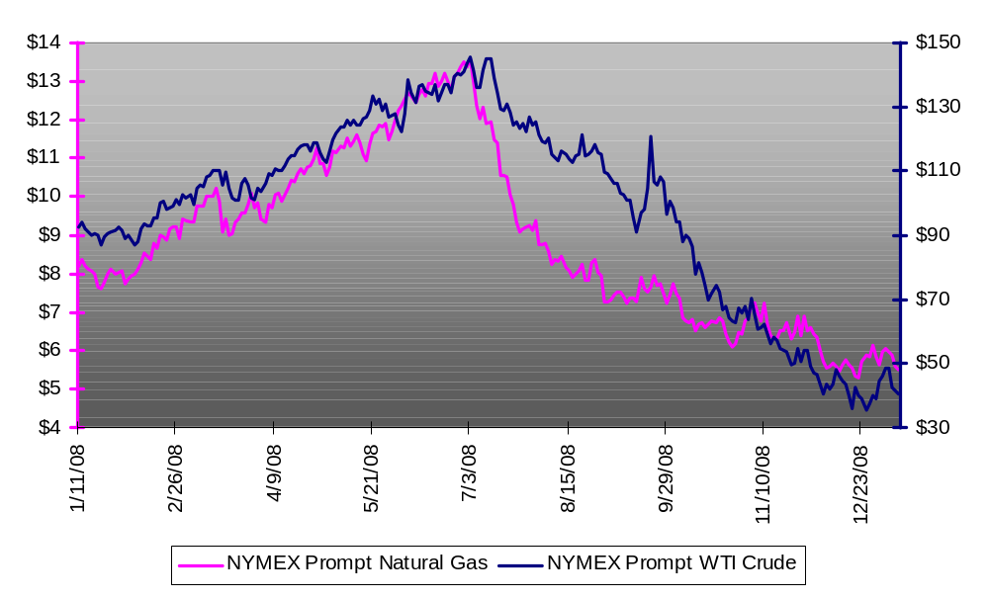
Elevated Volatility in 2008
  Financial firms, institutional investors entered & exited
-<number>-

Slide 8
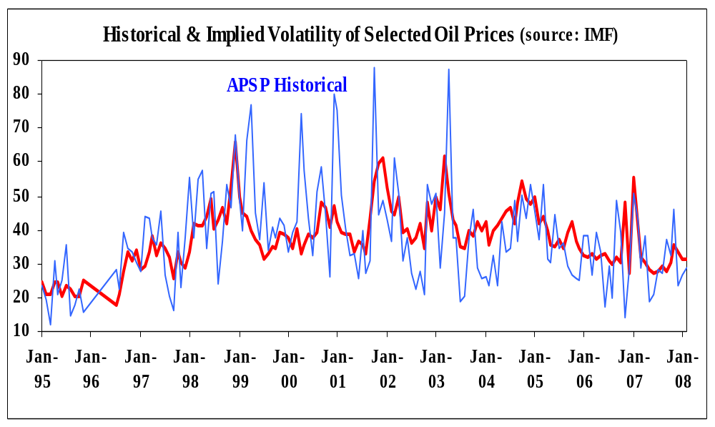
VOLATILITY HIGH BUT FLAT LAST DECADE Annualized standard deviation of daily crude-oil price changes
Source: IMF, APSP Avg. Producer Spot Price
Implied volatility from nearby Brent call options, 3 strike prices nearest the money

Slide 9
ANALYTICAL PERSPECTIVE
How can speculation influence price volatility?
Only two theoretical possibilities – dominant player or herding
First unrealistic – the market is too large and entry barriers too low
Second has long history in financial markets
”…I explained to you the instability of [stock] prices and the reasons therefore…and discussed the frenzy and foolishness of speculation. …As there are so many people who cannot wait to follow the prevailing trend of opinion, …they think only of doing what others do and following their examples” (de la Vega, Confusion de Confusiones, 1688)

Slide 10
What is Herding, and is it Rational?
Easier to recognize than define
Broadly, making decisions by observing others and copying them, rather than by assessing fundamentals
Can be rational if others are better informed. Wide-spread phenomenon: buying books on best-seller lists, choosing restaurants because they are crowded
In financial markets, fixed asset supply → can only take place among a subset of participants, e.g. speculators. “Flocking”
Herding can move prices away from fundamentals and exacerbate volatility. Possibility of “stampede” as speculators try to buy or sell simultaneously

Slide 11
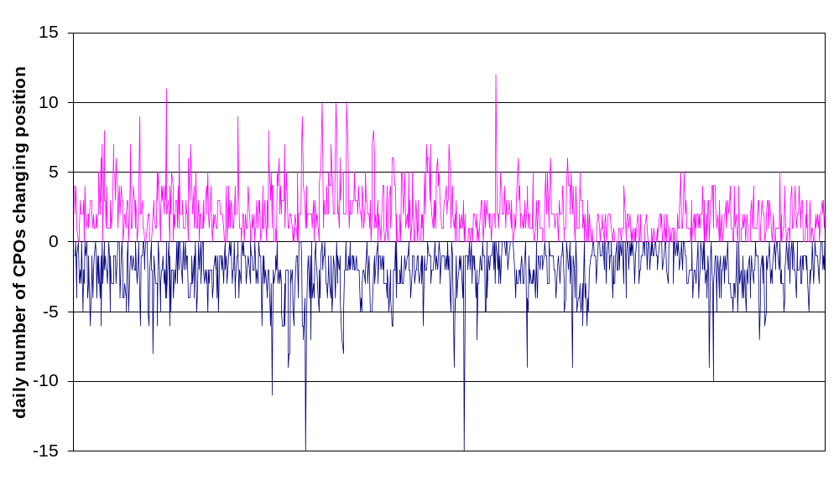
Do Commodity-pool Operators Herd in the Heating-oil Futures Market?

Slide 12
Summary of Analysis
Problem Actions of speculators difficult to monitor
Approach Use of CFTC microdata to measure parallel trading parallel trading in petroleum futures markets
Methodology Count number of speculators buying and selling each day, and test if most are on same side of the market

Slide 13
Summary of Findings
No evidence of parallel trading among commercial participants -- petroleum companies or financial institutions -- in crude-oil or heating-oil futures
No evidence of parallel trading among speculators (noncommercial participants) as a group in the crude-oil or heating-oil futures markets
Strong statistical evidence of flocking among fund managers in these markets, but levels moderate
Interpretation Roughly half the active speculators buying, rest selling on any day→ effect of trading on pieces limited

Slide 14
Implications
Oil Prices Reflect Fundamentals, not Speculation
Oil prices determined by current supply and demand, and expectations of future supply and demand
Widely heard claim that speculation is adding $X to oil price incorrect. Best guess: X=0
Futures reasonable basis for oil-price forecasts. Forecasts that diverge from futures prices subject to scrutiny
Need to examine fundamentals to understand oil market causes and consequences

Slide 15
Implications (cont’d)
Data scarcity, lack of market transparency serve industry, government, and the public poorly
Aggregate data (CFTC COT) widely used, yet not useful for addressing role of speculation in oil markets
Data void, market opacity → low-quality reports, policy analysis based on opinions or ideology
Herding calculation possible only because of CFTC/DOE cooperation
Regular reporting in other financial markets (e.g., FX, interest rates). Not difficult to break out petroleum in BIS reporting, enabling a handle on market size

Slide 16
For those interested in the gory details
The study is on the web:
www.rff.org/News/Features/Pages/Do-Birds-of-a-Feather-Flock-Together.aspx

