Slide 1
Investing in Oil and Natural Gas
Opportunities and Barriers
EIA Energy Conference
April 8, 2009
Bruce Bawks
Energy Information Administration
Notes:
Title Page

Slide 2
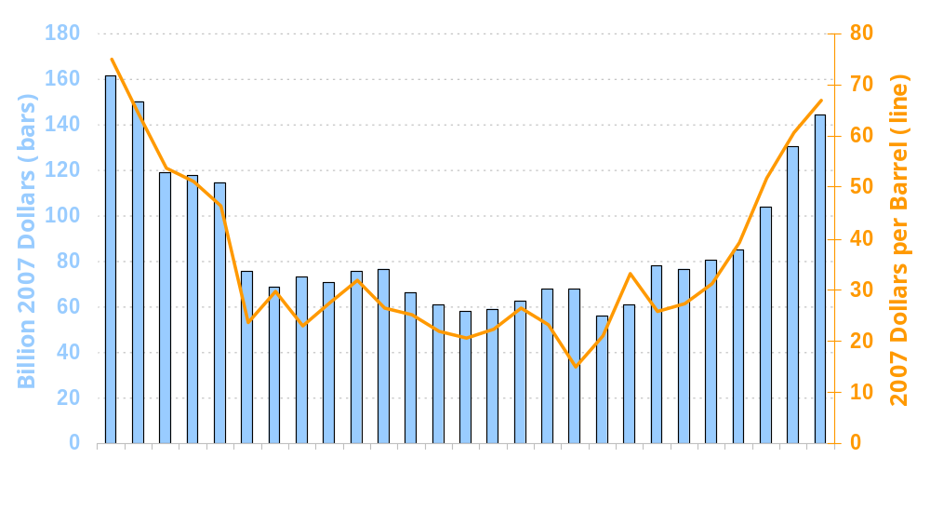
Expenditures for Exploration, Development, and Production Tend to Follow Changes in Crude Oil Prices
Expenditures for Exploration, Development, and Production (left)
Crude Oil Price (right)

Slide 3
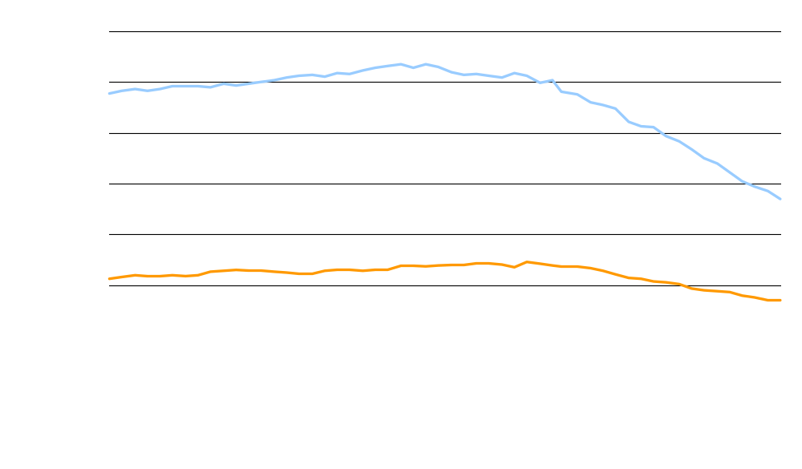
U.S. Rig Counts Have Declined
Substantially in the Past Few Months
Natural Gas
Oil
Source: Baker Hughes Inc.

Slide 4
Energy Information Administration
www.eia.doe.gov
Bruce Bawks
Bruce.Bawks@eia.doe.gov
202-586-6579

