Slide 1
Investing in Oil and Natural Gas:
A Few Key Issues
Prepared for EIA Conference
Susan Farrell, Senior Director
PFC Energy
April 8, 2009

Slide 2
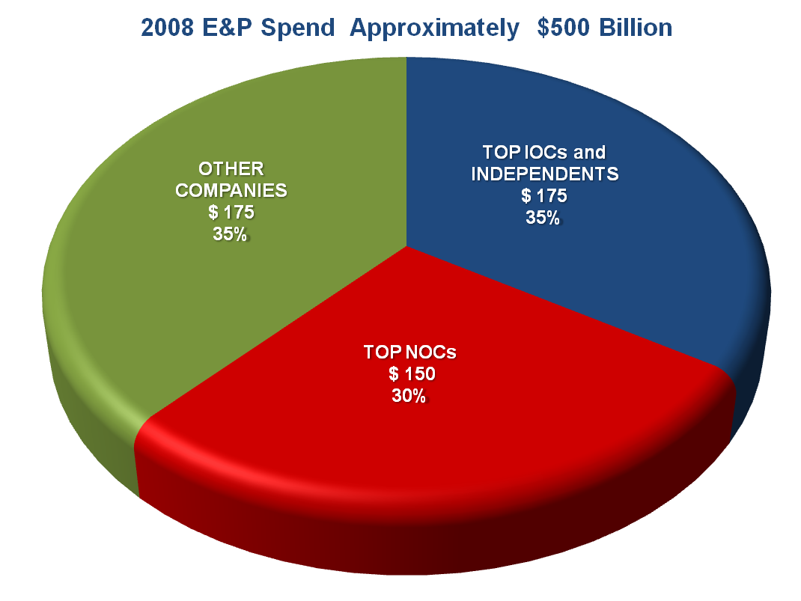
The Top 20 IOCs and Top 20 NOCs Account for Over Half of E&P Spend
Source: PFC Energy, Global E&P Surveys

Slide 3
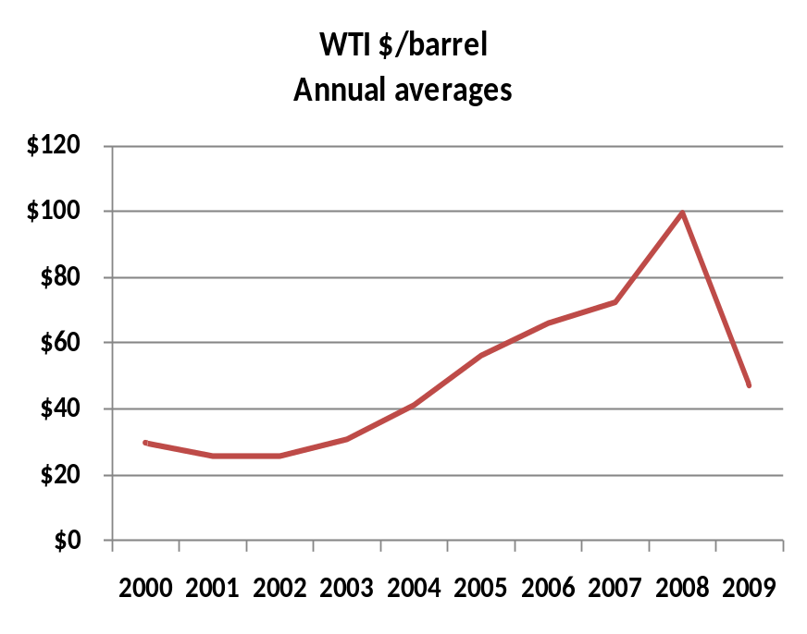
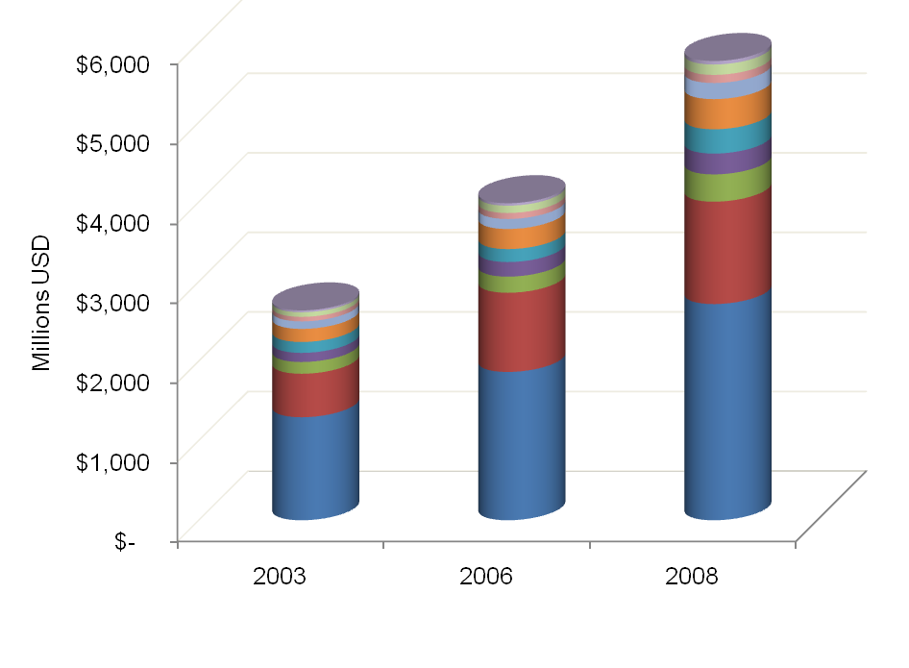
Oil Prices Rose, But So Did Costs
Avg $59.13
Large Gulf of Mexico Facility Costs by Segment
Avg $28.31
+ 52%
Source: PFC Energy

Slide 4
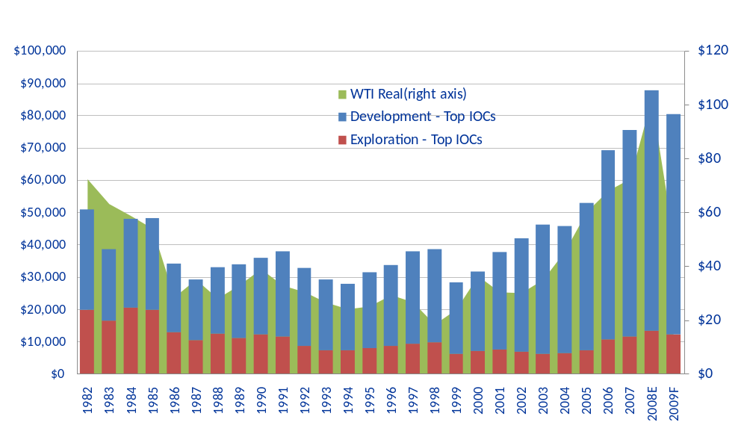
Near term Spending Cuts will be Significant
E&P Spending by Selected IOCs
Further cuts expected
2007 $mm
Oil Price 2007 $/bbl
-24%
-29%
-27%
Source: PFC Energy, Global E&P surveys

Slide 5
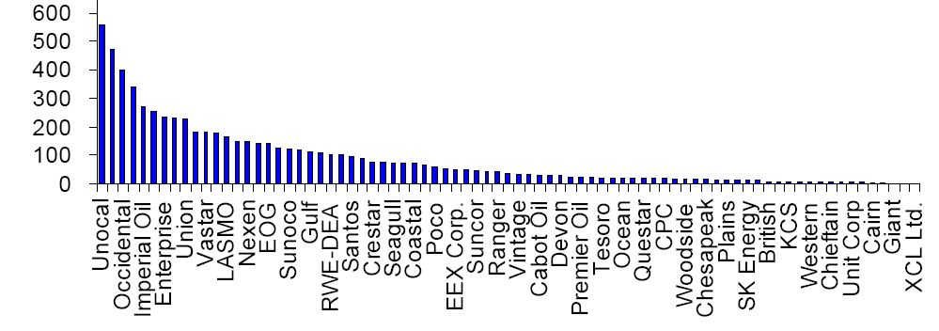
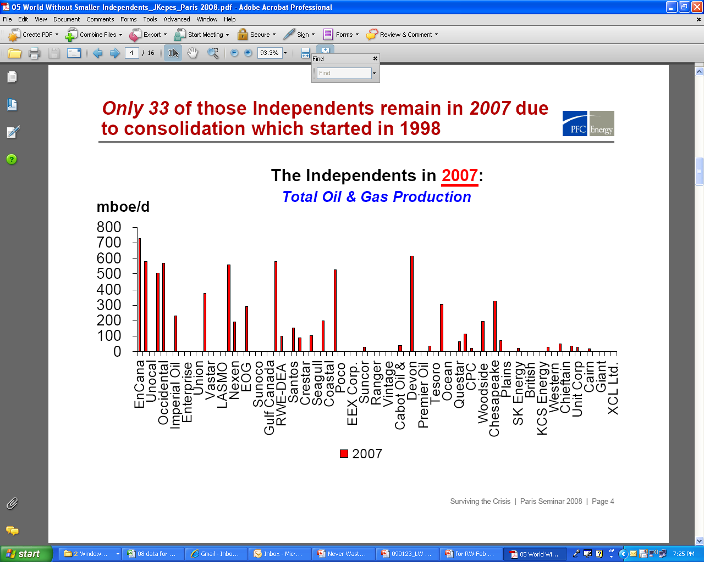
Some Companies will Disappear:
46 of 79 Independents No Longer Exist
000 mbd
1995
2007
Source: PFC Energy

Slide 6
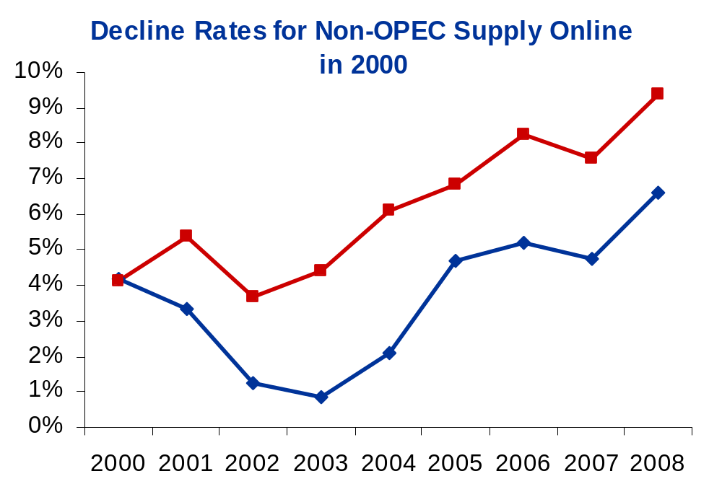
Non-OPEC Decline Rates Continued to Climb in Spite of Higher Prices
Source: PFC Energy

Slide 7
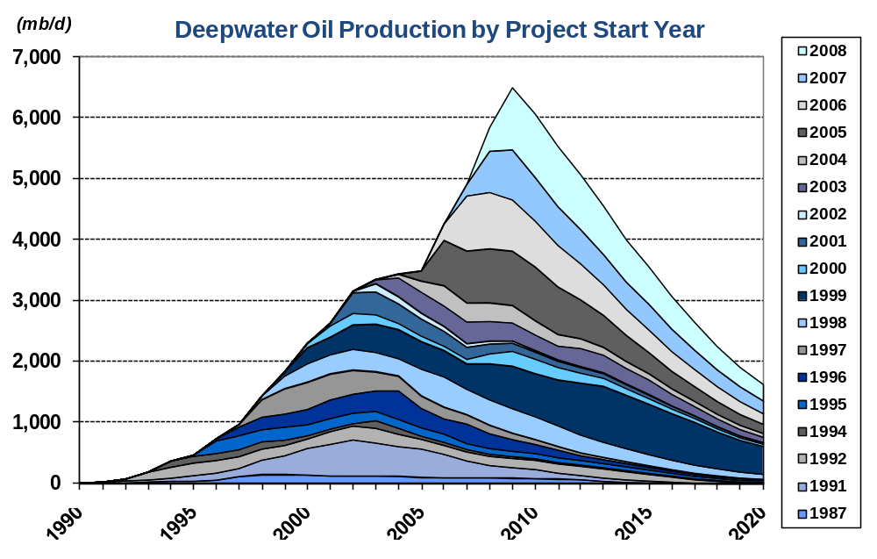
The Deepwater Contribution … Can it Continue?
12% average annual decline rate
Source: PFC Energy

Slide 8
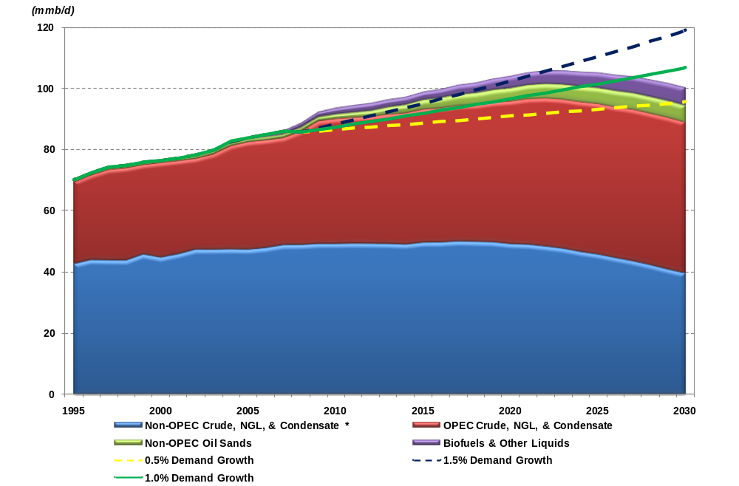
The Global Liquids Supply Crunch Still Exists
Demand
1.5%
Tar Sands
Biofuels
1.0%
0.5%
OPEC Liquids
Non-OPEC Liquids
Source: PFC Energy

Slide 9
