Slide 1


Household Vehicles Energy Use: Latest Data & Trends
Report Figures as of Aug 30, 2005*
Energy Information Administration
Official Energy Statistics from the U.S. Government
*Figures may differ from the published report available on www.eia.doe.gov/emeu/rtecs/contents.html.

Slide 2
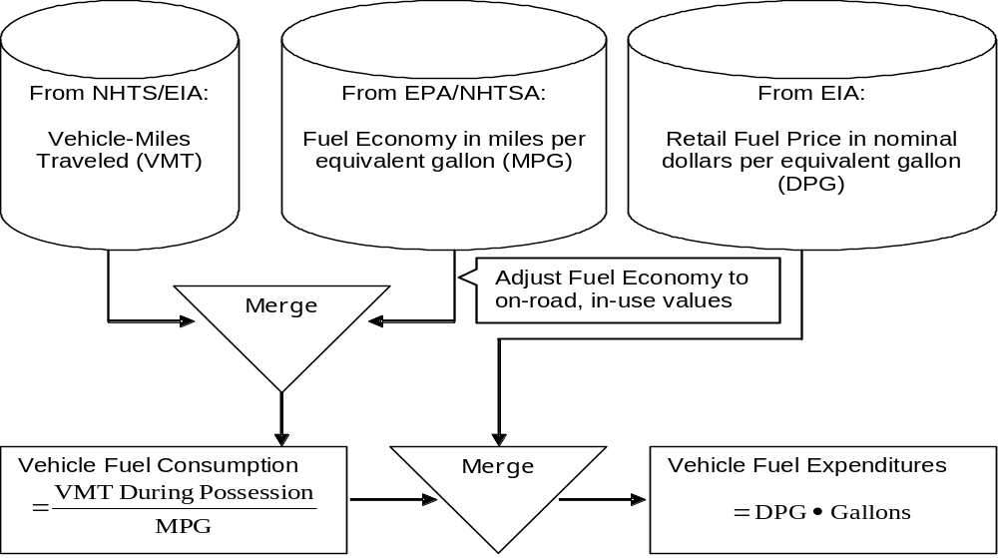
Figure ES1. Schema for Estimating Energy and Energy-Related Statistics, 2001

Slide 3
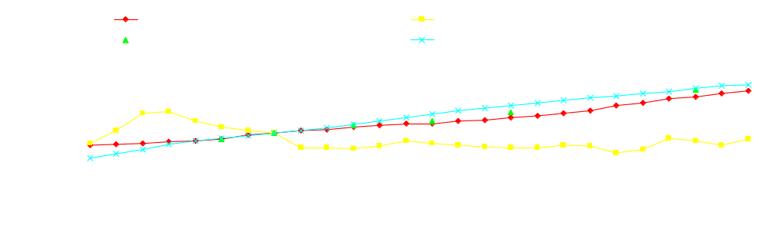
Figure ES2. Annual Indices of Real Disposable Income, Vehicle-Miles Traveled, Consumer Price Index (CPI-U), and Real Average Retail Gasoline Price, 1978-2003, 1985=100
While the real retail price of gasoline has risen and fallen over the past two decades, there has been an overall decline of 1.3 percent per year between 1983 and 2001, with substantial drops in 1986 and 1998 and somewhat smaller ones in 1991 and 2001 (see Figure E1 for a Chronology of World Oil Prices, as this price explains most of the variations found in refined gasoline prices). In contrast, the prices of other consumer products[1] have risen dramatically, taking a higher real percentage of consumers’ budgets. Given the minor role fuel prices have played in determining vehicle use, there is little surprise that vehicle-miles traveled is better correlated with disposable income than retail prices; furthermore, the improvement in energy intensity, though unexceptional, might have further weakened a diminished price signal by mitigating the effect of fuel prices, where consumers could travel further on a single dollar of transportation fuel. Given that retail price is primarily based on the price paid for crude oil, price signals to consumers should mimic world crude oil prices, which have exceeded $50 per barrel (bbl) – at times surpassing $60 per bbl.[2]
[1] See components of the Consumer Price Index conducted by the U.S. Bureau of Labor Statistics.
[2] See Federal Trade Commission, Gasoline Price Changes: the Dynamic of Supply, Demand, and Competition, July 5, 2005, Washington, DC. Accessed http://www.ftc.gov/opa/2005/07/gaspricefactor.htm on July 25, 2005.

Slide 4

Figure ES3. Sales-Weighted Horsepower and On-Road Fuel Mileage for New Light-Duty Vehicles, 1975-2004 Model Years
Tracking an economy’s energy intensity – one measure of energy performance – as the ratio of energy per Gross Domestic Product (GDP) or the environmentally analogous intensity of carbon dioxide emitted per GDP[1] is common in energy economics, and such a technique can be applied to transport. Instead of a ratio of economy-wide energy use per GDP, a ratio of gasoline-equivalent gallons (GEG) per vehicle-miles traveled for the entire vehicle stock is calculated. That overall intensity of energy use has steadily improved since 1983, though the greatest strides in lowering (improving) energy intensity had occurred before 1991. Post-1991 intensity improvements (i.e., energy performance) slowed dramatically, yielding an overall annual improvement of 1.6 percent between 1983 and 2001, as compared to the 3.2 and 4.2 percent gains seen in the 1983-1985 and 1985-1988 time periods, respectively. As evidence of the lopsided improvement in the nation’s energy performance, this report also decomposes the change in energy use over time.
[1] Emissions from petroleum-powered vehicles are directly proportional to energy use.

Slide 5

Sales-Weighted Horsepower and On-Road Fuel Mileage for New Light-Duty Vehicles, 1980-2004 Model Years
Tracking an economy’s energy intensity – one measure of energy performance – as the ratio of energy per Gross Domestic Product (GDP) or the environmentally analogous intensity of carbon dioxide emitted per GDP[1] is common in energy economics, and such a technique can be applied to transport. Instead of a ratio of economy-wide energy use per GDP, a ratio of gasoline-equivalent gallons (GEG) per vehicle-miles traveled for the entire vehicle stock is calculated. That overall intensity of energy use has steadily improved since 1983, though the greatest strides in lowering (improving) energy intensity had occurred before 1991. Post-1991 intensity improvements (i.e., energy performance) slowed dramatically, yielding an overall annual improvement of 1.6 percent between 1983 and 2001, as compared to the 3.2 and 4.2 percent gains seen in the 1983-1985 and 1985-1988 time periods, respectively. As evidence of the lopsided improvement in the nation’s energy performance, this report also decomposes the change in energy use over time.
[1] Emissions from petroleum-powered vehicles are directly proportional to energy use.

Slide 6

Figure ES4. Sales-Weighted Inertia Weight and On-Road Fuel Mileage for New Light-Duty Vehicles, 1975-2004 Model Years
Tracking an economy’s energy intensity – one measure of energy performance – as the ratio of energy per Gross Domestic Product (GDP) or the environmentally analogous intensity of carbon dioxide emitted per GDP[1] is common in energy economics, and such a technique can be applied to transport. Instead of a ratio of economy-wide energy use per GDP, a ratio of gasoline-equivalent gallons (GEG) per vehicle-miles traveled for the entire vehicle stock is calculated. That overall intensity of energy use has steadily improved since 1983, though the greatest strides in lowering (improving) energy intensity had occurred before 1991. Post-1991 intensity improvements (i.e., energy performance) slowed dramatically, yielding an overall annual improvement of 1.6 percent between 1983 and 2001, as compared to the 3.2 and 4.2 percent gains seen in the 1983-1985 and 1985-1988 time periods, respectively. As evidence of the lopsided improvement in the nation’s energy performance, this report also decomposes the change in energy use over time.
[1] Emissions from petroleum-powered vehicles are directly proportional to energy use.

Slide 7

Sales-Weighted Inertia Weight and On-Road Fuel Mileage for New Light-Duty Vehicles, 1980-2004 Model Years
Tracking an economy’s energy intensity – one measure of energy performance – as the ratio of energy per Gross Domestic Product (GDP) or the environmentally analogous intensity of carbon dioxide emitted per GDP[1] is common in energy economics, and such a technique can be applied to transport. Instead of a ratio of economy-wide energy use per GDP, a ratio of gasoline-equivalent gallons (GEG) per vehicle-miles traveled for the entire vehicle stock is calculated. That overall intensity of energy use has steadily improved since 1983, though the greatest strides in lowering (improving) energy intensity had occurred before 1991. Post-1991 intensity improvements (i.e., energy performance) slowed dramatically, yielding an overall annual improvement of 1.6 percent between 1983 and 2001, as compared to the 3.2 and 4.2 percent gains seen in the 1983-1985 and 1985-1988 time periods, respectively. As evidence of the lopsided improvement in the nation’s energy performance, this report also decomposes the change in energy use over time.
[1] Emissions from petroleum-powered vehicles are directly proportional to energy use.

Slide 8

Figure ES5. Actual Annual Energy Growth – All Effects Are Included
Consumers’ energy needs for travel using personally owned vehicles (POV) grew unevenly between 1988 and 2001, averaging 2.46 percent per year. Measuring…

Slide 9

Figure ES6. Fuel Economy Effects on Annual Energy Growth
the effect on the change in energy use from improving technologies shows that Fuel Economy effects had dampened energy use, but those effects have sharply diminished over time, suggesting significant savings occurred prior to 1991 and much less so in following years. By excluding the effects of technology advancements affecting fuel economy…

Slide 10

Figure ES7. Adjusted Annual Energy Growth – No Fuel Economy Effects
energy use would have surged to even higher levels, climbing higher than the actual amounts because of those exclusions – 2.30 percent per year versus 0.16 percent between 1988 and 1991; 4.35 percent versus 3.03 percent between 1991 and 1994; 4.03 percent versus 3.22 percent between 1994 and 2001, resulting in billions of gallons of energy “savings” and decreasing, though at a declining rate, the nation’s exposure to oil.

Slide 11
Program Contacts
Mark Schipper, Program Manager
  Mark.Schipper@eia.doe.gov
  (202) 586-1136 (voice)
Derrick Pinckney, Survey Statistician
  Derrick.Pinckney@eia.doe.gov
  (202) 586-5744 (voice)
Other Consumer-based Energy Information
  (202) 586-8800 (voice)

