Slide 1

North American Energy Outlook
For
Energy Mexico 2017
January 31, 2017 | Mexico City, Mexico
By
Howard Gruenspecht, Acting Administrator

Slide 2
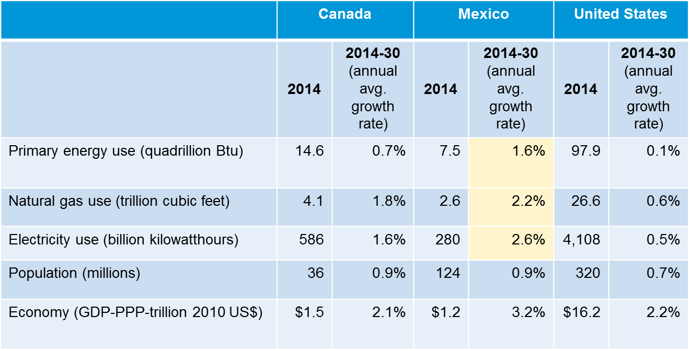
North American energy demand outlook
Source: EIA, Annual Energy Outlook 2017; International Energy Outlook 2016, International Energy Statistics Database, and Oxford Economics

Slide 3
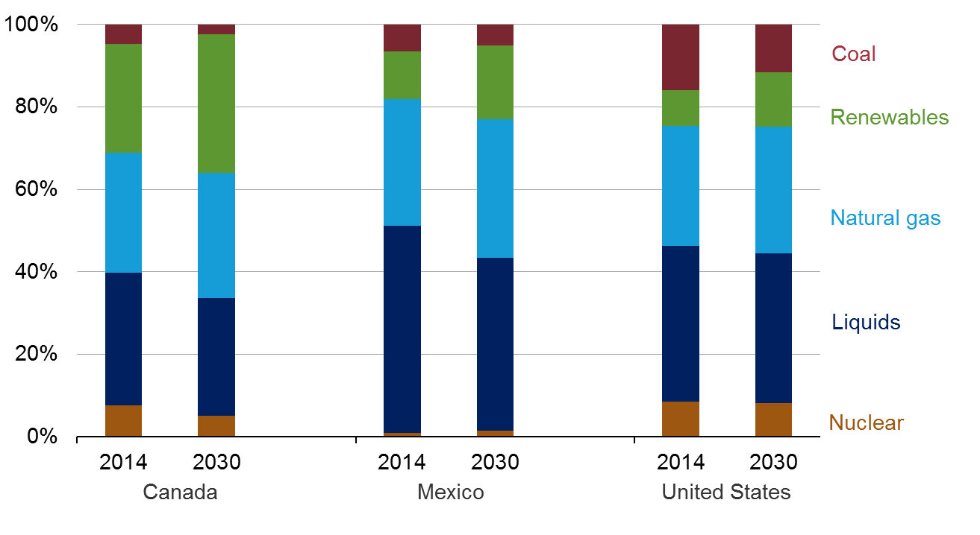
Mix of energy consumed in North America, 2014 and 2030
energy consumption
percent of total
Source: EIA, Annual Energy Outlook 2017, International Energy Outlook 2016

Slide 4
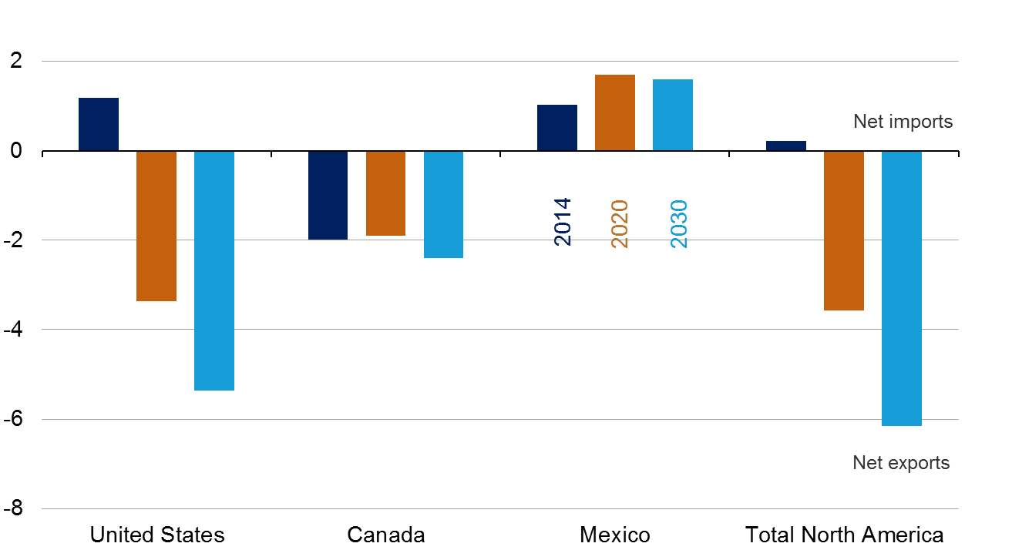
Although U.S. exports to Mexico are projected to grow through 2020, LNG exports accounts for over half of U.S. exports by 2020
North American net natural gas trade, 2014-30
trillion cubic feet
Source: EIA, Annual Energy Outlook 2017, International Energy Outlook 2016

Slide 5
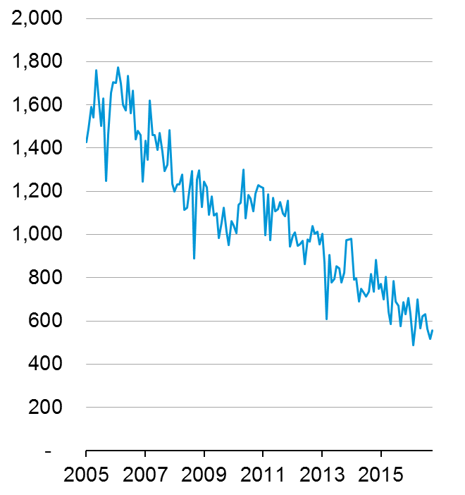
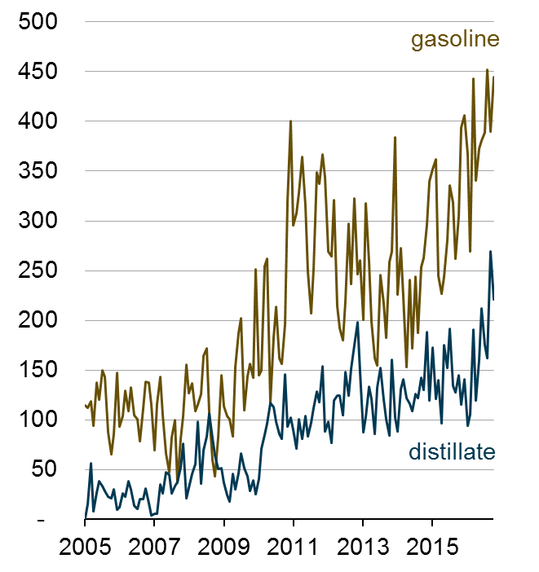
As U.S. imports of Mexican crude oil decline, U.S. product exports to Mexico increase
U.S. crude oil imports from Mexico
thousand barrels per day
U.S. gasoline and distillate exports to Mexico
thousand barrels per day
Source: EIA, Form EIA-814 "Monthly Import Report", U.S. Census Bureau and EIA estimates

Slide 6
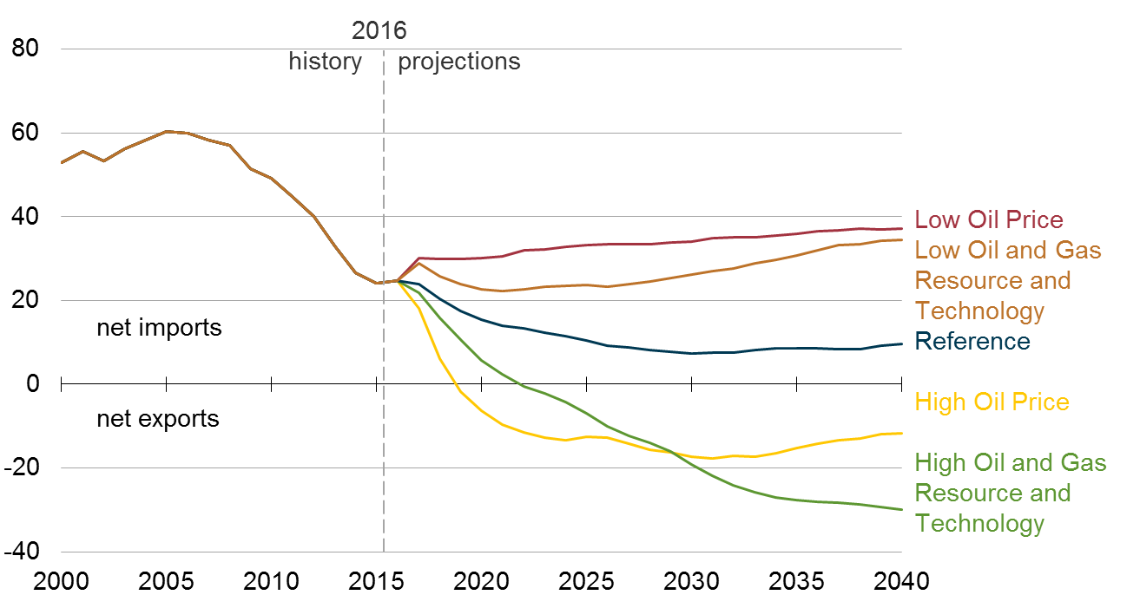
Projected U.S. net oil exports are sensitive to assumptions made regarding resources, technology, and world oil market prices
Petroleum net imports as a percentage of products supplied
percent
Source: EIA, Annual Energy Outlook 2017

Slide 7
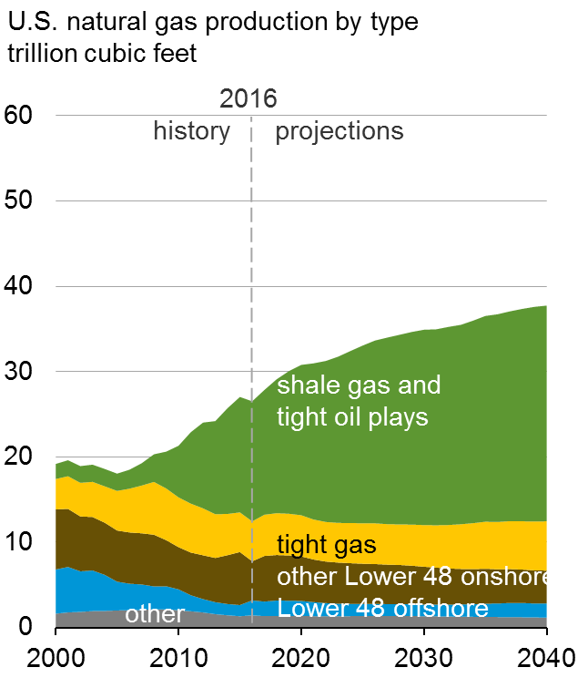
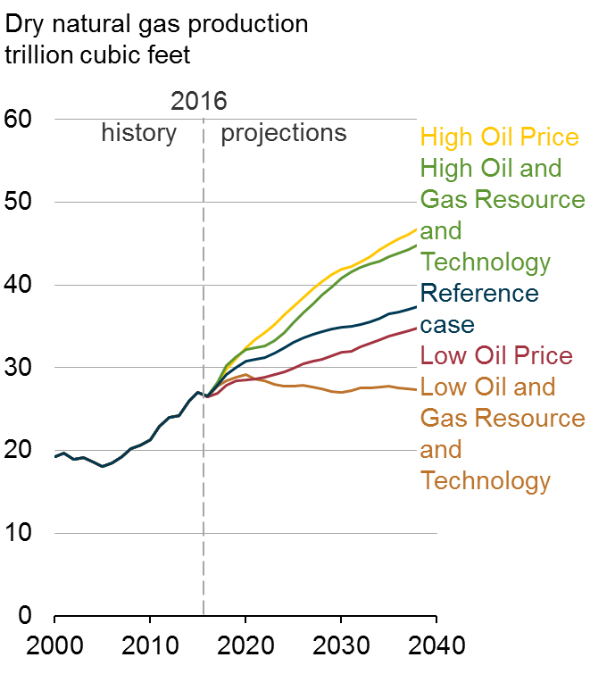
U.S. natural gas production is driven by continued development of shale gas and tight oil plays; projections vary significantly under alternative assumptions
Source: EIA, Annual Energy Outlook 2017

Slide 8
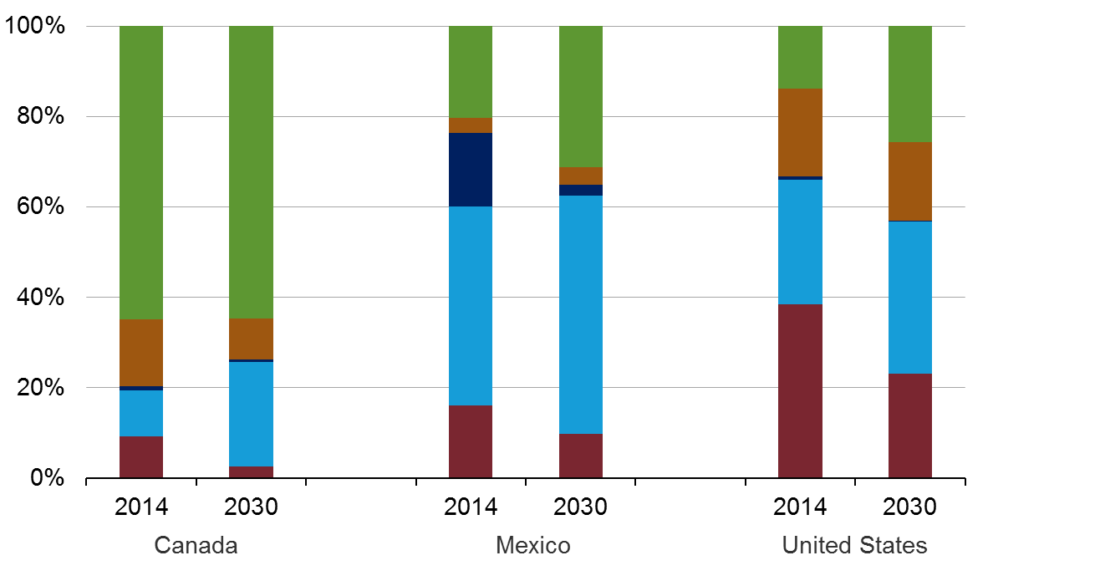
Renewables share of North America electricity mix expected to rise
share of North American electricity
percent of total
Renewables
Nuclear
Liquids
Natural gas
Coal
Source: EIA, Annual Energy Outlook 2017, International Energy Outlook 2016

Slide 9
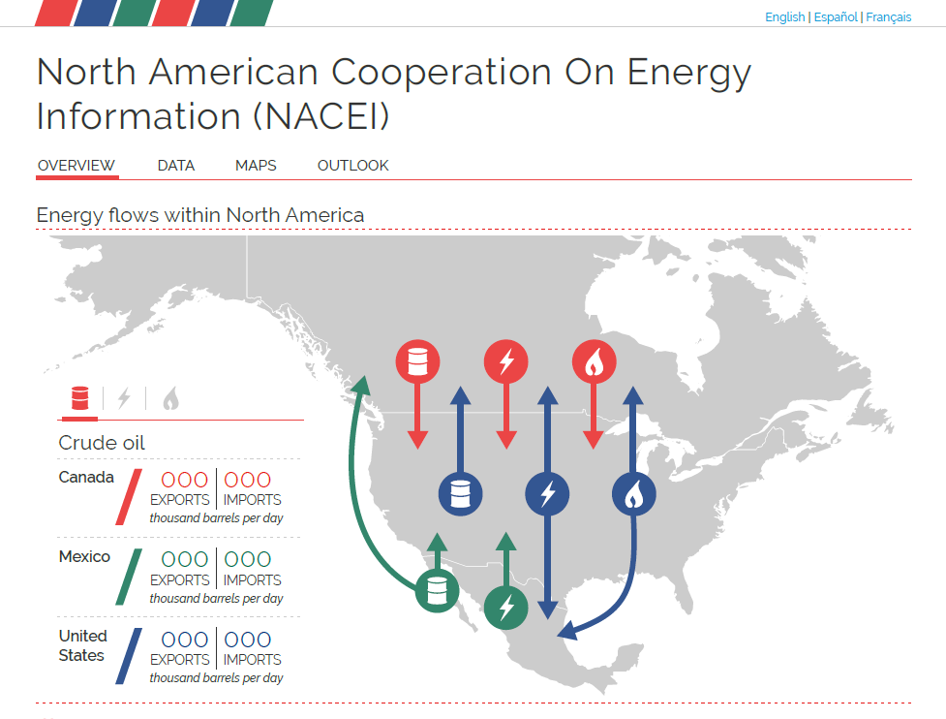
www.nacei.org

Slide 10
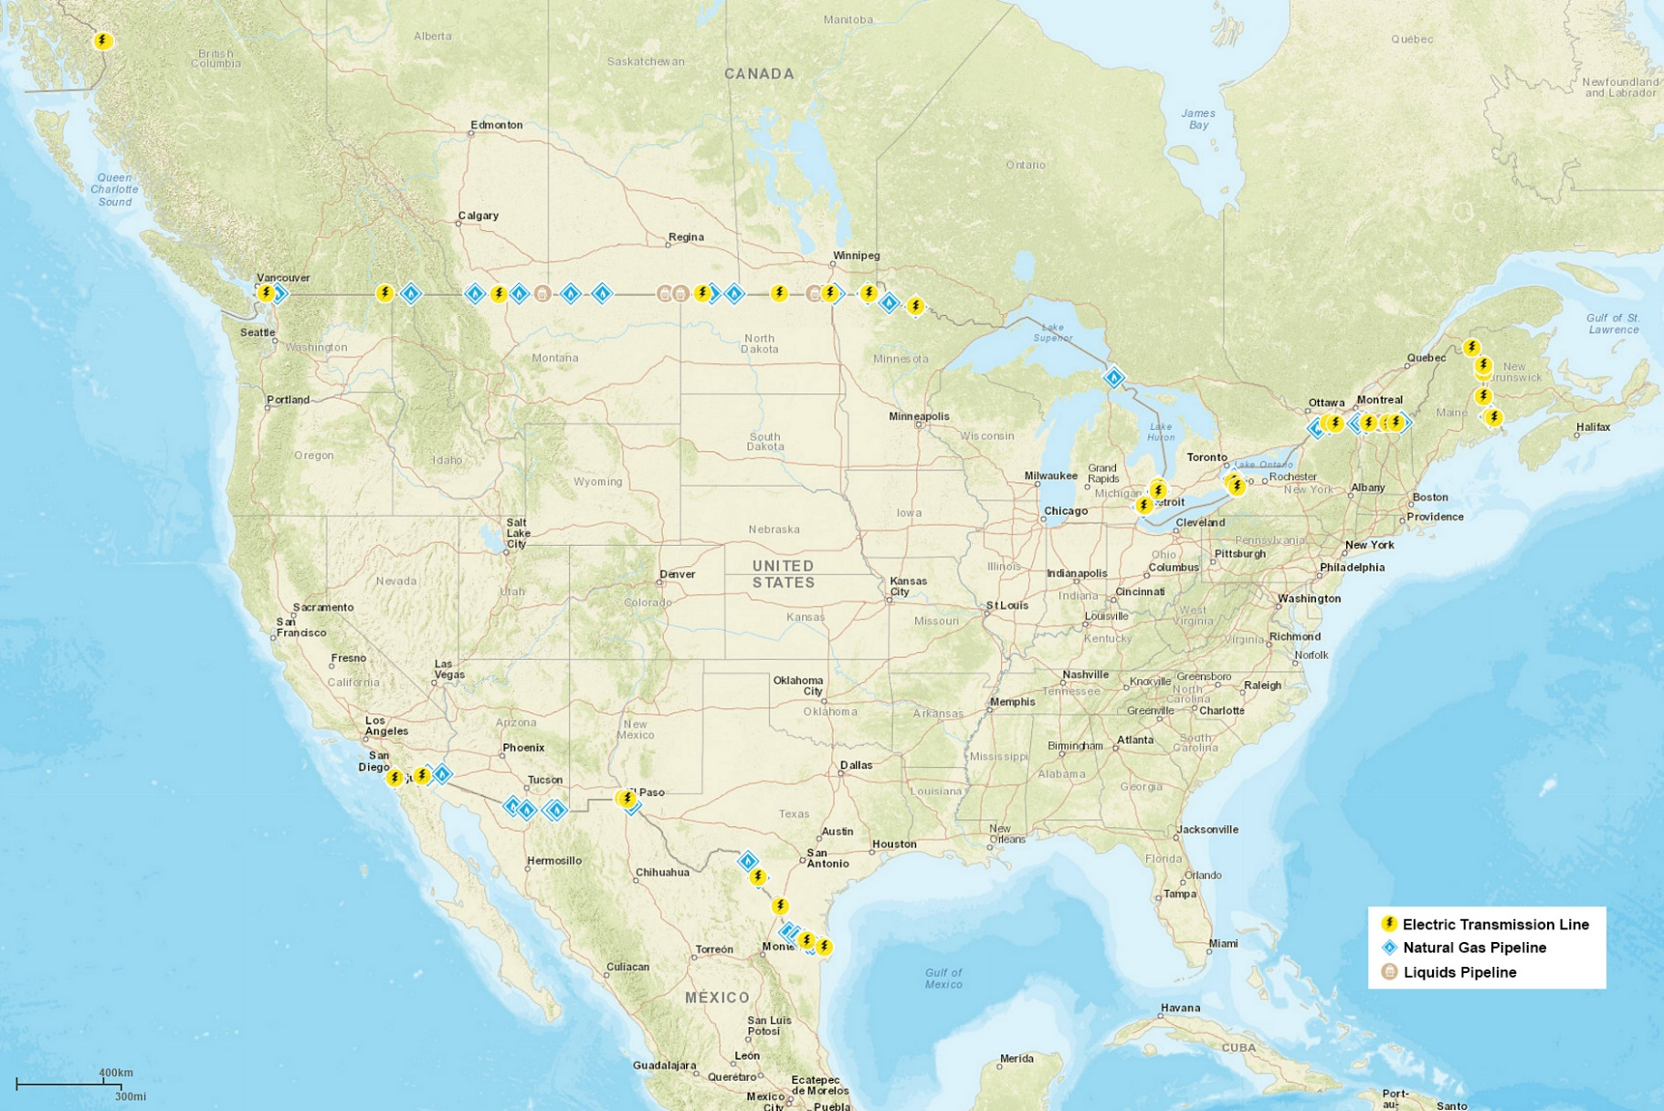
Border Crossing Points in North America
www.nacei.org

Slide 11
For more information
U.S. Energy Information Administration home page | www.eia.gov
International Energy Outlook | www.eia.gov/ieo
Annual Energy Outlook | www.eia.gov/aeo
Short-Term Energy Outlook | www.eia.gov/steo
Monthly Energy Review | www.eia.gov/mer
Today in Energy | www.eia.gov/todayinenergy
International Energy Portal | www.eia.gov/beta/international
North American Cooperation on Energy Information | www.nacei.org

