Slide 1

Major Changes in Natural Gas Transportation Capacity, 1998 – 2008
The following presentation was prepared to illustrate graphically the areas of major growth on the national natural gas pipeline transmission network between 1998 and 2008.
Two maps are used to provide a generalized depiction of pipeline capacity levels along the various major natural gas pipeline transportation corridors that span the United States. The upper map depicts the corridor sizes as they existed in 1998. The lower map shows these same corridors, with their relative capacities, as of the end of 2008.
Next →
Prepared by James Tobin
Office of Oil and Gas
James.Tobin@eia.doe.gov
November 2008

Slide 2
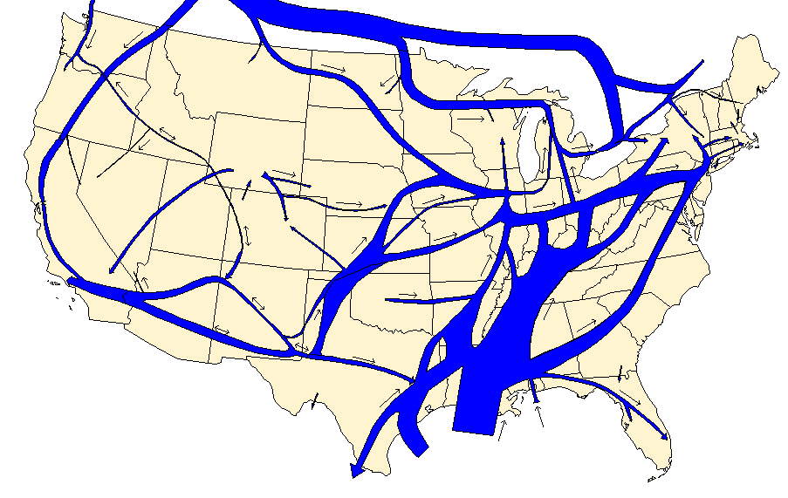
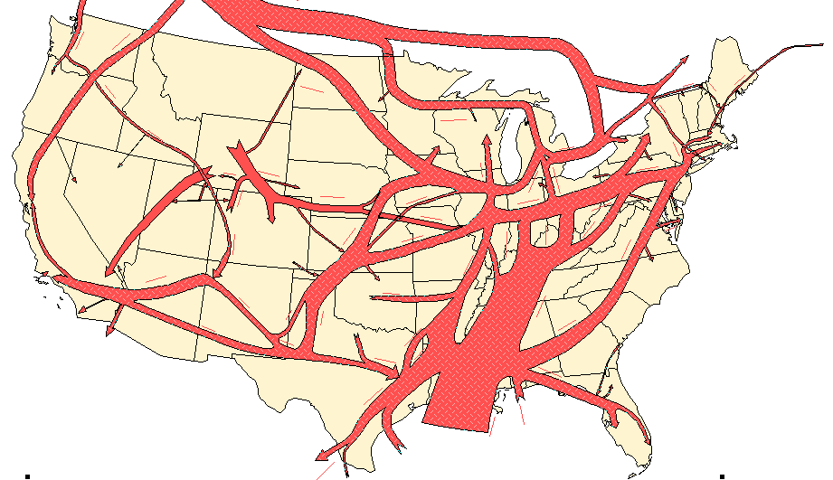
U.S. Natural Gas Pipeline Additions 1998-2008
More than 20,000 miles of new natural gas transmission pipeline, representing more than 97 billion cubic feet per day of capacity, were placed in service in the United States over the past 10 years.
Much of that growth was driven by the need to:
access new supply sources such as:
- imports from Canada
- expanding production from new natural gas fields
meet increased demand from new natural-gas-fired electric power plants.
Details on next slides…
1998
2008
Capacity
(million cubic feet per day)
15,000
9,000
3,000
= Direction of
= Direction of Flow
= Bi-directional

Slide 3
Summary of Major Additions to Natural Gas Transportation Capacity 1998- 2008
Wyoming – Expansion of the intrastate pipeline systems in the Green River and Powder River basins and an increase in interstate pipeline capacity towards Midwest and Western markets.
Canadian Border Import Growth – Completion of Alliance Pipeline and expansion of the Northern Border Pipeline system.
Canadian Border Export – Completion of the Vector Pipeline system designed to transport supplies back to Canada.
Midwest – Completion of Cheyenne Plains and Rockies Express Pipelines to transport Wyoming/Colorado production to the Midwest.
Wyoming/Utah/Nevada Doubling of capacity on the Kern River system.
New England – Completion of the Maritimes & Northeast and the Portland Natural Gas pipeline systems.
New Mexico/Arizona – Expansion of the Transwestern, El Paso Natural Gas, and Questar systems.
Capacity
(million cubic feet per day)
15,000
9,000
3,000
= Direction of
= Direction of Flow
= Bi-directional
California – Completion of the North Baja Pipeline adding export capacity to Mexico.
Texas – Expansion of intrastate pipeline network in the Barnett Shale formation area and to interstate pipelines for transport to midwestern and eastern natural gas markets.
Florida – Completion of the Gulfstream Pipeline system and expansion of Florida Gas Transmission system.
Louisiana – Capacity to accommodate new deepwater production.

Slide 4
Northern New England Expansion Brings in Offshore Canadian Natural Gas
1998
In 1999, the Maritimes & Northeast Pipeline and the Portland Natural Gas Transmission systems were the first pipelines to bring significant quantities (0.7 billion cubic feet per day) of Canadian natural gas to northern New England.
2008
Capacity
(million cubic feet per day)
15,000
9,000
3,000
= Direction of
= Direction of Flow
= Bi-directional

Slide 5
Export Capacity to Eastern Canada Increases Significantly
In 2000, the 1 billion cubic foot per day (Bcf/d) Vector system was completed, increasing the capacity along this corridor by about 45 percent.
The Vector system provides shippers with the capability to move their natural gas from the Chicago (Illinois) Hub to underground storage facilities and customers in Ontario, Canada, and in Michigan. Much of the natural gas transported on Vector is produced and transported from western Canada to the Aux Sable processing plant in northern Illinois, where it is then shipped back to eastern Canada.
Since its initialization in 2000, the Vector system has been expanded once, by 0.25 Bcf/d, or 25 percent in 2007. Another 0.1 Bcf/d expansion is slated for completion in 2009.
1998
2008
Capacity
(million cubic feet per day)
15,000
9,000
3,000
= Direction of
= Direction of Flow
= Bi-directional

Slide 6
Natural Gas Pipeline Capacity into Florida Doubles
1998
Since 1998, natural gas pipeline capacity into the State of Florida has more than doubled, increasing more than 2.2 billion cubic feet per day (Bcf/d). In 2002, the Gulfstream Natural Gas System was completed, accounting for 1.1 Bcf/d. Between 1999 and 2007, the existing Florida Gas Transmission system added 750 million cubic feet per day (MMcf/d). In 2007, completion of the Cypress Pipeline, transporting natural gas from the Elba Island liquefied natural gas import facility in Georgia, provided an additional 355 MMcf/d to the State.
Most of this expansion in capacity was to meet the demands of new natural-gas-fired electric generation plants built in Florida during the past 10 years.
2008
Capacity
(million cubic feet per day)
15,000
9,000
3,000
= Direction of
= Direction of Flow
= Bi-directional

Slide 7
Gulf of Mexico Capacity Increases Despite Production Decreases
1998
Despite a 44-percent decrease in production from the Gulf of Mexico between 1999 and 2006, approximately 4.8 billion cubic feet per day (Bcf/d) of natural gas pipeline capacity was added to the offshore pipeline network that brings natural gas from the Gulf of Mexico to the Gulf Coast States of Texas, Louisiana, Mississippi, and Alabama.
Much of this 30-percent increase in offshore-to-onshore pipeline capacity was installed to accommodate newly developed deepwater sources, while existing pipelines, servicing older declining offshore sources, e.g. the western Gulf, became less utilized.
The largest new pipeline installed in the area was the 1.2 Bcf/d Destin Pipeline completed in 1998. Another large pipeline, the 1 Bcf/d Independence Trail Natural Gas Pipeline, which links the Independence Hub platformin the deepwater Mississippi Canyon area to the mainland, was completed in 2007.
2008
Capacity
(million cubic feet per day)
15,000
9,000
3,000
= Direction of
= Direction of Flow
= Bi-directional

Slide 8
Expanding East Texas Production Generates Major Pipeline Expansions
1998
Since 2003, several new intrastate pipeline systems have been built to transport increasing levels of natural gas production from the Barnett Shale formation in northeast Texas. This part of the State has developed into one of the most prolific coal shale natural gas production areas in the United States. Since 2000, natural gas production in the Barnett formation has grown significantly, reaching an average of more than 1.5 billion cubic feet per day in 2007.
New pipeline systems in the area have been developed by intrastate companies such as:
- Crosstex Energy Services Inc.
Atmos Energy Pipeline Co.
Energy Transfer Partners L.P.
Enbridge Energy Pipeline Co.
- Enterprise Products Partners L.P.
Since 1998, interstate natural gas pipeline capacity leaving the eastern part of Texas has increased by 75 percent in response to expanded production.
Among the interstate pipeline systems that have expanded to meet this growing demand are (by capacity added):
- Centerpoint Energy, Inc.
- Gulf South Pipeline Co.
- Trunkline Gas Co.
- Natural Gas Pipeline Co. of America
2008
Capacity
(million cubic feet per day)
15,000
9,000
3,000
= Direction of
= Direction of Flow
= Bi-directional

Slide 9
Demand for Greater Canadian Natural Gas Supplies Prompts Pipeline Expansions
Between 1998 and 2008, this import corridor experienced a 175-percent increase in natural gas pipeline capacity, expanding from 1.5 billion cubic feet per day (Bcf/d) to 4.1 Bcf/d. Contributing to this growth was the completion of several major pipeline projects:
In 2000, the Alliance Pipeline system was built to transport “wet” Canadian natural gas from Alberta and British Columbia to a new gas processing plant in northern Illinois. After the natural gas liquids are removed, a portion of the “dry” output (1.8 Bcf/d) is delivered to Midwest markets while the rest is transported to eastern Canada via the newly built Vector Pipeline System.
In 1999, the existing Northern Border Pipeline system was expanded by almost 50 percent, or 0.7 Bcf/d. The increase in capacity was installed to support the extension of the system to the Chicago, Illinois, market.
In 2003, the Williston Basin Interstate Pipeline Company’s Grasslands Pipeline was built to transport Powder River Basin (Wyoming/Montana) production into the Northern Border Pipeline system. By 2007, the Grassland system increased its capacity to 0.12 Bcf/d.
1998
2008
Capacity
(million cubic feet per day)
15,000
9,000
3,000
= Direction of
= Direction of Flow
= Bi-directional

Slide 10
Expanding Rockies Production Requires Major Pipeline Development
Many new major gathering systems and interstate natural gas pipelines were built to accommodate the expansion of coalbed methane and tight-sands natural gas production in the Powder River, Green River, Piceance, and Unitah basins of Wyoming, Colorado, and Utah. Altogether, more than 14 billion cubic feet per day (Bcf/d) of interstate natural gas pipeline capacity and 6 Bcf/d of new intrastate headers and laterals were built to transport this natural gas to markets in the Midwest and the West.
In western Colorado and Wyoming, and in eastern Utah, the primary emphasis has been on development of gathering systems that feed directly into the area’s interstate pipeline network, which is being expanded continuously. Several projects, including the initial phase of the Rockies Express system, are designed to deliver new natural gas supplies to the Cheyenne Hub located in the northeastern area of Colorado.
1998
All of the other major interstate natural gas pipelines operating in the region have undergone an expansion during the period.
In western Wyoming, the emphasis has been on expanding capacity on the Northwest Pipeline and Kern River systems to transport more natural gas to the western States.
In eastern Wyoming, expansions and new production were set up to deliver supplies destined for the most part to Midwest markets. Major system expansions occurred on the:
- Colorado Interstate ,
- Wyoming Interstate, and
- Questar Overthrust Systems.
2008
Capacity
(million cubic feet per day)
15,000
9,000
3,000
= Direction of
= Direction of Flow
= Bi-directional

Slide 11
New Interstate Pipelines Move Rockies Natural Gas to Midwest Markets
1998
To transport the continuously expanding supplies of natural gas out of the Rocky Mountain area of Wyoming and Colorado, the Trailblazer and KM Interstate Pipeline systems have also been expanded several times, adding 1 billion cubic feet per day (Bcf/d) of new capacity to existing routes.
In 2004, a new natural gas pipeline, the Cheyenne Plains system, added 0.75 Bcf/d along the corridor. Its route extends from eastern Colorado to interstate interconnections in Kansas that link its shippers to Midwest markets.
In 2008, the largest increment of new capacity, 1.5 Bcf/d, was added along this corridor with the completion of the Rockies Express (West) pipeline system between eastern Colorado and eastern Missouri.
Altogether, since 1998, pipeline capacity along this corridor has increased by more than 180 percent, or about 3.4 Bcf/d.
2008
Capacity
(million cubic feet per day)
15,000
9,000
3,000
= Direction of
= Direction of Flow
= Bi-directional

Slide 12
Growing Colorado Natural Gas Production Reaches Western Markets Via Expansions
1998
Expanding natural gas production in the San Juan and Piceance basins of Colorado has contributed to an additional 0.75 billion cubic per day of new pipeline capacity in the area. Most of the new capacity is directed toward California and Arizona, to meet the demands of a growing natural-gas-fired electric generation market.
The existing Transwestern and El Paso Natural Gas systems have been expanded several times during the period. In addition, a new pipeline system, the Questar Southern Trails Pipeline, was installed in 2002.
2008
Capacity
(million cubic feet per day)
15,000
9,000
3,000
= Direction of
= Direction of Flow
= Bi-directional

Slide 13
Increased Demand Requires Kern River Gas Transmission to Double its Capacity
1998
In 2003, the Kern River Pipeline system doubled its capacity to 2.0 billion cubic feet per day to transport expanding production from the Green River Basin of Wyoming and Utah to growing gas-fired power generation markets in the Las Vegas area and in southern California.
2008
Capacity
(million cubic feet per day)
15,000
9,000
3,000
= Direction of
= Direction of Flow
= Bi-directional

Slide 14
Major Pipeline Export Transportation to North Baja Mexico Begins
1998
In 2002, the North Baja Pipeline became the first major pipeline built to export significant quantities of natural gas to the North Baja peninsula in Mexico (0.5 billion cubic feet per day).
However, in 2008, with the completion of the first of several LNG import terminals on Mexico’s west coast, the operational focus of the system was redirected toward shipping natural gas supplies to Arizona and southern California.
2008
Capacity
(million cubic feet per day)
15,000
9,000
3,000
= Direction of
= Direction of Flow
= Bi-directional

Slide 15
Major New Natural Gas Pipelines Built Since 1998
2000 - Alliance Pipeline (2.0 Bcf/d)
2007 – Cheyenne Plains Pipeline (0.8 Bcf/d)
2008 – Rockies Express Pipeline (1.8 Bcf/d)
1999 -2008 – Six intrastate header pipelines with in excess of 3.4 Bcf/d of capacity, primarily to transport coalbed methane gas to interstate pipeline interconnections.
2006 - Grasslands Pipeline (0.1 Bcf/d)
2002 –Guardian Pipeline (0.7 Bcf/d)
2002 – Horizon Pipeline (0.4 Bcf/d)
2000 –Vector Pipeline System (1.0 Bcf/d)
2007 – Rockies Express Entegra Pipeline (1.5 Bcf/d)
1999 – Maritimes & Northeast
1999 - Portland Natural Gas pipeline systems.
1998 – TransColorado Pipeline System (0.4 Bcf/d)
2008 – Millennium Pipeline (0.5 Bcf/d)
2002 – Questar Southern Trails Pipeline (0.1 Bcf/d)
Capacity
(million cubic feet per day)
15,000
2002 – North Baja Pipeline ( 0.5 Bcf/d)
9,000
3,000
= Direction of
2002 – Gulfstream Pipeline System (1.1 Bcf/d
2007 – Cypress Pipeline System (0.4 Bcf/d)
= Direction of Flow
= Bi-directional
2003-2008 – Five intrastate pipelines from the Barnett Shale formation area to interconnections with interstate pipelines (more than 3 Bcf/d)
1998 –Destin Pipeline (1 Bcf/d)
2006 – Independence Trail Pipeline (1 Bcf/d)
2008 – Southeast Supply Header Pipeline (1.1 Bcf/d)
2008 – Centerpoint Perryville Extension (1.2 Bcf/d)

Slide 16
To learn more about natural gas pipeline expansions over the past decade
check out the following articles on EIA’s web site:
Natural Gas Pipeline Expansions in 2007
Natural Gas Pipeline Expansions in 2005
Natural Gas Pipeline Expansions in 2004
Natural Gas Pipeline & Storage Expansions in 2003
Natural Gas Pipeline Expansions in 2002
Status of Pipeline System Capacity 2000-01
Natural Gas Pipeline Expansions in 2000
Deliverability on the Interstate System - 1998

