Slide 1
Annual Energy Outlook 2012
Full Report Reference Case
AEO2012 Reference Case
June 2012 | Washington, DC

Slide 2
Key results from the AEO2012 Reference case, which assumes current laws remain unchanged
Projected growth of energy use slows over the projection period reflecting an extended economic recovery and increasing energy efficiency in end-use applications
Domestic crude oil production increases, reaching levels not experienced since 1994 by 2020
With modest economic growth, increased efficiency, growing domestic production, and continued adoption of nonpetroleum liquids, net petroleum imports make up a smaller share of total liquids consumption
Natural gas production increases throughout the projection period and exceeds consumption early in the next decade
Renewables and natural gas fuel a growing share of electric power generation
Total U.S. energy-related carbon dioxide emissions remain below their 2005 level through 2035
Energy Information Administration AEO2012, June 2012

Slide 3
What is included (and excluded) in developing EIA’s “Reference case” projections?
Generally assumes current laws and regulations
  excludes potential future laws and regulations (e.g., proposed greenhouse gas legislation and proposed fuel economy standards are not included)
  provisions generally sunset as specified in law (e.g., renewable tax credits expire)
Some grey areas
  adds a premium to the capital cost of CO₂-intensive technologies to reflect current market behavior regarding possible future policies to mitigate greenhouse gas emissions
  assumes implementation of existing regulations that enable the building of new energy infrastructure and resource extraction
Includes technologies that are commercial or reasonably expected to become commercial over next decade or so
  includes projected technology cost and efficiency improvements, as well as cost reductions linked to cumulative deployment levels
  does not assume revolutionary or breakthrough technologies
Energy Information Administration AEO2012, June 2012

Slide 4
Major changes in the final AEO2012 Reference case from the early release
Incorporation of Mercury and Air Toxics Standards (MATS) issued by EPA in December, 2011
Updated historical data and equations in the transportation sector, based on revised data from the National Highway Traffic Safety Administration (NHTSA) and Federal Highway Administration
Revised long-term macroeconomic projection based on an updated long term projection from IHS Global Insight, Inc.
New model for cement production in the industrial sector
Updated handling of biomass supply
Energy Information Administration AEO2012, June 2012

Slide 5
Overview of U.S. energy supply and demand
Energy Information Administration AEO2012, June 2012

Slide 6


Current U.S. energy consumption is 83% fossil fuels; demand is broadly distributed among the major sectors
2010 total U.S. energy use = 98.0 quadrillion Btu
Primary energy demand by fuel
Primary energy demand by sector
Nuclear
8.6%
Electricity – Industrial
10.4%
Petroleum
36.7%
Industrial
20.4%
Renewable
8.2%
Electricity –
Commercial
14.3%
Coal
21.3%
Electricity –
Residential
15.6%
Transportation
28.1%
Natural gas
25.2%
Residential and Commercial
11.2%
Source: EIA, Annual Energy Review 2010
Energy Information Administration AEO2012, June 2012

Slide 7
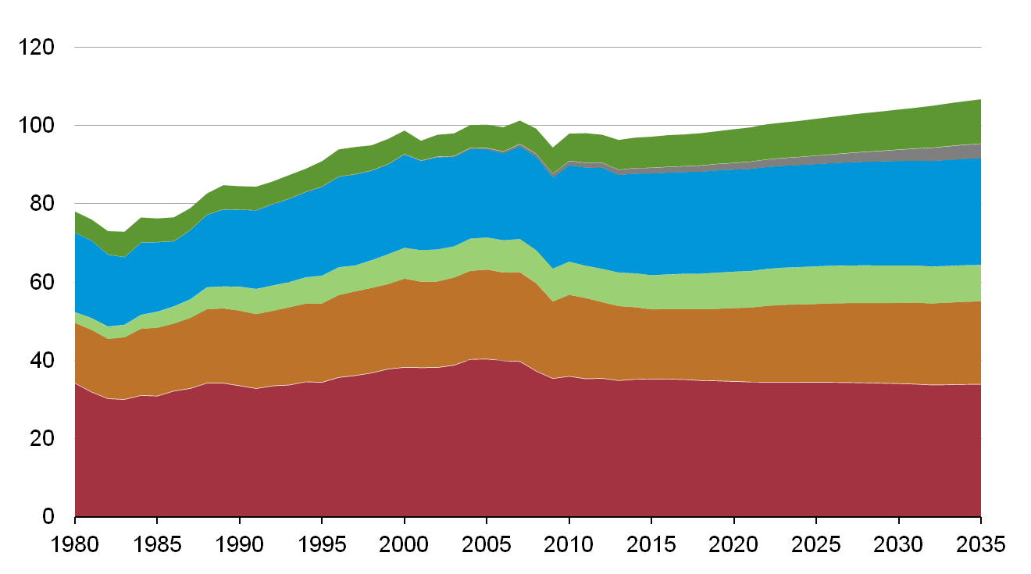
Energy use grows slowly over the projection in response to a slow and extended economic recovery and improving energy efficiency
U.S. primary energy consumption
quadrillion Btu per year
Shares of total U.S. energy
History
2010
Projections
Renewables
(excluding liquid biofuels)
7%
11%
1%
4%
Liquid biofuels
25%
Natural gas
26%
9%
Nuclear
9%
21%
Coal
20%
37%
Oil and other liquids
32%
Source: EIA, Annual Energy Outlook 2012
Energy Information Administration AEO2012, June 2012

Slide 8
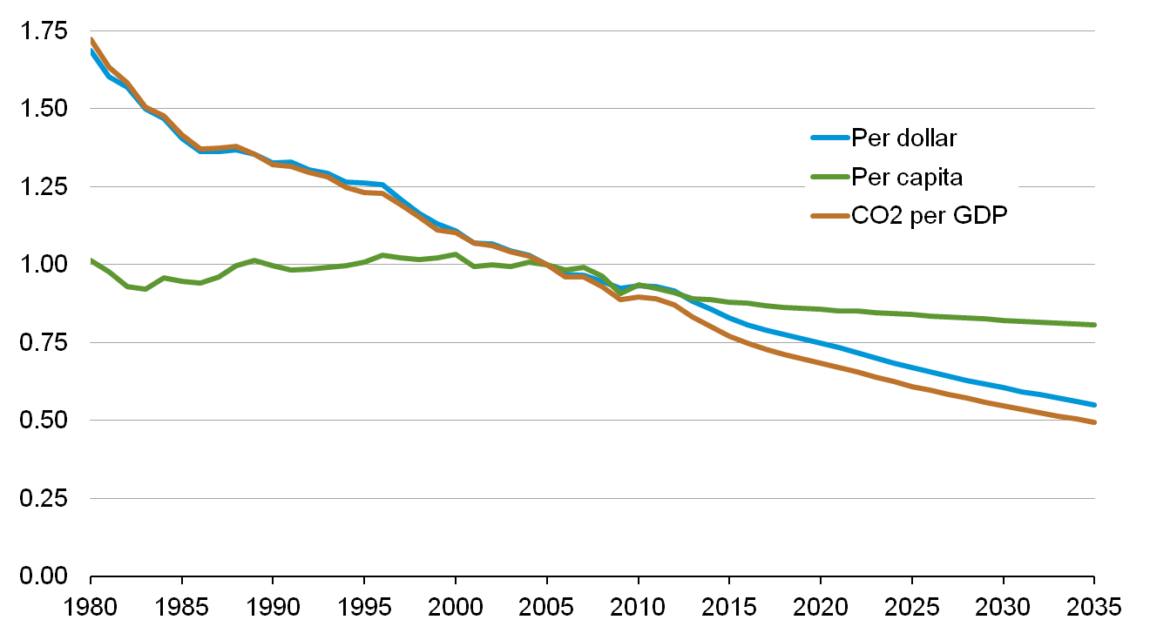
Energy and CO₂ per dollar of GDP continue to decline; per-capita energy use also declines
index, 2005=1
History
2010
Projections
Source: EIA, Annual Energy Outlook 2012
Energy Information Administration AEO2012, June 2012

Slide 9
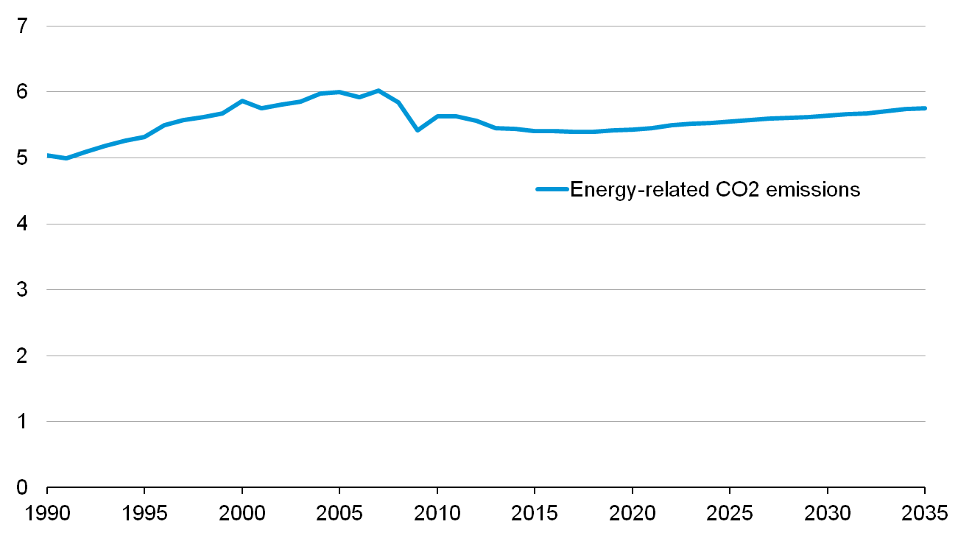
In the AEO2012 Reference case, energy-related CO₂ emissions never get back to pre-recession levels by 2035
billion metric tons carbon dioxide
History
Projections
2005
2010
 | 2005 | 2020 | 2035
Energy-related CO₂ emissions | 6.00 | 5.43 | 5.76
% change from 2005 | - - | -9.4% | -4.0%
Source: EIA, Annual Energy Outlook 2012
Energy Information Administration AEO2012, June 2012

Slide 10
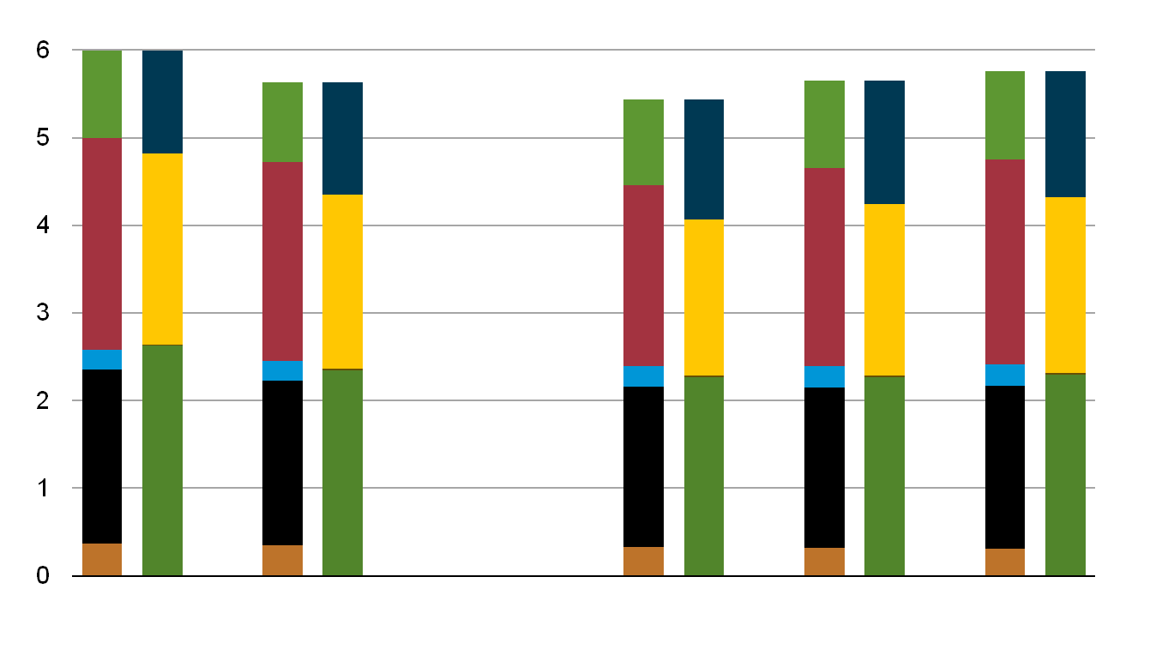
In the AEO2012 Reference case, energy-related CO₂ emissions never get back to pre-recession levels by 2035
billion metric tons carbon dioxide
History
Projections
Natural gas
Coal
Petroleum
Industrial
Electric power
Commercial
Transportation
Residential
2005
2010
2020
2030
2035
Source: EIA, Annual Energy Outlook 2012
Energy Information Administration AEO2012, June 2012

Slide 11
Natural Gas
Energy Information Administration AEO2012, June 2012

Slide 12
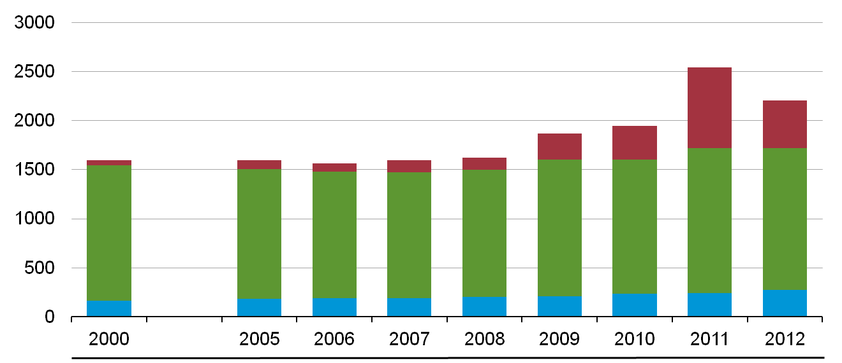
Technically recoverable natural gas resources reflect updated assessments
U.S. dry gas resources
trillion cubic feet
Unproved shale gas
Unproved other gas (including Alaska* and offshore)
Proved reserves (all types and locations)
2,203
482
1,449
273
AEO Edition
*Alaska resource estimates prior to AEO2009 reflect resources from the North Slope that were not included in previously published documentation.
Source: EIA, Annual Energy Outlook
Energy Information Administration AEO2012, June 2012

Slide 13
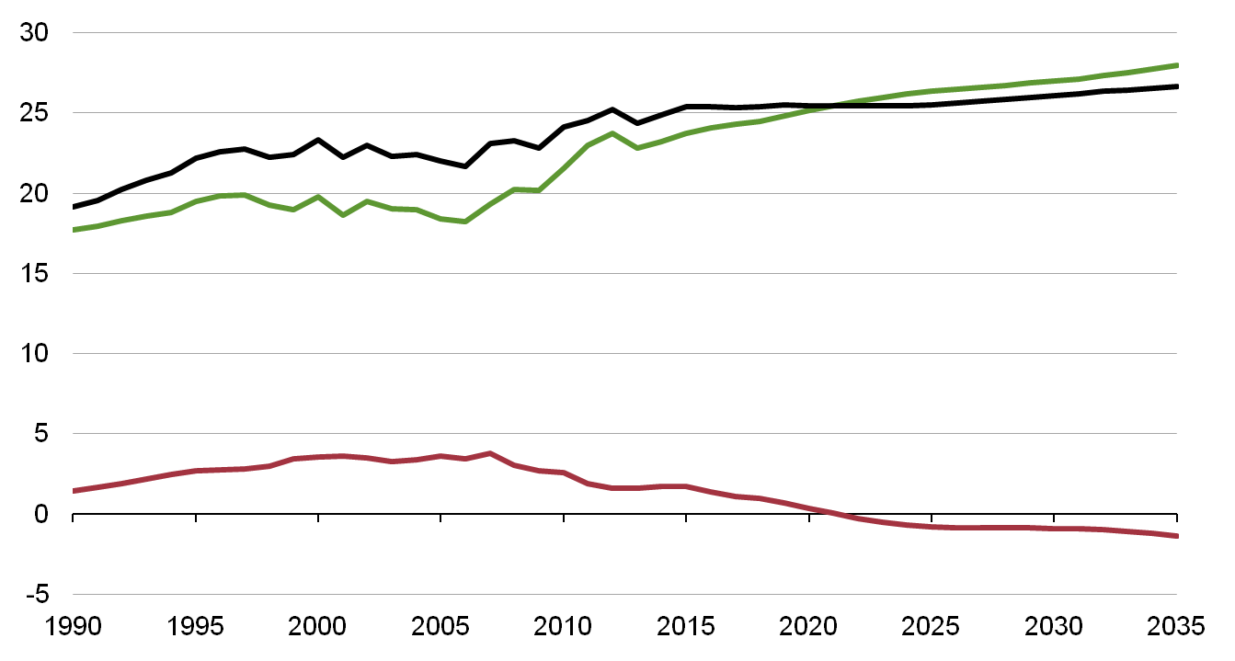
Domestic natural gas production grows faster than consumption
U.S. dry gas
trillion cubic feet per year
History
2010
Projections
Consumption
Domestic supply
Net imports
Source: EIA, Annual Energy Outlook 2012
Energy Information Administration AEO2012, June 2012

Slide 14
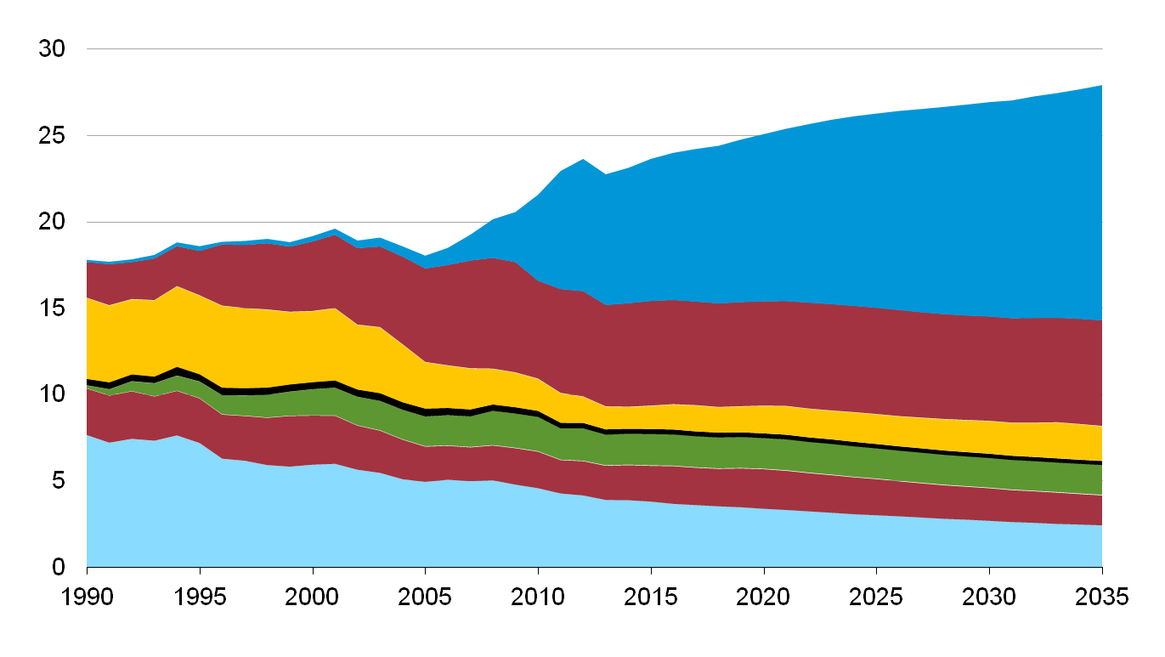
Shale gas offsets declines in other U.S. natural gas production sources
U.S. dry gas production
trillion cubic feet per year
History
2010
Projections
49%
23%
Shale gas
26%
Tight gas
22%
9%
2%
Non-associated offshore
9%
Coalbed methane
7%
10%
Alaska
Associated with oil
1%
6%
6%
21%
Non-associated onshore
9%
Source: EIA, Annual Energy Outlook 2012
Energy Information Administration AEO2012, June 2012

Slide 15
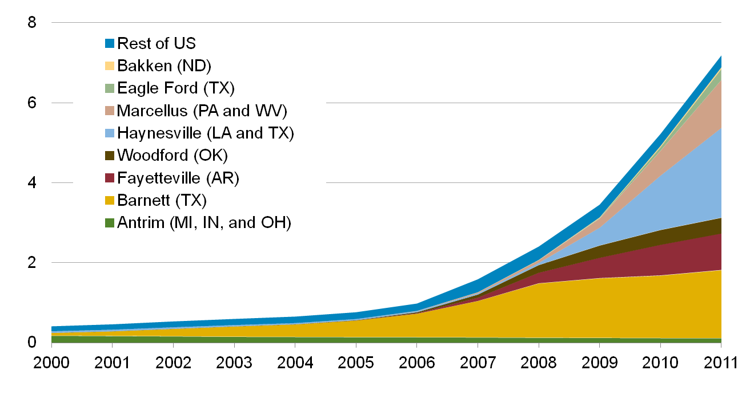
Since 2000, U.S. shale gas production has increased 17-fold and now comprises about 30 percent of total U.S. dry production
annual shale gas production (dry)
trillion cubic feet
Sources: Lippman Consulting, Inc. gross withdrawal estimates as of November 2011 and converted to dry production estimates with EIA-calculated average gross-to-dry shrinkage factors by state and/or shale play. Note: 2011 is annual rate for first 11 months.
Energy Information Administration AEO2012, June 2012

Slide 16
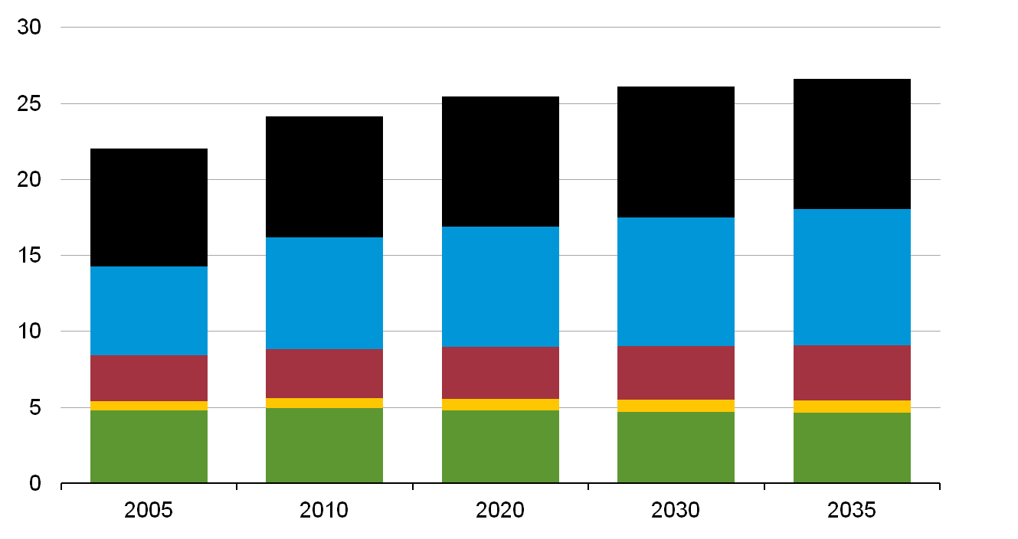
Natural gas consumption is quite dispersed; electric power and industrial use drives much of the future demand growth
U.S. dry gas consumption
trillion cubic feet per year
History
Projections
34%
Electric
power
31%
33%
32%
Industrial*
13%
14%
Commercial
3%
3%
Transportation**
21%
17%
Residential
*Includes combined heat-and-power and lease and plant fuel. **Includes pipeline fuel.
Source: EIA, Annual Energy Outlook 2012
Energy Information Administration AEO2012, June 2012

Slide 17
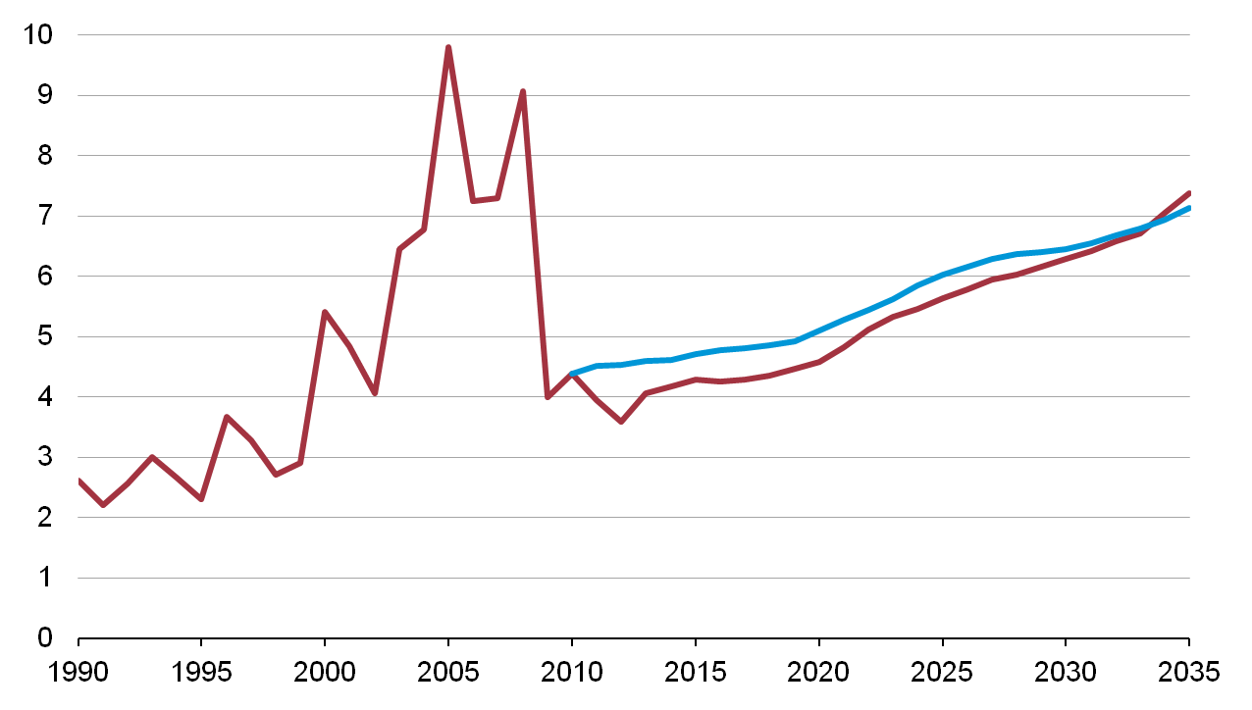
Natural gas price projections are lower than in AEO2011, consistent with recent market developments
natural gas spot price (Henry Hub)
2010 dollars per million Btu
History
2010
Projections
AEO2011
AEO2012
Sources: EIA, Annual Energy Outlook 2012 and EIA, Annual Energy Outlook 2011
Energy Information Administration AEO2012, June 2012

Slide 18
Petroleum and other liquid supply
Energy Information Administration AEO2012, June 2012

Slide 19
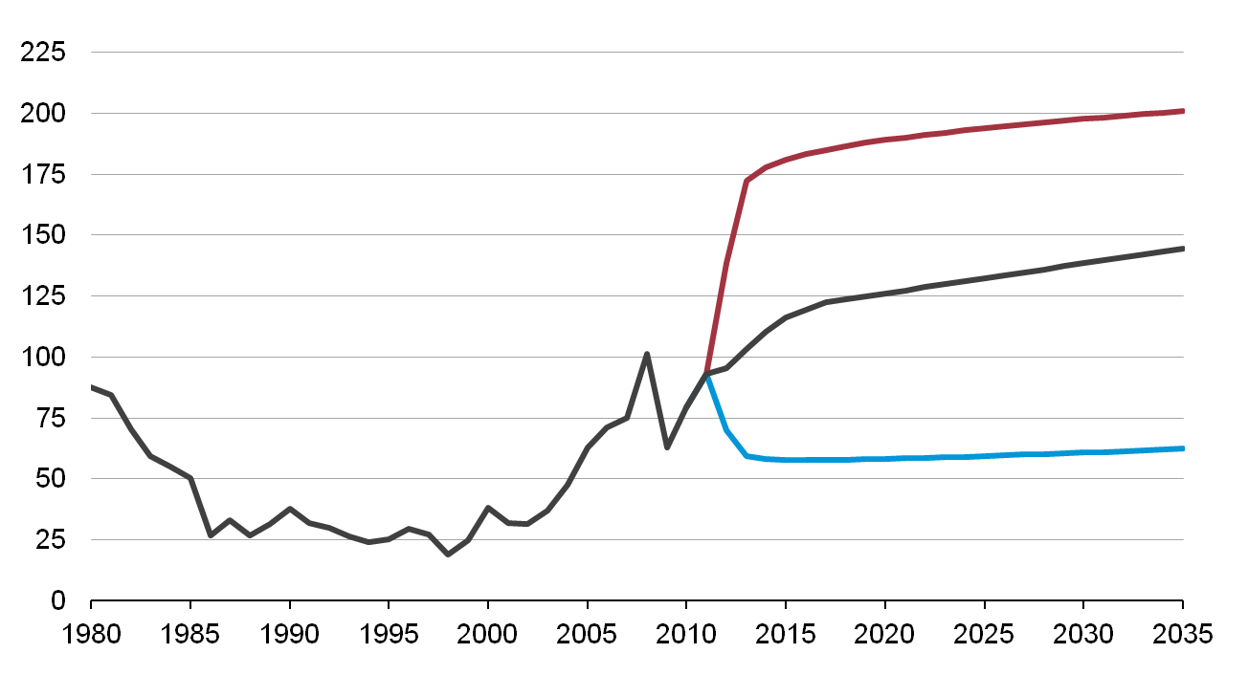
Oil prices in the Reference case rise steadily; the full AEO2012 includes a wide range of oil prices
annual average price of light low sulfur (LLS) crude oil
real 2010 dollars per barrel
History
2010
Projections
High Oil Price
AEO2012 Reference
Low Oil Price
Source: EIA, Annual Energy Outlook 2012
Energy Information Administration AEO2012, June 2012

Slide 20
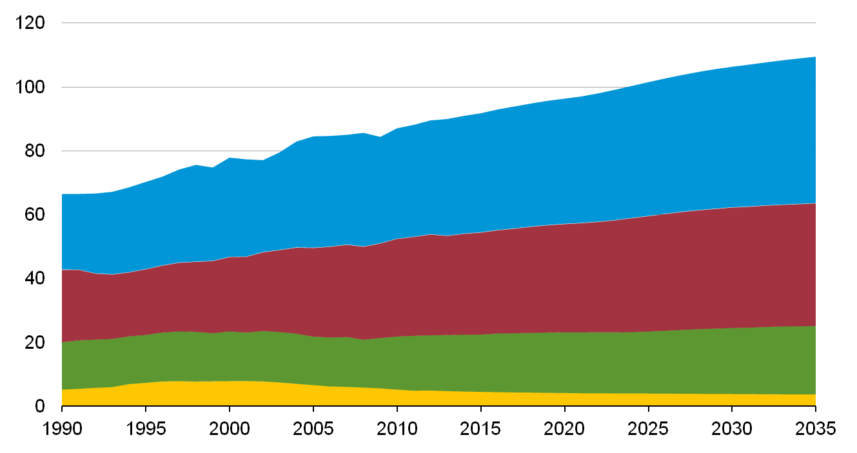
Global liquids supply increases 26% while market shares hold relatively stable
liquids supply
million barrels per day
History
2010
Projections
42%
OPEC
40%
35%
35%
Other non-OECD
19%
OECD Americas
20%
6%
OECD other
3%
Source: EIA, Annual Energy Outlook 2012
Energy Information Administration AEO2012, June 2012

Slide 21
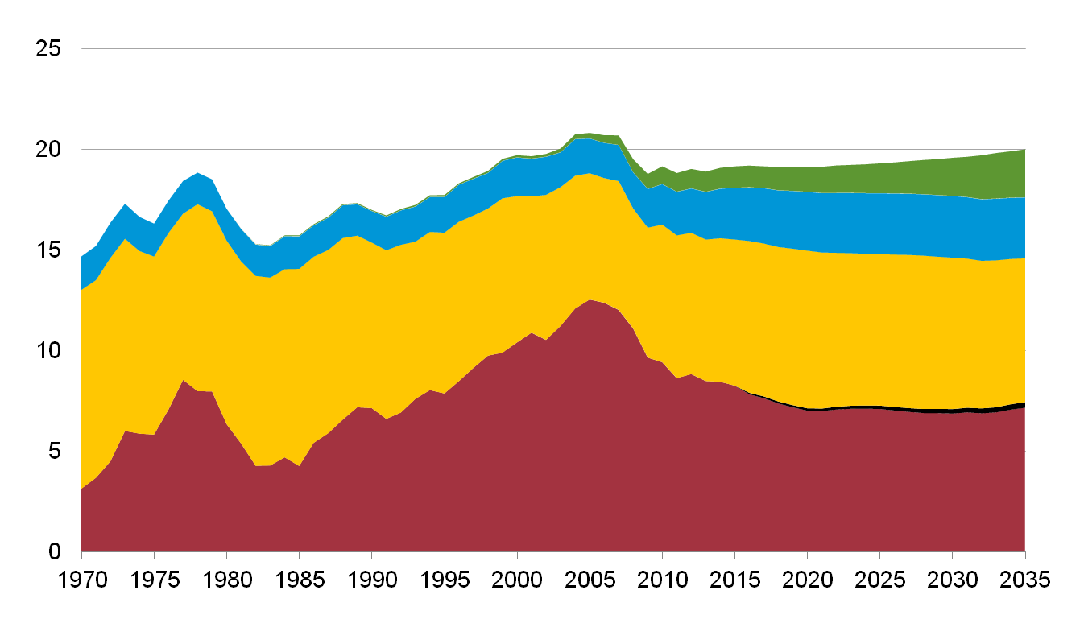
U.S. imports of liquid fuels continue to decline due to increased production of gas liquids and biofuels and greater fuel efficiency
U.S. liquid fuels supply
million barrels per day
History
2010
Projections
5%
Biofuels including imports
12%
10%
Natural gas plant liquids
15%
36%
Petroleum production
36%
Liquids from coal
1%
49%
Net petroleum imports
36%
Source: EIA, Annual Energy Outlook 2012
Energy Information Administration AEO2012, June 2012

Slide 22
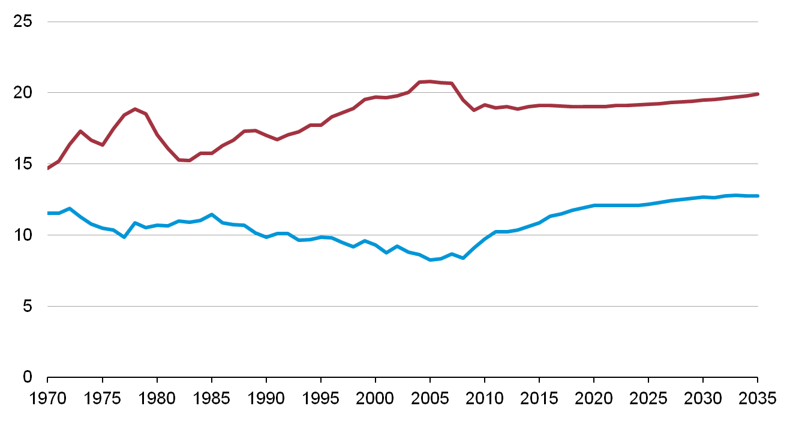
U.S. dependence on imported petroleum continues to decline
U.S. liquid fuel supply
million barrels per day
History
2005
2010
Projections
Consumption
36%
Net petroleum imports
60%
49%
Domestic supply
Source: EIA, Annual Energy Outlook 2012
Energy Information Administration AEO2012, June 2012

Slide 23
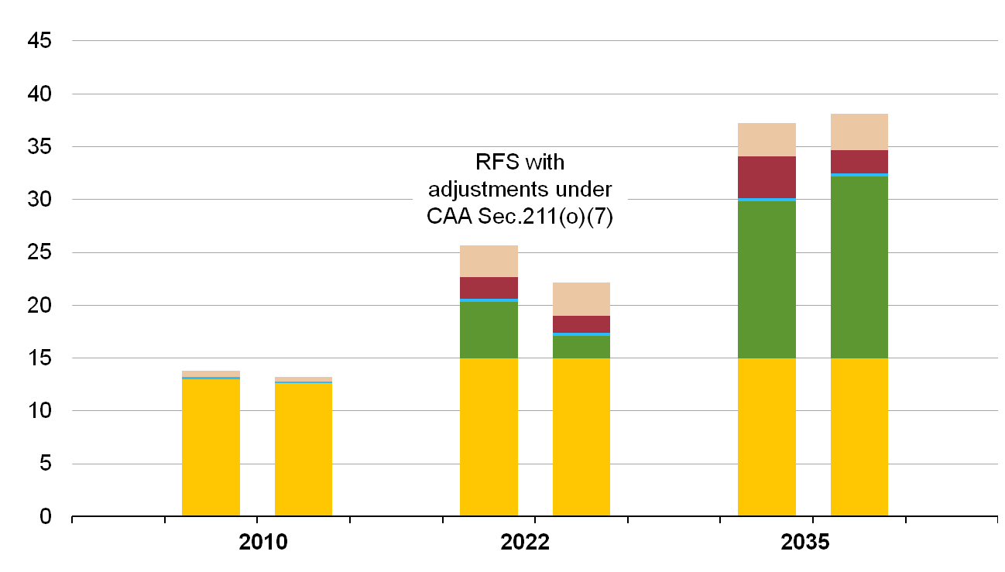
Biofuels fall short of the RFS target in 2022, but exceed 36 billion gallons by the early 2030s
billions ethanol-equivalent gallons
Legislated RFS in 2022
Biodiesel
Net imports
Other Advanced
Cellulosic biofuels
AEO2011
AEO2012
Corn ethanol
Sources: EIA, Annual Energy Outlook 2012 and EIA, Annual Energy Outlook 2011
Energy Information Administration AEO2012, June 2012

Slide 24
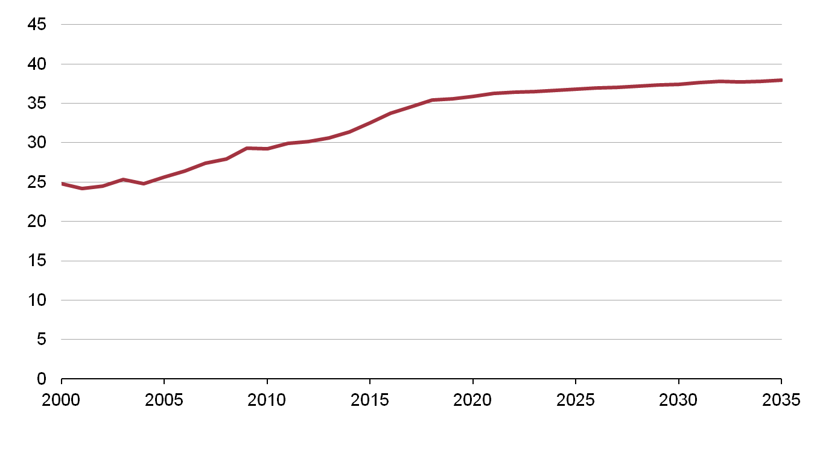
New light duty vehicle fuel economy reaches almost 38 mpg by 2035 in the Reference case, which does not include proposed standards for MY2017 to MY2025 vehicles
miles per gallon
History
2010
Projections
Summary of standards
2012-2016: | 34.1 mpg CAFE average (based on NHTSA vehicle footprint sales distribution)
2020: | 35 mpg by statute
2017-2025: | Reference case does not include proposed rulemaking from December 2011
Source: EIA, Annual Energy Outlook 2012
Energy Information Administration AEO2012, June 2012

Slide 25
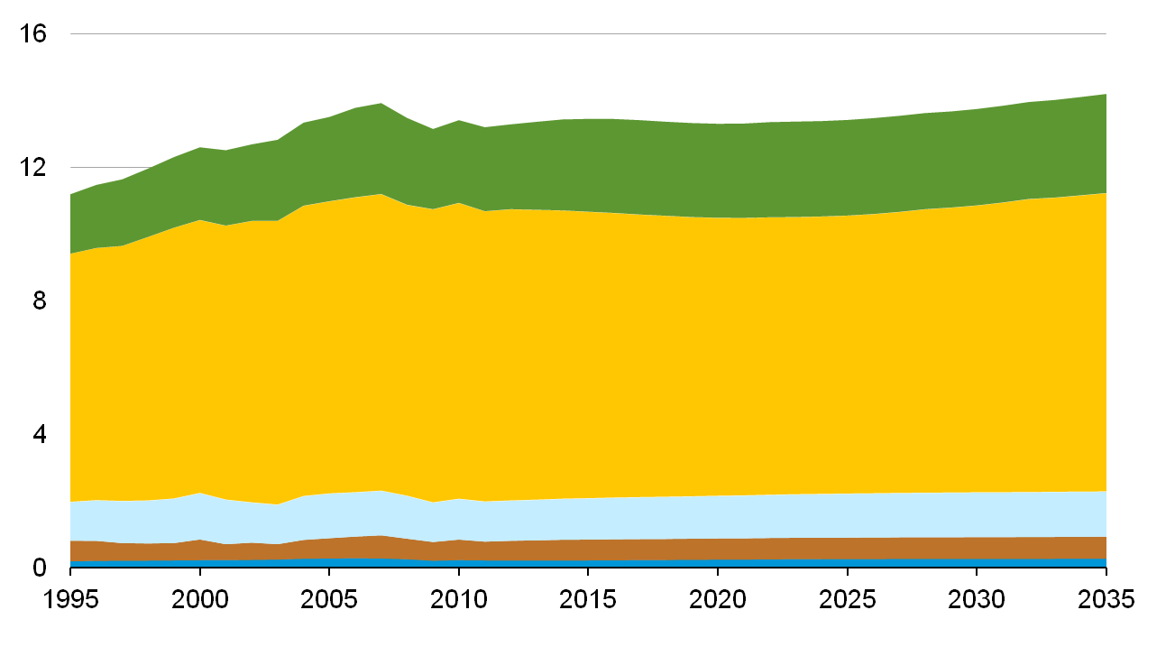
Most transport fuel consumption is in light and heavy duty vehicles
U.S. transportation energy consumption
million barrels per day oil equivalent
History
2010
Projections
21%
18%
Heavy-duty vehicles
Light-duty vehicles
63%
66%
9%
Air
9%
Rail
5%
5%
Marine
2%
2%
Source: EIA, Annual Energy Outlook 2012
Energy Information Administration AEO2012, June 2012

Slide 26
Efficiency improvements mostly offset underlying drivers of growth in transportation services
 | 2010 | 2035 | Growth (2010-2035)
Light duty vehicles
Fuel consumption (million barrels per day oil equivalent) | 8.6 | 8.6 | 0%
Number of licensed drivers (millions) | 210 | 269 | 28%
Miles per licensed driver | 12,700 | 13,300 | 5%
Efficiency of vehicle stock (mpg) | 20.4 | 28.2 | 38%*
Heavy duty vehicles
Fuel consumption (million barrels per day oil equivalent) | 2.3 | 2.8 | 21%
Manufacturing output (billion 2005 dollars) | 4,260 | 6,285 | 48%
Number of freight trucks (millions) | 8.9 | 12.5 | 40%
Miles per vehicle | 26,200 | 27,600 | 5%
Efficiency of vehicle stock (mpg) | 6.7 | 8.1 | 22%**
* Equal to a 28% reduction in fuel use per mile. ** Equal to an 18% reduction in fuel use per mile.
Source: EIA, Annual Energy Outlook 2012
Energy Information Administration AEO2012, June 2012

Slide 27
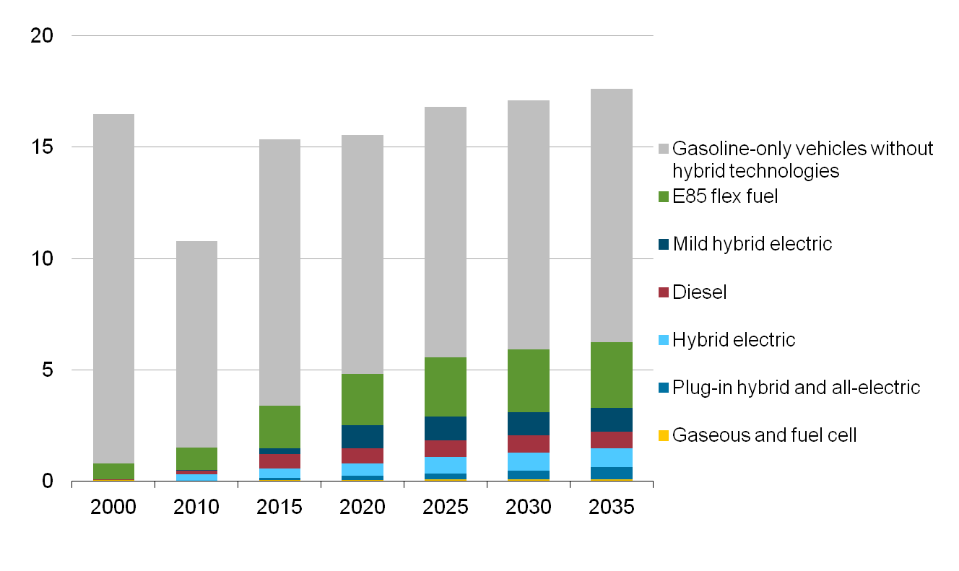
Gasoline-only vehicles without hybrid technologies decline as a share of new vehicle sales
U.S. light car and truck sales
millions
Source: EIA, Annual Energy Outlook 2012
Energy Information Administration AEO2012, June 2012

Slide 28
Electricity
Energy Information Administration AEO2012, June 2012

Slide 29
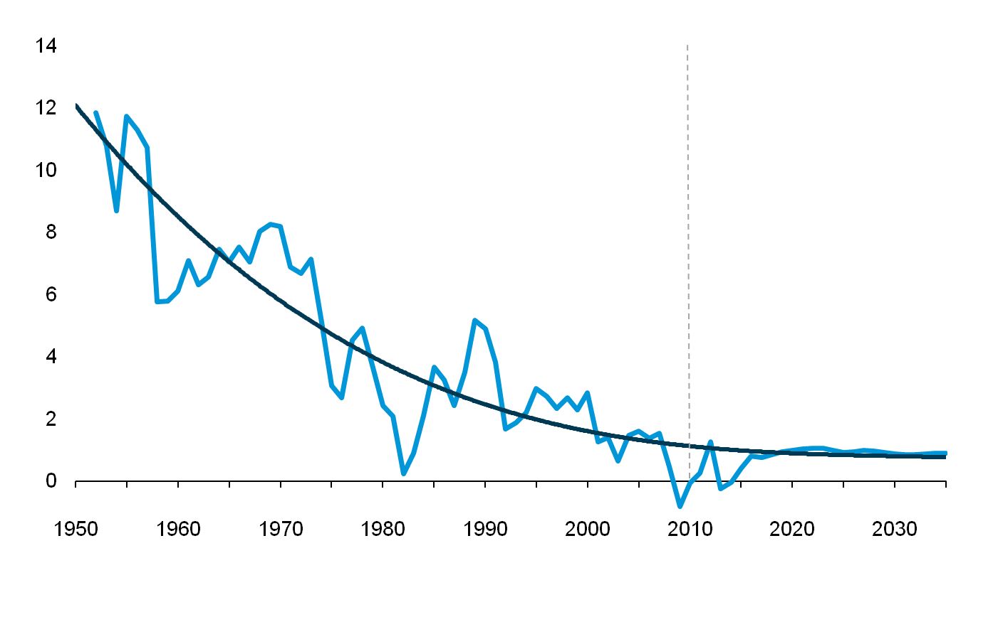
While total electricity generation grows by 21% over the projection, the annual rate of growth slows
percent growth (3-year rolling average)
Period Annual Growth
1950s 9.8
1960s 7.3
1970s 4.7
1980s 2.9
1990s 2.4
2000-2010 1.0
2010-2035 0.8
History
2010
Structural Change in Economy - Higher prices - Standards - Improved efficiency
Projections
Source: EIA, Annual Energy Outlook 2012
Energy Information Administration AEO2012, June 2012

Slide 30
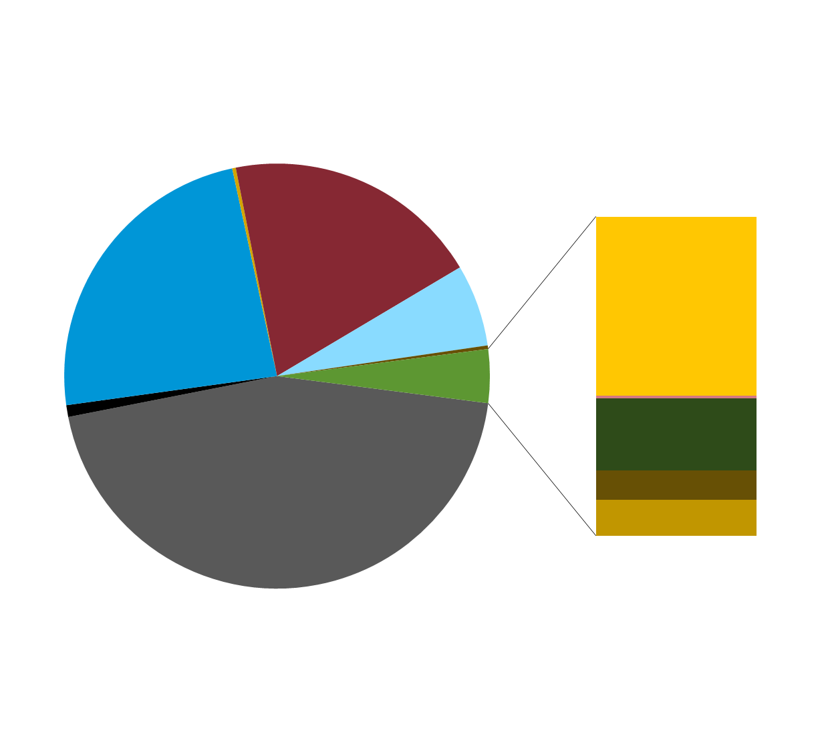
In 2010, U.S. electricity generation was 70% fossil fuels, 20% nuclear, and 10% renewable
2010 Total net generation:
4,120 billion kWh
2010 Non-hydro renewable
net generation:
168 billion kWh
Other gases
0.3%
Conventional
hydroelectric
6.2%
Nuclear
19.6%
Natural gas
23.8%
Other
0.3%
Wind: 2.3%
Other
renewable
4.1%
Solar thermal and PV: <0.1%
Wood and wood-derived fuels: 0.9%
Geothermal: 0.4%
Coal
44.9%
Petroleum
0.9%
Other biomass: 0.5%
Source: EIA, Annual Energy Review, October 2011
Energy Information Administration AEO2012, June 2012

Slide 31
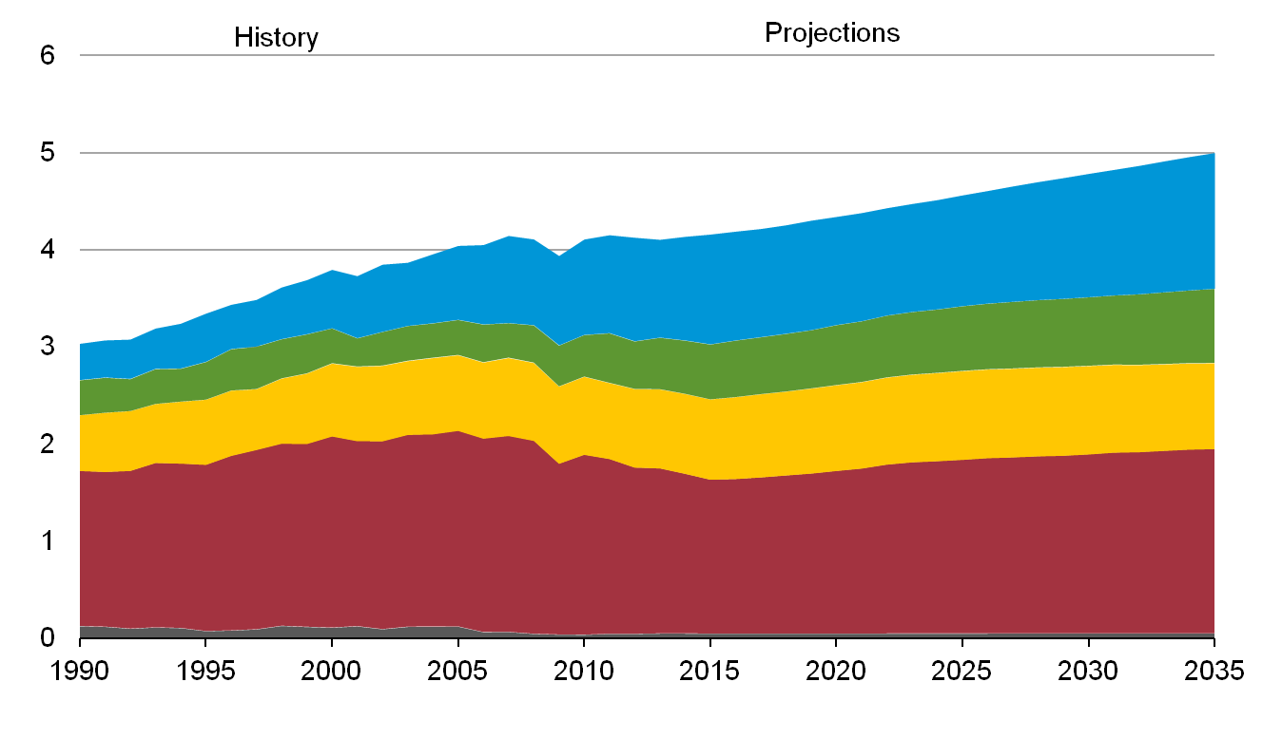
Electricity mix gradually shifts to lower-carbon options, led by growth in renewables and natural gas
electricity net generation
trillion kilowatthours per year
2010
28%
Natural gas
24%
Renewables
15%
10%
20%
18%
Nuclear
45%
Coal
38%
Oil and other liquids
1%
1%
Source: EIA, Annual Energy Outlook 2012
Energy Information Administration AEO2012, June 2012

Slide 32


Natural gas, wind and other renewables account for the vast majority of capacity additions from 2010 to 2035
2010 capacity
Capacity additions 2010 to 2035
Nuclear
101 (10%)
Coal
313 (30%)
Hydropower*
3 (1%)
Nuclear
9 (4%)
Hydropower*
101 (10%)
Coal
11 (5%)
Other renewables
34 (14%)
Other renewables
16 (2%)
End-use coal
6 (2%)
Wind
30 (13%)
235
gigawatts
Other fossil
1 (0.4%)
Wind
39 (4%)
1,036
gigawatts
End-use coal
4 (0.4%)
Natural gas
142 (60%)
Natural gas
350 (34%)
Other fossil
111 (11%)
* Includes pumped storage
Source: EIA, Annual Energy Outlook 2012
Energy Information Administration AEO2012, June 2012

Slide 33
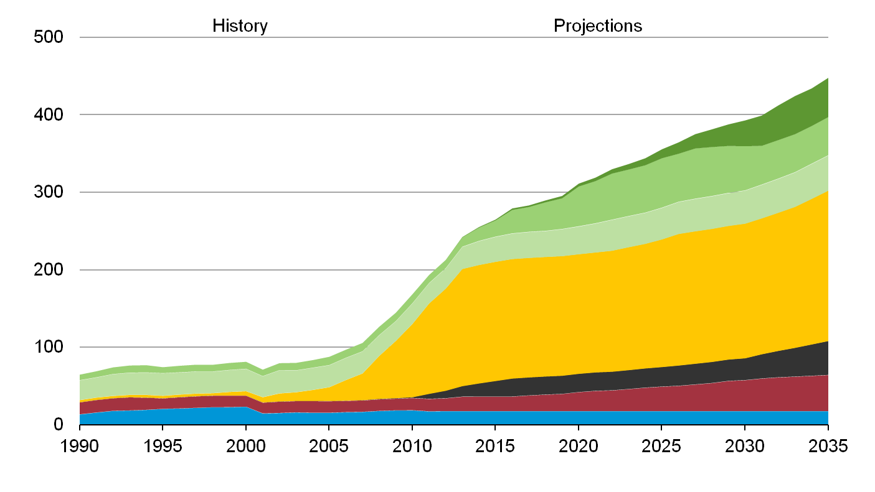
Non-hydro renewable sources more than double between 2010 and 2035
non-hydropower renewable generation
billion kilowatthours per year
2010
Advanced biofuels cogeneration
Biomass
Power sector
Industrial CHP
Wind
Solar
Geothermal
Waste
Source: EIA, Annual Energy Outlook 2012
Energy Information Administration AEO2012, June 2012

Slide 34
For more information
U.S. Energy Information Administration home page | www.eia.gov
Annual Energy Outlook | www.eia.gov/forecasts/aeo
Short-Term Energy Outlook | www.eia.gov/forecasts/steo
International Energy Outlook | www.eia.gov/forecasts/ieo
Monthly Energy Review | www.eia.gov/totalenergy/data/monthly
Annual Energy Review | www.eia.gov/totalenergy/data/annual
Energy Information Administration AEO2012, June 2012

