Slide 1
Distributed Generation in the NEMS Buildings Modules
Steve Wade
March 27, 2001

Slide 2
Distributed Generation in Today’s Buildings
Historically, the buildings sector has done very little electricity generation. Reasons include:
  Utility supplied electricity prices are relatively low compared to self-generation options
  Buildings have not been designed to incorporate self-generation
  Utility supplied electricity has generally been reliable enough for most applications

Slide 3
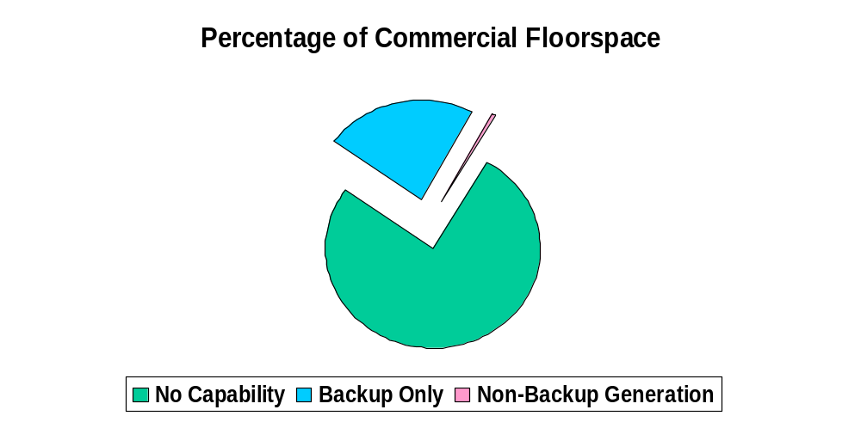
Buildings with Generation Capability
CBECS 95

Slide 4
Distributed Generation
CBECS 1995
Buildings reporting generation for non-emergency use:
  Building Types: large office, in-patient health care, lodging, education and public assembly
  On average they are 30 times larger than the average CBECS building
  These buildings still purchase roughly an average of 75% of their electricity
  Based on the weighted share of energy consumption of the sample buildings reporting generation:
    Roughly 25% generated during peak conditions only
    Approximately 6 % reported grid-sales

Slide 5
NEMS Building Sector
DG Modeling Approach
Two kinds of penetration are modeled for buildings:
    “economic” -- based on cumulative cash flow analysis
    “non-economic” -- based on estimated installations from program participation or other sources (e.g., fuel cell demonstration projects, Million Solar Roofs program)

Slide 6
Cumulative Cash Flow Approach
Cash flows are computed for a 30-year period.
The number of years required to achieve a positive cumulative cash flow is computed.
Logistic penetration curves are driven by the number of years to a positive cumulative cash flow.

Slide 7
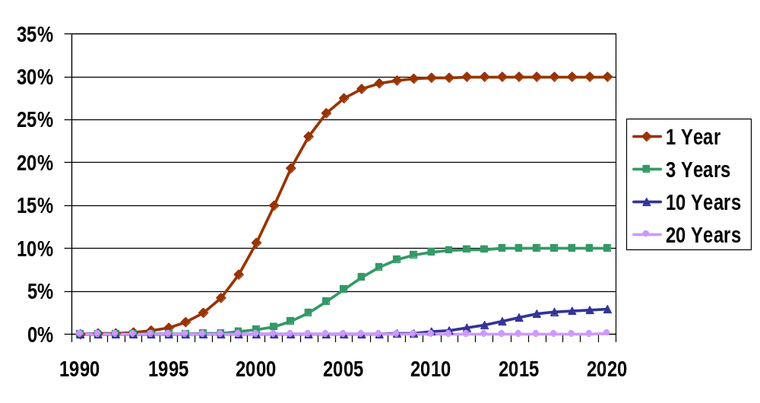
Sample Penetration Functions for New Construction using Alternate Number of Years to Reach
Positive Cumulative Cash Flow

Slide 8
Cumulative Cash Flow Approach
(continued)
Cash Flow Model Variables, Assumptions and Parameters:
  borrowing assumptions (interest rate, term)
  tax effects (depreciation, interest expense), tax credit provisions (commercial PV credit)
  inflation assumptions for fuel prices
  grid sales prices (NEMS electric utility module)
  electricity and fuel prices (NEMS supply modules)

Slide 9
Cumulative Cash Flow Approach
(continued)
Cash Flow Model Variables, Assumptions and Parameters: (continued)
  technology assumptions
    installed capital cost, annual maintenance cost
    equipment availability
    equipment capacity
    electrical conversion efficiency
    thermal recovery for water and space heating
    equipment life

Slide 10
Cost and Performance of DG Technologies
Technologies can be broadly classified into “emerging” vs “mature”.
For emerging technologies, significant cost declines and efficiency increases are incorporated into a DG technology menu.
In addition to declining menu costs,emerging technologies can also experience cost declines due to technology “learning” (given high enough cumulative shipments).

Slide 11
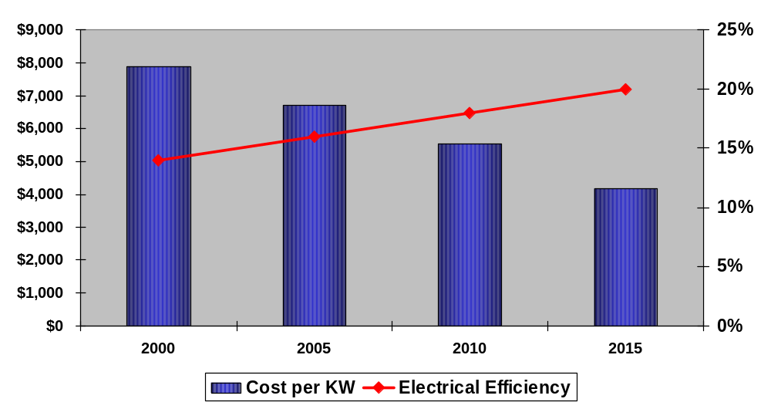
Photovoltaics Cost and Performance Assumptions

Slide 12
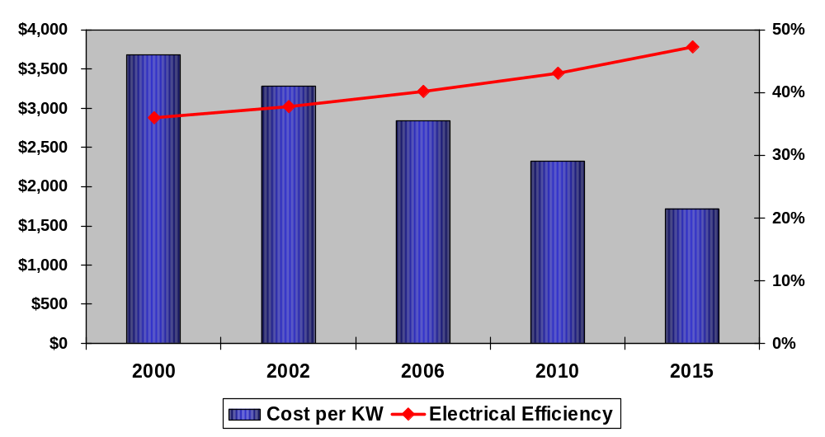
Fuel Cell Cost and Performance
Assumptions

Slide 13
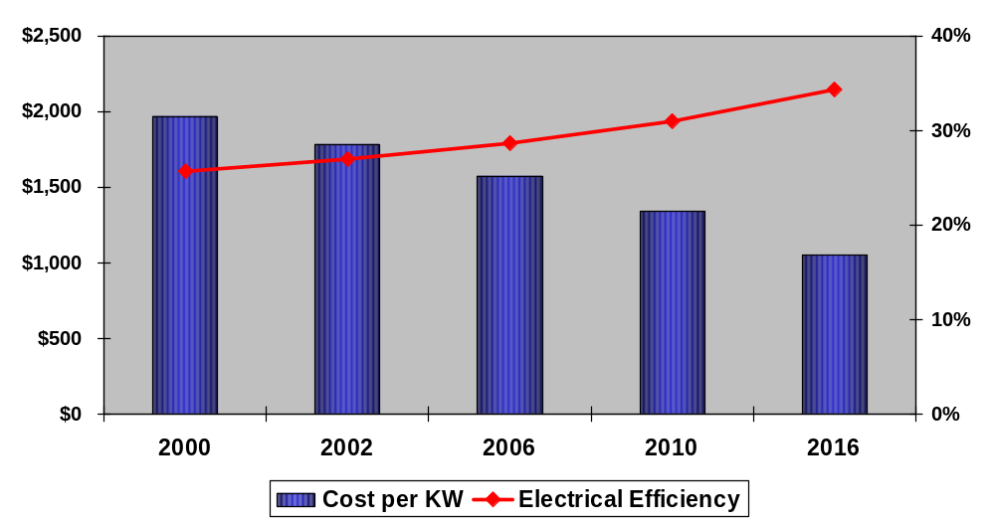
Gas Micro-Turbine Cost and Performance Assumptions

Slide 14
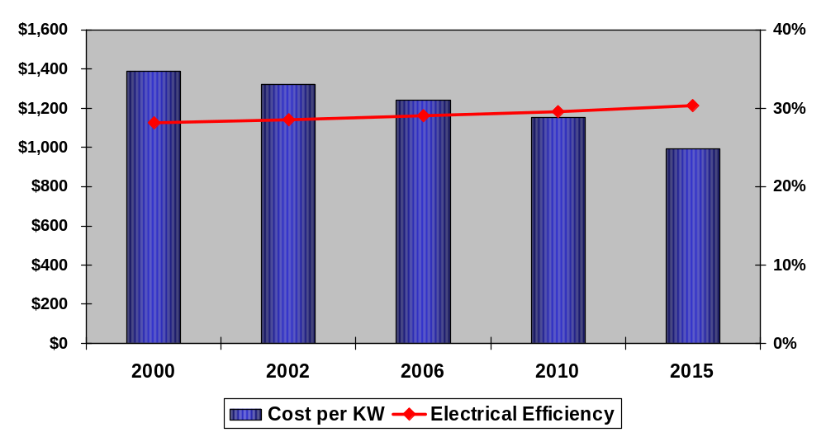
Gas Engine Cost and Performance Assumptions

Slide 15
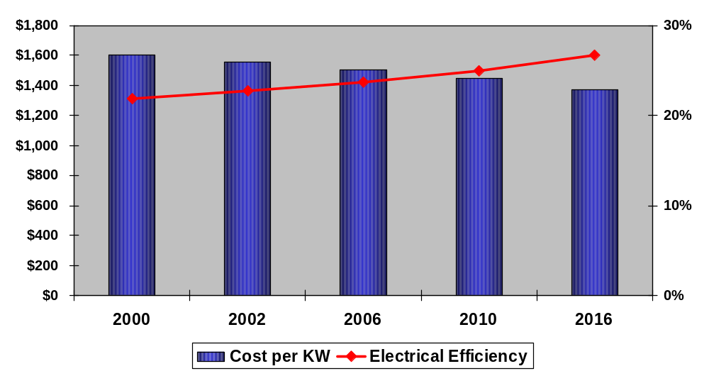
Gas Turbine Cost and Performance Assumptions

Slide 16
Reference Case Projections
Penetration of DG increases over the forecast horizon.
Most of the penetration is projected to occur post 2015 as technology cost and performance projections improve economic results.
NEMS projected price trends tend to discourage DG -- real electricity prices decline while fossil fuel prices are projected to remain close to current levels.

Slide 17
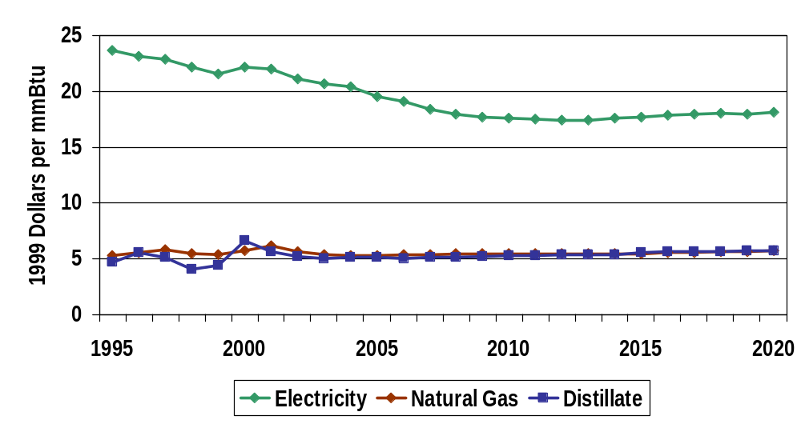
AEO 2001 Reference Case Projections:
Real Energy Prices

Slide 18
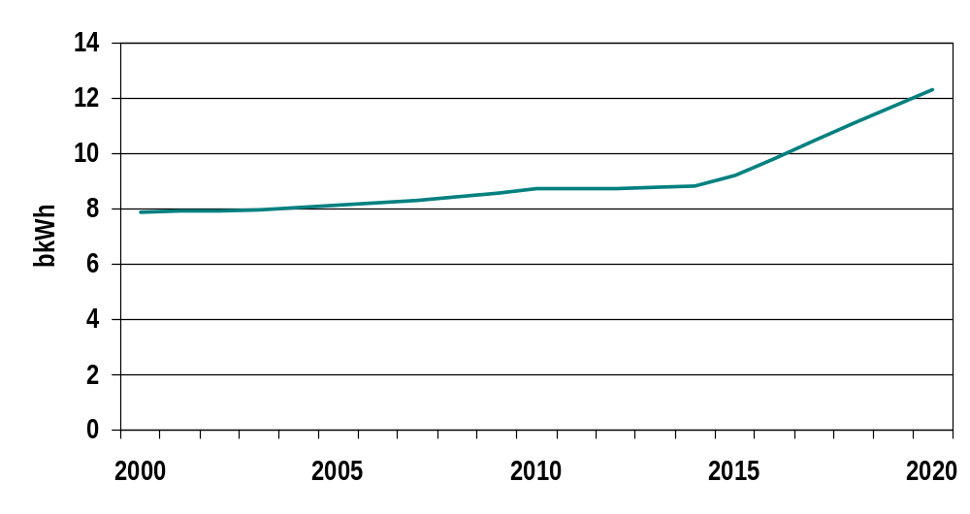
AEO 2001 Reference Case Projections:
Buildings Total Distributed Generation

Slide 19
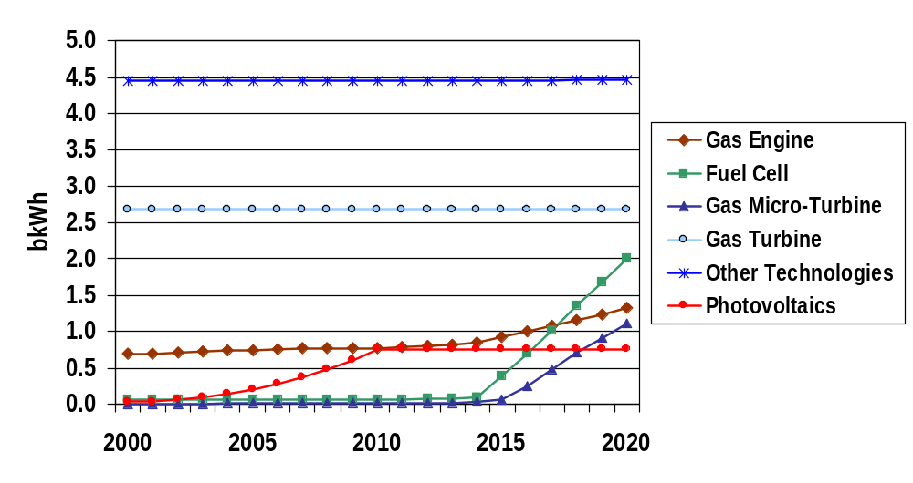
AEO 2001 Reference Case Projections for Selected Technologies

Slide 20
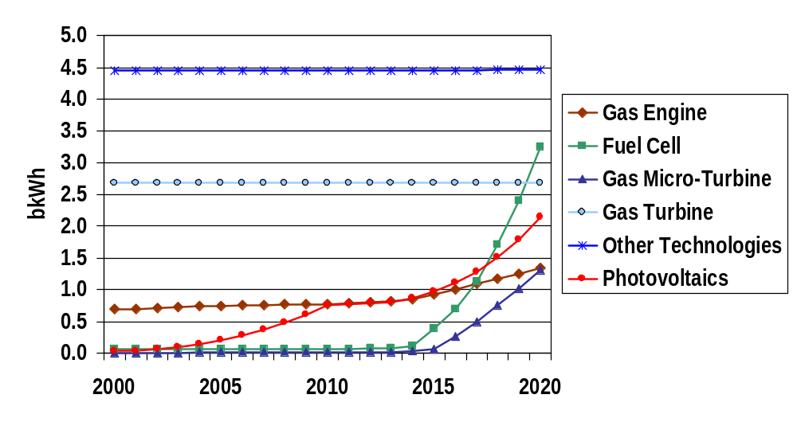
AEO 2001 Best Technology Case Projections for Selected Technologies

Slide 21
Sensitivity Simulations
A series of simulations were performed using a spreadsheet implementation of the NEMS buildings algorithm.
The simulations cover alternate technology cost and performance assumptions combined with alternate energy prices.
Purpose is to illustrate the sensitivity of the NEMS cash flow model to economic conditions.

Slide 22
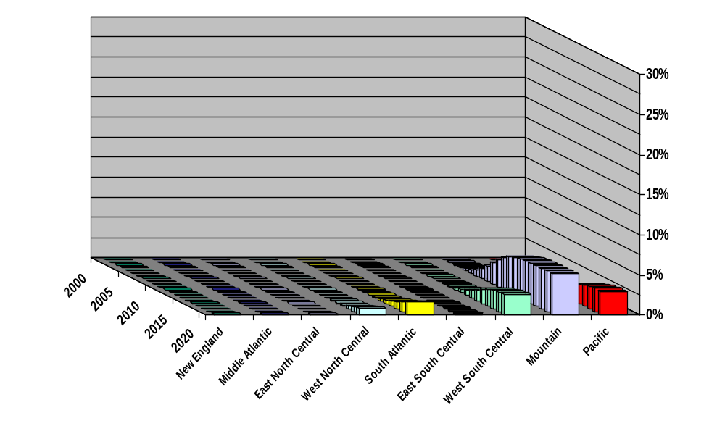
Simulated Solar PV Penetrations for New Construction
2015 Technology, Electricity Price Set to 12 Cents per kWh

Slide 23
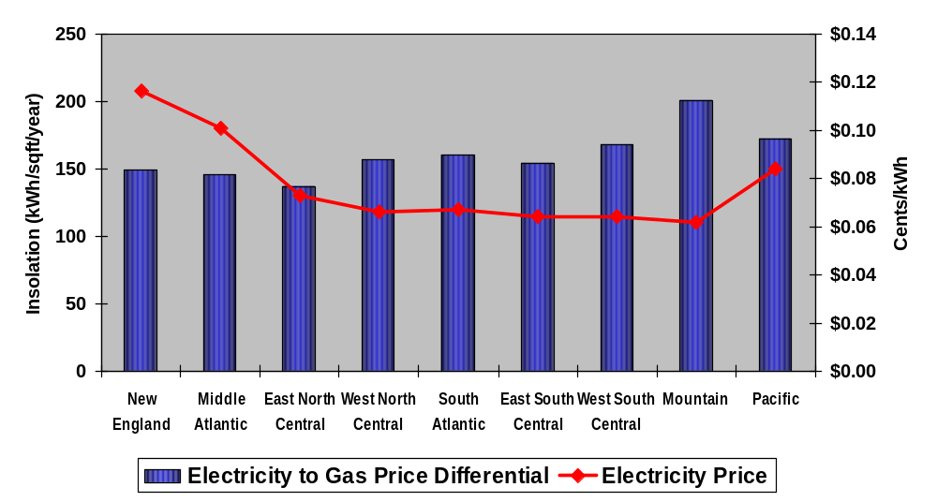
Solar Resource versus Electricity Price
(1998)

Slide 24
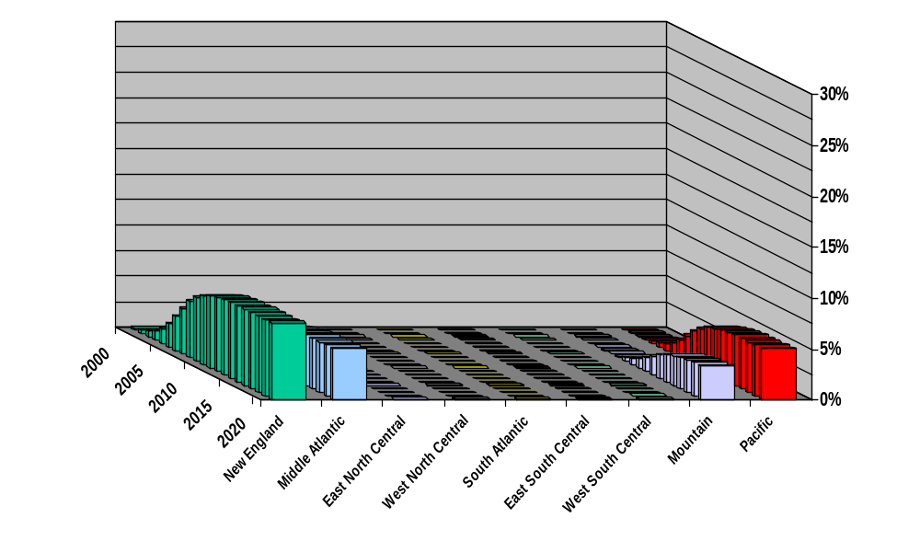
Simulated PV Penetrations for New Construction
2020 Technology, 1998 Electricity Prices

Slide 25
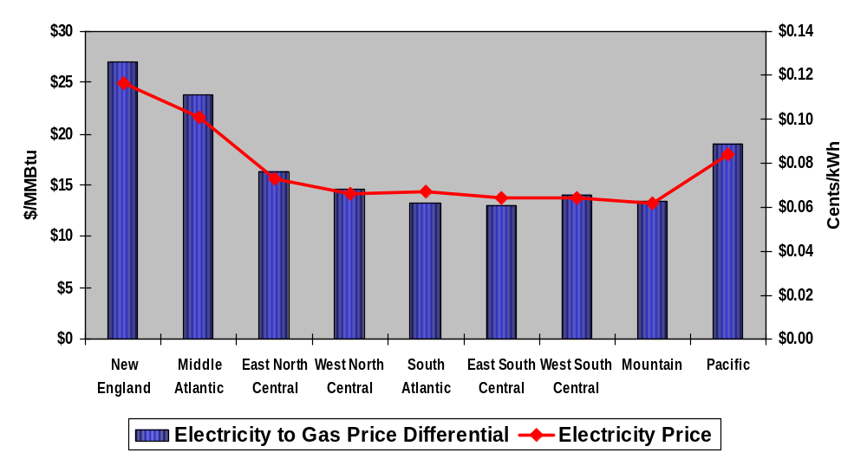
Electricity / Gas Price Differentials
(1998)

Slide 26
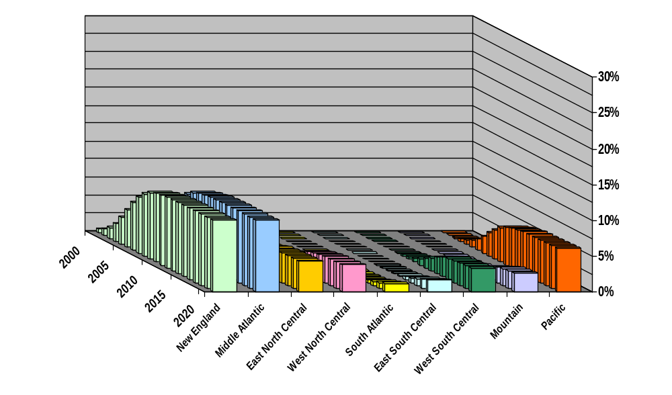
Simulated Fuel Cell Penetrations for New Construction
2005 Technology, 1998 Prices

Slide 27
The Future Potential
Increased Reliability Requirements
Energy Prices
Technology Costs and Performance
Increasing Familiarity with Equipment and Installation
Integrated Building Design
Removing Barriers
ESCOs

