Slide 1
Art Wiese
Senior Economist
American Petroleum Institute wiesea@api.org
March 27, 2001
The views expressed herein do not necessarily reflect those of the American Petroleum Institute or any of its members.
Industry Perspectives on Diesel Desulfurization

Slide 2
Industry Perspectives on Diesel Desulfurization
National Energy Modeling System/Annual Energy Outlook Conference
March 27, 2001

Slide 3
Topics
Brief Summary of On-Highway Diesel Rule
Refiner Response
Likely Industry Response
Revamp vs Grassroots
Do EPA Transition Provisions Adequately Address Supply Concerns?
Regulatory Avalanche: Cannot Consider ULSD Rule in Isolation
Availability of Imports
Nonroad
Summary

Slide 4
New On-Road Diesel Sulfur Regulations
Applies to Refiners and Importers
Share of On-Highway as ULSD in 2006
  Requires 80% ULSD (15 ppm at pump), PADD Average
Timing of ULSD implementation
  Production at refinery by June 1, 2006
  Available at terminals by July 15, 2006
  Available at retail/wholesale by Sept. 1, 2006
100% Industry Compliance by May 31, 2010

Slide 5
Transition Provisions
ULSD temporary compliance option, 2006-2010
  80% ULSD, Allows 20% of production as 500 ppm
Intra-PADD averaging, banking and trading (ABT) of sulfur credits allowed, June 2005 - June 2010
  Credit received for producing >80% ULSD
  Credits required to produce >20% 500 ppm
Geographic phase-in area (GPA)
  Extended (to Dec. 31, 2007 or 2008) Tier II gasoline standard for ULSD compliance
Small Refiner Hardship Provisions

Slide 6
Refiner Response
Response Will Vary Greatly Across Industry: Function of Expected Return, Available Capital, Existing Technology, Location, Size, Alternative Markets...
Exit from on-road diesel market
Revamp existing units
  Depends upon status of existing technology
    Cost 50%- 60% of new units for major revamp
  Lower feed rates, change catalyst in existing units
Build new technology units
  Capital intensive option
  Economies of scale important to ROI

Slide 7
Likely Industry Response in 2006
No. of U.S. ULSD
Refineries Capacity
New “grass-roots” units 40 54%
Revamp/reduce feed 36 46%
Withdraw from on-road market 18 0
Do not currently make on-road 51 0
Total 145 100%
Source: Baker and O’Brien (March, 2001)

Slide 8
Revamp vs Grassroots: Critical Parameter Impacting Costs, Supply
CRA/Baker and O’Brien Considered: Location, Status of Existing Technology, Available Alternative Product Markets, Corporate Objectives, Commitment to Diesel Market, Capital Availability, Expected Return for every U.S. Refinery. Determined 54% of ULSD capacity would be Grassroots.
EPA determined 20% of Capacity Grassroots based on comments at an NPRA Q&A meeting, comments made by vendors and “Considering there are few compelling reasons for going with a grassroots unit”. (p. IV-26 EPA RIA)

Slide 9
Do EPA Transition Provision Adequately Address Supply Concerns?
Potential Supply Concerns in 2006 and 2010
Best Case Outcome: Adequate Aggregate Supply in 2006 but Potential Regional Shortfalls as Distributors/Marketers may handle only 15 ppm
More Realistic Outcome: Total Supply Reduced in 2006 .
  Some refiners exit on-road market
  Many refiners, defensive investment
  Few refiners, aggressive investment

Slide 10
Do EPA Transition Provision Adequately Address Supply Concerns?
Potential Supply Concerns in 2006 and 2010
Capital Constraints, Regulatory and Technological Uncertainty Could Hinder Investment in 2006. • Tier 2, MTBE, NSR. Cannot Consider ULSD in Isolation. •Will Transition Provisions Work as Expected? Nonroad? •Refiners have 18-24 Months for Technology Decision for 2006 Compliance⇨ Conventional Proven Technology. Aggressive Investment now in face of Emerging Lower Cost Technology?
Potential Second Bump in 2010 as High Cost 20% Need to Invest or Leave Market at that Time

Slide 11
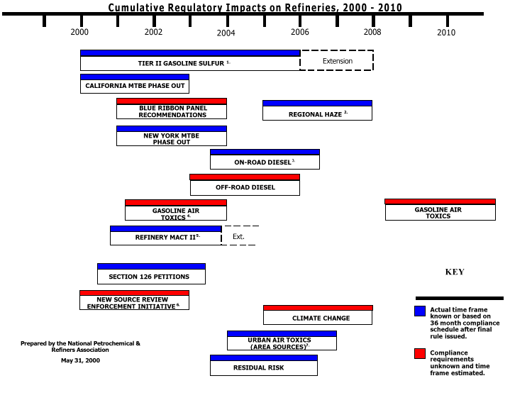
Regulatory Avalanche

Slide 12
Final Rule (80/20 Phase-In) is an Unjustified Tax on Diesel Consumers
A Phase-in ( if chosen) Should be Structured to Match Supply with Demand
“Oversupply” of ULSD that few need/want
  Very few new technology trucks in service
“Undersupply” of 500 ppm that most want
  Most will be “forced” to buy ULSD
Large Unnecessary Fuel Overcharge to Consumers (billions of dollars over 20 years). Low-volume phase-in would mitigate supply concerns, capture desired environmental benefits and is more cost-effective.

Slide 13
Import Availability?
Europe: Regulatory Uncertainty (50 or 10 ppm and when?) and Poor Returns in Downstream Cause European Refiners to Delay ULSD Investments, Process Clean Streams for Tax Advantage, Incremental Low-Volume Approach.
Europe’s Current Tax Incentive Incremental Approach Not Likely to Produce Excess ULSD Product for Export.
Canada, Caribbean, S. America, Middle East: Need more study. Should not assume, a priori, that additional imports (over and above historical averages) of ULSD will be available or base public policy on such assumptions.

Slide 14
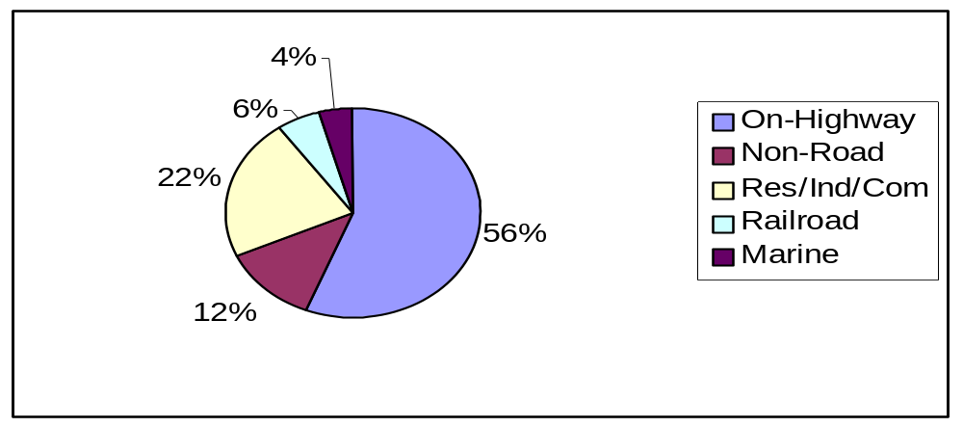
Projected Growth in On-Road Diesel Demand
Total 1999 Distillate Demand = 3.76 MMBPD
1999 On-Highway Demand = 2.09 MMBPD 2007 On-Highway Demand = 2.63 MMBPD 3.3% growth rate through 2007
Share of On-Road Diesel Demand Projected to Approach 60% in 2007.
Non-road includes Farm, Construction, Mining, Military, Electric Utilities...
API anticipates EPA will seek to Control Farm and Construction Non-road diesel fuel (Part 89, <12%)
Source: EIA “Fuel Oil & Kerosene Sales”, 1999.

Slide 15

EPA Needs to Clarify the Nonroad Picture Promptly
Most refiners cannot make optimal (cost-efficient) highway and nonroad diesel investment decisions separately
  Revamp versus new unit
  Number of reactors, reactor size and pressure
  Disposition of LCO
Could exacerbate E&C and supply concerns
Consideration must be given to infrastructure and distribution issues. Number of grades of diesel should be kept to minimum.
Need to be sensitive to impacts on HHO (and related products) availability & price
What size reactor(s) will I need?
What nonroad fuels may be covered?
Will EPA find the existing nonroad standards feasible?
Will there be a Tier 4?
Uncertainty with Respect to Non-Road Could Lead to Delayed and Sub-Optimal Investment

Slide 16
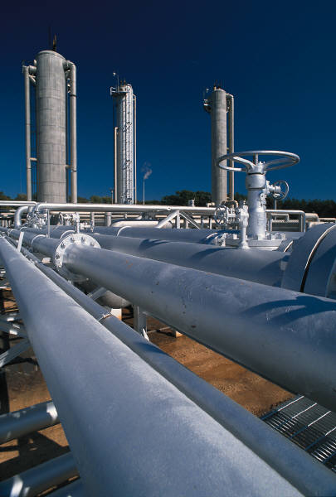
Fuel Distribution Impacts Must Be Recognized in Consideration of Nonroad
Regulations must not disrupt efficient distribution of fuels
Most pipelines/terminals handle highway diesel fuel (500 ppm) and up to two grades of nonroad diesel fuel (typically 2,000 ppm and/or 5,000 ppm)
2007 highway rule combined with a nonroad rule could increase the system to 5 grades
  New highway
  Old highway (during phase-in)
  New nonroad
  Old 2,000 ppm nonroad
  Old 5,000 ppm nonroad

Slide 17
Summary
Final On-Highway Rule With Transition Provisions Does not Adequately Address Potential Supply Concerns.
Alternatives Exist to Final On-Highway Rule that Mitigate Supply Concerns, are More Cost-Effective and Deliver the Desired Environmental Benefits. On What Basis is Final ULSD Rule justified?
Timely Clarification of Non-Road Rule is Necessary for Cost-Effective Diesel Desulfurization Investment.
Non-Road Standards Should be Based Upon Demonstrated Health and Environmental Needs, Sound Science and be Cost-Effective.
Refining Synergies for Producing ULSD and non-road should be captured.
Number of Distillate Grades in Distribution System should be kept to Minimum

