Slide 1

Status of Wholesale U.S. Power Markets
2001 NEMS/AEO Conference
Jack Cashin, Alliance of Energy Suppliers
March 27, 2001

Slide 2
2001 A Supply Market Odyssey
Status of Strategies
Status of State Restructuring
Status of Markets
Status of Federal Restructuring

Slide 3
Markets & Strategies and Restructuring’s Influence
Partial Deregulation
  Retail access and consumers
Hodgepodge of state and regional structured markets
  Volatility
Strategic response of market participants

Slide 4
Companies and Structural Changes
FEWER COMPANIES
Vertical disaggregation
  External
    Divestiture
    Spin-offs
    Outsourcing
  Internal
    Business units
    Unbundling (vs
    full-requirements)
Horizontal aggregation
  External
    M&A activity
    Business alliances
  Internal
    Functionalization
MORE COMPANIES

Slide 5
Energy Value Chain
Natural gas
  Exploration & production
  Gathering & processing
  Transmission and storage
  Distribution
  Retail services
Electricity
  Fuel Sourcing
  Generation
    Regulated
    Unregulated
  Transmission
  Distribution
  Retail
    Regulated
    Unregulated

Slide 6
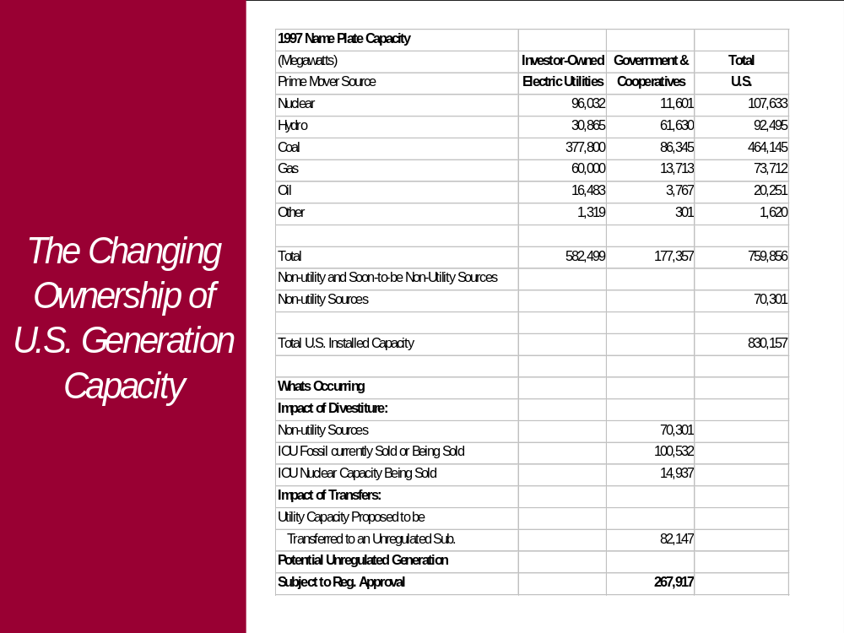

Slide 7
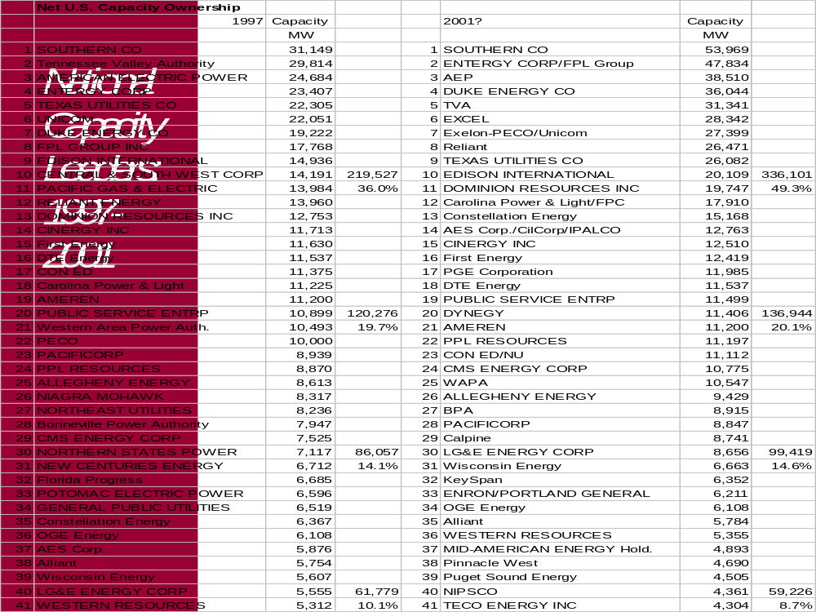

Slide 8
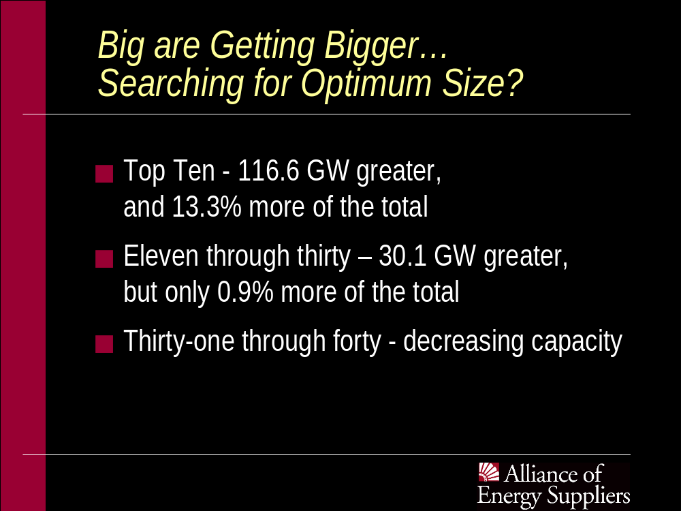

Slide 9
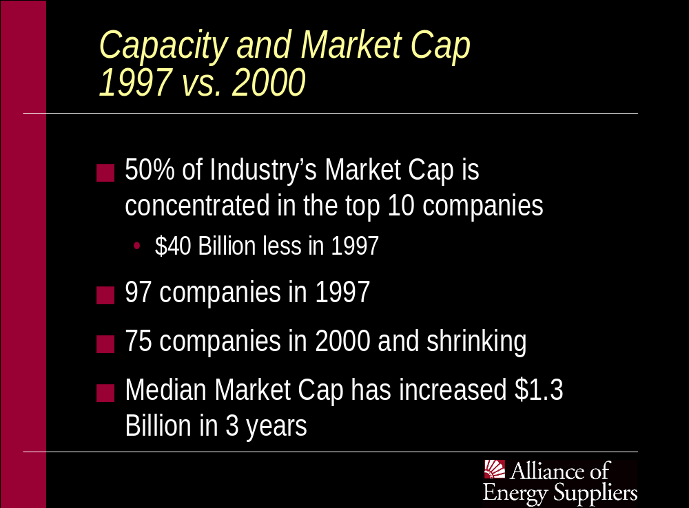

Slide 10
1999 Power Marketer Sales Statistics
Million
MWH Share
Enron Power 388.3 14.6%
Aquila Energy 236.5 8.9%
PG&E Energy 225.1 8.5%
Southern Co. Energy 220.1 8.3%
Avista Energy 135 5.1%
Duke Energy 120.8 4.6%
Reliant 112.2 4.2
Citizens Power 92.3 3.5%
Million
MWH Share
Williams 91 3.4%
Statoil Energy 75.6 2.9%
Dynegy PM 69.8 2.6%
Constellation PS 69.8 2.6%
El Paso PS 67.7 2.6%
Koch ET 56.8 2.1%
Total 1961 73.9%
Total Marketer Sates 2652

Slide 11
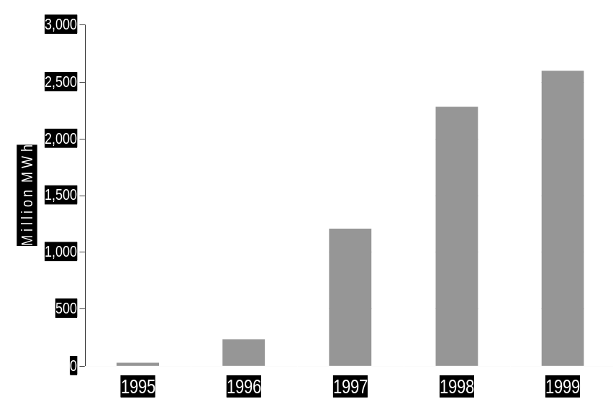
Power Marketer
Total Annual Wholesale Sales
1999:
2.6 billion MWh (projected)
1998:
2.3 billion MWh
1997:
1.2 billion MWh
1996:
230 million MWh
1995:
27 million MWh

Slide 12
Strategic Landscape
Consolidation is old reliable
Convergence is still evolving
Retail access is now business driven
Regional wholesale electric and gas players
Many physical players, limited financial players

Slide 13
The State of State Restructuring…the Glass is Half Full
25 states are on their way
Approaching 70% of U.S. customers will have choice in the future
Evolving wholesale market
Liquidity and evolving market structures

Slide 14
State Decisions to Implement Retail Access
As of September 2000
D.C.
Retail access for large customers only
Regulatory
Law
Both
Decision
Enacted

Slide 15
The Promise of Deregulation: “Lower Electricity Prices”
Competitive Generation Market is Essential to Wholesale Market Development
Reliance on Cheap, Plentiful Natural Gas & Highly Efficient Combined Cycle Technology
Natural Gas Supply Market is Continent-Wide --- Gas Delivery by Displacement
The Public Still Expects This Result --- Sees Manipulation; Not Shortages

Slide 16
Perceptions and Beliefs
“I am not going to let these generators, making eight and nine hundred percent profits unduly bring California to its knees.” -- California Governor Gray Davis

Slide 17
Oops, California Did It Again
Restructured States, Reflect…..Reverse?
Populist States, Pause to Reflect…..
Is California’s Buy out a Western Solution
  Generation
  Wires

Slide 18
Deregulation Momentum Falters in Other States
Iowa
“Recent events in CA have all but ruined the climate for restructuring…”
  Megawatt Daily
New Mexico
“May push back plans to open its market to competition by up to 3 years.”
  Electric Power Daily
Nevada
Restructuring on hold
North Carolina
“California has sent a chill through North Carolina”

Slide 19
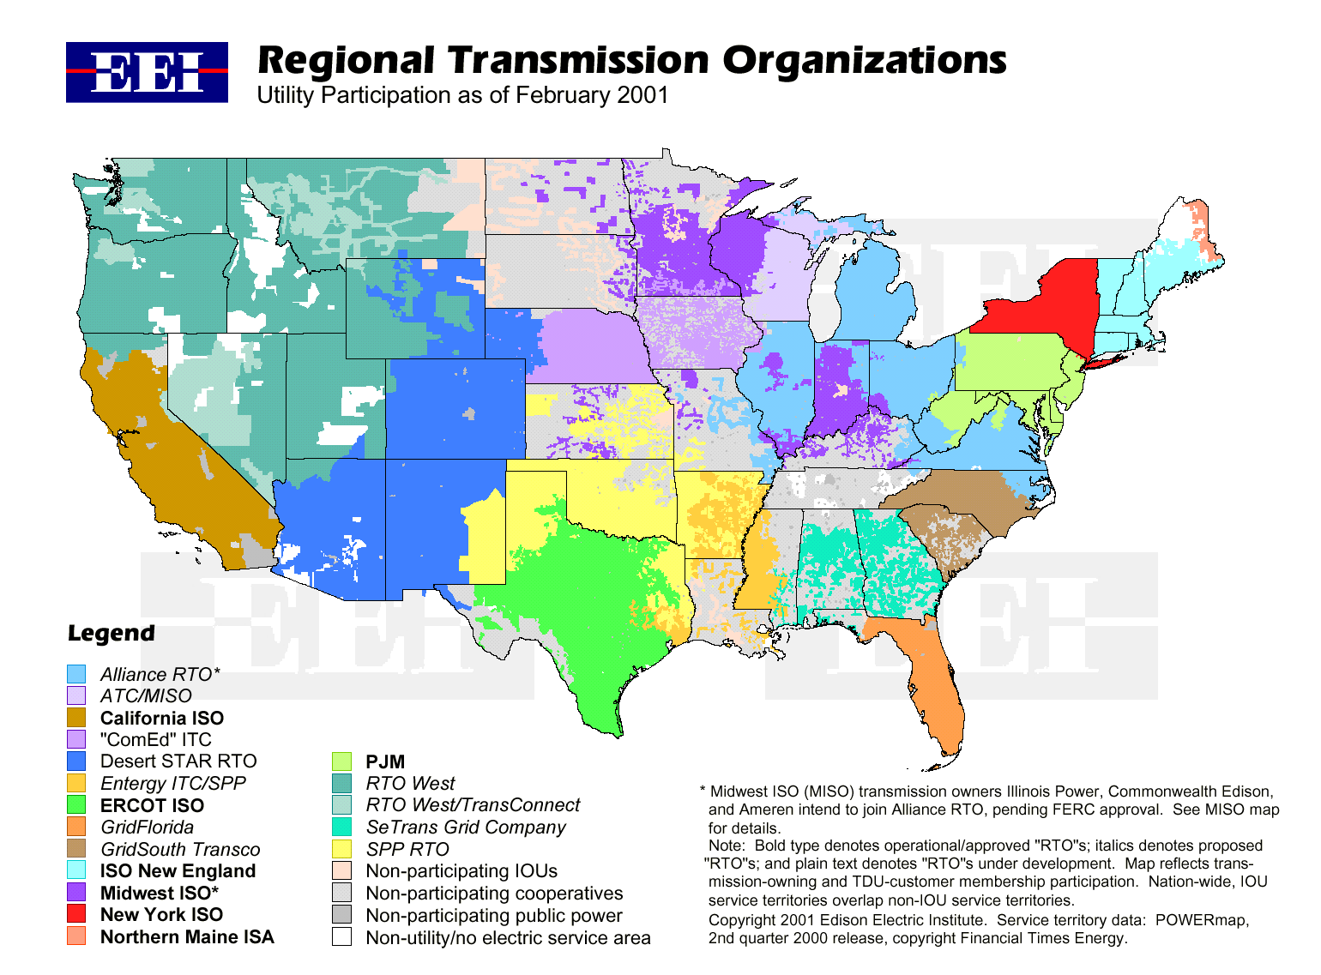


Slide 20
RTO Rules & Filings -The Devil is in the Details
Minimizing Intervention – Governance Emphasis
  Market Monitoring
Determining Strategic Position
  Congestion and Seams
Detail Avoidance
  System expansion
  RTO Role with Interconnection
The Ides of December
  Should FERC be responsible for Market Legitimacy?

Slide 21
Federal Restructuring
The House – existing straw man
The Senate – Interests of Senators
The Administration
FERC authority
  Chair and Commissioner Changes

Slide 22
National Energy Legislation
Production Oriented Bill
  Oil Concerns
  Coal-based Generation
  Natural Gas Production and Transmission
  Electric Transmission – Eminent Domain
  Interconnection Standards
Conservation Title
Environment Title

Slide 23
The End of Regulatory Franchises Exposes Energy
Firms and Consumers to a Complex Set of Risks
Capacity Transmission Addition Pipelines Addition Natural Gas Storage Capital Credit Event Unit Outage Weather | Commodity Energy Price Risk - Volatility NOx Emissions Allowances Political Price Caps Regulatory Lag State Retrenching

Slide 24
The Competitive Crossroad
Status Quo
Political & Regulatory Market Interventions
Deregulation Stalled
Companies hold generation as a hedge against market risks
DISCOs go unhedged but retain POLR duties
Markets stay illiquid, futures, forwards and derivatives markets don’t evolve
Industry Risk Management Solution
Insulate consumers from volatile market
Keep deregulation on track, accelerate competition trend
Grow the wholesale market, enhance liquidity, new derivatives
Improve the regulatory environment for risk management
Enhance DISCO earnings

Slide 25
Summary
Strategic Platform for Energy Industry is Enterprise Risk Management
Business Interests Will Need to Drive Market Development
Feds Won’t Restructure Industry - They Will Deliver Energy Supply Policy Legislation

