Slide 1
Distributed Generation in the NEMS Electricity Market Module
J. Alan Beamon
March 27, 2001

Slide 2
Attractive Characteristics of Distributed Generators
Small size, modular
Located near customer sites and amenable to cogeneration
Able to provide localized ancillary services
Potential offset/reduce transmission and distribution investments
Direct competitors to central station generators, transmission and distribution equipment

Slide 3
Factors Affecting Penetration of Distributed Generators
Site characteristics
Distributed generator technology economics - capital costs, efficiency, fuel costs
Central station generator economics
Potential transmission savings
Potential distribution savings
Pricing of transmission and distribution services
Pricing of ancillary services

Slide 4
Methodology in EMM / NEMS
Compete distributed generators against central station generators plus wires
2 generic distributed generation technologies
6 step distribution of growth related transmission & distribution costs
Key economic drivers:
  Cost of DG technologies versus central station technologies
  Avoidable transmission and distribution costs
  Percentage of growth related T&D costs avoidable

Slide 5
Potential Technologies
Micro turbines
Mid-size turbines
Engines
  Diesels
  Spark ignited
Fuel cells
Storage devices - (batteries and flywheels)
Renewables

Slide 6
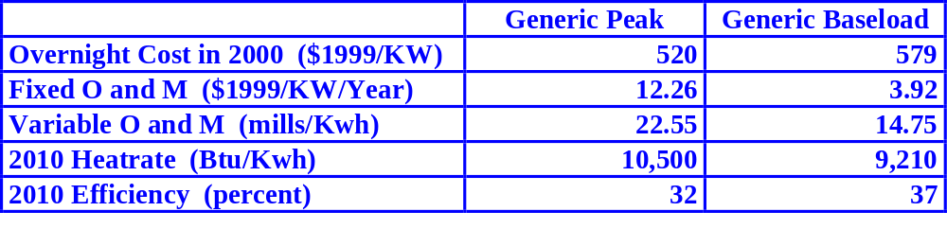
Generic Technologies in the EMM
2 generic technologies - peak and baseload

Slide 7
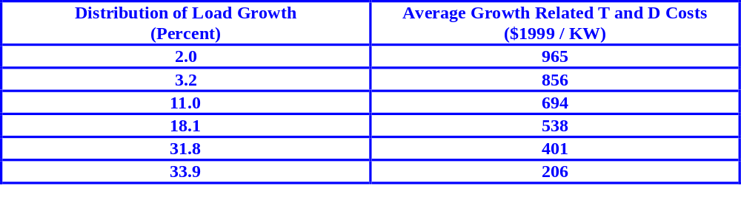
Transmission and distribution savings
Regional distribution of growth related transmission and distribution costs
Reference Case assumes 60 percent of costs avoidable with DG
Two sensitivity cases assuming 50 and 75 percent avoidable

Slide 8
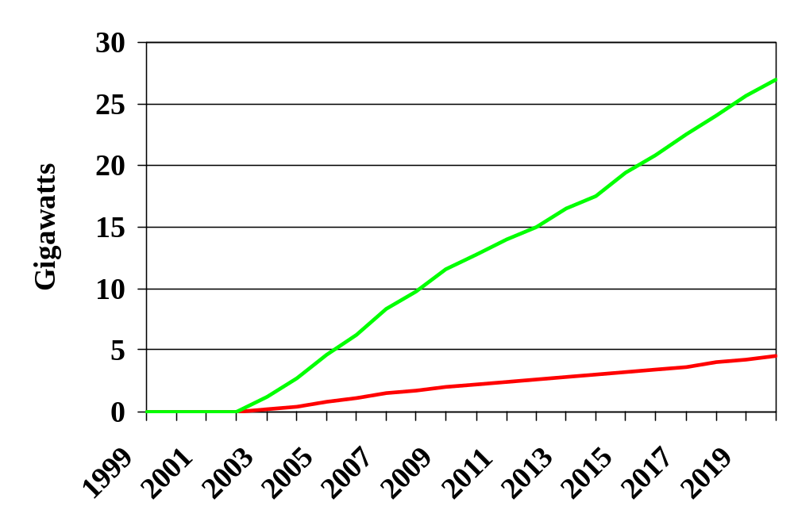
Incremental Distributed Capacity Added
75 % Avoidable
Reference 60% Avoidable
50 % Avoidable

Slide 9
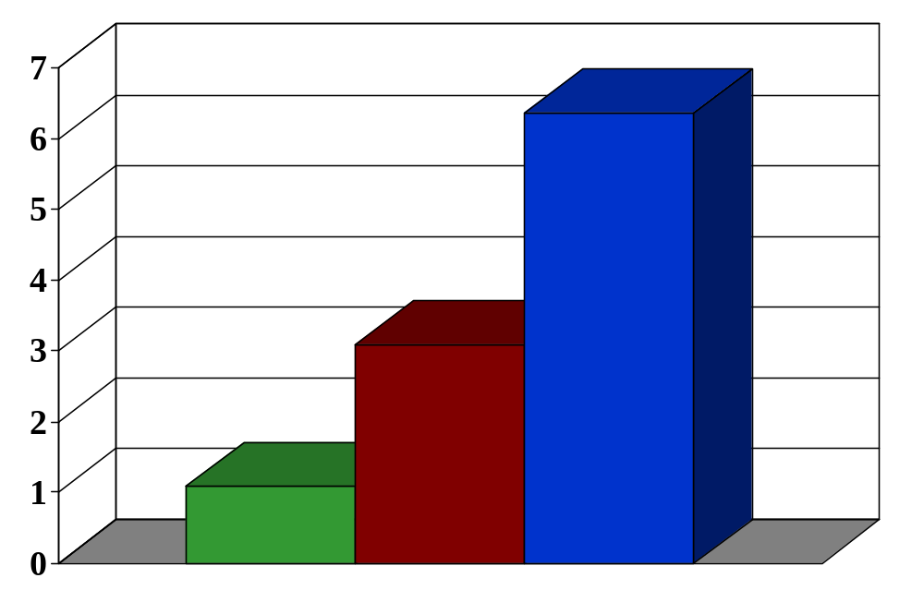
Percent of Total Capacity Additions
75 % Avoidable
Reference 60% Avoidable
50 % Avoidable

Slide 10
Uncertainties
Transmission and distribution cost data
Future cost and performance of DGs
Future cost and performance of central station generators
Fuel prices to distributed generators
Valuing and capturing transmission and distribution cost savings
Valuing and capturing ancillary services provided by distributed generators

