Slide 1
NEMS/AEO Conference - March 2001
Comments on
International Oil Demand and Supply
Dermot Gately
New York University
Dermot.Gately@nyu.edu
Notes:
I would like to thank Mary Hutzler for inviting me to participate in this conference on energy projections, and, frankly, on the difficulties involved in such projections. I’ve been looking forward to coming down to Washington, and I would occasionally check the web site of the Washington Post. The last time I checked the site was three weeks ago, and it said that you were going to get 24” inches of snow, which really alarmed me. … So you can imagine how relieved I was to see all that snow had melted by the time I arrived yesterday. … Hey, doing projections is a tough job!

Slide 2
DOE projections: world oil market
Reference Case: the need for OPEC oil is projected to double over the next two decades, requiring unprecedented investment in capacity expansion, mostly in Persian Gulf.
Given relatively little response in NEMS to higher prices, OPEC’s key producers would prefer – and could impose – much higher prices than even the High-Price Case, with much slower growth in oil output.

Slide 3
DOE projections: world oil market
If NEMS were to be modified -- assuming greater price-responsiveness for world oil demand and/or Non-OPEC supply -- then the demand for OPEC oil could be satisfied over the next two decades with only modest increases in OPEC oil output, at prices below $30 / barrel.

Slide 4
The NEMS model and its use are internally inconsistent
If NEMS accurately represents the price-responsiveness of world oil demand and Non-OPEC supply, then both the Reference Case & the High-Price Case project future oil prices that are far too low – because these cases rely on supply behavior by Gulf producers that is not in their own self-interest.
The NEMS projections of world oil prices could be reasonable, but only if world oil demand and/or Non-OPEC supply are much more price-responsive than are represented in NEMS.

Slide 5
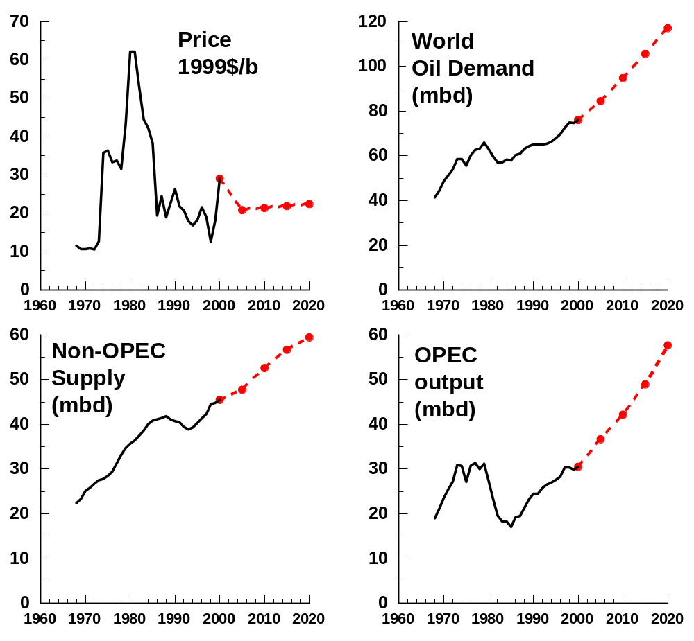
DOE Reference Case projection to 2020:
Oil Price about $21/barrel
Demand for OPEC output doubles -- to unprecedented levels.

Slide 6
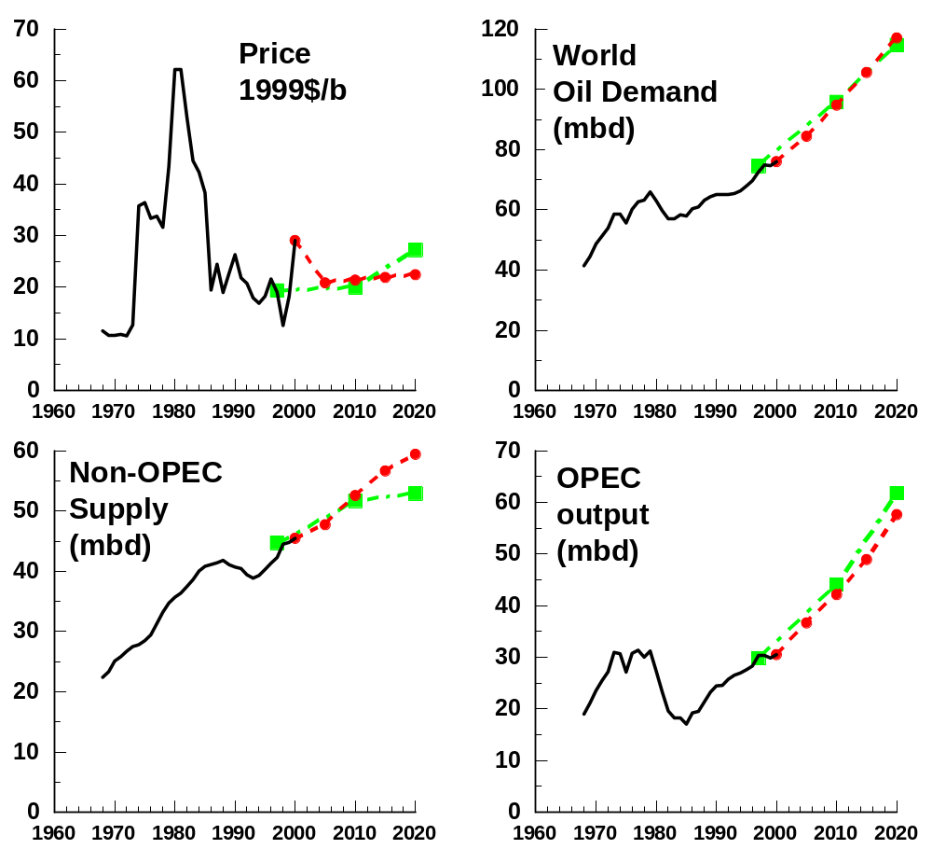
DOE Ref.Case and IEA projections
DOE Ref.Case & IEA projections are similar.
DOE has higher Non-OPEC supply. Both require huge increases in OPEC output.

Slide 7
Key issue: whether OPEC, especially Saudi Arabia and its neighbors, would be willing to expand production as rapidly as is projected.
IEO 2000, page 34: “The combination of potential profitability and the threat of competition from non-OPEC suppliers argues for the pursuit of an aggressive expansion strategy for OPEC.”

Slide 8
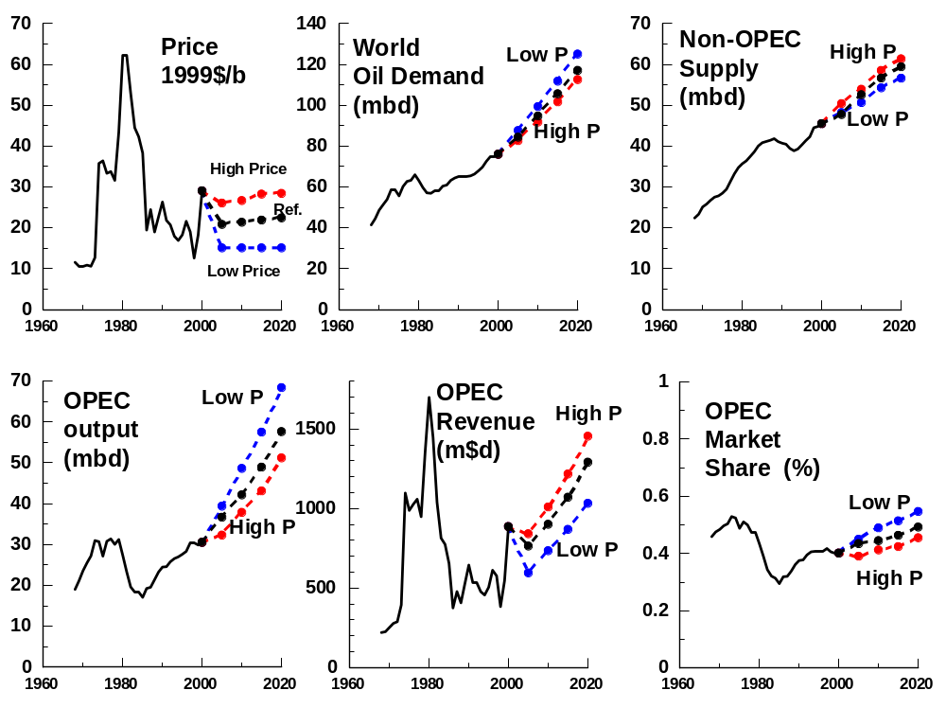
DOE projections: Ref.Case, High Price & Low Price Cases

Slide 9
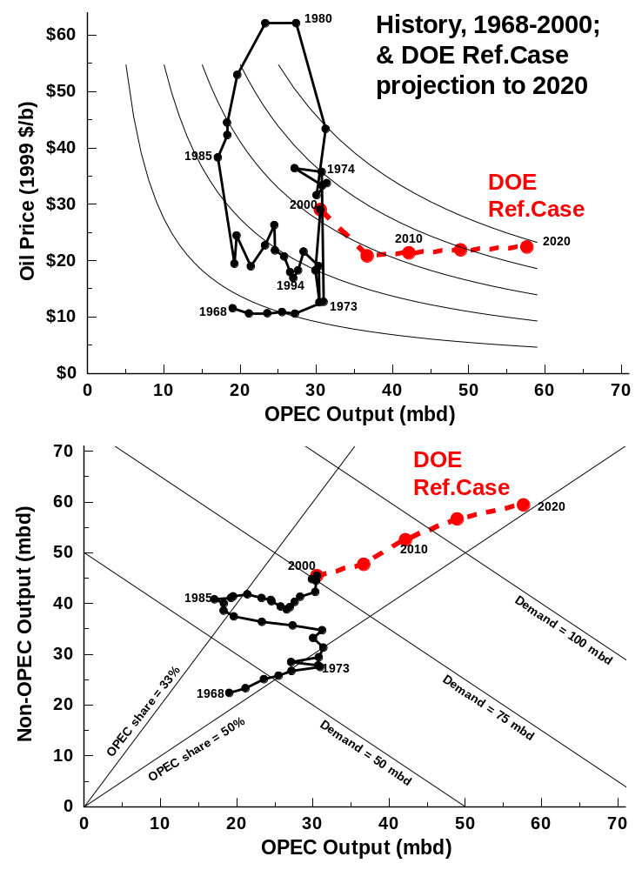
DOE Reference Case projection to 2020: oil price about $21, and OPEC output doubling, to unprecedented levels.
Notes:
Need better graphic representation of all these variables. Better representation is shown here, on two graphs. Top graph shows OPEC output on horizontal and Oil Price on vertical, historical data in black, with DOE Ref.Case projection in red. In background are iso-revenue curves for OPEC: the higher the curve, the greater is OPEC Revenue.
Bottom graph also shows OPEC output on horizontal (same as does top graph), but with Non-OPEC output on vertical. Historical data in black; DOE projection in red. Total World Demand is shown in 3 lines from NW to SE. OPEC Market Share is shown by 2 diagonal lines from origin of graph: higher share moving clockwise.

Slide 10
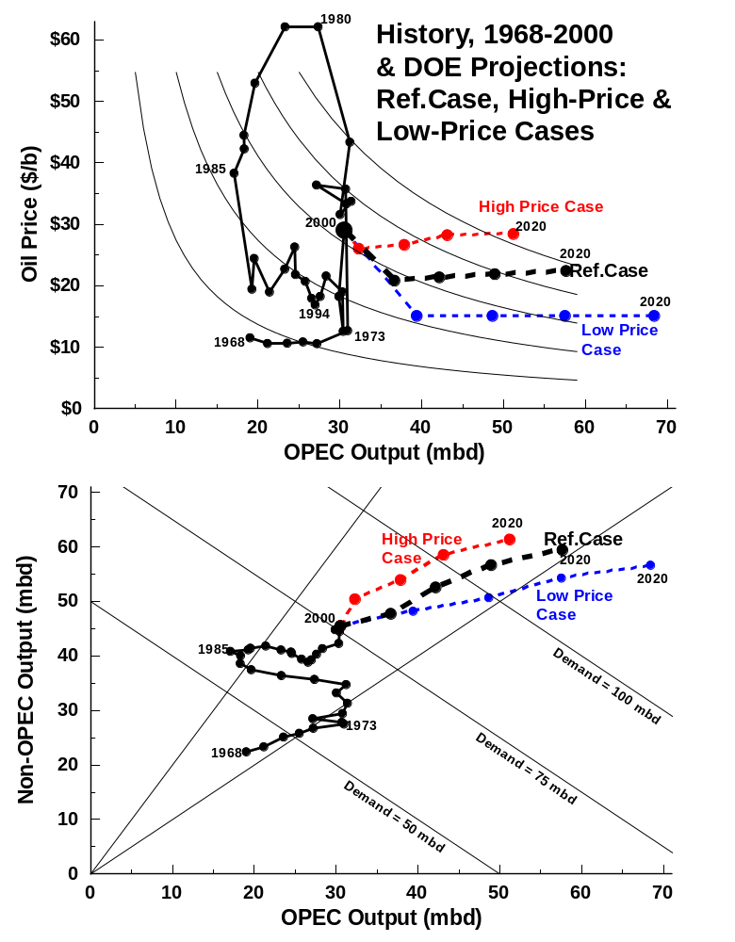
Alternative Price Cases versus Reference Case: Demand & Supply results are relatively unresponsive to Oil Price changes (price-inelastic)
Notes:
If demand for OPEC oil is price-inelastic, then reducing OPEC output (thus increasing price) will have the result that OPEC revenue increases.

Slide 11
High Price Case versus Reference Case: results are relatively unresponsive to Oil Price changes (price-inelastic)
Price: 2005-20 | Ref. Price case $ 21.50 | High Price case $ 27 ( + 26%)
World Oil Demand in 2020 | 119 mb/d | 115 mb/d (-3.4%)
Non-OPEC Supply in 2020 | 60 mb/d | 62 mb/d (+3.3%)
Demand for OPEC oil, 2020 | 59 mb/d | 53 mb/d (- 10%)
% Price increase > % decrease in OPEC output: hence OPEC revenue increases when price increases

Slide 12
High Price Case versus Low Price Case: results are relatively unresponsive to Oil Price changes (price-inelastic)
Price: 2005-20 | Low Price case $ 15 | High Price case $ 27 ( + 80%)
World Oil Demand in 2020 | 127 mb/d | 115 mb/d (- 9%)
Non-OPEC Supply in 2020 | 57 mb/d | 62 mb/d (+ 9%)
Demand for OPEC oil, 2020 | 70 mb/d | 53 mb/d (- 24%)
% Price increase > % decrease in OPEC output: hence OPEC revenue increases when price increases
Notes:
To see the comparison more clearly, compare the High & Low Price Cases. The High Price is 80% higher than the Low Price, but World Oil Demand is only 9% lower than in the Low-Price Case by 2020, and Non-OPEC Supply would be only 9% higher than in the Low-Price Case by 2020.

Slide 13
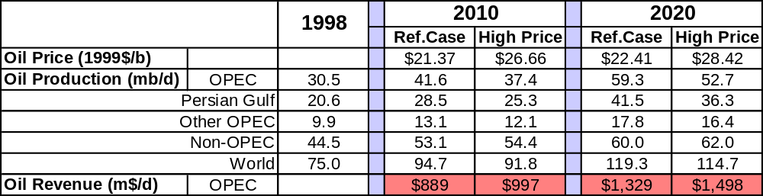
High Price or Reference Price:
which would OPEC prefer?
The High Price Case, because:
  Higher Oil Revenue
  Less investment required
  Less oil reserves used up

Slide 14
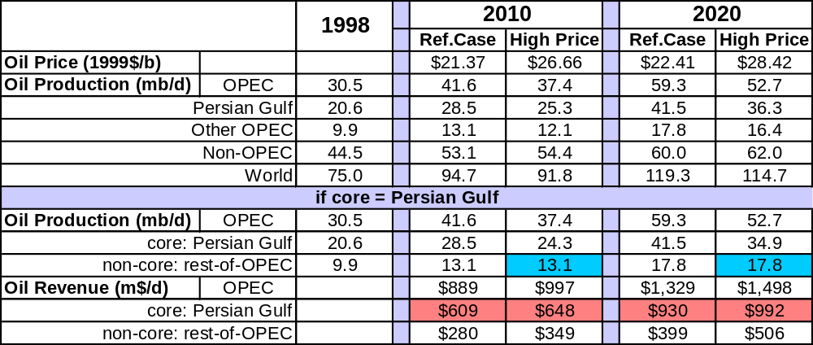
High Price or Reference Price:
which would Persian Gulf prefer?
Assume that the burden of slowing output growth fell only on Persian Gulf (the supply-restricting “core”), not on Other OPEC.
Notes:
We assume that the non-core members of OPEC would be satisfied in their output levels from the Ref.Case, that they would not increase output above that. Of course, if they did increase their output this would make it more difficult for the core to restrict output.

Slide 15
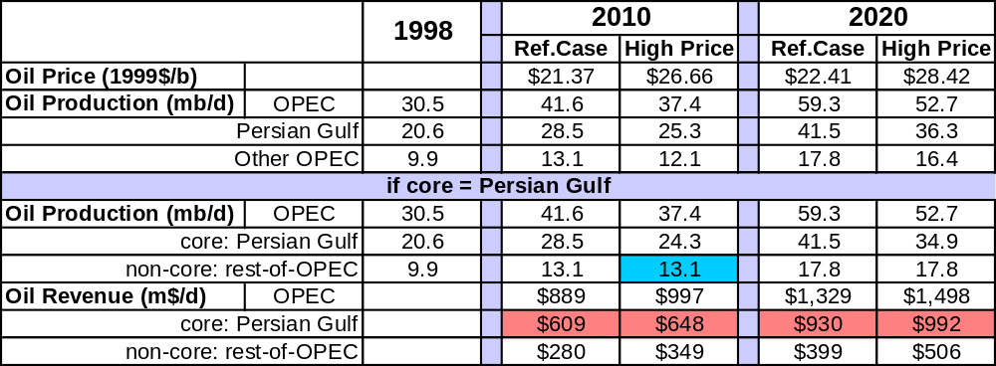
High Price or Reference Price:
which would Persian Gulf prefer?
Persian Gulf prefers High Price Case:
  Higher Oil Revenue
  Less investment required
  Less oil reserves used up

Slide 16
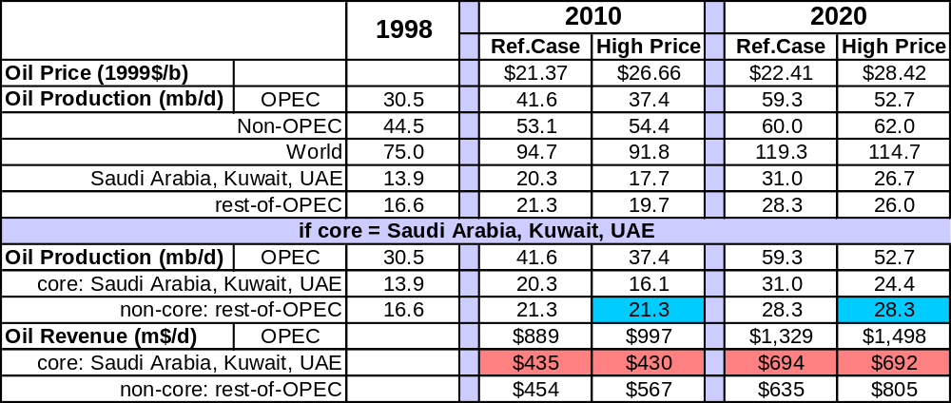
High Price or Reference Price: which
would Saudis, Kuwait & UAE prefer?
Assume that the burden of slowing output growth fell only on these 3 countries (the supply-restricting “core”), not on the rest of OPEC.
Notes:
[to EIA: for Ref.Case production levels within Persian Gulf, I assumed same capacity utilization for all Persian Gulf producers.] We assume that the non-core members of OPEC would be satisfied in their output levels from the Ref.Case, that they would not increase output above that. Of course, if they did increase their output this would make it more difficult for the core to restrict output.

Slide 17
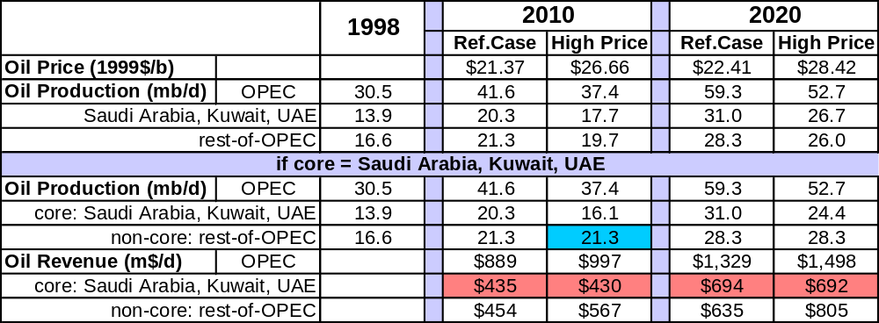
High Price or Reference Price: which
would Saudis, Kuwait & UAE prefer?
These 3 still prefer High Price case: virtually the same revenue, less investment needed, more oil left.

Slide 18
What incentive do these 3 countries have for producing an extra 4.2 mb/d in 2010 -- increasing output to 20.3 instead of to 16.1 mb/d ? They’d get an extra $5 m$/d: less than $1/barrel; this would not even cover their production costs, much less capacity-expansion costs, or the opportunity cost of not selling that oil in the future.

Slide 19

High Price or Reference Price: which
would Saudi Arabia prefer?
Assume that the burden of slowing output growth fell only on Saudi Arabia, not on rest-of-OPEC.
In 2010, for producing an extra 4.2 mb/d, they’d get an extra $40 m$/d: less than $10/barrel.
Notes:
If Saudis produce an extra 4.2 mbd in 2010, they get an extra $30 m$d revenue ($7/b).
For an extra 6.6 mbd in 2020, they’ll get an extra $58 m$d revenue (<$9/b).

Slide 20
Same question, phrased differently:
Should OPEC’s core increase its output faster, in order to move from High-Price-path to Ref.Case Price-path?
What extra revenue does OPEC’s core get for producing the extra output?
Notes:
If they produce an extra 4.2 mbd in 2010 (18.5-14.3) they’ll get an extra $15 m$d in Revenue (<$4/b extra). For an extra 6.8 mbd in 2020, they get an extra $34 m$d.

Slide 21
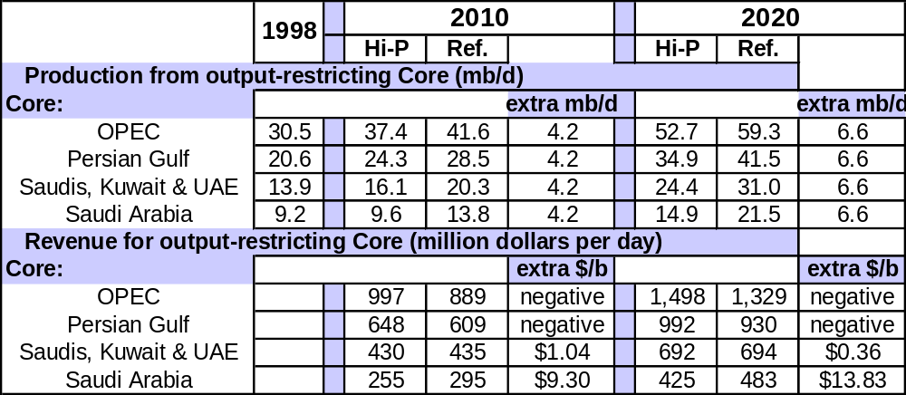
For different membership of OPEC’s core, what extra revenue does core get for producing the extra output?
Answer: from negative to very little extra per barrel

Slide 22
Conclusions:
Even the smallest core in OPEC would prefer High Price Case to Reference Case: there is too little incentive to increase output so rapidly. The Reference Case could not occur, because OPEC’s core prefers the High-Price-Case instead, and it has the power to impose it.

Slide 23
Similarly, by extension, neither could the High-Price Case occur – because OPEC’s core prefers an Even-Higher-Price Case, and it has the power to impose it.
Unless demand & Non-OPEC supply are more price-responsive, OPEC will slow output growth, let price increase, and be better off for doing so.

Slide 24
What if we allow Demand & Non-OPEC Supply to be more price- responsive than NEMS?
Use Gately world-oil-model spreadsheet that is calibrated to track NEMS results for Ref. Case price-path, but has more price-responsive Demand & Non-OPEC Supply than NEMS has.

Slide 25
Gately world-oil-model spreadsheet
Higher price-elasticities of Oil Demand:
- 0.4 for Transportation Oil
- 0.8 for Non-Transportation Oil
These assumptions are still price-inelastic, but they are much more elastic than NEMS.
Non-OPEC Oil Supply is also assumed to be more price-responsive than NEMS.
Elasticity assumptions are illustrative.

Slide 26
Gately world-oil-model spreadsheet
Price: 2005-20 | Ref. Price case $ 21.50 | High Price case $ 27 ( + 27%)
World Oil Demand in 2020 | 119 mb/d Same as DOE | 104 mb/d (-13%) [DOE: 115 mbd]
Non-OPEC Supply in 2020 | 60 mb/d Same as DOE | 69 mb/d (+ 15%) [DOE: 62 mbd]
Demand for OPEC oil, 2020 | 59 mb/d Same as DOE | 35 mb/d (- 41%) [DOE: 53 mbd]
% Price increase < % decrease in OPEC output: hence OPEC revenue decreases when price increases

Slide 27
Compare DOE High-Price results with High-Price-path results from Gately spreadsheet with its higher price elasticities of Demand & Non-OPEC Supply.
Gately spreadsheet calibrated to produce DOE Ref.Case results when using Ref.Case Price-path.

Slide 28
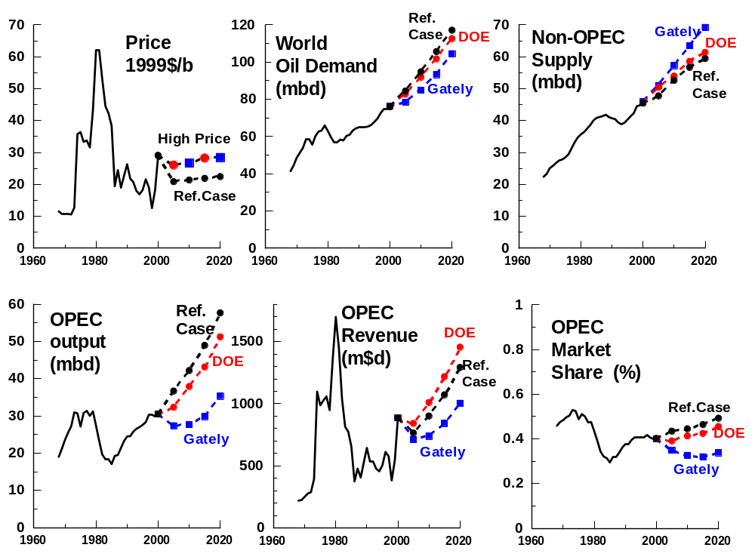
High-Price Case: comparing DOE & Gately results
Notes:
Gately model has same results as DOE for Ref.Case price-path, but more price-responsive results for High-Price path than does DOE. With High-Price-path, Gately demand rises more slowly than DOE, and Non-OPEC Supply rises more rapidly than DOE. Effects on demand for OPEC oil cumulate: Gately results are MUCH lower than DOE. Hence Gately results for OPEC Revenue are now the reverse of those for DOE – instead of High-Price-path yielding higher-than-Ref.Case OPEC Revenue as DOE projects, the Gately model projects that it will yield lower OPEC revenue than under the Ref.Case.

Slide 29
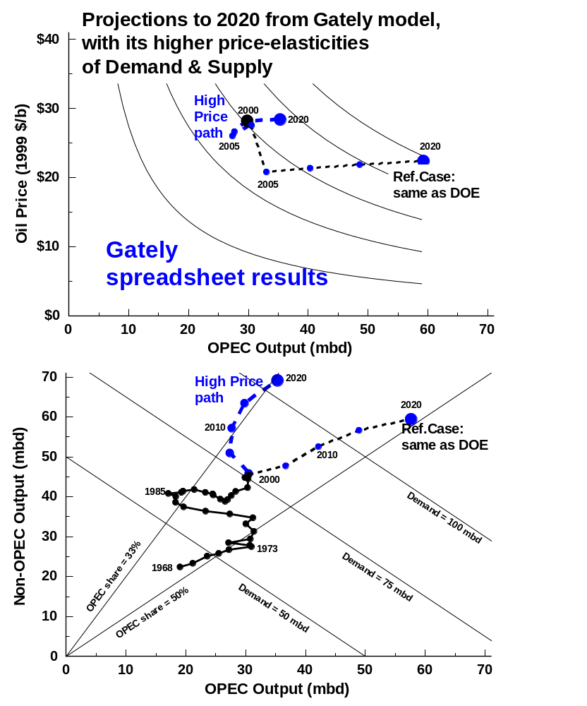
Same Ref.Case result as DOE, but High-Price-path increases Non-OPEC supply more, reduces Demand more, and greatly reduces the need for OPEC oil. Also, much lower OPEC revenue & market share from High-Price path.

Slide 30
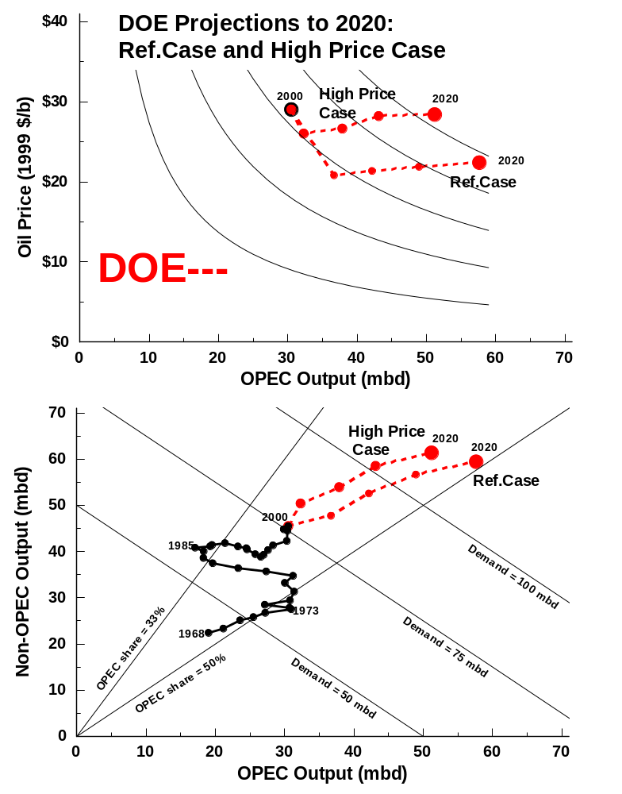
Notes:
In top diagrams, note the Revenue change in going from Ref.Case to High-Price Case. In 2 bottom diagrams, note the differences in OPEC-market-shares from High-Price case. For DOE, demand for OPEC oil declines little given High-Price-path – in contrast, Gately spreadsheet’s demand for OPEC oil declines dramatically.

Slide 31
Gately world-oil-model spreadsheet
Why would OPEC (or any core within OPEC) not choose the High-Price case under more price-responsive assumptions? Because it cannot restrain OPEC output below 30 mbd for 15 years – which would be necessary if Price were to follow the High-Price path. Nor would OPEC want to restrain its output when it faces elastic demand for its oil --because price will rise but revenue will fall.

Slide 32
Gately world-oil-model spreadsheet
Consider 2 additional cases that illustrate the choices facing OPEC:
OPEC output rises gradually to 40 mb/d by 2020
OPEC output rises gradually to 50 mb/d by 2020
What would be the resulting price, world oil demand, Non-OPEC supply, OPEC revenue & market share?

Slide 33
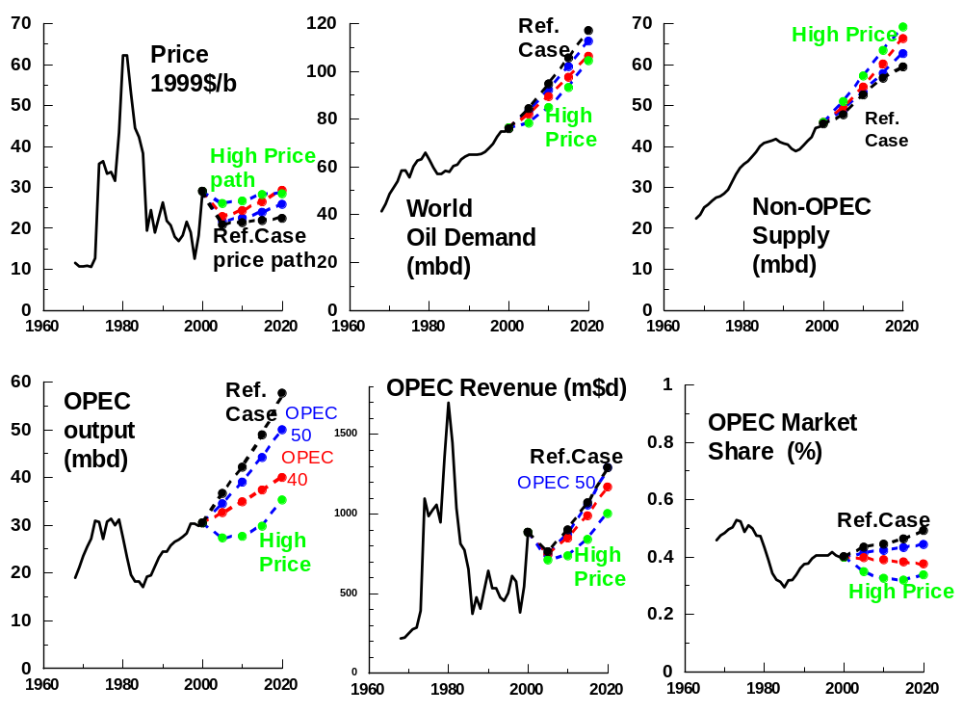
Gately world-oil-model spreadsheet: other cases

Slide 34
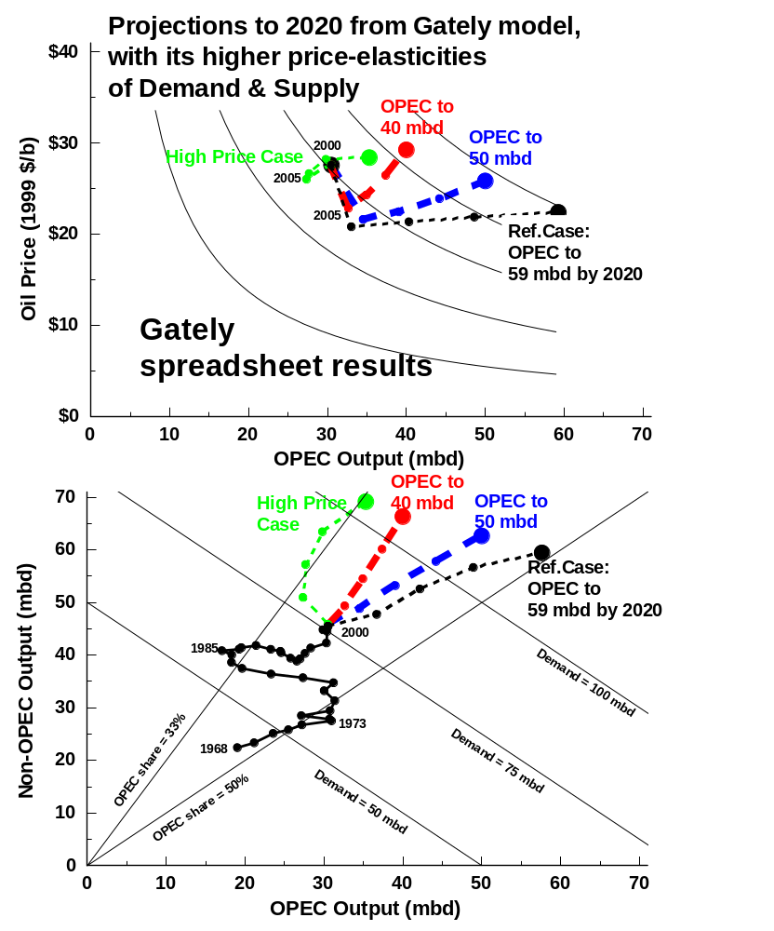
Gately world-oil-model spreadsheet: other cases
Most likely case: OPEC output grows slowly, to 40 mbd by 2020. OPEC market share stays almost constant. After initial price decline, price & revenue grow steadily to 2020.
Notes:
If OPEC output increases to 40 mbd by 2020 (to 35 by 2010), its market share stays roughly constant, and price and revenue rise would steadily to 2020 – after an initial decline. If OPEC increases output faster, to 50 mbd by 2020, then price will be lower but revenue would be higher. However, such revenue increases might not compensate for the costs involved: production costs, capacity expansion costs, and the opportunity cost of not being able to sell the output later.

Slide 35
Conclusions
DOE Reference Case requires rapid growth in OPEC oil output, to unprecedented levels that would require huge increases in capacity. OPEC’s core producers would prefer – & could impose – higher prices and slower output-growth.
Similarly for DOE High-Price Case: rapid increases in OPEC output & capacity. OPEC’s core producers would prefer – & could impose – an even-higher price-path, with more modest growth in oil output and capacity.

Slide 36
Conclusions
If NEMS were to be modified by assuming greater price-responsiveness of world oil demand and/or Non-OPEC supply, then OPEC output could grow more slowly – say only to 40 mbd by 2020 – without price increasingly significantly.

Slide 37
Conclusions
The NEMS model & its use are internally inconsistent
If NEMS accurately represents the price-responsiveness of world oil demand and Non-OPEC supply, then both the Reference Case & the High-Price Case project future oil prices that are far too low – because these cases rely on supply behavior by Gulf producers that is not in their own self-interest.
The NEMS projections of world oil prices could be reasonable, but only if world oil demand and/or Non-OPEC supply are much more price-responsive than are represented in NEMS.

Slide 38
Appendix
Additional Slides

Slide 39
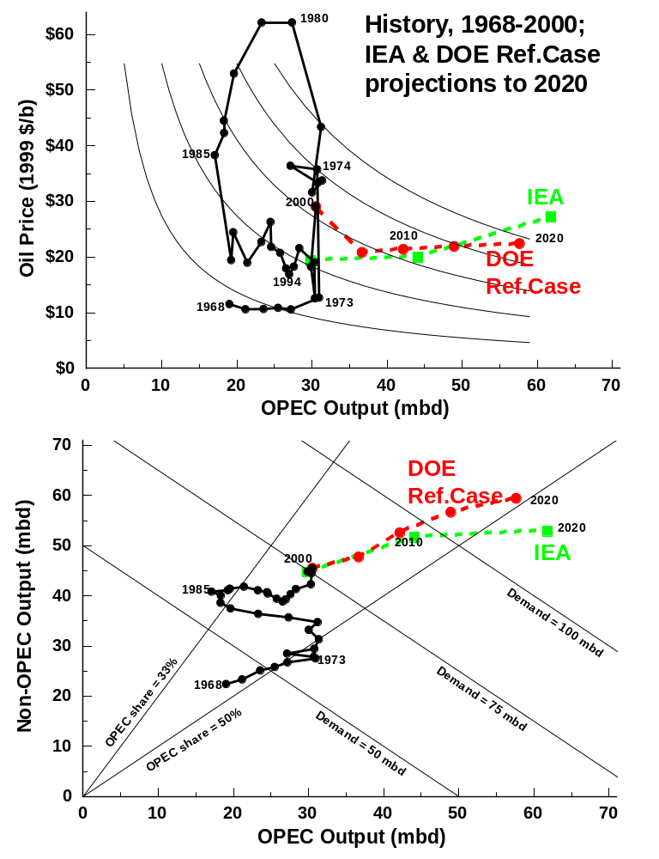
IEA & DOE Reference Case projections are similar. DOE has higher Non-OPEC supply. Both require huge increases in OPEC output.

Slide 40
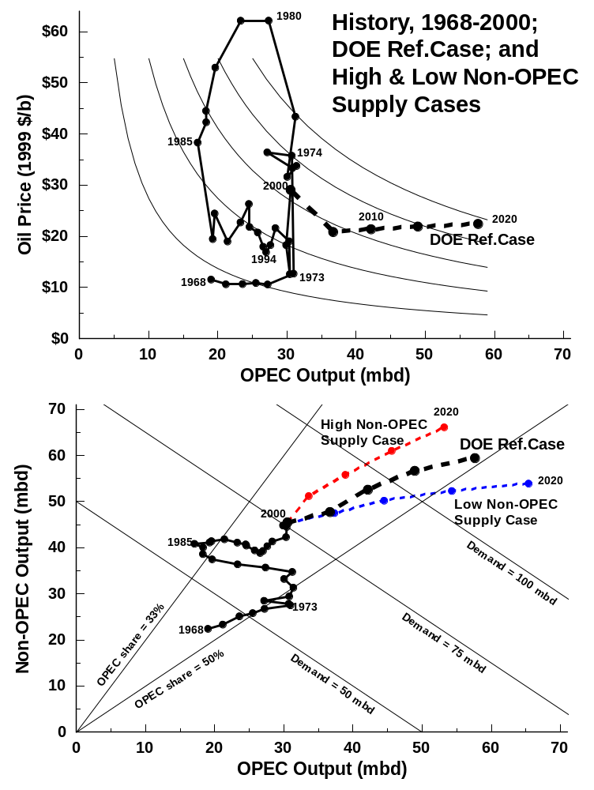
Alternative DOE Cases: Higher Non-OPEC Supply, with Ref.Case prices

Slide 41
“Constrained OPEC” Case for NEMS ? how high might price have to rise to keep demand for OPEC oil below 40 mbd in 2020?
Price: 2005-20 | High Price case $ 27 | “Constrained OPEC” $ 43 ( + 60%)
World Oil Demand in 2020 | 115 mb/d | 106 mb/d (- 8%)
Non-OPEC Supply in 2020 | 62 mb/d | 67 mb/d (+ 8%)
Demand for OPEC oil, 2020 | 53 mb/d | 39 mb/d (- 26%)
Notes:
These are my calculations. They assume the same proportional response to higher prices as indicated in the slides comparing High Price results with Ref.Case or with Low Price results.

Slide 42
What if we use DOE High Non-OPEC Supply assumptions as the basis for comparison between High- Price-path and Reference Price-path? Will the conclusion still hold, that OPEC’s core would impose the High-Price-path? ( Yes. )

Slide 43
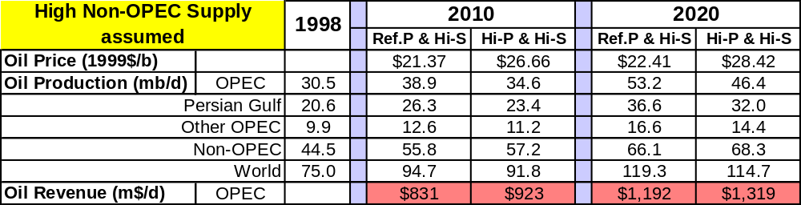
With High Non-OPEC Supply --
which would OPEC prefer between High Price or Reference Price ?
High Price, because: higher Revenue, less investment required, less oil reserves used up

Slide 44
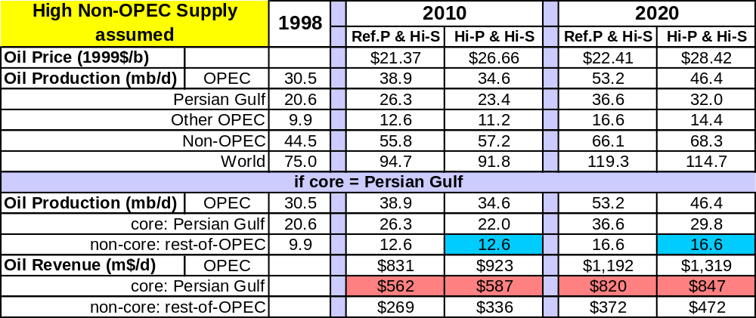
With High Non-OPEC Supply --
which would Persian Gulf prefer between High Price or Ref. Price ?
High Price, because: higher Revenue, less investment required, less oil reserves used up

Slide 45
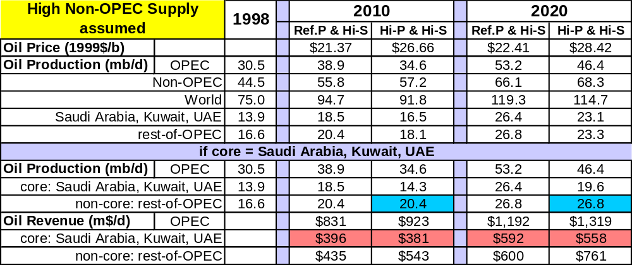
With High Non-OPEC Supply --
which would Saudis, Kuwait & UAE prefer: High Price or Ref. Price ?
High Price, because: almost the same Revenue, less investment required, less oil reserves used up
Notes:
If they produce an extra 4.2 mbd in 2010 (18.5-14.3) they’ll get an extra $15 m$d in Revenue (<$4/b extra). For an extra 6.8 mbd in 2020, they get an extra $34 m$d.

Slide 46
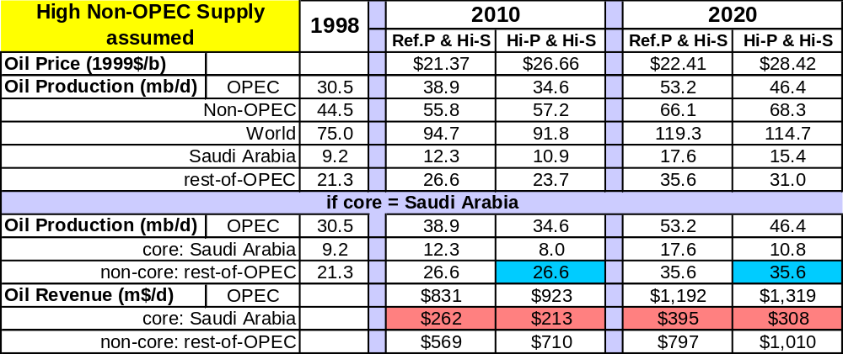
With High Non-OPEC Supply --
which would Saudi Arabia prefer: High Price or Ref. Price ?
Perhaps Ref.Case? Higher output & revenue & market share may offset higher costs.
Notes:
If they produce an extra 4.2 mbd in 2010 (18.5-14.3) they’ll get an extra $15 m$d in Revenue (<$4/b extra). For an extra 6.8 mbd in 2020, they get an extra $34 m$d.

Slide 47
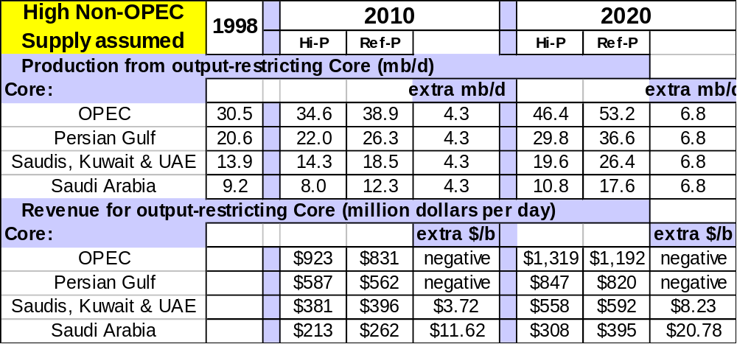
For different membership of OPEC’s core, what extra revenue does core get for producing the extra output?
Answer: from negative to very little extra per barrel

Slide 48
Conclusion: the core producers in OPEC would prefer High Price Case to Reference Case: there is too little incentive for them to increase output so rapidly.

