Slide 1
Forecasting Long-Term Non-OPEC Supply, Science and Art
Michael C. Lynch
WEFA Energy, March 2001
lynch@wefa.com

Slide 2
WOLF AT THE DOOR...
RESOURCE ARGUMENT (LONG-TERM)
  CLOSE TO URR MIDPOINT
  NO NEW GIANT FIELDS (AND ONLY GIANTS COUNT)
OPERATIONAL ARGUMENTS (SHORT-TERM)
  FIELD DEPLETION RATES RISING SHARPLY
    MUCH MORE DRILLING NEEDED TO OFFSET
  RIG RATES TOO LOW FOR NEW RIG BUILDING
PRICES WILL INCREASE
  COSTS RISING DUE TO RESOURCE DEPLETION
  OPEC MARKET SHARE TO RISE

Slide 3
…OR CRYING WOLF?
WARNINGS CONSISTENT SINCE LATE 1970S
  AND CONSISTENTLY WRONG
    ALWAYS A PEAK, SOON, EVERYWHERE BUT MIDEAST
BILLIONS WAGERED, BILLIONS LOST
  SHALE OIL, ELECTRIC CARS, T. BOONE PICKENS
  ETHANOL, FBR, PV, FUEL CELL CARS
BUT NOT PROOF OF ERROR NOW
  SHEPHERD WAS EATEN

Slide 4
MANY MISREPRESENTATIONS
SIDES IN THE DEBATE
  NOT CAMPBELL VS. LYNCH
  NOT GEOLOGISTS VS. ECONOMISTS
  MOSTLY PESSIMISTS VS. OPTIMISTS
RESERVES DATA NOT AN ISSUE
PESSIMISTIC VIEW NOT WIDELY ACCEPTED
  A FEW OIL COMPANIES, NOT REALLY IEA
HUBBERT GOOD, HUBBERT MODEL BAD
  HUBBERT US OIL PRODUCTION FORECAST GOOD, OTHERS VERY BAD

Slide 5
THE LAZY MAN’S APPROACH
HISTORICAL REVIEW: LOOK FOR
  ACCURACY
  RECURRING ERRORS
  OMITTED VARIABLES
  BIAS
INPUT/OUTPUT CONSISTENCY
  GIVEN PESSIMISTIC DEVELOPMENTS, HOW DOES SUPPLY KEEP RISING?

Slide 6
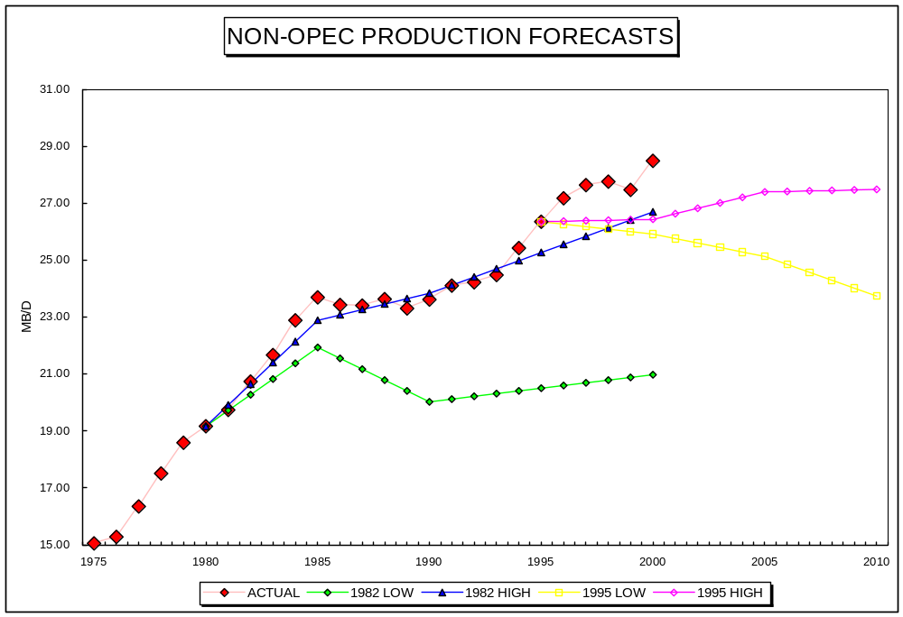
THE “AUTHORITATIVE” IEA VIEW

Slide 7
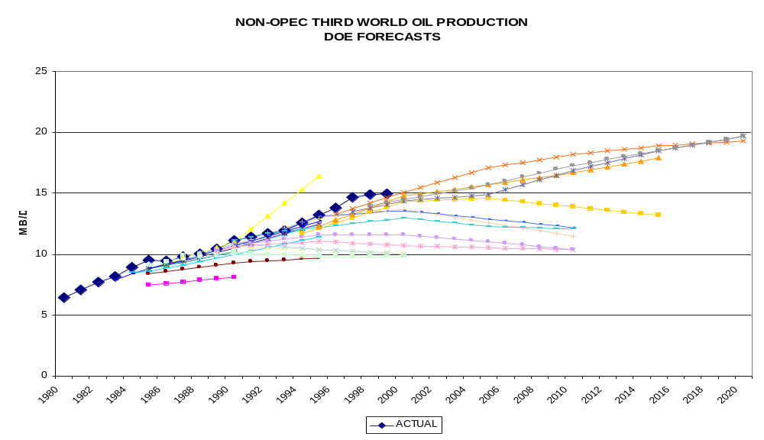
RECURRING ERRORS: NEAR-TERM PEAK (1)

Slide 8
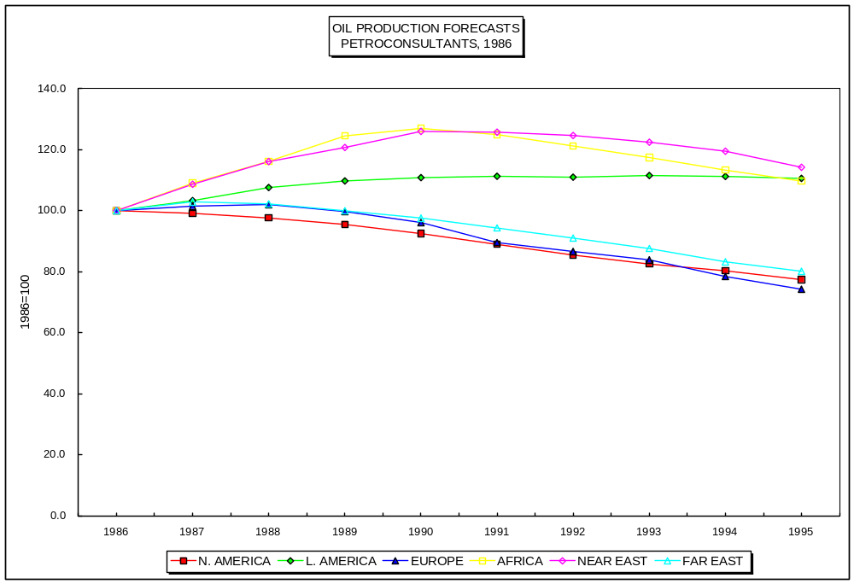
PEAK AND DECLINE (2)

Slide 9
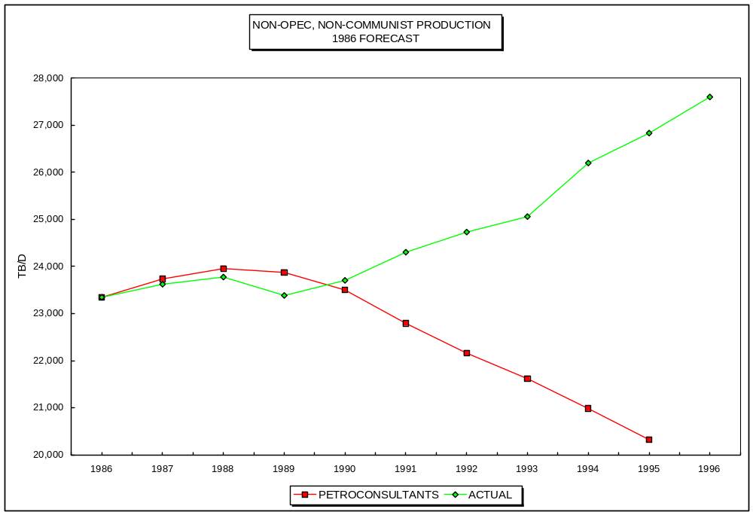
…AND RESULTING ERROR

Slide 10
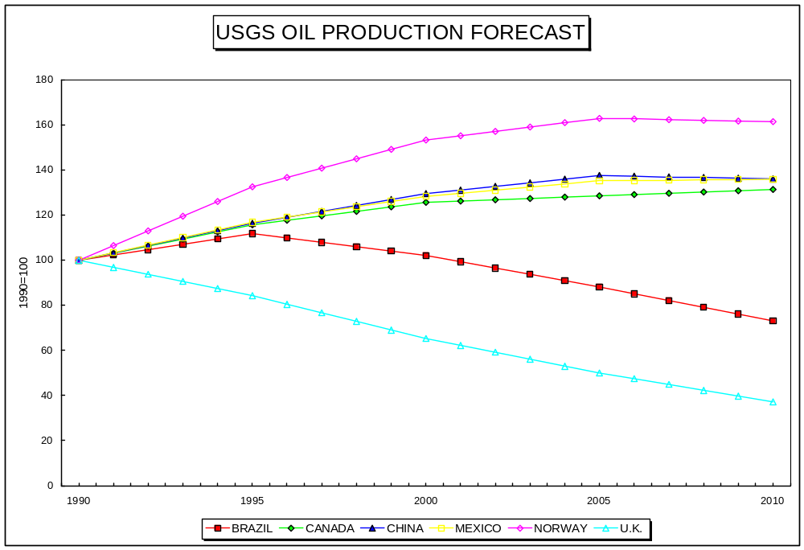
PEAK AND DECLINE (3)

Slide 11
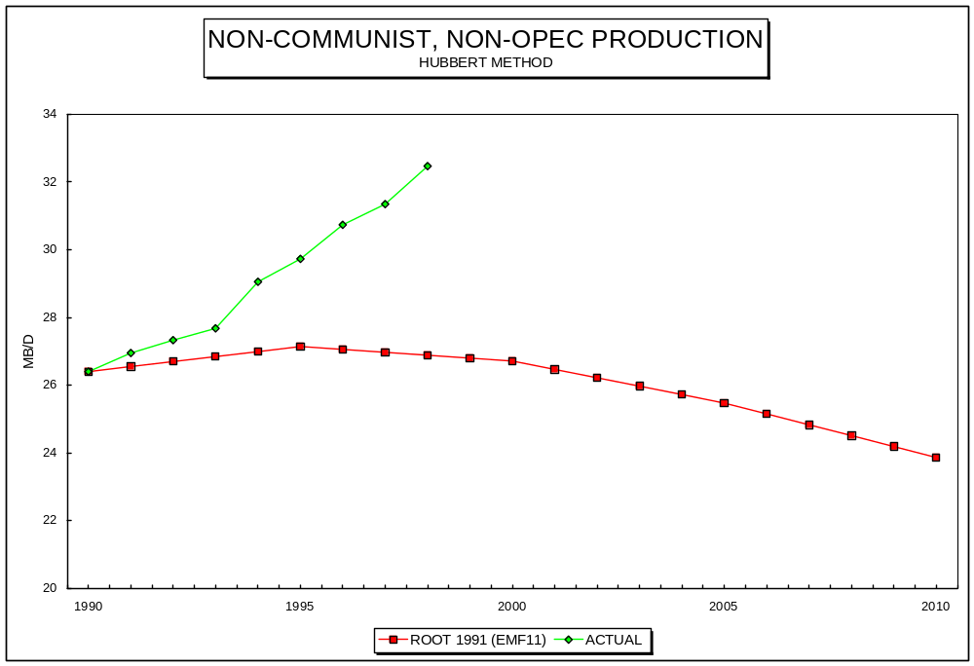
…AND RESULTING ERROR

Slide 12
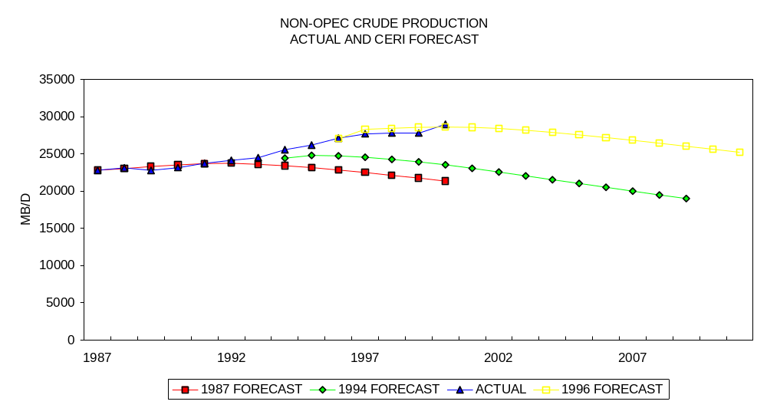
PEAK AND DECLINE (4)

Slide 13
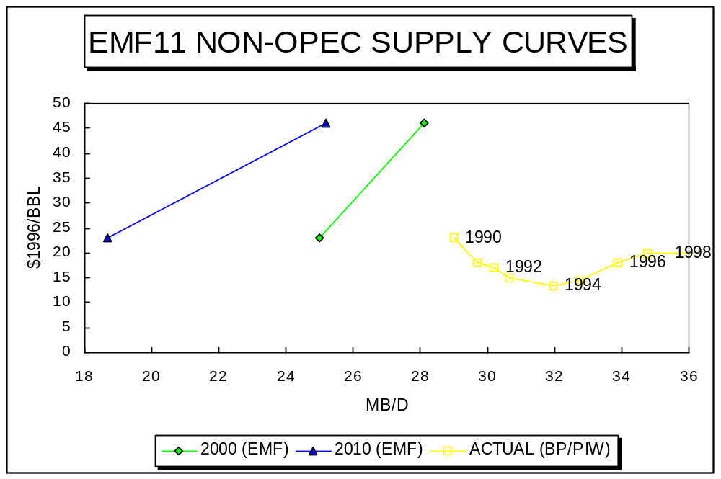
EMF11 SUPPLY CURVES

Slide 14
Non-OPEC Production Forecasts (1989/91)
35.0
33.0
31.0
29.0
27.0
25.0
MB/D
23.0
21.0
19.0
17.0
15.0
1985
1986
1987
1988
1989
1990
1991
1992
1993
1994
1995
1996
1997
1998
1999
2000
ACTUAL
DOE
CERI
IEW MEAN
LYNCH
EMF 11 AVG
CAMPBELL

Slide 15
LESSONS FROM HISTORICAL REVIEW OF SUPPLY FORECASTING
(LYNCH 1990, 1996)
SHIFT FROM OPTIMISM TO PESSIMISM (1979/80)
RAMPANT MALTHUSIAN BIAS
  95% FORECASTS TOO LOW
OMITTED VARIABLES
  TECHNOLOGY, INFRASTRUCTURE, ETC.
RECURRING ERRORS
  BAD YPE, RETURNS TO DRILLING
  NEAR-TERM PEAK FOR EVERYWHERE BUT MIDEAST
  DEPLETION RATES TOO HIGH
IMPROPER CORRECTION
  RETAIN DEPLETION RATE, MOVE PEAK UP AND OUT

Slide 16
CASE STUDY: THE HUBBERT METHOD
RELIANCE ON BELL CURVE
  NO PARTICULAR REASON ORIGINALLY
  FIELD BEHAVIOR (SOMETIMES)
PAST PRODUCTION
URR ESTIMATES
TECHNOLOGY, PRICE, POLICY ASSUMED IRRELEVANT (CAMPBELL) OR IMPLICIT (OTHERS)

Slide 17
TECHNOLOGY AND RECOVERY RATES: TWO VIEWS
“Recovery is primarily related to the quality of the oil and the reservoir, and has little to do with technology.” C. J. Campbell, 1998
“Operators of deep- and ultra-deep water fields can anticipate increases in recovery rates from a given oil field of as much as 50% via new well technologies alone,” according to Torstein Dale Sjoveit, President of Norsk Hydro West Africa Oil & Gas, 2000 (PIW 7/10/2000)

Slide 18
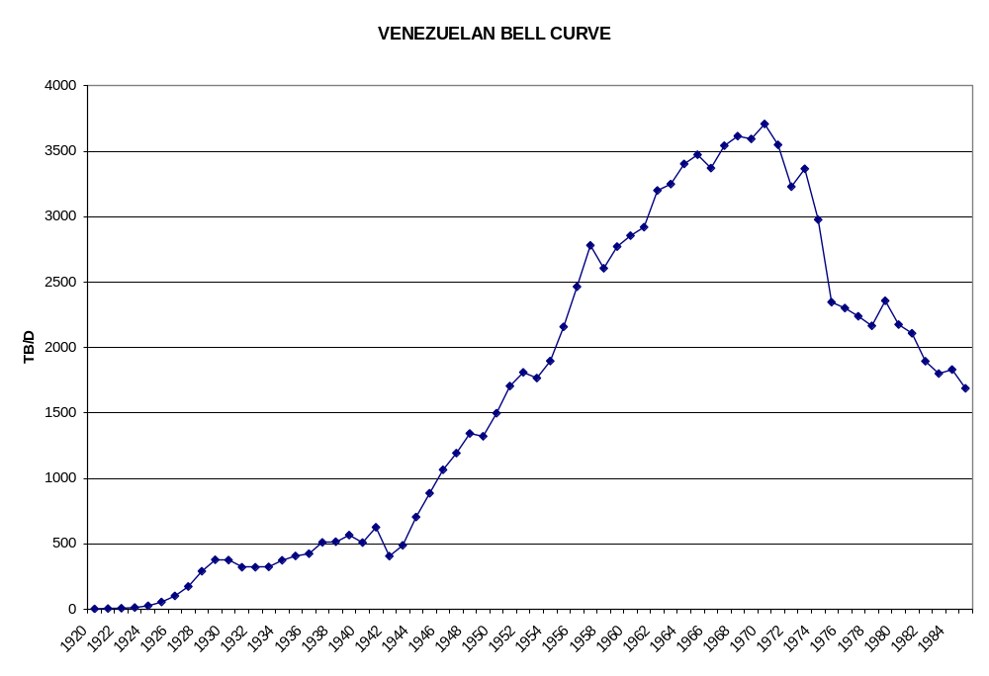
DOES POLICY MATTER?

Slide 19
RESOURCE ARGUMENTS
URR
  DISTANT, VAGUE, WRONG, RECEDING
PEAK PRODUCTION
  RESOURCE EFFECT OVERWHELMED BY OTHER FACTORS
    PRICE, TAXES, ACCESS TO LAND
    WORRY ABOUT SAUDI GREENPEACE, NOT SAUDI URR
OPERATIONALLY MEANINGLESS
  STRATEGICALLY MEANINGFUL?
    HAVE I GOT A SHALE OIL PLANT FOR YOU
ONLY EFFECTS MATTER
  RAISES COSTS (THEN HOPEFULLY PRICES)
  BUT EFFECTS CAN HAVE OTHER CAUSES

Slide 20
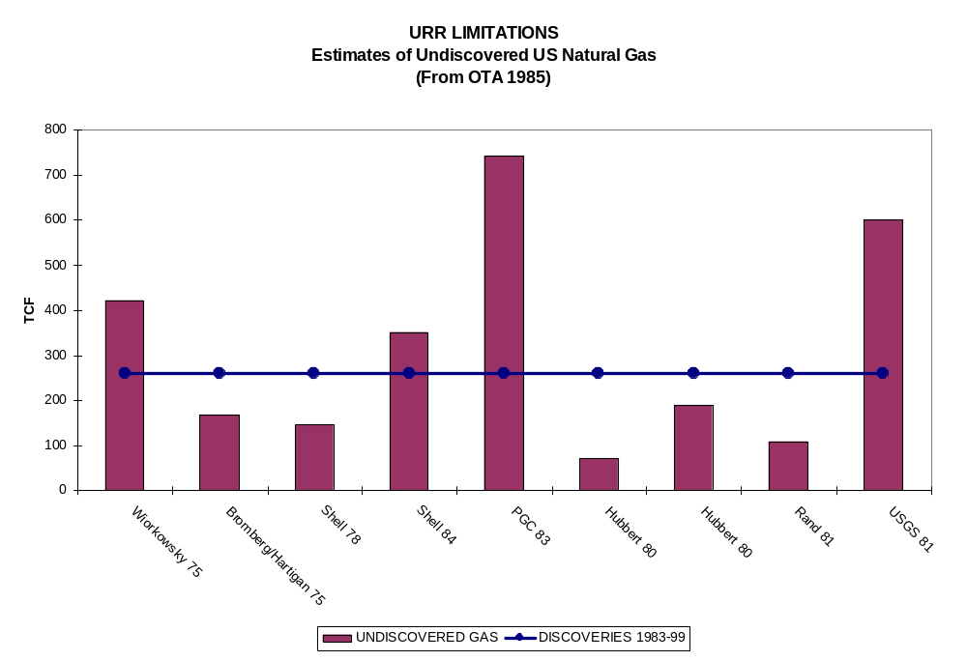
US NATURAL GAS URR

Slide 21
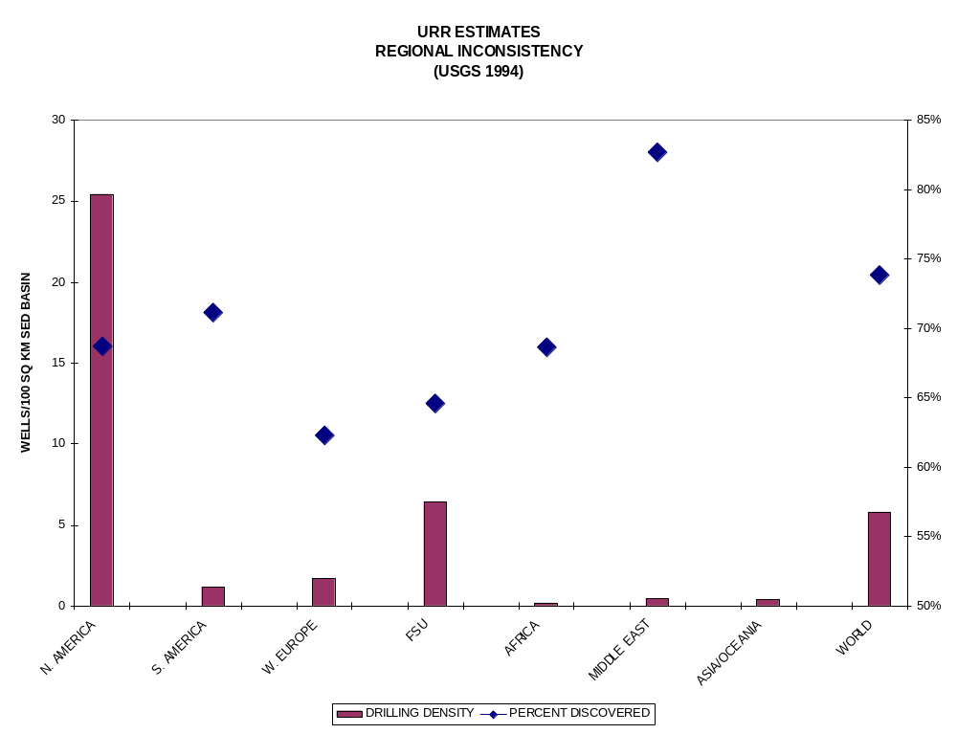
URR RELIABILITY

Slide 22
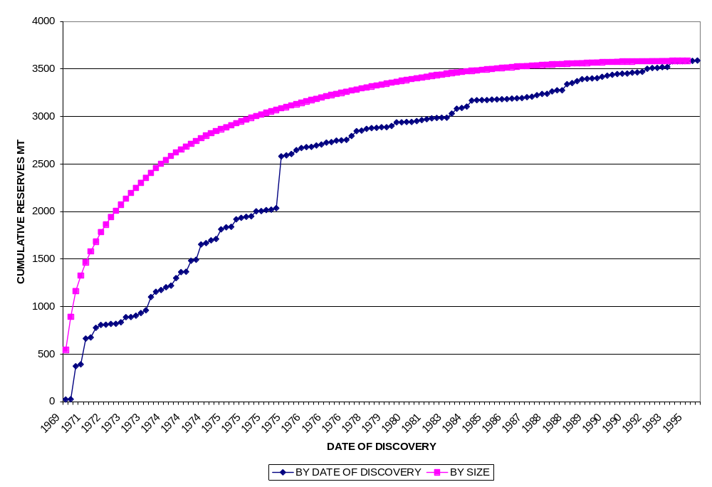
DO CREAMING CURVES PREDICT URR?
UK Reserves by field size

Slide 23
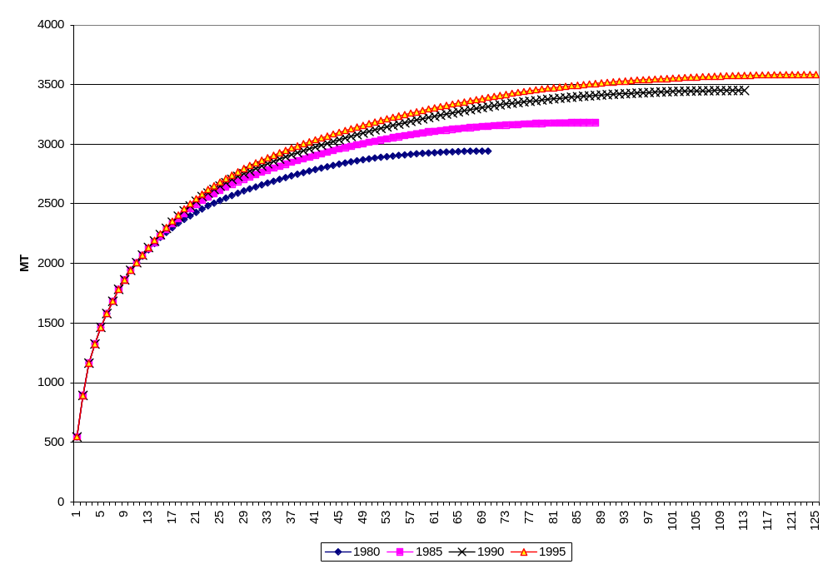
MOBILE ASYMPTOTES
UK Creaming Curves by Date

Slide 24
GROWTH IN URR
HUBBERT ESTIMATES, 1956-1973
  FROM 1250 TO 2000 BILLION BARRELS
  2.8%/YR INCREASE, 750 BB COMPARED TO CONSUMPTION OF 228
USGS ESTIMATES, 1982-2000
  FROM 1796 TO 3000 BILLION BARRELS
  2.9%/YR INCREASE, 1204 BB VS. 425 BB CONSUMPTION
CAMPBELL ESTIMATES, 1989-1996
  FROM 1575 TO 1800 BB
  1.9%/YR, 225 BB GROWTH VS. 200 CONSUMPTION

Slide 25
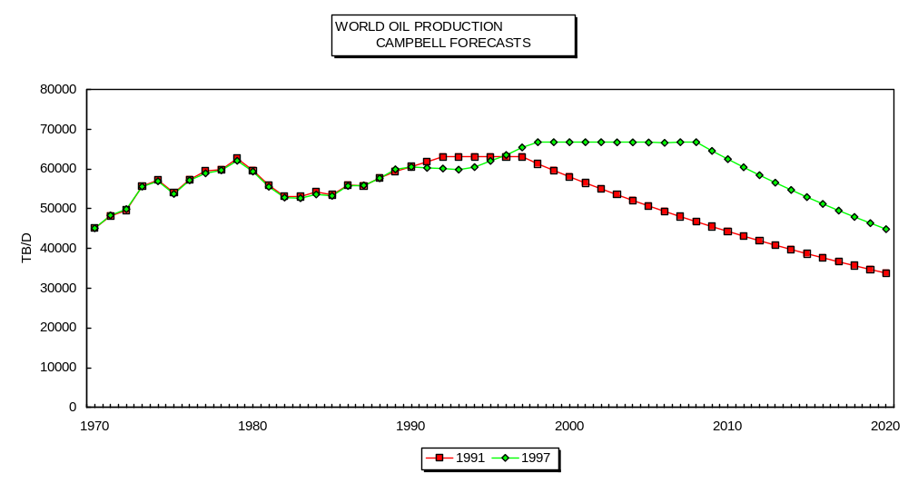
BELL CURVES

Slide 26
WHY THE POPULARITY?
PROFESSIONAL RIVALRY (?)
  GEOLOGISTS VS. ECONOMISTS
ALARMS SELL NEWSPAPERS
LOOKS “SCIENTIFIC”
FIELDS DECLINING, WHY NOT THE WORLD?
  BUT DOESN’T AGGREGATE TO NATIONAL OR GLOBAL LEVEL

Slide 27
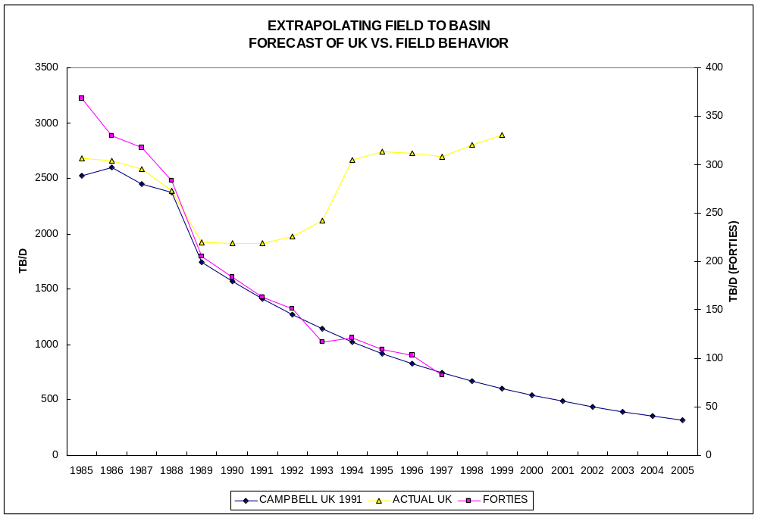
AGGREGATE PRODUCTION

Slide 28
OTHER ARGUMENTS
NOT ENOUGH RIGS
  SAME IN 1996/97, BUT 1.7 MB/D PRODUCTION INCREASE (NON-FSU OVER 2 YEARS)
ALL GIANTS DISCOVERED
  SMALL FIELDS DON’T MATTER
ONLY CONVENTIONAL OIL COUNTS
DEPLETION RATES HIGH AND GROWING

Slide 29
SMALL FIELDS MATTER
DOG THAT DIDN’T BARK
  UK, US, CANADA DROPPED 2.3 MB/D FROM 1986-1990
  GREW BY 0.7 MB/D FROM 1991 TO 1997
US STRIPPER PRODUCTION 1 MB/D

Slide 30
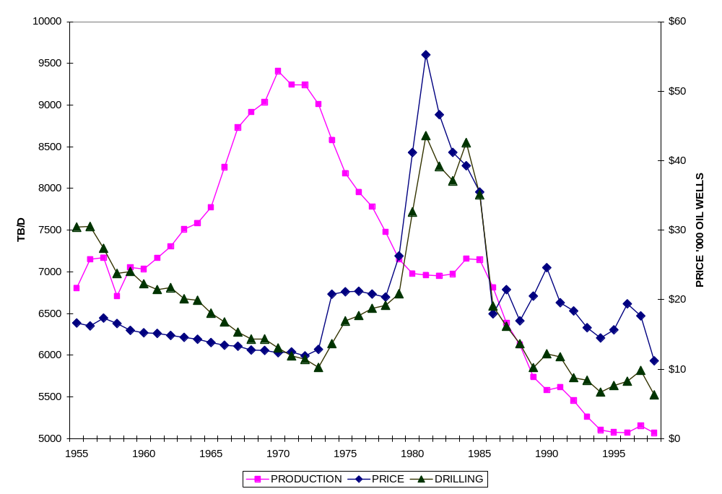
THE CONTRIBUTION OF SMALL FIELDS
U.S. Lower-48 Drilling, Production and Price

Slide 31
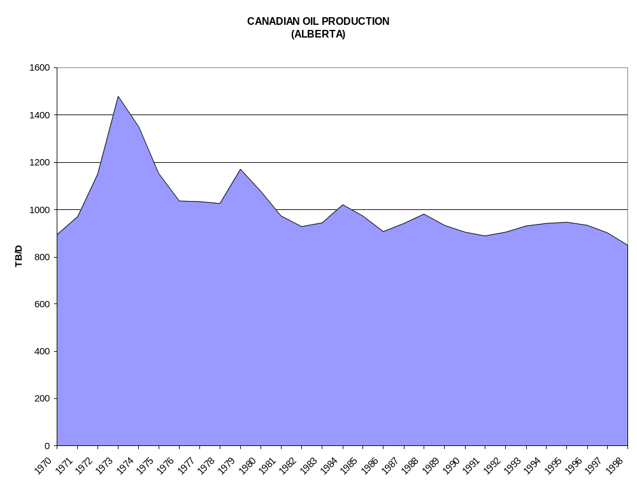
PRODUCTION PEAKING

Slide 32
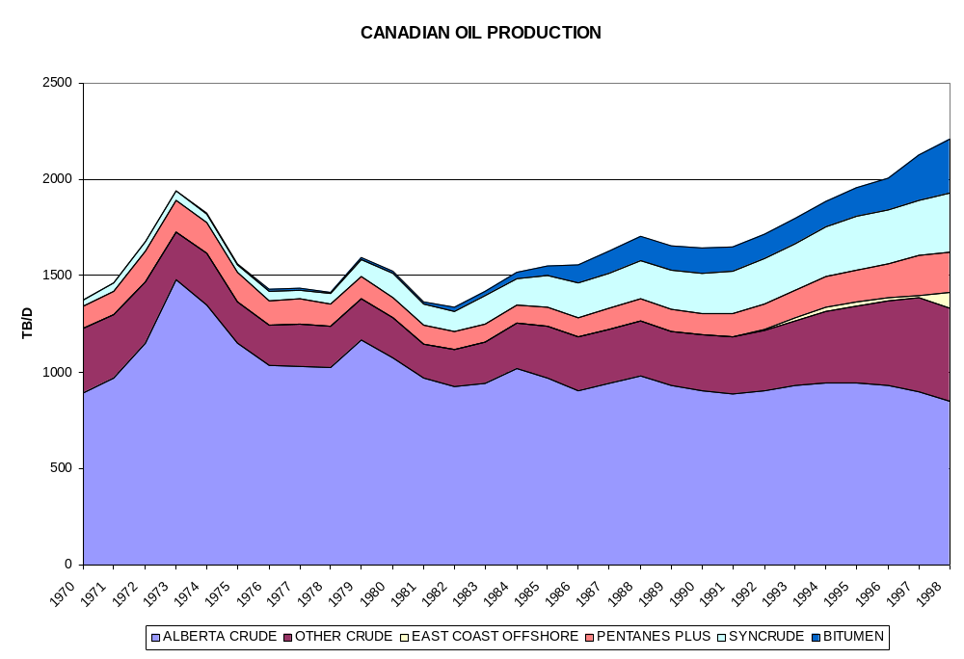
…BUT SO WHAT?

Slide 33
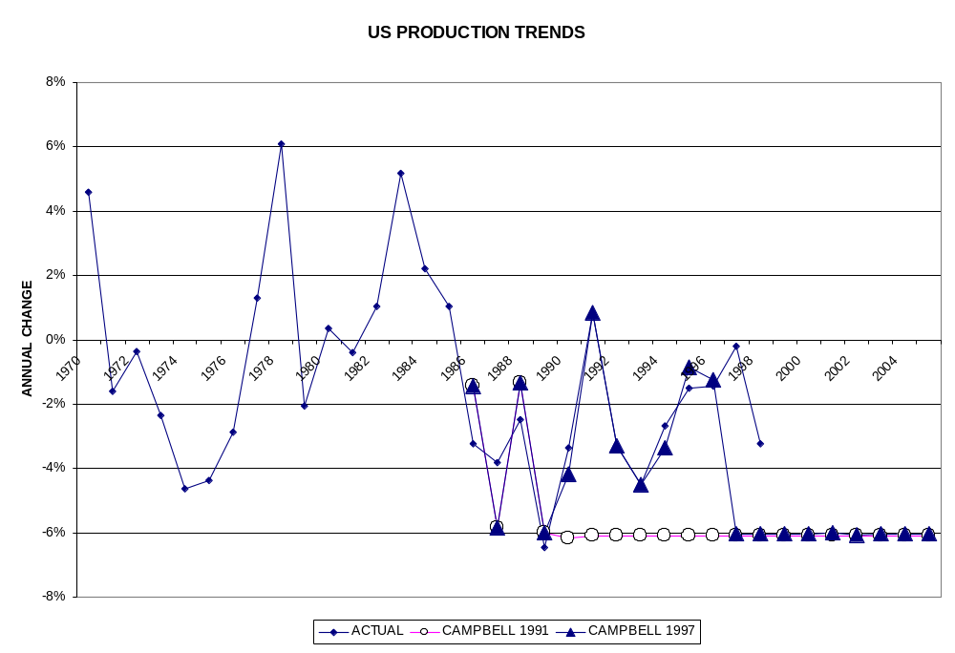
RECURRING ERRORS, DEPLETION

Slide 34
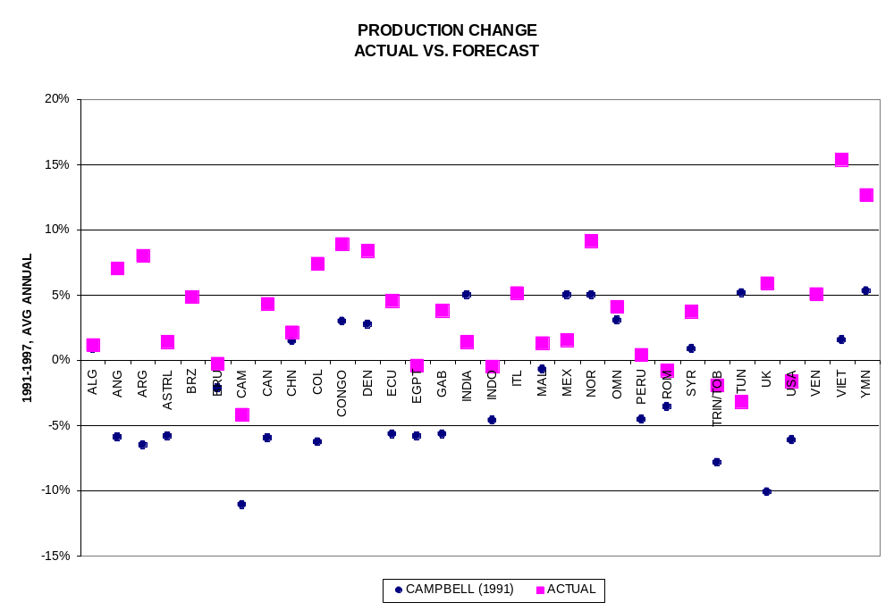
OVERESTIMATED DEPLETION

Slide 35
WHAT DOES MATTER?
LOCATION OF PRODUCTION
  VULNERABILITY TO DISRUPTION
  NEED FOR INFRASTRUCTURE/SERVICES
    RIG RATES, TANKERS, PIPELINE CONSTRUCTION
  WHO GETS TO PRODUCE THE OIL?
    Aramco, BP, Conoco
DEMAND FOR OPEC OIL
  OPEC MARKET POWER, PRICE-SETTING ABILITY
PRODUCTION COST TRENDS
  NEED FOR INVESTMENT, PROFITABILITY

Slide 36
CONVERGENCE
PRICE=F(OPEC MARKET SHARE, X₁-X_{N})
OPEC MARKET SHARE=F(DEMAND, NON-OPEC SUPPLY)
NON-OPEC SUPPLY=F(PRICE, COSTS, TAXES)
THEREFORE, NON-OPEC COST TRENDS INFLUENCE NON-OPEC SUPPLY, WHICH INFLUENCES OPEC MARKET SHARE, WHICH INFLUENCES PRICE, WHICH INFLUENCES NON-OPEC PROFITABILITY AND SO INVESTMENT IN NON-OPEC SUPPLY, ETC.
THUS, COST TRENDS NOT THE ONLY FACTOR, BUT A BIG ONE

Slide 37
COSTS
HARD TO MEASURE
  ACCOUNTING PROBLEMS
  TAXES/ROYALTIES
  DATA PROBLEMS
HARD TO PREDICT
  UNIQUENESS OF FIELDS
  COMPLEXITY OF OPERATIONS

Slide 38
COST TREND DRIVERS
RESOURCE DEPLETION (+)
  GLOBALLY IN THEORY
  BY BASIN, IN PRACTICE
TECHNOLOGY (-)
INFRASTRUCTURE (-)
MANAGEMENT (-, hopefully)
ENVIRONMENTAL REGULATIONS (+)
CUMULATIVE IMPACT:
  NO MINERAL PRICES EXHIBIT LONG-TERM RISING PRICE TRENDS

Slide 39
COST TREND EXPECTATIONS
ALWAYS HIGHER
  CERI, EMF11
FOCUS ON RESOURCE DEPLETION IMPACT
  RETURNS TO DRILLING DECLINE SHARPLY
TECHNOLOGY USUALLY IGNORED
  OR AUTONOMOUS IMPROVEMENT
OTHER FACTORS IGNORED
  INFRASTRUCTURE
    MY WVA ROYALTIES: 2 GAL/D
  MOSTLY BULLISH (COST-LOWERING)

Slide 40
WHAT EVIDENCE OF TRENDS?
IF ONLY GIANTS MATTER, THEN BIG PROBLEM, SHARP DECLINE (HUBBERTESQUE)
IF DEPLETION IS INCREMENTAL EFFECT, THEN QUESTION IS OFFSETTING TRENDS
APPARENT:
  SHARP SIZE DECLINE FROM FIRST FIELDS, THEN GRADUAL
  SHARP COST DECLINE AS INFRASTRUCTURE DEVELOPS, THEN GRADUAL

Slide 41
CHANGES INCREMENTAL, GRADUAL
FIELD SIZE DECLINES SLOWLY (EG., UK)
RETURNS TO DRILLING FLATTENS OUT
RESOURCE DEPLETION EXISTS, BUT SMALL, OVERWHELMED BY OTHER FACTORS
  TECHNOLOGY (2% PER YEAR?)
  OPENING NEW AREAS
    FSU, OPEC
  INFRASTRUCTURE
    SOCIO-ECONOMIC (ROADS)
    INDUSTRY (PIPELINES, WAREHOUSES)

Slide 42
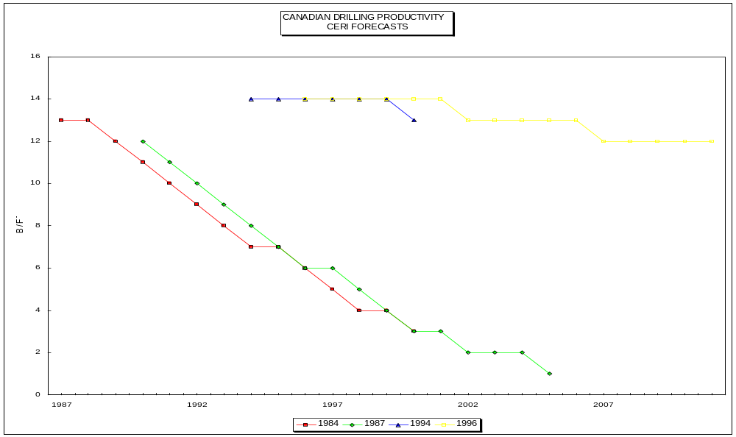
RETURNS TO DRILLING

Slide 43
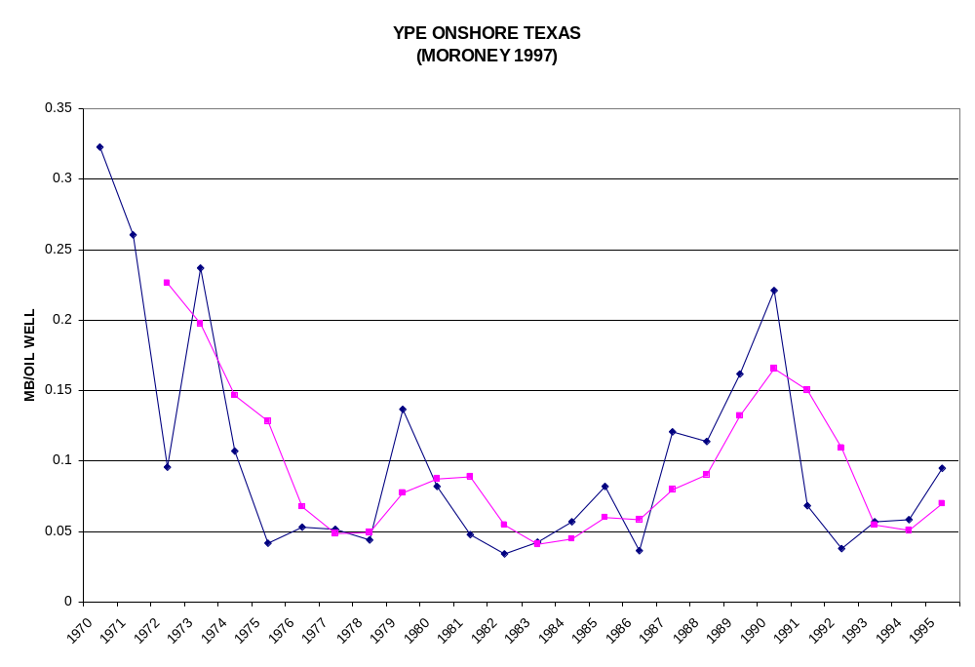
EVIDENCE OF DEPLETION?

Slide 44
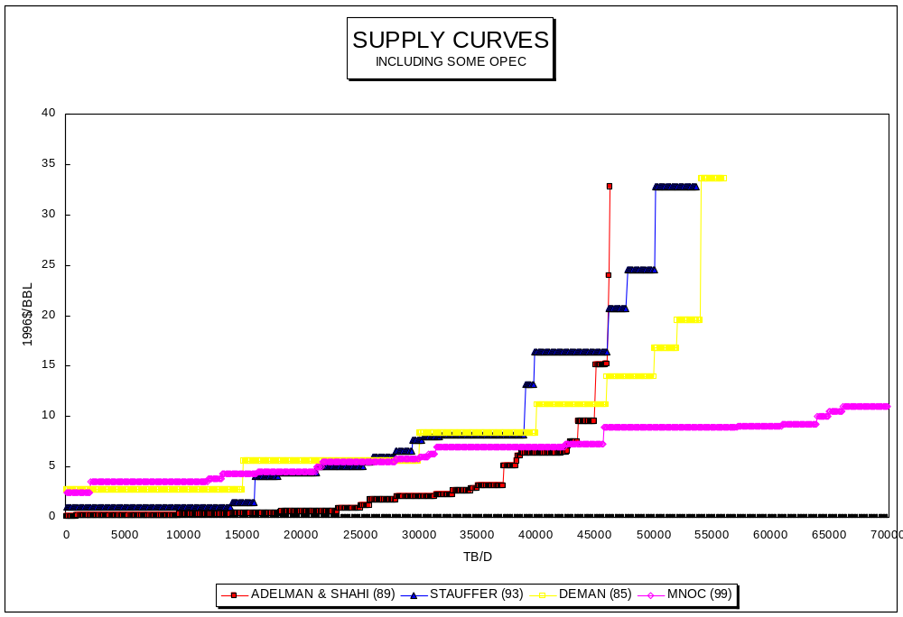
SUPPLY CURVES: FLAT AS TEXAS

Slide 45
REMAINING ANALYTICAL CONCERNS
CHANGING DEPLETION RATES
  IMPACT OF NEW TECHNOLOGIES
    HORIZONTAL DRILLING
  EFFECT OF DIFFERENT GEOLOGY
    DEEPWATER
  EFFECT OF SMALLER SIZE
HAS RESERVE APPRECIATION DECLINED?
  BETTER INITIAL ESTIMATES
  BUT TECHNOLOGY STILL IMPROVING

Slide 46
CONCLUSIONS
SIMPLISTIC ANALYSIS NOT VERY VALUABLE
  IF YOU INSIST, SEE NEXT PAGE
  ENOUGH DATA TO PROVE ANYTHING, IF YOU IGNORE DATA THAT DISAGREES WITH YOU
COMPLEXITY MAKES ANALYSIS DIFFICULT
  DON’T CONFUSE SHORT-TERM, LONG-TERM EFFECTS
  DON’T CONFUSE POLICY CONSTRAINTS FOR PHYSICAL CONSTRAINTS

Slide 47
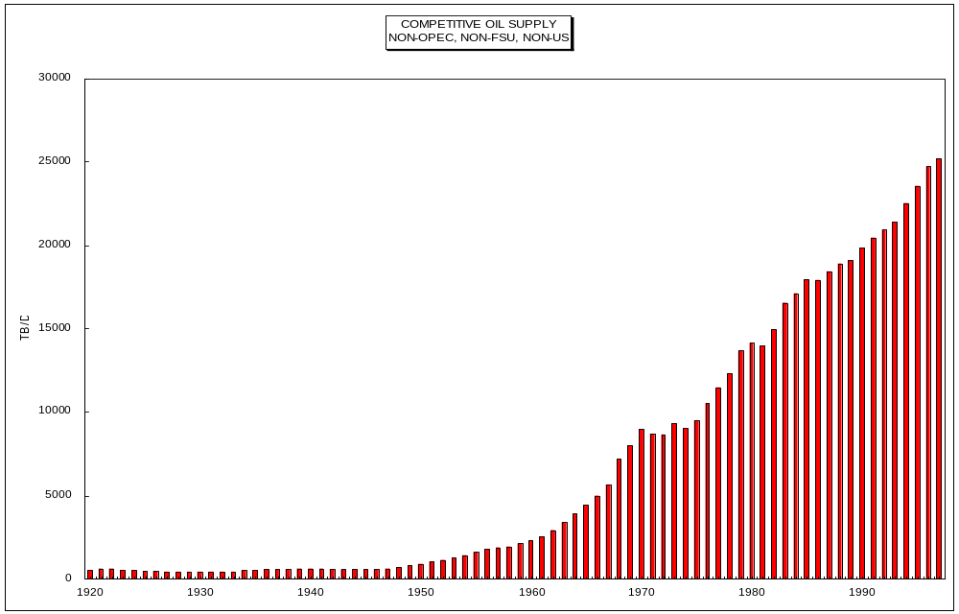
EXTRAPOLATE THIS!

Slide 48
CONCLUSIONS (2)
NO MINERAL HAS EVER SHOWN LONG-TERM RISING PRICE TREND
CARTELS ALMOST ALWAYS FAIL
  USUALLY BY RAISING PRICES TOO HIGH
IS WOLF HERE?
  LATE 1970S: NON-MIDEAST HAS PEAKED, OIL $100 IN 2000
  LATE 1980S: NON-MIDEAST HAS PEAKED, OIL $60 IN 2000

Slide 49
NOT STRAIGHTFORWARD
(THANK GOD)
ANALYTICAL PROBLEMS
  MOST DATA TERRIBLE
    SERIOUS SEMANTIC DIFFERENCES
  NUMEROUS VARIABLES
  DIFFERENT LAG-TIMES
  EASY TO MISMEASURE, MISINTERPRET EFFECTS
COMPREHENSION AND JUDGEMENT
  HOW TO GAUGE VALIDITY OF EVENT IN 20 YEARS?
  15 MINUTE PRESENTATION INADEQUATE TO COVER MAJOR VARIABLES
  EASY TO MISREPRESENT
    ALWAYS DATA TO SUPPORT ANY ARGUMENT
SEND MONEY

Slide 50
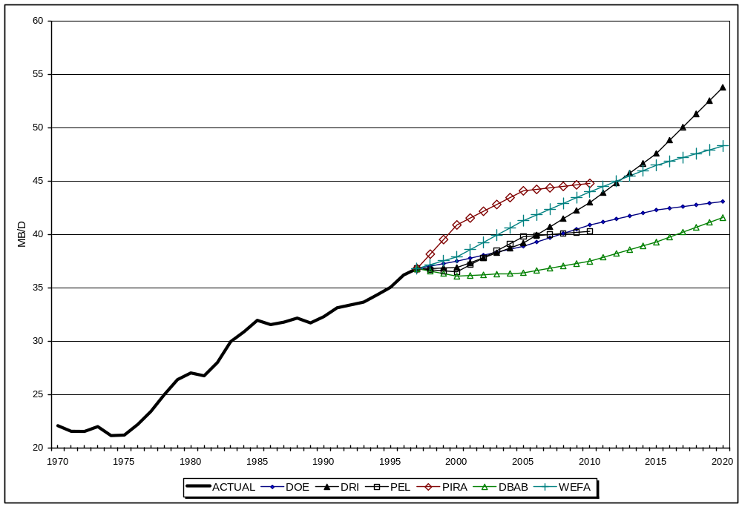
RECENT (2000) FORECASTS
NON-OPEC, NON-FSU

