Slide 1
The 2001 Annual Energy Outlook’s Macroeconomic Forecast and Energy Market Implications
Kay A. Smith
Energy Information Administration
March 27, 2001

Slide 2
Topics
Long Run Economic Trends
  Labor Force and Productivity Growth
  Industrial Output Forecasts
  Comparison to AEO2000
Energy Market Implications of Revised Macroeconomic Outlook
  End Use Energy Forecasted Demand Growth
  Macroeconomic Drivers

Slide 3
Long-Run Economic Trends
Long-Run Growth
  Labor Force and productivity determine the long run growth of the economy. Labor force growth is 1%; Productivity growth should be 2% yielding long run growth of GDP at 3%.
  The 5-Year Growth rates of GDP, Labor force decline as 2020 approaches.
  Labor Force growth drops sharply, but productivity keeps GDP at relatively high rates of growth

Slide 4
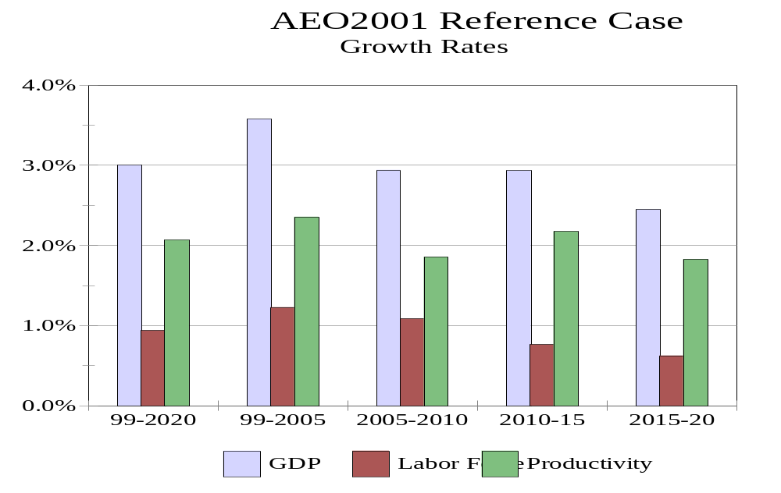

Slide 5
Long Run Economic Trends
(continued)
Comparison to AEO 2000
  Increased productivity growth leads to higher forecasted long run growth. Labor force growth is slightly higher but main reason for the 0.9% differential in growth lies in productivity.
  Real investment growth is much higher this year for several reasons: redefinition of investment; more optimistic view of economy at full employment.

Slide 6
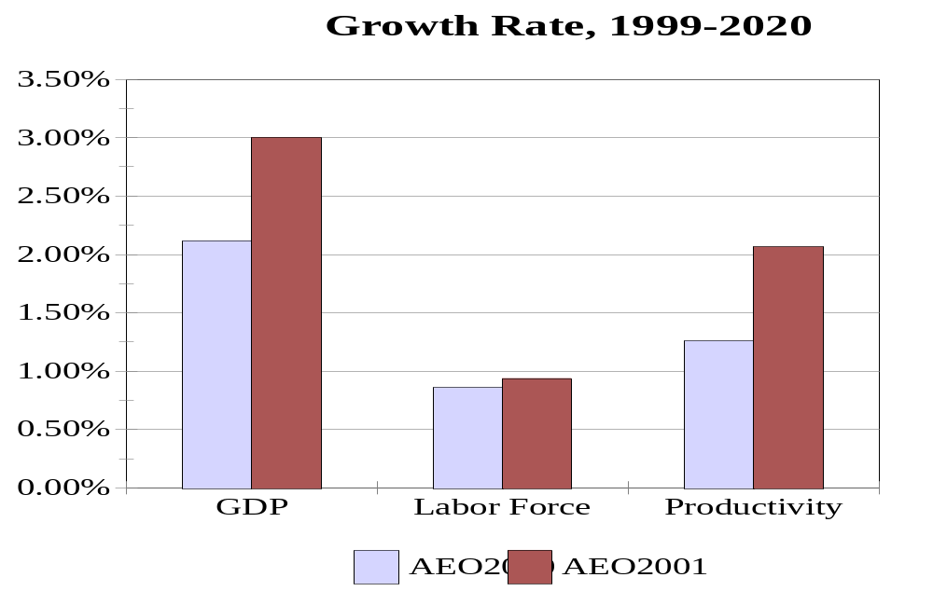

Slide 7
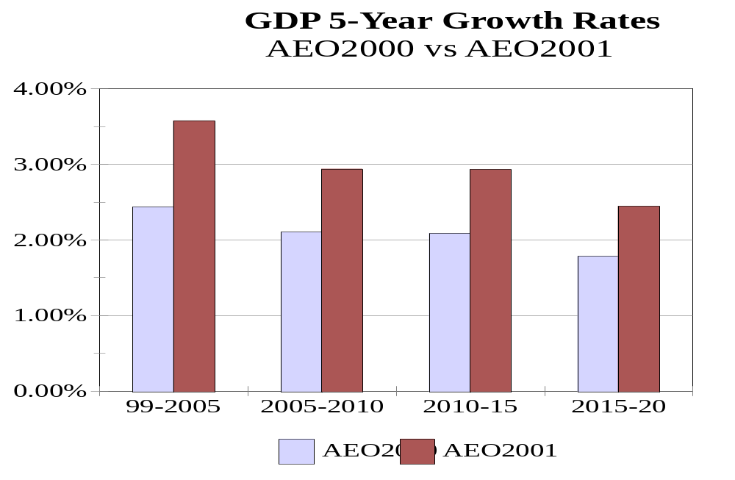

Slide 8
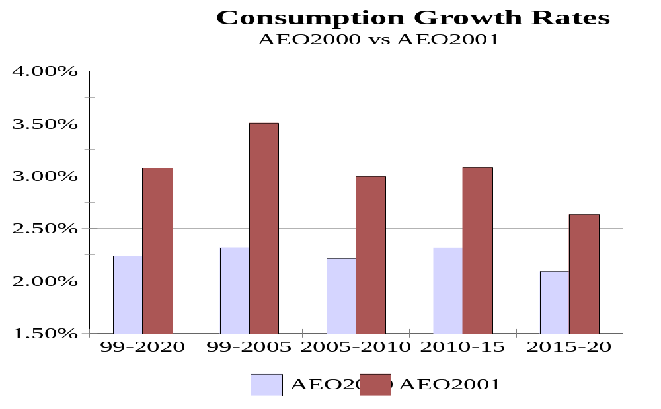

Slide 9
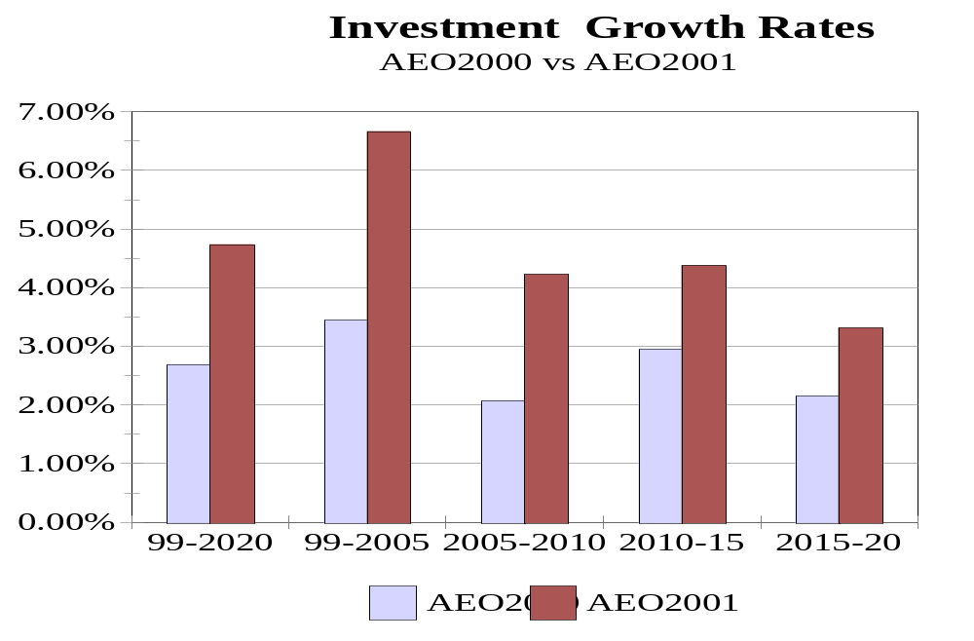

Slide 10
Long Run Economic Trends
(continued)
Industrial Sector Growth
  Industrial Output comes from a linked input-output and macroeconomic model
  Gross Output grows at rates close to the overall GDP growth of 3 percent
  Manufacturing output increases by 2.8% over the forecast, with industries that use energy intensively growing the slowest.
  High growth industries include electronic equipment and industrial machinery

Slide 11
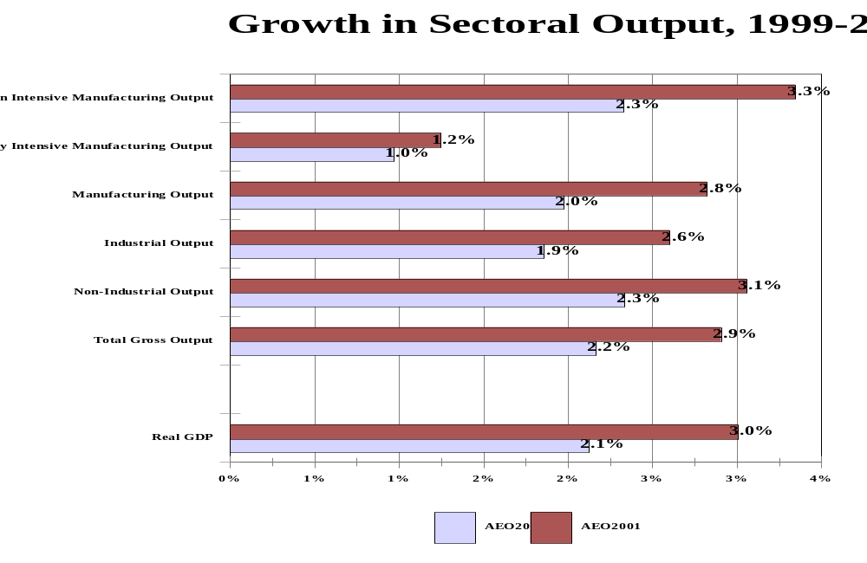

Slide 12
Long Run Economic Trends
(continued)
Industrial Sector Growth
  The industries that use energy most intensively grow at less than half the growth expected from other manufacturing industries.
  The highest growth industries are concentrated in the technology sector: computers and semiconductors.

Slide 13
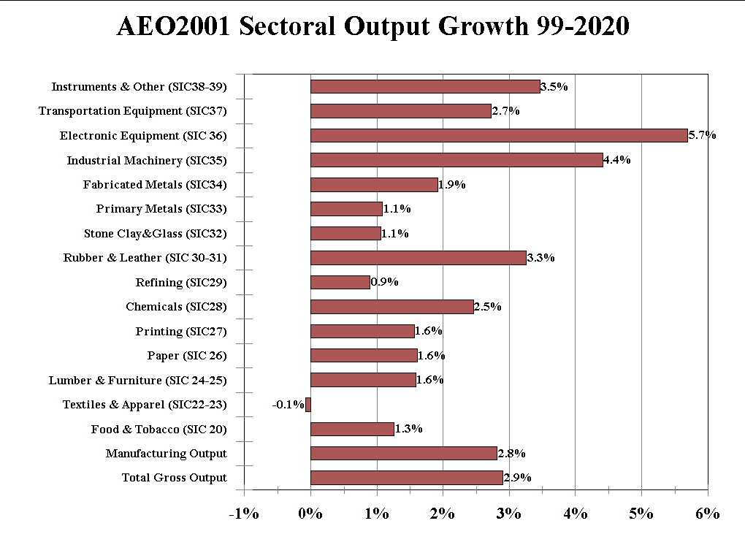

Slide 14
Implications of Macroeconomic Forecasts on Energy Markets
Residential, Commercial, Industrial and Transportation Sectors
  Each end-use demand model uses a different set of macroeconomic activities to help forecast energy demand.
  As an aggregate measure of energy intensity, GDP is commonly used as an economic activity measure, but many argue that using GDP masks actual energy intensity in particular end use energy markets.
  Instead of using a common measure of economic activity (GDP), each demand sector delivered energy consumption is matched with an economic activity that the demand module uses.

Slide 15
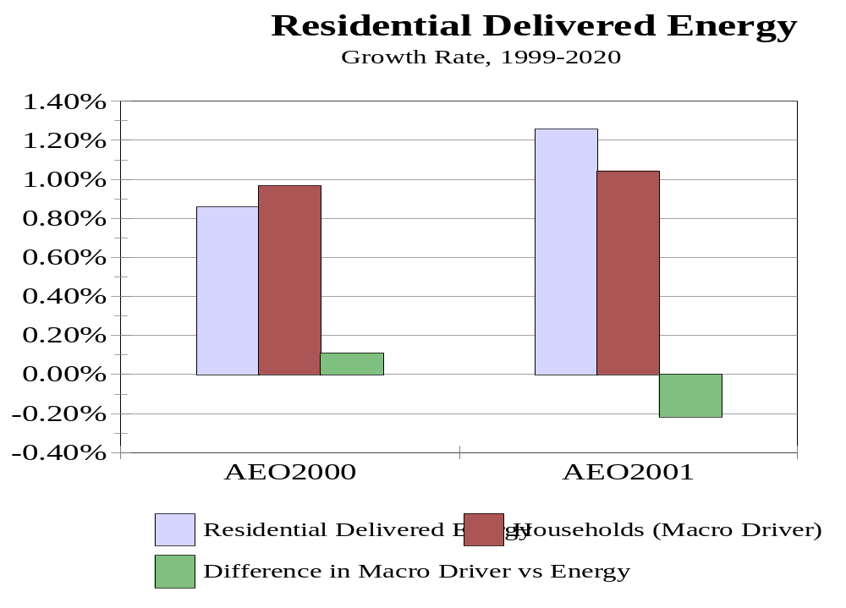

Slide 16
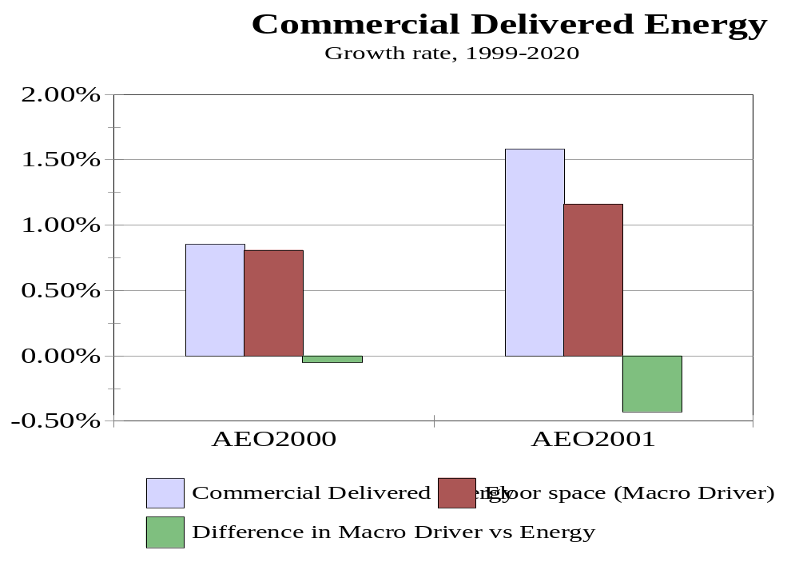

Slide 17
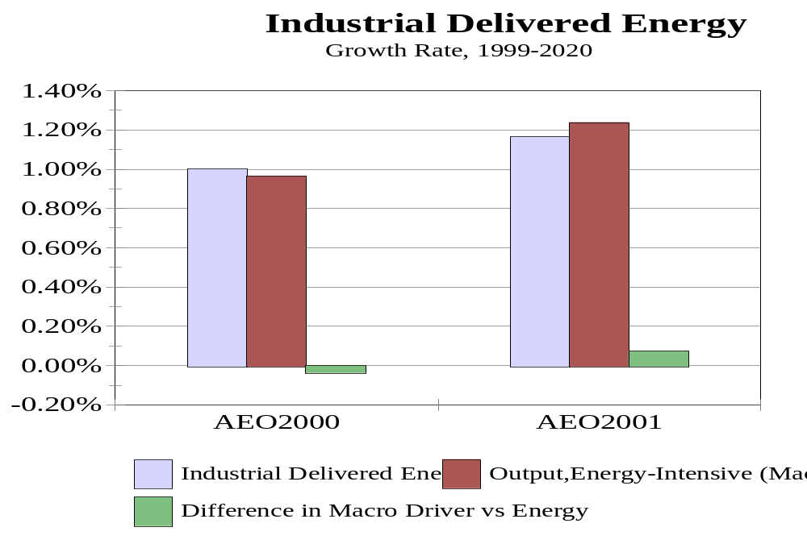

Slide 18
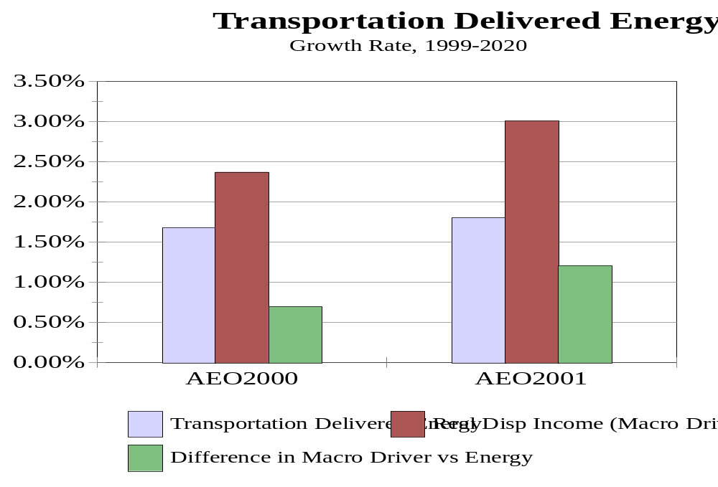

Slide 19
Conclusions
AEO2001 predicts higher economic activity
  Redefinition of GDP and investment
  More optimistic notion of how much potential supply can expand without increasing prices and unemployment
  Higher rates of productivity growth

Slide 20
Conclusions
continued
Impacts on energy demand forecasts
  A more optimistic forecast of growth in economic activity explains some of the differences in energy forecasts.
  Other factors may be more important in explaining the differences in energy demand forecasts, such as underlying efficiencies in equipment or technology assumptions pertaining to a particular energy process.

