Slide 1
Analysis of Strategies for Reducing Multiple Emissions from Power Plants: Sulfur Dioxide, Nitrogen Oxides, and Carbon Dioxide
Scott Sitzer
Energy Information Administration

Slide 2
Modeling Tools
National Energy Modeling System
Comprehensive Model of the Energy/Economy/Environmental System
Reference Case Based on Annual Energy Outlook 2001

Slide 3
Key Assumptions
Emission Cap and Trade System
Competitive Electricity Pricing in the Wholesale Market
Marginal Unit Sets the Price

Slide 4
Key Assumptions (contd.)
NOx and SO2 Emissions 75 % Below 1997 Levels by Either 2005 or 2008
CO2 Emissions at 1990 Levels By Either 2005 or 2008
CO2 Emissions at “Kyoto” Levels by 2008-2012

Slide 5
Key Findings
NOx and SO2 Cases Have Little Impact on Price, But Increase Industry Costs
CO2 and Integrated Cases:
-Have Greatest Impact on Price
-Reduce Need for NOx/SO2 Retrofits
Achieving Reductions by 2005 Will Pose Challenge to Electricity and Natural Gas Industries

Slide 6
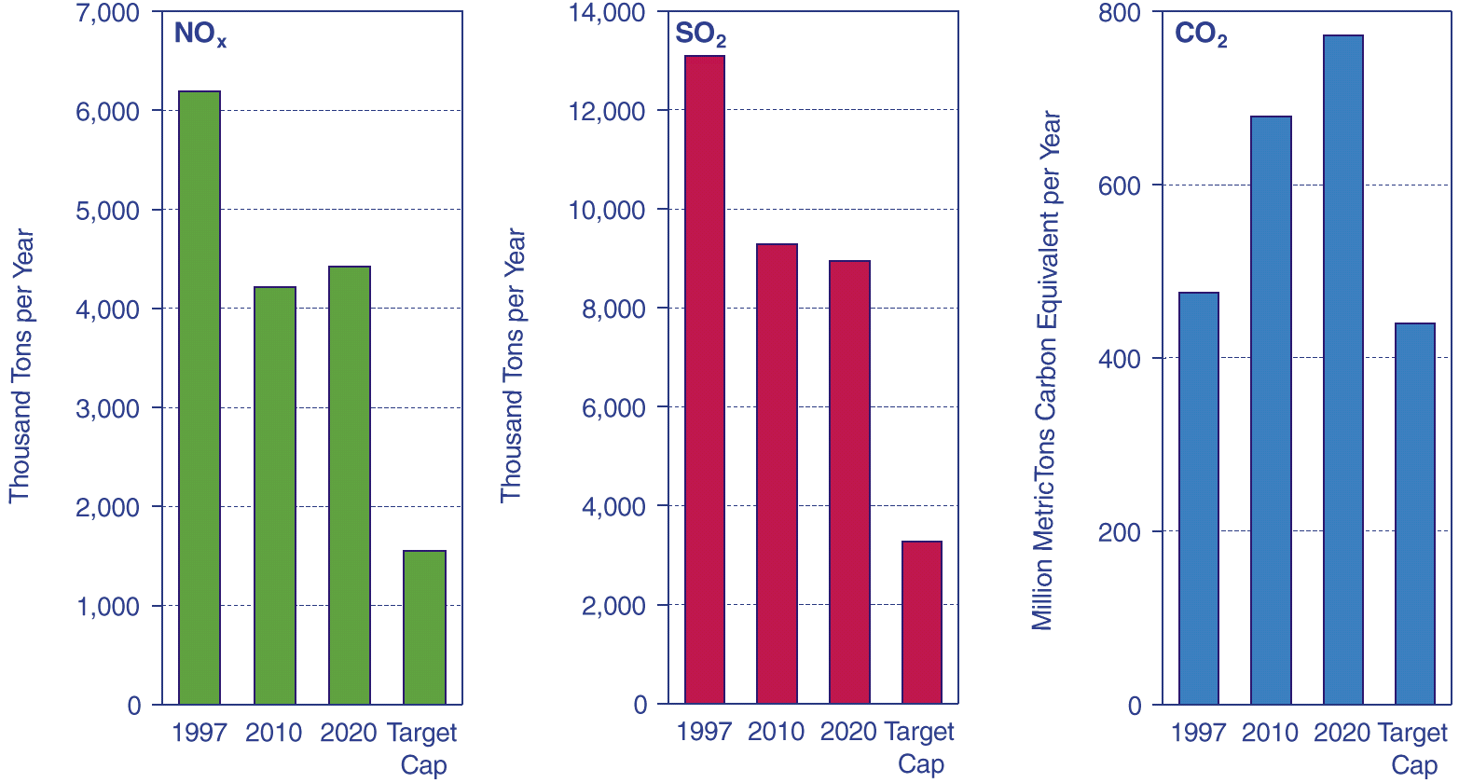
1997 Emissions, Reference Case Projections for 2010 and 2020, and Target Caps for Electricity Generators

Slide 7
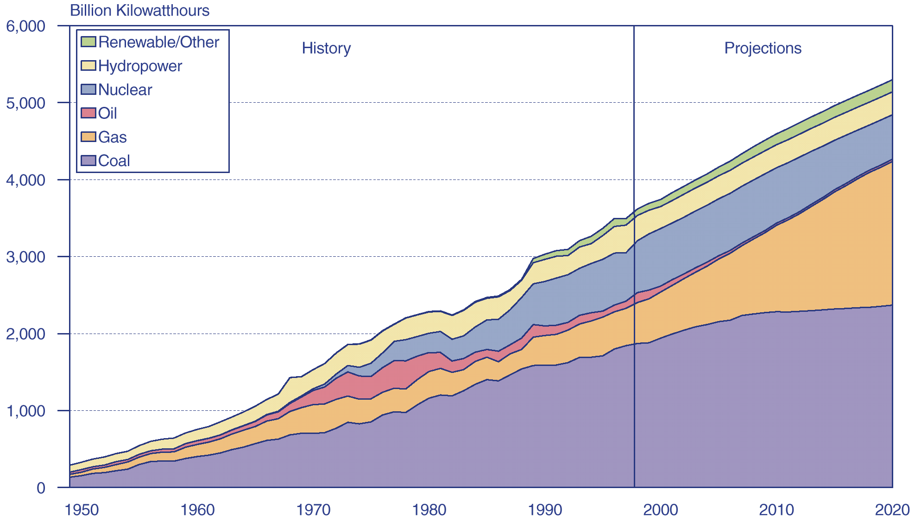
Electricity Generation by Fuel, 1949-1998, and Projections for the Reference Case, 1999-2020

Slide 8
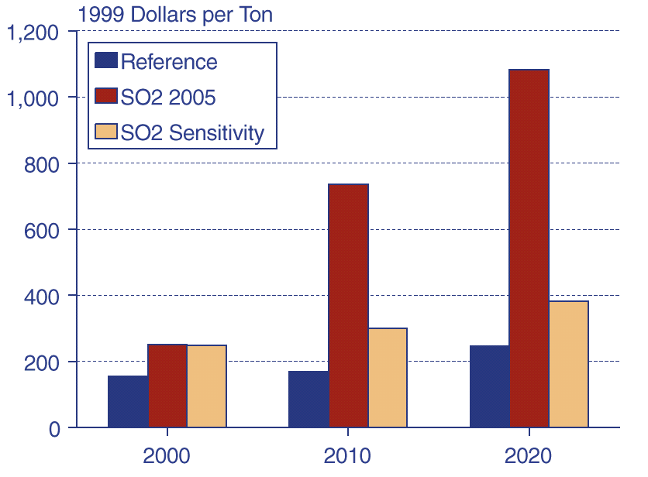
Projected SO2 Allowance Prices, 2000,
2010, and 2020

Slide 9
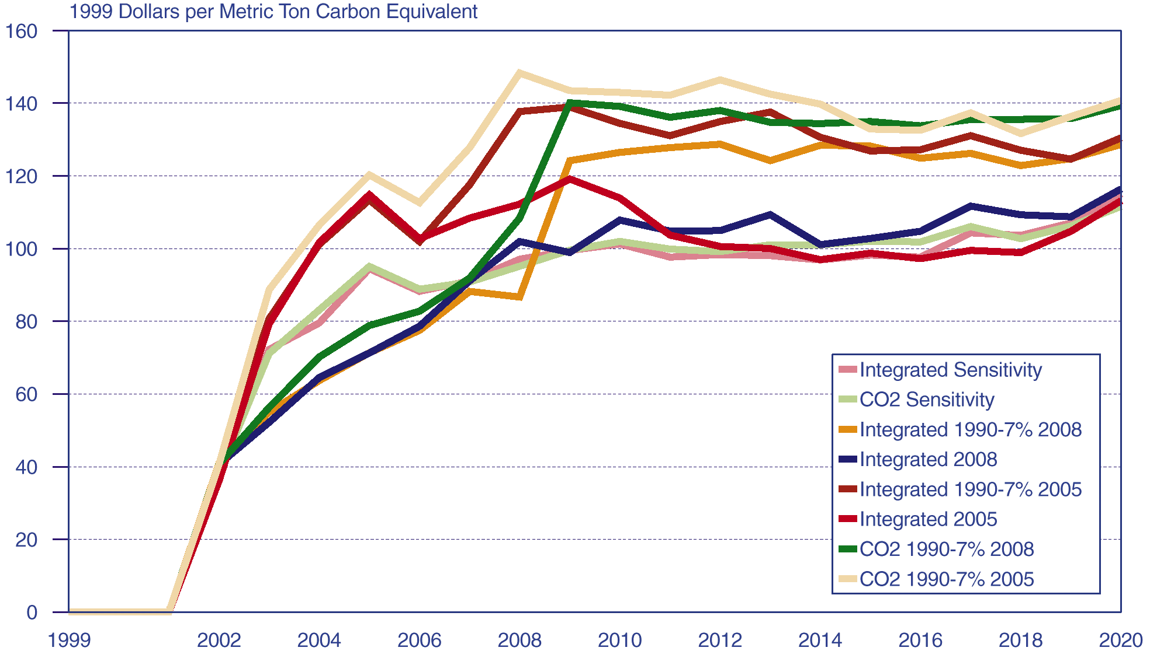
Projected Carbon Fees, 1999-2020

Slide 10
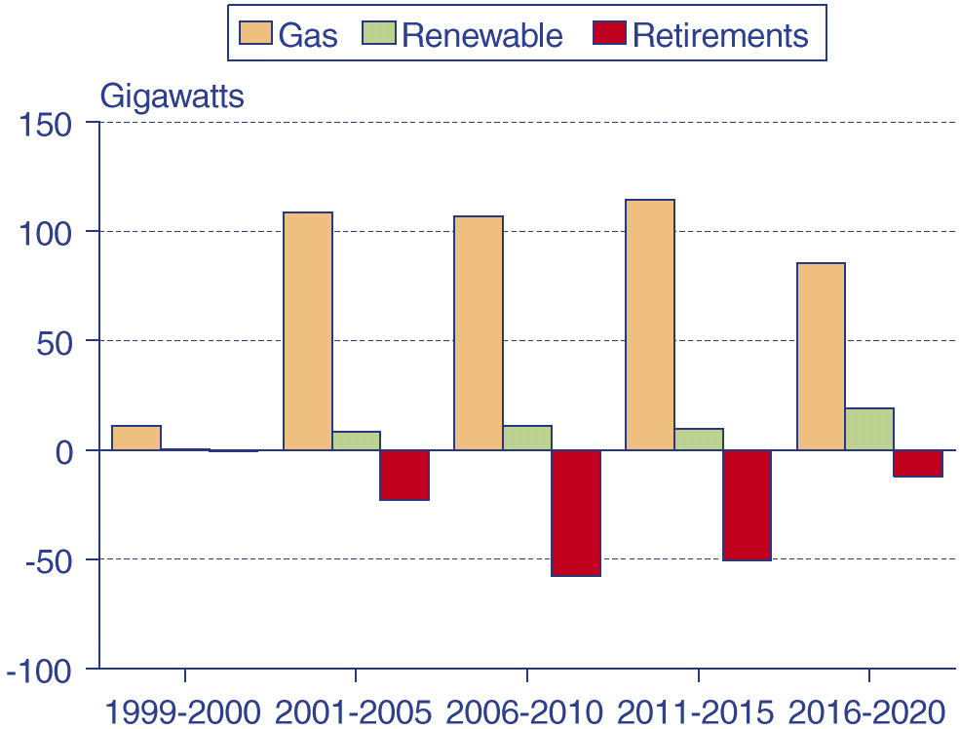
Projected Capacity Additions by Fuel and
Projected Retirements in the Integrated
1990-7% 2005 Case, 1999-2020

Slide 11
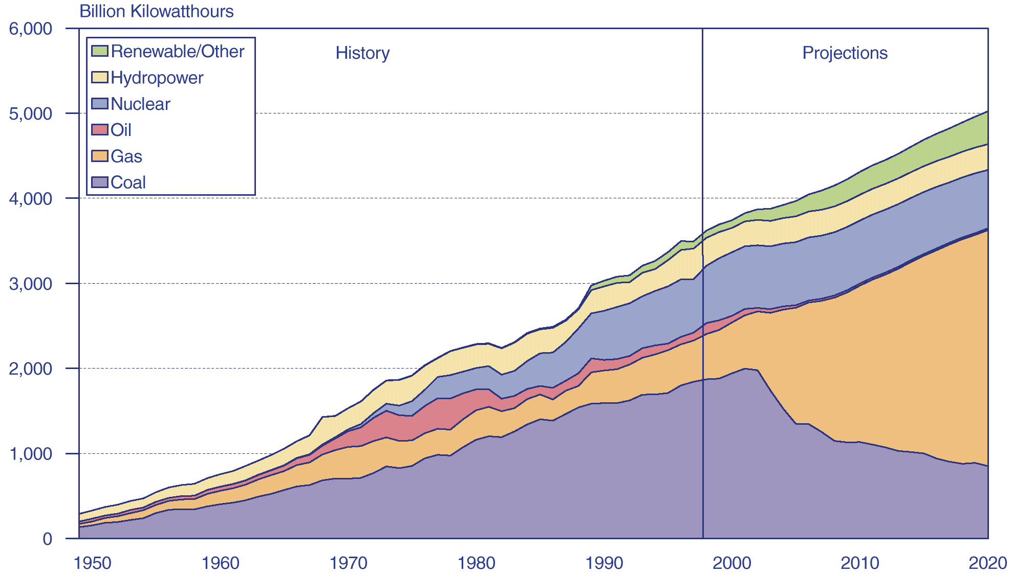
Electricity Generation by Fuel, 1949-1998, and Projections for the Integrated 1990-7% 2005 Case, 1999-2020

Slide 12
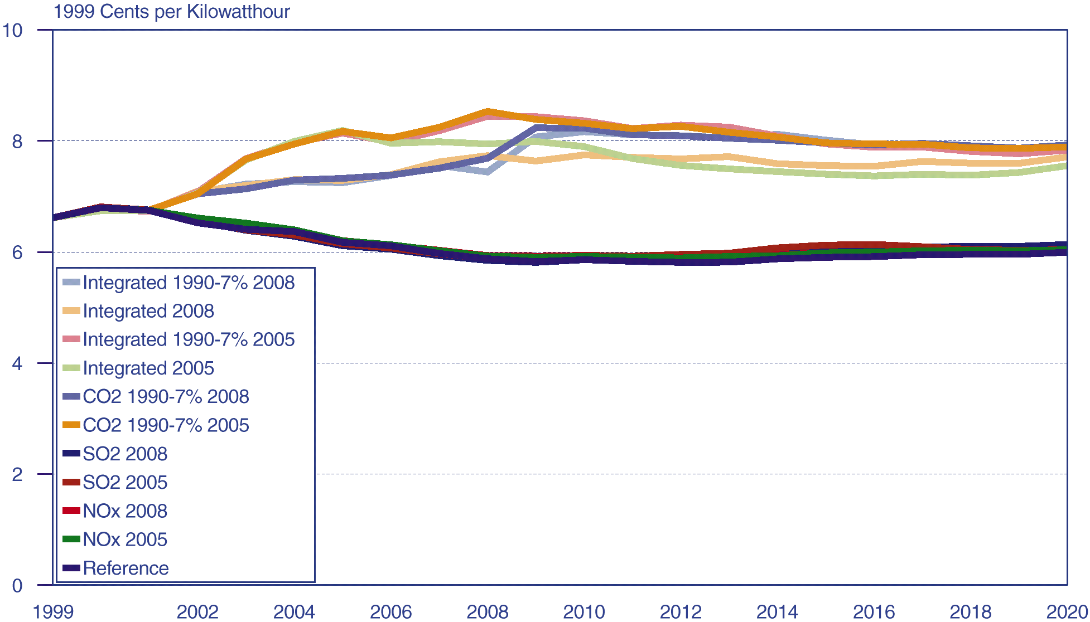
Projected Electricity Prices, 1999-2020

Slide 13
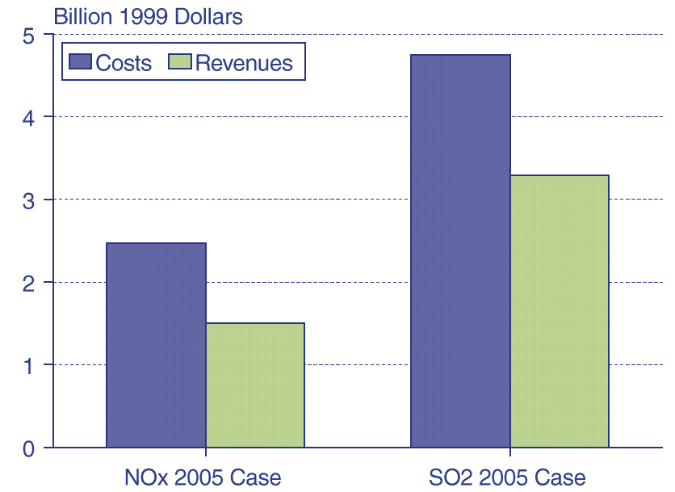
Projected Average Annual Changes from Reference Case Power Plant Costs and Revenues in the SO2 and NOx 2005 Cap Cases, 2005-2020

Slide 14
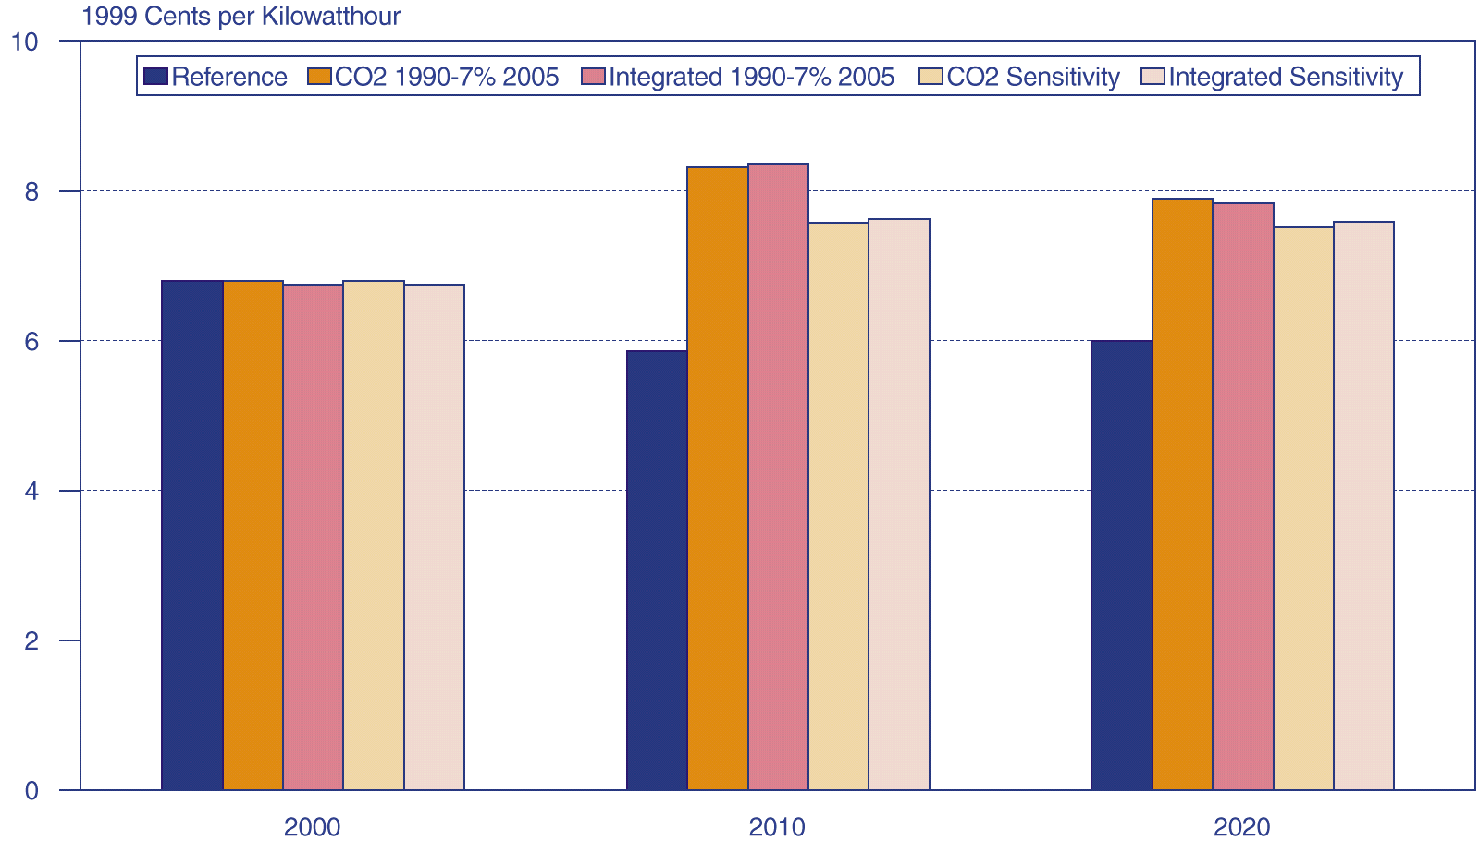
Projected Electricity Prices, 2000, 2010, and 2020

Slide 15
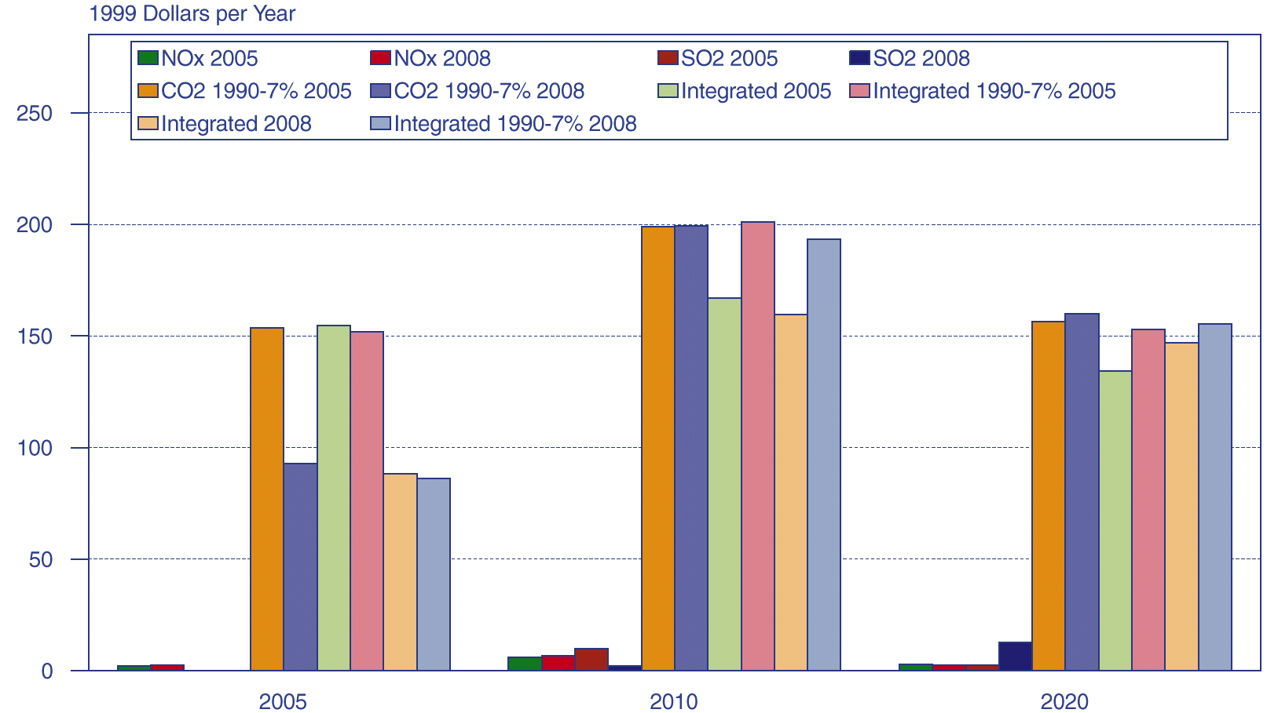
Average Projected Changes in Annual Household Electricity Bills Relative to Reference Case
Projections, 2005-2020

Slide 16
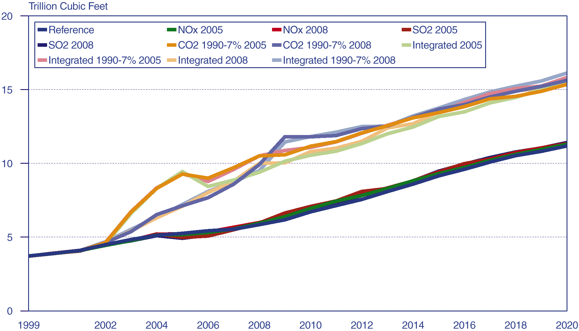
Projected Natural Gas Consumption for Electricity Generation, 1999-2020

Slide 17
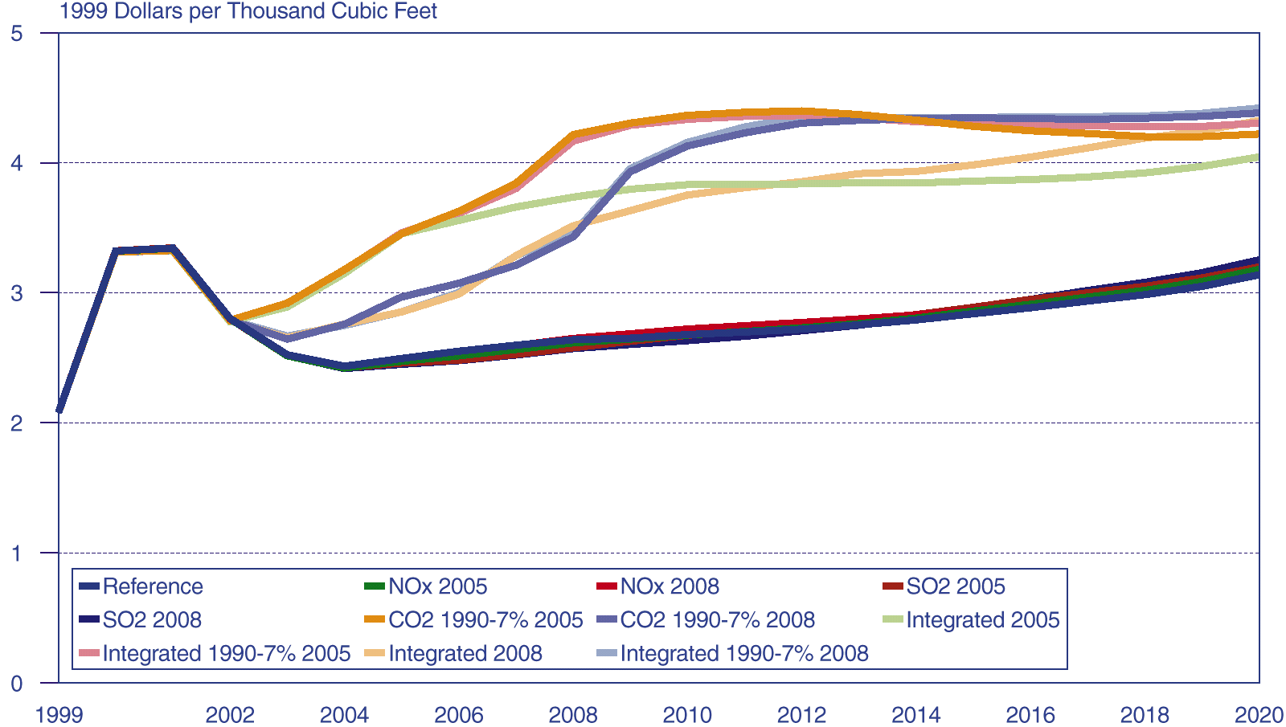
Projected Domestic Wellhead Natural Gas Prices, 1999-2020

Slide 18
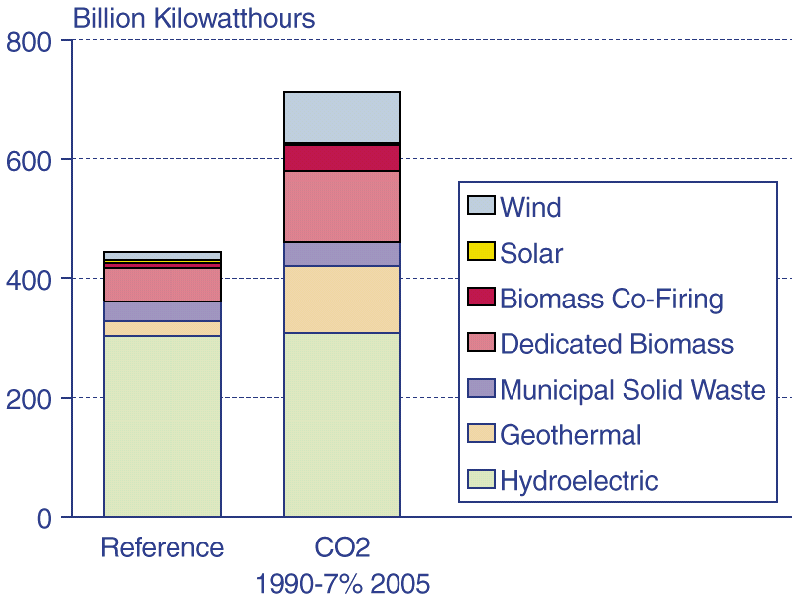
Projected Renewable Electricity Generation by Fuel in the Reference and CO2 1990-7% 2005 Cases, 2020

Slide 19
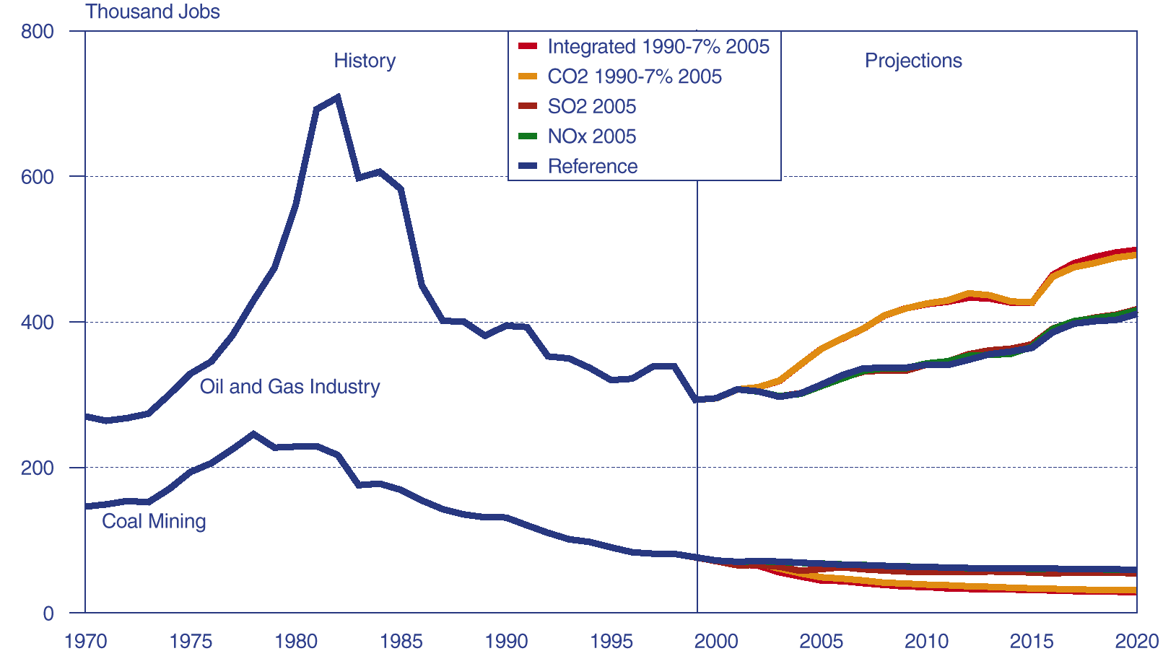
Coal Mining and Oil and Gas Industry Employment, 1970-2020

Slide 20
Uncertainties
Impacts on Technology Costs
Timing of Scenarios
Response of Market Participants, Both Industry and Consumers
Reliability and Volatility

