Slide 1
The Impact of Technology and Economic Uncertainty in the NEMS Demand Modules
John H. Cymbalsky
Energy Information Administration
March 27, 2001

Slide 2
Topics
Areas of Uncertainty
  Economic Growth
  Technology Innovation and Adoption
  Political Uncertainty
Results of Model Simulations
  AEO 2001 High and Low Macro Cases
  AEO 2001 High and Low Technology Cases
  AEO 2001 with New Appliance Standards

Slide 3
Key Macroeconomic Variables
Residential Sector
  Housing Starts: Range from 1.7 to 2.2 million units per year through 2020 (2.0 in 1999)
  Disposable Personal Income: Ranges from $87,953 to $95,295 per household in 2020 ($61,136 in 1999)
  Average Delivered Energy Prices: Range from $12.27 to $13.77 per million Btu in 2020 ($12.60 in 1999)

Slide 4
Key Macroeconomic Variables (continued)
Commercial Sector
  Commercial Floorspace: Ranges from 76.4 to 87.8 billion square feet in 2020 (62.8 in 1999)
  Real Yield on Government 10 Year Bonds: Ranges from 6.99 to 4.88 percent in 2020 (4.75 in 1999)
  Average Delivered Energy Prices: Range from $10.92 to $12.88 per million Btu in 2020 ($12.68 in 1999)

Slide 5
Key Macroeconomic Variables (continued)
Industrial Sector
  Total Industrial Output: Ranges from $7.4 to $9.3 trillion in 2020 ($4.7 in 1999)
  Energy Intensive Manufacturing: Ranges from $1.3 to $1.5 trillion in 2020 ($1.1 in 1999)
  Average Delivered Energy Prices: Range from $5.03 to $6.12 per million Btu in 2020 ($5.10 in 1999)

Slide 6
Key Macroeconomic Variables (continued)
Transportation Sector
  Light-Duty Vehicle Sales: Range from 15.6 to 17.6 million units per year through 2020 (16.9 in 1999)
  Average Delivered Energy Prices: Range from $8.54 to $9.25 per million Btu in 2020 ($7.94 in 1999)

Slide 7
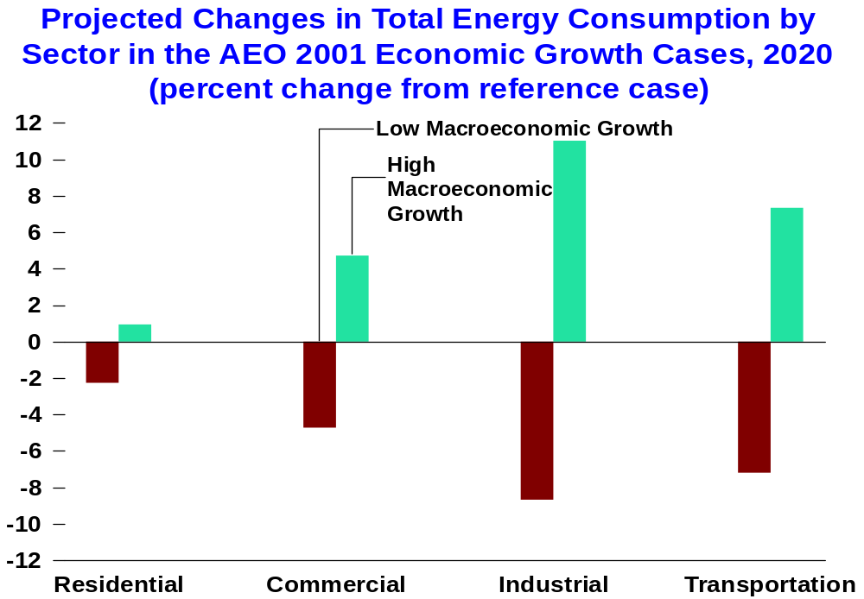

Slide 8
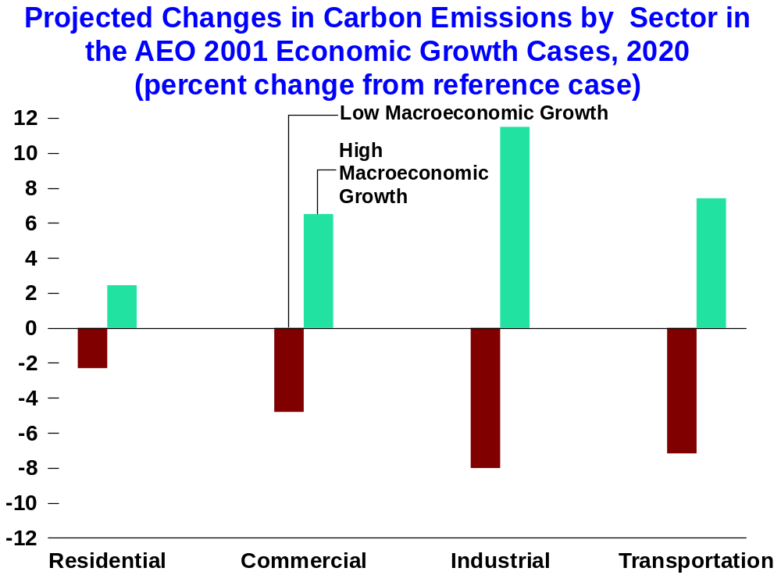

Slide 9
Technology Issues
Residential, Commercial, and Transportation Sectors
  Technology represented by cost, performance, and other attributes for transportation (horsepower, cargo room)
  Forecast provided by Arthur D. Little (Buildings)
  Technology adoption based on economics of a combination of first cost, operating cost, and life-cycle cost, where appropriate
  2001 technology case freezes cost and performance at 2001 levels
  High technology case incorporates gains in efficiency and/or cost reductions over time

Slide 10
Technology Issues (continued)
Industrial Sector
  Process and Assembly
    UECs for current and 2020 equipment installations based on study by Arthur D. Little
    Path and timeliness of reaching 2020 UEC driven by energy prices
    New additions a function of industry growth rates and retirement rates
  Cogeneration
    Cogeneration systems based on thermal loads
    Market penetration based on payback criteria
    Data based on Onsite SYCOM report

Slide 11
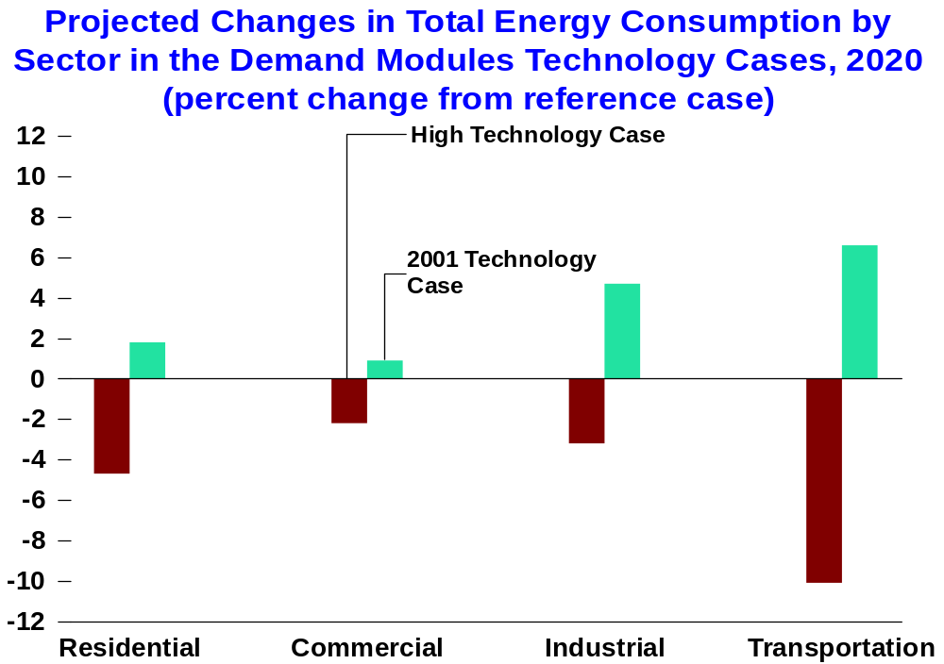

Slide 12
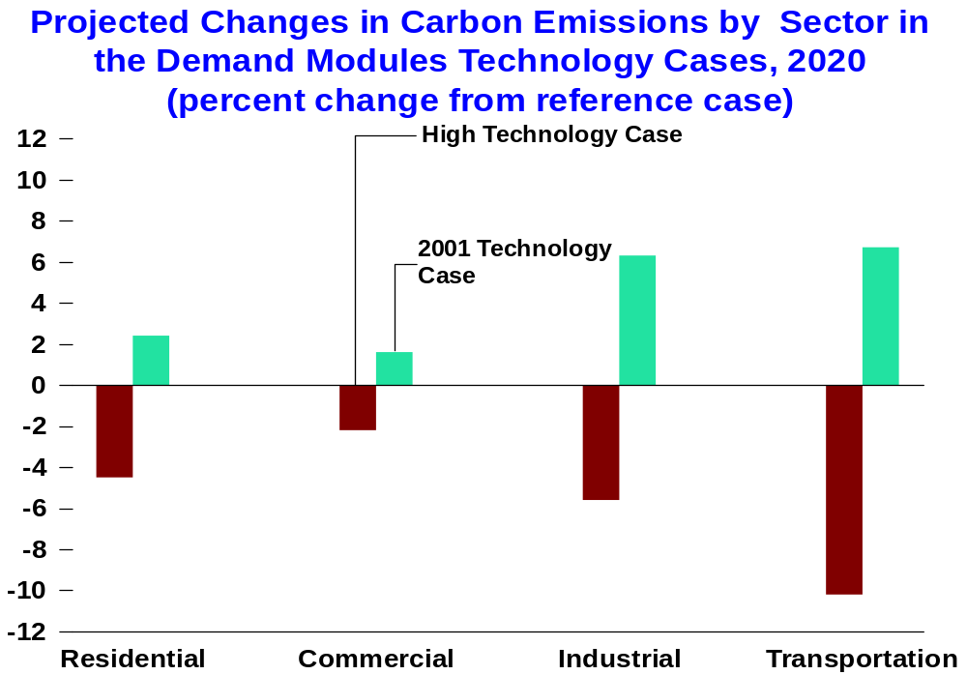

Slide 13
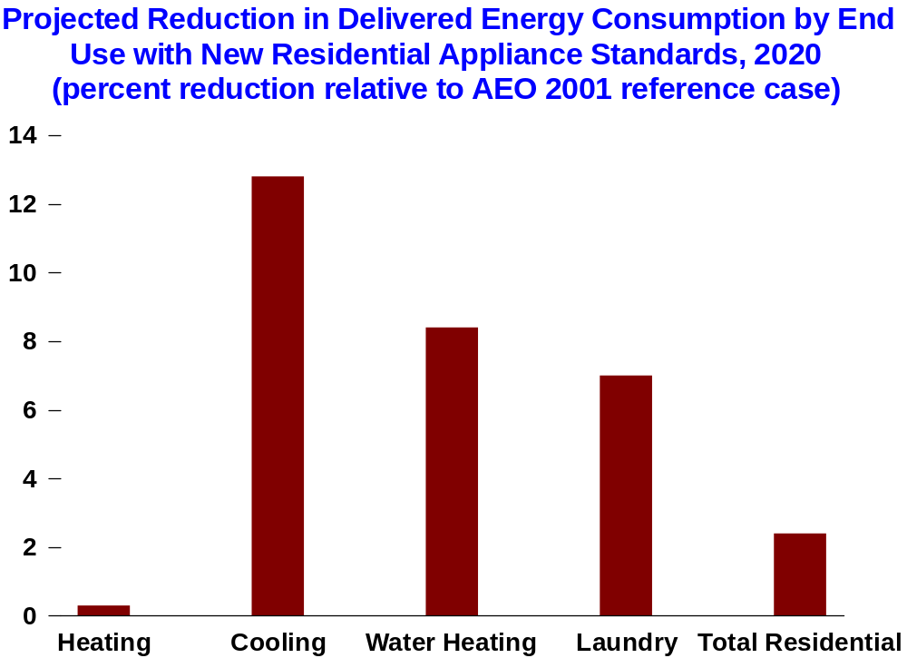

Slide 14
Conclusions
Uncertainty Difficult to Assess in NEMS
  Many layers of uncertainty
  Potential interaction between certain parameters
  Pure uncertainty analyses costly and time consuming
Scenario Analyses Useful
  Help bound “what if” questions
  Assumptions straightforward
  Relatively quick, sometimes dirty

