Slide 1

Technology and Geology: Key Elements
Shaping the Oil and Natural Gas Markets
Dana Van Wagener
National Energy Modeling System/
Annual Energy Outlook Conference
March 27, 2001
Washington, DC
dana.vanwagener@eia.doe.gov

Slide 2
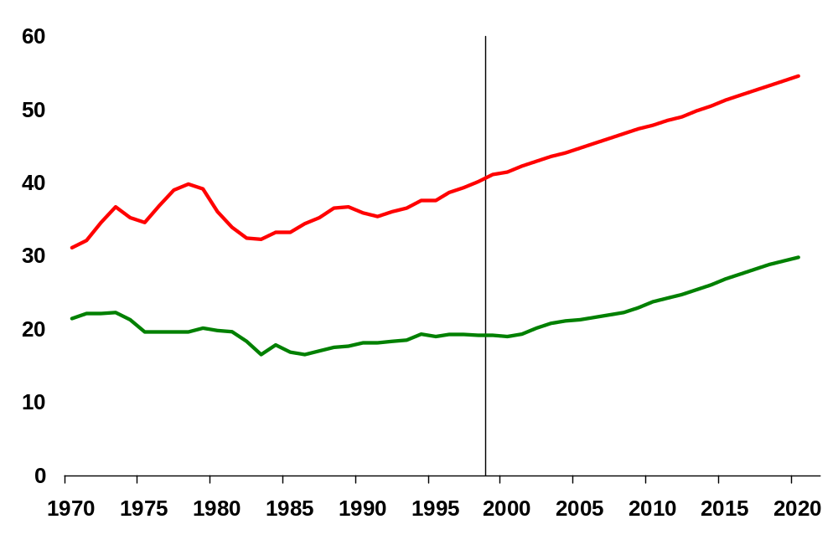
U.S. Petroleum and Natural Gas Consumption
(quadrillion Btu per year)
Petroleum
Natural Gas
History
Forecast

Slide 3
Key Components in the Oil and Gas Supply Module
Technology
  Costs
  Success rates
  Reserve additions per well
Geology
  Conventional
  Unconventional
  Offshore

Slide 4
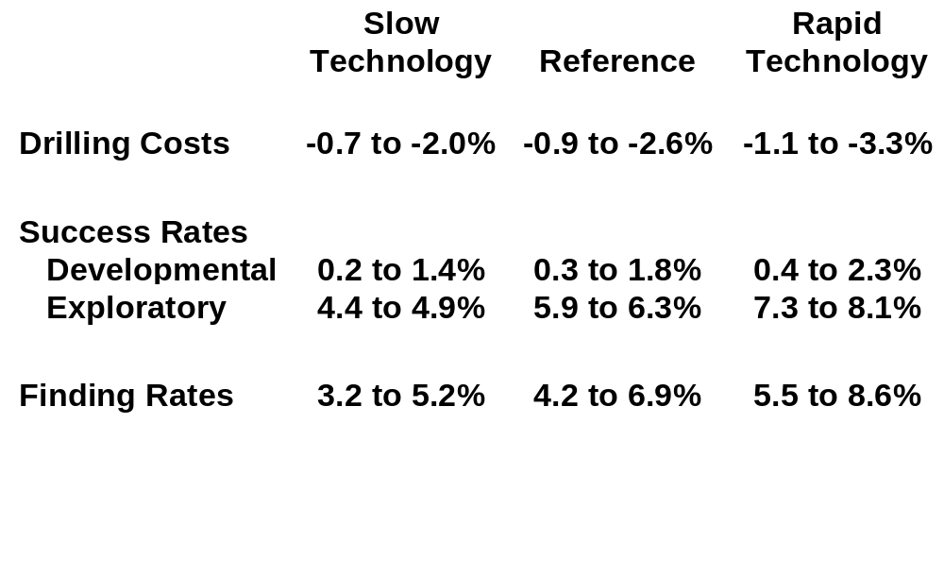
Rates of Technological Progress

Slide 5
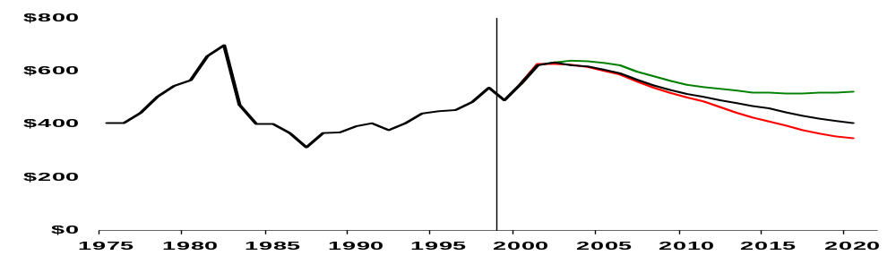
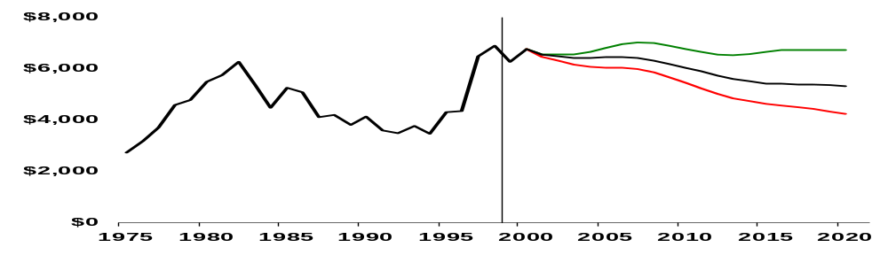
Average Drilling Costs
(1999 thousand dollars per well)
Onshore
Slow Technology
Reference
Rapid Technology
History
Forecast
Offshore
Slow Technology
Reference
Rapid Technology
History
Forecast

Slide 6
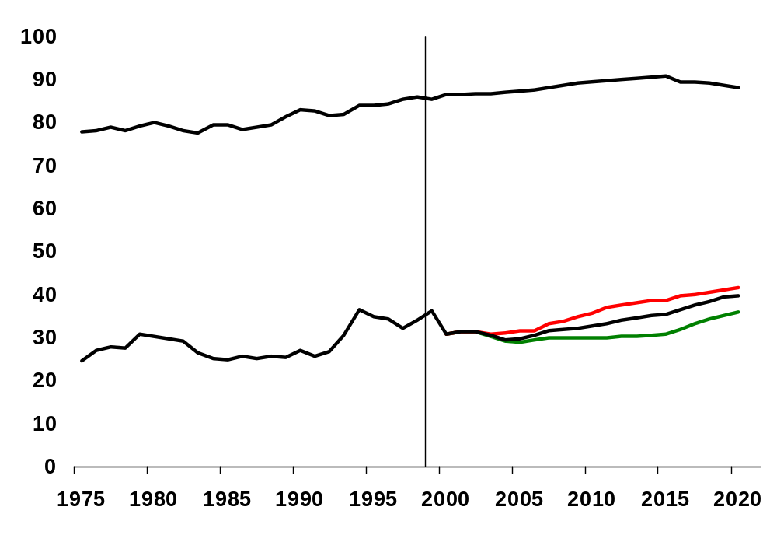
Average Success Rates
(percent)
Developmental
Reference
Rapid Technology
Exploratory
Reference
Slow Technology
History
Forecast

Slide 7
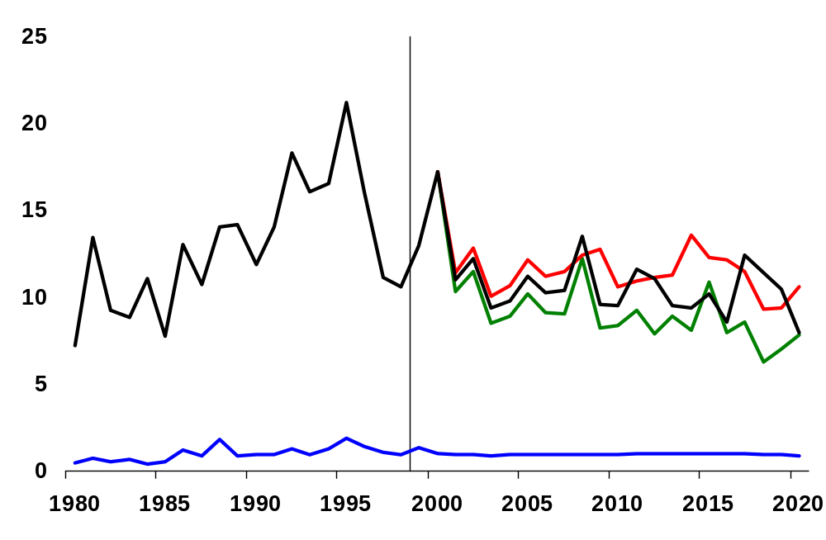
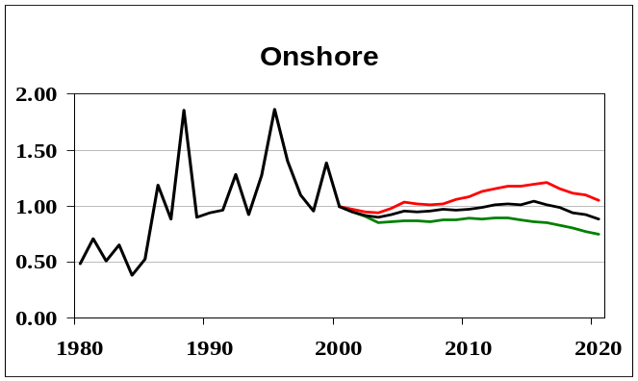
Average Reserve Additions per Nonassociated
Gas Well (billion cubic feet per well)
History
Forecast
Offshore
Rapid Technology
Reference
Slow Technology
Onshore

Slide 8
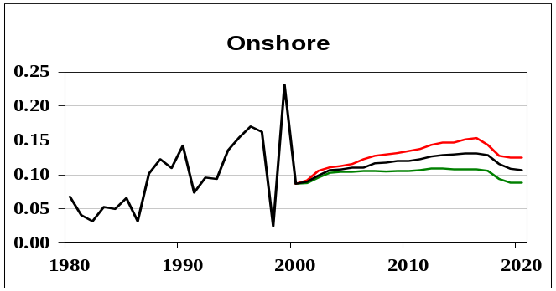
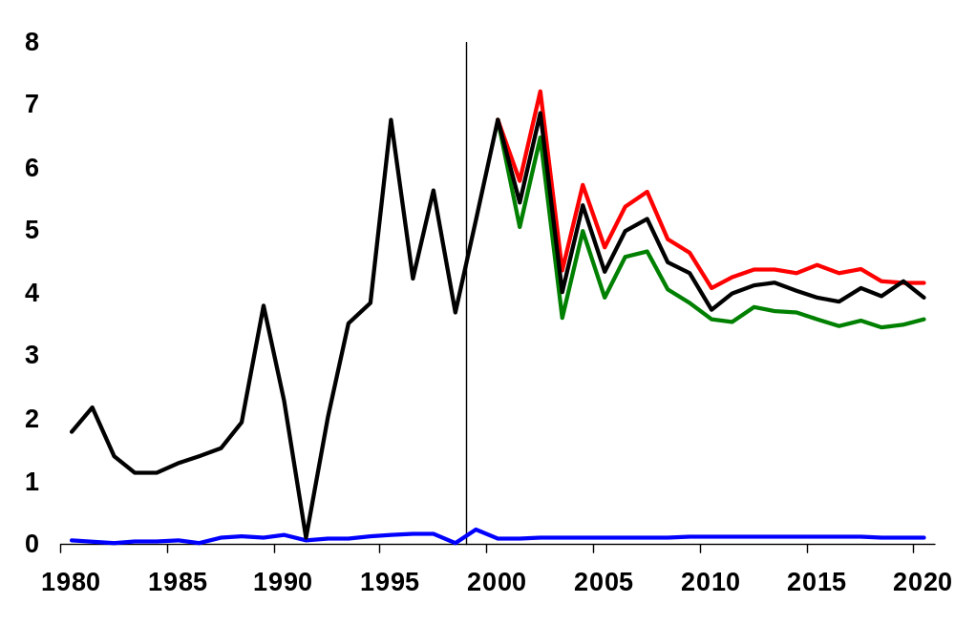
Average Reserve Additions per Oil Well
(million barrels per well)
History
Forecast
Rapid Technology
Reference
Slow Technology
Offshore
Onshore

Slide 9
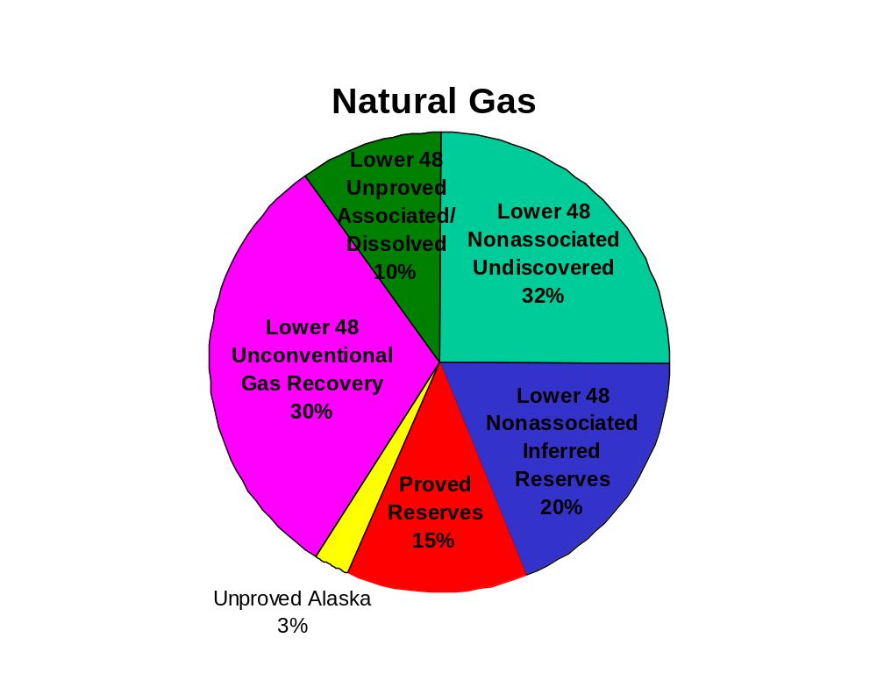
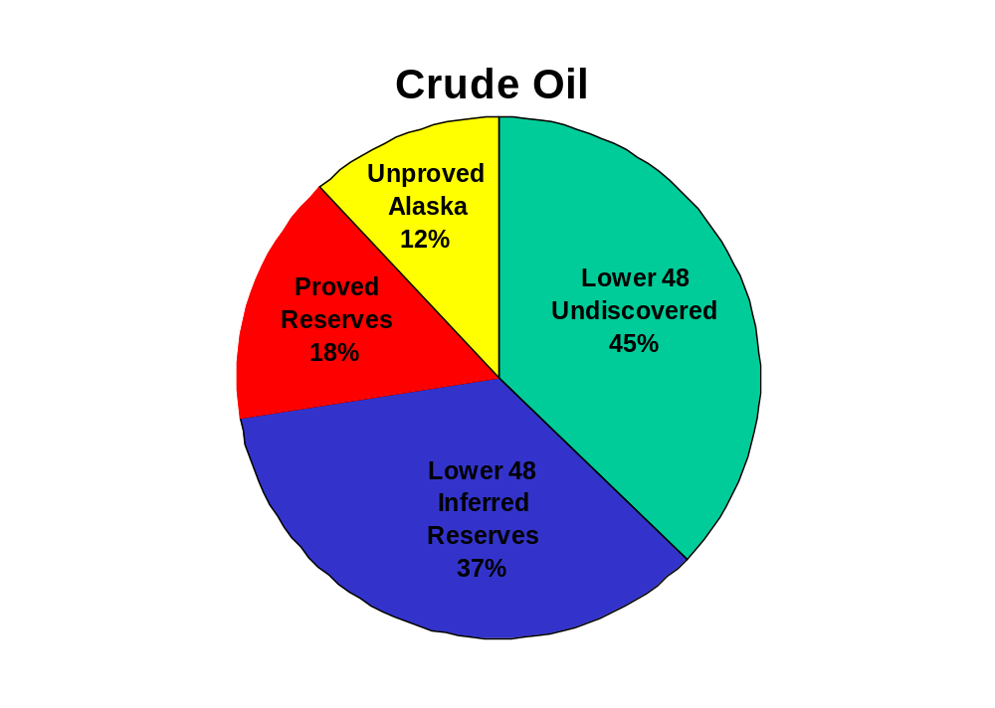
Remaining Crude Oil and Natural Gas Resources,
as of January 1, 1999
Note: Resources in restricted areas (where drilling is prohibited) are not included in these estimates.

Slide 10
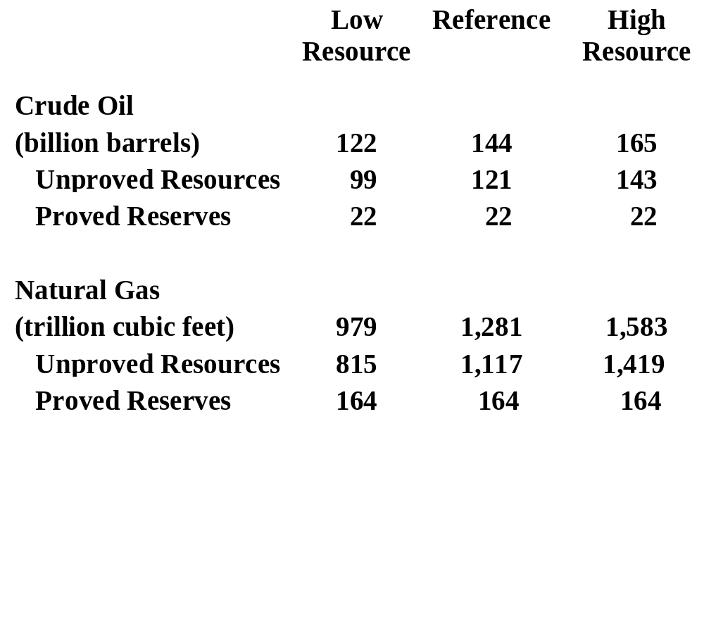
Technically Recoverable Oil and Natural Gas Resources, as of January 1, 1999

Slide 11
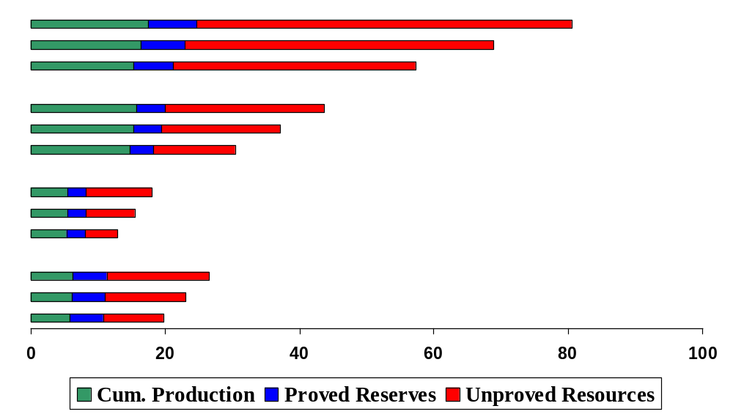
Technically Recoverable Lower 48 Crude Oil Resources
in Jan. 1999, as seen in Dec. 2020 (billion barrels)
Onshore conventional
High Resource Case
Reference Case
Low Resource Case
Offshore conventional
Onshore Enhanced Oil Recovery
Alaska

Slide 12
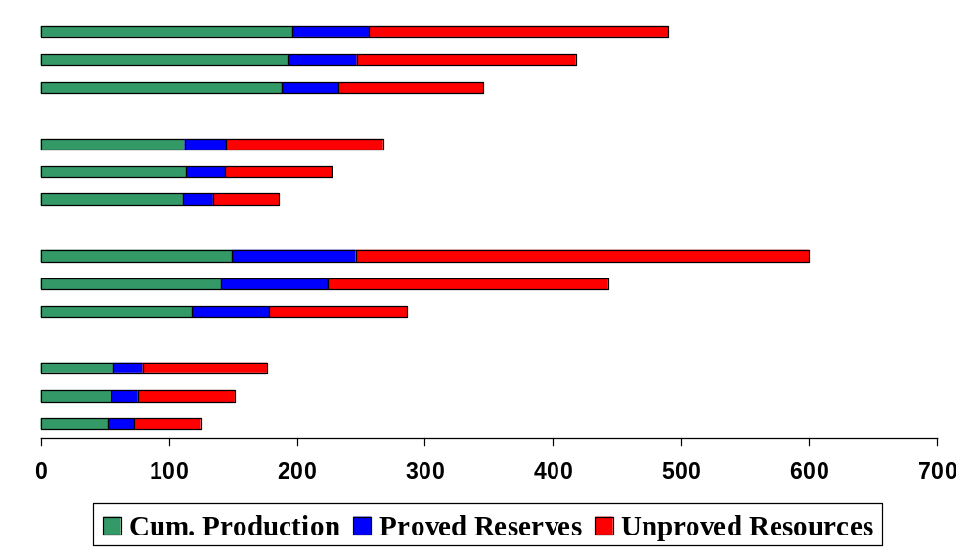
Technically Recoverable Lower 48 Natural Gas Resources
in Jan. 1999, as seen in Dec. 2020 (trillion cubic feet)
Onshore nonassociated conventional
High Resource Case
Reference Case
Low Resource Case
Offshore nonassociated conventional
Unconventional
Associated-Dissolved

Slide 13
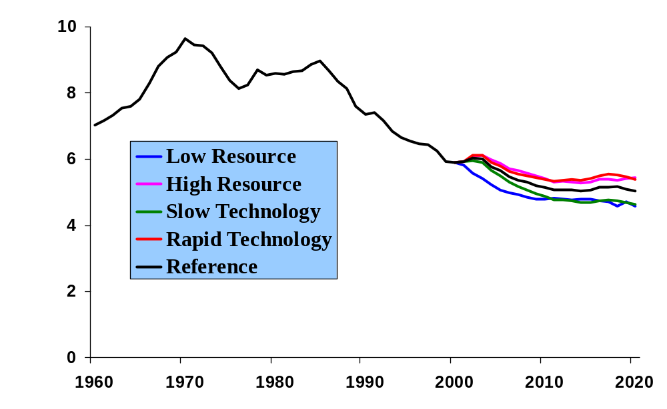
U.S. Crude Oil Production
(million barrels per day)

Slide 14
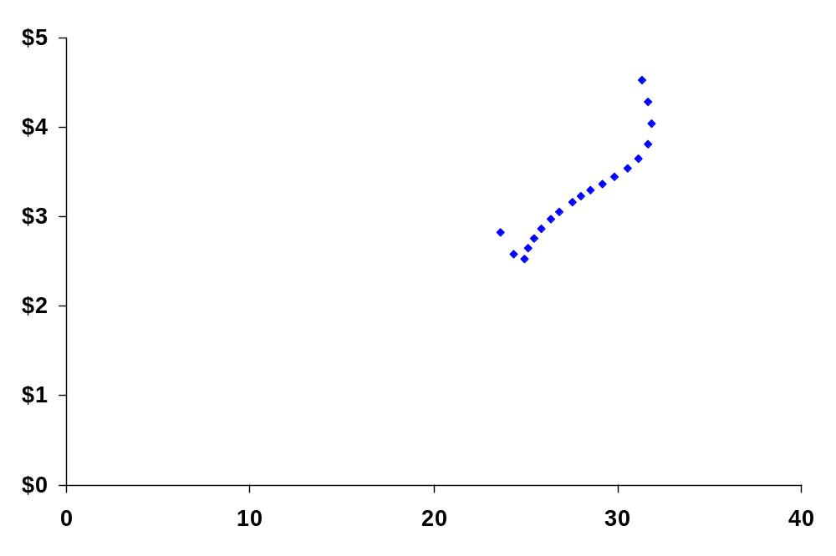
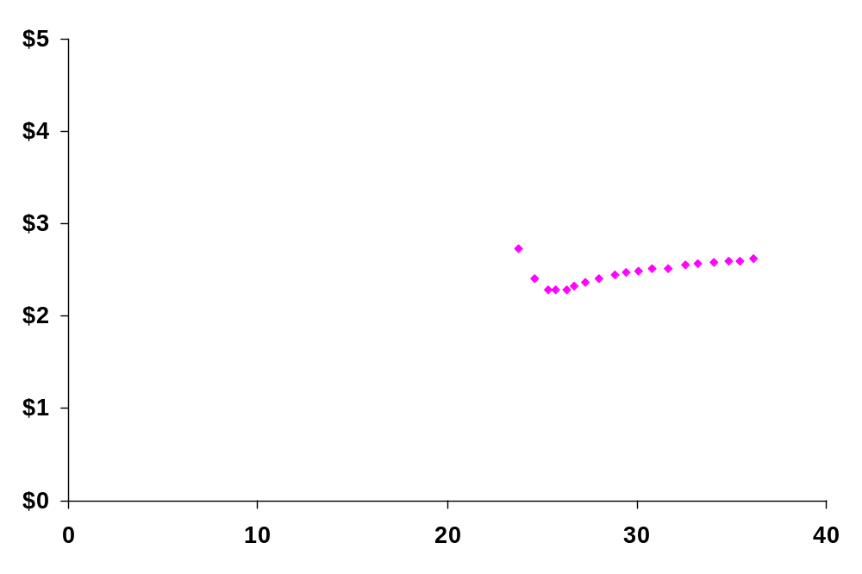
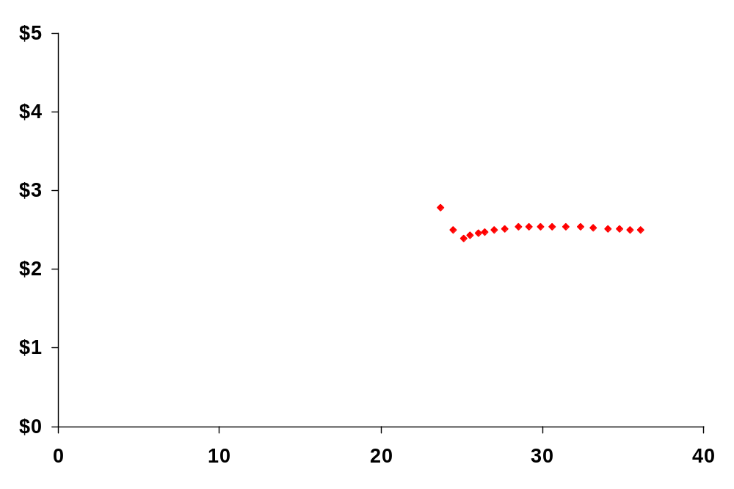
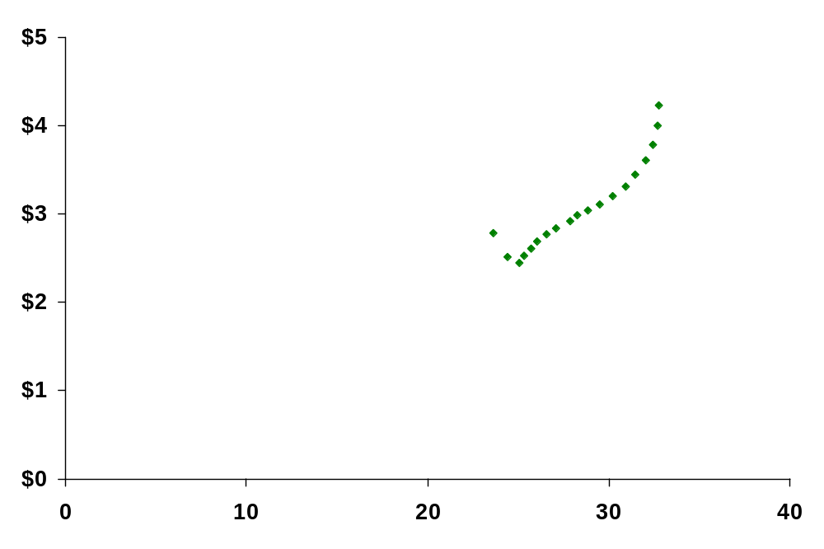
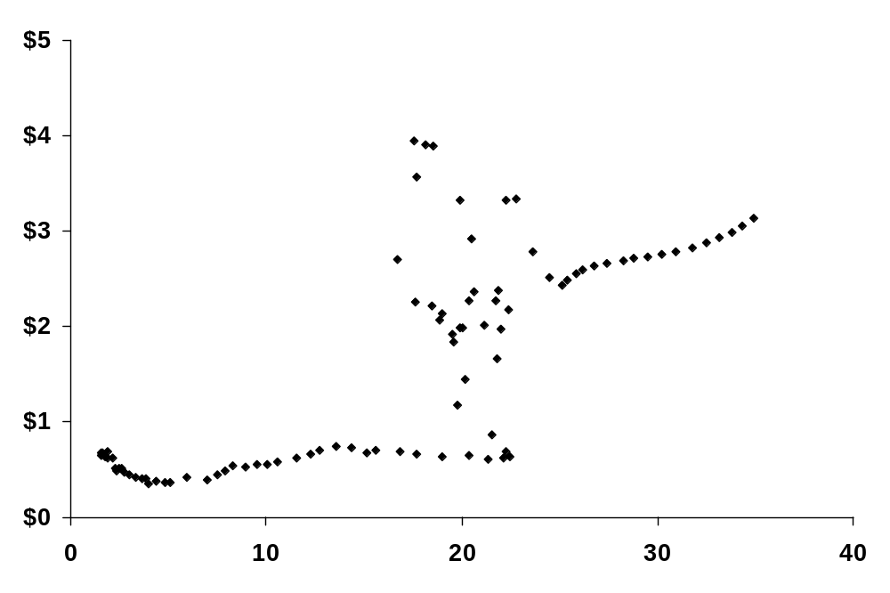
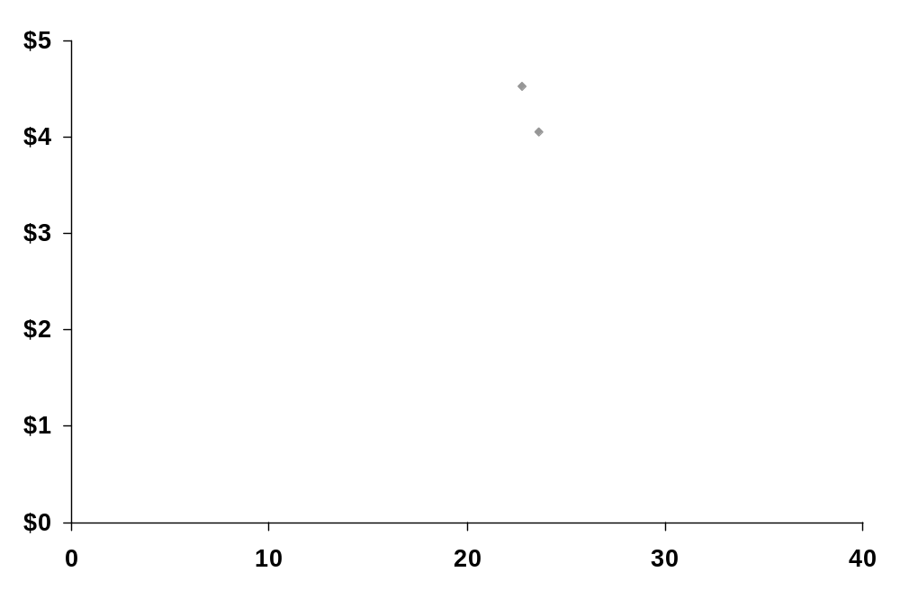
Natural Gas Wellhead Prices vs. Total Supply
2001*
Low Resource
Slow Technology
2002*
1980 - 1985
2000-2001
Reference
1986
High Resource
1999 Dollars per Thousand Cubic Feet
Rapid Technology
1977 - 1979, 1987 - 1999
1976
1975
1930 - 1975
Trillion Cubic Feet
* March 2001 STEO

Slide 15
Related Analysis
(www.eia.doe.gov/oiaf/analysis.html)
Accelerated Depletion: Assessing Its Impacts on Domestic
Oil and Natural Gas Prices and Production (September 2000)
Impact of Unconventional Gas Technology in the Annual
Energy Outlook 2000 (September 2000)
Historical Impact of Technology on Oil and Natural Gas
Exploration and Development (Summer 2001)

