Slide 1
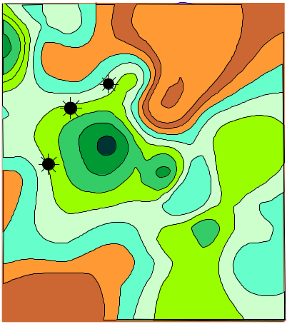
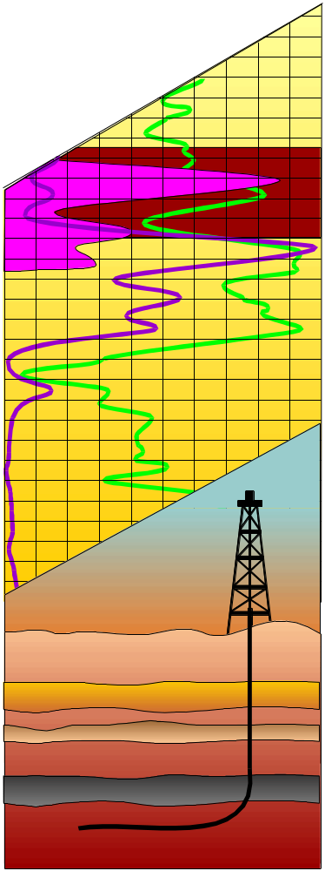
A Long Term View for Unconventional Gas
(Tight Gas, Coalbed Methane, Gas Shales)
Presented at:
National Energy Modeling System/Annual Energy Outlook Conference 2001
The Natural Gas Frontier: 2015 and Beyond
March 27, 2001
Washington, DC
Presented by:
Vello A. Kuuskraa
Brian T. Kuck
Advanced Resources International, Inc.

Slide 2
Outline
1. Growing Importance of Unconventional Gas
Significant New Unconventional Gas Plays
MUGS (Model of the Unconventional Gas Supply)
Outlook for Technology Progress
Outlook for Unconventional Gas
Tight Gas
Coalbed Methane
Gas Shales

Slide 3
Importance of Tight Gas, Gas Shales and Coalbed Methane
Tight Gas, Gas Shales and Coalbed Methane are the fastest growing areas of domestic natural gas supply:
  25% of gas production
  32% of proved gas reserves
Six of top ten natural gas fields produce “unconventional gas”.
Large undeveloped resource base whose economic production depends on continued strong progress in E&P technology.

Slide 4
Sources of Domestic Production of Natural Gas (1999)
Total
Domestic
Production
Onshore
Conventional/
Other
Coalbed
Methane
Federal
Offshore
Unconventional
Gas
Tight Gas
Gas Shales
20
4.0
18.7
3.5
15
3.0
2.9
2.5
Domestic Production (Tcf in 1999)
Domestic Production (Tcf in Yr 1999)
2.0
10
9.0
1.5
1.3
5
5.1
4.6
1.0
0.5
0.4
0
0.0
Source:
Total – EIA Monthly Energy Review, Feb 2001.
Offshore – EIA 1999 Annual Reserve Report, includes state waters.
Unconventional – ARI data base.
Source: EIA 1999 Annual Reserve Report and ARI data base.

Slide 5
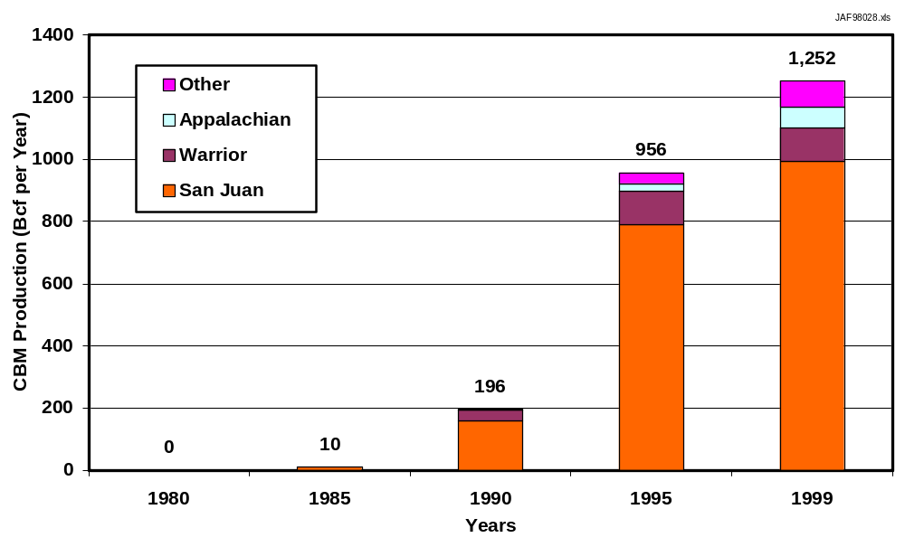
Growth in Coalbed Methane Production (1980 – 1999)

Slide 6
Largest Domestic Fields Producing
Tight Gas, Gas Shales and Coalbed Methane
1999 Gas
Production
(Bcf)
Field
Basin/State
Resource
1. Blanco/ San Juan, NM/CO CBM/T. Gas 714 Ignacio-Blanco
2. Basin San Juan, NM CBM/T. Gas 674
4. Giddings Austin Chalk, TX Tight Gas 240
5. Carthage East Texas, TX Tight Gas 204
9. Antrim Michigan, MI Gas Shale 126
10. Wattenberg Denver, CO Tight Gas 126

Slide 7
Unconventional Gas Reserves and Resources (1999)
Unconventional gas accounts for 52 Tcf of proved reserves and holds over 400 Tcf of undeveloped resources.
Proved Reserves
(Tcf)
Undeveloped Resources
(Tcf)
Tight Gas 35 287
Coalbed Methane 12 60
Gas Shales 5 55
TOTAL 52 402

Slide 8
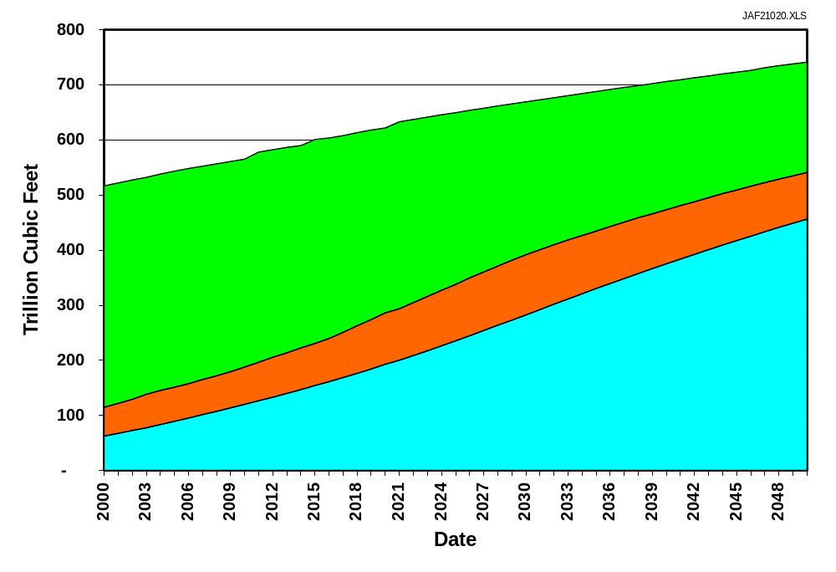
Growth of Unconventional Gas Resources
2000 – 2050
“Ultimate” Recoverable
Resource Base
(Increasing with
Advancing Technology)
200
90
Proved
Reserves
Cumulative
Production
450

Slide 9
Tight Gas
The Jonah Field (Green River Basin) is a large new tight gas play in the Rockies:
Gas production of nearly 400 MMcfd,
Over 240 recently drilled wells.
High well productivity and reserves have made Jonah an economically attractive play:
2 Tcf estimated reserves,
3 Bcf per well (range 1 Bcf to 10 Bcf),
D&C costs of $1.0 to $1.5 million per well.
Technology progress in pay definition, well stimulation and cost control have been keys to this gas play.

Slide 10
Coalbed Methane
Shallow, low rank Powder River Basin coal is currently the most active gas play in the Rockies:
Gas production of 500 MMcfd,
Over 5,000 recently drilled wells.
The Powder River gas play is large and low cost:
12 Tcf of technically recoverable gas,
0.4 Bcf/well (range 0.2 Bcf to 1.0 Bcf),
D&C costs of less than $100,000 per well.
The key technology advances include:
Establishing mechanisms controlling production,
Low cost drilling,
Non damaging well completions.

Slide 11
Gas Shales
The Barnett Shale in the Fort Worth Basin is a recent gas shales play:
Gas production of nearly 300 MMcfd,
Over 600 recently drilled wells,
The Barnett gas play is large and moderate in cost:
10 Tcf of technically recoverable gas,
1 Bcf per well (range 0.5 Bcf to 2 Bcf),
D&C costs of $500,000 to $800,000 per well.
Technology advances have improved economics:
Upper zone completions/recompletions (+25% recovery/well),
Lower cost, light sand frac (saving $ 300,000/well),
Intensive development (20 to 40 acres/well spacing).

Slide 12
The MUGS Supply and Technology Model
Resource Base
and Productivity Module
Technology Impacts
and Timing Module
INTEGRATED
FORECASTS OF SUPPLY,
PRICES AND
BENEFITS
Activity,
Production and
Reserves Module
Drilling and
Capital Allocation
Module
Costs and
Economic Module
Production, Reserve Additions and Reserves Accounting Module
Note: See Attachment 1 for details.

Slide 13
Technology Outcomes Modeled
by MUGS
The outlook for unconventional gas depends greatly on technology advances in five broad areas (see Attachment 1 for details):
Increased Technically Recoverable and Available Resource Base
More Efficient Exploration and Exploitation of Sweet Spots
Improved Recovery of Resources In Place
Lower Cost Development and Operations
Breakthrough Technologies

Slide 14
Progress In E&P Technology Has Declined in Recent Years
Oil and Gas
Exploration Success
(1994-2000)
Drilling Efficiency
(1994-2000)
35
190
33.3%
32.7%
32.6%
181
180
178
Footage Drilled per Rig-Yr (000s)
% Successful Exploration Wells
30
170
164
0
160
1994-97
(Avg.)
1998
1999-2000
(Avg.)
1994-97
Avg.
1998
1999-2000
Avg.
Source: EIA Monthly Energy Review, Feb 2001.
Source: EIA Monthly Energy Review, Feb 2001.

Slide 15
R&D Expenditures by Major Producers for Oil and Gas Recovery Have Fallen by More Than 50% Since 1992
1,000
900
800
700
R&D Expenditures (Million, $99)
*
*
600
500
400
300
200
1992
1993
1994
1995
1996
1997
1998
1999
2000
Source: EIA, Performance Profiles of Major Energy Producers, 1999.
*Additional companies added to Survey of Major Energy Producers.

Slide 16
Outlook for Tight Gas Sands
1. Current Status. In 1999, 2,920 Bcf of natural gas was produced from 42 significant tight gas plays:
Rocky Mountain (25 plays) -- 1,130
East/South Texas (4 plays) -- 910
Appalachia (7 plays) -- 330
Other (6 plays) -- 550
TOTAL 2,920
Bcf
Bcf
2. Impact of Technology. In the Reference Case, tight gas increases to 7 Tcf by 2030. With Low Technology, the decline in resource quality exceeds technology progress, limiting the economic contribution of tight gas.
2000 2020 2030 2050
Reference Case* (Tcf) 3.0 5.7 7.0 5.5
Low Technology (Tcf) 3.0 3.5 3.6 2.8
*Assumes wellhead natural gas prices rise to $3.13/Mcf (real $1999) by 2020 and increase by 1% per year (real) to 2050.

Slide 17
Outlook for Coalbed Methane
1. Current Status. In 1999, 1,250 Bcf of natural gas was produced from 28 significant coalbed methane plays:
San Juan (5 plays) -- 980
Rocky Mountain (14 plays) -- 80
Warrior (3 plays) -- 110
Other (6 plays) -- 80
1,250
Bcf
Bcf
2. Impact of Technology. In the Reference Case, CBM increases modestly and plateaus. Only High Technology Progress enables this technology sensitive resource to make a substantial long term contribution.
2000 2020 2030 2050
Reference Case (Tcf) 1.3 1.7 1.7 1.3
Low Technology (Tcf) 1.3 0.9 0.7 0.6
High Technology (Tcf) 1.3 3.1 2.8 3.6
*Assumes wellhead natural gas prices rise to $3.13/Mcf (real $1999) by 2020 and increase by 1% per year (real) to 2050.

Slide 18
Outlook for Coalbed Methane
1. Current Status. In 1999, 1,250 Bcf of natural gas was produced from 28 significant coalbed methane plays:
San Juan (5 plays) -- 980
Rocky Mountain (14 plays) -- 80
Warrior (3 plays) -- 110
Other (6 plays) -- 80
1,250
Bcf
Bcf
2. Impact of Technology. In the Reference Case, CBM increases modestly and plateaus. Only High Technology Progress enables this technology sensitive resource to make a substantial long term contribution.
2000 2020 2030 2050
Reference Case (Tcf) 1.3 1.7 1.7 1.3
Low Technology (Tcf) 1.3 0.9 0.7 0.6
High Technology (Tcf) 1.3 3.1 2.8 3.6
*Assumes wellhead natural gas prices rise to $3.13/Mcf (real $1999) by 2020 and increase by 1% per year (real) to 2050.

Slide 19
Gas Shales
1. Current Status. In 1999, 360 Bcf of natural gas was produced from gas shales:
Appalachia (5 plays) -- 120
Michigan (2 plays) -- 190
Fort Worth (1 play) -- 40
Other (2 plays) -- 10
TOTAL 360
Bcf
Bcf
2. Impact of Technology. In the Reference Case, gas shales production grows steadily until 2030. With Low Technology, gas shales remain a minor contributor to domestic natural gas supplies.
2000 2020 2030 2050
Reference Case* (Tcf) 0.4 1.1 1.5 0.9
Low Technology (Tcf) 0.4 0.5 0.5 0.7
*Assumes wellhead natural gas prices rise to $3.13/Mcf (real $1999) by 2020 and increase by 1% per year (real) to 2050.

Slide 20
Summary
1. Long Term Contribution of Unconventional Gas. Strong progress in technology can stimulate continued near term growth of unconventional gas production and sustain its long term contribution at about 8 to 10 Tcf per year:
Reference Case* (Tcf)
2000 2020 2030 2050
Tight Gas 3.0 5.7 7.0 5.5 CBM 1.3 1.7 1.7 1.3
Gas Shales 0.4 1.1 1.4 0.9
TOTAL 4.7 8.5 10.2 7.7
*Assumes wellhead natural gas prices rise to $3.13/Mcf (real $1999) by 2020 and increase by 1% per year (real) to 2050.

Slide 21
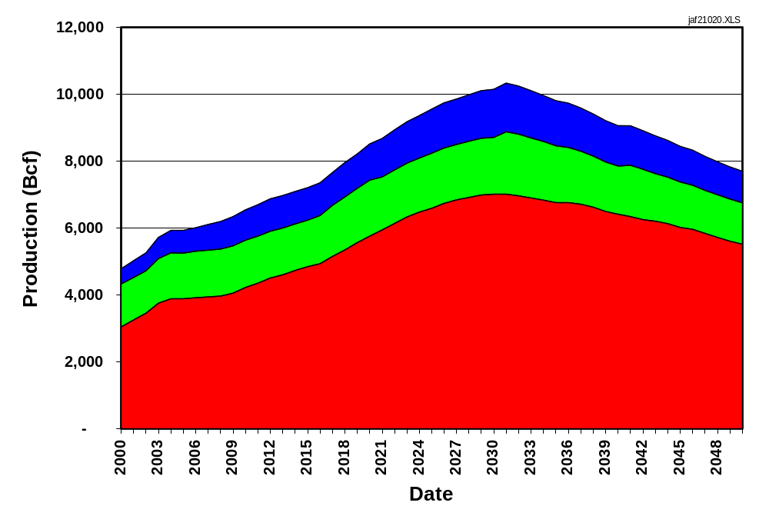
Long-Term Unconventional Gas Production, 2000 - 2050
Gas Shales
CBM
TGS

Slide 22
Summary (cont.)
Importance of Technology Progress. However, should technology progress falter, the long term contribution from unconventional gas will be much less. Increasing gas prices maintain production at today’s levels:
Low Technology Case* (Tcf)
2000 2020 2030 2050
Tight Gas 3.0 3.5 3.6 2.8 CBM 1.3 0.9 0.7 0.6
Gas Shales 0.4 0.5 0.5 0.7
TOTAL 4.7 4.9 4.8 4.1
*Assumes wellhead natural gas prices rise to $3.13/Mcf (real $1999) by 2020 and increase by 1% per year (real) to 2050.

Slide 23
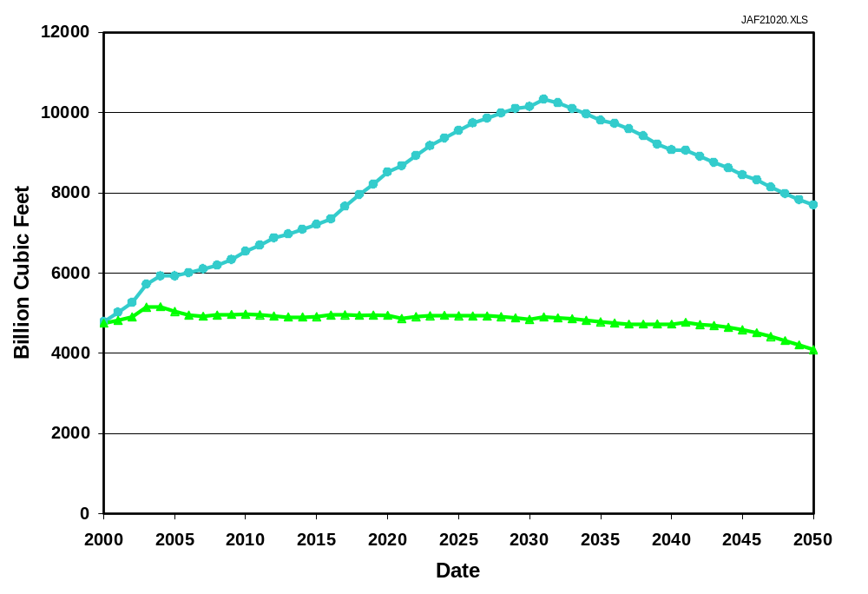
Unconventional Gas Production --
Two Technology Cases
Reference
Technology
Case
Low
Technology
Case

Slide 24
Summary (cont.)
Benefits of Technology Progress. Technology progress, sufficient to assure Reference Case results, has value to industry and even more to consumers.
The Benefits to Domestic Gas Consumers of Technology Progress will be $1.6 Trillion, equal to the currently proposed Tax Cut.
Assumptions:
35 Tcf annual consumption, 2020 – 2050.
$1.10 to $2.00/Mcf lower wellhead gas prices, due to technology progress
35 Tcf/yr x 30 yrs. x $1.55 = $1.6 Trillion

Slide 25
Attachment 1
Model of Unconventional Gas System (MUGS)
Analytic Modules
Technologies

Slide 26
Overview of MUGS Modules
The Supply and Technology Model contains six modules:
1. Resource Base -- Derived from the recent USGS National Assessment, the NPC Study, Advanced Resources’ work for the USGS National Assessment, internal ARI basin and play level evaluations, and reservoir simulation and history matching based well performance.
2. Current and Expected Activity, Production and Reserves -- Based on state survey data, industry inputs, Dwights/PI completion and production files, and EIA’s annual reserve reports. Linked to NEMS historic accounting module.
3. Costs and Economics -- Developed by Advanced Resources from extensive work with industry and producers in tight gas, CBM and gas shale basins, plus JAS/API drilling cost surveys. Linked to main NEMS basin specific price module.

Slide 27
Overview of MUGS Modules (cont.)
4. Technology Impacts, Timing and EV Constraints -- Developed by Advanced Resources to incorporate DOE’s and industry’s R&D programs and technology progress. Includes environmental and other constraints to unconventional gas development. Linked to NEMS Reference, High and Low Technology Cases.
5. Drilling and Capital Allocation -- Establishes pace of well drilling and capital allocation for economically feasible gas plays based on relative profitability. Linked to NEMS drilling and capital allocation assumptions.
6. Production, Reserve Additions and Reserves Accounting -- Tracks gas production, reserve additions and reserve status by plays, basins and NEMS regions. Linked to NEMS integrating module and output reports.

Slide 28
Technology Outcomes Modeled
by MUGS (cont.)
1. Increased Technically Recoverable and Available Resource Base
Technology #1. Basin Assessment
Hypothetical plays become available
Play probabilities increase
Technology #2. Well Performance Diagnostics and Remediation
Reserve growth improves
Technology #3. Environmental Mitigation/Access
Restricted areas become available for development
2. More Efficient Exploration and Exploitation of Sweet Spots
Technology #4. Extended Resource Characterization
Emerging resource characterization
Technology #5. Natural Fracture Detection Technology
Exploration success rates improve
Development of unconventional reservoirs becomes more efficient

Slide 29
Technology Outcomes Modeled
by MUGS (cont.)
3. Improved Recovery of Resource In Place
Technology #6. Matching of Geology with “Appropriate” Technology
Reserves per well increase
Technology #7. Lower Damage, More Effective D&C Technology
Reserves per well increase
Technology #8. Horizontal Wells/Multi-Laterals
Recovery efficiency and reserves per well increase
4. Lower Cost Development and Operations
Technology #9. Optimized Drilling and Completion Practices
Lower capital costs per well
Technology #10. Advanced Gas and Water Treating
Lower O&M costs per Mcf

