Slide 1
What We Do and Do Not Know About How Electricity Markets Work: implications for energy modeling and policy
James Bushnell
University of California Energy Institute
www.ucei.org

Slide 2
Outline
Energy Policy and Modeling
  traditional goals of modeling
  deregulation and the new paradigm
A generic blueprint of electricity restructuring
Measuring market efficiency
What we do and do not know

Slide 3
Energy Policy in the 21st Century
Deregulation of supply is a reality
  Utilities aren’t investing in new production
  Regulators don’t get to firms what kind of production to invest in any more
    policies setting goals for nuclear, coal, and renewable technologies need to recognize this reality
Policy-makers have two main levers through which to influence energy markets
  Competition policy
    anti-trust policy, RTOs as regulators
  Environmental policy/ regulation
    straighten out the ends and the means

Slide 4
Modeling Energy Markets
Traditional models rely upon cost-based approaches
  Deregulated firms act differently than regulated ones
  example on transmission planning
  example on ethanol in California
Deregulation of energy markets creates a need for two new modeling approaches
  modeling imperfect competition
    equal emphasis on strategic behavior and costs
  Competitive benchmarking models
    ‘backcasting’ market performance to measure market efficiency

Slide 5
Competitive Benchmark Analysis in Electricity Markets
Nature vs. Nurture argument in electricity
  is it market structure or market design??
Estimate perfectly competitive price levels and compare to observed price levels. Accounts for
  fuel costs, shortages, outages, reserves, imports, hydro and must-take production
Produces estimates of margins (p - MC) and Lerner Indices (p-MC)/p
  Borenstein, Bushnell & Wolak (California)
  Mansur (PJM)
  Bushnell & Saravia (New England)

Slide 6
US Electricity Restructuring: a generic blueprint
Deregulate power production
  in some areas many assets retained by IOUs
Create ISOs responsible for operating grid and maintaining system balance
  ISOs run operating reserve and `imbalance energy’ markets
  market-based prices for energy overseen by FERC
Customers can choose their retailers
  but most of the retailers buy power from the same place at the same price
‘default’ rates frozen for transition period
  mechanism for funding `stranded’ investments (i.e. nukes) by locking in `high’ retail rates for some period
  transition charge cannot be bypassed by switching retail providers
No serious efforts to implement direct demand-side participation in wholesale markets

Slide 7
Important differences between US electricity markets
Ownership structure
  eastern markets more concentrated
  more capacity was retained by incumbent utilities in PJM than other markets (roughly 50%)
  sale of capacity usually accompanied by ‘buy-back’ contracts in the east
  by this measure, California was more ‘deregulated’
Market Design
  Eastern markets are more ‘centralized’ (PJM >>NE>>Cal)
    history of integrated operations
  Differences in transmission pricing (PJM >>Cal>>NE)
Regulation
  price-caps (California & PJM ) vs. bid-caps (NE, PJM)
Relative capacity?

Slide 8
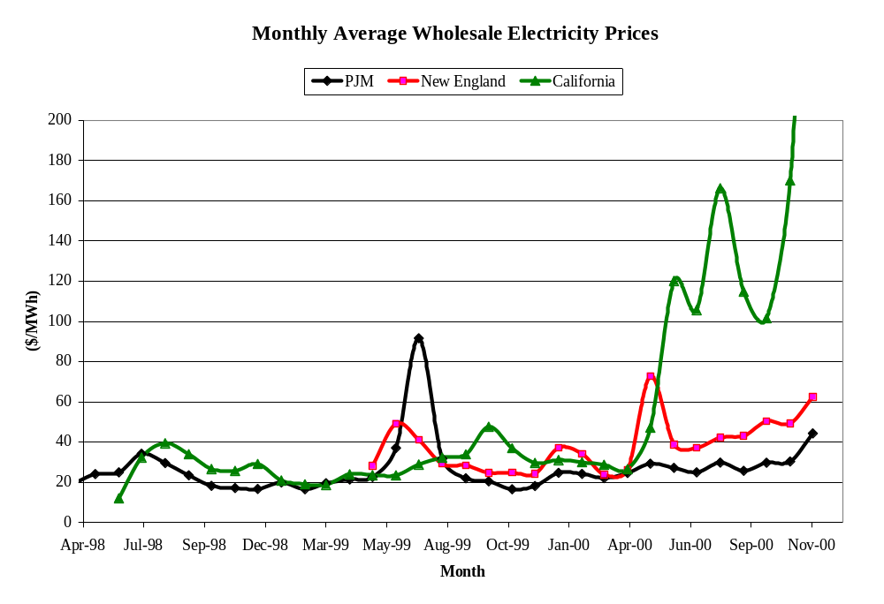

Slide 9
Market Power
Market power is the ability to raise prices above marginal costs
It exists in a lot of industries
  although a lot of commodity markets are perfectly competitive
Unilateral market power is not illegal (in U.S.)
Electricity markets are particularly vulnerable
  lack of storage,
  binding capacity limits,
  lack of price-responsive demand
It does not require near scarcity or collusion to exist
  Lerner Index (p-mc)/p ~ θ /(nε)

Slide 10
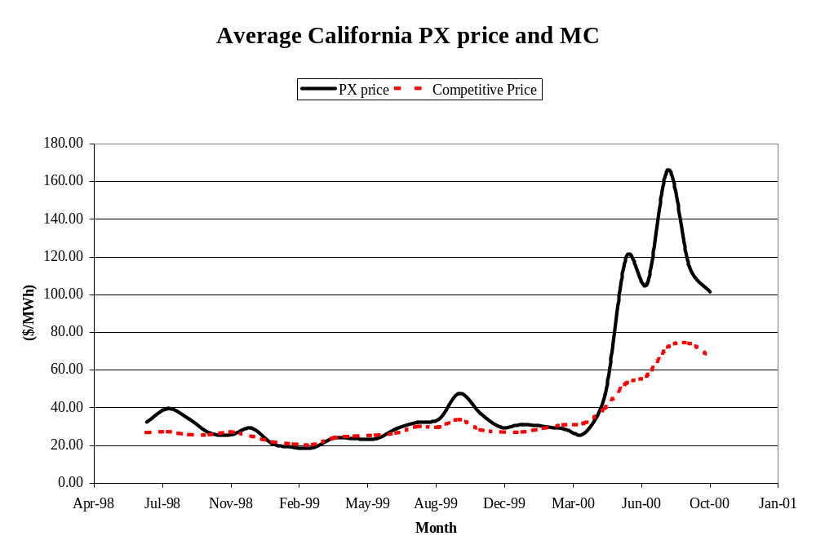

Slide 11
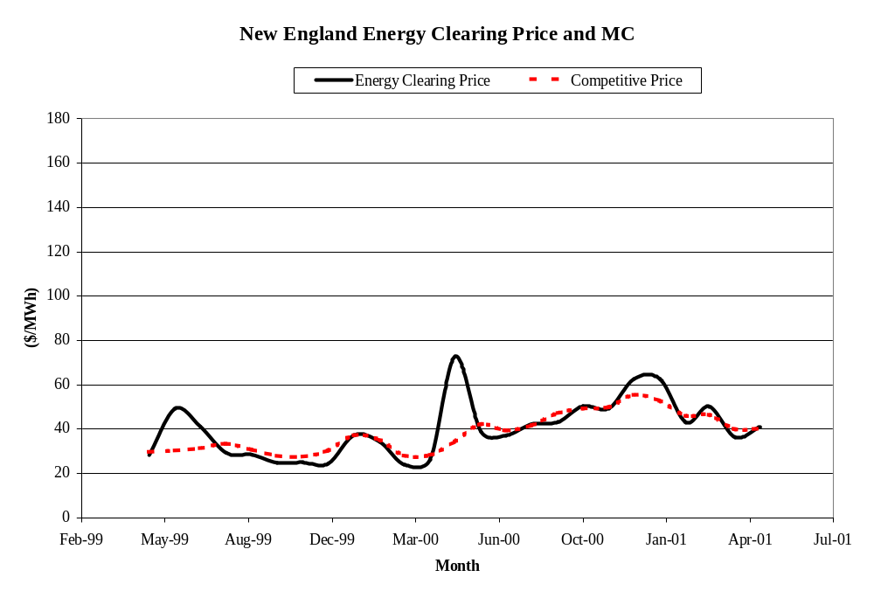

Slide 12
Measuring Relative Demand
Is California producing higher margins because of `tight’ capacity conditions?
How to compare market tightness?
Residual Demand - demand net of
  imports
  hydro & nuclear
  very small thermal, renewables, cogeneration
Residual Capacity - capacity of large fossil-fired generation within the ISO system

Slide 13
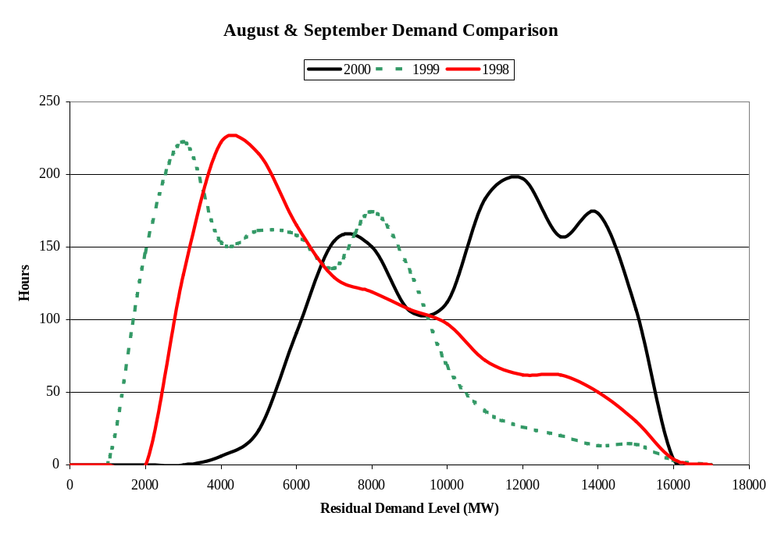

Slide 14
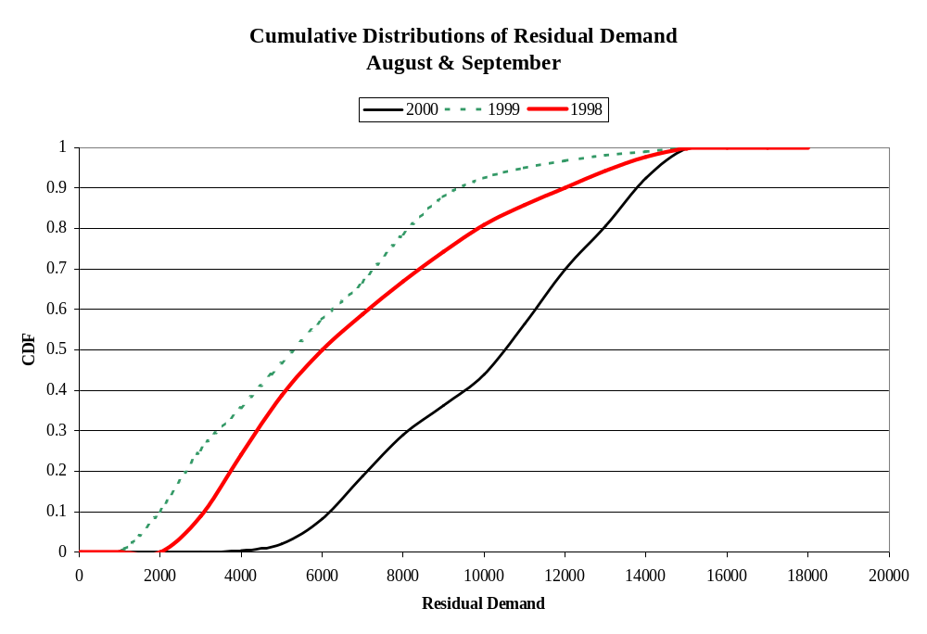

Slide 15
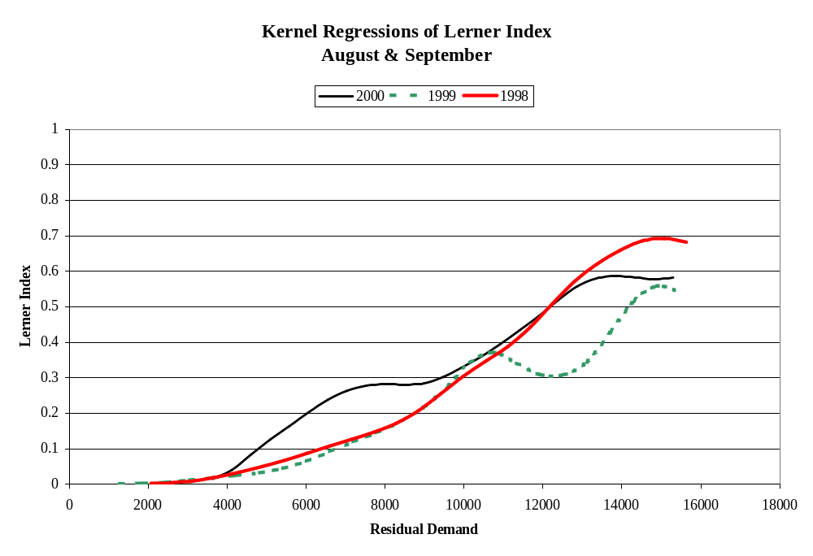

Slide 16
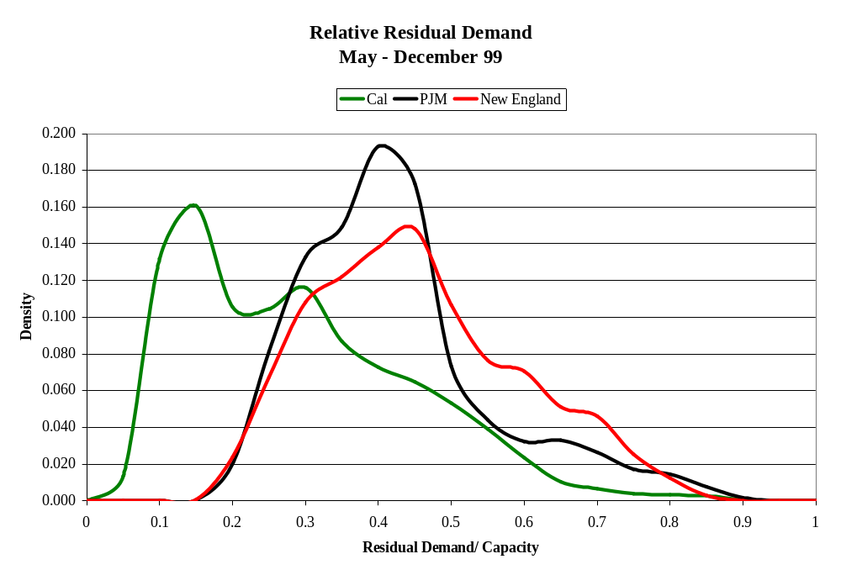

Slide 17
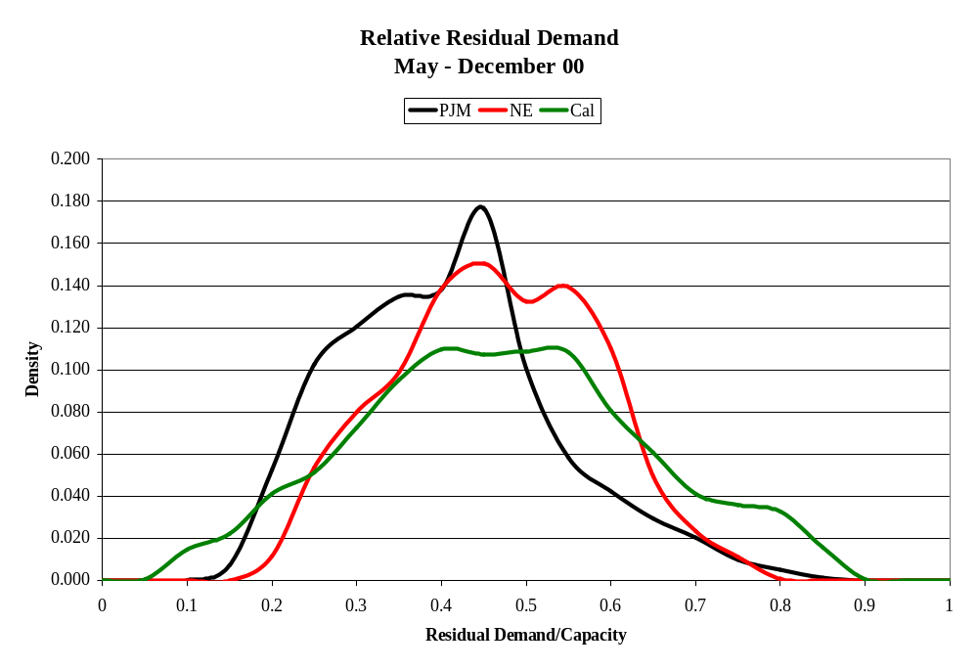

Slide 18
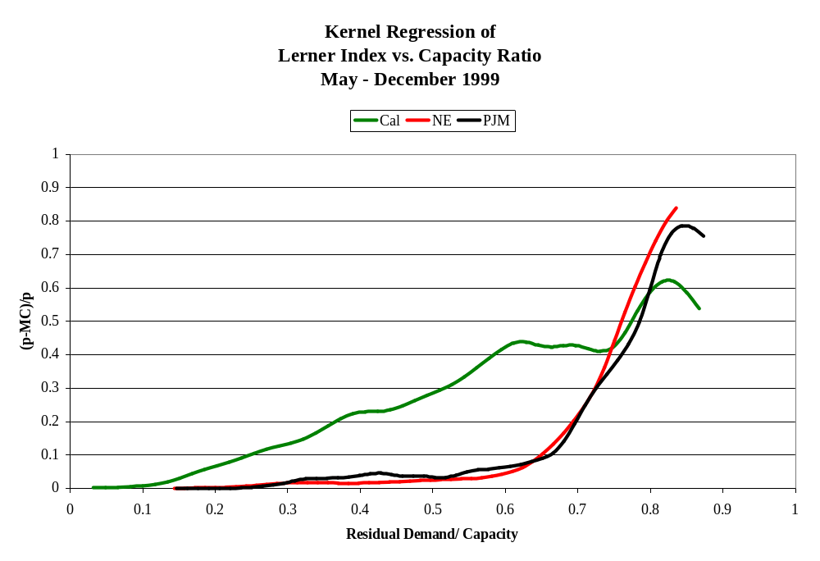

Slide 19
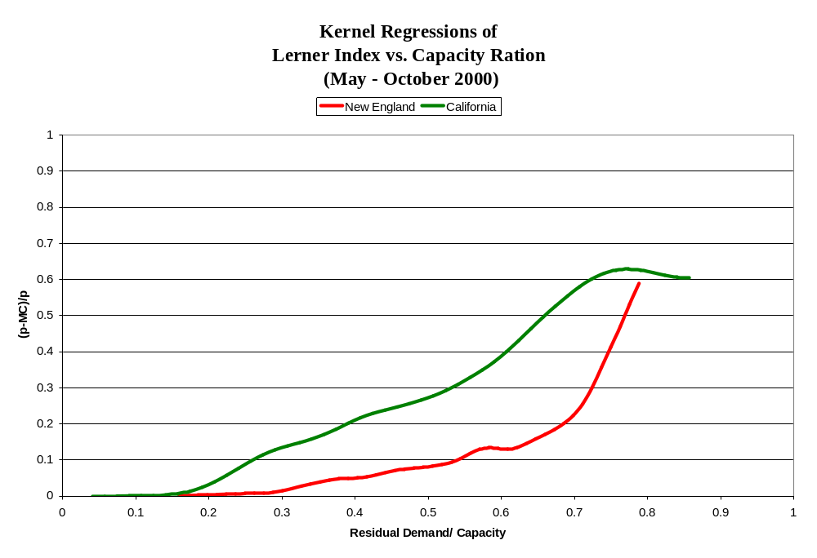

Slide 20
What we do know
Electricity markets are vulnerable to market power
  collusion not necessary to create large transfers
Eastern markets have experienced less market power than California
  at least when markets are not highly capacity constrained
The higher market power in California does not appear to be due to `tighter’ markets
  the dollar consequences of that market power are
Transmission pricing methods do not explain these differences
  New England (1 zone) and PJM (4000 zones) perform comparably, California (23 zones) does worse

Slide 21
What We Don’t Know
Why did the eastern markets do better?
  Mix of generation technologies?
  More vertical integration & buy-back contracts?
  Tougher market power mitigation measures?
  Market design?
How have the markets performed according to other standards?
  Costs of transmission congestion?
  Efficiency of operations (& reserves)?
  Environmental consequences?
  Investment environment?
What’s the best market standard?
Is restructuring a good idea?

