Slide 1
Analysis of Agriculture and Mining Sectors in the Southwest United States
Anna Monis Shipley
R. Neal Elliott
American Council for an Energy-Efficient Economy
March 2002

Slide 2
The Southwest Region - Is it Unique?
Region is comprised of: Arizona, Colorado, Nevada, New Mexico, Utah, Wyoming
Highest rate of population growth and economic growth in the U.S.
Larger share of agriculture and mining than U.S average

Slide 3
The Southwest Region - Is it Unique? (continued)
Large diversity in the manufacturing sector
Initiatives such as the National Border Technology Partnership have been set up to alleviate environmental problems in the region and promote energy-efficient growth in the region.

Slide 4
Industry Sector Data Sources
1997 Census of Agriculture - U.S. Department of the Census
1997 Economic Census, Mining
1999* Minerals Yearbook - Produced under a M.O.M. between U.S. Geological Survey and the various state Geological Surveys
1997 Census of Manufacturers
1998 Manufacturing Energy Consumption Survey
^{* Based on 1997 Data}

Slide 5
Data Gaps and Assumptions
Many of the manufacturing sectors in the Southwest region are comprised of either a small number of facilities or companies.
The 1997 Economic Census had several significant data gaps in the Mining sector - alternate data sources such as the Minerals Yearbook and Economy.com data were utilized.

Slide 6
Economic Growth and Activity Data
Sector-specific economic growth data not publicly available on a state-by-state basis.
Data on projected GDP growth was purchased for a reasonable fee from Economy.com

Slide 7
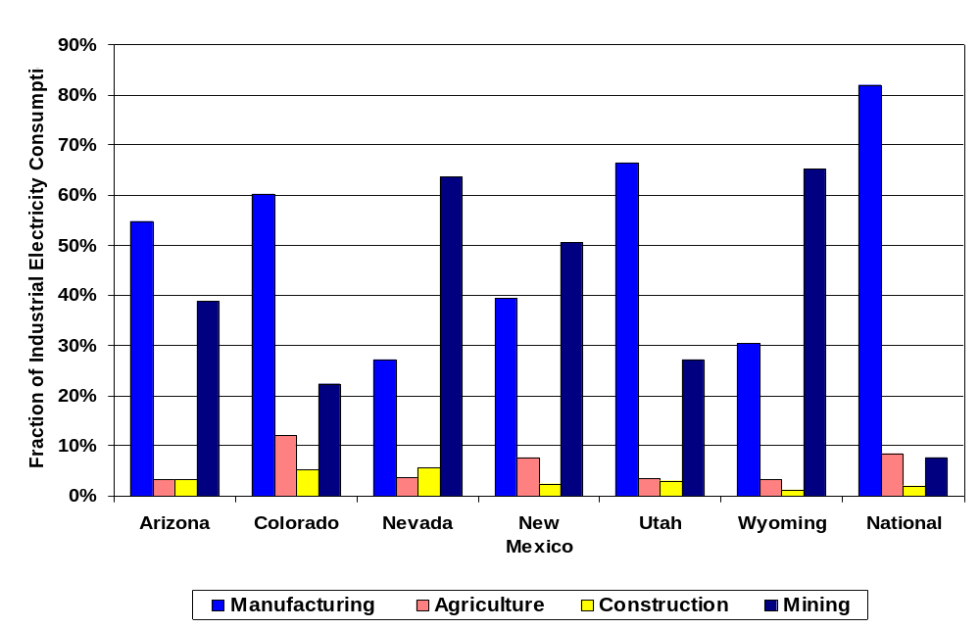
Percentage State of Electricity Use by Sector

Slide 8
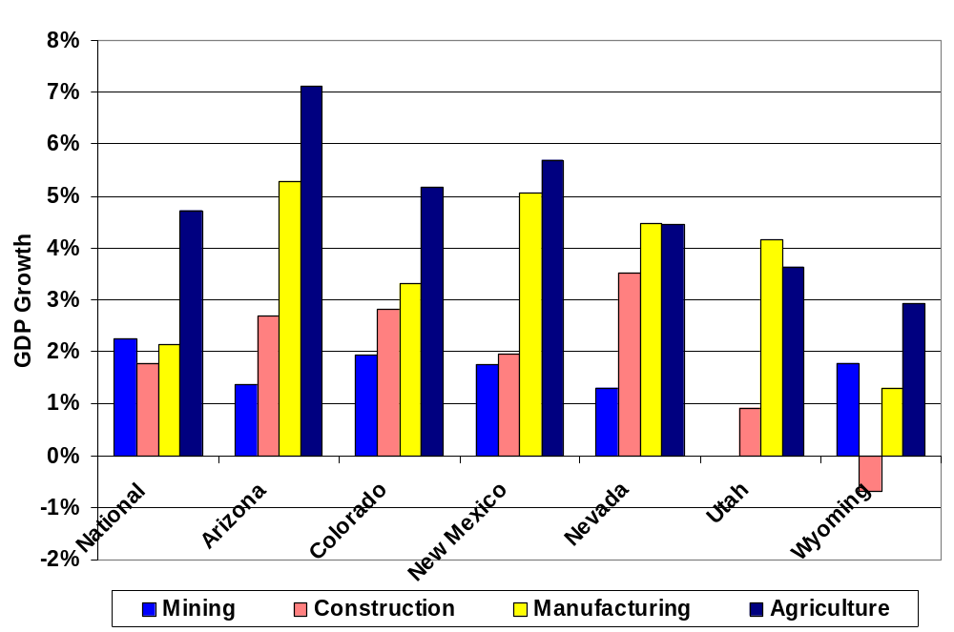
State and National Manufacturing Sector 2000-2020 Economic Growth Projections

Slide 9
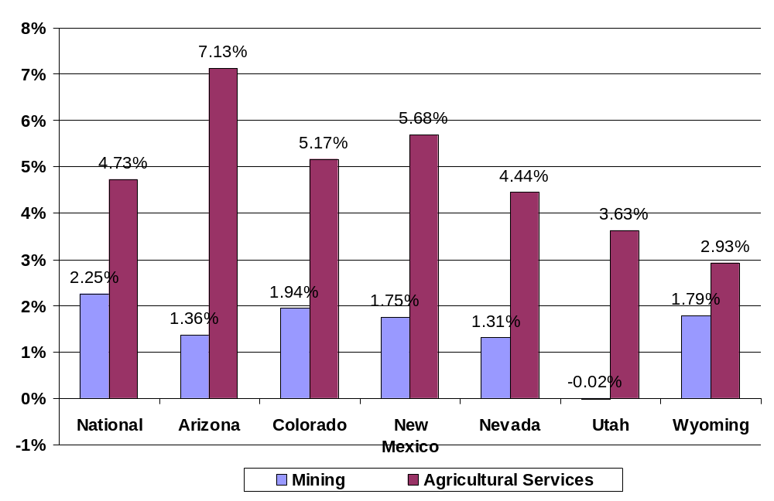
State and National Industrial Sector 2000-2020 Economic Growth Projections

Slide 10
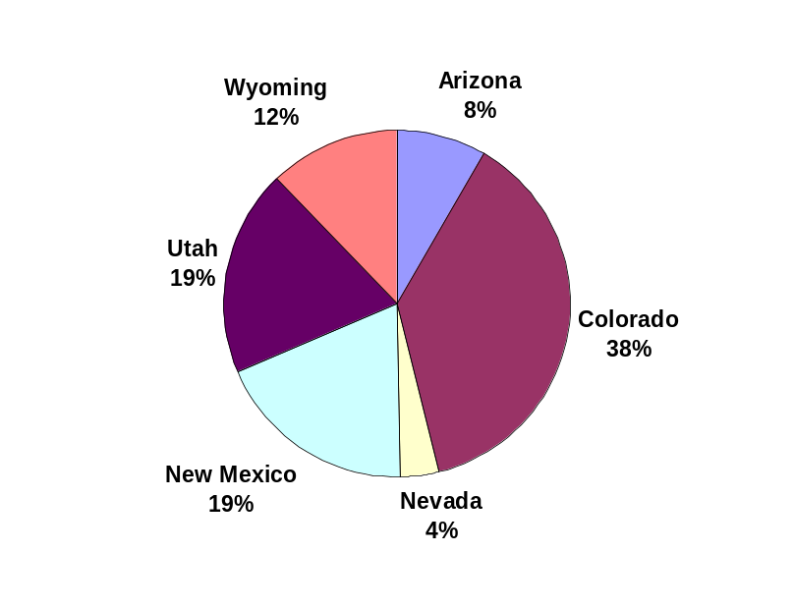
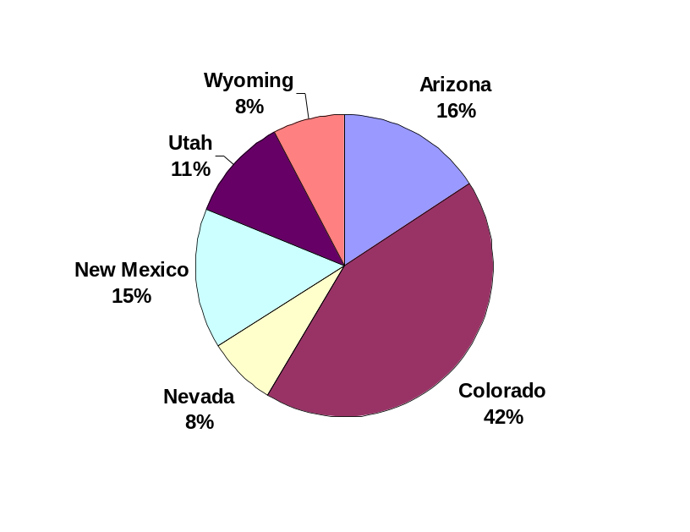
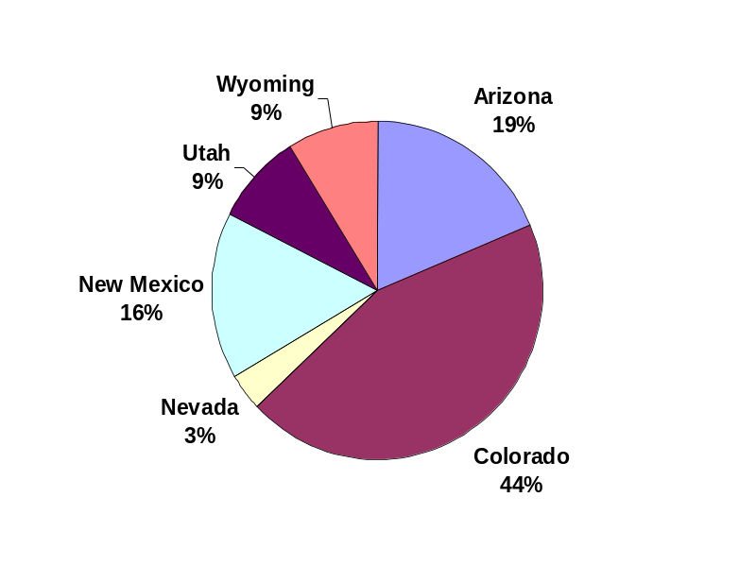
Characterization of Agriculture Sector in the Region
Total Farms
Electricity Consumption
Value of Shipments

Slide 11
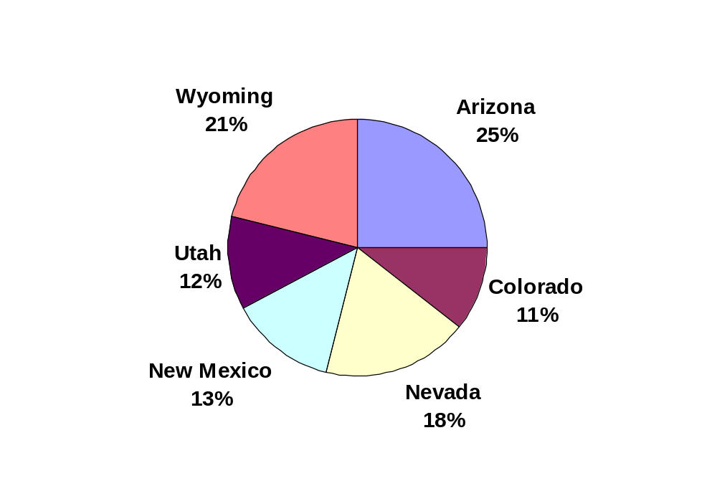
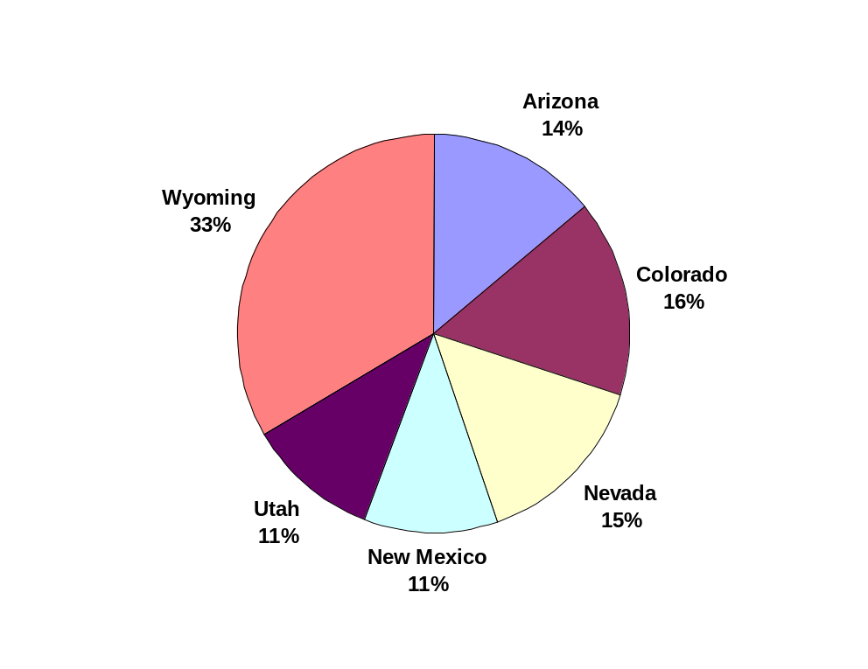
Characterization of Mining Sector in the Region
Value of Shipments
Electricity Consumption

Slide 12
End-Use Electricity Consumption
Mining Sector - approximately 90% of the electricity use in the sector is used to power electric motors.
Agricultural Sector - approximately 40% of the electricity use in the sector is used to power electric motors, 30% for lighting, and 30 percent other (heating, etc.)

Slide 13
Findings
Economic growth rates in the mining sector generally mirror the national average - a large portion of the existing U.S. mineral and metals mining industry is located in the region
Agriculture economic growth rates are significantly higher than the national average in Arizona, New Mexico, and Colorado - this could pose future natural resource issues (especially water)

Slide 14
Energy-Efficiency Opportunities
Motors Systems - (especially in mining) efficient motors, improved system design
Lighting - (especially in agriculture) advanced lighting design, efficient fixtures

Slide 15
Where to Find the Data
State-by-State Economic Census of Mining - http://www.census.gov/epcd/www/97EC21.HTM
State-by-State Census of Agriculture - http://www.nass.usda.gov/census/census97/volume1/vol1pubs.htm
State-by-State Minerals Yearbook - http://minerals.usgs.gov/minerals/pubs/state/

