Slide 1

Biomass for Electricity Generation in NEMS
Zia Haq
Office of Integrated Analysis and Forecasting
Energy Information Administration
March 12, 2002

Slide 2
Presentation Outline
Introduction
  Present assumptions and methodology for the biomass forecast in NEMS
  Why are biomass supplies of concern?
Modeling inputs and methodology for forecast
  Capital cost
  Supply schedules
  Conversion technology
Forecasts - Reference case, high renewables case, 20% RPS case
Conclusions

Slide 3
Why Are Biomass Supplies of Concern?
AEO2002 reference case: adequate supplies to meet demand
AEO2002 High renewables case: demand higher due to increased supply assumptions
20% RPS study: aggressive demand for biomass due to assumption of nationally mandated RPS provision, supply could be constraining
Can biomass substitute for fossil fuels on a very large scale in environmental cases?
  Uncertainty of available quantities at high prices
  Price impacts of large-scale use of biomass

Slide 4
Biomass Utilization in NEMS
Industrial cogeneration
Agricultural residues
Dedicated biomass
Electric utility
Energy crops
Biomass cofiring
Biomass supply schedule
Total demand
Ethanol from cellulose
Forestry residues
Transportation
Ethanol from corn
Urban wood waste/mill residues
Residential
Sectors interacting with the biomass supply schedule
Commercial

Slide 5
Modeling Assumptions and Methodology for Forecasts
Capital costs
Biomass supply schedule
Transportation cost
Biomass conversion technologies in NEMS
Assumptions regarding carbon taxes, Production Tax Credit, Renewable Portfolio Standards

Slide 6
Biomass* Capital Cost Assumptions in NEMS
Attribute | Value
On-line year | 2005
Unit size | 100 MW
Construction lead time | 4 years
Overnight cost (2000$) | $1,536/kW
Contingency factor | 1.07
Technological optimism | 1.05
Total cost – 2000 | $1,725/kW
Total cost – 2020 | $1,303/kW
* Defined as biomass gasification and combined cycle

Slide 7
Overnight Capital Costs and Capacity Factors in AEO2002
Technology Type | Capital cost (2000$/kW) | Maximum capacity factor (%)
Conventional combustion turbine | 339 | 92
Advanced combustion turbine | 474 | 92
Generic distributed generation – peak | 559 | 5
Generic distributed generation – base | 623 | 50
Wind | 982 | 39
Conventional pulverized coal | 1,119 | 85
Integrated gasification combined cycle (coal) | 1,338 | 85
MSW/Landfill gas | 1,429 | 90
Biomass gasification combined cycle | 1,725 | 80
Geothermal | 1,746 | 95
Fuel cells | 2,091 | 87
Advanced nuclear | 2,144 | 90
Solar thermal | 2,539 | 42
Photovoltaic (central station) | 3,831 | 30
Reference case, for new plants initiated in 2001

Slide 8
Supply Schedule Components
Forest products: salvageable dead wood, logging residues, and excess polewood
Urban wood waste and mill residues: mill residues, urban wood waste, and construction and demolition debris
Agricultural residue: wheat straw and corn stover
Energy crops: switchgrass, hybrid poplar, and willow
(available from 2010)

Slide 9
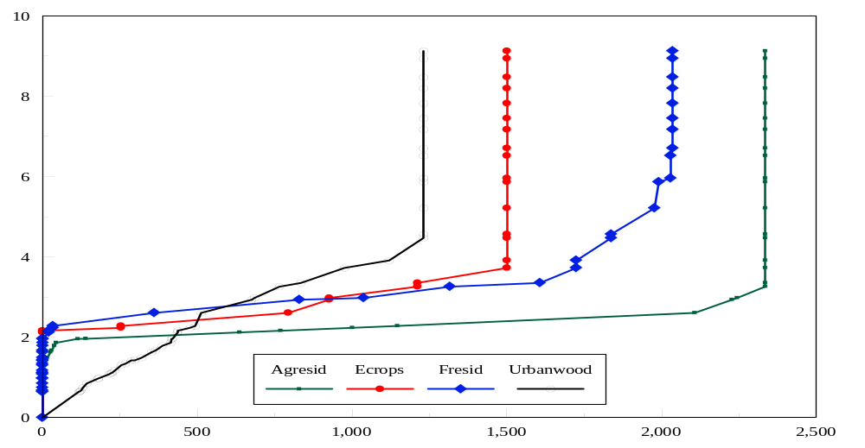
Biomass Supply Schedule, 2020
Price (2000$/MMBtu)
Quantity (Trillion Btu)

Slide 10
Transportation Cost
Transportation cost included in all feedstock types and therefore supply curve represents delivered price (farm-gate + transportation)
Urban wood waste and mill residues transportation cost: $0.24/ton-mile, maximum supply distance 100 mile radius
Forest residues, agricultural residues, energy crops transportation cost: $10/ton, maximum supply distance 50 mile radius
No biomass is transported across EMM regions
In future, capability to transport biomass across regions could be included for sensitivity cases

Slide 11
Conversion Technologies
Dedicated biomass: biomass integrated gasification combined cycle (BIGCC) - Hot gas filtration is assumed
Biomass co-firing with coal
  Up to 5% on heat-input basis allowed depending on resource availability
  No capital cost or O&M cost penalty
  Retrofit existing coal plants
  Modification planned to allow more biomass for additional capital and O&M costs
Industrial cogeneration

Slide 12
Capacity History and Forecasts (GW)
Sector | 2000 | 2020
 |  | AEO2002 Reference Case | AEO2002 High Renewables case | 20% RPS case
Electric generators* | 1.39 | 1.97 | 2.09 | 61.41
Industrial cogenerators | 5.26 | 8.43 | 10.21 | 8.44
Biomass capacity | 6.65 | 10.40 | 12.30 | 69.85
Total installed capacity** | 808 | 1,136 | 1,147 | 1,205
* Dedicated biomass only, no biomass cofiring
** Includes electric generators and cogenerators
AEO2002 reference case: aeo2002.d102301a, AEO2002 high renewables case: hirenew02.d102300a, 20% RPS: rps20.d011702b

Slide 13
Generation History and Forecasts
(Billion kWh)
Sector | 2000 | 2020
 |  | AEO2002 Reference Case | AEO2002 High Renewables Case | 20% RPS Case
Dedicated biomass | 7.46 | 11.25 | 12.09 | 408.1
Biomass cofiring | 0.91 | 4.07 | 3.97 | 67.69
Electric generators* | 8.37 | 15.32 | 16.06 | 475.8
Industrial cogeneration | 29.63 | 48.99 | 59.92 | 49.06
Biomass generation** | 38.00 | 64.31 | 75.98 | 524.9
Total generation*** | 3,841 | 5,471 | 5,474 | 5,434
* Electric generators = Dedicated biomass + biomass cofiring
** Biomass generation = Electric generators + industrial cogeneration
*** Includes electric generators and cogenerators
AEO2002 reference case: aeo2002.d102301a, AEO2002 high renewables case: hirenew02.d102300a, 20% RPS: rps20.d011702b

Slide 14
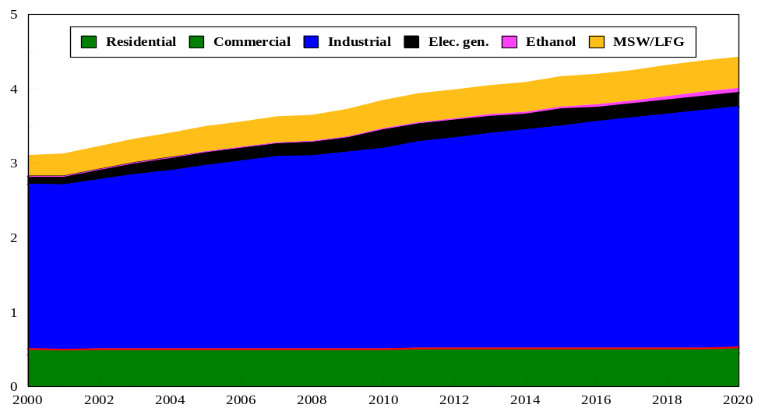
Consumption Forecast by Sector,
AEO2002 Reference Case
Consumption (Quads)
AEO2002 reference case: aeo2002.d102301a

Slide 15
Consumption Under Different Scenarios
 | Biomass consumption, 2020 (Quads) | Maximum available biomass* (Quads)
AEO2002 reference case | 3.48 | 8.28
AEO2002 high renewables case | 4.13 | 9.10
20% RPS case | 7.67 | 8.28
* At greater than $7/MMBtu (2000$)
Biomass consumption = Dedicated biomass + cofiring + industrial cogeneration + cellulosic ethanol
AEO2002 reference case: aeo2002.d102301a, AEO2002 high renewables case: hirenew02.d102300a, 20% RPS: rps20.d011702b

Slide 16
Supply Curve Uncertainties
Competing uses of biomass – mulch market
Agricultural waste: Impact of biomass removal on soil quality
Forestry residues: Impact of changes in fire prevention policies
Urban wood waste/mill residues: Impact of increasing quantities of recycling
Energy crops: Competing uses of land (commodity crops versus energy crops)

Slide 17
Conclusions
Maximum of 590 million (wet) tons of biomass available in 2020
AEO2002 reference case capacity grows from 6.6 GW in 2000 to 10.4 GW by 2020
AEO2002 high renewables case capacity grows to 12.3 GW by 2020
20% RPS case capacity grows to 69.8 GW by 2020

