Slide 1
Latest Measured Data on Data Center Power Use in the U.S.
Jonathan Koomey, Ph.D.
Lawrence Berkeley National Laboratory
JGKoomey@lbl.gov, 510/486-5974, http://enduse.lbl.gov/
For more details on the analysis discussed here, go to
http://N4E.LBL.gov
Download: http://enduse.lbl.gov/shareddata/datacenterstalk020312.ppt
To be presented at the 2002 NEMS conference
March 12, 2002
Notes:
1

Slide 2
Background
_x0008_The Internet Begins with Coal, was published in Forbes in May 1999. Results were widely cited and have become conventional wisdom
  Internet = 8% of all electricity use
  All office equipment = 13% of all electricity use
  Total projected to grow to 50% of all electricity use in 10-20 years
These numbers are incorrect, but their prominence has prompted much research.

Slide 3
Mills’ electricity “used by the internet in 1999”, corrected by LBNL
TWh per year

Slide 4
Data centers/server hotels
_x0008_Some utilities receiving requests for tens to hundreds of MW of power from proposed data centers
Estimates for power use almost certainly too large
  One facility maximum = 90 W/sf, actual <40W/sf.
  Another facility claimed 65 W/sf, but floor area defined incorrectly to exclude aisles and other common areas, leading to an overestimate of power use (this definition is critical)
  Still another facility took direct server load and multiplied by three (!) to account for cooling, lighting, and other uses

Slide 5
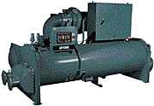
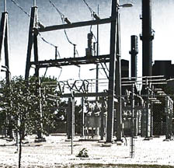
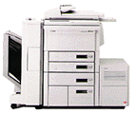
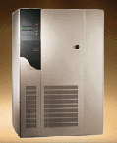
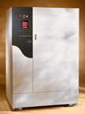
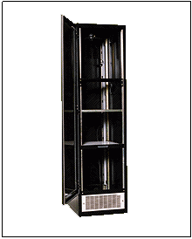

Electricity Flows in Data Centers
HVAC system
local distribution lines
lights, office space, etc.
uninterruptible
load
to the building, 480 V
computer
equipment
UPS
PDU
computer racks
backup diesel generators

Slide 6
Defining metrics for data centers
Power Loads
(in watts)
Footprint
(in square feet)
W/ft²
computer
equipment
(e.g., server)
computers
one rack
(e.g., rack of servers)
HVAC (in data center
and for whole facility)
Data center designers, media
all racks
mechanical equipment
excluding HVAC (e.g.,
UPS, PDU)
all core data
center space
(net floor space)
lights (in data center
and for whole facility)
Utilities
single data center
floor within a
multipurpose
office building
other (e.g., copiers
and faxs in office space)
whole building
(gross floor space)
total power load

Slide 7
Results from one data center based on measured data
(1) Source: Mitchell-Jackson, Jennifer. 2001. Energy Needs in an Internet Economy: A Closer Look at Data Centers. M.S. Thesis, Energy and Resources Group, University of California, Berkeley. http://enduse.lbl.gov/projects/infotech.html
Contact: JGKoomey@lbl.gov, 510/486-5974.

Slide 8
Total computer room power densities based on billing data
(1) Source: Mitchell-Jackson, Jennifer. 2001. Energy Needs in an Internet Economy: A Closer Look at Data Centers. M.S. Thesis, Energy and Resources Group, University of California, Berkeley. http://enduse.lbl.gov/projects/infotech.html
(2) Data are for server hosting facilities and are not necessarily representative of corporate data centers. Power use includes all HVAC and auxiliary equipment.
Contact: JGKoomey@lbl.gov, 510/486-5974.

Slide 9
Electricity used by hosting-type data centers in the U.S
(1) Source: Mitchell-Jackson, Jennifer. 2001. Energy Needs in an Internet Economy: A Closer Look at Data Centers. M.S. Thesis, Energy and Resources Group, University of California, Berkeley. http://enduse.lbl.gov/projects/infotech.html
(2) Power density estimates ignore the possibility that server loads are shifted from existing installations and are not new loads.
(3) Electricity use calculated assuming 8760 hours per year operation, flat load curve.
(4) Total U.S. electricity use taken from EIA’s Annual Energy Outlook 2001.
Contact: JGKoomey@lbl.gov, 510/486-5974.

Slide 10
Publications
Article summarizing latest estimates of power used by office equipment in Energy--The International Journal, vol. 27 (3) pp. 255-269.
Article summarizing latest estimates of power used by a specific South Bay data center under review by Energy--The International Journal.
Article summarizing latest estimates of aggregate power used by data centers to appear in a special issue of Resources, Conservation, and Recycling.

Slide 11
Future work
Working with Uptime institute to compile data on power used by corporate data centers.
Seeking more accurate data on floor area of hosting and corporate data centers.
Collecting data on measured consumption of all different types of office equipment for EPA’s Energy Star program.

Slide 12
Conclusions
Misinformation seems to spread more quickly than truth.
Bad data = wrong decisions
Electricity used by computers and network equipment= 3% of U.S. electricity use, not 13%.
Electricity used by data centers is relatively small in the aggregate; in certain cities such centers can be important contributors to load.

Slide 13
Conclusions (continued)
More work needed to estimate floor area for hosting facilities and corporate data centers, given the volatility in the market.
Credible data are urgently needed. Join our network for energy, environment, efficiency, and the information economy (N4E) at http://n4e.lbl.gov

