Slide 1
Reducing CO2 Abatement Costs –
the Importance of Learning by Doing
Alan S. Manne, Stanford University
Richard G. Richels, EPRI
Presented at the NEMS/AEO Conference
Arlington, VA 22202
March 12, 2002
Notes:
1
1

Slide 2
MERGE 4.5
Model has nine regions (5 of which comprise Annex B and 4 of which comprise non Annex B)
For technologies, which benefit from “learning by doing”, costs decrease by 20% for every doubling of capacity (dynamic cost component)
One carbon-free LBD technology for electric and one for nonelectric
There is global diffusion of learning
There is a limit to cost reduction associated with learning by doing (static cost component)
There is an autonomous factor, which contributes to decline in technology costs
There are introduction constraints on new technologies and decline constraints on existing technologies

Slide 3
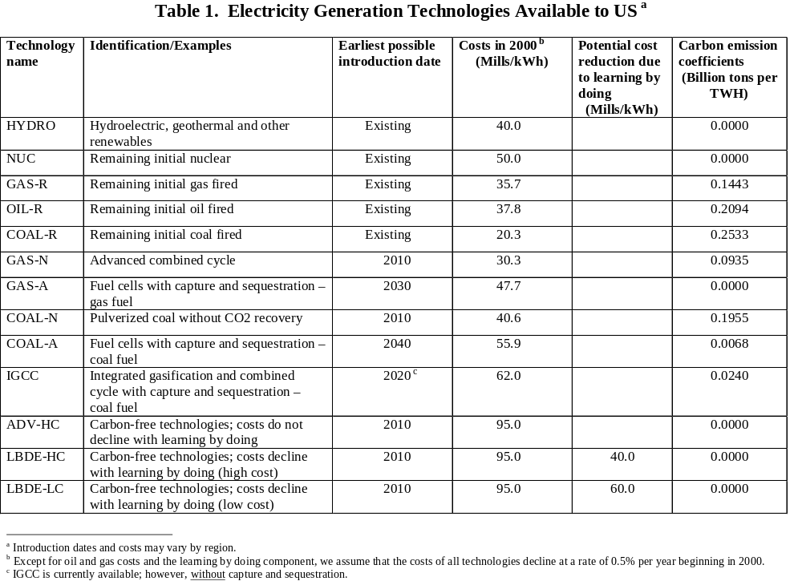

Slide 4
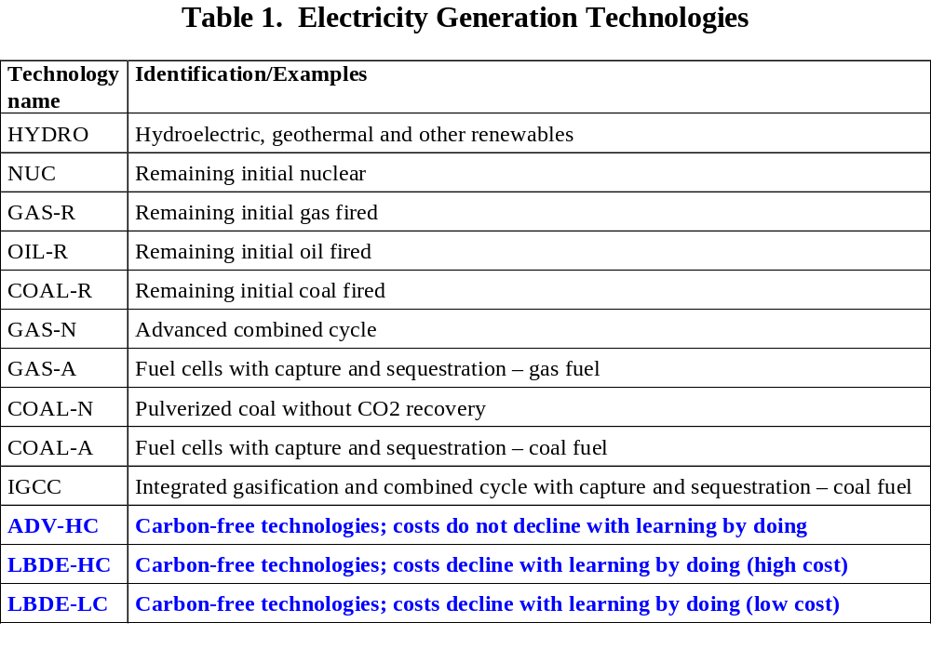

Slide 5
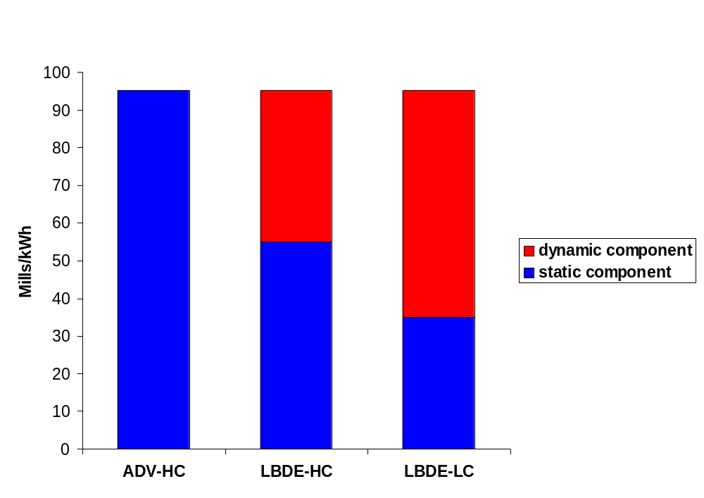
Figure 1. Initial Costs for Carbon-free LBD Technologies in the Electric Sector
Source: A.S. Manne and R.G. Richels “Reducing CO2 Abatement Costs – the Importance of Learning by Doing”

Slide 6
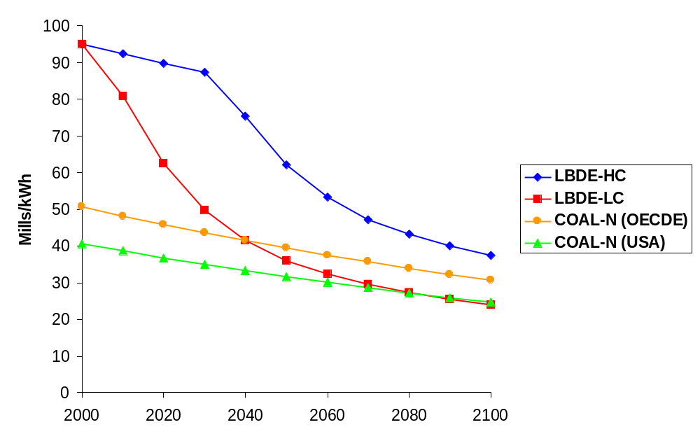
Figure 2. Electricity Generating Costs for Three Technologies in the Absence of a Carbon Constraint
Source: A.S. Manne and R.G. Richels “Reducing CO2 Abatement Costs – the Importance of Learning by Doing”

Slide 7
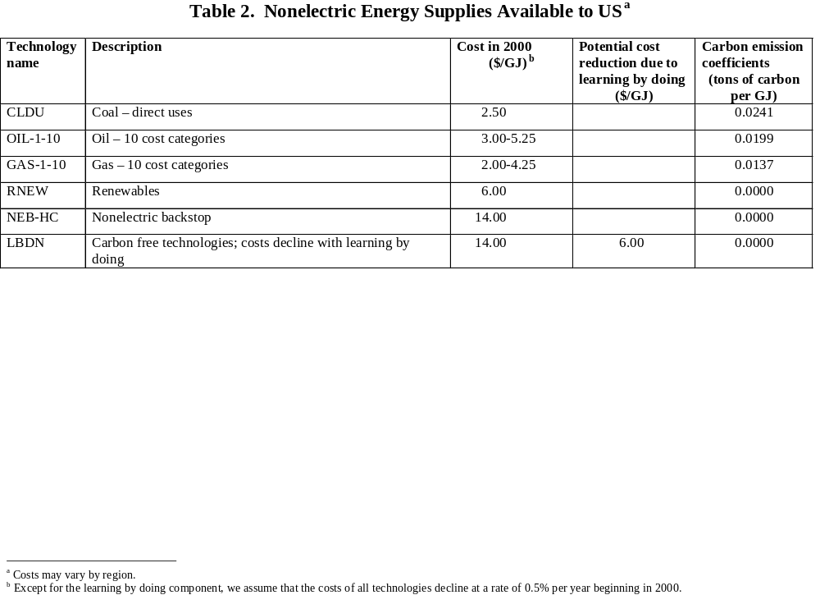

Slide 8
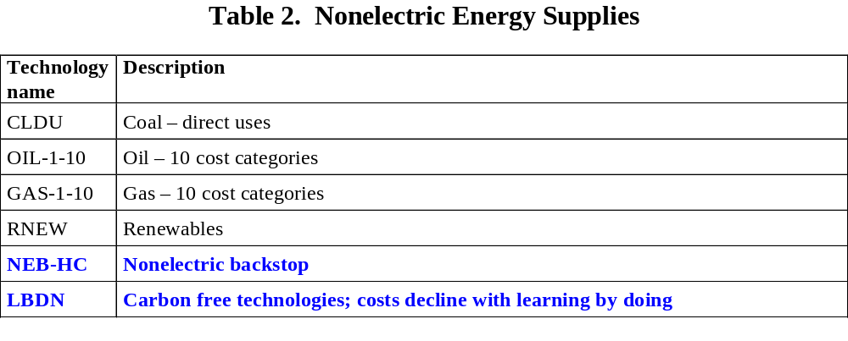

Slide 9
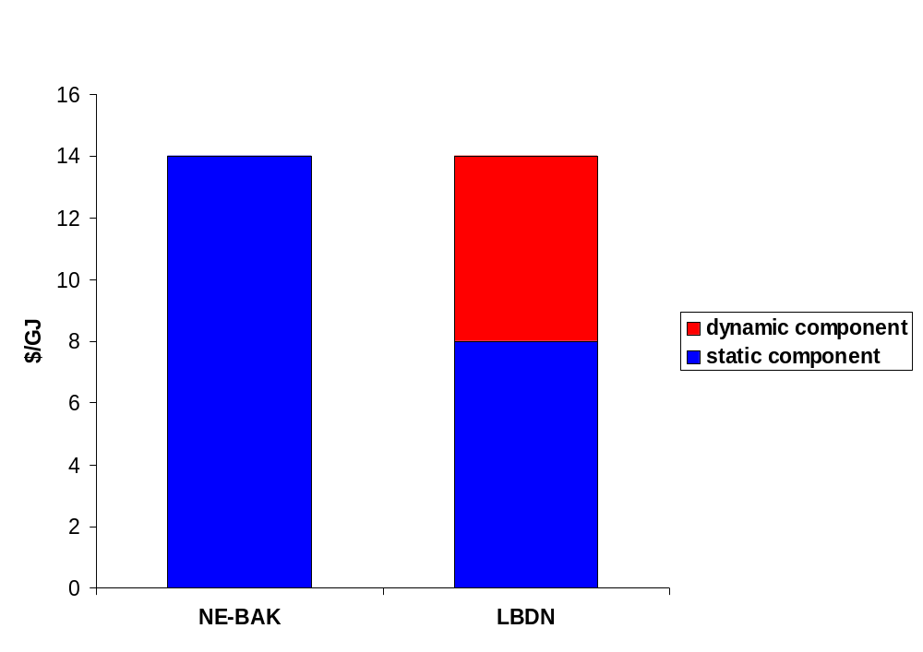
Figure 3. Initial Costs for Carbon-free LBD Technology in the Nonelectric Sector
Source: A.S. Manne and R.G. Richels “Reducing CO2 Abatement Costs – the Importance of Learning by Doing”

Slide 10
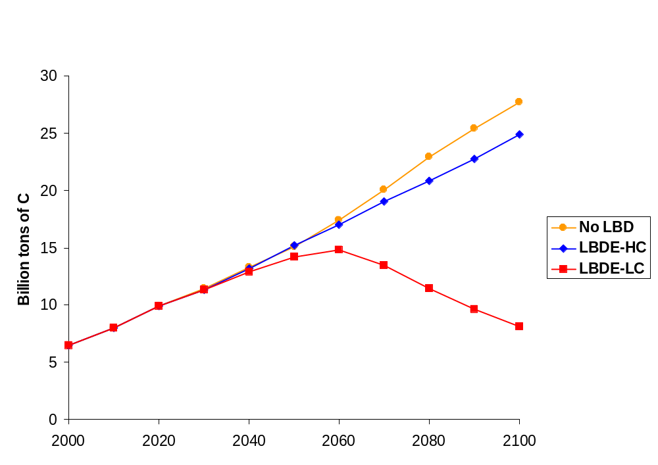
Figure 4. Global Carbon Emissions – no carbon constraints
Source: A.S. Manne and R.G. Richels “Reducing CO2 Abatement Costs – the Importance of Learning by Doing”

Slide 11
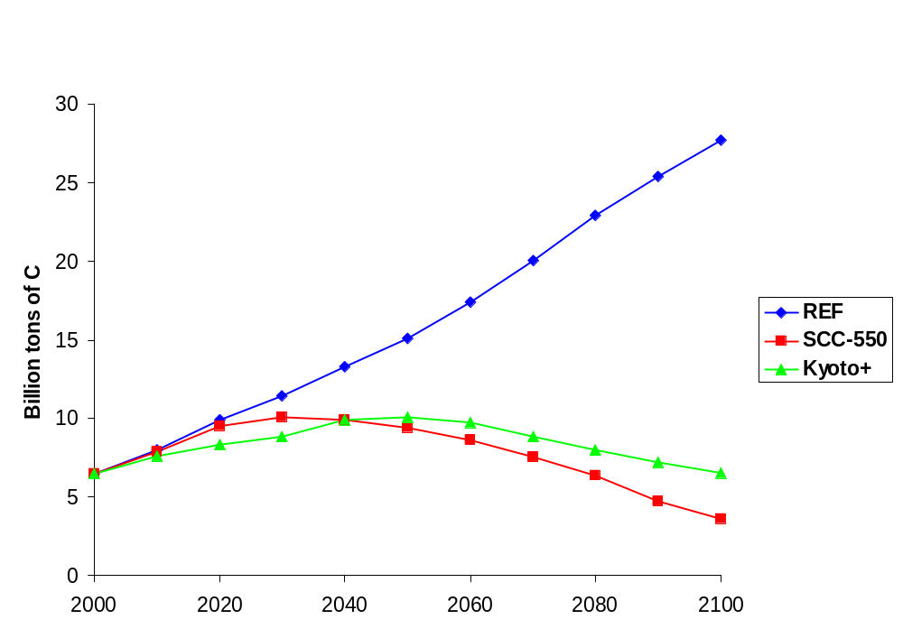
Figure 5. Global Carbon Emissions – reference case and two control scenarios (No LBD)
Source: A.S. Manne and R.G. Richels “Reducing CO2 Abatement Costs – the Importance of Learning by Doing”

Slide 12
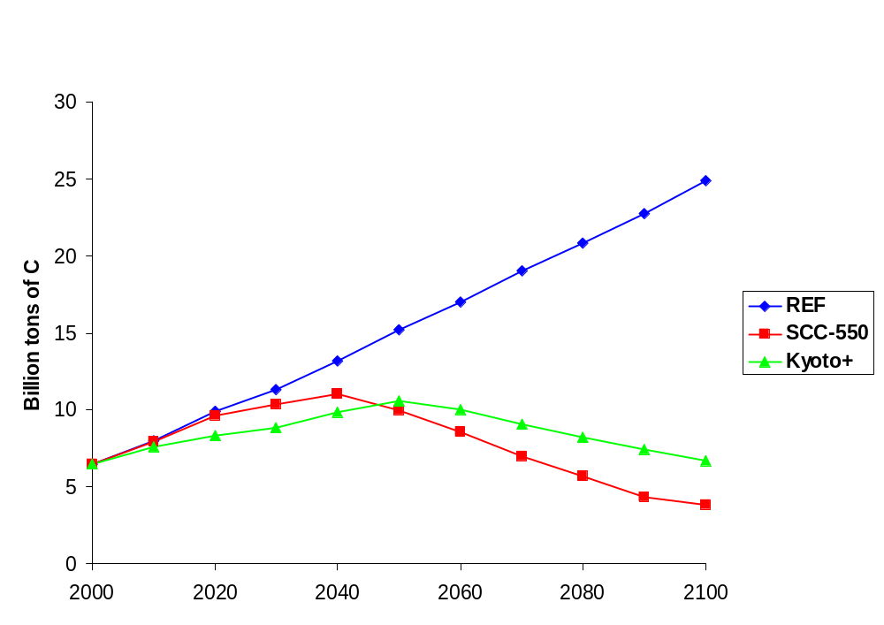
Figure 6. Global Carbon Emissions – reference case and two control scenarios (LBDE-HC)
Source: A.S. Manne and R.G. Richels “Reducing CO2 Abatement Costs – the Importance of Learning by Doing”

Slide 13
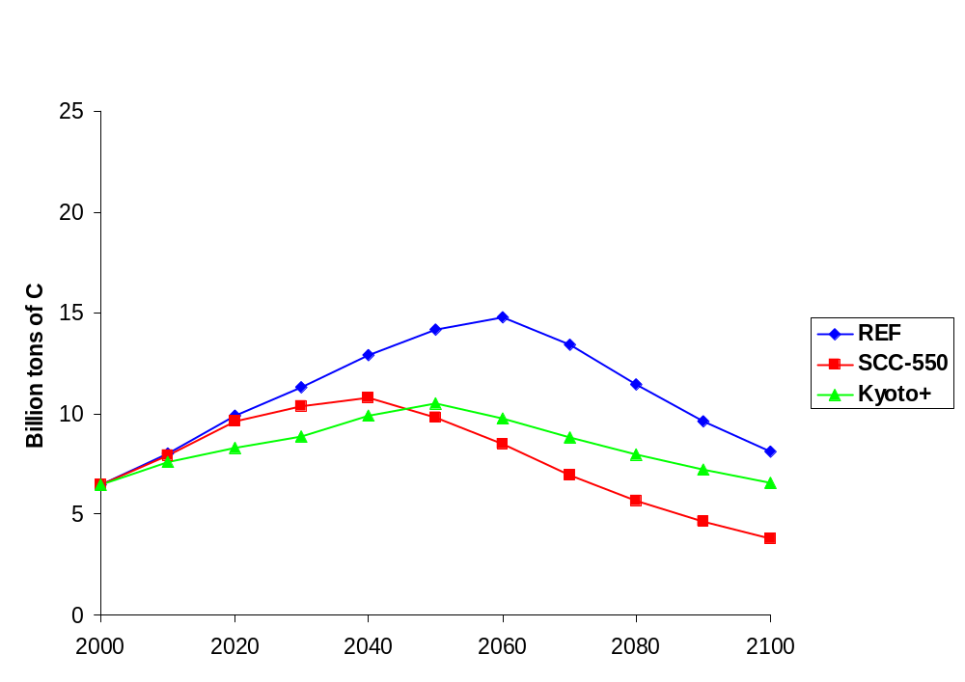
Figure 7. Global Carbon Emissions – reference case and two control scenarios (LBDE-LC)
Source: A.S. Manne and R.G. Richels “Reducing CO2 Abatement Costs – the Importance of Learning by Doing”

Slide 14
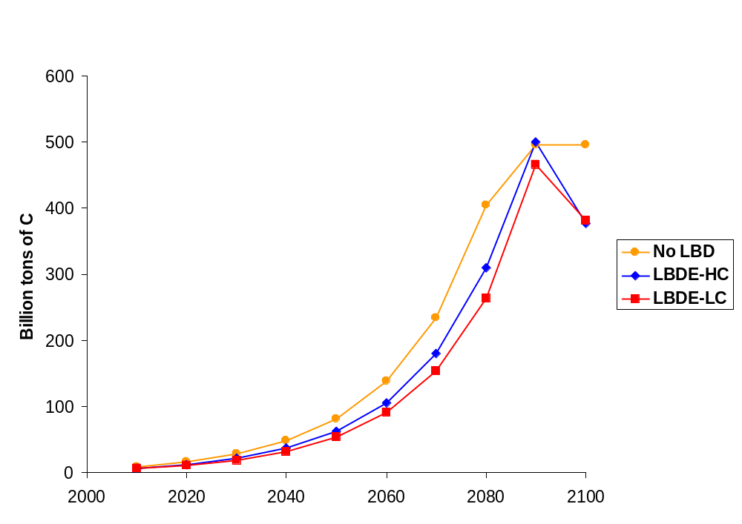
Figure 8. Incremental Value of Carbon Emission Rights
(SCC-550)
Source: A.S. Manne and R.G. Richels “Reducing CO2 Abatement Costs – the Importance of Learning by Doing”

Slide 15
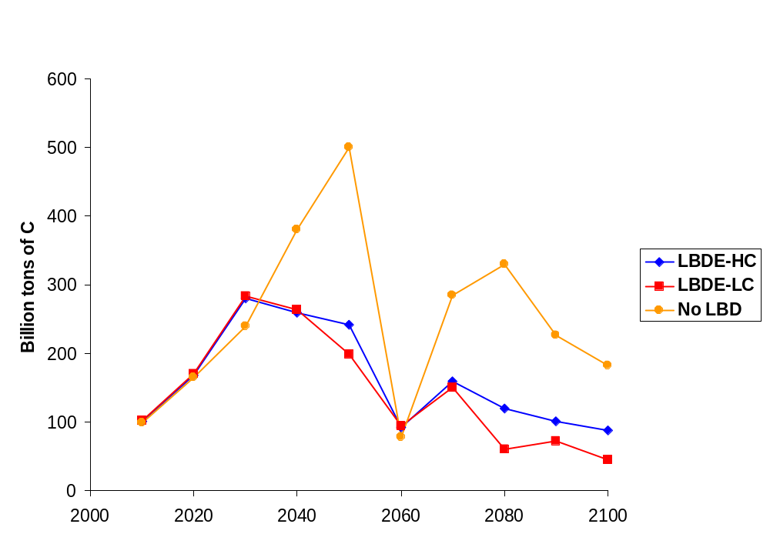
Figure 9. Incremental Value of Carbon Emission Rights
(Kyoto+)
Source: A.S. Manne and R.G. Richels “Reducing CO2 Abatement Costs – the Importance of Learning by Doing”

Slide 16
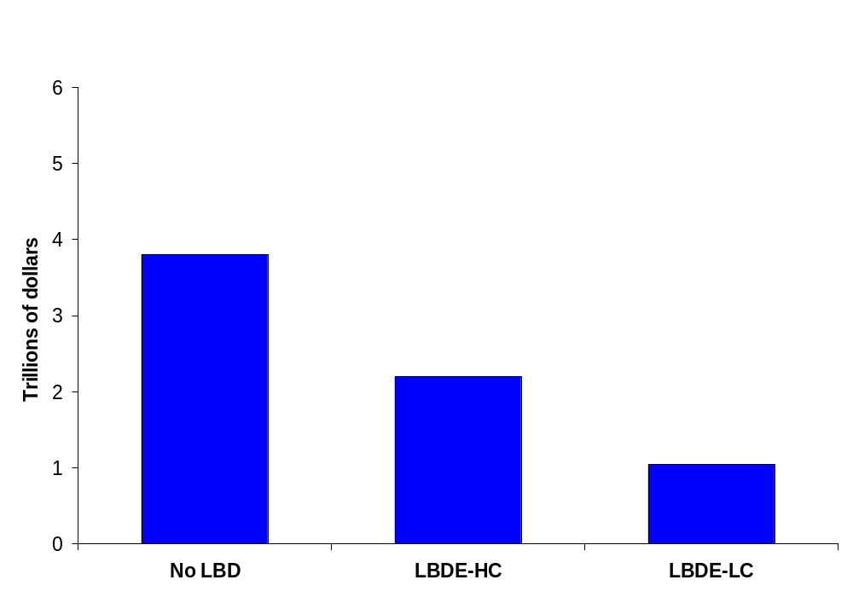
Figure 10. Cumulative Discounted Global Abatement Costs for Stabilizing Concentrations at 550 ppmv – discounted at 5% from 2000-2100
Source: A.S. Manne and R.G. Richels “Reducing CO2 Abatement Costs – the Importance of Learning by Doing”

Slide 17
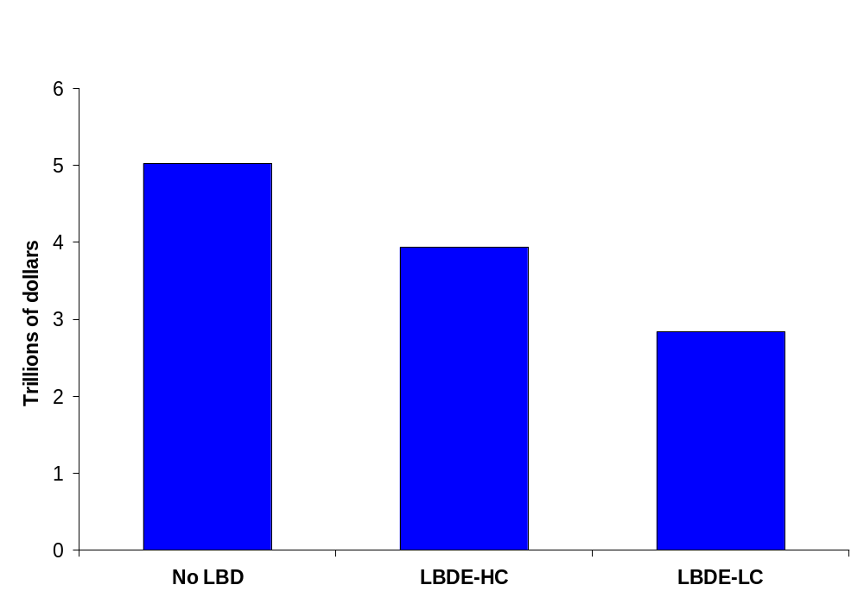
Figure 11. Cumulative Discounted Abatement Costs for Kyoto+ – discounted at 5% from 2000-2100
Source: A.S. Manne and R.G. Richels “Reducing CO2 Abatement Costs – the Importance of Learning by Doing”

Slide 18
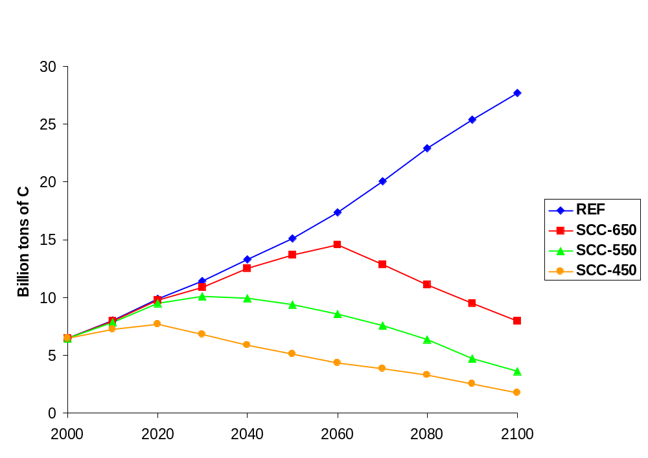
Figure 12. Global Carbon Emissions for Alternative Concentration Limits (No LBD)
Source: A.S. Manne and R.G. Richels “Reducing CO2 Abatement Costs – the Importance of Learning by Doing”

Slide 19
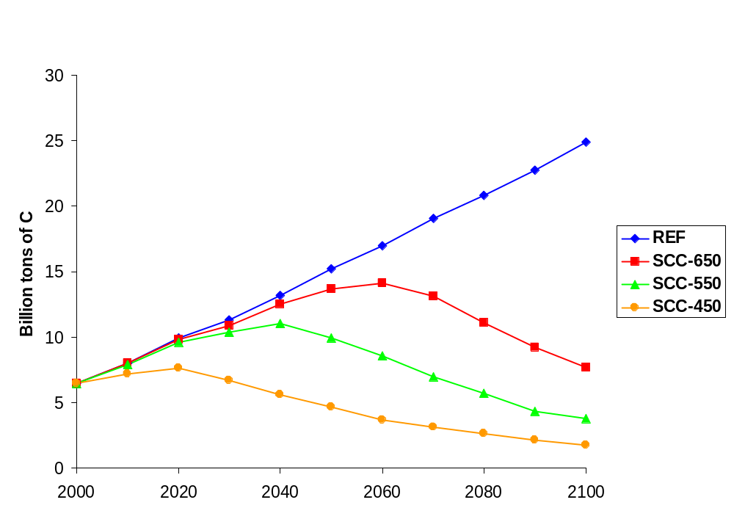
Figure 13. Global Carbon Emissions for Alternative Concentration Limits (LBDE-HC)
Source: A.S. Manne and R.G. Richels “Reducing CO2 Abatement Costs – the Importance of Learning by Doing”

Slide 20
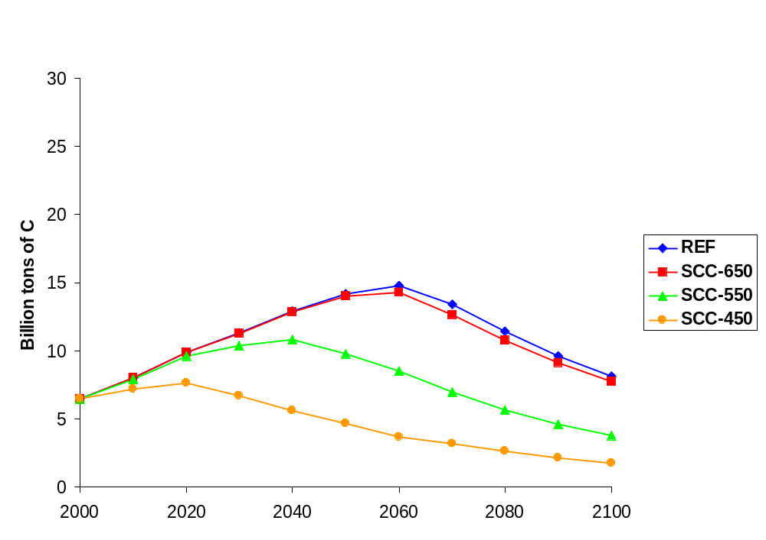
Figure 14. Global Carbon Emissions for Alternative Stabilization Ceilings (LBDE-LC)
Source: A.S. Manne and R.G. Richels “Reducing CO2 Abatement Costs – the Importance of Learning by Doing”

Slide 21
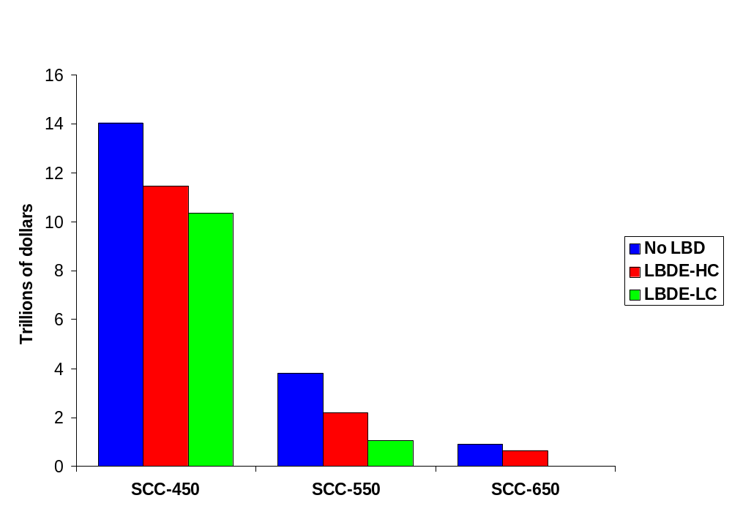
Figure 15. Cumulative Discounted Global Abatement
Costs – discounted at 5% from 2000-2100
Source: A.S. Manne and R.G. Richels “Reducing CO2 Abatement Costs – the Importance of Learning by Doing”

Slide 22
Some Candidates for Sensitivity Analysis
Expansion and decline constraints
Rate of learning
Ultimate costs achievable with learning
Costs of other technologies
Environmental goals

Slide 23
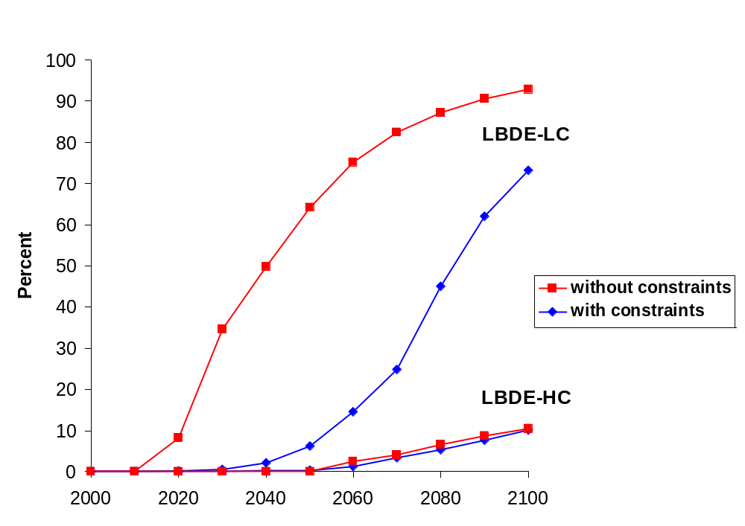
Figure 16. Percent of Global Electricity Generation Supplied by LBDE (with and without expansion constraints)
Source: A.S. Manne and R.G. Richels “Reducing CO2 Abatement Costs – the Importance of Learning by Doing”

Slide 24
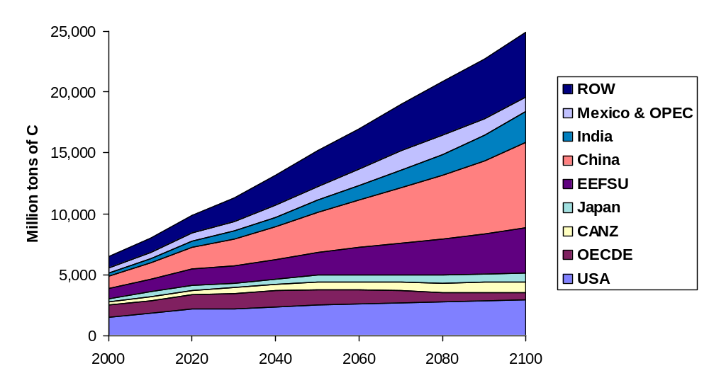
Figure X. Global Carbon Emissions – LBDE-HC
Source: A.S. Manne and R.G. Richels “Reducing CO2 Abatement Costs – the Importance of Learning by Doing”

Slide 25
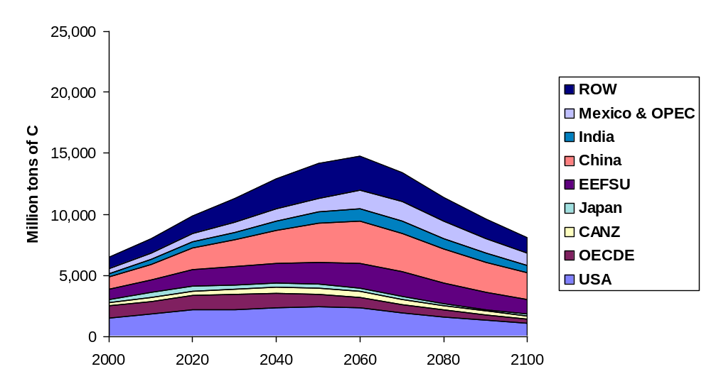
Figure Y. Global Carbon Emissions – LBDE-LC
Source: A.S. Manne and R.G. Richels “Reducing CO2 Abatement Costs – the Importance of Learning by Doing”

