Slide 1
DOE’s EPAct Regulations
Margo Melendez
National Renewable Energy Laboratory
Center for Transportation Technologies and Systems

Slide 2
What is EPAct?
Energy Policy Act of 1992 was passed to encourage the use of alternative fuels, not derived from petroleum, to help reduce dependence on imported oil
DOE’s Office of Technology Utilization focuses on transportation sector petroleum use

Slide 3
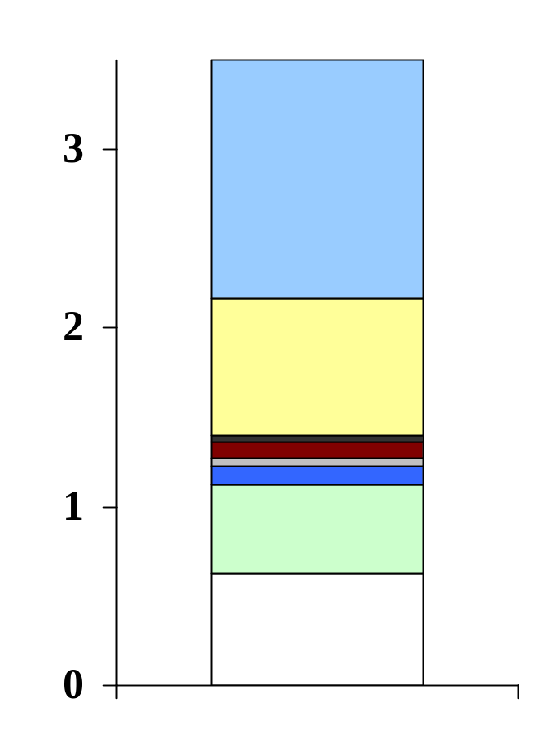
EPAct Impacts
30
EPACT Goal
Approximately 450,000 AFVs are on the road today (not including FFVs)
Over 115B gallons of gasoline are used on highways and 366M gallons of alternative fuel
?????
P&L Baseline
P&L Max w/100% AF Use
Percent of 2010 Highway Fuel Consumption
Transit Bus Mandate
S&FP and Fed Fleet
MTBE Replacement
Non-EPACT AF Use
Gasohol

Slide 4
Alternative Fuels
Methanol, denatured ethanol, and other alcohols containing 85% or more by volume of alcohol with gasoline or other fuels; natural gas; liquefied petroleum gas; hydrogen; coal-derived liquid fuels, fuels (other than alcohol, including biodiesel) derived from biological materials; and electricity
Additions (since passage of EPAct)
P-Series Fuels, liquid fuels derived from natural gas – domestically produced, and Biodiesel purchased for use in MDVs/HDVs in blends of 20% or greater

Slide 5
EPAct Programs at DOE
Federal Fleet Program
EPAct requires fleets to purchase 75% of new light duty acquisitions as AFVs
Executive Order 13149 established a goal of a 20% reduction in petroleum use by 2005
Agencies must submit a strategy outlining their plan for achieving the 20% goal
Strategies should include alternative fuel use and acquisition of highly efficient motor vehicles

Slide 6
EPAct Programs at DOE
Federal Fleet Program
EPAct and Federal Fleets
Goal of achieving petroleum reduction and energy security through acquisition of AFVs
75% of new acquisitions in covered Federal fleets must be AFVs
Light duty vehicles only – less than 8,500 lb GVWR
No requirement for alternative fuel use

Slide 7
EPAct Programs at DOE
Federal Fleet Program
Executive Order 13149
20% petroleum reduction in covered federal fleets in FY 2005 compared to FY 1999 baseline
Use of alternative fuel majority of time in AFVs by FY 2005
Increased average fuel economy of new light duty vehicle acquisitions (1 mpg by 2002 and 3 mpg by 2005)
DOE has the lead in coordination and overall reporting to White House

Slide 8
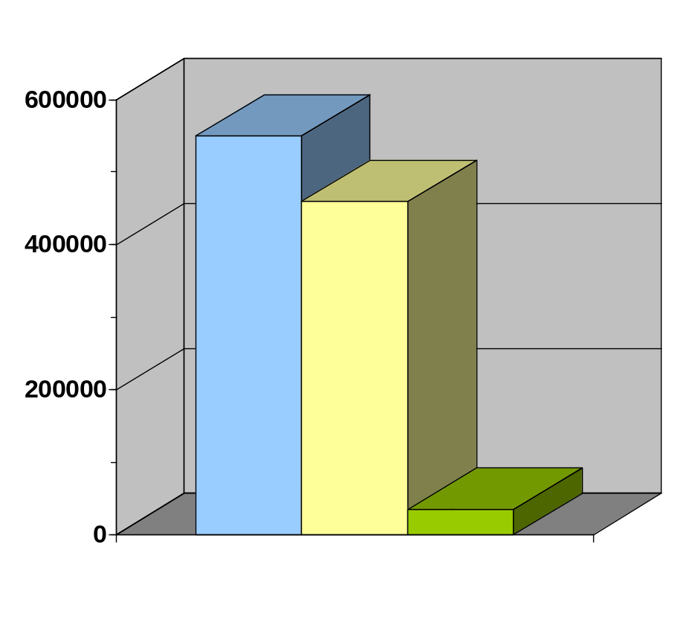
EPAct Programs at DOE
Federal Fleet Program
Federal Fleet Status
Acquire approximately 55,000 vehicles per year
Approximately 7,500 are AFVs
Total Federal Vehicles
Federal LDVs
AFVs

Slide 9
EPAct Programs at DOE
State & Alternative Fuel Provider Program
Requires vehicle acquisitions of covered fleets in metropolitan statistical areas
Fuel providers must use alternative fuel in their AFV
Uses a credit program where fleets earn credits for AFV acquisitions and biodiesel fuel use that can be traded or banked
Allows for exemptions for certain circumstances such as lack of fuel or vehicle availability

Slide 10
EPAct Programs at DOE
State & Alternative Fuel Provider Program
Covered Fleets
50 or more light-duty vehicles in the U.S.
20 or more LDVs in a single MSA/CMSA
  MSA is metro area with 1980 Census population of 250,000 or more (125 exist in the U.S.)
  20 or more vehicles in MSA must be capable of being centrally refueled at least 75% of the time
Excluded vehicles: law enforcement, emergency, non-road, personal residence, research and testing vehicles…

Slide 11
EPAct Programs at DOE
State & Alternative Fuel Provider Program
Covered Fuel Provider Organizations
Alternative fuels are their principal business
OR
At least 30% of the gross revenues are derived from producing, storing, refining, processing, transporting, distributing, importing, or selling at wholesale or retail any alternative fuel

Slide 12
EPAct Programs at DOE
State & Alternative Fuel Provider Program
Alternative Fuel Use
EPAct requires alternative fuel providers to use alternative fuel whenever possible.
EPAct does not require alternative fuel use for state fleets, however substantial infrastructure incentives are available.
Several States have adopted state policies to use alternative fuel (New York, Iowa, Texas)

Slide 13
EPAct Programs at DOE
State & Alternative Fuel Provider Program
Exemptions
Only if AFVs and/or alternative fuels are not available that meet the fleet’s normal business requirements and practices
For one model year only
May be granted in whole, part, or rejected
File exemption request early in model year

Slide 14
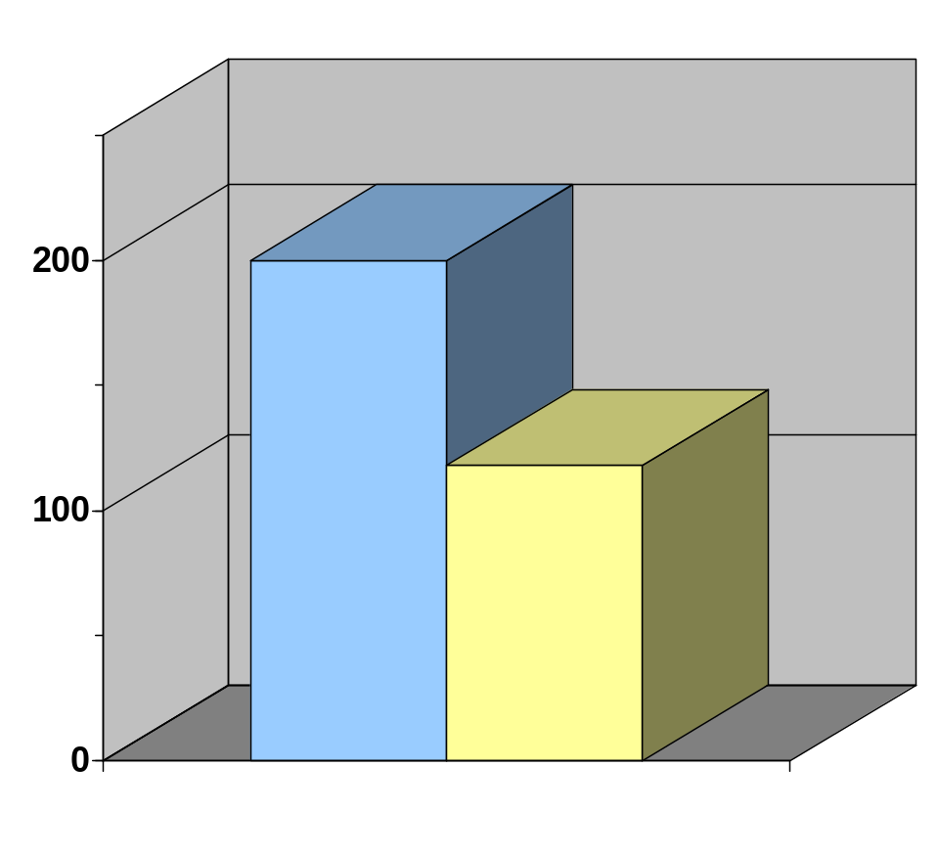
EPAct Programs at DOE
State & Alternative Fuel Provider Program
314 covered State and fuel provider fleets on record
13,700 AFVs acquired in MY2000 due to program
59,000 vehicles in DOE compliance database
Fuel Provider Fleets
State Fleets

Slide 15
EPAct Programs at DOE
Private & Local Government Program
EPAct authorizes DOE to expand fleet programs if necessary
ANOPR was issued in 1998 to gather comments
Workshops held in 2000 to gather comments
Currently the program is being analyzed to determine its potential impacts
Decision will need to be made by the new administration as part of entire energy policy plan

Slide 16
EPAct Programs at DOE
Private & Local Government Program
Comments Mixed
Participants split on mandates - approximately half supporting and half objecting; Fuel-use-based program was favored by mandate supporters
Replacement Fuel Goals were seen as important
Concern over technical issues and fuel availability
Incentives are critical
Flexibility in meeting requirements and integration with existing regulatory programs was emphasized

Slide 17
EPAct Regulations Summary
EPAct programs have been effective in getting vehicles on the road – less effective with fuel use
Status of the P&L rulemaking is tentative based on mixed comments and analysis
Various items in proposed energy bills could impact EPAct and alter the course

Slide 18
Information Resources
EPAct Fleet Information and Regulations website: www.ott.doe.gov/epact
Regulatory Email: regulatory_info@afdc.nrel.gov
Regulatory Line: (202) 586-9171 or 1-800-832-0885 ext 69171
Literature (See EPAct website)
Final Rule (S&FP)
Executive Order (Fed Fleet)
Compliance Guidelines (Bluebook)
Executive Order Guidance
Frequently Asked Questions

