Slide 1

Natural Gas Transmission Infrastructure: How Much is Necessary, at What Cost, and Who Pays For It
National Energy Modeling System/Annual Energy Outlook Conference
Arlington, Virginia
March 12, 2002
Kevin Petak
Energy and Environmental Analysis, Inc.
1655 North Fort Myer Drive, Suite 600
Arlington, VA 22209
(703) 528-1900
kpetak@eea-inc.com

Slide 2
Contents
Natural Gas Market in Review
Forecast Assumptions
Natural Gas Demand and Supply Outlook
Transmission Infrastructure Requirements
Industry Challenges

Slide 3
Natural Gas Market in Review
New power plants are continuing to be built and gas-fired generation is coming “on-line.”
  Approximately 120 GW of new gas-fired capacity will be completed over the next three years, on top of 70 GW already completed during the past three years.
Significant “boom-bust cycle” in natural gas prices caused by a confluence of factors, including the economy, weather, and oil prices.
Slump in manufacturing activity and natural gas price “spike” in 2000-01 hurt industrial gas use.

Slide 4
Natural Gas Market in Review
Bush Administration “National Energy Strategy” and the terrorist attack of September 11, 2001 have refocused attention on development of domestic energy infrastructure.
Equity prices and bond ratings for a number of energy companies experienced substantial pressure in the wake of the filing for “Chapter 11” bankruptcy protection by Enron.
  Capital to develop energy projects will be more expensive, at least in the short-run.

Slide 5
Forecast Assumptions
U.S. economic activity increases during the first half of this year.
  GDP grows at an average rate of 2.5 percent per year during projection.
Oil prices nearly constant at $22 per barrel (in real terms) throughout the projection.
U.S. electricity demand grows along with the economy, averaging approximately 2 percent per year growth.

Slide 6
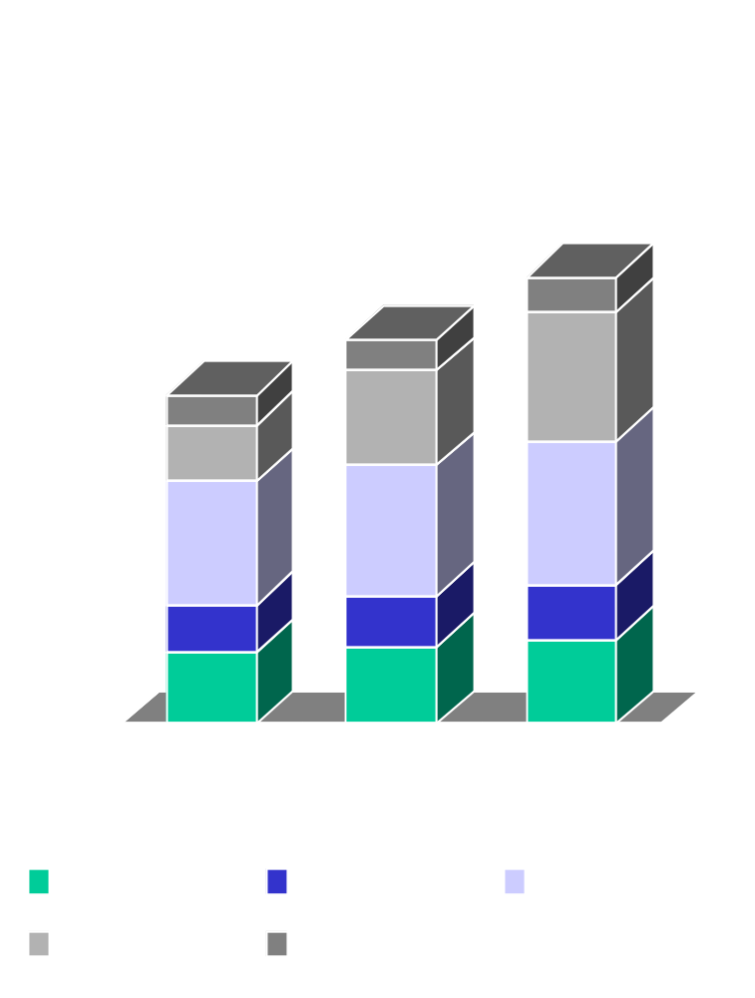
U.S. Natural Gas Demand
U.S. gas demand will grow to over 30 Tcf by 2020.
Most growth will occur in power generation, primarily a result of new gas-fired generating capacity added from 2000-05.
Residential/commercial gas use will increase (albeit at a modest rate of just over 1 percent per year) as housing stock and commercial floor space grows.
Industrial gas use will increase modestly over time.
Source: EEA Gas Market Compass

Slide 7
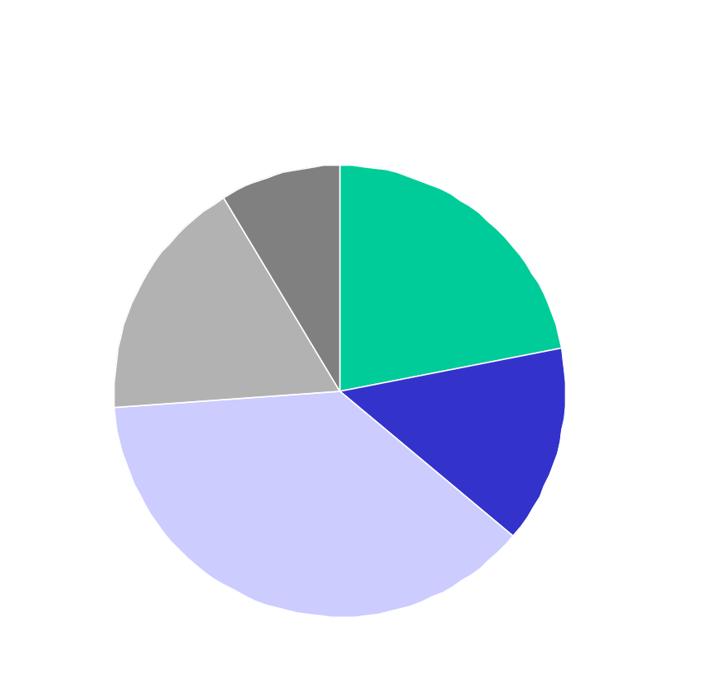
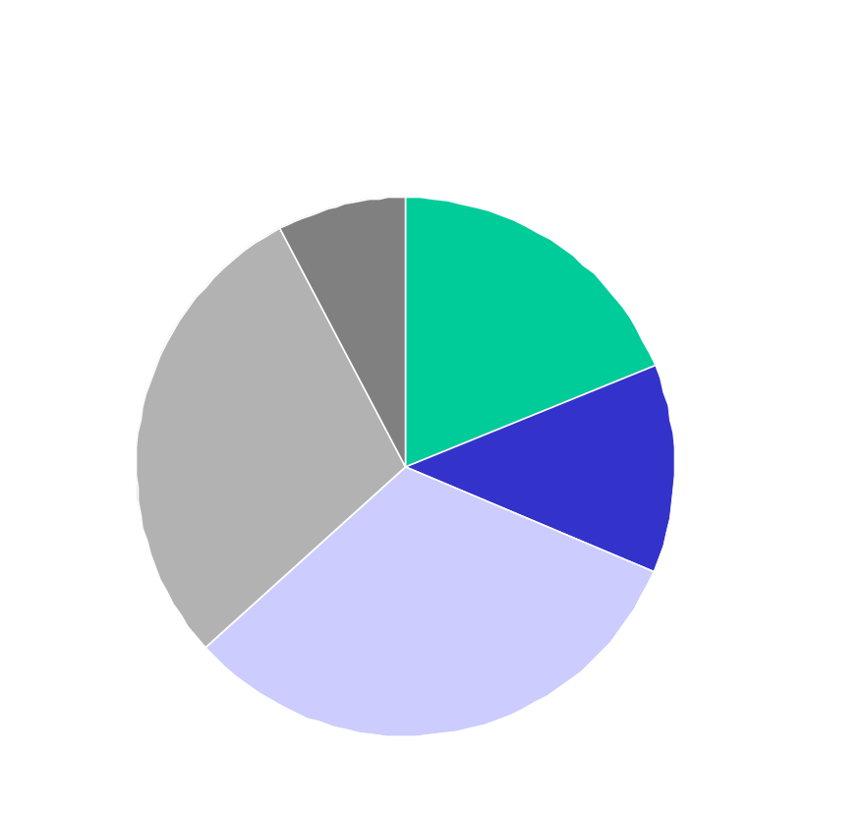
U.S. Natural Gas Demand (continued)
By 2020, power generation gas use rises to over 25 percent of gas demand and industrial gas use falls to under one-third of total gas use.
Source: EEA Gas Market Compass

Slide 8


U.S. Natural Gas Demand (continued)
Growth in gas demand will be regionally widespread. However, regions dominated by growth in gas-fired power generation (e.g., the South Atlantic) will account for a slightly greater percent of gas use by 2020.
Source: EEA Gas Market Compass

Slide 9



North American Gas Supply
Gas supply will be adequate to satisfy gas demand throughout the next 20 years, but significant development of “new frontiers” will be required.
Gas supply from new frontiers will account for 18 Tcf, or nearly half of total supply in 2020, versus only 3 Tcf, or 14 percent of today’s supply. Production from mature areas will decline by over 10 percent by 2020.
Source: EEA Gas Market Compass

Slide 10
Transmission Infrastructure Requirements
Widespread growth in gas demand coupled with development of “new frontier” gas supplies creates a significant need for new transmission infrastructure.
New transmission assets (along with regional shifts in gas supply) may alter/reduce the use of existing transmission infrastructure.
  Capital cost recovery for transmission assets could become an issue as value is shifted from existing to new assets.

Slide 11
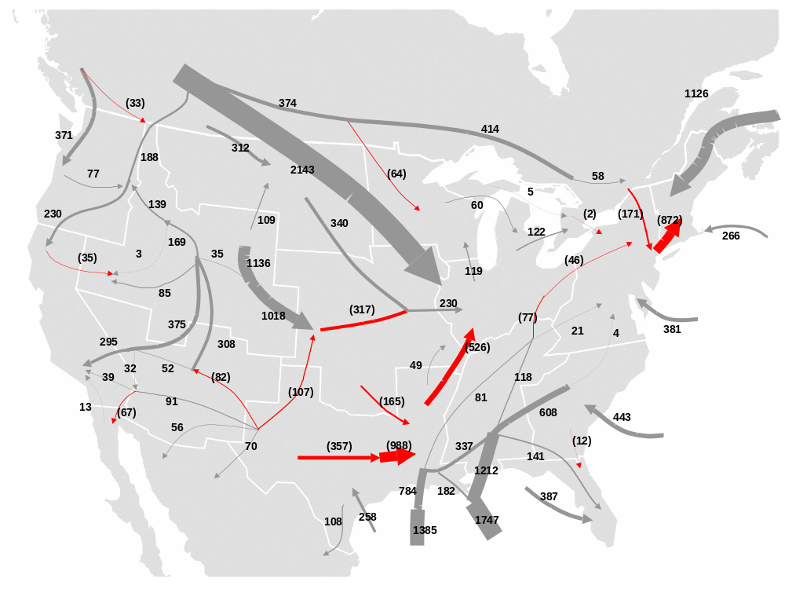
Interregional Flow Changes
- Change from 2000 to 2020; values in Bcf/yr -

Slide 12
Notable Pipeline Expansion
- 2000 through 2020 -
4 Bcfd to Northeast U.S.
2 Bcfd to Florida
2 Bcfd to South Atlantic
7 Bcfd from Western Canada to U.S.
5 Bcfd out of the Rockies
6 Bcfd from Alaska to Canada
7 Bcfd to connect deepwater Gulf Coast gas

Slide 13
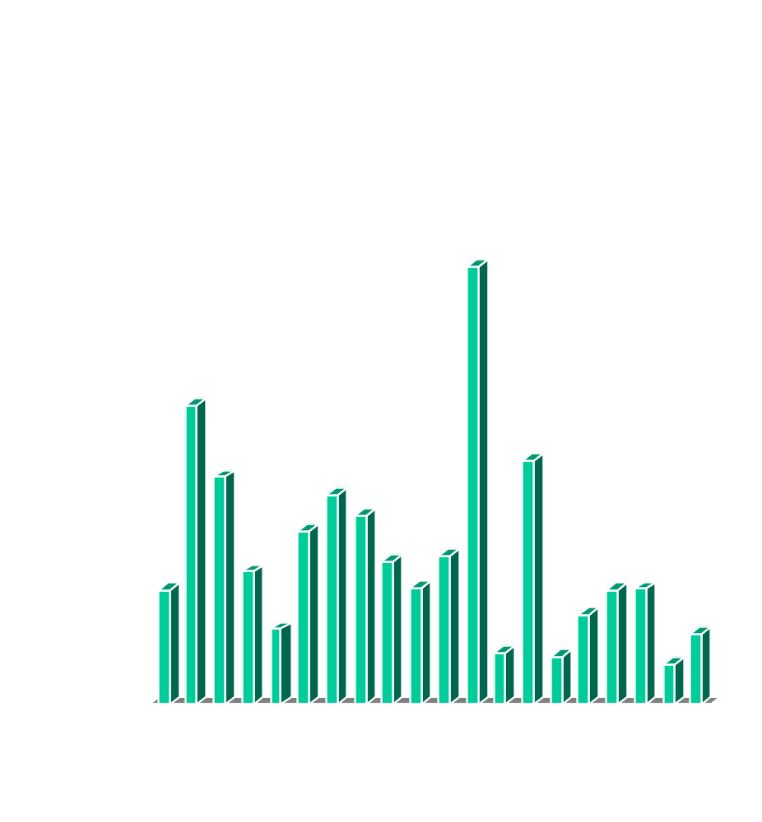
Transmission Infrastructure Requirements
Over 3,800 miles per year for a total of nearly 77,000 miles of new pipeline will be required over the next 20 years.
  Equates to approximately 1/4 of the transmission pipe currently in place in North America.
Almost 11,000 miles of pipe will be required to deliver Alaskan gas to Canada and the Lower-48 U.S.
Source: EEA Infrastructure Analysis

Slide 14
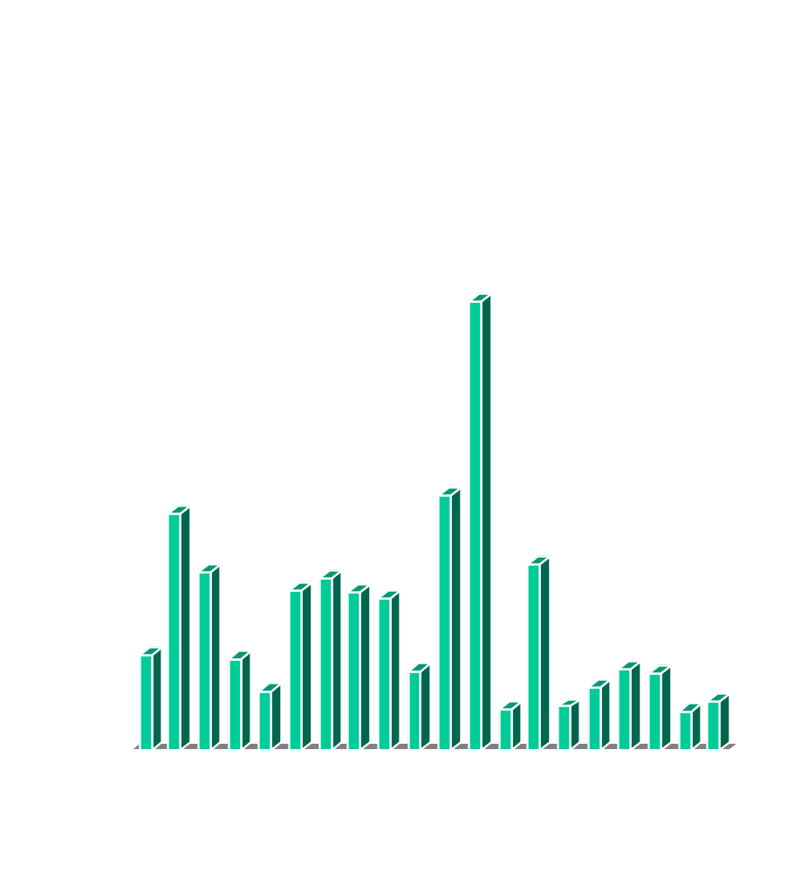
Transmission Infrastructure Requirements
Over $4 Billion (US) per year for a total of over $83 Billion will be required over the next 20 years.
  Total includes $250 Million per year for development of gas storage infrastructure.
The Alaskan pipeline project will account for nearly 1/4 of the total capital expenditures.
Source: EEA Infrastructure Analysis

Slide 15
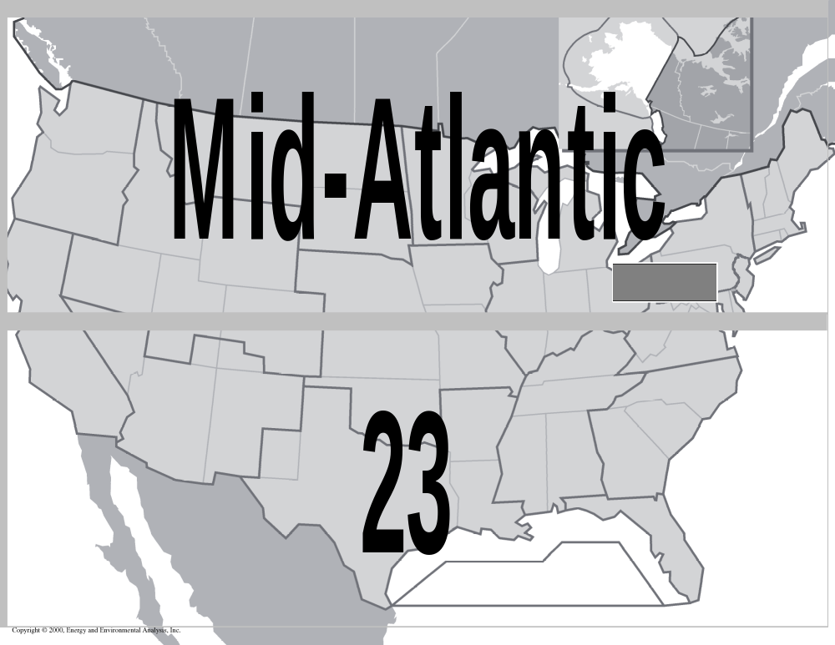
New Storage Capacity
- Bcf of Working Gas Capacity Added from 2000 through 2020 -

Slide 16
Industry Challenges
Transmission companies must secure capital to construct the pipe and storage infrastructure necessary to satisfy gas demand.
  Total financing of over $80 billion required during next 20 years.
  Enron bankruptcy raises cost of capital, at least in the near term.
Gas providers must continue to develop mature basins and new frontiers to satisfy market growth at prices that remain competitive with other alternatives. New sources of gas supply include:
  Alaska
  LNG
  Maritimes
  Deepwater Gulf of Mexico
  Rocky Mountains
  Western Canada Coalbed Methane

Slide 17
Industry Challenges
Industry must help customers manage price volatility.
Customers must be willing to contract for new pipeline and storage capacity.
  Pipelines must be allowed to develop innovative services that meet the service and economic needs of customers, particularly new power generation customers.
  Power providers and power marketers must be willing to contract for new pipeline and storage assets.
Maintaining transmission system reliability and flexibility will be a concern.
  Increasing load for power generation may require that the system is operated differently in some locations.

Slide 18
Industry Challenges
Environmental policy should not overly burden gas technologies and be based on efficient, fuel-neutral emission regulations measured on an output basis.
Energy independence and system security is becoming a greater priority after September 11, 2001.
  Producers, regulators, and politicians must work together to secure access to gas resource.
  Pipelines, regulators, and politicians must work together to secure right of way for new transmission and storage assets.
  Protecting the environment (while developing sufficient assets) should be a top priority for all industry participants.

