Slide 1
“Bottom-Up”, “Top-Down” and
Non-Convex: Recent Modeling Activities at IIASA-ECS
Leonardo Barreto and Leo Schrattenholzer (Project Leader)
Environmentally Compatible Energy Strategies Project (ECS)
International Institute for Applied Systems Analysis (IIASA)
AEO/NEMS Conference
Washington D.C., March 12, 2002

Slide 2
Outline
IIASA Modeling Framework
Combining “Top-down” and “Bottom-up”
Endogenizing non-convex technical change
Conclusions

Slide 3
The IIASA Modeling Framework
“Storyline”
Economic Development
Demographic Projections
Technological Change
Environmental Policies
Energy Intensity
Common Databases
CO2DB
EDGAR etc.
Scenario Generator
-Economic and Energy Development
RAINS
Regional Air Pollution
Impacts Model
MACRO
Soft
Link
MESSAGE
BLS
Basic Linked System of
National Agricultural Models
MAGICC
Model for the Assessment of
GHG-Induced Climate Change
Notes:
Brundland report definition?

Slide 4
Other Models Used at IIASA-ECS
ERIS
Small-scale model
Endogenous Technical
Change
-Learning-by-Doing
-Learning-by-Searching
Technology Policy, R&D
ISPA
Stochastic Meta-model for
Multi-Objective
Policy Analysis
MERGE
Model for Evaluating
Regional and
Global effects of GHG Policies
Notes:
Brundland report definition?

Slide 5
The MESSAGE-MACRO Link-1
Iterative link between the “bottom-up” MESSAGE and “top-down” MACRO models
The link keeps consistency between demand and supply cost curves and thus between scenarios
The models are solved independently
  Nonlinearities are collected in one place
  High flexibility

Slide 6
The MESSAGE-MACRO Link-2
Reference final-energy
demand
Scenario Generator
Reference GDP
Energy intensities
Conversion
Conversion
Useful-energy
demand
Conversion
Final-energy
demand
Useful-energy
demand
MESSAGE
MACRO
Final energy shadow prices
Final energy demand
Cost functions
Total energy system cost
Conversion

Slide 7
The MESSAGE Model
Includes 400 individual energy conversion and end-use technologies
11 World Regions
Calculates least-cost optimal energy supply technology structure, which satisfies a given useful-energy demand
Technological progress in different path dependent directions according to the scenario specification

Slide 8
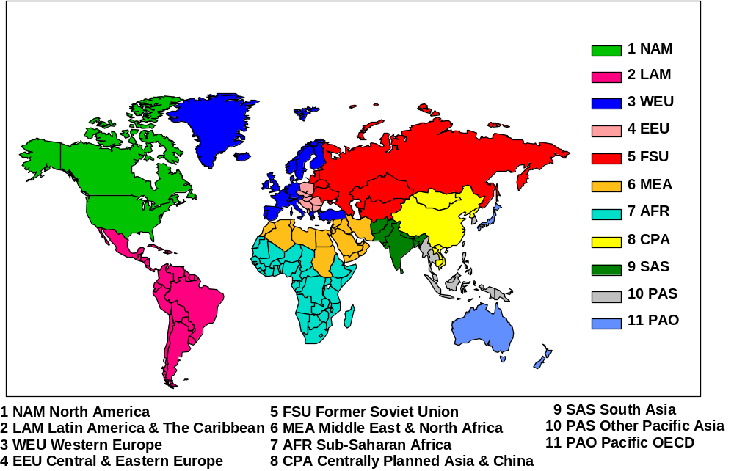
11 World Regions in MESSAGE
Notes:
I rather would like to present only global GDP assumption

Slide 9
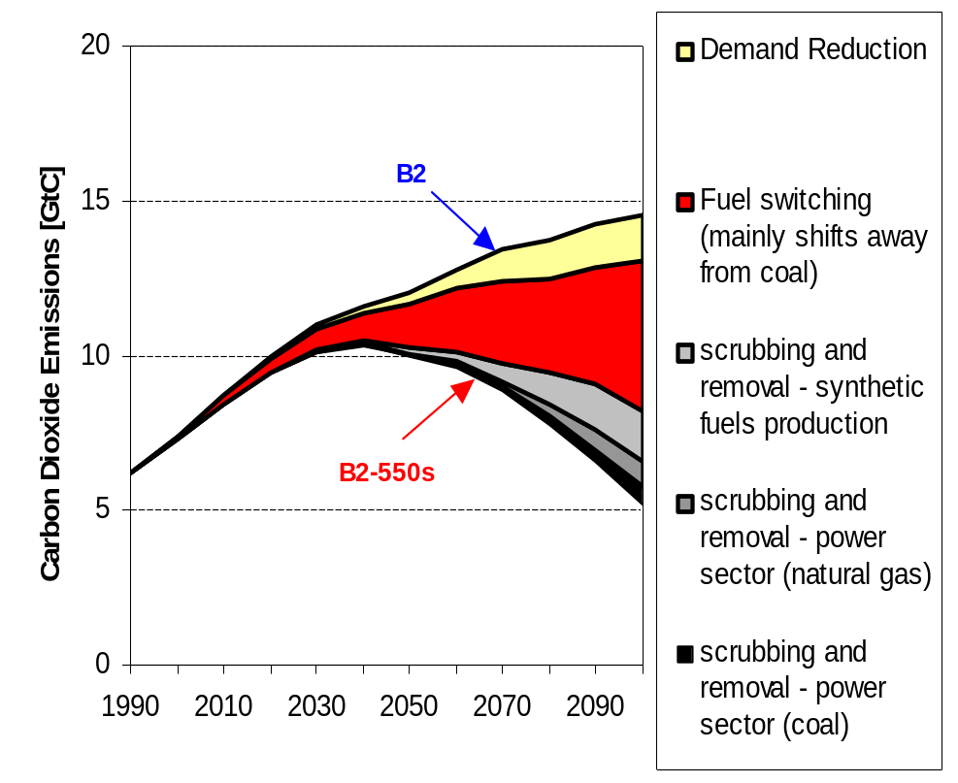
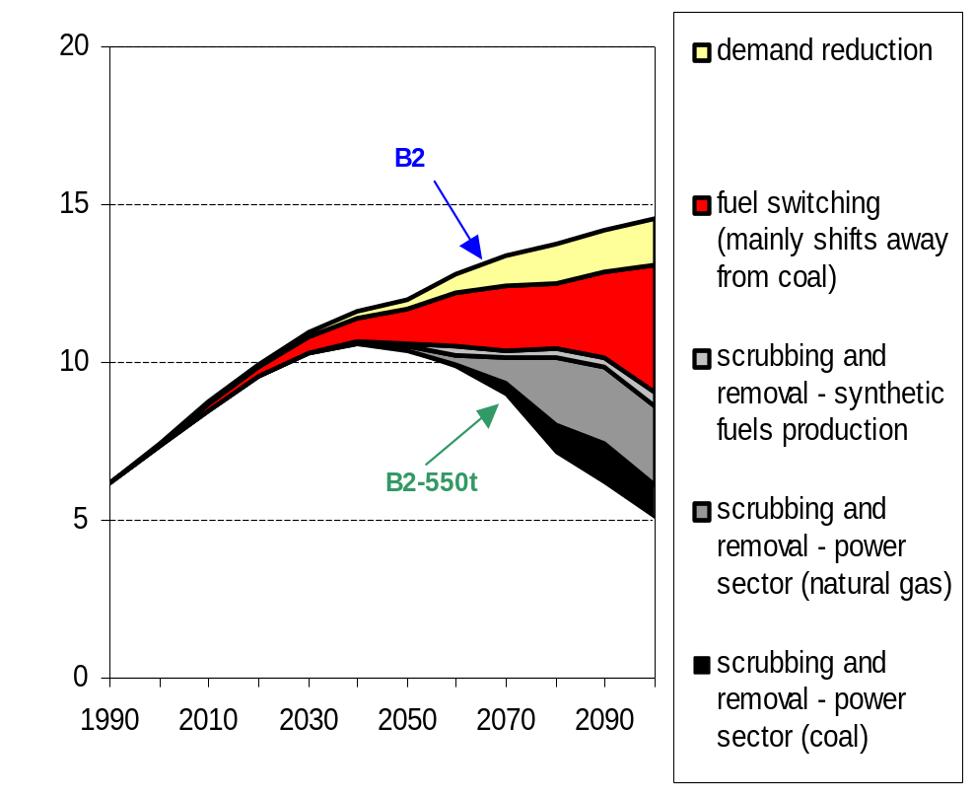
Examining Carbon Scrubbing
No learning for CCT
Learning for CCT

Slide 10
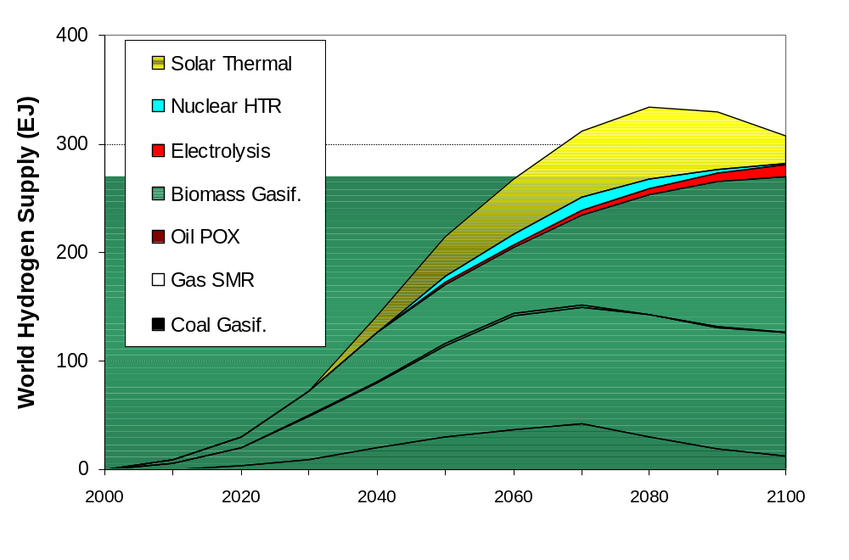
Exploring Hydrogen Futures
The B1H2 Scenario

Slide 11
The ERIS Model
ERIS (Energy Research and Investment Strategy)
Small-scale model with endogenized learning curves (learning-by-doing and learning-by-searching)
Flexible tool to assess approaches to endogenize technological change
Global, multi-region, electricity generation model with CO₂ trading

Slide 12
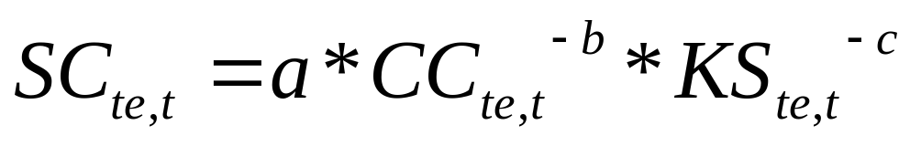
Two-Factor Learning Curves
R&D should be examined as a technological learning mechanism
Specific cost as function of Cumulative Capacity and Knowledge Stock
b: Learning-by-doing elasticity
c: Learning-by-searching elasticity

Slide 13
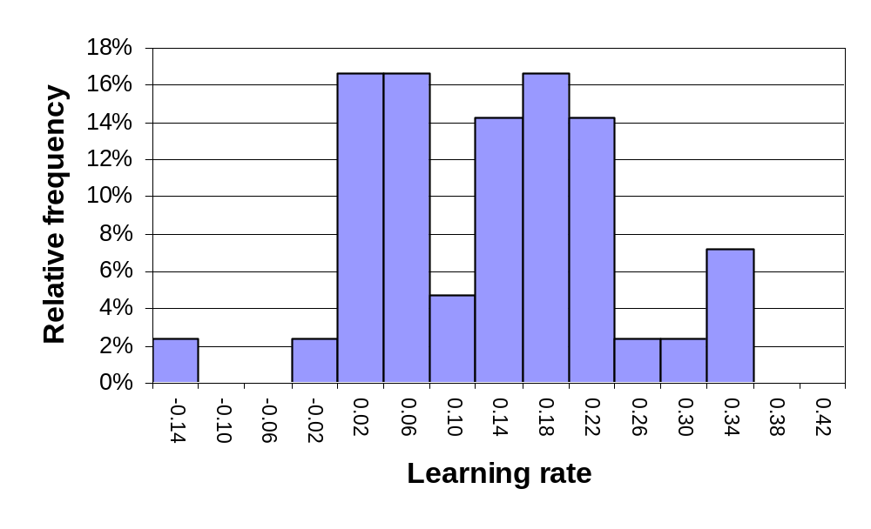
Learning Rates of Energy Technologies
Source: McDonald and Schrattenholzer (2001), 42 technologies

Slide 14
Endogenizing Learning Curves
Non-linear, non-convex optimization problem
Multiple locally optimal solutions: Alternative paths the energy system may follow
Globally optimal solution: Least-cost energy system path
No guarantee of globally optimal solution with conventional NLP solvers

Slide 15
Solving the Problem
  Mixed Integer Programming (MIP) if other nonlinearities do not exist
  “Guided” optimization with conventional NLP algorithms (different solvers/starting points)
  Global optimization algorithms (e.g. BARON)

Slide 16
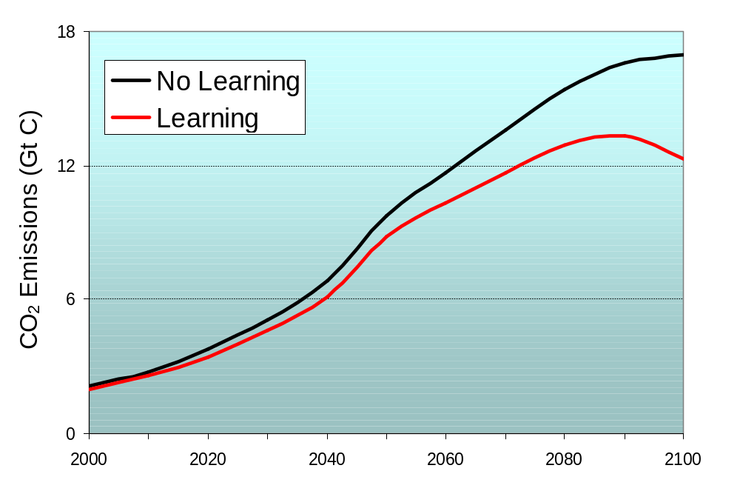
Different Model Outcomes with Learning

Slide 17
ERIS and Spillovers of Learning
Multi-regional ERIS endogenizing learning-by-doing using MIP approach
Learning investments in one region may drive to cost reductions also in others
With spillovers of learning deploying a technology in a region can affect technology choices in other regions
This phenomenon cannot be captured by models with exogenous technical change

Slide 18
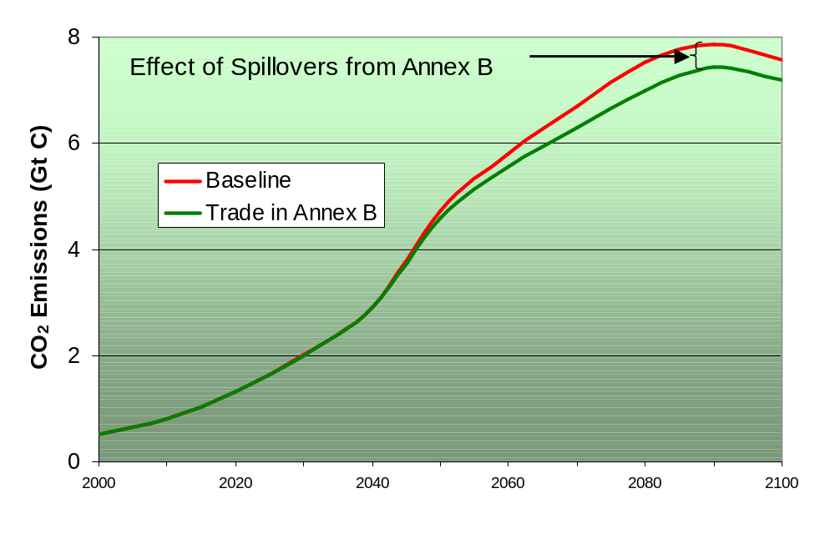
Spillovers of Learning
Carbon Emissions in Non-Annex B

Slide 19
Finding Globally Optimal Solutions
BARON: Branch and Reduce Optimization Navigator (Sahinidis, 2000)
General purpose global optimization software
Combines enhanced branch and bound with range reduction techniques
GAMS/BARON

Slide 20
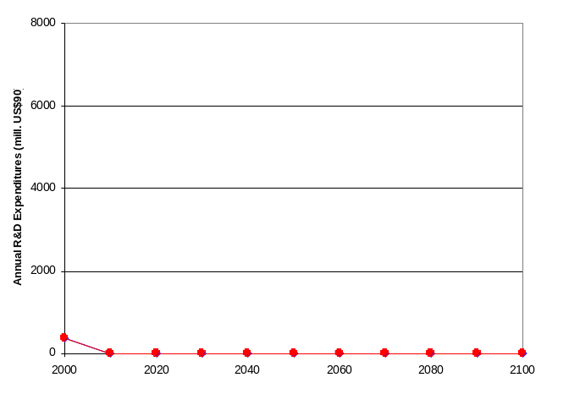
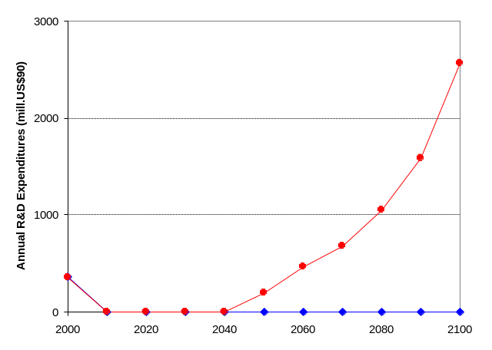
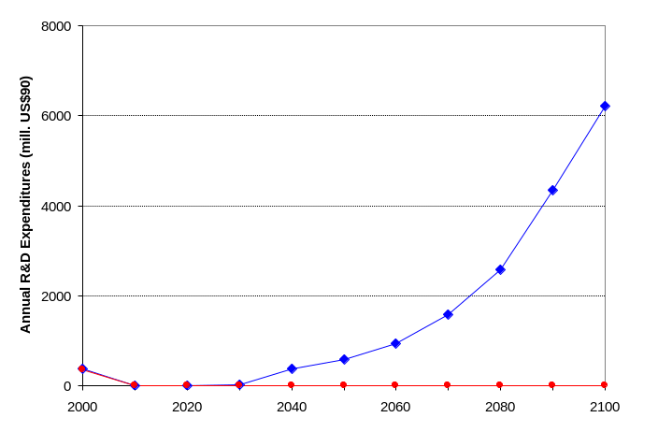
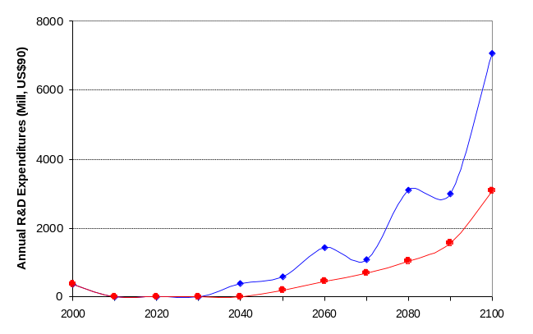
Example: 4 Locally Optimal Solutions
R&D Expenditures (Mill. US$90)
1
2
3
4
Global Optimum
Wind Turbine
Solar PV

Slide 21
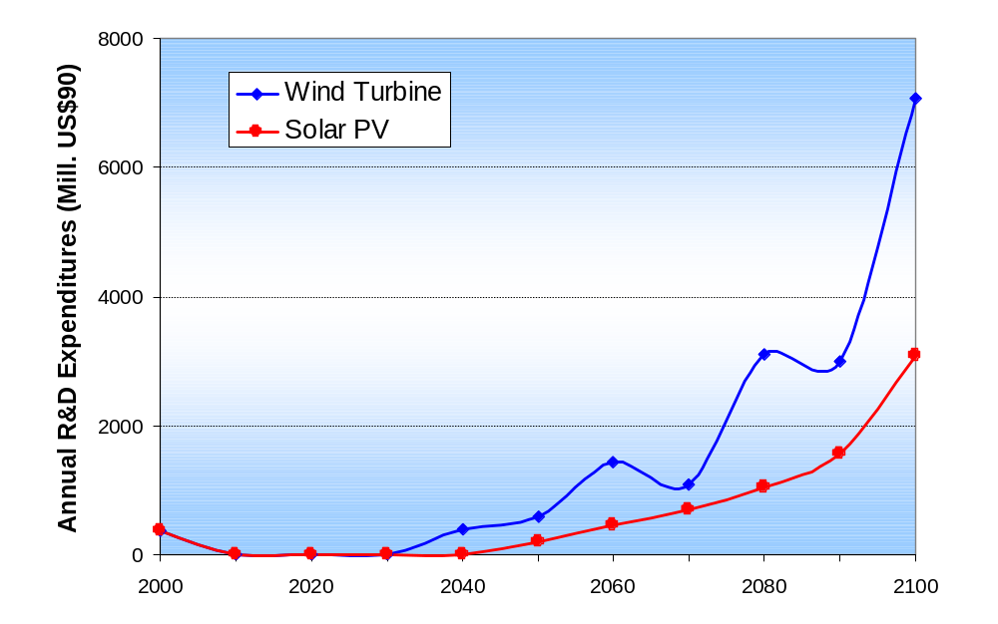
Globally Optimal R&D Expenditures
Example with two Technologies

Slide 22
Conclusions
MESSAGE-MACRO provides a flexible combination of top-down and bottom-up approaches and allows consistent quantification of E3 scenarios
ERIS endogenizes learning-by-doing and learning-by-searching mechanisms and allows investigating energy technology dynamics

