Slide 1
Manufacturing Energy Use in IEA Countries
Impacts from Changes in
Structure and Energy Intensities
Fridtjof Unander
Energy Technology Policy Division
International Energy Agency
Paris

Slide 2
Manufacturing Energy use
Structural Changes and Energy Efficiency
IEA manufacturing energy use has declined since 1973
Energy efficiency and structural changes can both be expected to have contributed to the decline
The aim of this presentation;
  Compare the long-term impact on manufacturing energy use from structural changes to those induced by changes in branch-by-branch energy intensities for a group of eleven IEA countries
  Investigate impacts of recent developments in the U.S and Japan

Slide 3
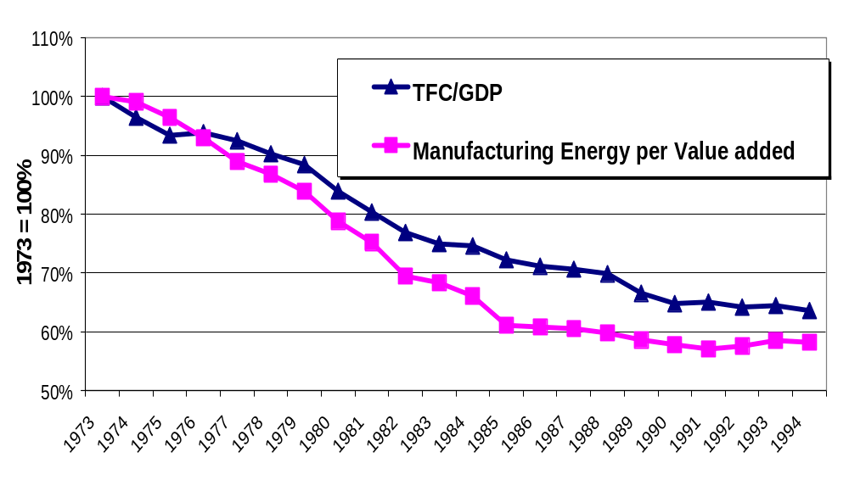
IEA-11 TFC per GDP and Manufacturing
Energy Use per unit of Value Added

Slide 4
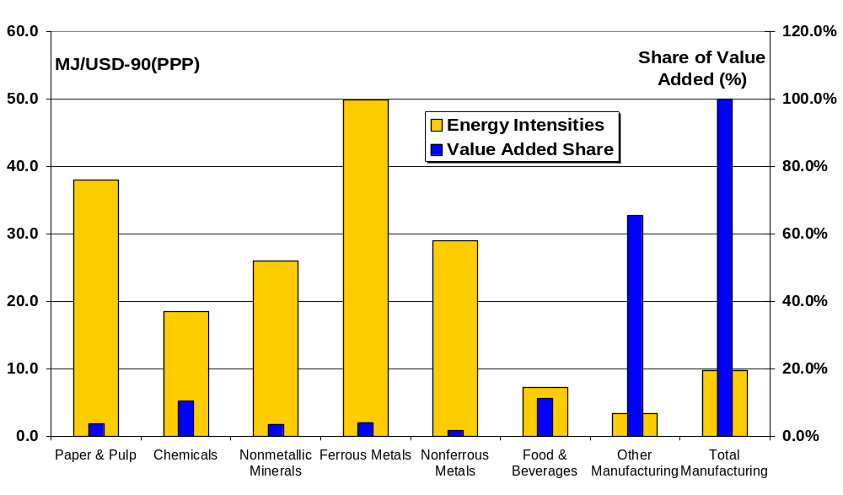
IEA-11 Sectoral Manufacturing Energy Intensities and Value Added Shares, 1994

Slide 5
Changes in Manufacturing Energy use
Decomposing changes in Energy Into three Components
E = A * S_{i} * I_{i}
E : Manufacturing Energy
A : Sectoral Activity (value added)
S_{i} : Sectoral Structure (sub-sector i share of value added)
I_{i} : Energy Intensity in sub-sector i (energy per value added)
Using Laspeyres or Adaptive Weighting Divisia Index Method (AWD) to study trends over time

Slide 6
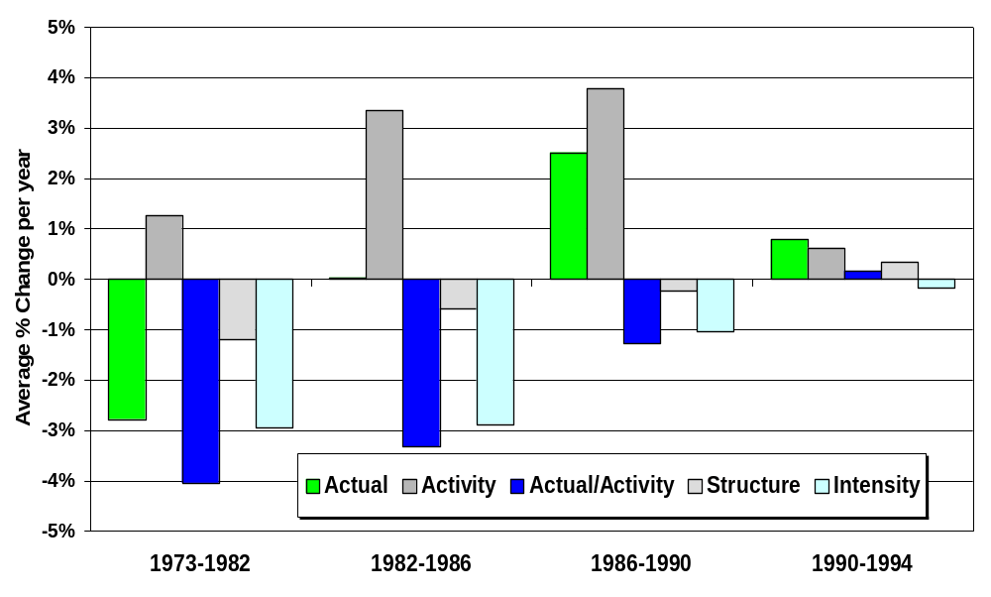
Changes in Manufacturing Energy Use IEA-11

Slide 7
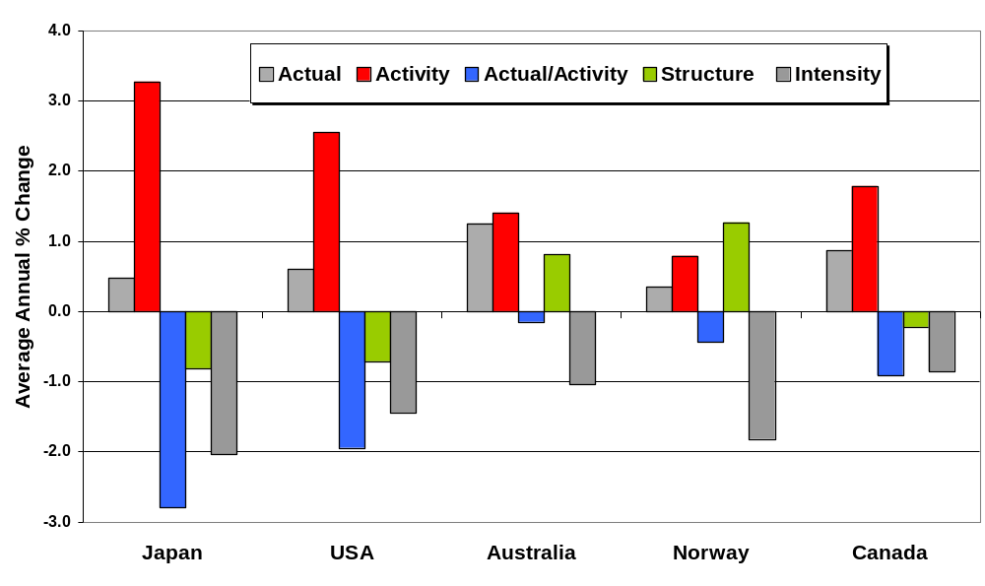
Manufacturing Energy Use 1981-1994
Impact of changes in Structure and Energy Intensities

Slide 8
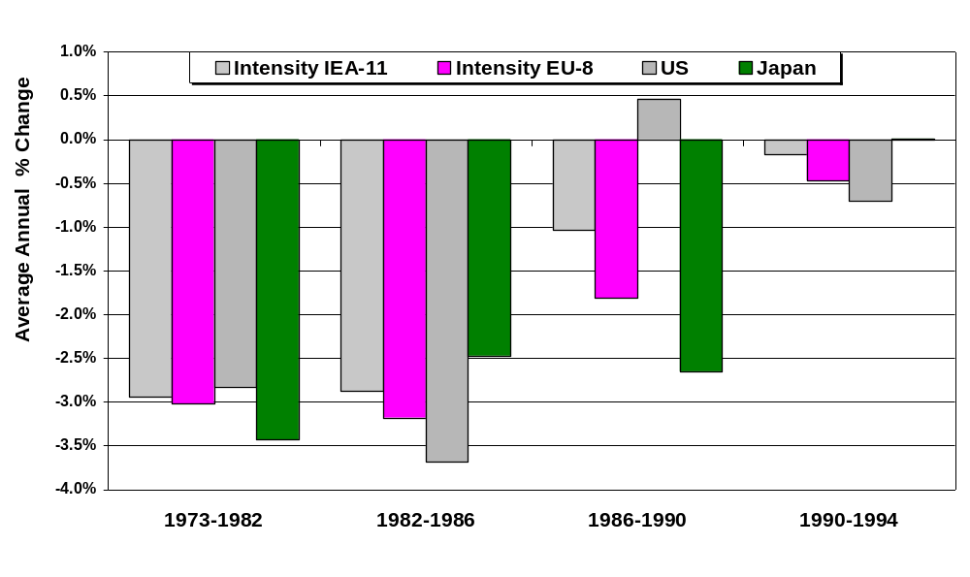
Changes in Manufacturing Energy Intensities
Constant Structure

Slide 9
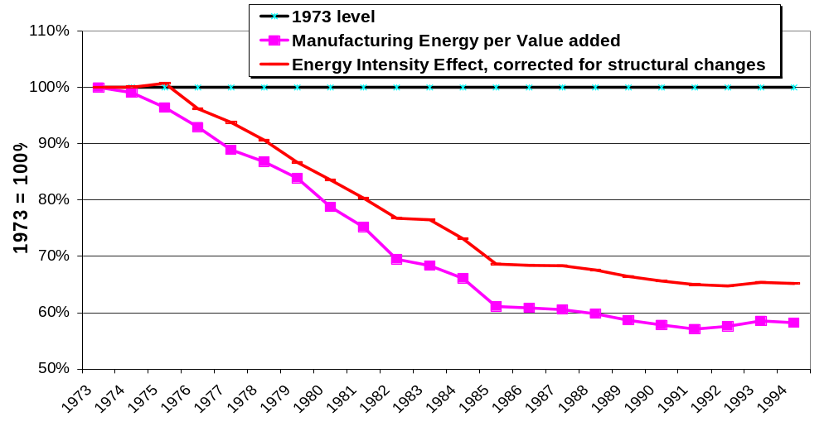
IEA-11 Manufacturing Energy Intensity
With and without correction for Structural Changes

Slide 10
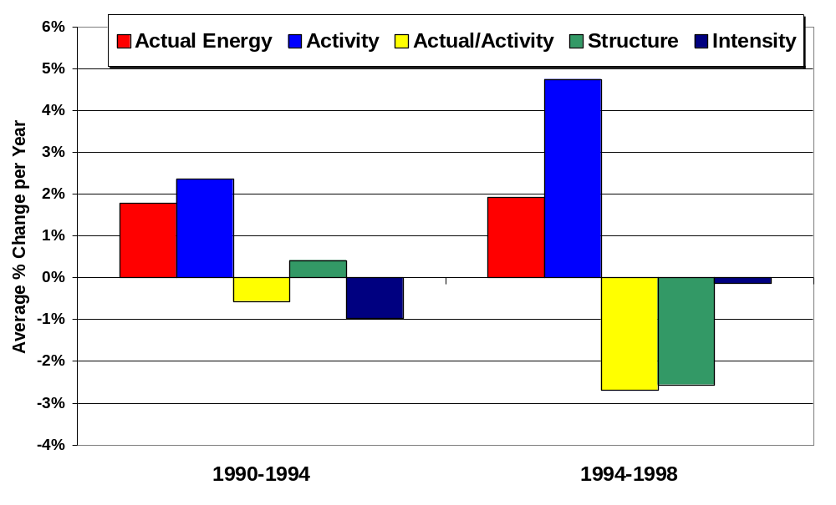
Changes in U.S. Manufacturing Energy Use
1990 - 1998

Slide 11
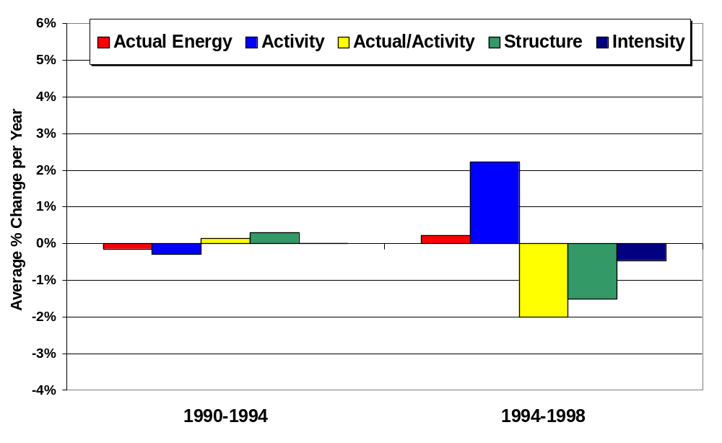
Manufacturing Energy Use in Japan
1990 - 1998

Slide 12
Conclusions
Long term trends
Structural changes can explain about a quarter of the reduction in IEA-11 manufacturing energy use per unit of value added between 1973 and 1994
In a few countries structural changes drove up energy use in the same period
The decline in branch-by-branch energy intensities has slowed everywhere since the late 1980’s

Slide 13
Conclusions
Recent trends in the U.S and Japan
Virtually no effect from declining intensities
The significant reduction in manufacturing energy use per value added since 1994 is mostly due to structural changes
In the U.S growth in the production of electronics induced a shift in manufacturing structure, restraining growth in energy use by some 10% between 1994 and 1998

