Slide 1

Ethanol on the Brink:
Significant Growth and New Technology
Is there a tradeoff between food and fuel?
Energy Information Administration
National Energy Modeling System/
Annual Energy Outlook
Arlington, VA
March 12, 2002
John M. Urbanchuk
Executive Vice President
AUS Consultants

Slide 2
Are Renewable Fuels Necessary?
President George W. Bush on America’s energy security
AUS Consultants
“As our economy continues to grow, U.S. oil consumption is projected to increase about one-third during the next 20 years”.
“America is already using more energy than our domestic resources can provide, and unless we act to increase our energy independence, our reliance on foreign sources of energy will only increase”.
“Renewable energy can increase our energy independence and help our farm economy”.
Radio address by the President to the nation. February 23, 2002

Slide 3
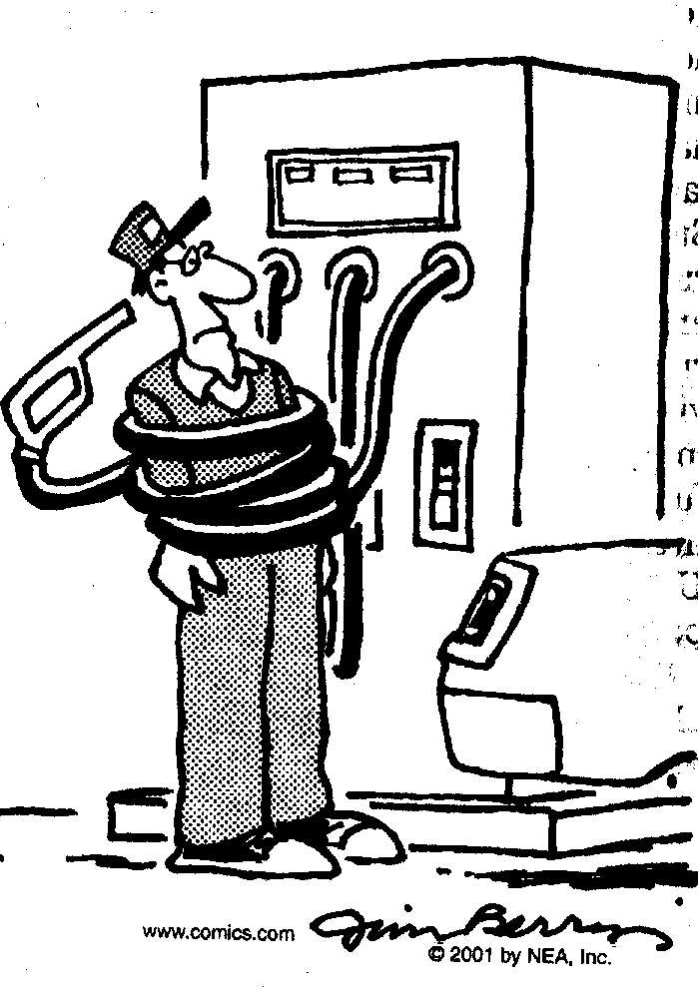
Energy security is multifaceted
AUS Consultants
National/homeland security
  Reduced dependency on foreign suppliers
Economic security
  Lower trade deficit
  Increased investment
  Higher economic growth
  New jobs and increased income

Slide 4
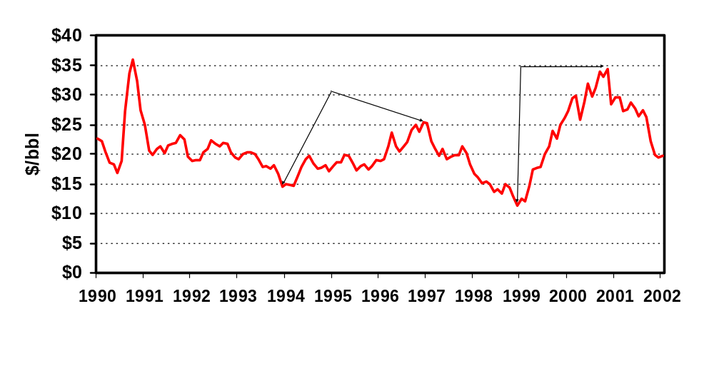
Oil prices are down for now, but history has shown that there is a significant upside potential.
(Crude oil, West Texas Intermediate)
AUS Consultants
JMU 07/01. Source: U.S. Energy Information Administration Petroleum Supply Annual

Slide 5
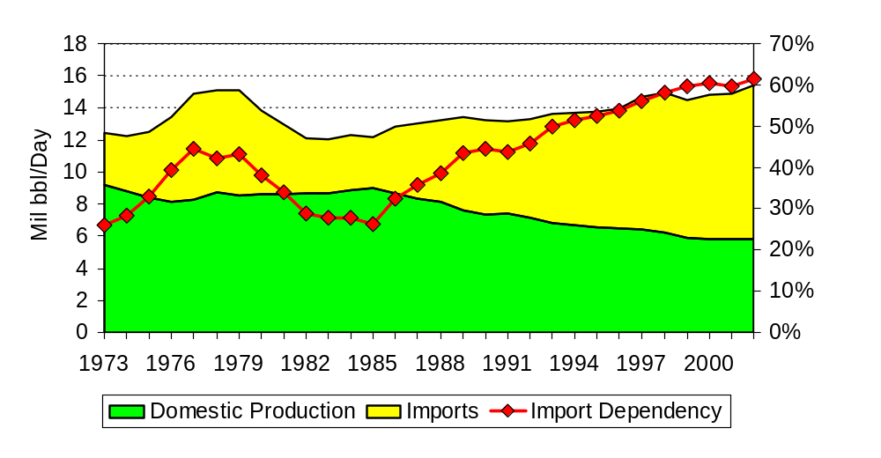
America’s dependence on imported oil continues to grow.
AUS Consultants
Source: U.S. Energy Information Administration Petroleum Supply Annual

Slide 6
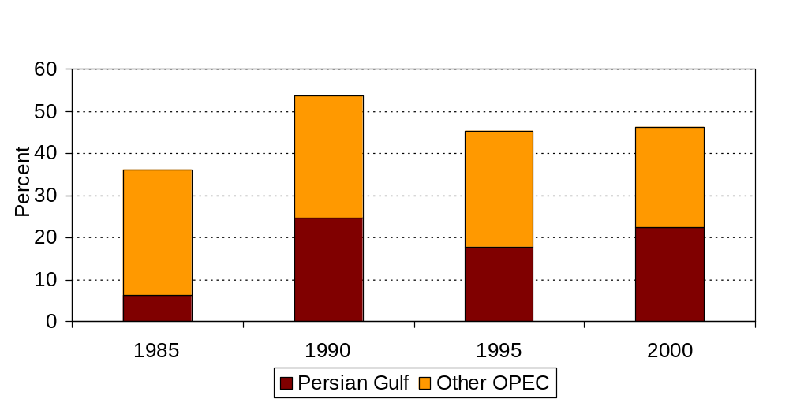
OPEC supplies almost 50% of our petroleum requirements, and increasingly unstable Persian Gulf nations supply half of that.
AUS Consultants

Slide 7
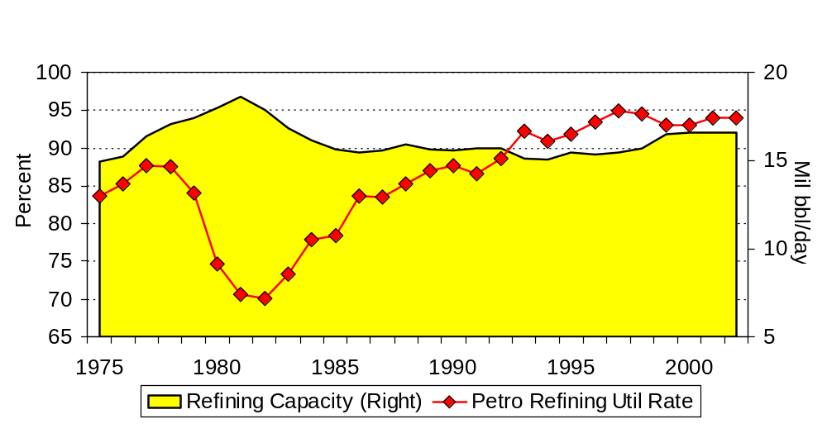
Declining oil production and high imports are only part of the problem. Domestic refining capacity is tight and utilization is high.
AUS Consultants
Source: DOE/EIA; Federal Reserve Board

Slide 8
Ethanol and biodiesel are part of the solution
AUS Consultants
  A renewable fuel standard resulting in 5 billion gallons of ethanol and significantly increased biodiesel use will displace 1.6 billion barrels of oil over the next decade.
  An additional $34.1 billion (1996$) will stay in the American economy to be spent, saved, or invested.
  This “fiscal stimulus” combined with the investment spending to increase ethanol and biodiesel production will stimulate the U.S. economy.

Slide 9
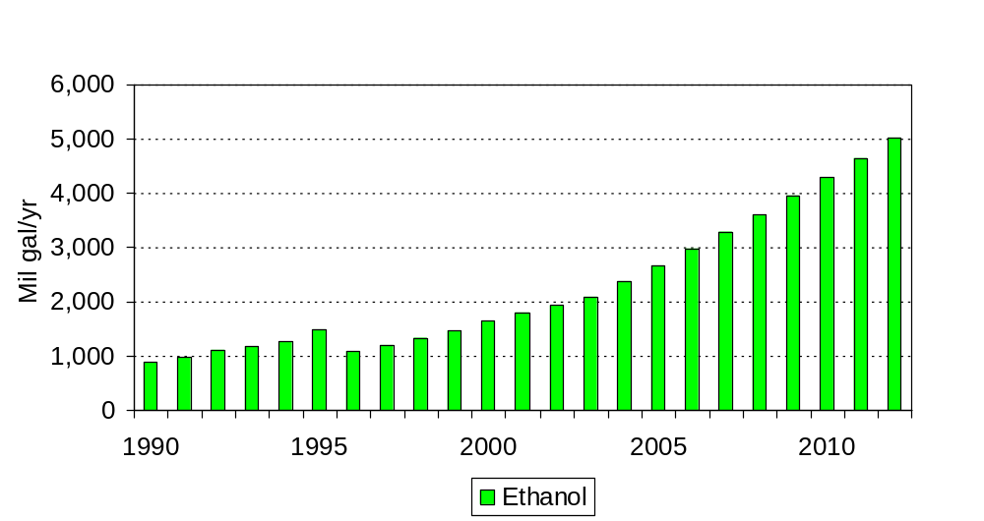
A Renewable Fuel Standard will boost ethanol demand and production.
AUS Consultants

Slide 10
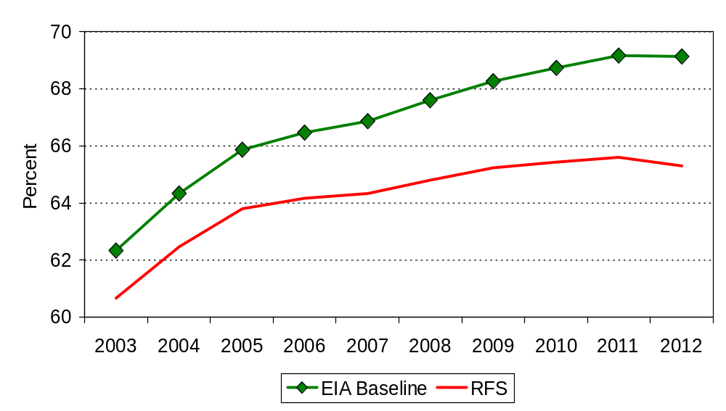
Increased use of ethanol and biodiesel will reduce America’s dependency on imported oil
AUS Consultants
1.6 billion barrels of oil displaced
between 2003 and 2012
Source: AUS Consultants; DOE/EIA

Slide 11
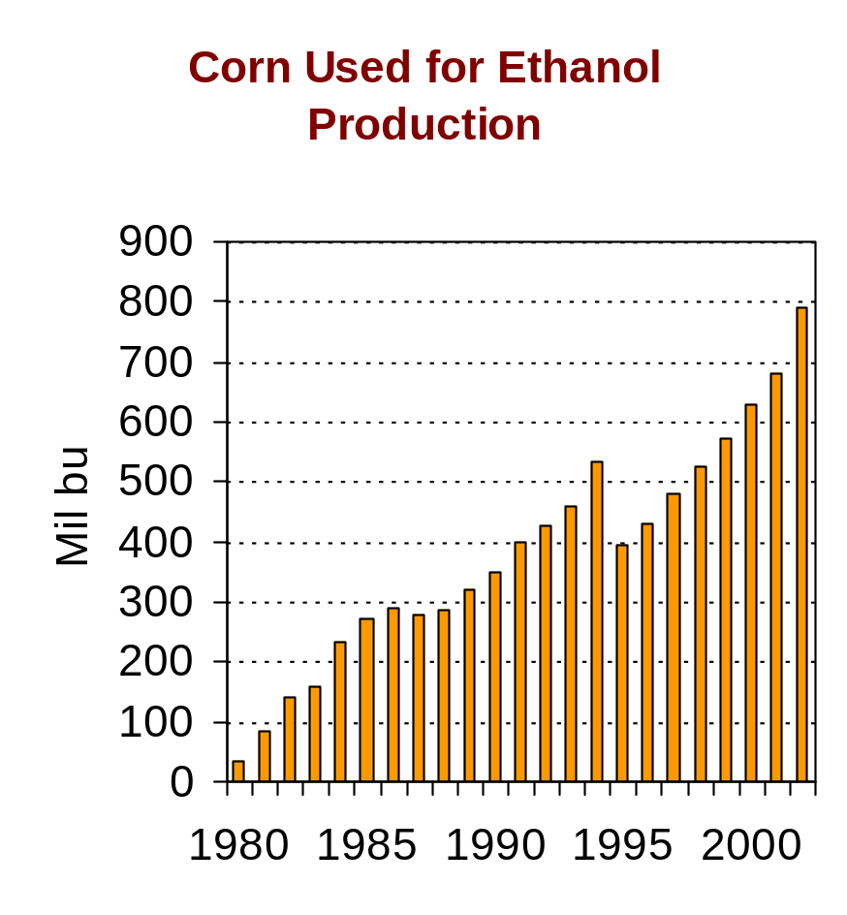
Where does ethanol come from?
AUS Consultants
In the U.S. almost exclusively from grain with corn the predominant feedstock.
Small quantities of ethanol also are produced from sorghum, wheat, barley, and agricultural byproducts and waste.
Ethanol is being produced in 58 plants with a current capacity of 2,346 MGY.
60 percent produced by dry mill plants and 40 percent by wet mill plants.

Slide 12
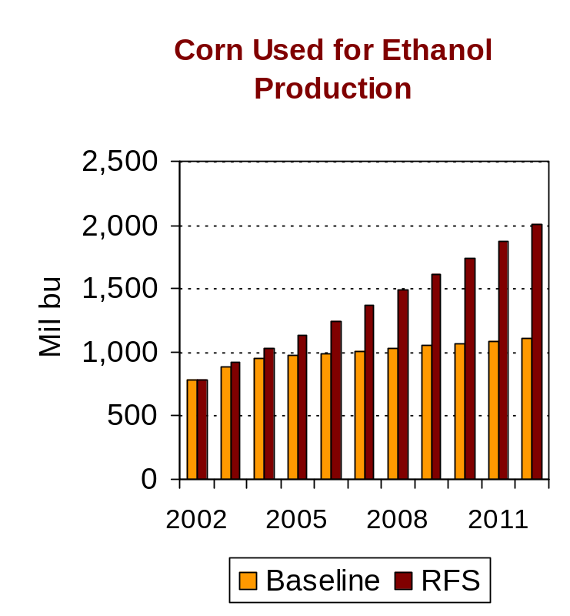
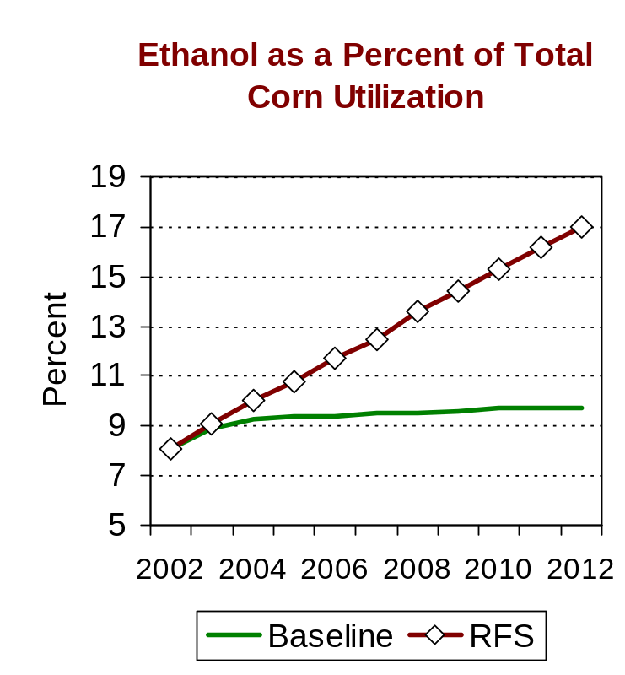
Can we produce both food and fuel?
AUS Consultants
Increasing ethanol production from 2,000 MGY to 5,000 MGY by 2012 will require an additional 425 million bushels per year.

Slide 13
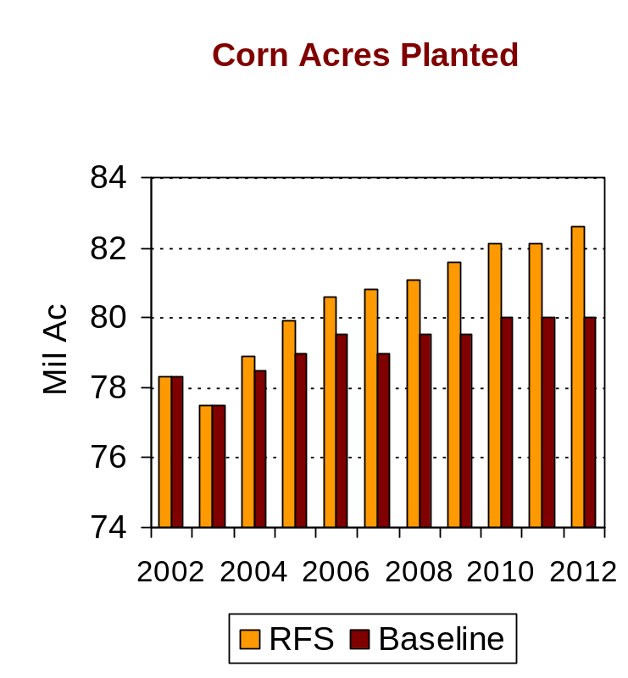
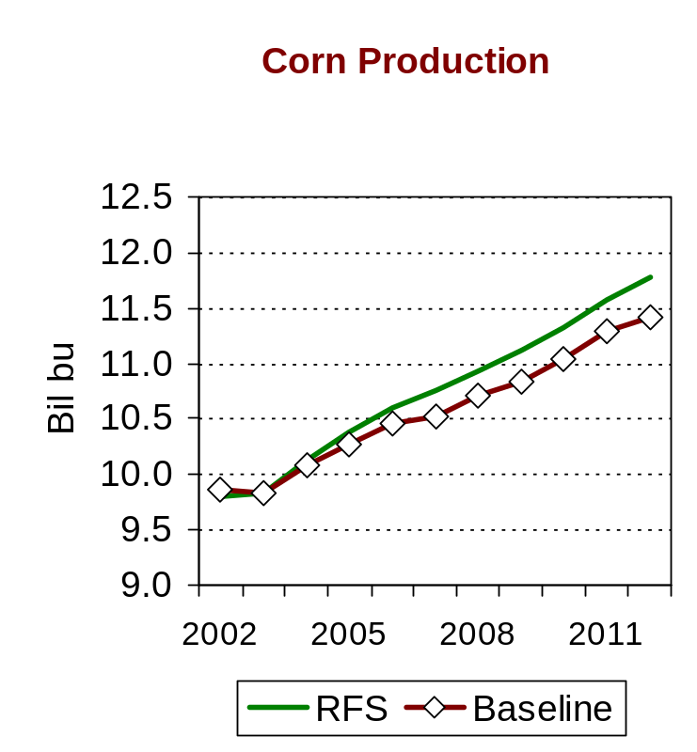
This additional demand can be met with a relatively small increase in acres planted.
AUS Consultants
Increased ethanol demand will require an additional 1.5 million acres of corn to be planted per year over the next decade resulting in planted area of 82.5 million acres by 2012.

Slide 14
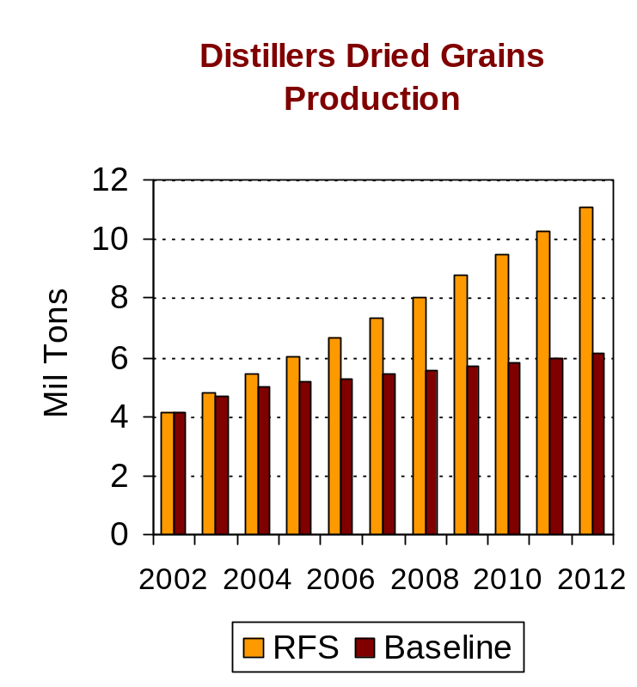
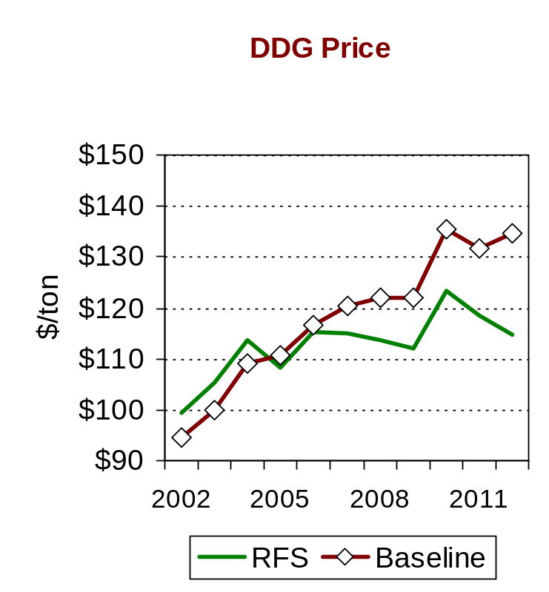
Increased use of corn for ethanol production will have a small impact on livestock producers.
AUS Consultants
Producing ethanol from corn does not remove the full feed value since DDG (a medium protein feed ingredient) also is produced. Increased ethanol production will double DDG output.

Slide 15
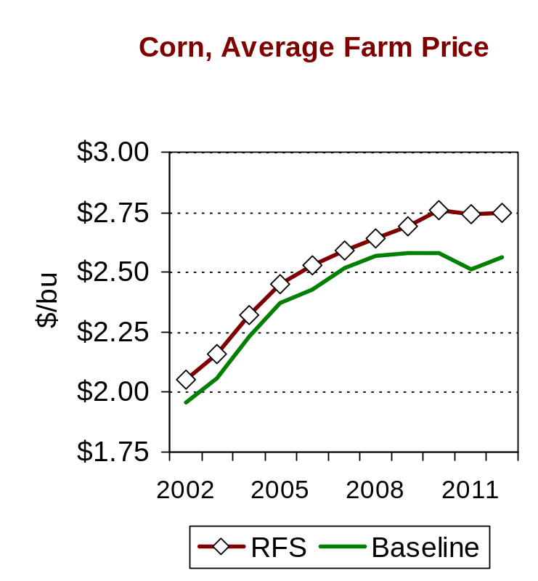
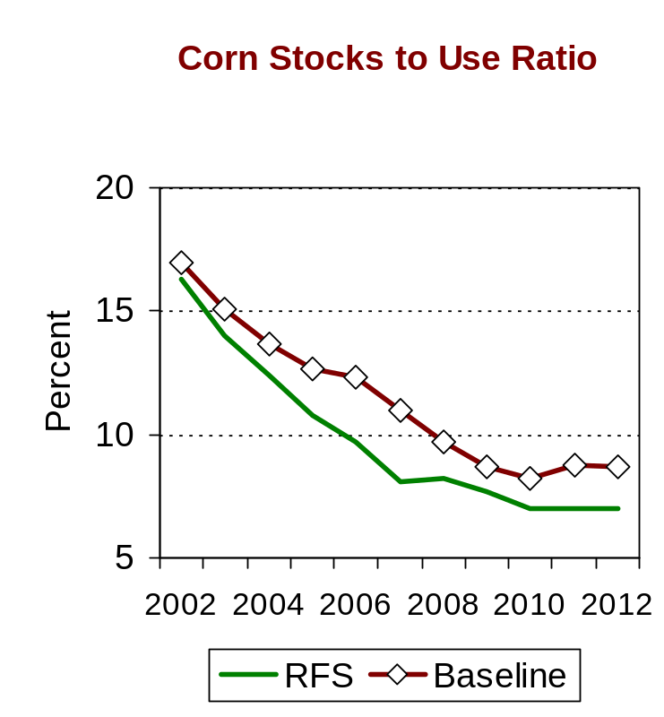
Increased ethanol production will provide important market-based support for corn prices.
AUS Consultants
An RFS will increase corn prices an average of 12 cents per bushel, or 5%, over the next decade.

Slide 16
A Renewable Fuel Standard will have a significant impact on both the farm and overall economy.
AUS Consultants
Demand for grain (mainly corn) to produce ethanol will increase 41 percent over the next decade.
The impact of higher corn prices on the livestock sector will largely be offset by larger availability and lower prices for DDG.
Little on no increase in consumer food prices should result.
Crop prices and cash receipts from marketings will increase, thereby boosting market-derived farm income.
More than $5.3 billion (1996$) of new investment spending will be made to expand renewable fuel production capacity.

Slide 17
Can we produce both food and fuel?
AUS Consultants
In short, yes.
Adequate land is available to increase plantings of corn and other grains, and a market-oriented farm bill encourages farmers to plant the most profitable crop.
Using grain to produce ethanol does not reduce the feed value available to livestock, dairy, and poultry producers. More DDG will be available at competitive prices.
The impact of higher grain prices will be offset by lower feed ingredient prices, resulting in littlt or no impact on consumer food prices.
Increased ethanol demand will provide market support for modestly higher corn prices, thereby boosting farm income and reducing direct government payments.

Slide 18
In summary, with an RFS everyone gains …
AUS Consultants
Corn prices and farm income increase with little or no impact on consumer food prices.
Dependence on foreign oil is reduced thereby enhancing national security.
The nation’s trade deficit will be reduced by more than $34 billion (1996$).
U.S. GDP will be $156 billion (1996$) higher by 2012.
More than 214,000 new jobs will be created throughout the entire economy.
Household income will expand by an additional $51.7 billion (1996$) over the next decade.

Slide 19
Thank you!
AUS Consultants

