Slide 1
Deep-Draft Channel Projects Corps of Engineers Analysis– Issues
Transportation Cost Analyses
Refinery Infrastructure Considerations
Notes:
Good Afternoon. I’m delighted to be here ! During my time, I want to acquaint you with the Corps of Engineers role in regard to waterborne commerce

Slide 2
My Role with the Corps
Corps of Engineers District Office in Galveston, Texas
Economic Evaluation and Determination of Federal Interest in Waterway and Channel Improvements (Channel Dredging Projects).
Notes:
I work for the Galveston District Corps of Engineers as a Regional Economist.
The EIA contacted the Corps of Engineers main office in Washington DC asking for participation in today’s conference.
The EIA wanted input from the Corps on how the Corps evaluates refinery infrastructure in our navgation planning studies.
The Corps Washington Office asked if I would represent the Corps.

Slide 3
Organization of Corps
The US Army Corps of Engineers Headquarters is made up of made up of an Executive Office and 17 Staff Principals. The Headquarters, located in Washington, DC, creates interprets, and enforce policy and plans future direction of all the other Corps organizations.
The workforce of the U. S. Army Corps of Engineers (USACE) consists of 98% civilian & 2% military personnel.
The Corps is involved in civil works and military support.
Notes:
The US Army Corps of Engineers Headquarters, which is located here in Washington, consists of an Executive Office and 17 Staff Principals.
Corps Headquarters is responsible for defining policy and plans future direction of all the other Corps organizations.
The United States Army Corps of Engineers is made up of approximately 34,600 civilian and 650 military men and women.
98% CIVILIAN 2% MILITARY

Slide 4
Division Alignment
Great Lakes and
Ohio River Division
Northwestern
North
Atlantic
South Pacific
Southwestern
South
Atlantic
Pacific Ocean
Division
Mississippi
Valley Division
Notes:
The Corps is organized geographically into 8 divisions in the US and 41 subordinate districts throughout the US, Asia and Europe. The districts oversee project offices throughout the world. Divisions and districts are defined by watershed boundaries, not by states.

Slide 5
Divisions and Districts
The Corps is organized geographically into 8 divisions in the US and 41 subordinate districts throughout the US, Asia and Europe. The districts oversee project offices throughout the world. Divisions and districts are defined by watershed boundaries, not by states.

Slide 6
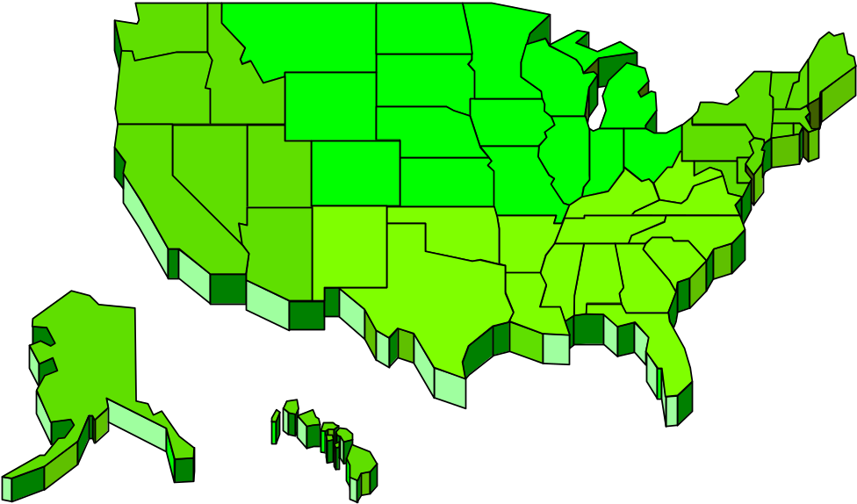

Project Missions
Lock / Dam Replacement -
Inland Waterways System
Salmon Mitigation
Environmental Infrastructure Needs
Environ. Restoration
Port / Harbors
Flooding
Erosion/Hurricane Protection
Wetland Losses
Water Supply
Navigation
Environmental Infrastructure Needs
“High Priority” Missions:
Flood Damage Reduction
Commercial Navigation
Ecosystem Restoration
Letter to Corps District Office
Notes:
•Planning, designing, building and operating water resources and other civil works projects (Navigation, Flood Control, Environmental Protection, Disaster Response, etc.)
•Designing and managing the construction of military facilities for the Army and Air Force. (Military Construction)
•Providing design and construction management support for other Defense and federal agencies. (Interagency and International Services)

Slide 7
Corps / Civil Works Mission
Planning, designing, building and operating water resources and other civil works projects (Navigation, Flood Control, Environmental Protection, Disaster Response, etc.)
Designing and managing the construction of military facilities for the Army and Air Force. (Military Construction)
Providing design and construction management support for other Defense and federal agencies. (Interagency and International Services)

Slide 8
Purpose of Presentation
General Overview of Corps Navigation Economic Evaluation Procedures
Outline Criterion for Determining Federal Interest in Navigation Projects
Notes:
My purpose is to provide a general overview of Corps evaluation procedures
And
Outline the criterion for determining Federal Interest

Slide 9
Application to EIA
The Corps often uses or considers the Dept. of Energy (DOE/EIA) forecasts, along with site specific trend data, and other published forecasts for our project specific port and waterway studies and general channel improvement evaluations.
Notes:
The Corps uses and evaluates EIA forecasts and trend data.
As part of our regional studies and associated requests to participate in determining whether the Federal government should recommend and provide financial support in the form of Tax Dollars for Channel Deepening and Widening and general port associated modifications.
Texas Port Studies: channel deepening and widening; general navigation.
The Galveston District geographical area of responsibility includes the entire coast of Texas. Channel Improvement evaluations are underway for
CORPUS CHRISTI BEAUMONT/PT ARTHUR
TEXAS CITY FREEPORT
UNDER CONSTRUCTION: HOUSTON SHIP CHANNEL

Slide 10
Navigation Project Initiative
Port Authority through their congressional representative asks the Corps to evaluate waterway improvements.

Slide 11
Examples of Waterway Improvements that the Corps is involved with
Channel deepening or widening.
Anchorages
Turning Basins
Locks and Dams
Harbors of Refuge
Protective Jetties & Breakwaters

Slide 12
Examples of Project Features NOT in the “Federal Interest”
Not in the Federal Interest is Defined by Corps Policy and Regulations.
Docks
Terminal & Transfer Facilities
Berthing Areas
Local Access Channels

Slide 13
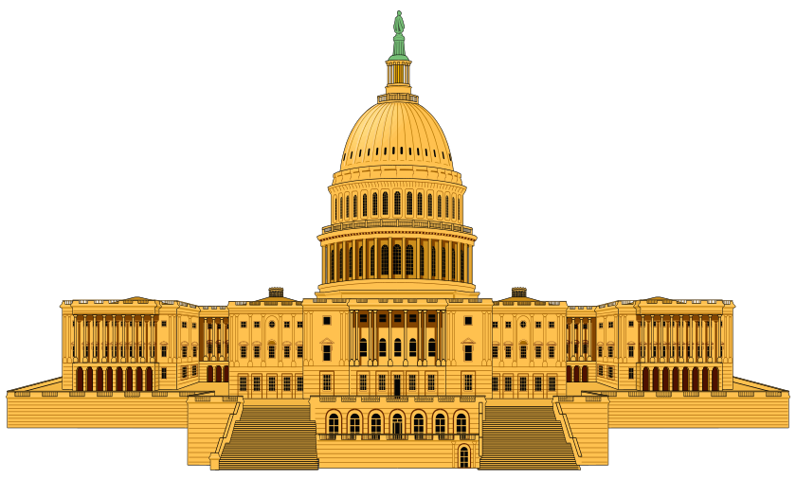

Congressional Study Resolution / Authorization
Passage ~ 2-yr. Intervals
WRDA Bill
Authority - Congress!
Study Resolutions
WRDA Bills
Standing Authorities
Appropriations Bills
( Step 1 )
Member
Have we studied the problem before?
Environment & Public Works Committee
Transportation & Infrastructure Committee
OR
Senate Resolution
House Resolution
Civil Works Project Delivery - “An Overview”
- Signed by President

Slide 14
The economic merits of Civil works projects are primarily measured against the Federal Objective--

Slide 15
Federal Interest in Navigation
Commerce Clause of the Constitution, and subsequent court decisions, defined the right to regulate navigation and waterway improvements establish the Federal interest in navigation
Navigable waters facilitate commercial transportation in support of interstate and foreign trade.

Slide 16
The Federal Objective of water and related land resources project planning is to contribute to NED consistent with protecting the Nation’s environment, pursuant to national environmental statutes, applicable executive orders & other Federal planning requirements.

Slide 17
Determination of Federal Interest as it applies to Navigation
Federal interest in a project depends on whether it provides benefits to the public by facilitating commerce.
Determination of federal interest requires identification of public purpose and access.

Slide 18
Determination of Federal Interest as it applies to Navigation (continued)
Federal Projects must be open to public use for the project purposes.
For navigation projects, the access required is at least one location with the vessel services needed to achieve project benefits.

Slide 19
General Example of a Navigation Project Initiative or Request
Existing Channel Dimension:
40 feet deep by 400 to 500 feet wide
Sponsor (example might be a port authority) asks the Corps to evaluate channel depths up to 50 feet; along with channel widening.

Slide 20
Water and related land resources project plans shall be formulated to alleviate problems and take advantage of opportunities in ways that contribute to the National Economic Development (NED) objective.

Slide 21
Contributions to National Economic Development (NED) are increases in the net value of the national output of goods & services, expressed in monetary units.

Slide 22
Principles and Guidelines (P&G)
P&G were established pursuant to the Water Resources Act of 1965 (Pub. L. 89-80), as amended (42 U.S.C. 1962a-2 and d-1).
P&G is intended to ensure proper and consistent planning by Federal agencies in the formulation and evaluation of water and related land resources implementation studies.

Slide 23
Federal Water Resource Project Planning: Principles and Guidelines (P&G)
Federal Water Resource Agencies
Corps of Engineers (Civil Works)
Bureau of Reclamation
Tennessee Valley Authority
Soil Conservation Service

Slide 24
Examples of Typical Vessel-Draft Constrained Commodities at U. S. Ports
Crude Oil & Petroleum Products
Bulk Grain
Container / General Cargo

Slide 25
Planning Constraints (may include)
Financial / Limited Budget
Trade Route Limitation
(Panama Canal; Channel Depths)
Logistical Variables
(i.e. refinery capacity, infrastructure, pipeline networks, land side limitation; and other general water & land interface variables.

Slide 26
Data Analysis Trends
Foreign imports of crude petroleum and products have replaced domestic production for both the U. S. and the Gulf Coast.

Slide 27
General Evaluation Considerations
Analysis of vessel sizes and associated loaded drafts by commodity groups
Review commodity Origin-to-Destination Routings.
Primary emphasis historically has been on identifying % of movements that have the potential to be shipped in vessels at deeper depths

Slide 28
Evaluation Considerations
Port Depth Constraints
Trade Route Constraints
Vessel Size Utilization / Limitations
Evaluation of Offshore Lightering Costs
Cost of Channel Improvements (channel deepening, widening, environmental mitigation cost, & channel maintenance cost) on a life-cycle basis.
General Navigation Features.

Slide 29
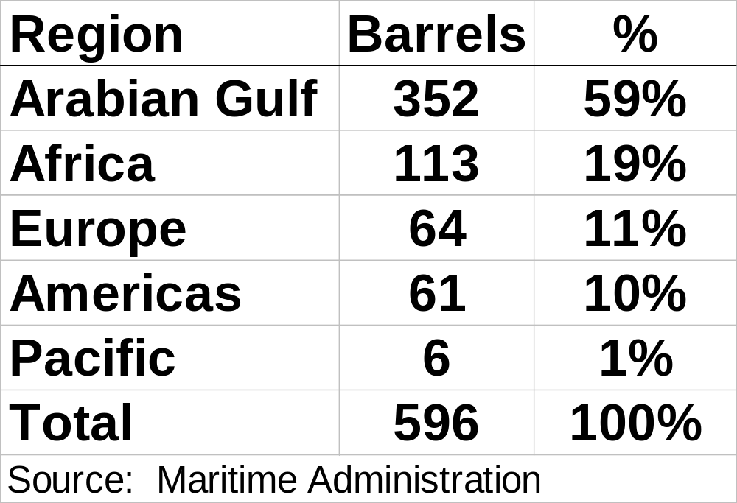
U. S. Crude Oil Imports
Offshore Lightering

Slide 30
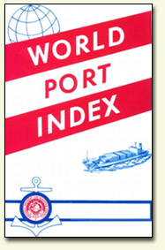
Channel Depth Constraints

Slide 31
Identification of Trade Route Constraints & General Data
General Data Sources:
Lloyds of London: Ports of the World
Fairplay Vessel Registers
Many internet links
Journal of Commerce
Waterway Journal

Slide 32
Reoccurring Issue for Texas Gulf Coast Channel Improvement Projects
Refinery Capacity *
Texas Gulf Coast petroleum refineries are operating at 93.4% of capacity for crude petroleum and products
Louisiana Gulf Coast refineries are at 98.9%.
Source: U. S. Dept. of Energy, Petroleum Supply Annual, Volume 1, p. 49.

Slide 33
Project Evaluation Considerations for Navigation Planning
Confirm vessel operating practices and ship size choices and determine the sensitivity of the project benefits to variable changes.
Determine the sensitivity of project benefits and project construction cost.
Determine effects of channel widening on vessel delay occurrences and frequencies.
Identify changes in vessel distribution & demand.

Slide 34
Effect of Refinery Capacity Expansions on Corps Waterway Projects
Determine if refinery expansion is needed to accommodate expected throughput volumes.
Cost of Refinery Expansion may need to be included in evaluation of and may be particularly important in comparison between Corps waterway improvements.

Slide 35
Data Analysis Trends
Comparison of 1980s series data with 1990/00 data slows an increasing move towards imports of not only crude petroleum but refined products

Slide 36
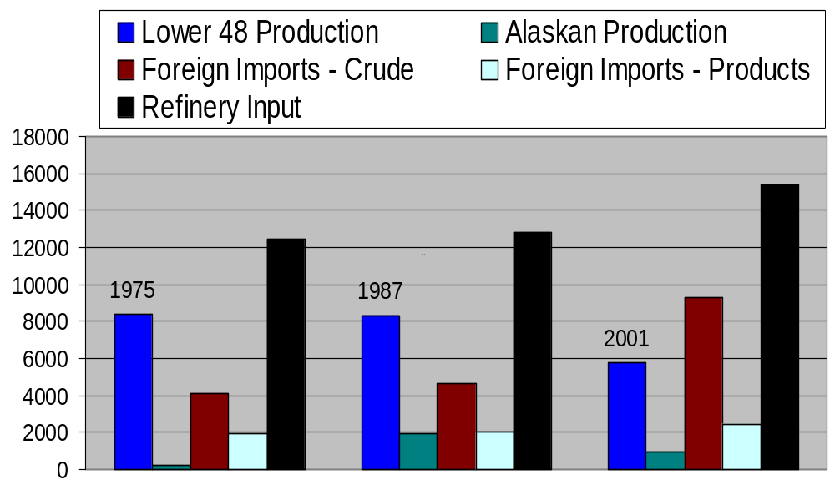

1975-2001 Petroleum Disposition barrels/day source: EIA

Slide 37
Data Analysis Trends
Since the late 1980s, receipts of domestic crude oil to the U. S. Gulf from Alaska and California has declined.

Slide 38
Data Analysis Trends
Foreign imports of crude petroleum and products have replaced domestic production for both the U. S. and the Gulf Coast.

Slide 39
Data Analysis Trends
During the 1970s and early 1980s
Most of the crude oil and products moved by water was associated with inland barges or coastwise movement between U. S. production/processing and consumption regions.

Slide 40
Data Analysis Trends
During the 1980s, high volumes of Alaskan crude oil was shipped to U. S. Gulf Coast ports. Oil went by ship from Alaska to Panama, where it was transferred by pipeline.

Slide 41
Data Analysis Trends
Comparison of decade interval data between 1981/00 and
1991/00 shows that product imports are up by over 70 percent.

Slide 42
Data Analysis Trends
The U. S. Gulf Coast leads the nation in refinery capacity. The Gulf is nation’s leading supplier in refined products. Products such as distillates or derivatives (gasoline, heating oil, diesel & jet fuel) are transported to the East Coast and the Midwest.

Slide 43
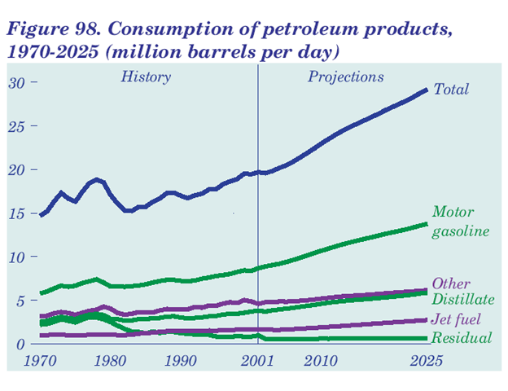
Source: DOE/EIA
Jan 2003

Slide 44
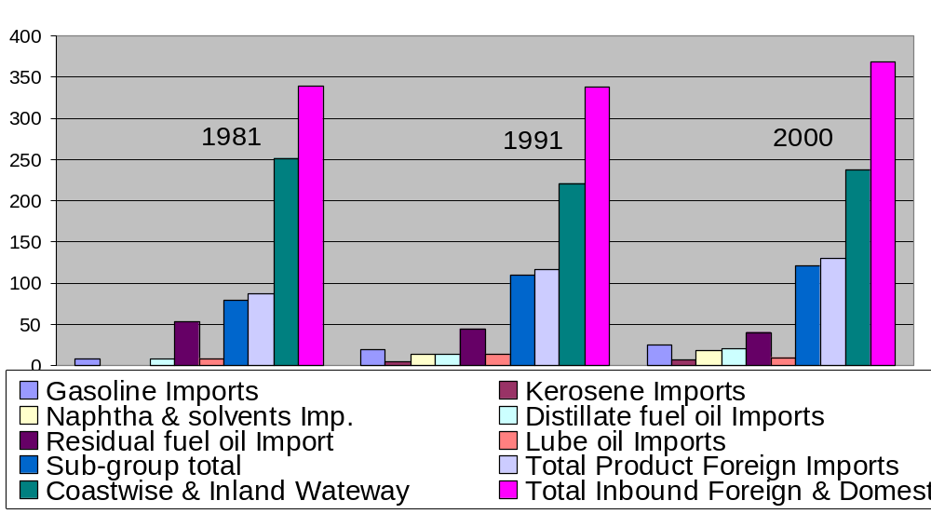
U. S. Foreign & Domestic Waterborne Commerce millions of short tons
Petroleum Products

Slide 45
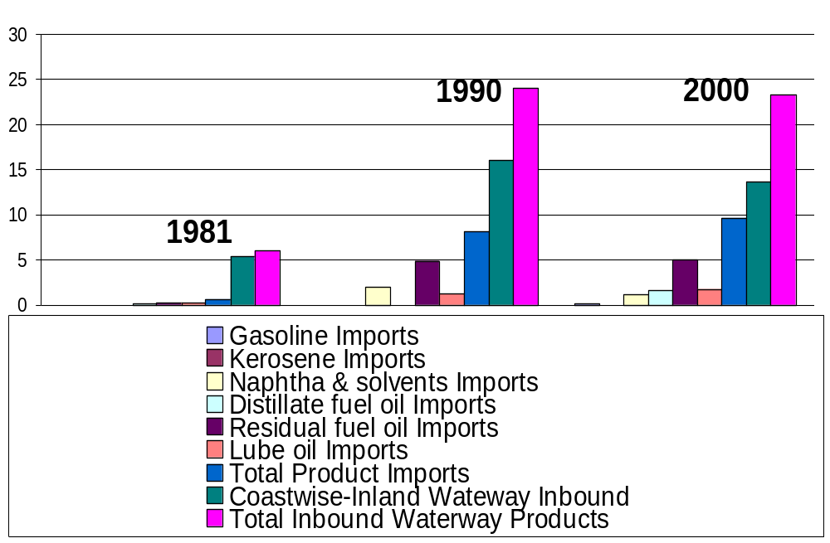
Corpus Christi, TX,
Foreign & Domestic Waterborne Commerce millions of short tons of Petroleum Products

Slide 46
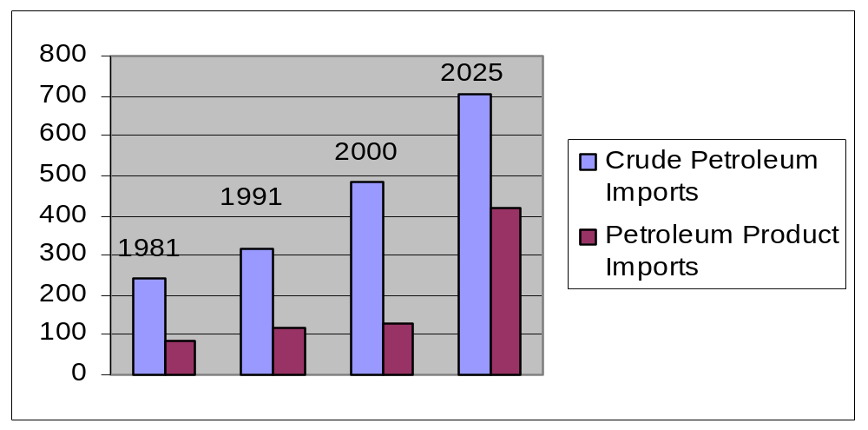
U. S. Petroleum Imports millions of short tons

Slide 47
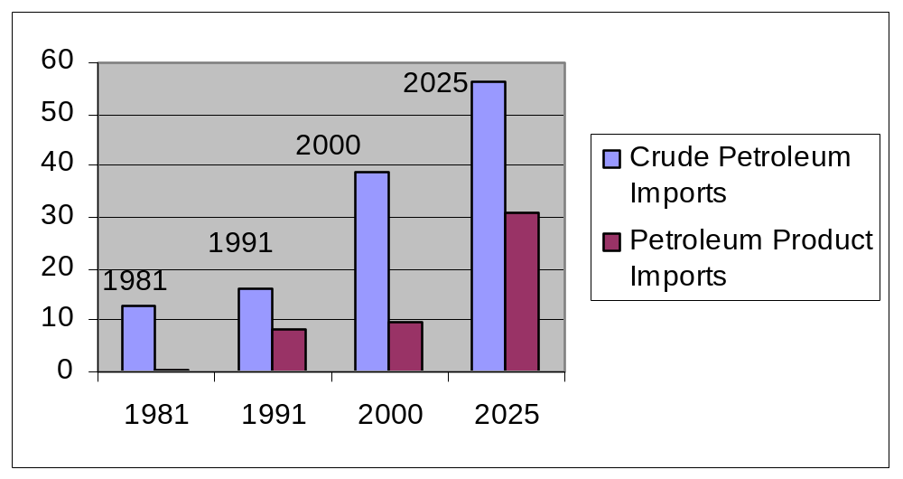
Corpus Christi, TX Petroleum Imports millions of short tons

Slide 48
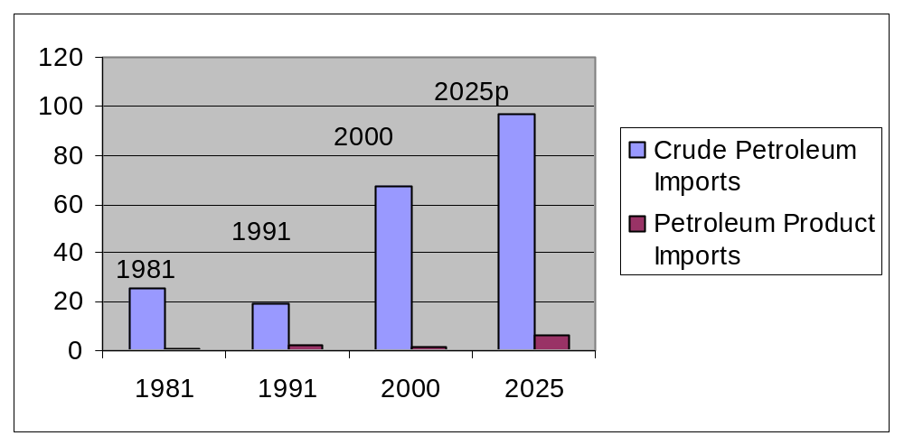
Beaumont-Pt. Arthur, TX Petroleum Imports millions of short tons

Slide 49
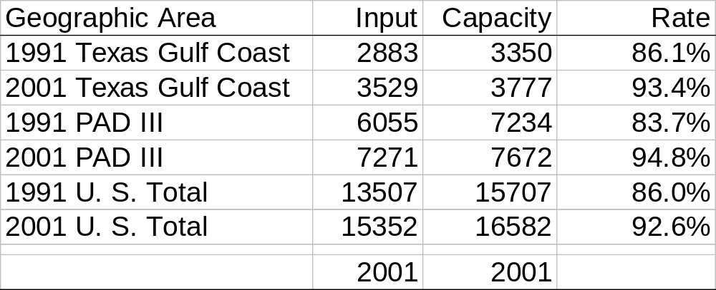
Atmospheric Crude Oil Distillation 1000’s of barrels, 1991-01
Notes:
Review of EIA statistical data shows that Capacity has increased but utilization rates are also up.
And the increase in utilization is what is of concern.
Terminal operators at the Texas Coastal Ports have expressed concern that they are operating at or near capacity.

Slide 50
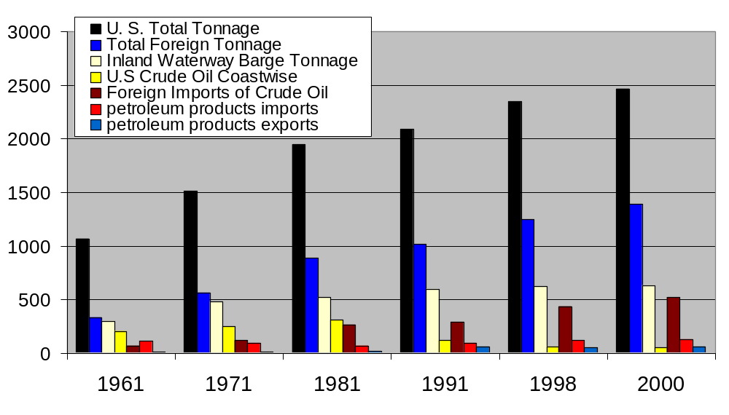
Waterborne Commerce
1961-2000 million of short Tons

Slide 51
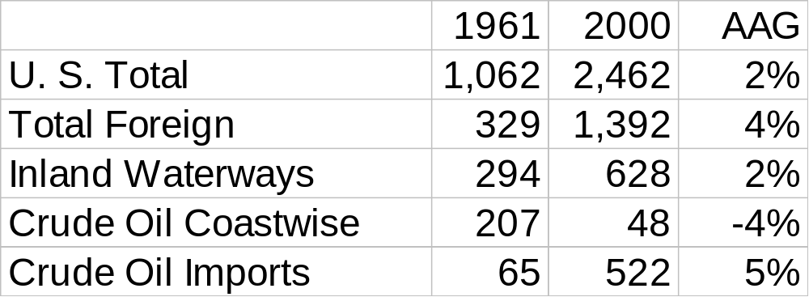
U.S. Waterborne Commerce
1961-2000 & Average Annual Growth Rate

Slide 52
MARAD: U. S. Foreign Waterborne Trade (million of short tons)
Port | 1998 | 1999 | 2000 | 2001
Houston | 98 | 95 | 109 | 118
S. Louisiana | 60 | 71 | 77 | 75
New York | 56 | 58 | 63 | 72
New Orleans | 79 | 70 | 67 | 65
Corpus Christi | 54 | 56 | 55 | 49
Los Angeles | 30 | 33 | 40 | 42
% of Total | 35% | 35% | 36% | 36%
All Ports Tons | 1075 | 1096 | 1158 | 1161

Slide 53
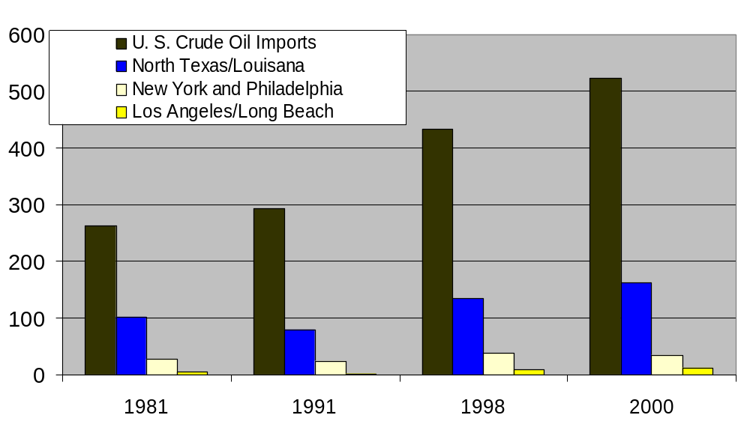
U. S. Crude Oil Imports millions of short tons

Slide 54
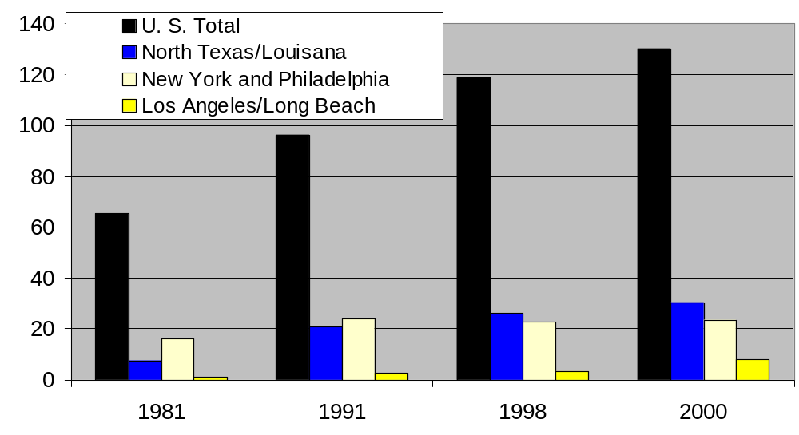
U. S. Product Imports millions of short tons

Slide 55
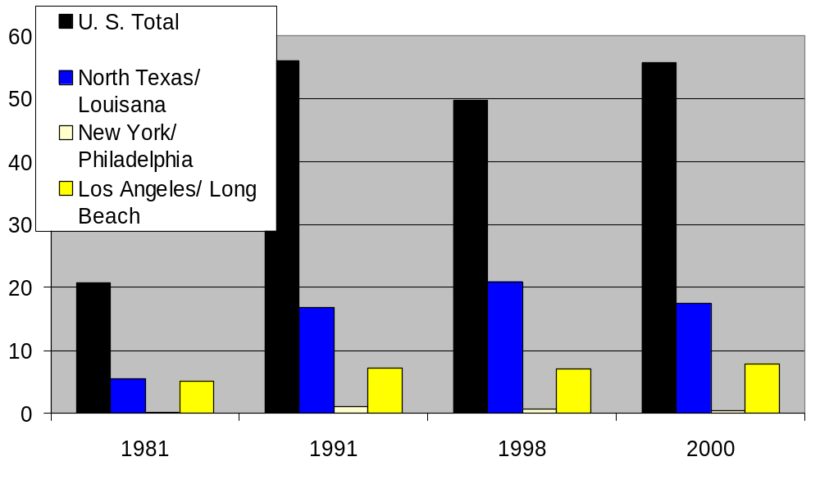
U. S. Product Exports millions of short tons

Slide 56
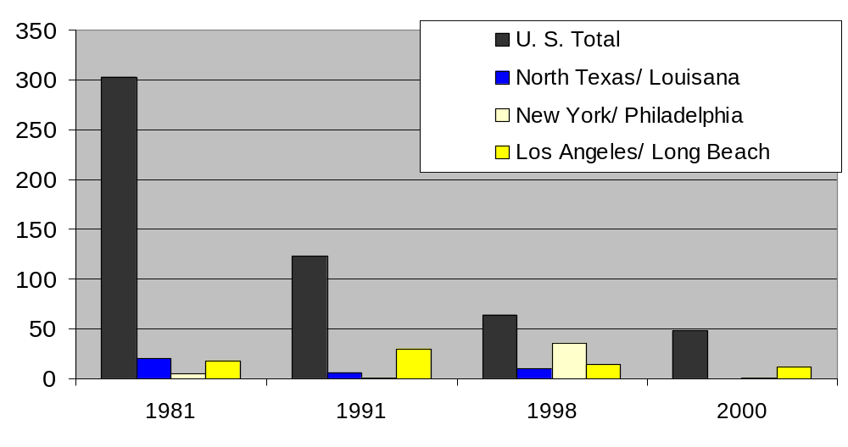
U. S. Coastwise Movements millions of short tons

Slide 57
Identification of Traffic Problems (general steps)
  Talk with Vessel Pilots, Sponsor, Port & Industry Representatives.
  Determine the number of vessels and % of tonnage presently light-loaded (I.e. transported in vessels with design drafts greater than the channel depth.
  Talk with vessel operators and harbor pilots.

Slide 58
Identification of Traffic Problems (general steps)
  Identify other sources of traffic problems (may include vessel meeting constraints due to channel width or unsafe bends)
  Determine trade route constraints
  Talk with sponsor, waterway users and vessel pilots, project engineers, environmental managers, obtain public input.

Slide 59
Identification of Traffic Problems (general steps)
Historic trends are assessed for the purpose of determining the commodity groups limited by the constraints of channel dimensions.
Within the context of this framework, channel constraints are defined to exist when some % of the tonnage currently or anticipated to be transported in vessels that cannot be fully loaded.

Slide 60
U. S. Gulf Coast Example Trips by Vessel DWT, Length and Beam (ft)
Vessel DWT | % Trips | LOA | Beam
<4000 | 1% | 253 | 47
4000 to 19999 | 6% | 436 | 65
20000 to 39999 | 23% | 602 | 90
40000 to 80000 | 17% | 677 | 104
80000 to 99999 | 46% | 795 | 136
100000 to 160000 | 8% | 831 | 140
Total | 100%

Slide 61
Evaluation Criteria
Identification of Traffic Problems
Identify range of potential solutions along with constraints
  Common constraints include:
    constraints are driven by costs,
    environmental impacts & associated cost
    shipping constraints / logistical constraints
    Implementability / engineering feasibility

Slide 62
Identify Vessel Traffic Problems
Review recent historical traffic data
Tonnage Volumes
Vessel Sizes
  Identify tonnage shipped in draft limited vessels
  Identify trade routes associated with draft limited tonnage and shipping methods.
  Traffic density, intensity, and congestion.
  Identify channel depths at trading ports.

Slide 63
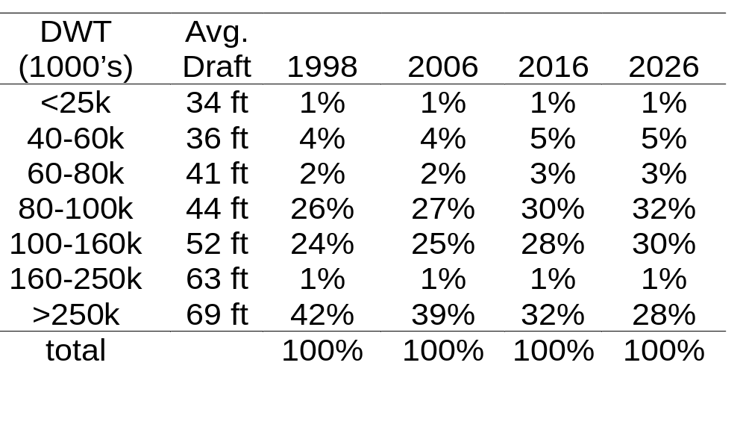
US Gulf Coast Crude Oil Imports
World Fleet Forecast Group Projections source: 1998 McGraw-Hill/DRI data extraction

Slide 64
Planning Guidance
The overall procedures used by the Corps for navigation planning project formulation and evaluation are contained in Engineering Regulation (ER) 1105-2-100.
The ER outlines the requirements for conducting planning studies within the Corps of Engineers Civil Works Program.
http://www.usace.army.mil/inet/usace-docs/eng-regs/er1105-2-100/toc.htm

Slide 65
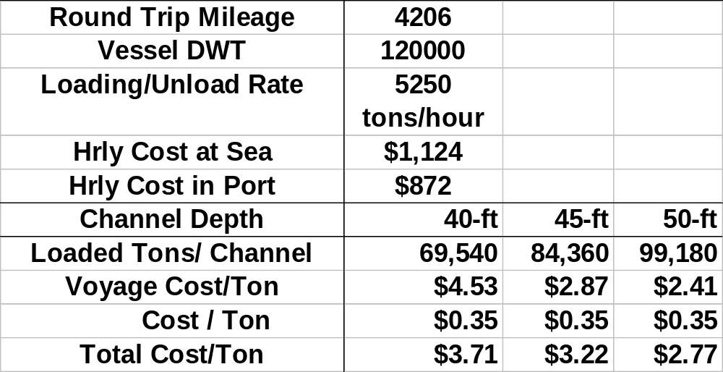
Crude Oil Cost/Ton by Channel Depth
Venezuela to Beaumont, Texas sample calculation for presentation

Slide 66
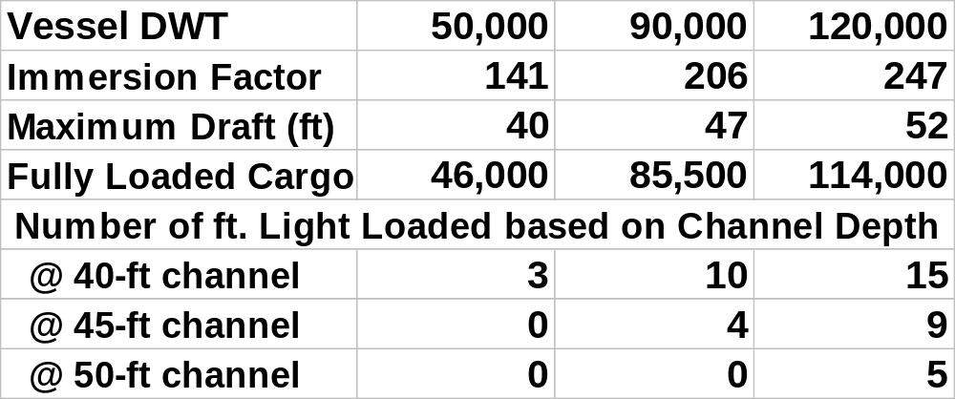
Cargo Capacity by Vessel Size & Channel Depth (abbreviated example)

Slide 67
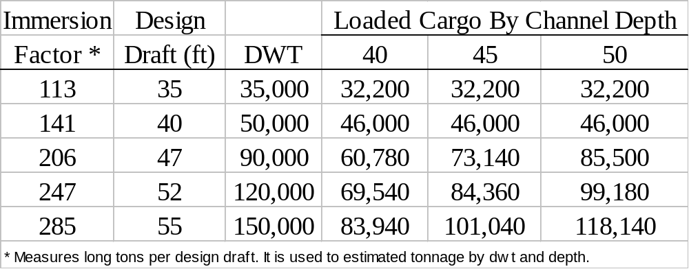
Immersion Factor Application to Estimate Loaded Tonnage based on Vessel DWT, Design Draft and Channel Depth

Slide 68
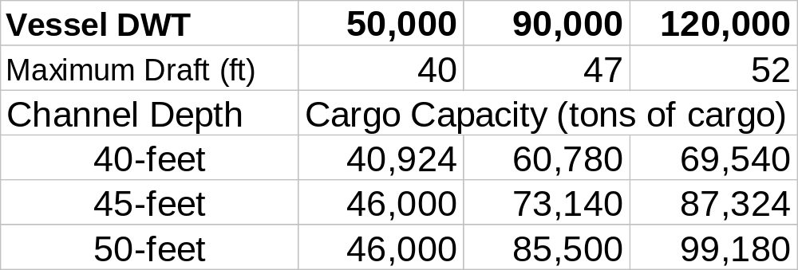
Cargo Capacity by Vessel Size & Channel Depth (abbreviated example)

Slide 69
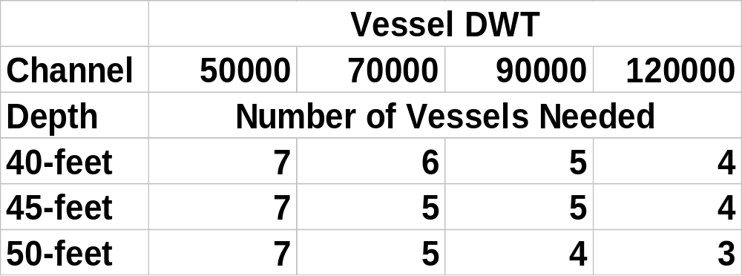
Number of Shuttles
Offshore Lightering
Mother Vessel: 325,000 dwt. (abbreviated example)

Slide 70
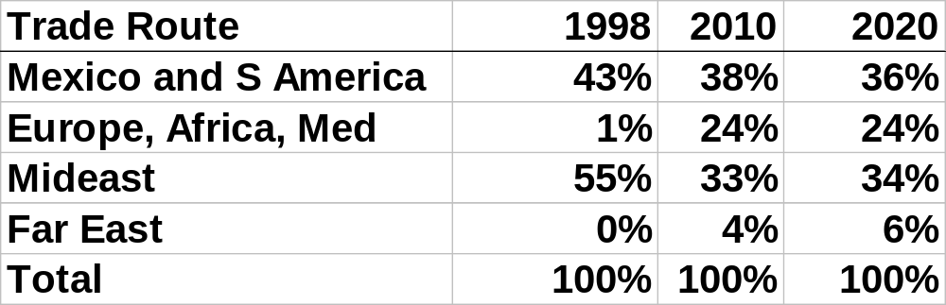
Texas Gulf Coast Port
% Crude Oil Imports by Trade Route
1998-2020 (compiled from Corps of Engineers & U.S. Dept. Commerce databases)

Slide 71
Evaluation Process
- The focus of the economic analysis is now to confirm vessel operating practices and ship size choices and determine the sensitivity of the project benefits.
-Determine the performance of selective channel
widening and calculate the reduction in expected delays.

Slide 72
Conclusions
Refinery Capacity and Expansion Issues are important to the Corps in terms of comparison of channel improvement projects.
The Corps needs to be aware of when improvements are needed and, when necessary, factor the additional cost of refinery expansion, as well as other logistical variables, into the evaluation.

Slide 73
Conclusions
Petroleum Import Growth and Demand data suggests that refinery expansions are likely needed.
48% of U. S. Crude Oil Refinery Input &
46% of operating capacity is concentrated in along the Texas and Louisiana Coast.
General concerns about comparative analysis and the importance of multiport comparative evaluations.

Slide 74
