Slide 1

Looking Out for Energy Related Multiple Pollutant Legislation
Dallas Burtraw
Resources for the Future
NEMS/AEO Conference
March 18, 2003
Background materials at http://www.rff.org/multipollutant

Slide 2
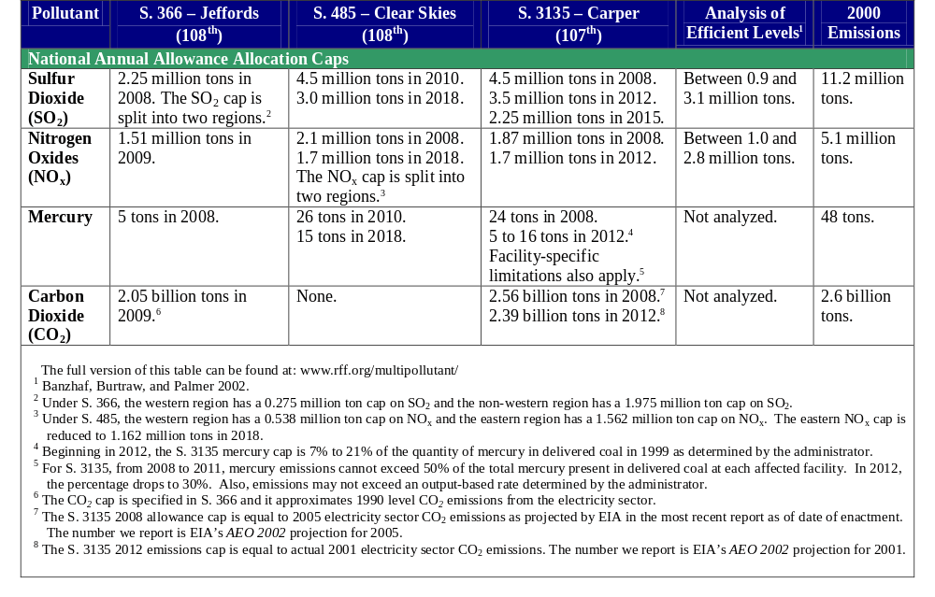
Allocation Schedules under Multipollutant Proposals
Notes:
This table lists allocations by year. Emissions will differ due to the role for banking. Although the point of multiple pollution legislation is to look at synergies in compliance and planning, I am going to look at pollutants separately.

Slide 3
Efficient Emission Levels for SO2 and NOx
Scenario and Key Assumptions
PM-health modeled only; no ozone benefits
Examine SO2 and NOx emission fees
No CO2 or mercury requirements
Results for 2010
Title IV SO2, SIP Call NOx baseline
Pope et al. (1995) for sulfates
Nitrates as ordinary PM₁₀
VSL=$2.25 million (Mrozek and Taylor, 2001)

Slide 4
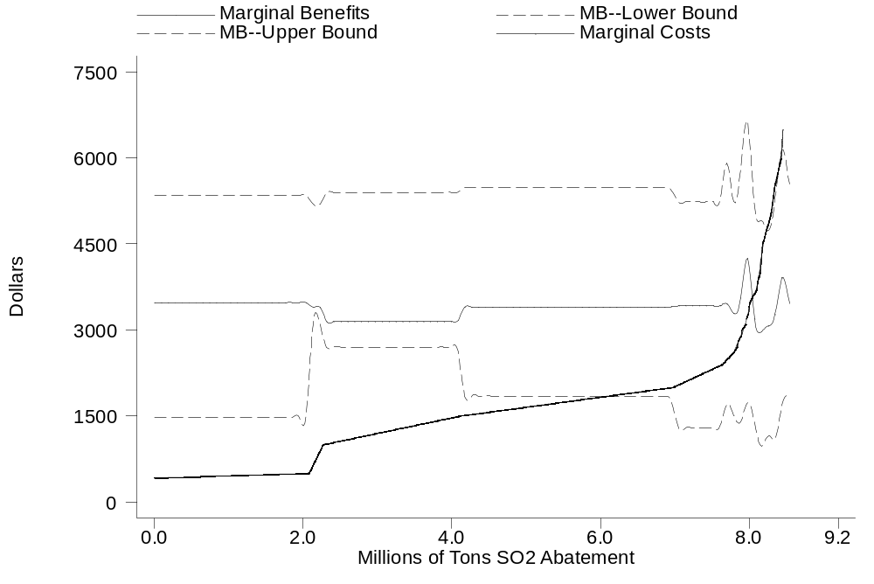

Marginal Benefits and Costs: SO₂

Slide 5
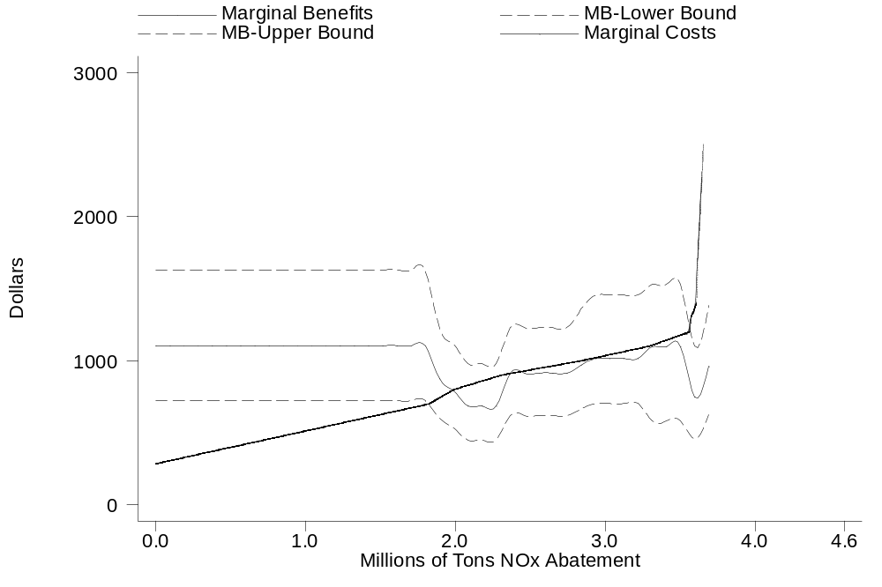
Marginal Benefits and Costs: NO_{X}

Slide 6
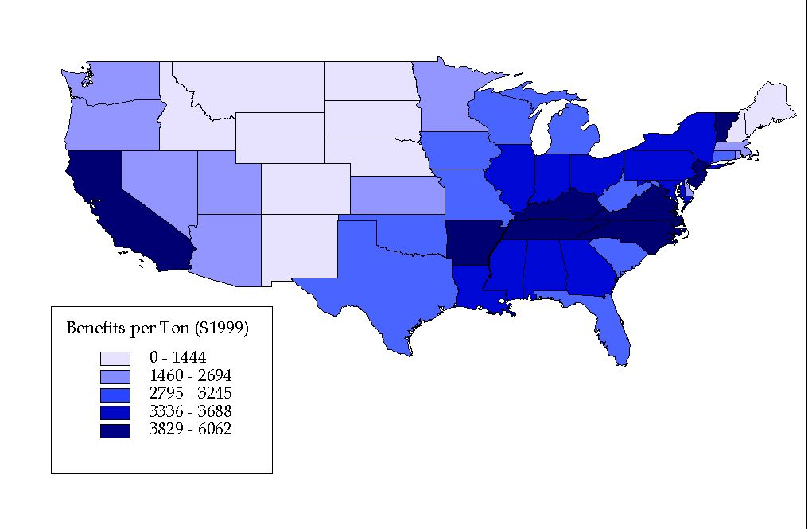
Value of SO₂ Emission Reductions by State
Notes:
Benefits per Ton SO2 by Emission Source

Slide 7
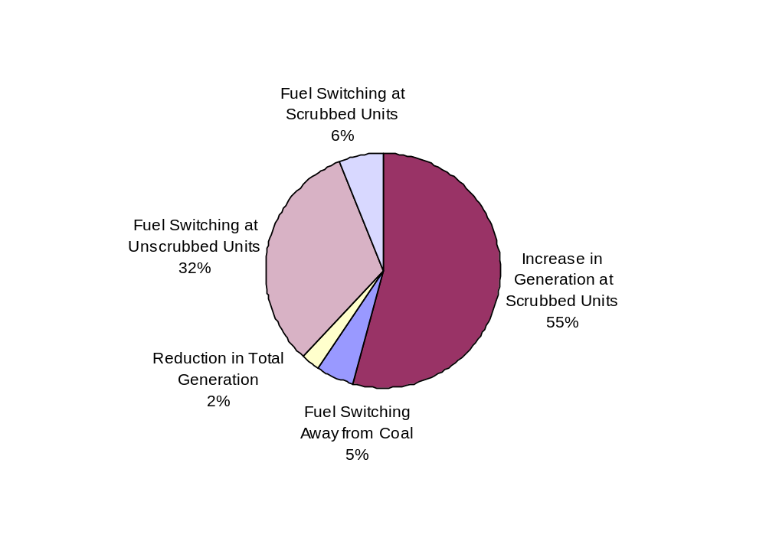
How SO₂ Reductions Are Achieved at ‘Efficient Levels’
Notes:
Note fuel switching at scrubbed plants.

Slide 8
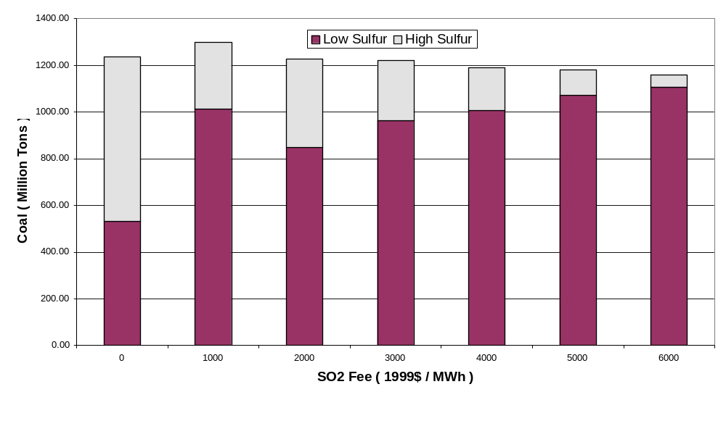
Coal Demand by Sulfur Content
Notes:
Not substitution to western coal, which is reversed when scrubbers are installed, but finally one has to switch further to low sulfur coal with scrubbers. Total tonnage remains fairly constant. The CSI levels correspond to about $2,000 permit fee, when mercury is modeled separately.

Slide 9
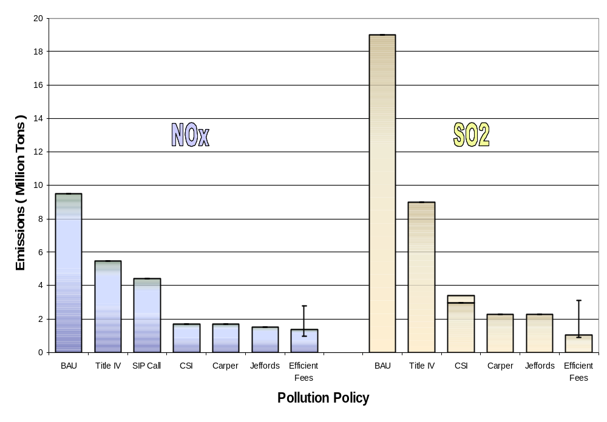
NO_{X} & SO₂ Electricity Sector Emissions in 2020
Source: Banzhaf, Burtraw and Palmer, 2002. Public Utilities Fortnightly
Notes:
This does not account for enforcement / implementation of the CAA. This only displays legislative initiatives against BAU absent the CAA.

Slide 10
Main Points on Criteria Pollutants
SO2 and NOx caps for all of the proposals appear justified... there is room for more SO₂ reductions; NO_{x} reductions about right.
  Efficient SO₂ fee ($4,700 - $1,800 per ton) would yield 0.9 – 3.1 million tons.
  Efficient NO_{X} fee ($1,200 - $700 per ton) would yield 1.0 – 2.8 million tons.
Evidence supporting regional caps.
Ancillary CO₂ reductions.

Slide 11
Mercury
Target:
What does benefit literature say?
MACT~7.4 tons/yr to Ancillary~28 tons/yr
(current levels in coal burned: ~75 tons/yr)
Timetable:
Help states
Design:
Trading enables tougher goals. Perhaps with…
- Maximum emission rate constraint
(not minimum emission rate reduction), and
- State opt out of trading for local protection
Notes:
One-third (37%) of US emissions from utilities.
About two-thirds of deposition in US from US sources.

Slide 12
Architecture for Carbon
Principles:
The fundamental divide: voluntary or binding
More important to start early than to start large
More important to end economy-wide than to start there
Compensation through allocation
Efficiency is essential if constraints tighten

Slide 13
1. Binding Policy
A cap provides environmental integrity.
Voluntary programs have limited possibility in a competitive economy.
Sequestration out-of-system has to be limited or carefully prescribed. Otherwise, in-system investments are undermined.

Slide 14
2. Start Early Rather Than Start Big
Signal to R&D, investment communities, households
Reward, not punish, early reductions
Banking builds buy-in to program for firms
Develop institutions
Time to plan for stricter policy serves as compensation
Harvest low hanging fruit
Starting modestly allows for learning about science, costs, economic trade-offs

Slide 15
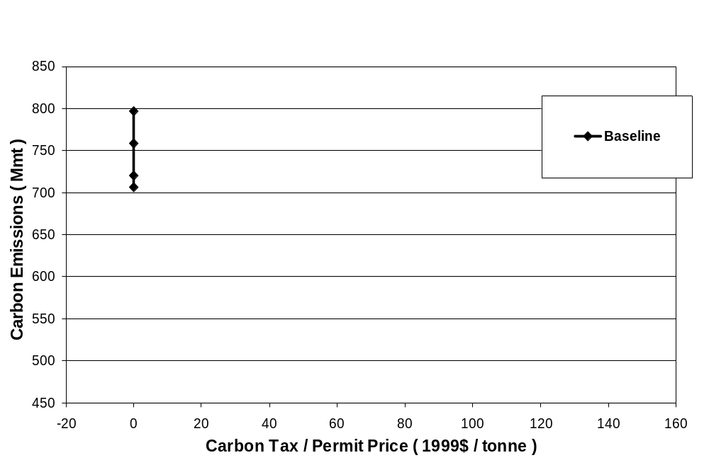
Carbon Schedules in Electricity Sector
Notes:
Note price along horizontal axis. Years in these simulations are 2008, 2010, 2015, 2020.

Slide 16
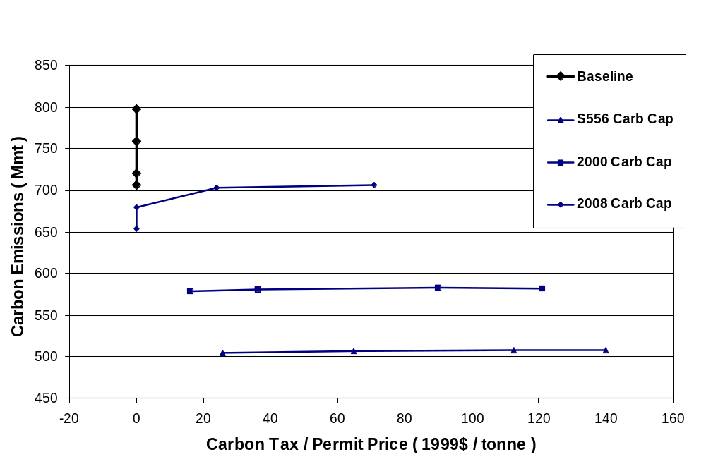
Carbon Cap Schedules in Electricity Sector
All allowances are auctioned. SO₂ and NO₂ caps from S.556, no mercury caps are modeled. SV=Safety Valve, with annual increase.

Slide 17
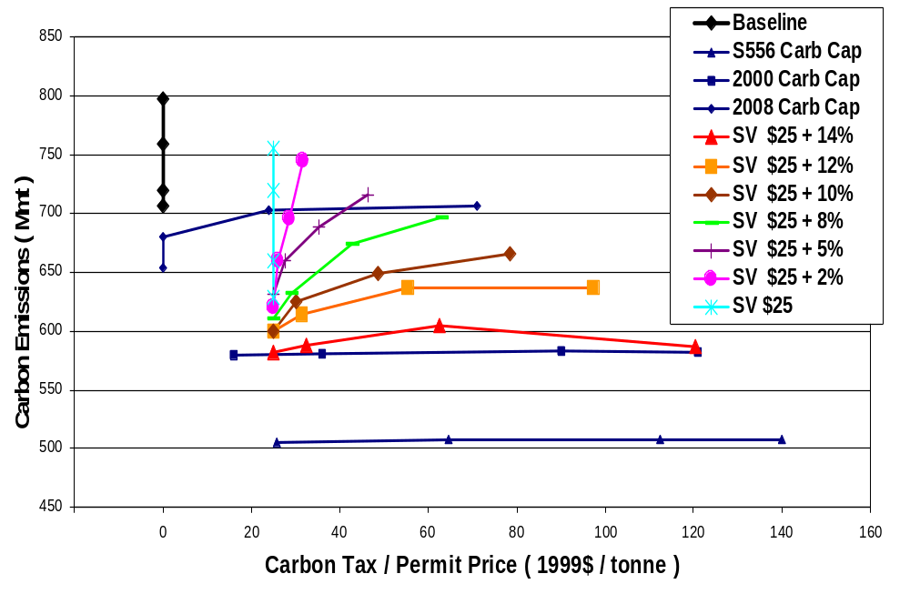
Carbon Schedules in Electricity Sector
All allowances are auctioned. SO₂ and NO₂ caps from S.556, no mercury caps are modeled. SV=Safety Valve, with annual increase.

Slide 18
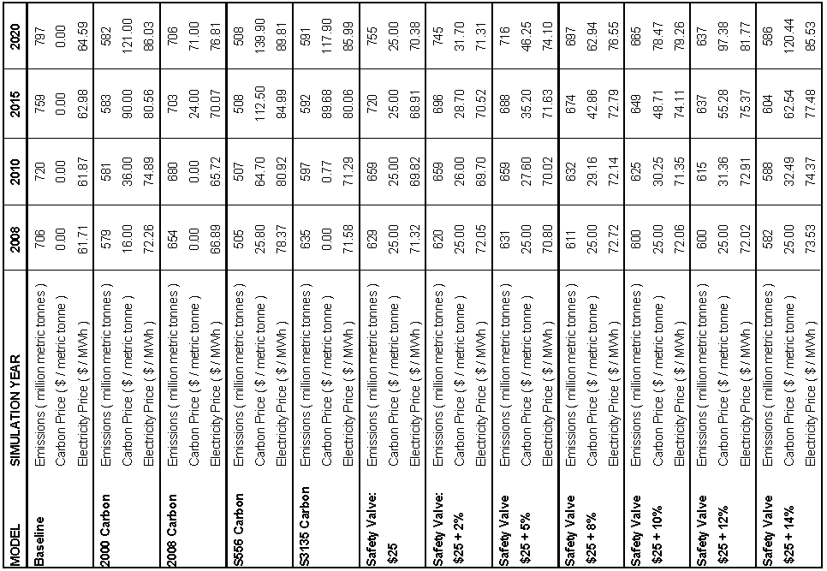
Carbon Targets and Schedules
In all runs, allowances are auctioned. SO₂ and NO₂ caps from S.556, no mercury caps are modeled.

Slide 19
3. Open Architecture: Economy-wide
Ultimately we must do economy-wide; plan for the transition
Capture least cost reductions across sectors

Slide 20
4. Compensation through Allocation
Free distribution of allowances with grandfathering can (over) compensate firms
Free distribution through output-based allocation undermines asset values and harms many firms
Auction revenues can compensate households/taxpayers; fund incentives for IGCC, etc.
A hybrid approach can achieve important compensation goals for affected groups
But interest group claims for allowances dilute opportunity for tax reductions

Slide 21
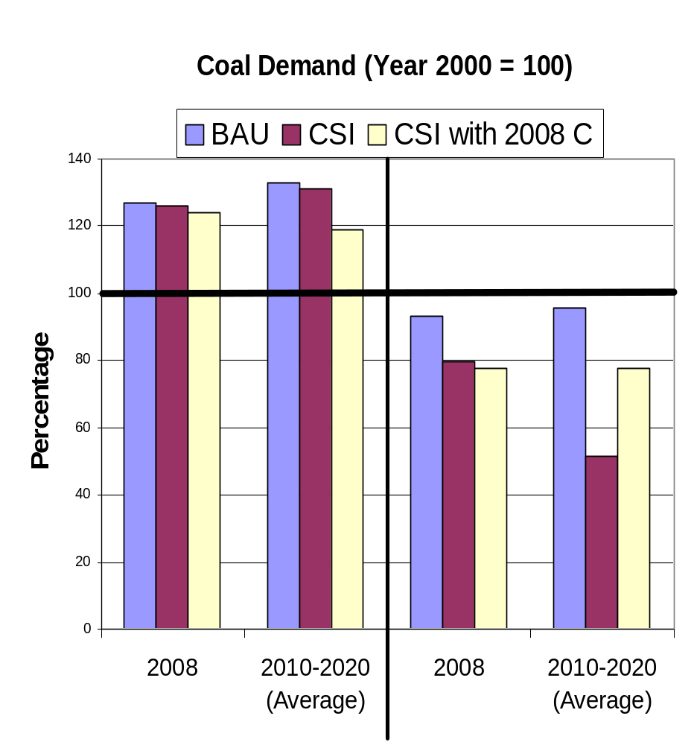
Effects on Coal Demand Of Adding Carbon to CSI
CSI maintains total coal demand (tons), but causes shifts among supply regions
Adding carbon reduces aggregate demand but lessens regional shift
NATIONAL
NORTHERN APPALACHIAN
Mercury constraints not modeled; would strengthen result.

Slide 22
Three Allocation Schemes
(Au) Auction (Safety Valve)
(GF) Grandfathering
(OBA) Output Based Allocation (updating)

Slide 23
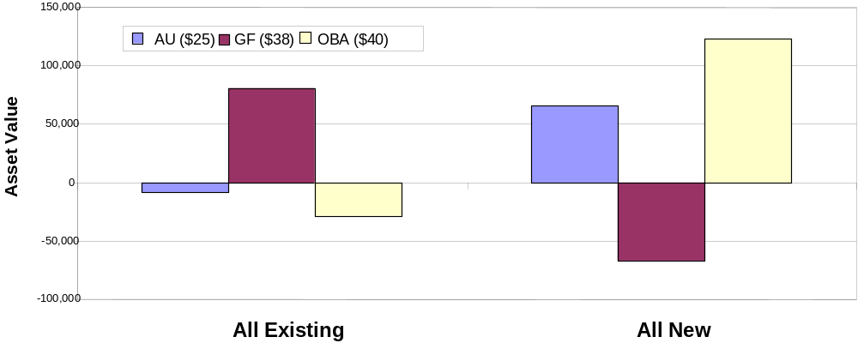
Change in Asset Values and Compensation
(1997 $/MW in 2001; 35 million mtc carbon)

Slide 24
Illustrative Effects on Three Firms
4
25 Au
38 GF
40 OBA
3
Change in Asset Value
(Billion 1997 $)
2
1
0
-1
Firm A
Firm B
Firm C
Coal
Coal
Coal
Capacity Mix
Capacity Mix
Capacity Mix
Non
Non
Non
-
-
-
emitting
emitting
emitting
Gas & Oil
Gas & Oil
Gas & Oil
Notes:
This slide tells the story for three large US utilities (names withheld here and conveniently forgotten by this 40+ year old researcher..).
These firms differ in terms of the composition of their generating capital stock
Firm A has just under 50% non-emitting more than 25% oil and gas and under 25% coal. This firm experiences increases in asset value under GF and AU
However, firm B which has no non-emitting resources and a huge proportion of coal suffers a loss in assets value under all three approaches
Firm C, which is composed mostly of gas and oil loses only slightly under the Auction and loses more under the GPS
The GPS is clearly the worst deal for all three firms.

Slide 25
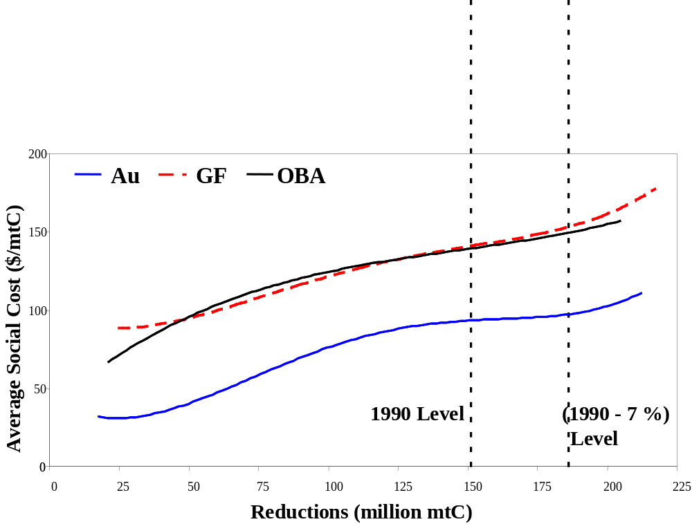
5. Efficiency is essential if constraints have to tighten because costs grow large
Notes:
Explain axes and lines on graph and dotted vertical lines.
Over wide range of possible reduction targets, auction is half as costly ….
For some levels of reduction 1/3 as costly as other two…

Slide 26
Why Allocation Matters to the Cost of Reducing Carbon Emissions
There are actually two reasons an auction (safety valve) is dramatically more efficient from social perspective:
Market Imperfections
(discussed below)
Tax/Regulatory Interaction Effects
…if revenues are linked to reducing distortionary taxes!

Slide 27

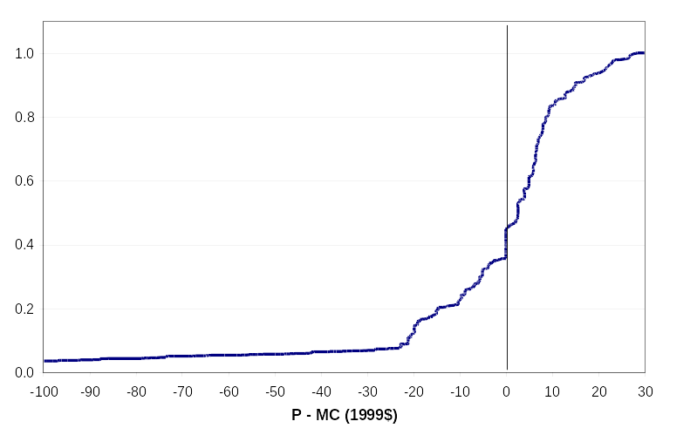
Inefficiency from
Notes:
Illustration of baseline (absent carbon policy) in 2012.

Slide 28
Determining Electricity Price
Total Cost ($):
capital + FOM + fuel + VOM + poll.allowances [Au]
Variable Cost Ordering ($/MWh):
fuel + VOM + poll.allowances - subsidy [OBA]
Price ($/MWh):
Regulated Price = Average Cost = (Total Cost ÷ Production)
=> Price [Au] > Price [GF, OBA]
Competitive Price = Variable Cost
=>    Price [Au, GF] > Price [OBA]

Slide 29
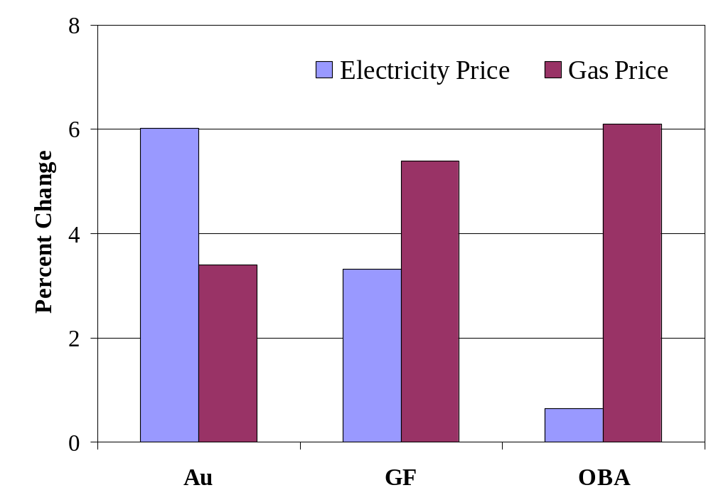
Price Effects Vary
(35 million mtC)
Notes:
Graphs shows percent change in national annual average price of electricity (for all regions and customer classes) and natural gas

Slide 30
Social Cost under Limited & Nationwide Restructuring
(1997 $ in 2012; required reductions vary to achieve same target)
100
AU
GF
OBA
80
60
Average Social Cost
(1997 $/mtC)
40
20
0
LR
NR

Slide 31
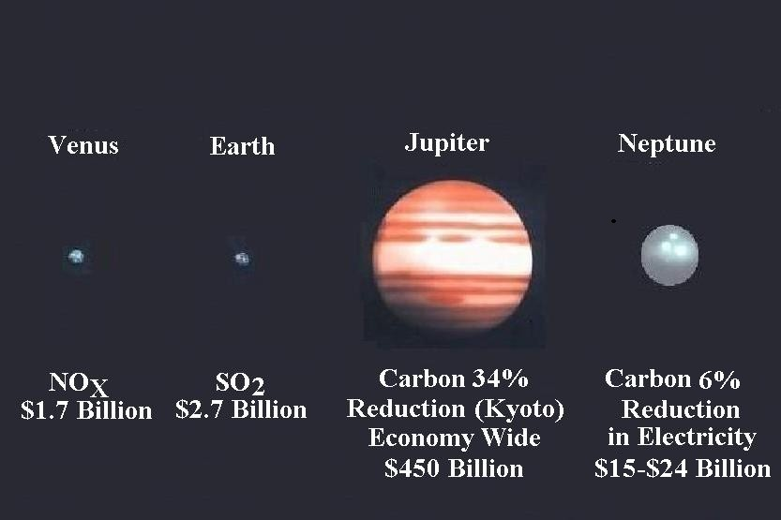
Annual Asset Value of Emission Allowances

Slide 32
Key Ingredients to Multipollutant Policy
SO₂ and NO_{X} caps are justified on benefit-cost.
Mercury trading, with constraints, can lower costs; benefits not well quantified.
Architecture is very important for carbon policy.
  Start soon rather than start large.
  Auction is less costly to society, and preserves asset values better than output-based allocation.
  The auction institution is expandable beyond electricity.
  A hybrid allocation approach to balance compensation and efficiency.

