Slide 1
Transmission Data and Analysis:
How Loose is the Connection?
Douglas R. Hale
Dhale @ eia.doe.gov
March 18, 2003

Slide 2
New Study of Transmission
Data and Analysis tools
Who?
  EIA
  DOE (Policy and Transmission)
  FERC
Objectives
  Assess whether Official data and analysis tools are sufficient to answer leading policy questions
  Identify how any gaps might be filled

Slide 3
Why the Interest in
Transmission Now?
Growth of Wholesale Power Trading
FERC’s Restructuring of Wholesale Power Markets
  Open Access (FERC 888, in 1996)
  Regional Transmission Organizations (FERC 2000)
  Standard Market Design NOPR, 2002
DOE, FERC and Congressional Concerns

Slide 4
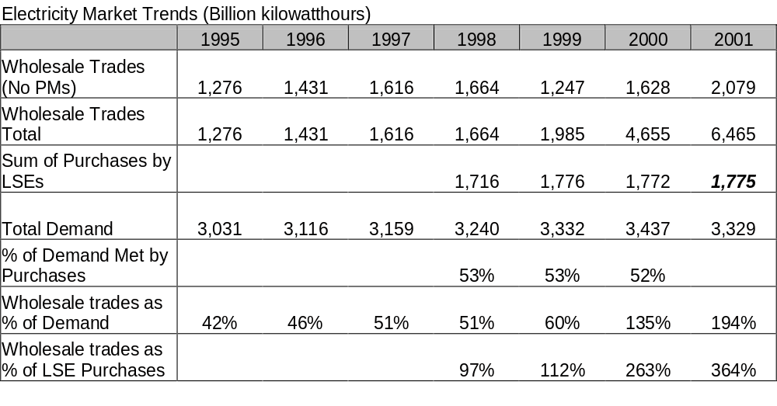
Growth of Wholesale Trading

Slide 5
FERC’s Restructuring Strategy Depends on Transmission
Open Access for generator competition
  More transmission, more competition
  Larger areas, more competition
Locational Pricing and CRRs to manage congestion
  Visible pricing of transmission constraints
  Values transmission hedges
Regional Approach to Investment

Slide 6
Government Concern: the Grid may not be up to new Roles
DOE, National Grid Study, May 2002
  …the U.S. transmission system is in urgent need of modernization. The system has become congested because growth in demand…has not been matched by investment in new transmission facilities
FERC found (New Release, July 31, 2002)
  A decade of under-investment …in needed transmission, generation siting in locations far from customers,…discriminatory behavior by transmission providers

Slide 7
Study Approach
List major policy issues
Identify and evaluate official data that addresses factual basis of policy concern
Assess how well analytical tools, including models, answer questions that data does not
Specify data and analytical tools necessary to better answer questions

Slide 8
A Point of View
Data show what has occurred
Models show what can occur under hypothetical conditions
Both are needed to answer most policy questions
Neither can be considered in isolation: data availability constrains models, theory and modeling technology determine what data is meaningful

Slide 9
Current Policy Questions (7)
What are the grid’s physical capabilities?
Are generators connecting to the grid and securing access at reasonable prices?
Is the grid operated economically, efficiently?
Are wholesale markets Competitive?
Is the Grid reliable?

Slide 10
Policy Questions (Continued)
Is the grid supporting growth? Is transmission capability expanded when economic?
Who pays unallocated costs, who benefits?

Slide 11
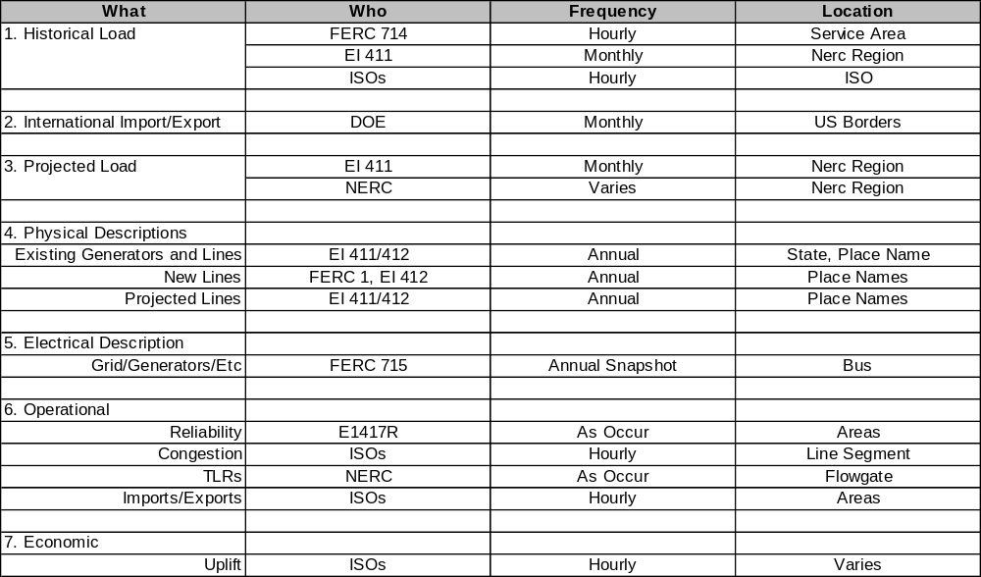
Official Transmission Data

Slide 12
Observations
Physical and electrical data are out of “sync”- means that precise 3rd party models are not possible
Investment data seriously incomplete: no metering, telemetry, computation,etc.
ISO Operational data good, others minimal
Transmission Market data is sparse

Slide 13
Congestion-One Example of
Living with the Data
Congestion refers to lines that are loaded to their limit. Results in out-of –merit dispatch (higher cost) and in some ISO’s congestion charges
FERC attempted to estimate national congestion charges
  Price data poor outside of ISO’s
  Replacement cost not always available

Slide 14
Does Data Answer Market critical Questions?
Do not seem to know, except for a few places, at a few times
  How much it costs and how long does it takes to connect
  How much generators pay to use grid
  What wholesale prices,Spot prices,Congestion are
  Grid’s reliability
  Who pays, who benefits.
Know for sure
  Bottlenecks, price differentials and controversy persist

Slide 15
Data Driven Modeling Choices
Grid Study: Simplified Model
  Highly aggregate physical network, generators, lines and load
  Assumed reference electrical flows possible under changed conditions
  Abstracted from voltage concerns

Slide 16
Bottlenecks (continued)
CRA SMD Study: Baseline, business as usual,very hard to capture
  Contingency limits
  Actual tariffs
  Actual price setting mechanism
Tentative answers reflect data, computational and conceptual difficulties

Slide 17
Investment, Competition and Growth: Any Answers?
Quantifying grid’s ability to support regional growth appears difficult, expensive and error prone
Calculating competitive prices and market boundaries doable, but controversial
Quantitative conclusions about “adequacy” or return to investment are fragile

Slide 18
Project Milestones
Independent Expert Review of Research Plan- April
First Awful Draft- Late June
Technical Workshops- July
Recovery/Rewrite/Review-August/October
Publication- December/ January

