Slide 1
Pacific Northwest Renewables
Recent experience & future prospects
Jeff King
National Energy Modeling System/Annual Energy Outlook Conference
Washington DC
March 18, 2003

Slide 2
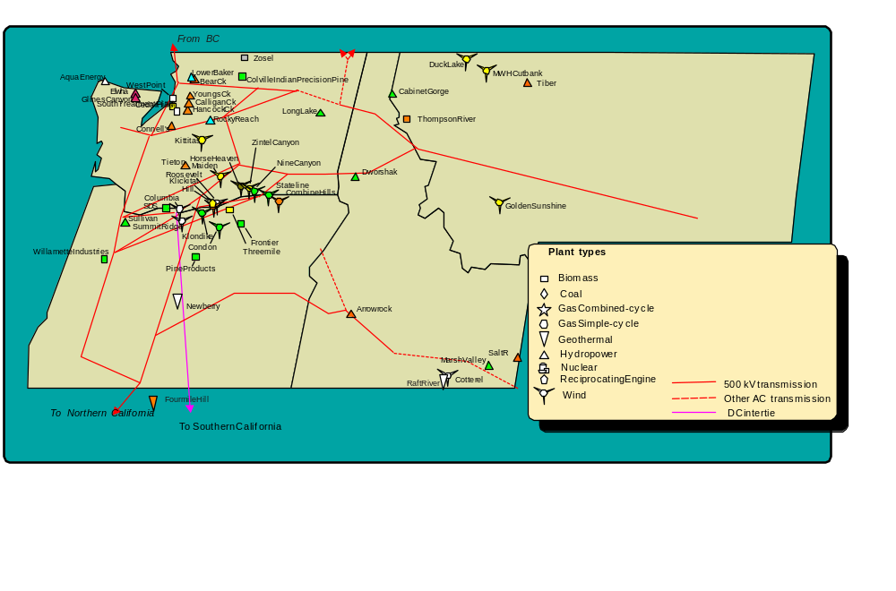
The Pacific Northwest

Slide 3
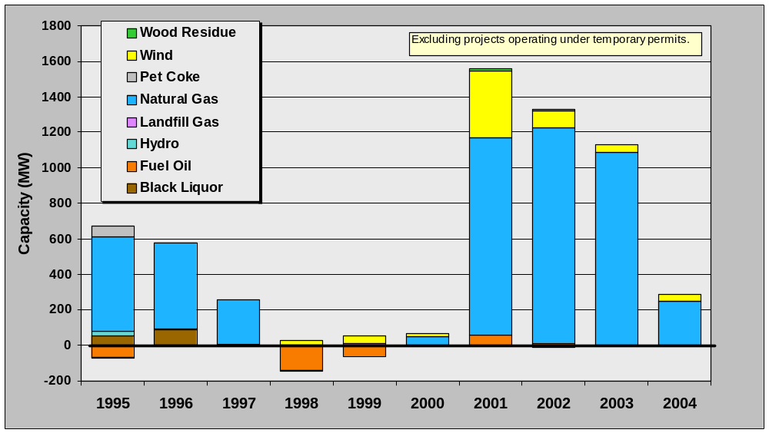
Additions & retirements: 1995 - 2004

Slide 4
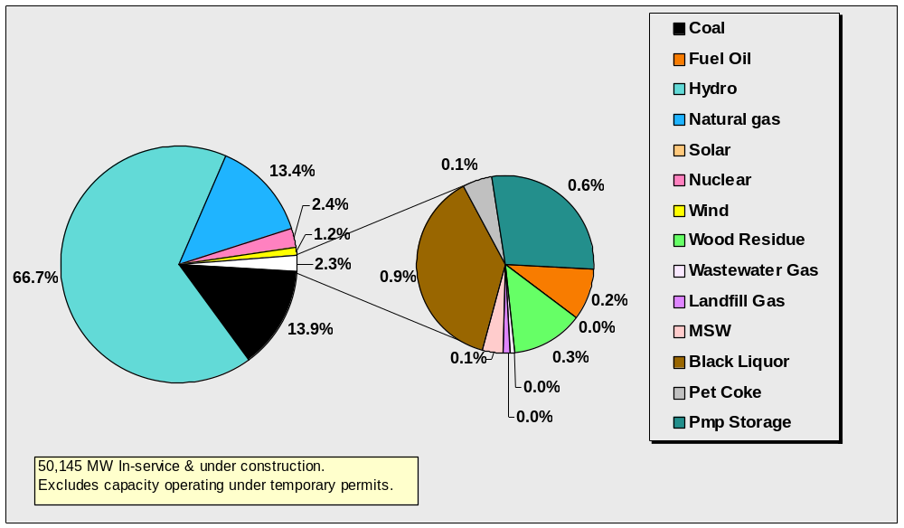
Resource mix (capacity): 2004

Slide 5
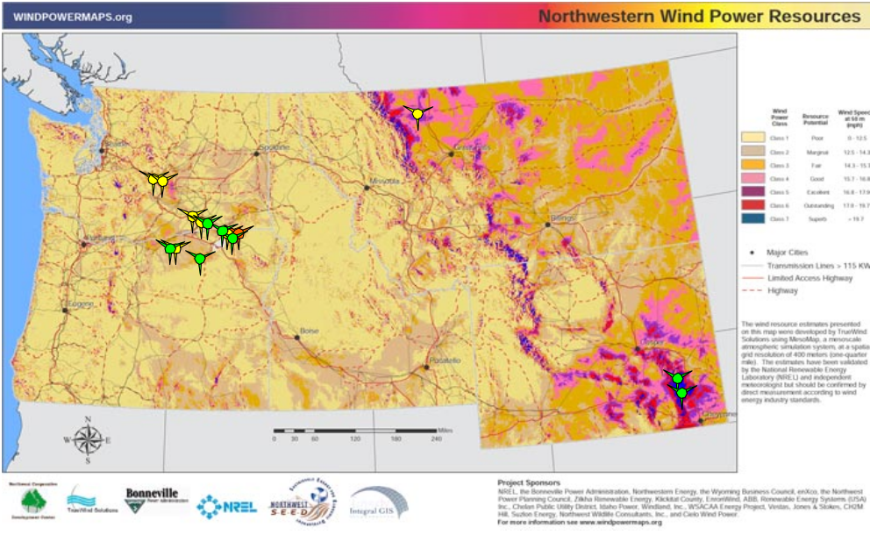
Wind

Slide 6
Why the recent success of wind?
Cost reduction
Federal production tax credit
Other revenue streams
Examples of successful resolution of siting issues
Optimism
  2000-2001 electricity price run-up
  current natural gas prices
Speculation
  CA & other renewable portfolio standards
  Risk hedging potential
Deal-making
  Condition of merger or acquisition

Slide 7
Cost of windpower has declined
Improved machine productivity
  Taller towers
  Larger rotor diameters
Improved understanding of resource and site conditions
  Usable width of ridge lines
  Extensive resource prospecting
Project scale
  Economics of development
  Economics of operation
Better understanding of the availability & cost of shaping

Slide 8
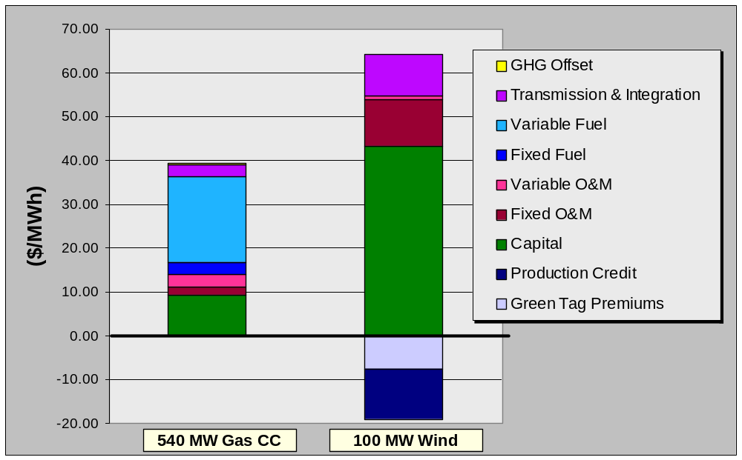
Production tax credit is key to development

Slide 9
Supplementary revenue closes the gap
RPS/System benefit charges
  OR & MT SBC “clean energy funds”
  Speculative effects of pending California; possible Washington RPS.
LSE risk-hedging
  gas price volatility
  future CO2 mitigation requirements
Retail green power purchases
  Residential (somewhat disappointing)
  Commercial (surprisingly robust)
CO2 offset market (minor player so far)
Energy component of green building certification (e.g. LEED certification)
  green product purchases
  green tag purchases

Slide 10
Siting solution is available
Dryland wheat – the ideal wind site
  Monoculture w/low ecological diversity
  Generally remote from prime aesthetic areas & population
  Few native American cultural sites
  Private ownership
Potential rent/royalty income to landowners
  Has eased siting & permitting
  Created unlikely allies for state RPS/SBC adoption.
Past & present conflicts
  Native American cultural sites (vision quest sites)
  Aesthetically sensitive areas (Columbia R. Gorge, Yakima canyon)
  Proximity to second home developments (Klickitat Co.)

Slide 11
Constraints & issues remain
Economics – not quite there
Shaping
  Some, but poorly-understood existing capability.
  Substantially attributable to the PNW hydro system.
  Probably a supply curve, increasing in cost with demand for shaping services. May steepen at 15 – 25% penetration.
  Geographic diversity of projects may reduce shaping load.
Transmission
  Limited wind resource near existing transmission
  Likely to limit development of High Plains resource
  New firm transmission expensive for wind (low capacity factor)
  Non-firm transmission access limited, probably resisted by hydro & thermal plant operators.

Slide 12
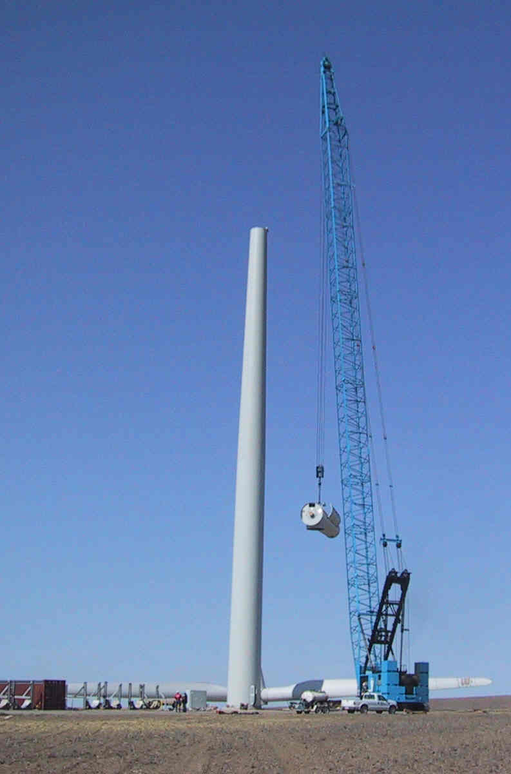
Wind prospects
Least-cost new renewable available in large quantity.
Near-term: Continued cyclic development driven by PTC and various supplementary revenue streams.
GW-scale market-driven development possible in long-term
  Greatest potential remote from load centers.
  Transmission & system integration may be limiting.
  Development sensitive to CO2 policy, gas prices.

Slide 13
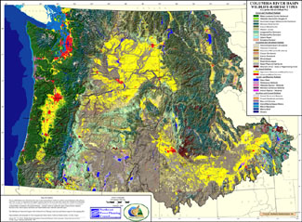
Biomass
Northwest Habitat Institute

Slide 14
Biomass status
Mill residue cogeneration has declined significantly
  declining industry
  higher value uses for residue (nearly full utilitzation).
Diverse, small-scale niche applications available:
  Upgrades of chemical recovery boilers (200 aMW potential).
  Clean urban wood residue (270 aMW potential)
  Landfill, wastewater and animal waste energy recovery (140 aMW)
A few fairly good deals (e.g. landfill gas), but most applications moderately expensive ($50/MWh & up).
Large PNW forest thinning potential (hundreds of MW), but expensive ($70/MWh) & controversial.
Uneasy acceptance as green resource: “burning stuff” vs. resolution of environmental problems.

Slide 15
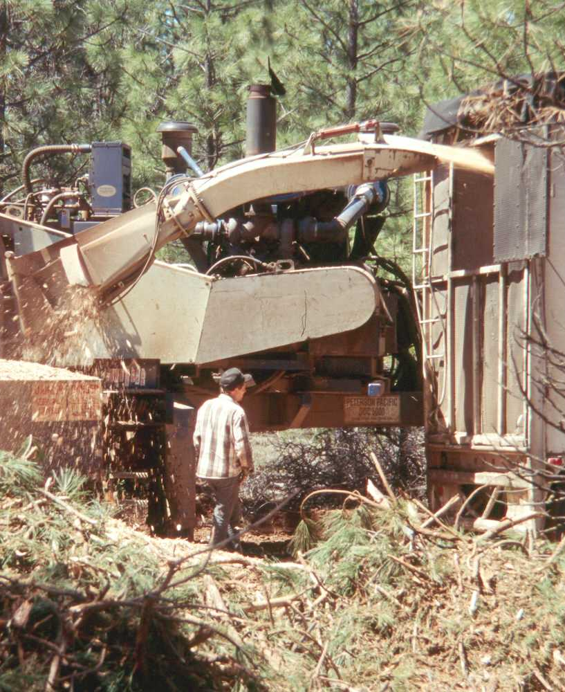
Biomass prospects
Slow development of niche applications (landfill gas, wastewater treatment, animal manure, chemical recovery upgrades). PTC may speed up.
The one big-time application, forest thinning residue, is controversial, expensive. Sensitive to PTC & federal forest policies.
Dedicated biofuel production not likely in foreseeable future (higher value alternative uses).

Slide 16
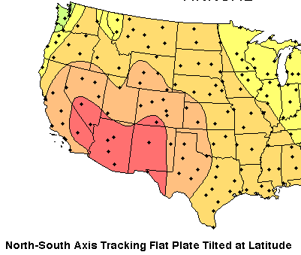
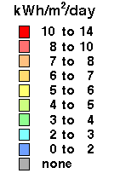
Solar
National Renewable Energy Laboratory Resource Assessment program

Slide 17
Solar status
High cost:
  Photovoltaic costs - $200 MWh & up, declining slooowly
  Solar thermal – $120 MWh, declining slooowly
Great regional interest in small-scale photovoltaic projects:
  Rooftop systems (Ashland, Chelen)
  Building-integrated systems (Orcas, Portland)
  “Mini” central-station systems (White Bluffs)
  Economic “remote” applications (microwave, RR signals, emergency communications, parking meters, etc.)
Large resource potential if costs can be reduced; but Southwest may be better source of bulk solar power.

Slide 18
Drivers of small-scale PV applications
Federal investment tax credit
State energy tax credits (OR)
System benefit charges/”clean energy funds” (OR & MT)
Feel good/green symbolism
Green building certification
  on-site systems
  green product purchases
  green tag purchases

Slide 19
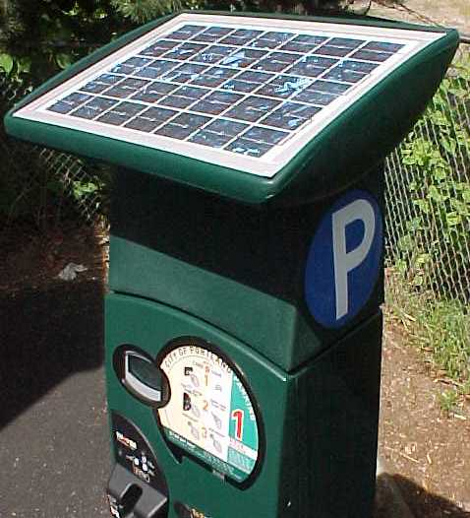
Solar prospects
Continuing development of cost-effective “remote” PV applications.
Continuing development of grid-connected kW-scale boutique PV applications.
Central-station PV or solar-thermal unlikely in foreseeable future.

Slide 20
What about geothermal?
Potential highly uncertain, but less optimistic now than in the past (unsuccessful exploration).
Glass Mountain appears to be potentially the big enchilada:
  Proven production wells
  Positioned for California RPS
  BPA holds contract rights
Continuing basin & range plays in Nevada – may be limited similar potential in OR & S. NV.
Some development of small-scale direct applications (appears to have been fairly static in recent years).

Slide 21
What about hydropower?
Will continue to be the major player, though a slowly declining fraction of total capacity.
Possible, but limited further derating for fish & wildlife mitigation.
Lower Snake R. breaching seems to be off the table.
Increasing probability of climate change effects with significant consequences (earlier runoff).
Limited potential for new construction.
Limited potential for hydro upgrades.

Slide 22
For more information:
Northwest Power Planning Council
851 SW Sixth Avenue
Portland, OR 97204
503-222-5151
www.nwcouncil.org

