Slide 1
Multi-emission Proposals
John Kinsman
Edison Electric Institute
Washington, D.C.
March 18, 2003
Energy Information Administration
Washington, D.C.

Slide 2
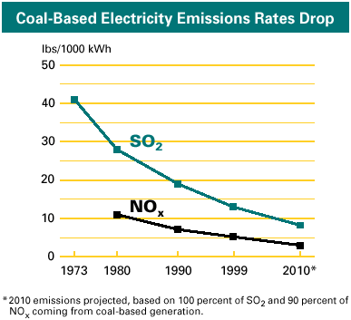
Electricity from Coal Is Essential & Increasingly Clean

Slide 3
The Clean Air Act’s Complex Set of Requirements
Further progress under the Clean Air Act is complex, burdensome and uncertain
NSR Permits for new sources & modifications that increase emissions
Note: Dotted lines indicate a range of possible dates.
¹ Further action on ozone would be considered based on the 2007 assessment.
² The SIP-submittal and attainment dates are keyed off the date of designation; for example, if PM or ozone are designated in 2004, the first attainment date is 2009
EPA is required to update the new source performance standards (NSPS) for boilers and turbines every 8 years
Ozone
Designate areas for
8-hr Ozone NAAQS
1-hr Severe Area
Attainment Date
Marg-inal 8-hr Ozone NAAQS Attain-ment Date
8-hr
Ozone
Attain-
ment
Demon-
stration
SIPs due
Assess Effectiveness of Regional Ozone Strategies
Moderate 8-hr Ozone NAAQS Attainment
Date
1-hr Serious Area Attainment Date
OTC NOx
Trading
Possible Regional NOx Reductions ?
(SIP call II)¹
NOx
SIPs
Due
NOx
SIP Call
Serious 8-hr Ozone NAAQS attainment Date
99
00
01
02
03
04
05
06
07
08
09
10
11
12
13
14
15
16
17
18
Mercury
Determination
Proposed
Utility
MACT
Final
Utility
MACT
Compliance
with Utility MACT
Compliance for BART Sources
Compliance for BART sources under the Trading Program
Phase II
Acid Rain
Compliance
Designate Areas
for Fine PM NAAQS
New Fine PM NAAQS
Implementation Plans
Latest attainment
date for Fine PM NAAQS ³
Second Regional Haze SIPs due
Interstate Transport Rule to Address SO2/ NOx Emissions for Fine PM NAAQS and Regional Haze
Regional Haze SIPs due
In developing the timeline of current CAA requirements, it was necessary for EPA to make assumptions about rulemakings that have not been completed or, in some case, not even started. EPA’s rulemakings will be conducted through the usual notice-and-comment process, and the conclusions may vary from these assumptions.
Acid Rain, PM_{2.5}, Haze, Toxics

Slide 4
Multi-Emission Legislation –
Possible Futures
  Environmental group alternative - “maxed out” emissions reductions, more lawsuits and limits on flexibility.
  Opposite extreme - poor economy, international strife, energy concerns and more lawsuits temper environmental regulations.
  Both of these alternatives are highly unlikely.
  In the middle are EPA’s regulatory alternative and the President’s Clear Skies Act.
Notes:
NRDC future
extreme regulations re: Hg MACT, 8-hour ozone, fine particles, regional haze, non-mercury HAP's
Lawsuits
all layered inefficiently on top of current Clean Air Act
E.g., Jeffords bill
Opposite extreme
increased recognition of the importance of cost-effective domestic energy supplies - especially coal
EPA regulatory future
Mercury MACT proposal (Dec. 15, 2003)
NSR routine maintenance proposal (final by end of 2003 remotely possible?)
regional transport rule to address fine particles (final by mid-2005, under which Administration?)
These are layered on top
Uncertain emissions reductions levels – for SO2 and NOx likely not as deep cuts as in Clear Skies; mercury = ?

Slide 5
The Current Path Provides Little Certainty for
Electric Providers, Shareholders or the Environment
  Increases complexity of multi-layered CAA.
  Increases difficulty of planning.
  Can lead to uneconomic decisions for companies.
  Causes higher prices for consumers.
  Increases shifts in fuels used (more natural gas).
  Can even undermine reliable electric generation.
Notes:
There are many disadvantages of staying on the current path of the Clean Air Act.
These disadvantages are magnified in the extreme Congressional proposals.

Slide 6
Power Generators Requirements Under a New Multi-emission” Approach
Reasonable targets and timing.
Certainty (e.g., resolving NSR and other problems).
Flexibility.

Slide 7
The Right Multi-Emission Bill Benefits Electricity Producers, Consumers and the Environment
Certainty due to simplified, streamlined Clean Air Act.
Flexibility through market-based programs (emissions trading).
Cost-effectiveness due to certainty and flexibility.
Adequate time to install technology due to reasonable targets and timetables, preserving coal generation.
Notes:
Emissions will continue to decrease without a multi-emission bill, but with less impact and efficiency, and at greater cost
For years, EEI and its members have promoted a comprehensive, flexible, and cost-effective approach
If done correctly, could lower compliance costs, save money for customers, and facilitate diverse fuel mix
Could reduce the litigation logjam that often postpones achievement of real air quality progress
Must allow sufficient time for the development and deployment of new technologies
The President’s CSI demonstrates leadership and vision toward a coherent statutory/regulatory framework; CSI’s major reductions will be extremely expensive
S.556 is unrealistic and contrary to sound energy, economic and environmental policy
Carper bill is thoughtful serious contribution to debate albeit still problematic because of CO₂, other impacts

Slide 8
The Right Multi-Emission Bill Benefits Electricity Producers, Consumers and the Environment
Minimal impact on natural gas prices due to less shifting to natural gas.
Continued reliable, low cost power.
Low cost impact for consumers and lesser impact on shareholders.
Major emission reductions and substantial reduction in number of non-attainment areas and reduced action needed in remaining non-attainment areas.
Notes:
Emissions will continue to decrease without a multi-emission bill, but with less impact and efficiency, and at greater cost
For years, EEI and its members have promoted a comprehensive, flexible, and cost-effective approach
If done correctly, could lower compliance costs, save money for customers, and facilitate diverse fuel mix
Could reduce the litigation logjam that often postpones achievement of real air quality progress
Must allow sufficient time for the development and deployment of new technologies
The President’s CSI demonstrates leadership and vision toward a coherent statutory/regulatory framework; CSI’s major reductions will be extremely expensive
S.556 is unrealistic and contrary to sound energy, economic and environmental policy
Carper bill is thoughtful serious contribution to debate albeit still problematic because of CO₂, other impacts

Slide 9
Administration vs. Carper Bill –
Emissions Caps and Timing
 | Administration bill | Carper bill
Sulfur Dioxide | 4.5 million tons – 2010 3.0 million tons - 2018 | 4.5 million tons – 2008 3.5 million tons – 2012 2.25 million tons - 2015
Nitrogen Oxides | 2.1 million tons – 2008 1.7 million tons - 2018 | 1.87 million tons – 2008 1.7 million tons - 2012
Mercury | 26 tons – 2010 15 tons - 2018 | 24 tons – 2008 5 to 16 tons - 2012
Carbon Dioxide | No cap | ~ 2.6 billion tons – 2008 ~ 2.3 billion tons – 2012

Slide 10
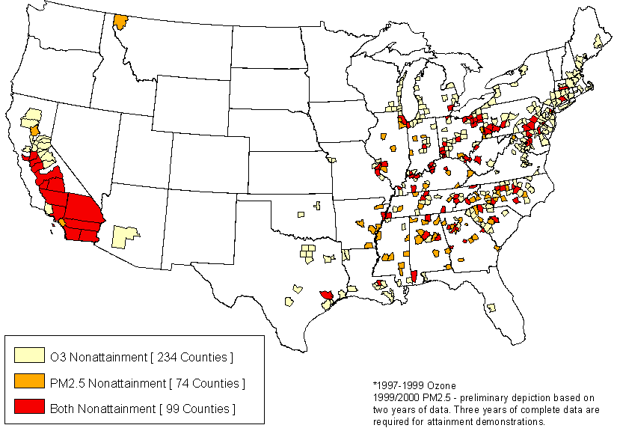
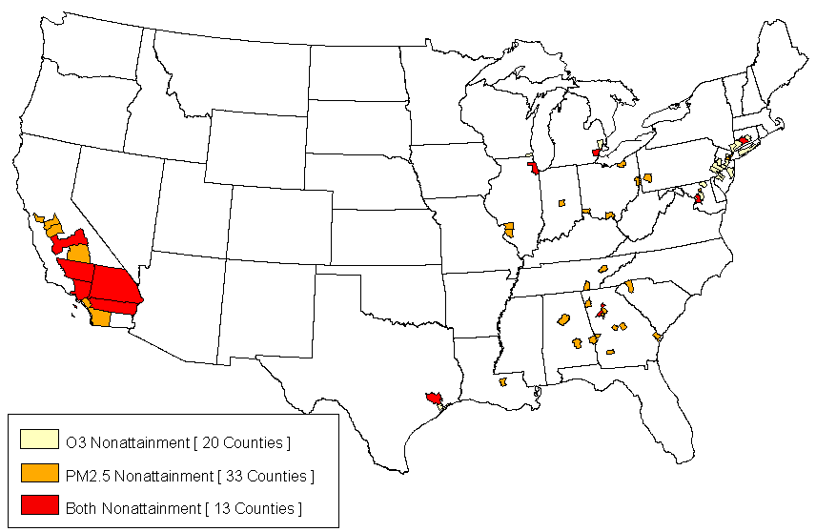
EPA’s Projected Attainment of PM2.5 and 8-hour Ozone Standards - Current and Under Clear Skies in 2020
Initial Modeling of Clear Skies in 2020

Slide 11
EEI Reaction to Clear Skies
  The scope and framework of the Clear Skies Initiative are on target.
  The targets and timetables would be extremely difficult for some companies to meet.
  To be most effective, the Clear Skies Initiative must:
    include New Source Review reform;
    facilitate emissions trading;
    provide credit for early reductions;
    eliminate the allowance auction; and
    set the Phase 1 mercury cap to not exceed "co-benefits" from SO₂ and NO_{x} controls (the Administration's stated objective for Phase 1 reductions).

Slide 12
Clear Skies Benefits
  Cleaner: Cuts sulfur dioxide, nitrogen oxides, and mercury emissions by 70 percent from current levels.
  Sooner: Achieves these additional emissions reductions faster than under existing Clean Air Act programs.
  Cheaper: Reduces costs and provides greater business certainty by eliminating multiple, overlapping regulations.
  Certain: Continuous emissions monitoring and large penalties for non-compliance.
Notes:
Sooner: Administration analyses indicate that 35 million additional tons would be eliminated during the next decade under the Clear Skies Initiative compared to the current Clean Air Act.
Cheaper: Reduce costs and provide greater business certainty by eliminating multiple, overlapping regulations and establishing specific emission-reduction requirements that remain unchanged for a definite period of time.

Slide 13
S. 3135 (Carper Bill) –
Some Key Issues
Carbon dioxide emissions reductions of about 20% in 2012 and 28% in 2020.
Early, tight caps for SO₂, NO_{x} and mercury.
Trading of mercury allowances would be limited by forcing each unit to either reduce emissions by 50-70% or to meet a specific emissions rate.

Slide 14
Modeling for EEI by Charles River Associates and E&MC Group
Costs incremental to a reference case of Title IV (acid rain) plus the NO_{x} SIP call (Eastern U.S. 2004 ozone program).
Costs would be much less if the reference case included future regulations for mercury, fine particles, 8-hour ozone and regional haze. However, it is difficult to predict the regulatory future in order to quantify these costs.
Assumptions include EIA Annual Energy Outlook 2003 natural gas reference case costs.

Slide 15
Clear Skies vs. Carper Bill
SCENARIO | NPV Cost (2004-2020, $1999) | Year 2010 Cost | Year 2015 Cost | Year 2020 Cost
Clear Skies | $32-37 billion, depending on SCR capital costs (~ $2/MWh) | $4.8-5.5 billion | $6.2-7.0 billion | $11.2-12.3 Billion (~$5-5.50/MWh)
Carper bill (modest carbon offsets) | $54-64 billion, depending on mercury cap (~ $3-4/MWh) | $7.3-8.7 billion | $10.4-12.1 billion | $13.9-16.3 Billion (~$6.50-8.15/MWh)

Slide 16
Clear Skies vs. Carper Bill
SCENARIO | 2020 Average Coal Unit Capacity Factor | 2020 Coal Consumption (compared to predicted future) | 2020 Gas Consumption (compared to predicted future)
Clear Skies | 75-77% (vs. reference of 79-80%) | 10-12% decline (little change from present usage) | 13-14% increase
Carper bill (modest carbon offsets) | 63-67% | 22-27% decline | 22-28% increase

Slide 17
S. 366 (Jeffords Bill)
Introduced in February 2003; essentially same as S.556.
Extremely tight caps starting in 2009 for SO₂, NO_{x} and CO₂ and in 2008 for mercury.
Major new provisions in bill passed by S. E&PW (S.556):
  “Birthday” provision at age 40 starting in 2014.
  Reduce non-Hg hazardous air pollutants by 2008.
  Coal combustion products treated as hazardous waste.
  Must purchase virtually all emissions allowances.
No sections of Clean Air Act eliminated or modified to provide certainty.

Slide 18
Jeffords Bill (S.556) –
Costs and Fuel Impacts
EIA evaluated S.556 in July 2001:
  Earlier, less burdensome version of bill.
  Costs for the period 2001-2020 of $140 billion.
  Coal-based generation would be reduced about 40 percent and natural gas generation increased 60 percent.
S.556 voted out of E&PW in June 2002 has much greater impact:
  The Congressional Budget Office in November 2002 estimated that S.556 could cost the power generation sector as much as $40 Billion in 2009 and $60 Billion in 2012.

Slide 19
Sufficient Time is Needed for Reliable Electric Generation and Cost-effectiveness
Retrofits of 100 GW or more of SCR, FGD, activated carbon/sorbent and probably fabric filters.
Need to spread installations over time to ensure reliability (to avoid having too many units off-line concurrently).
Need to avoid labor and materials shortages and bottlenecks.
Permitting of landfills for FGD products can take years.
Need to allow advanced mercury controls to be developed.
Need to allow expenses to be spread over time to minimize issues re: securing financing.

