Slide 1

Petroleum Supply, Consumption, and Imports from Annual Energy Outlook 2003
Han-Lin Lee
Energy Information Administration
han-lin.lee@eia.doe.gov
National Energy Modeling System/Annual Energy Outlook Conference
March 18, 2003
Washington, DC
Notes:
This presentation focuses on the petroleum supply, consumption, and import projections from the Annual Energy Outlook 2003 (AEO2003). In particular, we’ll look at how the domestic petroleum demand could be met.
The AEO projections are a product of the Energy Information Administration, an independent analytical and statistical agency within the U.S. Department of Energy. We do not speak for any particular point of view on energy policy, and our views should not be construed as representing those of the Department or the Administration.

Slide 2
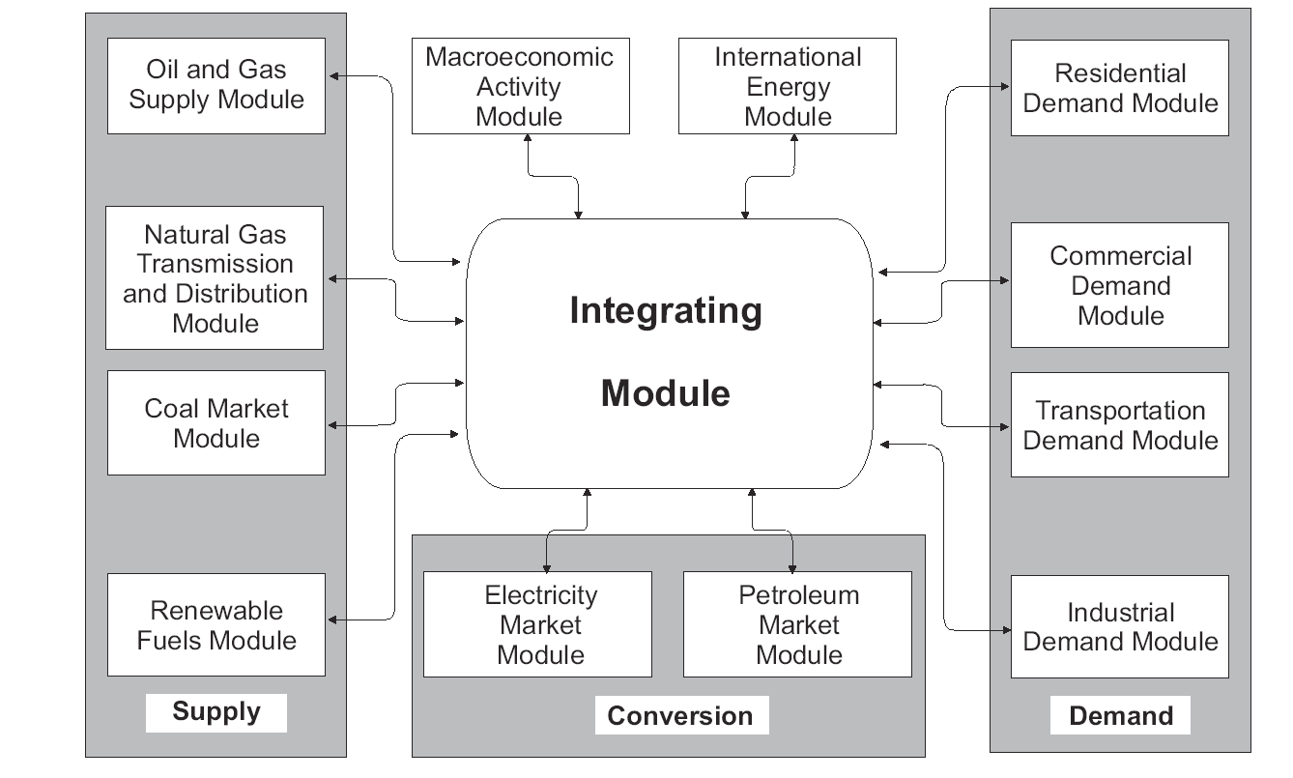
National Energy Modeling System
Petroleum
Market Module
Notes:
The Petroleum Market Module (PMM) within the NEMS is responsible for the petroleum market projections. The PMM is a linear-programming model, which derives solutions (i.e., forecasts) to satisfy the demands for petroleum products with available supplies. This is important because often the PMM is misunderstood as a model forecasting both the supply and demand of the petroleum products.

Slide 3
Assumptions
MTBE eventually banned in 17 States with legislation passed;
No nationwide MTBE ban;
No Renewable Fuels Standard (RFS);
Tier-II low-sulfur gasoline starting in 2004;
Ultra-low-sulfur highway diesel (ULSD) starting in mid-2006; and
No assumption on any non-road diesel regulations.
Notes:
Assumptions are critical to any forecast. The projections are not statements of what will happen but of what might happen, given certain assumptions. The reference case projections are business‑as‑usual forecasts, given known technology, demographic trends, and current laws and regulations as enacted.
For AEO2003, that means, for example, that MTBE is eventually banned in 17 States with legislation passed (of which only five States currently use MTBE-blended gasoline – CA, NY, CT, MO, and KY). Congress has not banned MTBE, so there’s no nationwide MTBE ban in AEO2003 projections. There’s no Renewable Fuels Standard (RFS) included either, although EIA has performed several studies last year analyzing the impacts of an RFS and/or MTBE ban. You can refer to our website for further details for those studies. AEO2003 also reflects the ultra-low-sulfur highway diesel (ULSD) regulation to take effect in mid-2006, but does not speculate any non-road diesel regulation at this point.

Slide 4
World Oil Prices in Three Cases, 1970-2025
(2001 dollars per barrel)
80
History
Projections
70
60
50
40
High price
30
Reference
20
Low price
10
0
1970
1975
1980
1985
1990
1995
2000
2005
2010
2015
2020
2025
Notes:
History shows substantial variability in world oil prices, and there is similar uncertainty about future prices.
It is important to note that AEO2003 provides longer-term energy market projections. We assumes the oil price would regress to lower levels on annual averages despite the recent run-up in world oil prices.
There are three AEO2003 cases based on alternative assumptions about oil production levels in OPEC nations: higher production in the low price case and lower production in the high price case.
Despite the strong growth in demand, oil prices are assumed to remain well below historical highs. Under the AEO2003 Reference case, crude oil prices are assumed to rise to $26.57 (in 2001 dollars) per barrel by 2025. The “high” price scenario assumes a price of $33.05 per barrel by 2025. Note that oil prices were above this level from 1974 through 1985, peaking at $67.10 per barrel in 1980. The “low” price scenario assumes a price of $19.04 per barrel by 2025.
The remaining presentation will focus primarily on the Reference case.

Slide 5
U.S. Petroleum Consumption by Sector, 1970-2025
(million barrels per day)
25
History
Projections
20
Transportation
15
Electricity generation
10
Industrial
5
Residential and commercial
0
1970
1975
1980
1985
1990
1995
2000
2005
2010
2015
2020
2025
Notes:
Most of the projected U.S. growth in petroleum use is in the transportation sector. Consumption is projected to grow from 13.7 million barrels per day in 2003 to 21.5 million barrels per day in 2025.
The extension of the AEO forecast from 2020 to 2025 amplifies the demand from the transportation sector towards the end of the forecast.

Slide 6
U.S. Petroleum Consumption and Production,
1970-2025 (million barrels per day)
35
History
Projections
30
25
20
Consumption
Net Imports
68% (imports share
of consumption)
15
55%
27%
10
Production
5
0
1970
1980
1990
2000
2010
2020
2025
Notes:
Projected U.S. petroleum production does not match the projected growth in consumption. The United States is projected to consume 10.6 million barrels per day more than it produces in 2003. In 2025, the United States is projected to consume 19.8 million barrels per day more than it produces.
Domestic production includes U.S. production of crude oil, natural gas liquids, methanol for MTBE production, ethanol, and volume gained in processing.

Slide 7
U.S. Refinery Capacity, 1960-2025 (million barrels per day)
21
History
Projections
20
19
18
17
16
15
14
13
12
11
10
0
1960
1965
1970
1975
1980
1985
1990
1995
2000
2005
2010
2015
2020
2025
Notes:
Refinery capacity traditionally is defined as the atmospheric distillation unit (ACU) capacity.
U.S. refinery capacity peaked at 18.62 million barrels per day (mmb/cd) in 1981. Then total capacity dropped sharply after the domestic crude oil price control ended in October 1981. Between mid-80’s to mid-90’s, the U.S. refinery capacity hovered around 15-16 mmb/cd and bottomed out at 15.03 mmb/cd in 1994. By 2001, the capacity climbed back to 16.80 mmb/cd.
In the same time frame, however, the number of refineries has been declining from a peak of 324 refineries in 1981 to 155 refineries in 2001. Most closed refineries had small capacities of less than 70,000 barrels per day (mb/cd), and were squeezed out because of competitive cost disadvantages compared to larger plants.
Nearly 70 percent of the refineries that have continuously operated since the mid-1980’s have expanded their distillation capacity. The growth in capacity has varied by region, by refinery size, by type of ownership, and by time periods since the mid-1980’s.
U.S. refinery capacity is projected to exceed the historical high before 2010 and to reach 19.8 mmb/cd by 2025.

Slide 8
U.S. Refinery Capacity and Unfinished Oil Imports (million barrels per day)
21
History
Projections
20
19
18
17
16
Unfinished Oil Imports
(1.07 million barrels/day by 2025)
15
14
13
12
11
10
0
1960
1965
1970
1975
1980
1985
1990
1995
2000
2005
2010
2015
2020
2025
Notes:
An important factor in the ability of the U.S. refineries to supply petroleum products is the increasing amount of unfinished oil imports, which is normally not counted in a refinery capacity survey. In 2001, 378 mb/cd unfinished oils were imported; most of them were heavy gas oils (62 percent) directly sent to the FCC’s and/or hydrocrackers, rather than through the distillation units like the crude oils.
AEO2003 projected a healthy growth in the unfinished oil imports, about 1.07 mmb/cd by 2025. This growth is projected to pick up between 2005 and 2010 when the U.S. refineries are expected to expand their sulfur removal capabilities for the ultra-low-sulfur highway diesel.
Although the crude oil and unfinished oils are not, strictly speaking, additive to represent the total refinery capacity, this graph serves as a reminder that the traditional indicator for the refinery capacity (i.e., the distillation unit capacity) may under-represent the actual capability of the U.S. refineries in supplying petroleum products to the market.

Slide 9
U.S. Refinery Utilization (percent)
100
History
Projections
95
90
85
80
75
70
65
60
55
50
0
1960
1965
1970
1975
1980
1985
1990
1995
2000
2005
2010
2015
2020
2025
Notes:
The average U.S. refinery utilization rate has been through a wild swing in the past 30 years. The utilization rates had dipped below 70 percent in 1981 when the refinery margins went south after the domestic crude oil price control ended. Subsequently, the utilization rate climbed back steadily through the rest of the ’80s and the ’90’s, mainly due to the closure of smaller refineries.
In the late 1990’s, the U.S. refinery utilization rate averaged as high as 95.6 percent in 1998. Between 1999 and 2001, due to the increase in product imports and additional U.S. refinery capacity, the average utilization rate declined slightly to the range between 92 and 93 percent. The average utilization rate for 2002 based on the latest data (i.e., post-AEO2003) is estimated to be less than 91 percent.
The U.S. refinery utilization rate is projected to eventually go back up to about 95 percent by 2025 due to increasing demand for petroleum products and the potentially limited growth in U.S. refinery capacity in the later forecast years.

Slide 10
U.S. Net Crude, Product, and Unfinished Oil Imports (million barrels per day)
25
History
Projections
20
UNFINISHED OILS
FINISHED PRODUCTS
15
10
CRUDE
5
0
1995
2000
2005
2010
2015
2020
2025
Notes:
This slide shows the split among the crude oil, finished product, and unfinished oil imports. Historically, it has been cheaper to import crude oils than to import finished products.
AEO2003 projections continue this trend until around 2010 when the U.S. refineries collectively reach their historical-level capacity (as seen two slides before). AEO2003 then projects a slower growth in the U.S. refinery capacity. To meet the increasing demand, more product imports would be needed.

Slide 11
Can U.S. Refinery Capacity Continue To Grow at Current Pace? (million barrels per day)
24
?
23
22
Pace Of Growth Over Last Decade
21
20
19
AEO2003
18
17
16
15
14
History
Projections
13
12
11
10
0
1960
1965
1970
1975
1980
1985
1990
1995
2000
2005
2010
2015
2020
2025
Notes:
Not a single major refinery has been built since 1977; capacity expansion in recent years has been in large part from the independents. In a hypothetical scenario where the U.S. refinery capacity is assumed to grow at a rate similar to that in the past few years, about 5 million barrels per day distillation unit capacity is needed in addition to AEO2003 projections by 2025. Or, 8 million barrels per day in addition to today’s capacity.
The relative economics between domestic refining and product imports may become more uncertain in the long term due to several factors to be discussed in the conclusion of this presentation.

Slide 12
How To Meet U.S. Domestic Petroleum Demands And What Is The Balance?
Land availability.
Environmental regulations (e.g., permitting, carbon cap).
Oil/products shipment bottlenecks (e.g., port capacity, double-hulled tankers).
Product imports availability of particular specifications (e.g., low-sulfur gasoline and diesel).
Market shift (e.g, hybrids, dieselization, fuel cell, etc.)
Notes:
Would there be lands available for either greenfield construction or brownfield expansion? How about more space for storage tanks at existing refineries?
Would future environmental regulations make U.S. refinery expansion prohibitively expensive? The next speaker, Mr. Lobue from API, would provide more insights on issues raised in the first two bullets from a refining industry perspective.
Could current oil/products shipment infrastructure handle the growth in U.S. domestic refining industry? Our other speaker, Ms. Appell from Corps of Engineers, would discuss the navigation economics and constraints associated with the shipment of oil and products.
Where would future finished products from foreign sources come from? Would it be realistic to expect foreign sources to supply more than 5 million barrels per day finished products (almost 4 million barrels per day of gasoline, diesel, and jet fuel)?
Finally, the shift in market demand for petroleum products would dictate the pressure on how much growth would be needed for the U.S. petroleum market.

