Slide 1
Knowledge to Shape Your Future

Slide 2
Leveraging NEMS to Produce State-Level Commercial End-Use Forecasts
Frank A. Monforte, Ph.D.
Paige Schaefer

Slide 3
Background
Late 1980’s early 1990’s electric utilities were heavy into end-use forecasting to support Demand Side Planning.
EPRI developed REEPS, COMMEND and INFORM to support end-use forecasting.
Market research funding was available to populate the model databases with utility specific survey data.
With market restructuring end-use forecasting fell out of favor.
Onsite survey worked dried up and the knowledge base of end-use modeling dwindled at the utilities.
The California experience, however, has led to a resurgence in Demand Side Planning.
Utilities are once again looking at end-use forecasting, but with limited market research dollars.

Slide 4
End-use Forecasting on a tight budget
Working closely with the EIA we have developed a Statistically Adjusted End-Use Approach.
This approach leverages the end-use data supplied by the EIA to produce end-use energy forecasts at the state or utility level.

Slide 5
SAE Approach
Break the Average Use Into End-Use Components
  Use_{y,m} = Heat_{y,m} + Cool_{y,m} + Other_{y,m}
Define Each Component in Terms of its End-Use Structure (e.g.)
  Cool = f( Saturation, Efficiency, Utilization)
Construct Annual End-use Indexes
Multiply by Monthly Variables (HDD, CDD, BD)
Estimate Model Using Least Squares

Slide 6
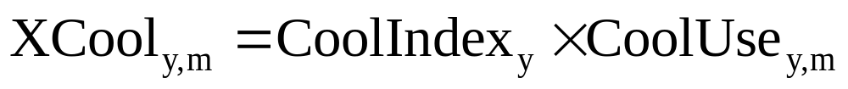
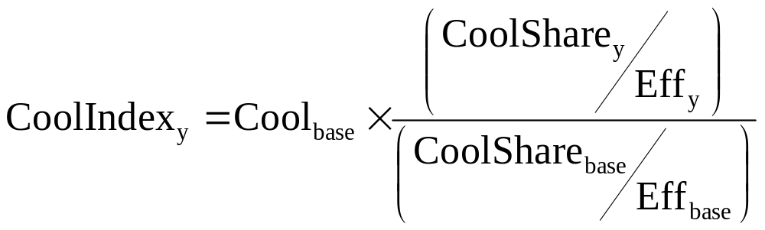
End-Use Variable Definitions
Index variables provide a measure of equipment stock in place

Slide 7
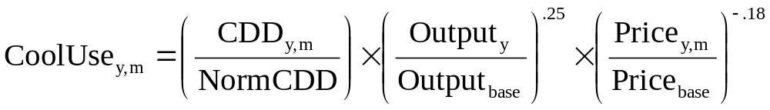
End-Use Variable Definitions
Use variables measure equipment utilization

Slide 8
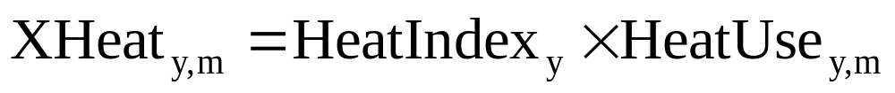
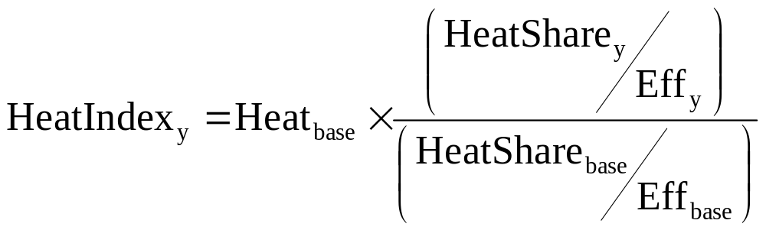
End-Use Variable Definitions

Slide 9

End-Use Variable Definitions

Slide 10
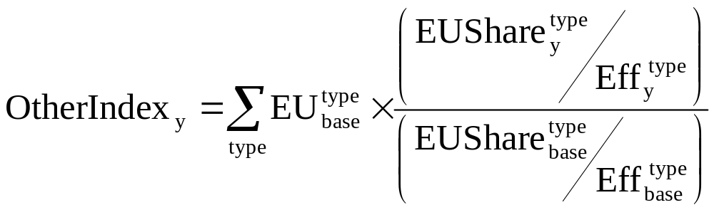
End-Use Variable Definitions

Slide 11
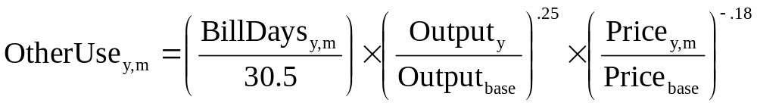
End-Use Variable Definitions

Slide 12
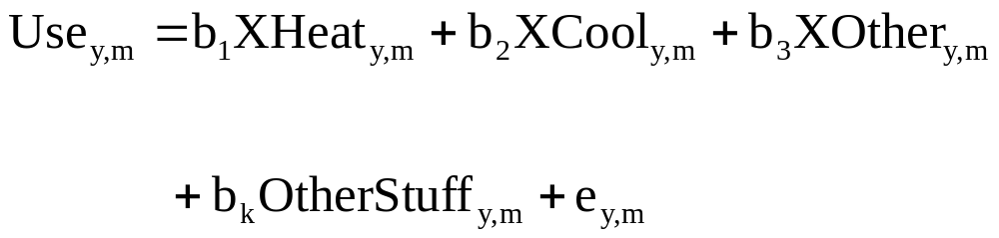
SAE Equation

Slide 13
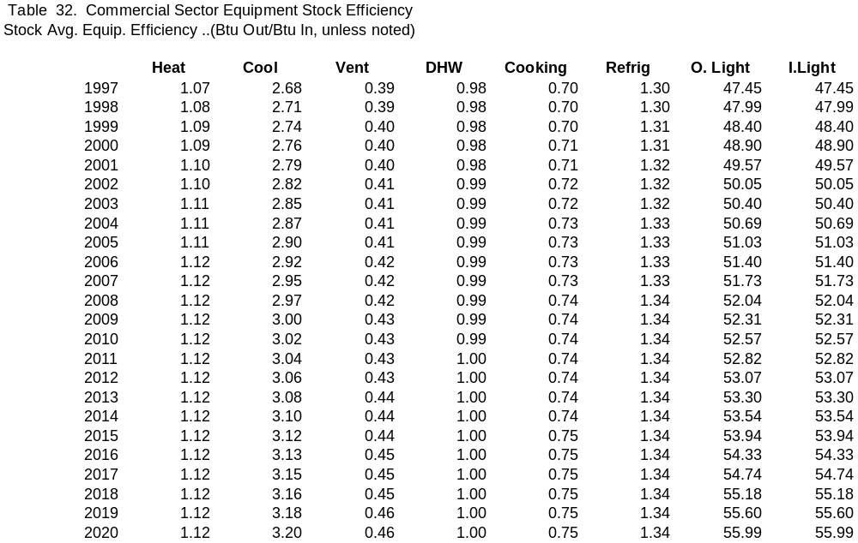
NEMS Efficiency Data

Slide 14
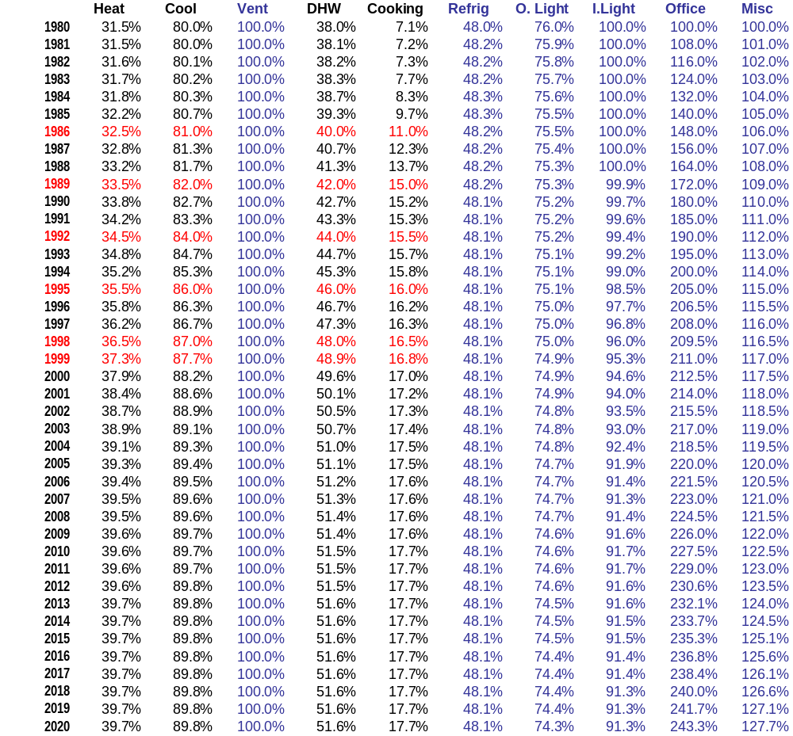
Sample Share Data (East South Central)

Slide 15
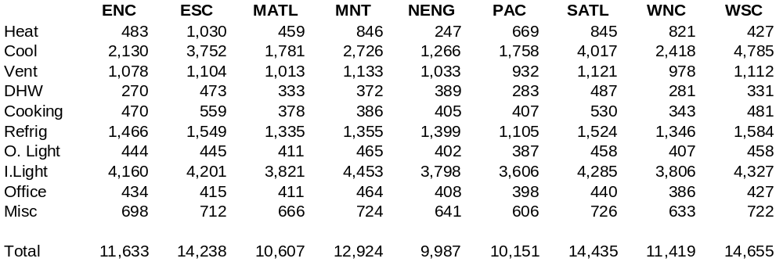
1998 End-Use Sales per Employee (kWh)

Slide 16
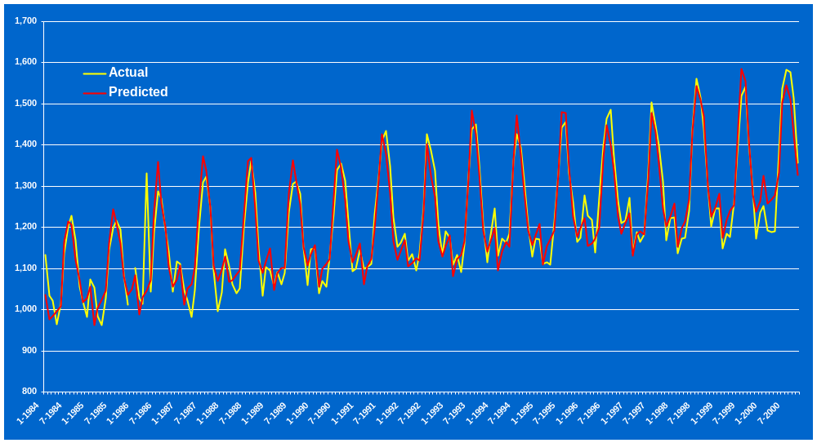
Use Per Employee – Monthly

Slide 17
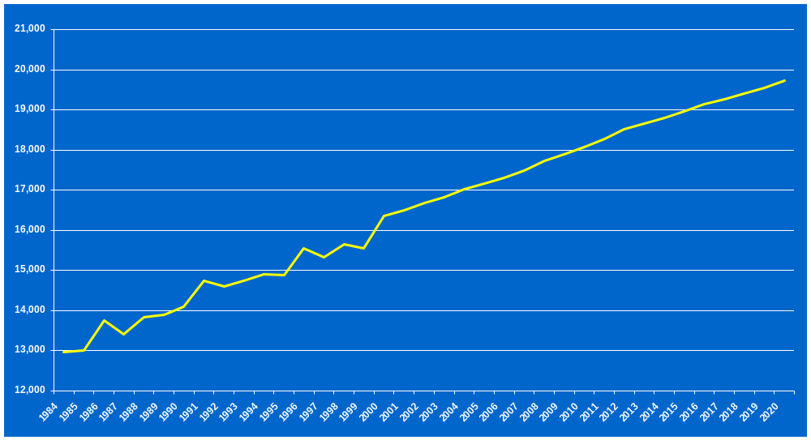
Use Per Employee - Annual

Slide 18
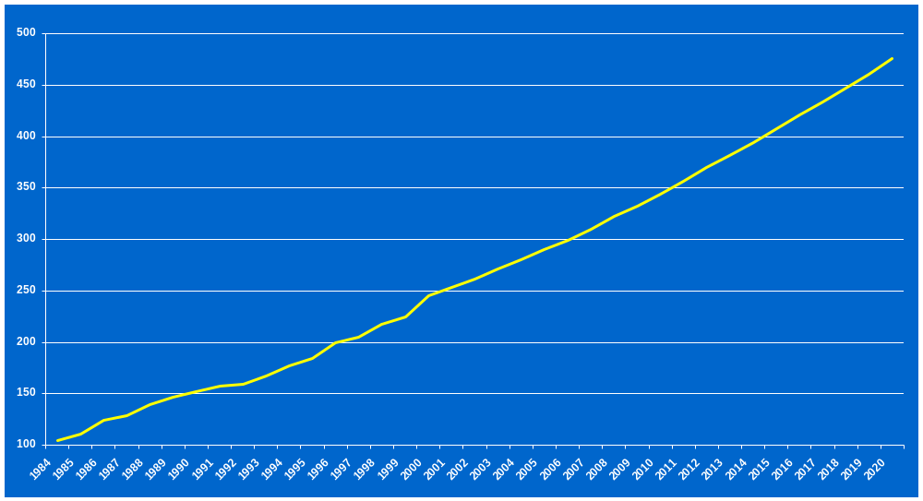
Commercial Sales Forecast (TWh)

Slide 19
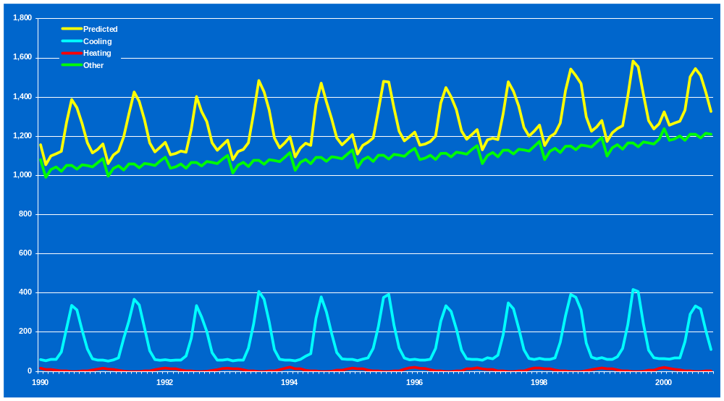
Decomposition of Predicted Value

Slide 20
Conclusions
The SAE modeling approach provides a reasonable balance between incorporating end-use structure for long-term forecasting and accuracy for short-term forecasting.
By leveraging the EIA produced end-use data, utilities have an inexpensive alternative to survey-based end-use forecasting.
End-use forecasts are still in the background, and they can be used to decompose the monthly and annual forecasts into end-use components.
Scenario analysis can be incorporated into this approach by running forecasts with alternative assumptions about appliance saturation levels and efficiency levels.

