Slide 1
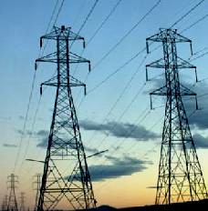
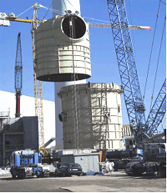
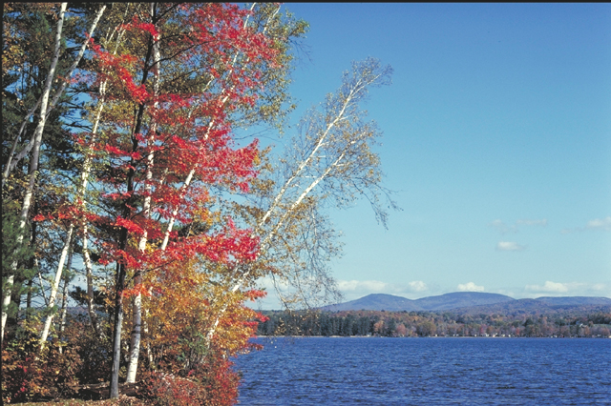
EPA’s Analysis of the Clear Skies ACT
Presentation for the
National Energy Modeling System/Annual Energy Outlook
by
Sam Napolitano
Office of Air and Radiation, US EPA
March 18, 2003

Slide 2
Clear Skies Act Is a Better Way to Do Business
Air quality has improved, but concerns persist.
Power generation remains major source of three major pollutants: SO₂, NO_{x}, and mercury.
Clean Air Act provides authority. However:
  The path is complex, burdensome and uncertain
  Aimed at direct control with limited flexibility
Clear Skies’ provides a better path to clean air.
  Based on proven cap and trade model for Acid Rain
  Flexible, cost-effective, certain, and mandatory
EPA completed analysis for the following results last year for the Clear Skies Act of 2002. The 2003 bill is very similar to last year. Results are measured against a base (reference) case covering EPA and State final regulatory actions and does not speculate on further regulatory actions. This has been the standard approach to this type of analysis since 1996.
Notes:
More than 40% of Americans live in counties with concentrations of pollutants above national standards
In 2000, the power sector was responsible for 63% of SO2 emissions, 37% of mercury emissions, and 22% of NOx emissions.
We developed the Clear Skies Act to do a more efficient, more effective job -- we coupled our knowledge of environmental needs with our knowledge of the power industry to create an ambitious but achievable set of goals.
Importantly, this allows us to provide both flexibility and certainty.

Slide 3
Clear Skies’ Emissions Caps and Timing
Current Emissions
Phase 1 Cap
Phase 2 Cap
Projected Emission Reductions
SO₂ (tons)
11 million
4.5 million (2010)
3 million (2018)
73%
NO_{x} (tons)
5 million
2.1 million (2008)
1.7 million (2018)
67%
Mercury (tons)
48
26 (2010)
15 (2018)
69%

Slide 4
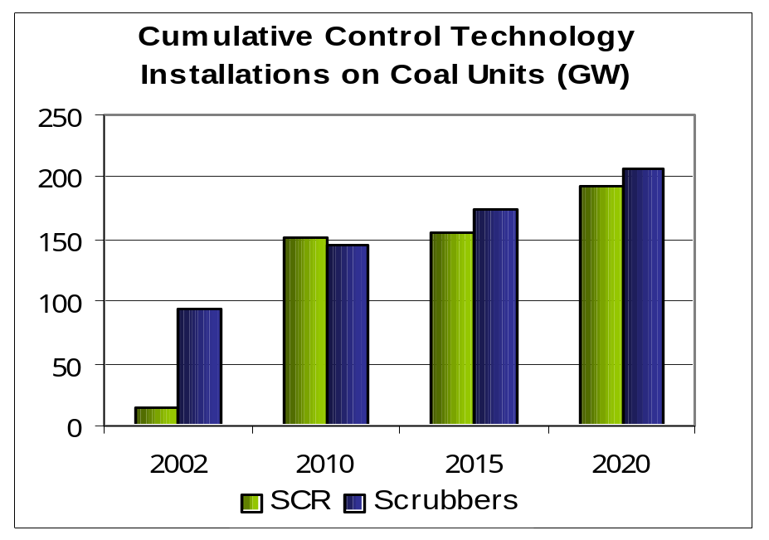
Control Technology and Generation Portfolio
  Caps and timing allow for steady implementation
  Significant pollution control additions occur
  Generation portfolio does not dramatically change
Projected Generation Portfolio in 2020
5000
4500
4000
3500
3000
2500
1000 GWh
2000
1500
1000
500
*
*
0
Base Case
Clear Skies
Coal
Gas/Oil
Nuclear
Hydroelectric
Other
Note that in the base case, there are about 102 GWs of Scrubbers and 94 GWs of SCR capacity in 2010 and that grows to 110 GWs and 103 GW, respectively, in 2020.
Notes:
Approximately 85 GW of SCR are expected to be installed over the next couple years due to the NOx SIP call and state rules (Texas, Connecticut and Missouri which were finalized by March 2001). Skills developed while constructing SCRs for the NOx SIP call can be easily applied to the construction of SCR and scrubbers for Clear Skies.
Caps and timing allow for steady implementation as the control technology installations are spread over twenty years.
The long implementation time will help attract skilled laborers such as boilermakers which are key to the construction of the control technologies.
The market will be provided time to supply the resources for the construction and operation of control technologies under this timeframe. In addition, the timing of the caps will help create a steady, long term market for the technology vendors, suppliers, and laborers.
It is likely that new technologies will be developed which are more efficient and less resource intensive than the current single pollutant technologies. Cap and trade programs such as Clear Skies encourage this type of innovation, providing flexibility to companies for their compliance choices.
Only a slight decrease in the generation from coal is expected when comparing Clear Skies to the base case scenario, even with the installation of significant numbers of control technologies on coal-fired units. Some of this generation is expected to be picked up by gas/oil-fired units.

Slide 5
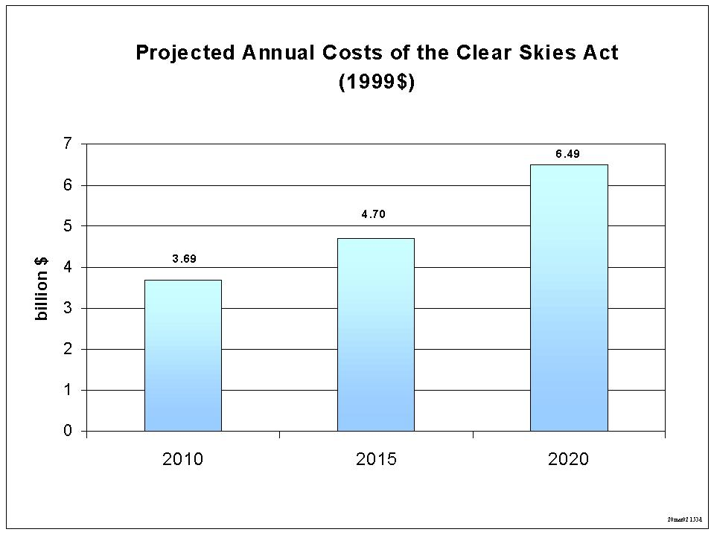
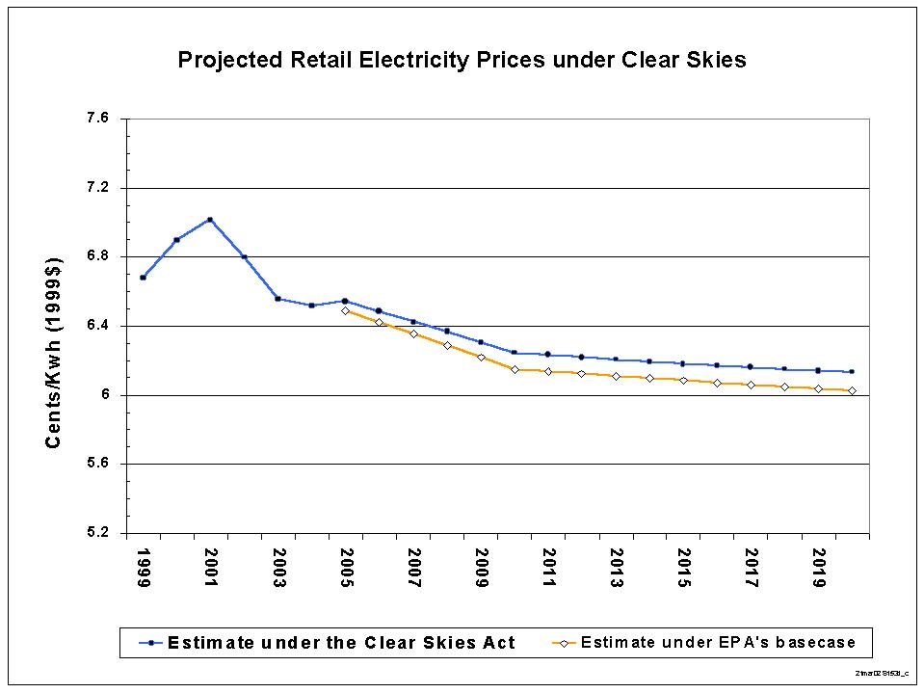
Production Cost and Electricity Price Forecast
  The annual cost to meet Clear Skies rises over time
  Downward trend in retail electricity prices continues
Mid-Atlantic
Nationwide
Southeast
Great Lakes
South Central
Plains
Rocky Mtns
Pacific NW
Notes:
The annual cost of Clear Skies is estimated to be $6.5 billion in 2020 when comparing the cost of electricity production under the base case to that of Clear Skies. Approximate revenue for electric generator sector is estimated around $300 billion by 2020 (AEO 2002).
These costs are over and above the costs power generators will incur to meet statutory and regulatory requirements that are already in effect.
Change in retail electricity prices on a national level is expected to be less than 2 % of the cost of electricity by 2020 (approximately a tenth of a cent/kW higher than base case).

Slide 6
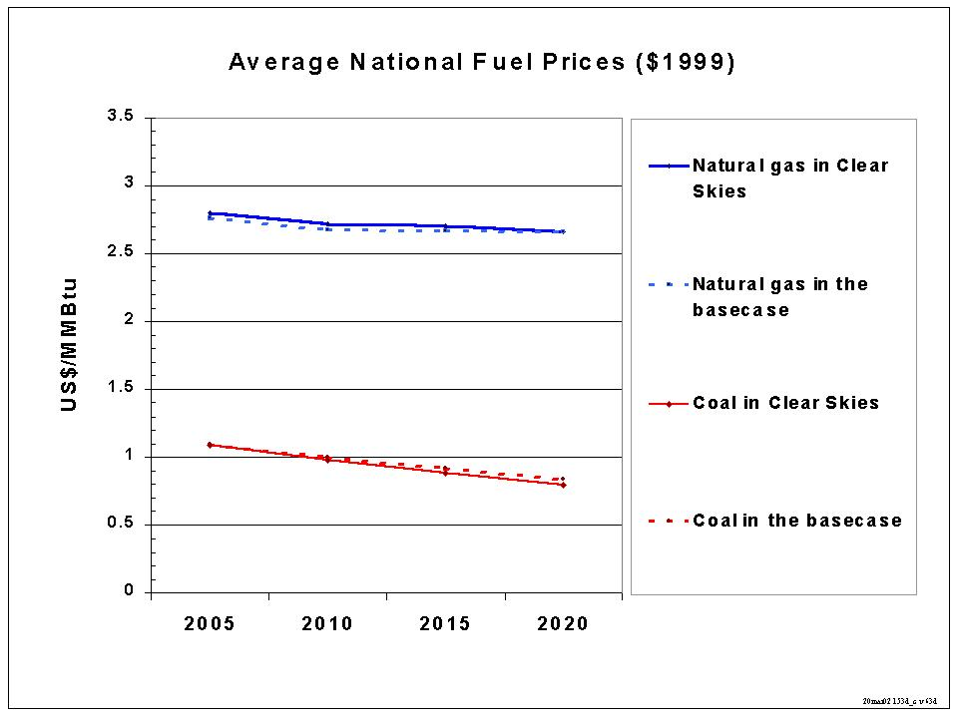
Impact on Fuel Prices
Note: the coal price represents an average across all twelve grades of coal in the model. The natural gas price is the Henry hub price,
the coal price is the minemouth price. Average national fuel prices are EPA’s estimates, EIA’s modeling would likely show different fuel
prices. Base case includes Title IV, the NOx SIP call, and state specific caps in CT, TX and MO. It does not include any potential future
regulations to implement the current CAA.

Slide 7
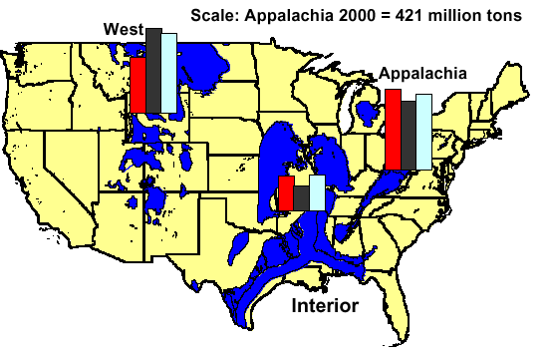
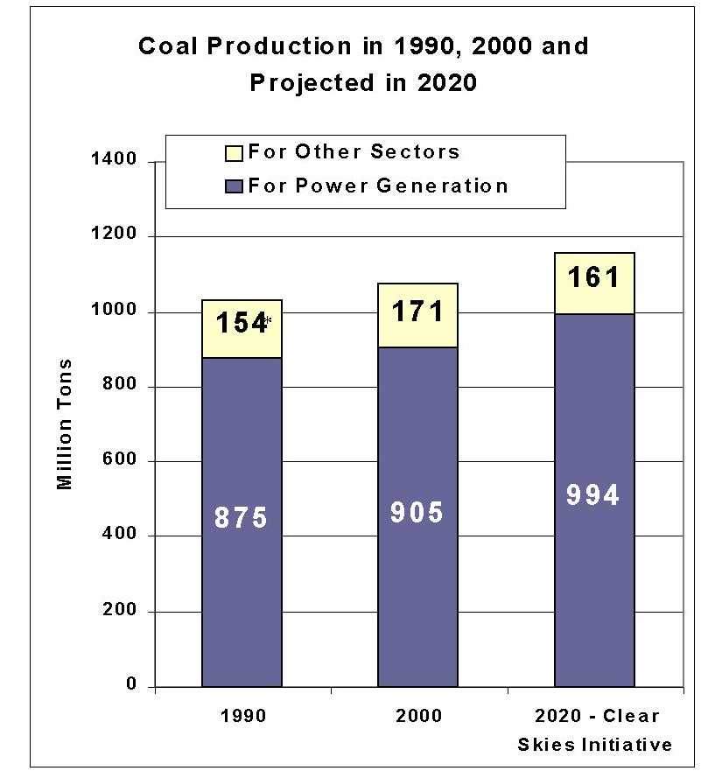
Coal Production Grows with Some Regional Shifting
1990 National Coal Production
2000 National Coal Production
2020 National Coal Production under CSA
Note: 2020 national coal production projections are EPA estimates from IPM.
1990 data: Coal Industry Annual 1994, Table 4 (DOE/EIA-0584 (2000)).
2000 data: Coal Industry Annual 2000, Table 4 and Table 63 (DOE/EIA-0584 (2000)), January, 2002.
2020 production for the power generation sector: Derived from the Integrated Planning Model.
2020 production for other sectors: Derived from the National Energy Modeling System.
Note: In 1990, EIA did not report the coal produced for power generators. From 1998-2000, 85% of coal produced was for the power generation sector. For an estimate of coal produced for the power generation sector in 1990, EPA assumed the same percentage (85%).

Slide 8
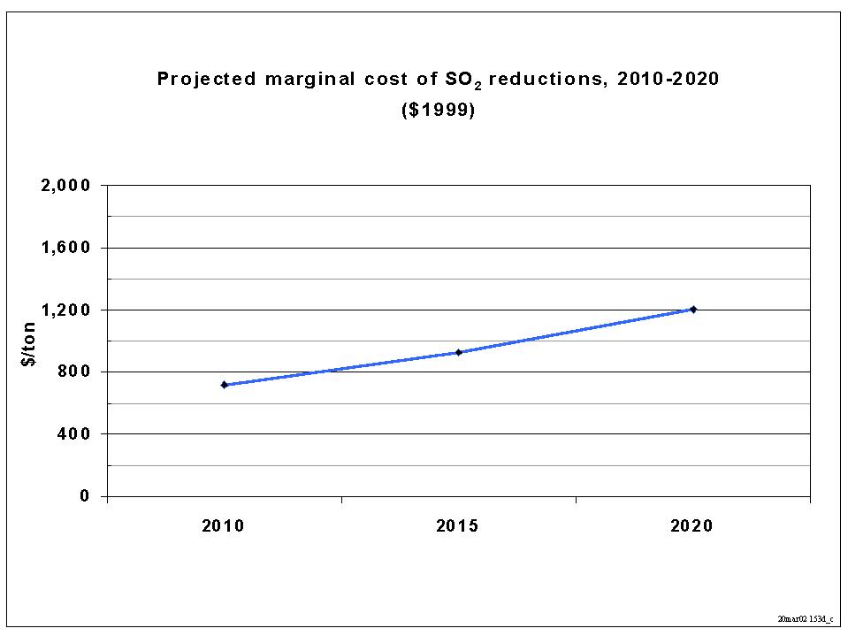
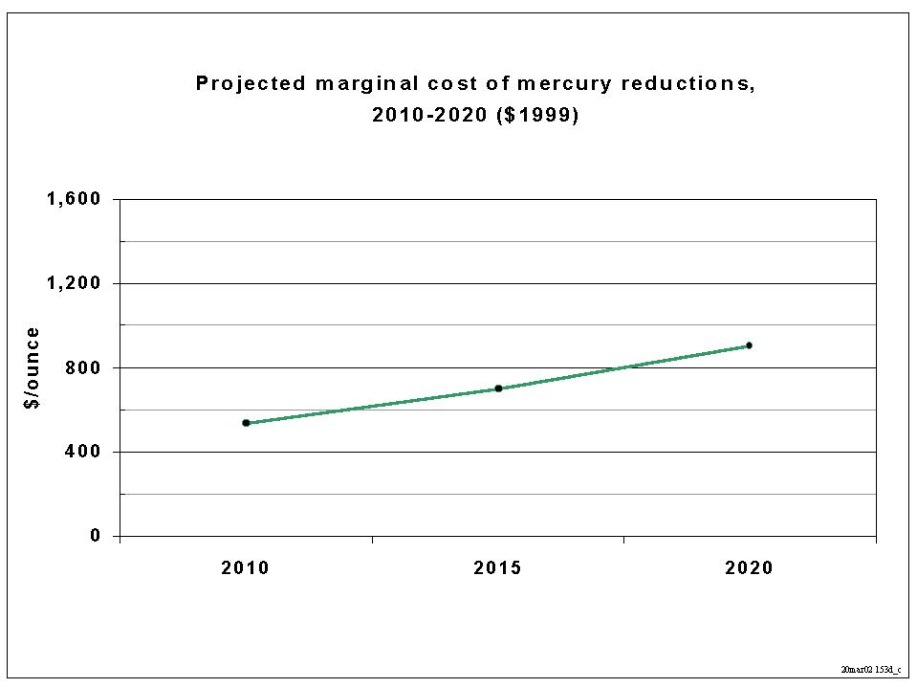
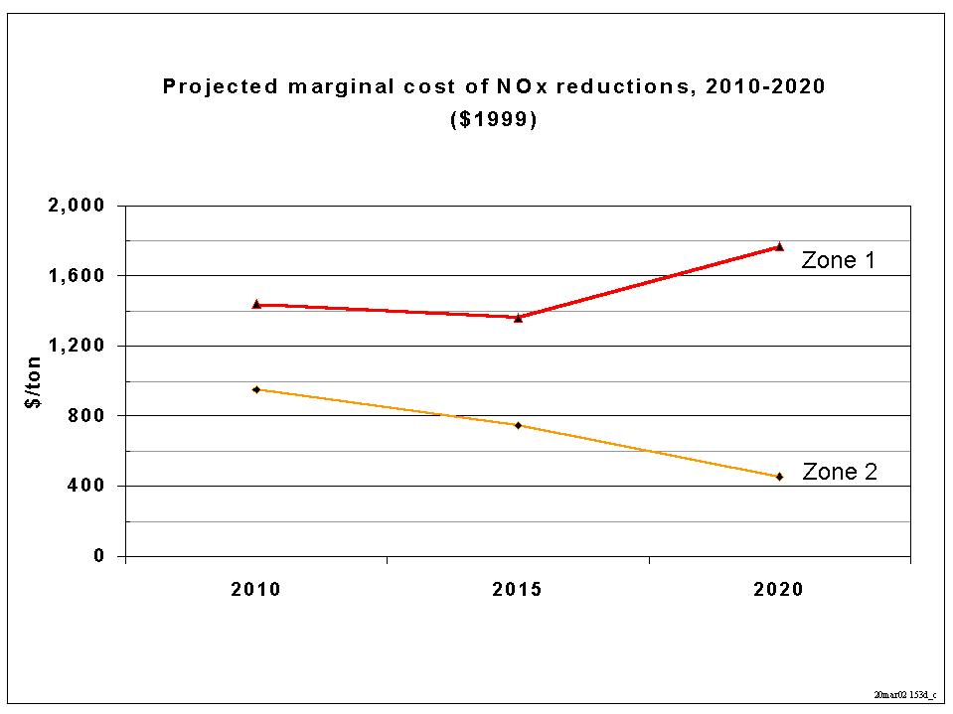
Projected Allowance Prices under Clear Skies
Note: under the Clear Skies Act, the marginal costs of SO₂ and NOx reductions are well below $2,000/ton and the marginal cost of mercury reductions are below $1,000/ounce.
The dollar value is the projected allowance price, representing the marginal cost (i.e., the cost of reducing the last ton) of emissions reductions. Marginal costs are based on modeling using IPM.

Slide 9

Distribution of Allowances under Clear Skies
The distribution of allowances under the Clear Skies Act occurs through the combination of an auction and an allocation:
  During the first year of the new trading program, 99% of the SO2, NOx and mercury allowances would be allocated to affected units with an auction for the remaining 1%.
  Each subsequent year, an additional 1% of the allowances for twenty years, and then an additional 2.5% thereafter, will be auctioned until eventually all the allowances are auctioned.
For the first twenty years of the trading programs, the majority of allowances are distributed for free via the allocation. Because of the time value of money, allowances allocated for these earlier years are generally more valuable in the allowance market than allowances allocated for later years.
  EPA analyzed the net present value (NPV) of the stream of allowances that would be distributed through 2030, as well as through 2061.
Despite the prevalence of the auction in the later years, EPA’s analysis shows that the vast majority of the net present value of the allowances is distributed for free via allocation:
-- For the period between 2008/2010 and 2030, 90-92% of the total NPV is allocated.
-- For the period between 2008/2010 and 2061, approximately 80% of the total NPV is allocated.
Note: The net present value calculations are based on allowances prices in IPM.

Slide 10
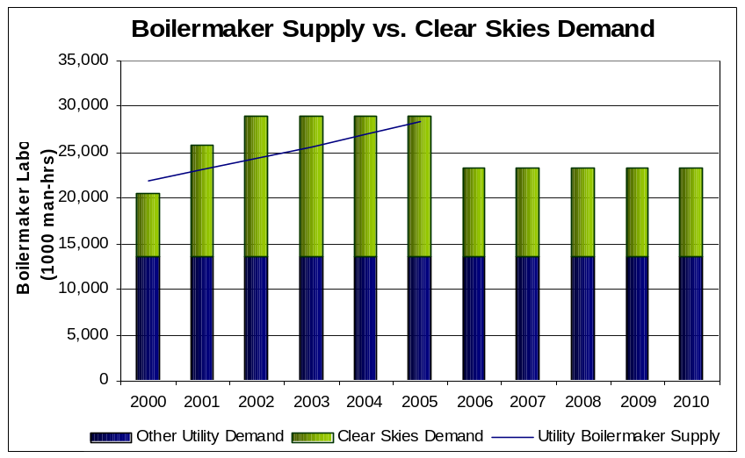
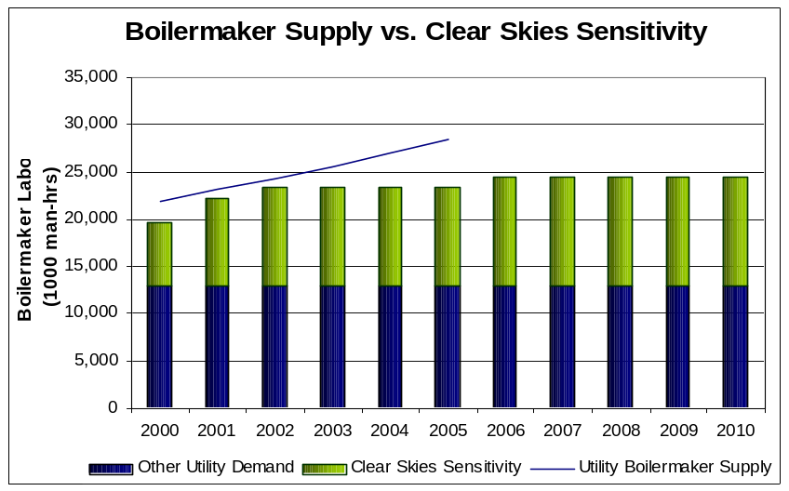
Engineering Analysis on Pollution Controls Shows
Only One Limitation: Boilermaker Labor Before 2010
Labor Resources Required for Construction of Control Technologies
Economic modeling projects 32 GW of scrubber builds by 2005 in addition to SCR for the NOx SIP Call.
Boilermaker labor, used primarily by the electric utility industry, is expected to be limiting out to 2005.
Engineering analysis estimates 10 GW of the 32 GW of scrubbers could be completed by 2005.
22 GW of the projected 32 GW of scrubbers will likely be pushed back beyond 2005.
General construction labor requirements for control technology installations are expected to be less than 0.3% of the current national labor pool of workers.

Slide 11
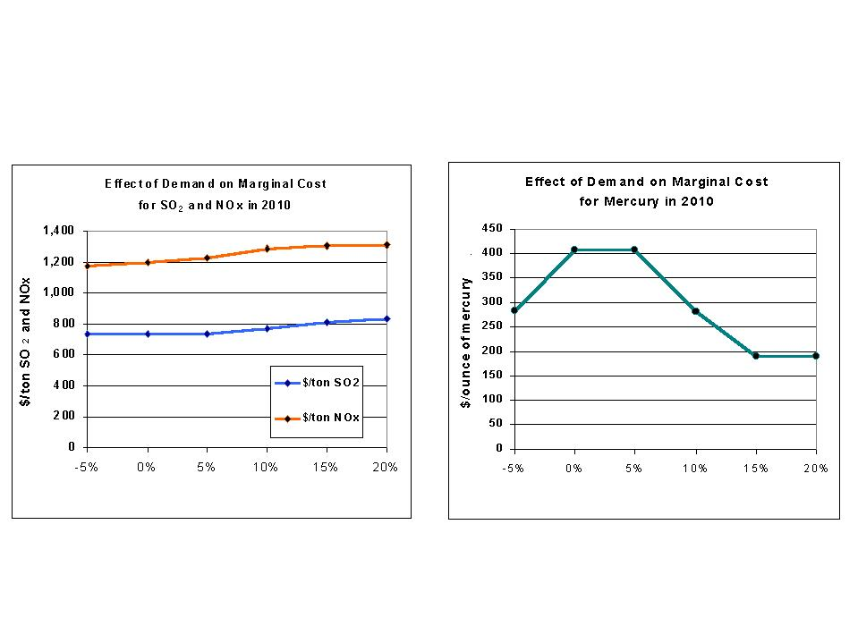
Sensitivity Analysis of Key Assumptions: Electricity Demand
Change in electricity demand from 2010 baseline
Change in electricity demand from 2010 baseline
Note: The projected emissions under the Clear Skies Act in 2010 were used for this analysis. Analysis uses the Technology Retrofit and Updating Model (see Section G for a description).

Slide 12
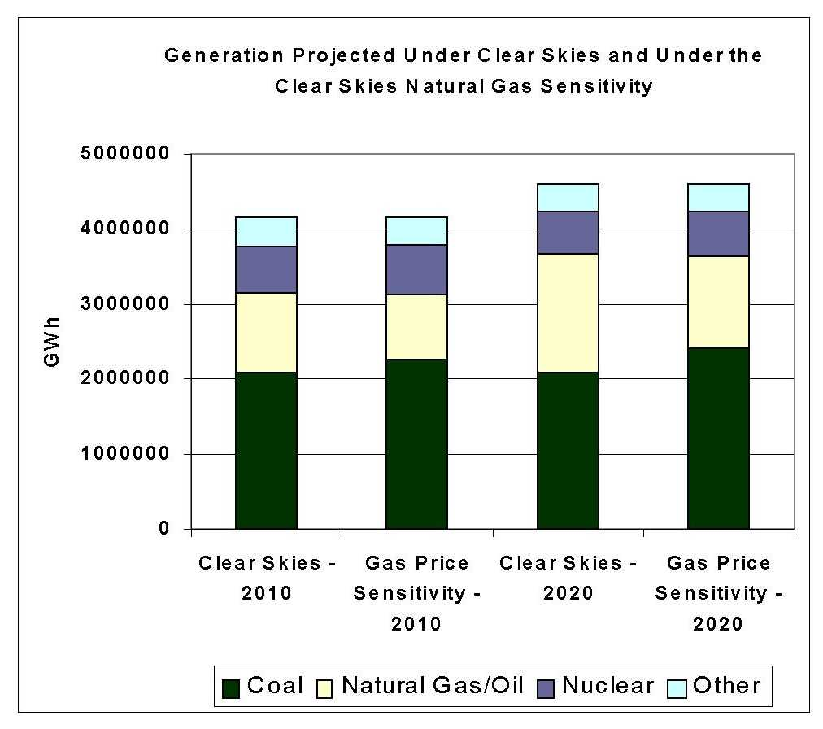
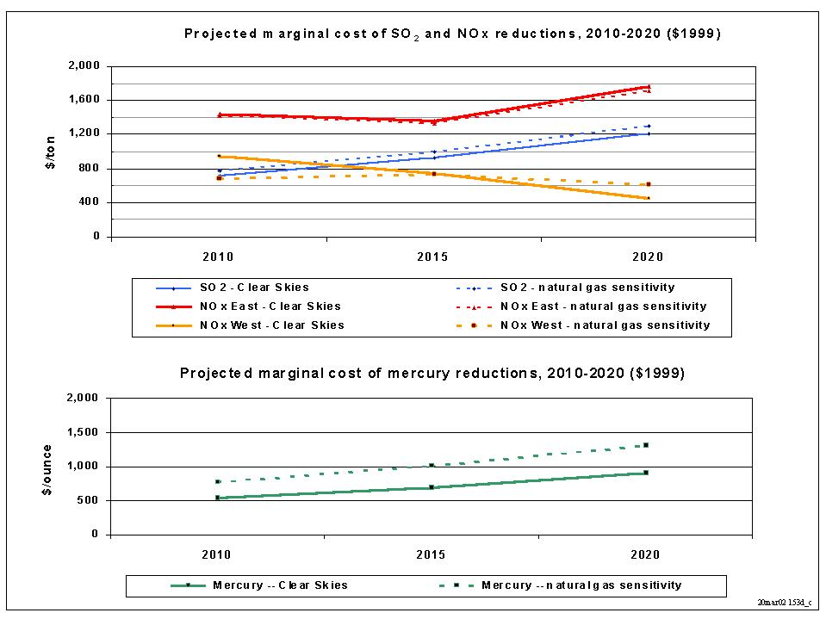
Sensitivity Analysis of Key Assumptions: Natural Gas Prices
Shifting the natural gas supply curve in IPM up $0.80/MMBtu, or approximately 30%, results in the following impacts on generation and marginal costs.
Note: For more information on the gas supply curves used in IPM see Chapter 8 and the Appendix to chapter 8 at http://www.epa.gov/airmarkets/epa-ipm/index.html#documentation,

Slide 13
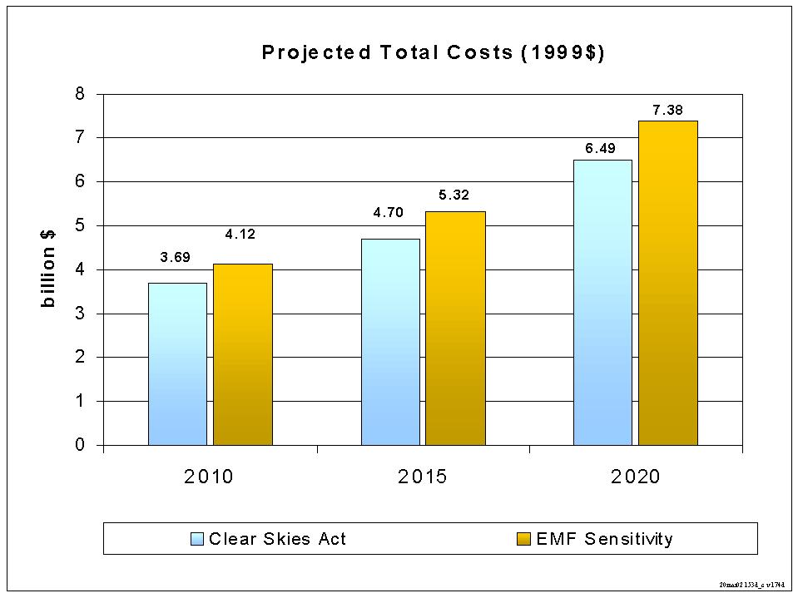
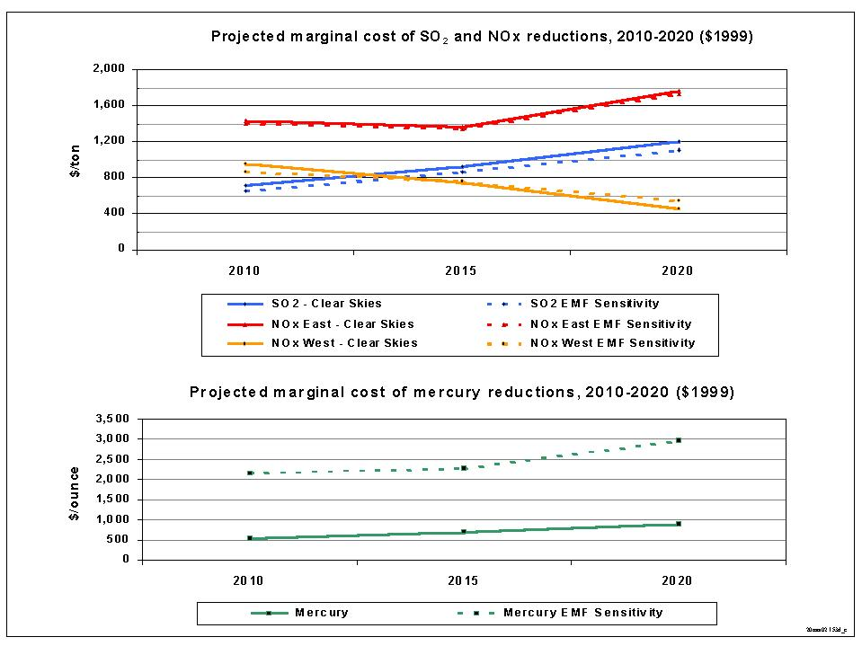
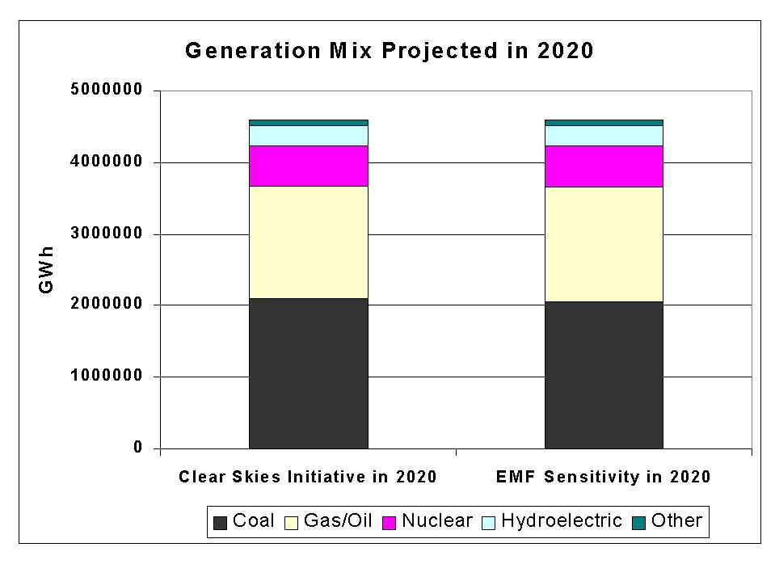
Sensitivity Analysis of Key Assumptions: Mercury
Impacts of varying the assumptions regarding the mercury removal efficiency of a combination of SCR and FGD were examined using IPM; the results are compared to the Clear Skies policy with standard assumptions.
Note: See the IPM documentation, chapter 5, table 5.7a (http://www.epa.gov/airmarkets/epa-ipm/index.html#documentation) for more information and 5.3.2 for a definition of “Alternative Emission Modification Factors (EMFs)”. An EMF is the ratio of outlet mercury concentration to inlet mercury concentration; EMF’s capture the mercury reductions attributable to different unit configurations and different configurations of SO2, NOx, and particulate controls.

Slide 14
Sensitivity Analysis of Coal Plant Retirement
Scenario | Cumulative Retirements 2005-2020 (GW) | Average 2010 – 2020 U.S. Coal Power Plant Capacity Factor (%)
Base Case | 0 | 82
Clear Skies (CS) | 0 | 77
CS + Higher Capital/Financing Costs¹ | 2.4 | 69
CS + Higher Coal Prices² | 1.2 | 69
CS + Lower Gas Prices³ | 8.8 | 52
CS + Excess Capacity Build⁴ | 0 | 79
¹Capital costs of environmental retrofits are doubled. ²Coal prices are maintained at the year 2000 level. ³Natural gas supply curves are scaled downward by 70 percent. ⁴In regions where capacity was being built in 2005, 20 percent excess is assumed to get built. Note: 3P case for the 3P and all sensitivities assume SO₂ cap of 4.5 million tons in 2010 and 3.0 in 2018; NO_{X} cap of 2.1 million tons in 2008 and 1.7 in 2018; Hg cap of 26 tons in 2010 and 15 tons in 2018.

Slide 15
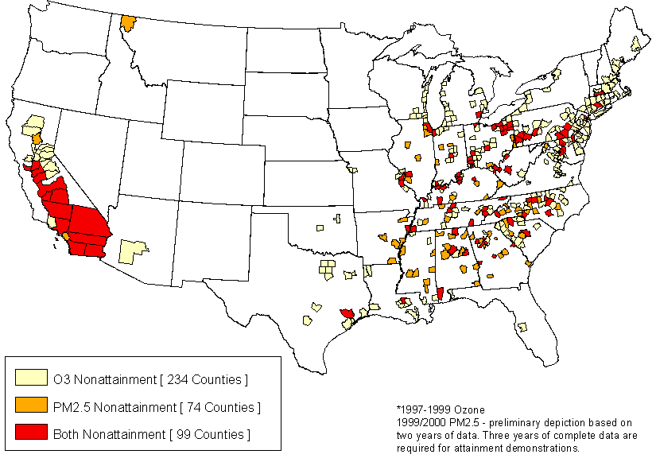
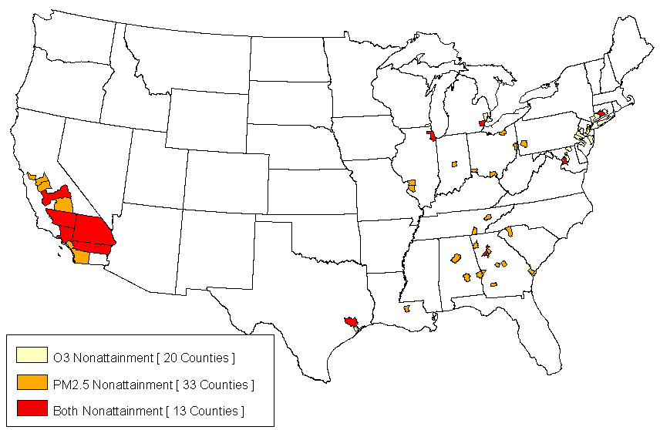
Clear Skies Delivers Extensive Health Benefits and Widespread Attainment with Standards for PM_{2.5} and Ozone
Current Data
Currently, hundreds of counties fail to meet national standards.
Clear Skies and Existing Programs Projections for 2020
Under Clear Skies, more than 20 million additional people would be breathing air that meets the national standards in 2020.
Air pollution in remaining counties would improve, facilitating local attainment planning.
Note: To permit comparisons among various analyses, the air quality data were the most complete and recently available as of mid-2001 (1997-1999 ozone monitoring data and 1999-2000 PM_{2.5} data). More complete and recent air quality data for ozone and fine particles (1999-2001 data) is expected to vary slightly from what is presented here.

Slide 16
Health and Visibility Benefits Are Substantial
Clear Skies does better than CAA over the next decade – added reduction of 35 million tons of SO₂ and NO_{x}.
Health and visibility benefits, that we can estimate, grow to about $96 billion annually by 2020.
  Most of the benefit results from prolonging lives – Clear Skies prevents about 12,000 premature deaths annually
  Prevents over 7,000 cases of chronic bronchitis, almost 12,000 hospitalizations and emergency room visits for lung and heart problems, and 15 million fewer days of respiratory illnesses and symptoms, including asthma attacks
  $93 billion of the benefits result from protecting the public’s health*
  $3 billion of the benefits are from improving visibility in Western and Southern parks
  $15 in benefits (“monetized”) for every dollar invested for a cleaner environment
  There are more health and environmental benefits that aren’t currently monetized
Recent study by Resources for the Future corroborates findings
*An alternative estimate projects $ 11 billion of benefits annually with 7,200 avoided premature deaths and is based on the use of short-term concentration/response functions for particles and a different approach to valuation of health effects damage.
Notes:
The human health benefits include are valued at $93 billion annually in 2020, including the value of avoiding:
12,000 premature deaths;
12,000 total hospitalizations and emergency room visits for cardiovascular and respiratory symptoms; and
15 million days with respiratory-related symptoms, including work loss days, restricted activity days, and asthma attacks;
The visibility benefits are valued at $3 billion annually from improving visibility at select National Parks and Wilderness Areas.
Compared to the Base Case in 2020, Clear Skies would:
- Reduce fine particle concentrations in the East and Midwest by 10-20%;
- Improve visibility in the East and Midwest by 1-2 deciviews;
- Reduce sulfur deposition to sensitive ecosystems in the East by more than 30%; and
- Reduce nitrogen deposition across the East by 15-30%.
- Virtually eliminate chronic acidity -- the most serious form of acidification -- in Northeastern lakes (including those in Adirondack Park) and prevent further deterioration of acidic Southeastern streams.

Slide 17
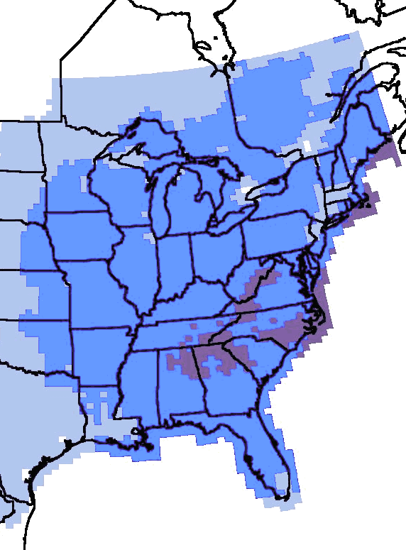
Clear Skies Improves and Protects Visibility
Visibility change in 2020 under Clear Skies compared to existing programs
Clear Skies would significantly improve visibility over much of the East and Midwest, especially in Shenandoah and Great Smoky Mountain National Parks, where visibility has been deteriorating
Clear Skies will honor the Western Regional Air Partnership emissions reductions, allowing future growth in the West to occur without degrading visibility
Deciview Improvement
-0.5 - 0.5
The benefits of improving visibility in select Southern and Western National Parks and Wilderness Areas, including Great Smoky, Shenandoah, and Grand Canyon National Parks, would total $3 billion annually by 2020
0.5 - 1
1 - 2
2 - 3
(A positive change in deciviews is an improvement in visibility; a negative change in deciviews is a decrease in visibility.)
Note: The western U.S. is not shown in this map because the emissions reductions expected from the WRAP have not yet been included in the air quality modeling analysis.

Slide 18
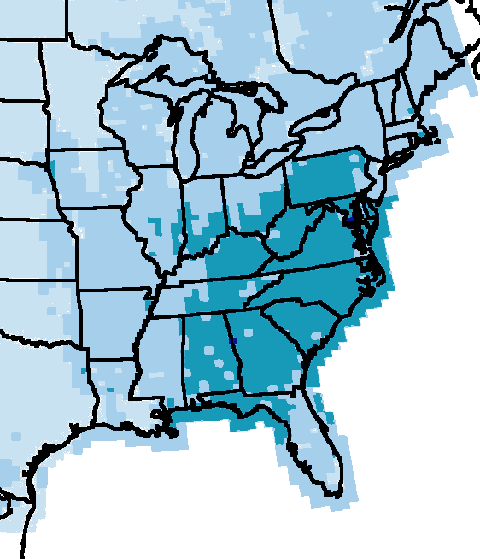
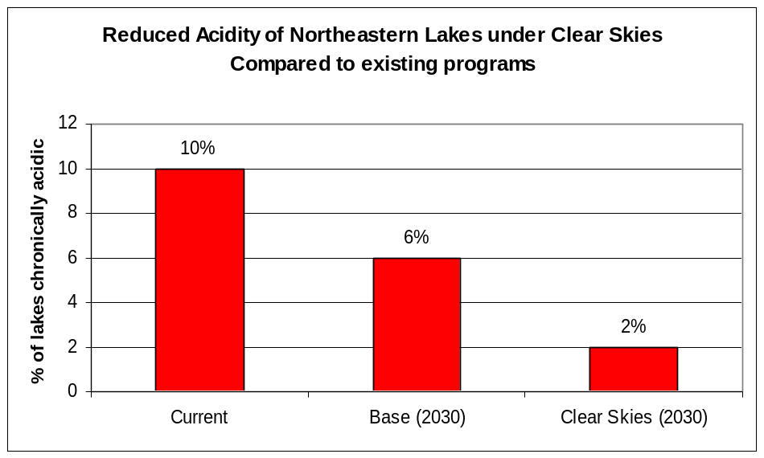
Clear Skies Reduces Acid Deposition
Percent Change in Sulfur Deposition in 2020 under Clear Skies compared to existing programs
Lakes in the Northeast have already begun recovering from acidification
Clear Skies would accelerate that trend, virtually eliminating chronic acidity in Northeastern and Adirondack lakes by 2030
  Clear Skies would also prevent further acidification of Southeastern streams
Percent Reduction
0 - 15
15 - 30
30 - 60
Note: The western U.S. is not shown in this map because the emissions reductions expected from the WRAP have not yet been included in the air quality modeling analysis.
Fewer Northeastern lakes would be acidic under Clear Skies compared to existing programs
Clear Skies would reduce sulfur deposition--a primary component of acid rain-- to sensitive ecosystems by up to 60% throughout the mid-Atlantic and Southeastern U.S.

Slide 19
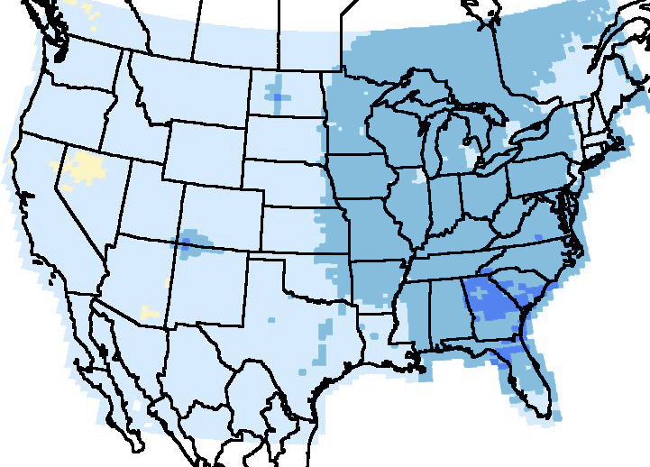
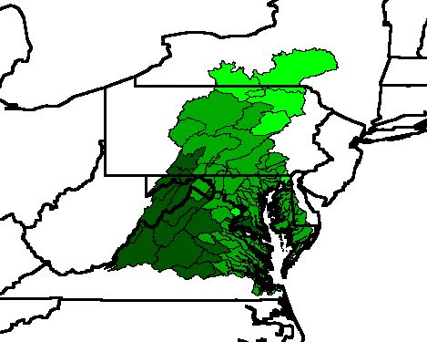
Clear Skies Reduces Nitrogen Deposition
Percent Change in Nitrogen Deposition in 2020 under Clear Skies compared to existing programs
Clear Skies would significantly reduce nitrogen deposition, the other key component of acid rain and a significant source of nitrogen to coastal waters:
  30-60% in areas of the Southeast, including Great Smoky Mountain National Park and coastal waters of North Carolina, Georgia, and Florida
  up to 30% in the Northeast, including in the the Adirondack and Catskill Mountains
Percent Reduction
-15 - 0
0 - 15
15 - 30
Percent Change in Summertime Nitrogen Deposition to the Chesapeake Bay watershed in 2020 under Clear Skies compared to current levels
30 - 60
In the West, Clear Skies would prevent further degradation of air quality and visibility even as economic growth continues
Clear Skies would reduce the amount of nitrogen entering the Chesapeake Bay by 10 million pounds annually by 2020
Percent Reduction
1996 vs. 2020 with Clear Skies
(oxidized nitrogen)
65-70%
60-65%
55-60%
50-55%
45-50%

Slide 20
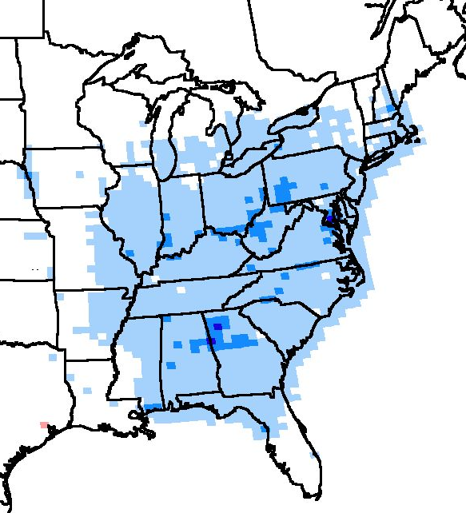
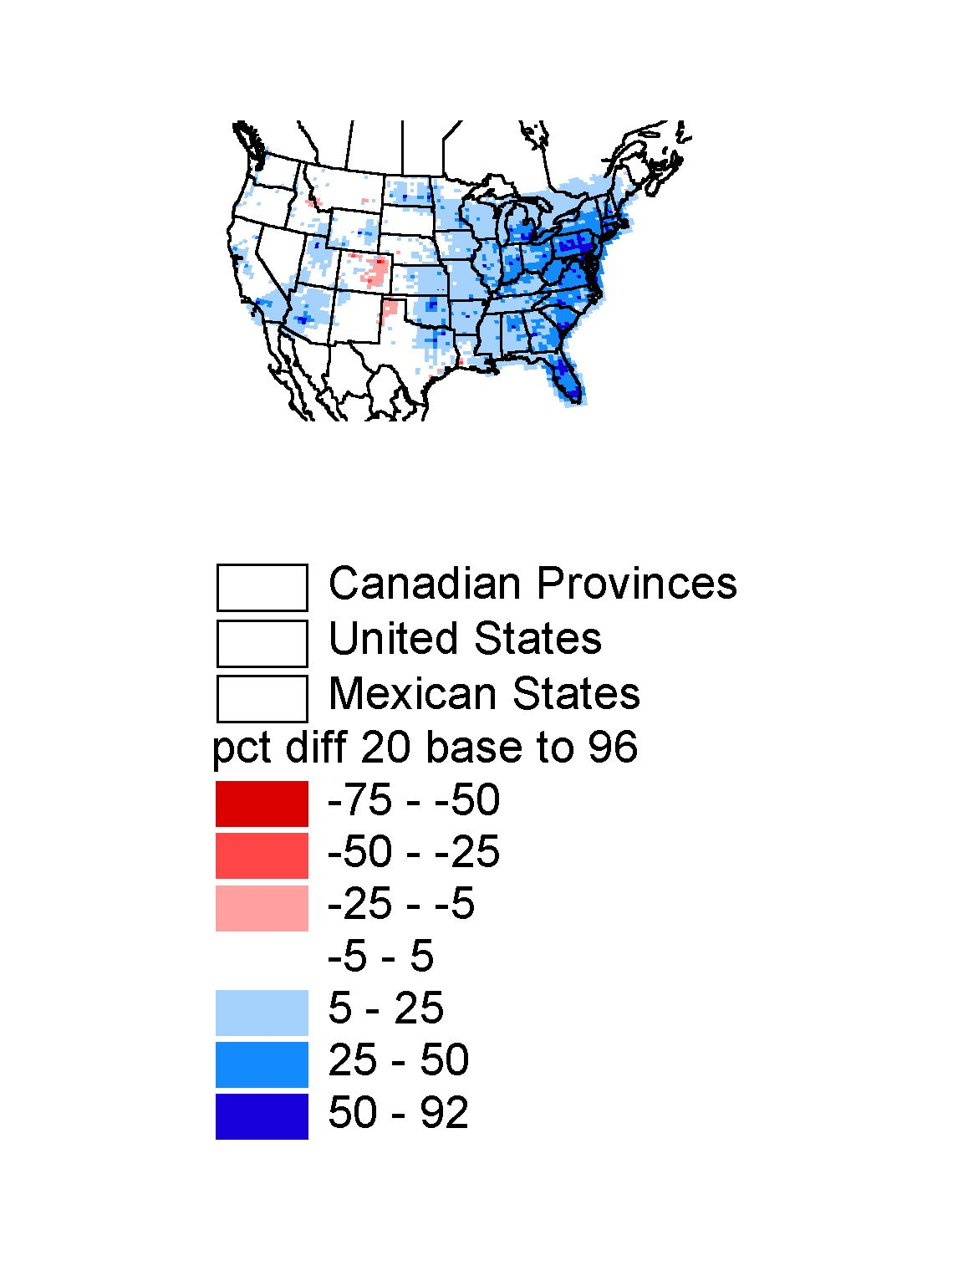
Clear Skies Reduces Mercury Deposition
Percent change in mercury deposition in 2020 under Clear Skies compared to existing programs
Mercury deposition is a significant source of contamination in many rivers, lakes, streams, and coastal waters
  currently 44 states have issued fish advisories due to mercury contamination
Clear Skies would reduce mercury deposition to lakes, rivers, and coastal waters up to 25% across much of the East:
  larger reductions--up to 50%--would occur along the Ohio River and in portions of the mid-Atlantic, northern Georgia, and Alabama
Percent reduction
-25 - -5
-5 - 5
5 - 25
25 - 50
> 50
Notes:
-- The small increase in mercury deposition at one location is attributable to a single facility mistakenly omitted from the Clear Skies mercury cap in the IPM analysis. Were this facility included in the cap, this increase would not have occurred.
-- The western U.S. is not shown in this map because the emissions reductions expected from the WRAP have not yet been included in the air quality modeling analysis.

Slide 21
Conclusions
Clear Skies addresses air pollution from the power sector in a serious, yet flexible way.
  Phases in control under a cap and trade approach
Costs and other impacts are manageable.
Benefits begin immediately, and are substantial:
  Air quality gains
  Health and visibility benefits
  Environmental improvements
Clear Skies provides cleaner air than the existing CAA through 2012 and is more cost-effective in cutting air pollution.
Benefits of Clear Skies are a bargain at the cost we pay.
Notes:
Ask that you join with EPA in supporting multi-pollutant legislation like Clear Skies and get involved in the national discussion with Congress on this in 2003. I look forward to the opportunity to work with you to pass this legislation.

Slide 22
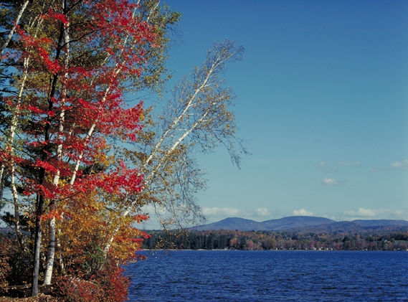
For Additional Information, Visit
Clear Skies Website
www.epa.gov/clearskies

